Slide 1
Illinois State University
Hebei University of
Science & Technology
Effect of Perceived Risk
in Moderating the Relationship of PPD and Website
Related to Product Return
Mingfang Li & Askar Choudhury

Slide 2
About
Disappointment
I should not have bought it from this seller
I should not have bought this product
Post purchase Dissonance
I must have made a wrong decision
Anxiety
Objective
How Website Information
influence Post purchase Dissonance
in product returns management?
Illinois State University

Slide 3
Contents
1
Background
2
Conceptual Model
3
Design & Methodology
4
Results
5
Implications & contributions
Illinois State University

Slide 4
1.1 Population of Online Shopping Users in China
Figure1: online shopping users and internet users
Illinois State University

Slide 5
1.2 Sales of Online Retail in China
Figure 2: growth of online retail volume
According to the data of China National Bureau of Statistics
2018F: 4.08 Trillion Yuan
Illinois State University

Slide 6
1.3 Consumer Returns in Online Purchase
Rapid growth of
online retail
Encouraged large number of returns
Consumer protection law
No return shipping fee
Illinois State University

Slide 7
1.4 The effect of Post Purchase Dissonance
Post purchase perception
Post purchase
dissonance
Consumer returns
Pre purchase expectation
Website
information
Illinois State University

Slide 8
Conceptual Model-1
Website Information (WI) refers to all kinds of information provided by vendors‘ websites, concerning product description, transportation, return policy, and customer online review, etc.
Purchase involvement (PI) refers to how much time, thought, energy,
and other resources consumers devote to the process of purchase decision
Post Purchase Dissonance (PPD) is defined as psychologically uncomfortable state following a purchase selected from a set of alternatives, each of which has some desirable attributes
Attractiveness of alternatives (AA) refers to customers' perceptions regarding the extent to which alternatives are available and how good quality they are in comparison with the purchased product
Perceived Risk (PR) is the uncertainty a consumer has when buying items, it also defined as "the expectation of loss associated with purchase" and be considered as an inhibitor of purchase judgment.
Attractiveness of Alternatives
H4
Perceived
Risk
Purchase
Involvement
H5
H2
H3
H6
Website
Information
Post Purchase
Dissonance
H1
Illinois State University

Slide 9
Conceptual Model-2
 | Hypothesis
H1 | WI is negatively associated with customers' PPD.
H2 | The lower the AA, the stronger the negative association of WI and PPD.
H3 | The lower PR in online purchase, the stronger the negative association of WI and PPD.
H4 | AA is positively associated with customers' PR.
H5 | The moderation of AA is mediated by customers' PR.
H6 | The moderation of AA will be strengthened by customers' high PI.
Illinois State University

Slide 10
3.1 Data Collection
Collecting Method
Data Scale
Shopping Platform
Electronic questionnaire distributed through WeChat and QQ
596 valid questionnaires were obtained
Taobao: 77.4%
JD: 11%
VIP: 6.5%
Others: 5.1%
Illinois State University

Slide 11
3.2 Data Analysis
Analysis Tools
Analysis Method
Model Fitness
Hierarchical Regression Analysis;
Path Analysis
MPLUS 7.0.
RMSEA =0.055
SRMR=0.044
CFI=0.955 TLI=0.944
Illinois State University

Slide 12
3.3 Measures
 | Content | Resource | Composite Reliability | Average Variance Extracted
WI | Product description; Overall review; Negative review | Self-design | 0.772 | 0.541
PPD | Product dissonance; Emotion dissonance | Sweeney et al, 2000; Keng & Liao, 2013 | 0.923 | 0.632
AA | Good alternatives; Lower price; Enhanced value | Kakar, 2016; Alhawari, 2014 | 0.769 | 0.528
PR | Product risk Performance risk | Sreya & Raveendran, 2016; Nepomuceno et al., 2014 | 0.805 | 0.579
PI | Sale information search; Review consideration; Product information search | Bruwer & Campusano, 2018; Teng & Lu, 2016 | 0.827 | 0.616
Illinois State University

Slide 13
Results-1
H1
H2
H3
PPD is significantly negatively associated with WI
Negative moderation of AA on the association of WI and PPD.
Negative moderation of PR on the association of WI and PPD.
Illinois State University

Slide 14
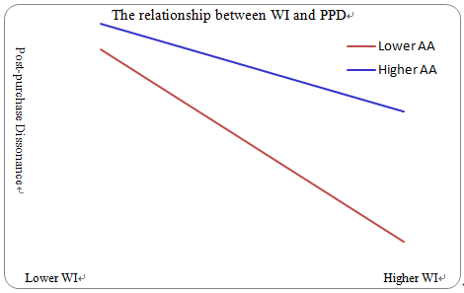
Results-2
Figure 3: Moderating role of AA
Illinois State University

Slide 15
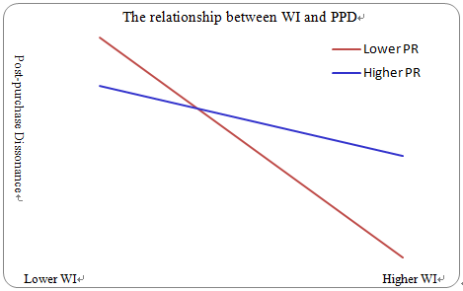
Results-3
Figure 4: Moderating role of PR
Illinois State University

Slide 16
Results-4
H4
H5
H6
PR is significantly positively associated with AA
The moderation of AA can be mediated by PR.
The moderation of AA moderated by PI.
Illinois State University

Slide 17
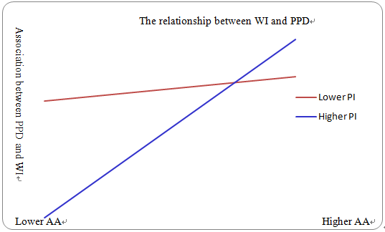
Results-5
Figure 5: The moderated moderation
Illinois State University

Slide 18
Implications and Contributions
Managerial Implications
1
2
3
Developing a reliable and active website information system is helpful for easing customers' post-purchase dissonance and managing consumer returns
Product with high involvement, Website information system becomes even more vital for managing consumer returns.
Website information system becomes more important when there is lack of attractive alternatives
Illinois State University

Slide 19
Implications and Contributions
Mediation and moderation
Analysis revealed that WI influence PPD in product returns management
1
Analysis also revealed that moderation of PR and mediated moderation of AA by PR is significant
2
Analysis also revealed that moderation of AA that is further moderated by PI is significant
3
Illinois State University

Slide 20
Hebei University of
Science & Technology
Thank You !
Welcome to Shijiazhuang
Mingfang Li & Askar Choudhury

