Slide 1
An Introduction to Machine Learning and Its Use in Predicting IBNR
Presented by Joseph Alberts, Tatiana Garcia and Clinton Aboagye

Slide 2
Overview
What is Machine Learning?
  Definition
  Examples
Modeling Parameters
Random Forest
Artificial Neural Networks
K Nearest-Neighbors
Comparing Each Model to Actuarial Technique

Slide 3
What is Machine Learning? Background
Definition
  Branch of Artificial Intelligence (AI), machine learning uses algorithms and other various techniques to teach a computer how to analyze data and find hidden patterns in data, as well as improve upon prior versions of itself while doing a certain task
Categories
  Supervised
  Unsupervised
  Reinforcement
Notes:
Supervised learning involves feeding training data into an algorithm that learns to identify this data based on labels.
Unsupervised learning is used to group data based upon similar factors in efficient ways.
Reinforcement involves giving an algorithm a situation with positive feedback and negative feedback that needs to be navigated through (sometimes as efficiently as possible)

Slide 4

What is Machine Learning? Typical Uses
Image recognition: Automatic friend tagging suggestion by Facebook
Voice recognition: Siri, Google Assistant
Online fraud protection
Automatic language translation
Email, spam and malware filtering
Notes:
Taken from https://www.javatpoint.com/applications-of-machine-learning, these examples highlight the depth at which Machine learning is changing how we do things. We can even predict credit card churners with a good degree of accuracy because of how machine learning.

Slide 5

What is Machine Learning?
Insurance context
  Chatbots/AI assistants
    Allstate Business Insurance Expert
  Driver performance monitoring
    Safe driving
    Texting
    Operating the radio
    Talking on the phone
  Fraud detection and prevention

Slide 6
Data Context
IBNR = Ultimate losses - Incurred loss
Predicting Ultimate Losses
  Policy Year and Months of Maturity (up to five years)
  Paid losses, case reserve losses, and incurred losses
  Premiums
  Response: Ultimate losses (ten year incurred loss)
Collinearity
  One explanatory variable can be linearly predicted from the others with accuracy.
  Paid loss + Case Reserve loss = Incurred loss
Notes:
Pinnacle’s analysis of industry data through 2019 had records dating back to around 1990. The data consisted of premiums, paid amounts, and incurred amounts by year and months of maturity for up to ten years. I organized this data into the following explanatory variables for commercial auto liability coverage: Policy year, months of maturity going up to five years, premiums, paid losses, reserved losses, and incurred losses. We used the incurred losses at ten years to simulate the ultimate losses which is the response variable of this model.
Collinearity: Collinearity is a condition in which some of the independent variables are highly correlated. This is a problem because it tends to inflate the variance of at least one estimated coefficient in this model, giving the model larger error. In order to fix this issue, we may have to remove one or more of the collinear variables.

Slide 7
Random Forest
Definition: An algorithm made up of smaller decision trees that are combined to make more accurate predictions than an individual tree
Devised by Breiman in early 2000s
Test Sample Input
Tree 1
Output
Prediction 1
Tree 2
Prediction 2
Average All Predictions
Random Forest Prediction

Slide 8
Random Forest
Pros
Ability to deal with small sample sizes
No need to scale or preprocess data
Can predict accurately on a wide range of problems
Cons
Easily overfit model
Cross validation is difficult and time consuming

Slide 9
Random Forest
Implementation of randomForest package in R
B = number of trees used = 500
l = number of variables randomly sampled at each split = 2
Notes:
Talk about what B and l represent.

Slide 10
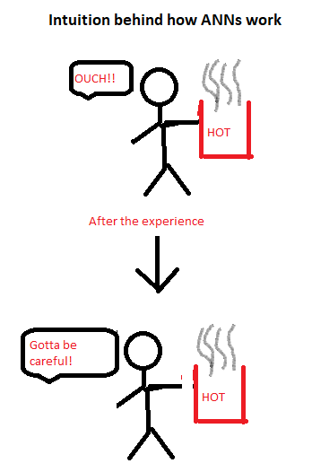
Artificial Neural Networks (ANNs)
History: Warren McCulloch and Walter Pitts in 1943
Definition: Mimic the human brain and its neural structure to perform tasks.
Uses: Regression and classification roles. Supervised and unsupervised learning.
Intuitive examples: Babies learning how to get what they want, faces, hot = hurt

Slide 11
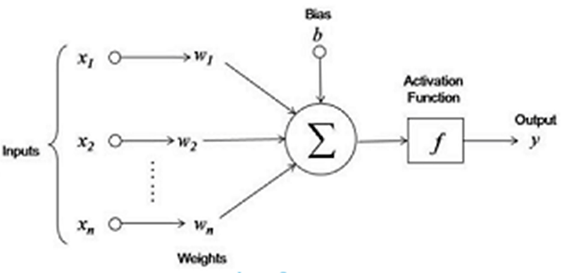
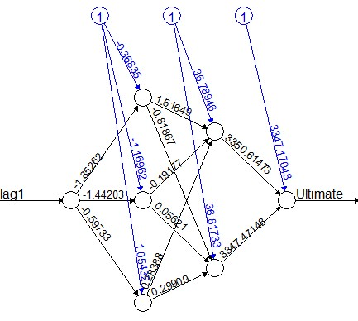

More on ANNs
Pros: Easy to understand, extensive research and application available
Cons: Numerical inputs, Better options may exist, Black boxes, requires lot of parameter tuning
Well known researcher (John S. Denker): “A neural network is the second best way to solve any problem. The best way is to actually understand the problem.”
Source: Towards Data Science, Aug. 2017

Slide 12
IBNR Analysis with ANN in R
Train: 80%, Test: 20%
First use the data without any adjustments for inflation.
IBNR predictions, RMSE = 6017.9
Adjust for Inflation using world bank CPI index to 2019 values
IBNR predictions, RMSE = 3610.9

Slide 13
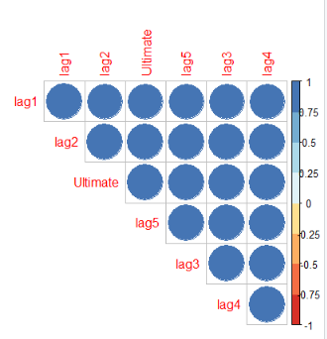
IBNR Analysis with ANN in R- Insights
High correlation
Tuned one model leading to better accuracy
Took too much time and can still be made better

Slide 14
K Nearest Neighbors (K-NN)
Definition
  K-NN is a supervised, non-parametric ML algorithm that predicts new observations based on summarizing the K data points that are most similar to it.
Classification versus regression
K-Value
Similarity
  Distance function
Assumptions:
  Standardization
  Outliers
Notes:
In simple words, it captures information of all training cases and predicts new cases based on a similarity.
Predictions are made for a new instance (x) by searching through the entire training set for the K most similar cases (neighbors) and summarizing the output variable for those K cases. In classification this is the mode (or most common) class value and in regression this is the mean (or average).
Supervised means it takes a bunch of labeled points and uses them to learn how to label other points
Non-parametric means not making any assumptions on the underlying data distribution. Non-parametric methods do not have fixed numbers of parameters in the model. Similarly in KNN, model parameters actually grows with the training data set - you can imagine each training case as a "parameter" in the model.
Assumptions: Standardization - When independent variables in training data are measured in different units, it is important to standardize variables before calculating distance. For example, if one variable is based on height in cms, and the other is based on weight in kgs then height will influence more on the distance calculation. In order to make them comparable we need to standardize them which can be done by any of the following methods : (X minus mean) divided by the Stan Dev, (X minus Mean) divided by (Max minus Min), or (X minus Min) divided by (Max minus Min).
Outliers - Low k-value is sensitive to outliers and a higher K-value is more resilient to outliers as it considers more voters to decide prediction.

Slide 15
Modeling IBNR with Standard K Value
First model: K = 9
  Including paid, case reserve, and incurred loss as explanatory variables.
  RMSE = 655.5
Second model: K = 9
  Removed Incurred loss as an explanatory variable
  RMSE = 475.6
Comparing other K-Values: K = 5
  First model: RMSE = 524.5
  Second model: RMSE = 460.3
Notes:
In the first knn model that I wanted to train, I selected the K value based on the general rule of taking the square root of the number of observations (sometimes seen as this value divided by 2). The original data set had 100 data points, but I split this into two groups. The first group that was used for model training received 75% of the data and the second group for model testing received 25% of the data. The resulting k value was around 8.7 which I rounded to 9. Results of this model (containing the collinear variables) lead to a root mean square error of 655.5 on the test data. The model with only paid and reserved losses lead to a rmse of 475.6 on the test data.

Slide 16
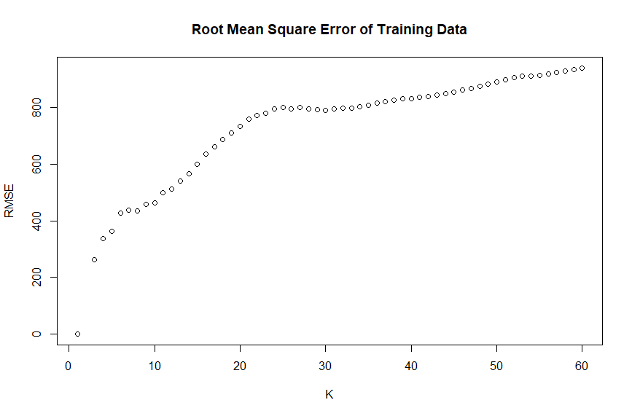
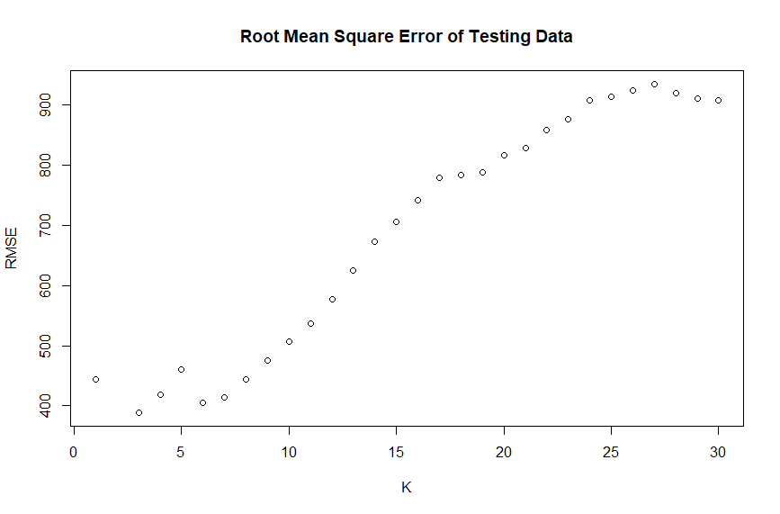
Testing Other K Values
Compare all possible K values
  Training data first
    Overfitting
  Testing data

Slide 17
Results
Best possible K value
  K = 3
  RMSE = 388.7
  Smaller error than previous
Pros versus cons of KNN

Slide 18
Traditional Techniques
Chain ladder technique using loss triangles
Loss development factors
Cumulative claim development factors
Projected ultimate claims

Slide 19
Comparing All Methods
Method | RMSE
Random Forest (RF) | 4826.40
Artificial Neural Networks | 6017.85
K Nearest Neighbors | 5647.68
Notes:
Talk through results. Also explain what we could have changed to make better models.

Slide 20
Conclusion
Unreasonable results:
  Negative IBNR is possible, but unlikely at this magnitude
  Paid and Incurred losses behaved differently than training data
Lessons to learn from this exercise:
  Need to understand ML model before implementation
  Many ML models need consistent data for reasonable results

Slide 21
Thank You for Your Attention
Joseph Alberts
JAlberts@pinnacleactuaries.com
Tatiana Garcia
TGarcia@pinnacleactuaries.com
Clinton Aboagye
nanak1.essiam@gmail.com

