Slide 1
Artificial Intelligence – Reshaping Insurance Markets
Presented by Mitch Caster, Maggie Sun and Elze Van Zyl

Slide 2
Meet the Presenters – Elzé van Zyl
Graduate from the University of Pretoria, South Africa
Currently a graduate student studying Actuarial Science at Illinois State University
Graduate Assistant at Illinois State University

Slide 3
Meet the Presenters – Maggie Sun
Graduate from Wellesley College in Wellesley, MA
With Pinnacle since January 2020
Experience in loss reserving and enterprise risk captive markets

Slide 4
Meet the Presenters – Mitch Caster
Graduate from Franklin College in Franklin, IN
With Pinnacle since September 2019
Experience in loss reserving, feasibility studies and enterprise risk captive markets

Slide 5
Agenda
Defining Artificial Intelligence (AI)
Impact of AI on insurance
Main challenges influencing AI implementation
Reactions from specific lines of business
Questions from the panel

Slide 6
Defining Artificial Intelligence
Artificial Intelligence (AI)
Exhibited by machines
Learning, perceiving, problem solving, and reasoning

Slide 7
Defining Artificial Intelligence
Artificial Intelligence
Deep Learning
Machine Learning

Slide 8
Defining Artificial Intelligence
Deep Learning (DL)
Teaches computer to steer by example
Training computers to perform tasks that humans normally do
Reduce time spent on administrative tasks & risk of human error

Slide 9
Artificial Intelligence Impact
1. Claims Handling
95% of policyholders rated speed of settlement as their top factor for satisfaction
Historically it has taken days to process claims
Advanced AI handles initial claims routing, increasing efficiency and accuracy
Uses include online interface, chatbots, virtual claims adjusters and many more

Slide 10
Artificial Intelligence Impact
2. Around the clock accessibility
Faster to buy insurance with less involvement on the part of the insurer and the insured
Save on staffing while also providing around-the-clock value to customers
Insureds have 24/7 access to services
A recent study found that 74% of customers say they would be happy to get computer-generated insurance advice

Slide 11
Artificial Intelligence Impact
3. Personalized input into products
Revolutionize the way customers purchase insurance
Enable engagement with all customers on personalized level
Create a full profile that can be used to offer only relevant products
Retain an insured’s preferences
Hone in on relative coverages based on insured’s preferences
Prevent attrition or lapses through insights on customers, their behaviors and their risk for letting policies lapse

Slide 12
Challenges Implementing Artificial Intelligence

Slide 13
Actuarial Challenges – Paid Loss Development
Historical paid patterns may become less predictive
Possible responses could include:
Berquest-Sherman Method
Heavy reliance on more recent development factors
Industry benchmarks pooling AI driven entities
The response’s potential impact on the bottom line:
Under reaction = less competitive products
Over reaction = high loss ratios

Slide 14
Regulatory Issues
NAIC Principles on Artificial Intelligence*
Fair and Ethical: Should respect the rule of law
Accountable: AI actors should be accountable that AI systems comply with these principles
Compliant and Regulations: AI actors should have knowledge and resources to comply with all insurance laws and regulations
Transparent: AI actors should have responsible disclosures regarding AI systems to relevant stakeholders
Secure, Safe, and Robust: AI systems should be safe, secure, and robust throughout the entire life cycle
*Summarized for conciseness

Slide 15
Regulatory Issues, Continued
Ethical issues become a huge focus
Artificial Intelligence products need to be accessible to all individuals
AI systems must avoid bias
Discriminatory rates: Drawing the line
Fitbit data and health insurance rates
Protection regarding insured’s data
Open web interactions

Slide 16
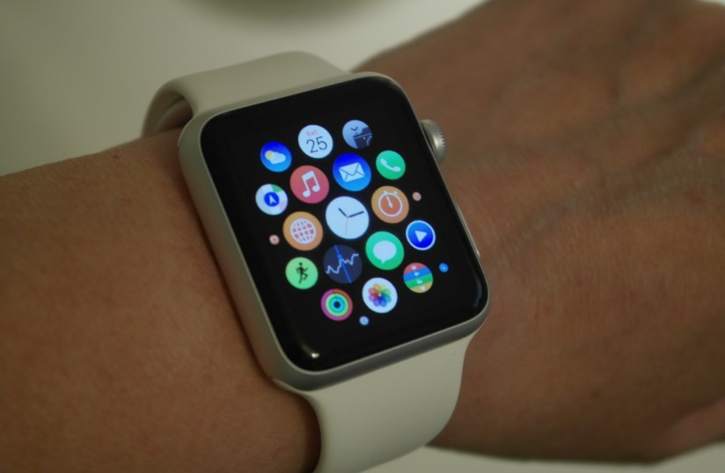
Specific Lines of Business

Slide 17
Title Insurance
Current State of the Market:
Cost breakdown:
90% Expenses
5% Claim Payments
5% Profit
Title Searches need to be thorough
Results in being costly
Top 4 insurers account for over 85% of written premium
AI provides an opportunity for a more competitive market

Slide 18
Title Insurance, Continued
AI Impact
Reduce title search costs and improve efficiency
Areas for automation/improvement
Task and process tracking
Workflow management
Communication
Search and Examinations
Challenges
Management and programming costs

Slide 19
Cyber Insurance
Current State of the Market:
Consulting Actuary Nick Gurgone, FCAS, blog on cyber insurance
96% of policy counts are package policies
43% of premiums come from package policies
Insured's mindset regarding their exposure
AI’s Impact
The market might experience significant lag
Small- to mid-market risks
Regulations and a cyber requirement

Slide 20
Long-Term Care Insurance
Current State of the Market:
Hardening: 2018 data:
Private room = $100,379
Assisted living = $46,350
Increased life expectancy complexity
AI’s Uses
More accurate life expectancy
Early identification of risks
Challenges for AI Implementation
Older demographic and technology may slow affect
Ethical challenges

Slide 21
Thank You for Your Attention
Mitch Caster
Mcaster@Pinnacleactuaries.com
Maggie Sun
Msun@Pinnacleactuaries.com
Elzé van Zyl
elzevzyl@gmail.com

