Slide 1
Generalized Linear Models
Theory vs. Practice
Hannah Kaufmann
Patryk Wiech
Nathan Schuele
March 28, 2019

Slide 2
Presentation Outline
Why use Generalized Linear Models?
Introduction to Simple Linear Regression
Data Processing
What is a Generalized Linear Model?
Choosing a Model
Validation
Interpreting Results

Slide 3
Why do Insurers use GLMs?
Efficiency
Account for the relationship between variables
Flexibility based on overall purpose
Error statistics
Accessible software
Notes:
Widely used in ratemaking
1. Simplifies process
2.
3.
4. Instead of analyzing only the relationship to the predictor
5. Choose distributions

Slide 4
Simple Linear Regression
Explores the relationship between a quantitative response variable (Y) and one explanatory variable (X)
Limited to a single pair of a response and an explanatory variable
μ represents the true mean of the response variable y given the data from the explanatory variable x
$$μ_{y|x}=β_{0}+β_{1}x+ε$$

Slide 5
Linear Regression Assumptions
Random Components: each component of the response vector ($Y$) is normally distributed and all share a common constant variance $σ^{2}$
Systematic Components: p covariates combined to give the linear predictor $\underline{η}$ such that: $\underline{η}=X∙\underline{β}$
Link Function: the identity function such that: $E\left[\underline{Y}\right]≡\underline{μ}=$ $\underline{η}$

Slide 6
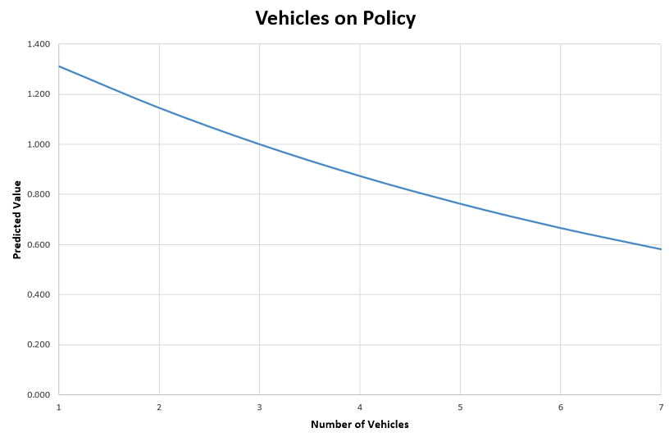
Simple Linear Regression Example

Slide 7
One-Way Charts
One-Way charts are a good way to begin exploring your data
Analyze reliability of data
Loss ratios
Exposure distribution
Correlation issues are difficult to detect
Helps with selecting a reference level and mapping data
Notes:
Patryk

Slide 8
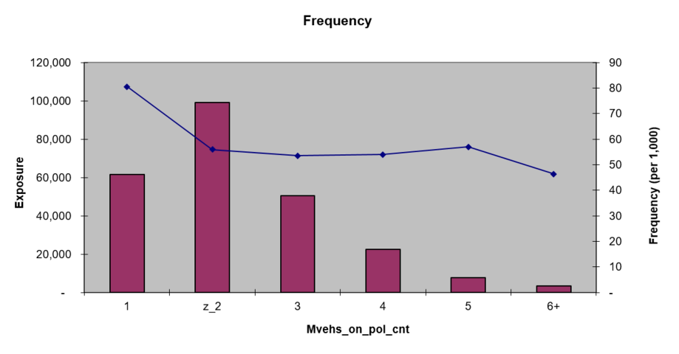
One-Way Graph

Slide 9
Mapping Your Data
Data can either be continuous or categorical
Continuous data can be transformed to categorical data
In general we want to group similar data levels within the same variable
Group miles driven, Ages, etc.
If we map data to too small of a group, results can be unreliable and non predictive
Too many degrees of freedom may cause model to not converge
If we map data to too large of a group, may miss an important factor

Slide 10
Selecting A Reference Level
Choose a reference level that helps with the interpretability of your model
In general we select the level with the most exposure to be the reference level
This is done so that the significance statistics produce meaningful p values
Reference level with too little data will produce less significant p values than one with more
Notes:
Significance statistics compare how different the level is to the base level
The model needs to have a good read on what the average value is for the base level so there has to be enough data, if you use a level with only a couple values, the model will not have a good understanding of what the “average” of that level should be
There needs to be confidence in both levels being reviewed

Slide 11
Why not Linear Regression?
Ignores any interdependencies the variables have
Assumes the response variable is normally distributed, has a constant variance, and that all predictors are entered additively
Why Generalized Linear Models?
Considers interdependencies
Allows for multivariate analysis

Slide 12
GLM Assumptions
Random Component: each component of the response variable vector ($\underline{Y}$) is independent and is from one of the distributions in the exponential family
Systematic Components: p covariates combined to give the linear predictor $\underline{η}$ such that: $\underline{η}=X∙\underline{β}$
Note: unchanged from assumption 2 on simple regression
Link Function: the relationship between the random and systematic components via a link function g, that is differentiable and monotonic such that
$E\left[\underline{Y}\right]≡\underline{μ}=g^{−1}(\underline{η})$
Notes:
Change

Slide 13
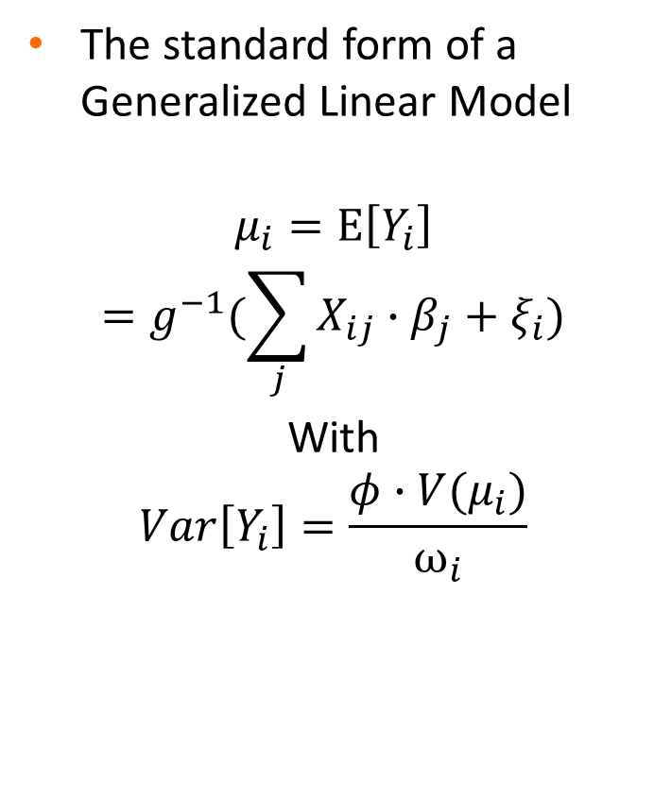
Basics of a GLM
The standard form of a Generalized Linear Model
$$μ_{i}=E\left[Y_{i}\right]$$
$$=g^{−1}(\sum_{j}{X_{ij}}∙β_{j}+ξ_{i})$$
With
$$Var\left[Y_{i}\right]=\frac{φ∙V(μ_{i})}{ω_{i}}$$
$Y_{i}$ is the response vector
$g(x)$ is the link function
$X_{ij}$ is the “design matrix”
$β_{j}$ is the vector of parameters
$ξ_{i}$ is the vector of offsets
$φ$ is the parameter of $V(X)$
$V(X)$ is the variance function ($σ^{2}$)
$ω_{i}$ is the prior weight

Slide 14
Exponential Family of Distributions
Includes:
Normal
Poisson
Binomial
Gamma
Inverse Gaussian
Variance function depends on the distribution chosen
Most distributions have a strictly increasing variance
More risky policyholders are expected to have higher variance
Notes:
The characteristics of the raw distributions lead to choosing a specific distribution for the specific type of model; in practice gamma for severity and poisson for frequency are the most commonly used distributions
Gamma – used for severity models; depending on the parameters, the results tend to have a large spike and then a long tail to the right which match the empirical distribution of claim severity
Poisson – used for frequency models, to model claim counts
Binomial – used for retention models, when you are trying to predict a probability, the probability that a policyholder will renew their policy
When it comes to actually creating the GLM, this decision is generally made at the beginning and then assumed for the rest of the process. Since there has been so much research done, these assumptions tend to be safe to make and then focus on the individual variables and the quality of the data in order to improve the model

Slide 15
Choosing a Model
Selecting a model is more of an art than a science
As models are built and results are analyzed, the model is likely to evolve
Choosing target and predictor variables
Choosing distribution for the target variable
Best form of predictor variables
Which variables to include

Slide 16
Choosing a Model
Compare Measures of Fit
Non Penalized
Log-Likelihood
Deviance
Penalized
AIC
BIC
Analyzing Residuals
They follow no predictable pattern
Normally distributed with constant variance (Homoscedastic)
Any deviation can indicate underlying distribution is incorrect

Slide 17
Bias vs. Variance Trade-Off
Bias: Expected Prediction – Correct Value
Pay little attention to the training data, which leads to high error in both the training data and test data
Variance: variability within the data
Pays lots of attention to the training data which leads to overfitting in the test data

Slide 18
P-Values
An estimate of the probability of a value of which the magnitude (or higher) arises by pure chance
Example: $P\left(β_{0}≥1.5\right)=p_{v}=0.0012$
Leads to the result that $β_{0}$ is significant, or that it is likely that $β_{0}≠0$
Example: $P\left(β_{0}≥1.5\right)=p_{v}=0.52$
Leads to the result that $β_{0}$ is insignificant, or that it is likely that $β_{0}=0$
The effect of $β_{0}$ may be present in the data set, but would need to be seen from a macro-level

Slide 19
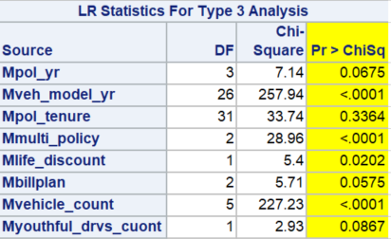
P-Value Example
Notes:
Output directly from SAS
Pr > Chi Sq (in yellow) gives the p-values
The top chart

Slide 20
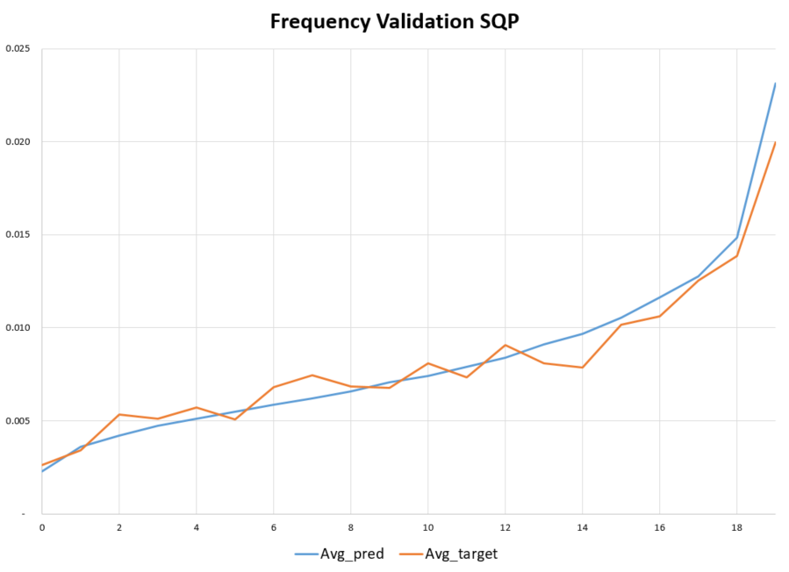
Simple Quantile Plots
Validation technique to compare the actual results with the predicted results
Judgment to determine “best” model
Predictive accuracy, monotonicity, vertical separation
Notes:
Simple quantile plots are a widely used technique to visualize how “well” your model is doing by comparing the actual results to the predicted values.
There are specific step by step instructions to create these graphs but the output needs to be analyzed
Blue curve is the model output and the orange curve is the validation (actual) values

Slide 21
Analyzing Results
Simplifying models
Smoothing results post model
Outside of model
Rerunning model
Communicating results to clients
Business considerations
Reliability of results
How feasible is it to implement the rates?
Notes:
Smoothing results – adjust for categorical variables
Business considerations
Competitor variables, do you want to use it even if there is not enough data available
Multi policy discount - market tends to show a much bigger discount than the model suggests. Decide between having a more spread out portfolio between mono line and mult policy. If decide not to give the bigger discount, you risk losing all the multi policies
Some variables arent usuable because you can’t verify the data
Ex. mileage,
Customer and agent control can be ruined if incentives are offered
By offering full pay, the people who wouldn’t normal chose full pay would not pick it. This changes the environment of the discount

Slide 22
Thank You for Your Attention
Hannah Kaufmann
(309) 807 2304
hkaufmann@pinnacleactuaries.com
Patryk Wiech
(678) 894 7263
pwiech@pinnacleactuaries.com
Nathan Schuele
(217) 278 9132
npschu1@ilstu.edu

