Slide 1
Frequency*Severity = Pure Premium, Right?
Presented by
Adam Majewski
Isaac Amartey-Vondee
Matt Kaufman

Slide 2
Agenda
Introduction
Getting Started
Frequency & Severity
Pure Premium
Developing Models
Results
Future Considerations

Slide 3
Introduction
Aim: Explore two major pricing model methodologies
Pure Premium
Frequency/Severity
Understand the usefulness of each in pricing auto policies
Methodology: Practical application of both modeling techniques to auto data
Notes:
Provide evidence for preference
Pure premium by Ernesto Schirmacher in 2016.

Slide 4
Getting Started

Slide 5
Source of Data
Dataset: Carfax VIP data
Number of Observations: Almost 22,000 data points
Variables include:
Policy specific: Deductibles, policy limits, etc.
Vehicle specific: Various safety features, mechanical makeup, etc.
Driver specific: Gender, marital status, age, driving habits, etc.
Notes:
The data we used was aggregating by CarFax
We only used a subset of the full data set, with nearly 22K data points to work with
Some of the variables we words with are listed here (give some examples)
Overall, we had 70 variables in our dataset, but we want to give you a feel of what variables we worked with.

Slide 6
Clean, Arrange and Rearrange
To ensure our models had the best capability of capturing information from the data, we started by analyzing the data;
Removing irrelevant variables
Removing non-applicable observations
Removing correlated information from variables
Notes:
Before jumping into modeling, it’s always a best practice to become familiar with the data you are working with.
Conduct EDA. A few things we looked at are removing policy ids, zip_type, which had two levels with one of the levels showing up just 39 times
Some Red Flags from the start included variables which had high correlations and a large number of missing values such as zip_occ_hous_units and zip_population
This should make modeling easier and more accurate

Slide 7
Model Background

Slide 8
Frequency-Severity
Frequency models are developed to both examine and predict the number of claims per policy
Severity models are used to examine and predict the average claim amount given a claim occurs
Models are then joined together to parameterize the pure premium function
Pros:
More flexibility choosing distributions
Greater interpretability
Cons:
More work
Not always more predictive
Need claim count
Notes:
You can pick a number of distributions of distributions when creating a frequency model such as binomial, Poisson, normal, and more.
Using a frequency/severity setup will allow us to see if an increase in pure premium is stemming from frequency side or the severity side of our models.
This frequency/severity setup does require the modeler to setup two separate models which can be a time consuming task
In the end, the greater amount of flexibility and having two separate models doesn’t guarantee that these models will be better than a pure premium model.
With the frequency model it is required that we have claim count as a variable. The pure premium model is not held to this same restriction.

Slide 9
What does this look like?
Theoretically the two models should give you the same result
$Pure Premium= \frac{Loss}{Exposure}= \frac{Claim Count}{Exposure} ∗ \frac{Loss}{Claim Count}$
$$=Frequency ∗Severity$$
Frequency Model
Log(CC_{i}) = $β_{F,0}+β_{F,1}x_{1,i}+β_{F,3}x_{3,i}+\log\left(eei\right)+ … +ε_{i}$
Severity Model
Log( Loss_{i} / CC_{i} ) = $β_{S,0}+β_{S,1}x_{1,i}+β_{S,2}x_{2,i}+ … +ε_{i}$
Weight = CC
Frequency*Severity Function
Log(Pure Premium_{i}) =$β_{F,0}+β_{S,0}+{( β}_{F,1}+ β_{S,1})x_{1,i}+β_{S,2}x_{2,i}+β_{F,3}x_{3,i}+\log\left(eei\right)+ …$
Notes:
As we can see when combining frequency and severity models when a variable only exists in one model no changes need to be made.
However, if a variable exists in both the frequency and severity models we will add the coefficients up from their respective models and use that as our pure premium coefficient.
When this process us done we will get the union of the two models where common variable coefficients will be summed together.
At times the coefficients from the two models can have offsetting effects that will cancel each other out.

Slide 10
Pure Premium
Positive correlation assumption between claim count and severity
Tweedie Distribution
Power Variable, p (estimated using maximum likelihood)
Point mass at 0
Pros
Less work
Comparable results to Freq/Sev Models
Fewer features used in constructing model
Cons
Not as interpretable
Convergence issues
Less flexibility in choosing distributions
Notes:
The Tweedie distribution is a combination of a Poisson/Gamma mixture. In the Tweedie Distribution a power parameter, p, exists that determines the shape of the tweedie distribution.
This power parameter is between (1,2)…when p is closer to 1 the distribution will be closer to a Poisson distribution and when it is closer to 2 it will be closer to a Gamma distribution.
This Tweedie dist. Works it allows for a large point mass at 0 claims like a Poisson, then models any claims with a Gamma distribution.
This method only requires one model to be constructed and processed.
When using a Tweedie distribution we often need a smaller number of variables in our model to get to a very similar outcome as the Freq/Sev method.
We aren’t able to see as well what is causing pure premium to change using this method.
If your data is not the best you can have convergence issues when constructing the model or calculating the maximum likelihood of the p parameter.

Slide 11
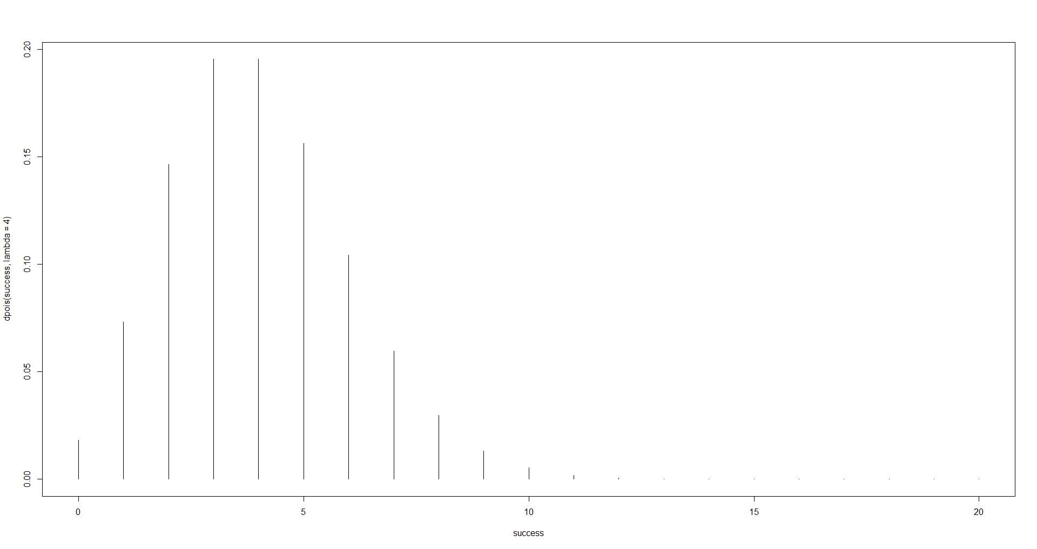
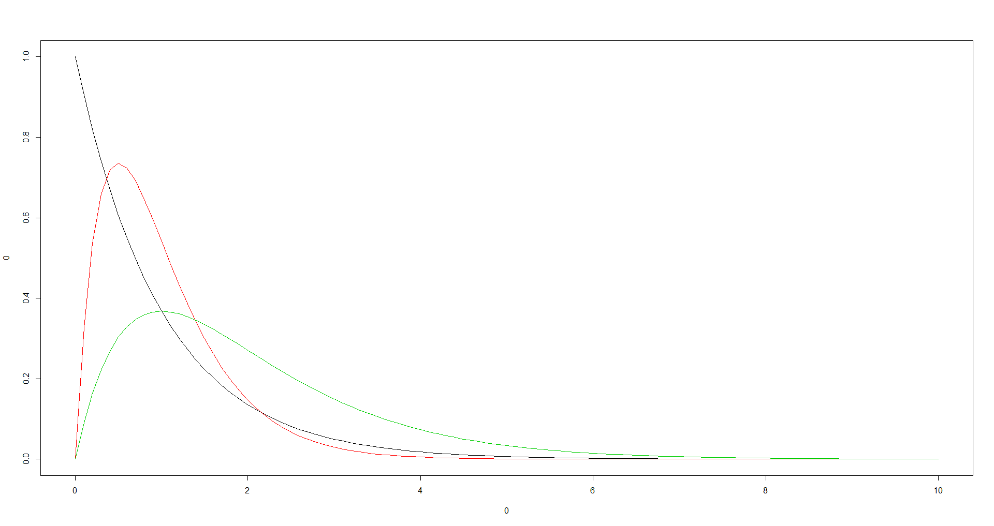
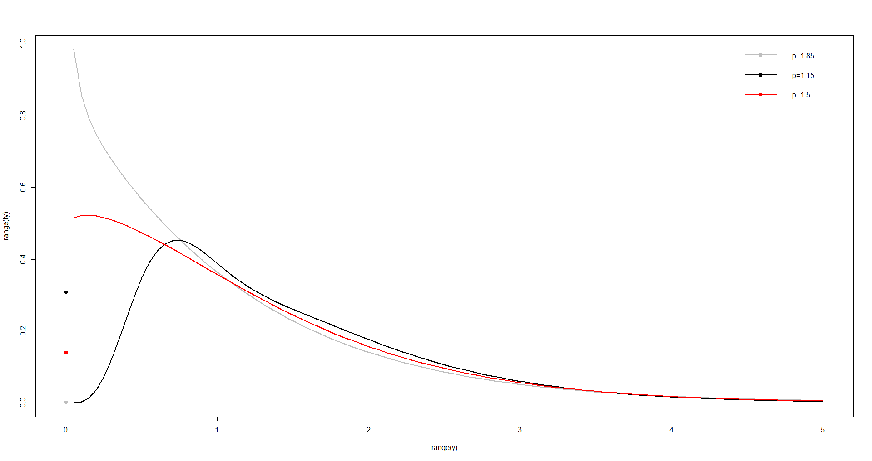
Tweedie
Notes:
These graphs help us show how joining the Poisson and Gamma distribution up top leads us to a Tweedie distribution on the bottom.
As we can see we have the point mass at 0 and after we have a Gamma distribution.

Slide 12
What’s really going on
Model Component | Frequency | Severity | Pure Premium
Dependent Variable | Claim Count | Loss/Claim Count | Loss
Response | # of Claims | Total Losses | Total Losses
Offset/Weight | Exposures | # of Claims | Exposures
Link | Log | Log | Log
Distribution | Poisson | Gamma | Tweedie
Variance Function | μ | μ² | μ^{p} Where p is between (1,2)

Slide 13
Modeling

Slide 14
Model and Variable Selection
Stepwise selection
AIC comparing forward and backward methods
Accounting for greedy algorithm
ANOVA and Deviance tests
Testing interactions
Incorporating higher powers
Notes:
We used the stepAIC function in R to run a forward and backwards stepwise selection algorithm on our data to create good base models for us to work with.
However, since the stepwise algorithms are greedy algorithms, they make the best decision for the model at that step with no care about future steps.
We then take the stepwise output and run some additional deviance tests and ANOVA tests to see if our model should include any other variables.
Afterwards, we used some of our remaining time to test some interactions between some variables like driver age, driver marital status, and driver sex.
Lastly, we also tried to incorporate some higher power variables where we could.

Slide 15
Results/Comparison

Slide 16
Compare - Double Lift Charts
Graphical comparison of two models performance against actual data
Simple process to create:
Create a table with predicted pure premium from both models and actual observations
Sort table based on the ratio of (Model A Prediction / Model B Prediction)
Bucket data into quantiles of even exposure
Within each bucket, calculate the average PP from Model A, Model B and actuals, then divide that average by the overall average for each respective column
Plot quantities calculated above
Notes:
Now that we have final models, lets talk about how they compare:
We used a double lift chart, which compares two models performance against actual observations
To do this, we use a hold out dataset, which was not used to model. This ensures that results are not skewed by potential overfitting of one model vs the other
*** Walk through the process ***
The “better” model will be closer to the graphed “actuals”

Slide 17
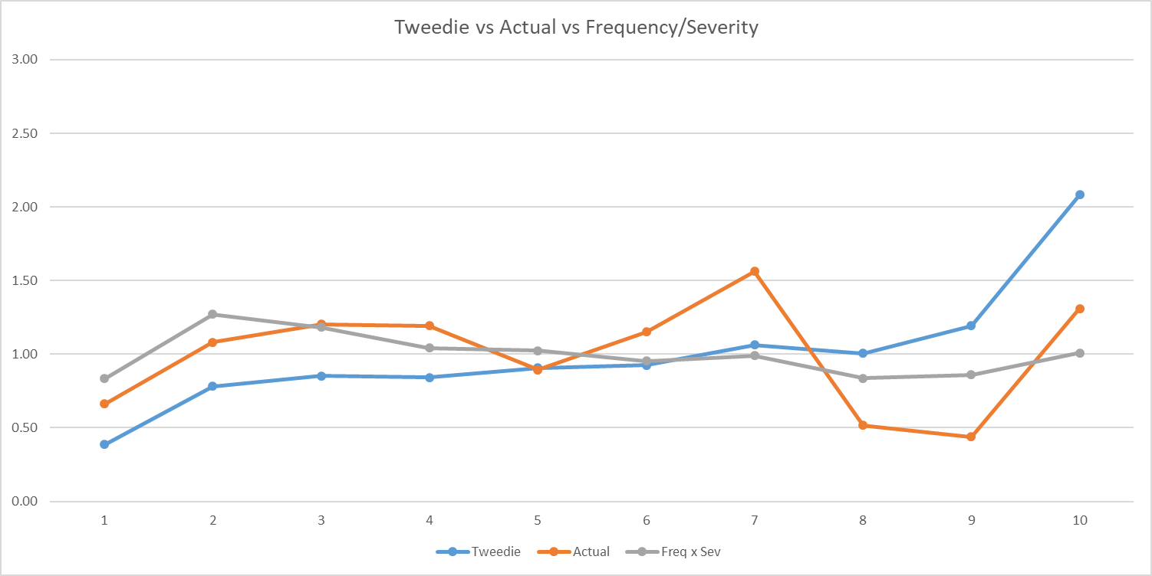
Results
$Decile of Ratio = \frac{Tweedie}{Freq x Sev}$ , smallest to largest
Notes:
Walk through graph. Key points:
(Blue = tweedie, Orange = Actual, Gray = Freq/sev
Starting at the first decile, this is the point where the frequency/severity predictions largest compared to the tweedie
You can see at this point that the tweedie under-predicts PP and the frequency/severity over predicts
Moving to the right, you can see that the frequency/severity tracks the actuals closer than the tweedie does
…
While there’s not necessarily a clear winner, we would argue frequency/severity performs better than tweedie

Slide 18
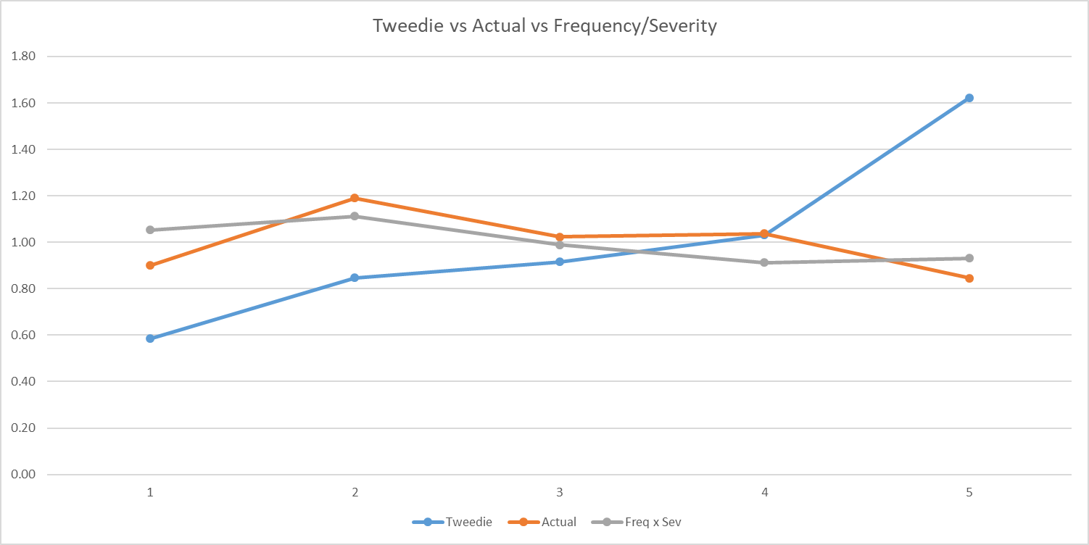
Results
$Decile of Ratio = \frac{Tweedie}{Freq x Sev}$ , smallest to largest
Notes:
5 buckets allows losses to stabilize (law of large numbers), in this case frequency/severity is a clear winner

Slide 19
Conclusion
Takeaways
Frequency/Severity appears to perform better in our case
Man power needed vs insight
Dataset Problems
Volatility
Low claim counts
Combining BI, PD, and COL
Notes:
Frequency and severity technique appeared to fit actual values better than tweedie, could be inherent to the data we used (more to come)
Working on one tweedie model roughly cuts the “man power” in half – huge advantage, but this comes at cost (no longer see impact on freq/sev separately)
Data issues that could impact our results:
Few losses, of the few losses some were very large
We capped pure premium at 100K prior to modeling. This could have impact our results – maybe should’ve chosen a lower point
Our raw data only had a claim frequency of 3.65% - a freq/sev would likely be more appropriate in this scenario
Additional volatility in losses due to all auto lines being combined
Maybe discuss: late in our process we noticed duplicate claims with different incurred loss amounts
Context: our loss amount columns were multiplied by a random number to protect confidentiality. This random factor prevented us from picking out repeat observations with claim history

Slide 20
Future Considerations
Larger dataset in both directions
More in-depth techniques for model development
Different distributions
Notes:
In todays world 22K data points is not a lot of data. Adding more data observations can allow for strong, more accurate models
“law of large numbers” could help average out the large spikes we noticed in our lift charts
Increasing variable options can tease out more predictive relationships
Our model/variable selection was basic. Could test out more sophisticated selection techniques such as LASSO, or other machine learning techniques
Tweedie is not the only option for pure premium models. Can test Quasi-Poisson and Quasi-Negative Binomial distributions

Slide 21
Thank You
Matthew Kaufman
MKaufman@pinnacleactuaries.com
Adam Majewski
Amajewski@pinnacleactuaries.com
Isaac Amartey-Vondee
iqvondee@gmail.com

Slide 22
Additional Slides

