Slide 1
Impact of Vehicle Technology on Auto Insurance
Presented by Nathan Dotterer, Toyin Larinde & Evan Harris
Notes:
Description: We will present our research on the history, current availability, and future outlook of vehicle technology. Gain insight on how auto insurance is affected by driver assistance technologies impacting crash frequency and severity. Learn about progress towards driverless cars being widely available.

Slide 2
Agenda
Background of Vehicle Technology
Perspectives on Driverless Cars
Collision Avoidance Technologies
Data Insight & Insurance Considerations
Future Expectations
Notes:
Picture from Pinnacle Stock Photography

Slide 3
Timeline of Vehicle Technology
First Mass Production of Cars
Partially Automated Safety
2016
Fully Automated Safety Features
Soon?
Basic Safety Features
Advanced Safety Features
Advanced Driver Assistance
1950’s
2000’s
2010
1910’s
Notes:
Driverless cars aren't here yet. More vehicles are incorporating a degree of automation with technologies such as adaptive cruise control and lane centering, but the driver will continue to share driving responsibilities for the foreseeable future. In theory, fully automated driving could eliminate the vast majority of crashes, but that level of automation won't be parked in your driveway anytime soon.

Slide 4
Levels of Vehicle Autonomy
0
No Automation
1
Partial Automation
Driver Assistance
2
Driver Monitors the Driving Environment
Notes:
Will talk about definition of each level

Slide 5
Levels of Vehicle Autonomy
3
Conditional Automation
4
Full Automation
High Automation
5
Automated System Monitors the Driving Environment
Notes:
Will talk about definition of each level

Slide 6
Snapshot of Available Vehicles
Sample of vehicles on the roads:
Level 0
  2005 Ford Explorer
  2005 Toyota 4Runner
  2005 Toyota Camry
Level 1
  Nissan Rogue
  Tesla S
  Toyota RAV4
Level 2
  Tesla Autopilot
  Mercedes-Benz Drive Pilot
Level 3
  Honda Legend – Available for lease in Japan as of March 2021
Notes:
In 2020, 35 states have had legislation or executive orders on autonomous vehicles
Majority of cars on roads are still level 0
Some manufacturers trying to skip level 3 because it’s harder to figure out what point the user should be intervening to drive the car.
Honda is trying to mass-produce level 3 autonomous cars
No level 4/5 vehicles

Slide 7
Consumer Perspective on Driverless Cars
Luxury
Convenience
Independence
Safety Benefits
Notes:
Other Pros
- Decreased Congestion
- Benefits Social Welfare
Cons
-Disruption of parking revenues
-Driving jobs
-Overregulation

Slide 8
Insurer Perspective on Driverless Cars
Focus on data driven adjustments as evidence continues to emerge on impact of various vehicle technologies
Challenges due to regulatory differences across 50 states
Common Questions
Will introduction of vehicles at level 4 and 5 require changes to the insurance system?
Will minor accidents become more expensive?
Will new risks emerge?

Slide 9
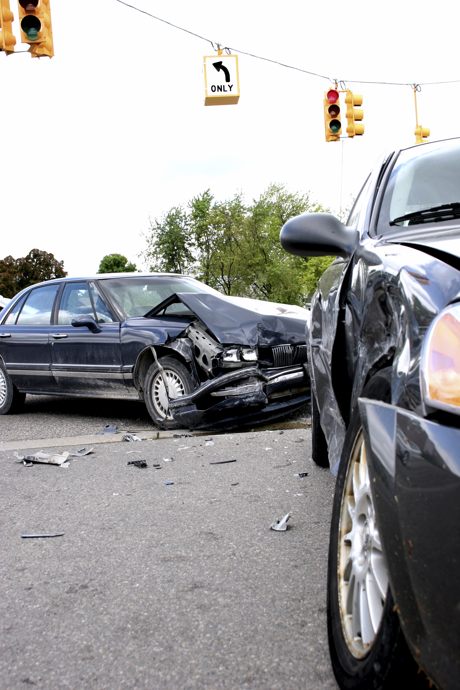
Collision Avoidance Technologies
Forward collision warning (FCW)
Autonomous Emergency Braking (AEB)
Rear Autonomous Emergency Braking
Curve - adaptive headlights
Lane departure warning (LDW)
Blind spot warning (BSW)
Parking sensors
Rear cameras
Notes:
Picture from Pinnacle Stock Photography

Slide 10
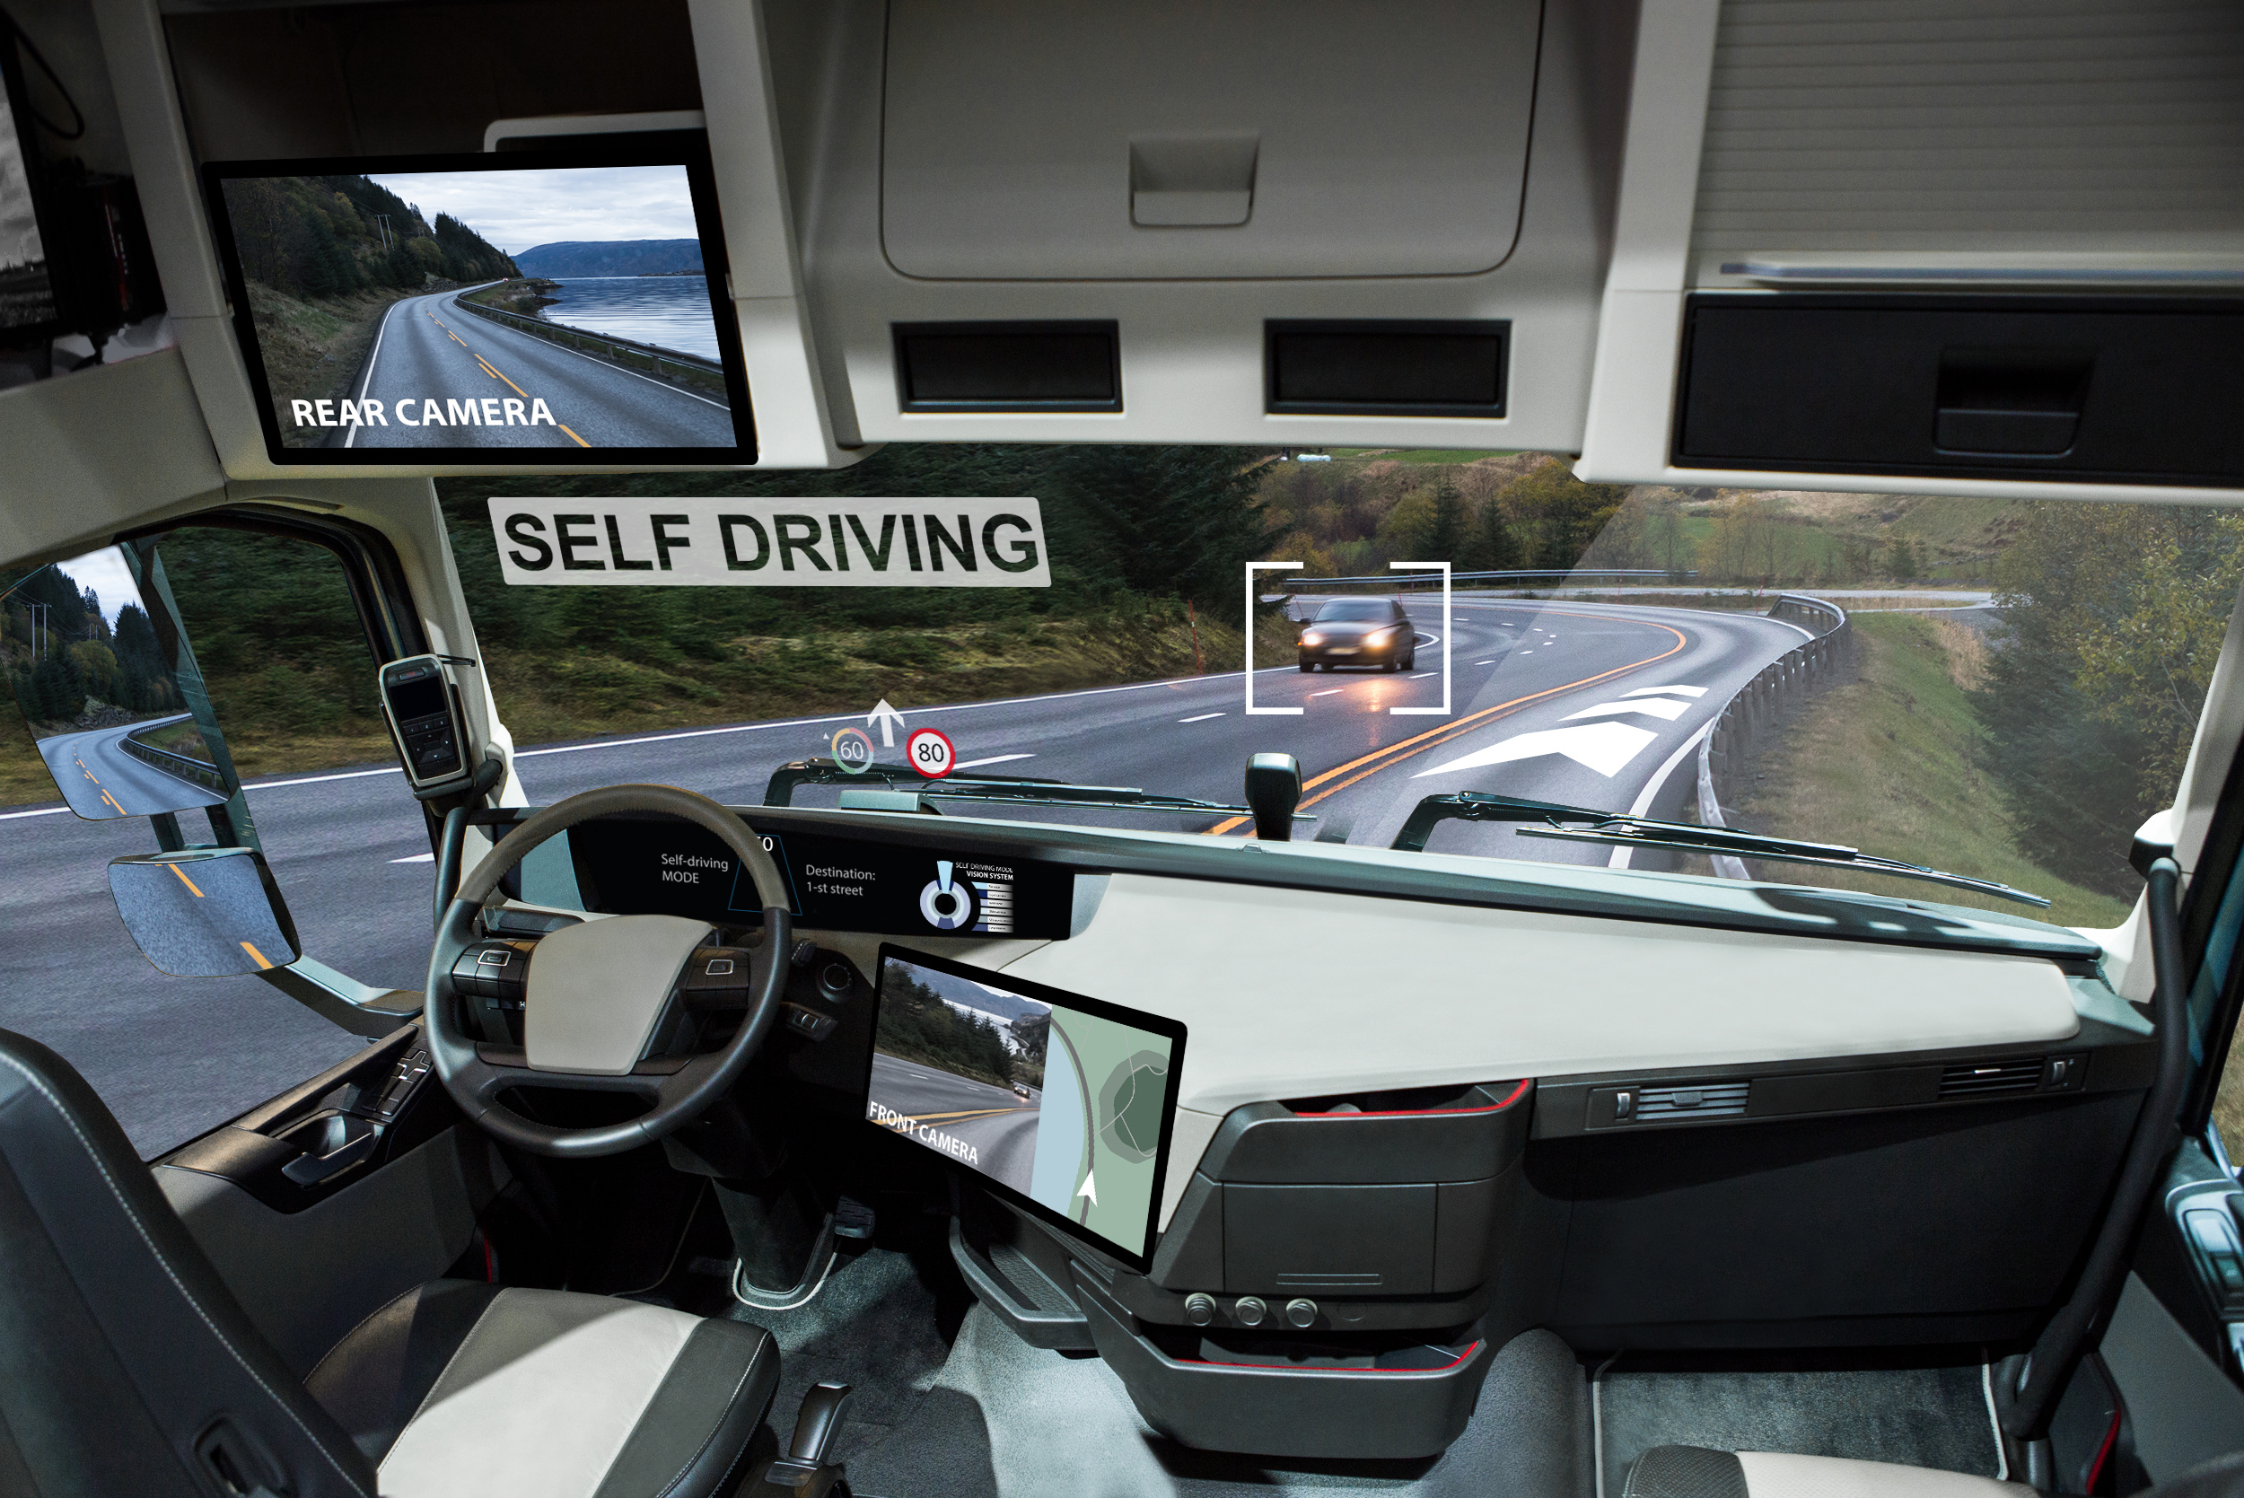
Other Technologies
Adaptive cruise control (ACC)
Rear cross - traffic alert (RCTA)
Distance alert
Fatigue warning
Surround view cameras
Automatic high beams
Notes:
Picture from Pinnacle Stock Photography
Adaptive cruise control is an available cruise control advanced driver-assistance system for road vehicles that automatically adjusts the vehicle speed to maintain a safe distance from vehicles ahead
http://www.care-drive.com/product/driver-fatigue-monitor-mr688/mr688-principles-and-characteristics.html
RCTA system
https://encrypted-tbn0.gstatic.com/images?q=tbn:ANd9GcRD_wh9c_antI82ijSs8Cw256OVArEpTYGaeg&usqp=CAU
Rear cross traffic alert monitors two areas behind you for vehicles approaching from the right or left. Rear cross traffic alert is active once the vehicle is shifted into REVERSE. When backing, you will receive a visual or auditory warning if an approaching vehicle enters the rear cross traffic alert detection areas.
A Fatigue Warning alert is a feature that is designed to remind a driver to take regular breaks while driving routes of at least two hours and will recommend options of where to stop. This feature is present during general navigation, and with an active route.

Slide 11
Impact of Collision Avoidance Technologies
Research by the Insurance Institute for Highway Safety (IIHS) and The Highway Loss Data Institute (HLDI):
Forward Collision Warning
27% Decrease Front-to-Rear Crashes
Forward Collision Warning Plus AutoBrake
56% Decrease Front-to-Rear Crashes with Injuries
Rear Automatic Braking
78% Decrease in Backing Crashes (when combined with rearview camera and parking sensors)
44% Decrease in Large Truck Front-to-Rear Crashes
24% Decrease in Claim Rates for Injuries to People in Other Vehicles
Notes:
https://www.iihs.org/media/259e5bbd-f859-42a7-bd54-3888f7a2d3ef/shuYZQ/Topics/ADVANCED%20DRIVER%20ASSISTANCE/IIHS-real-world-CA-benefits.pdf
Collision avoidance technology has been shown to reduce frequency and severity of claims

Slide 12
Impact of Collision Avoidance Technologies
Research by the Insurance Institute for Highway Safety (IIHS) and The Highway Loss Data Institute (HLDI):
Lane Departure Warning
11% Decrease Single Vehicle, Sideswipe and Head-On Crashes
Rear Cross-Traffic Alert
22% Decrease Backing Crashes
Blind Spot Detection
23% Decrease in Lane-Change Crashes with Injuries
21% Decrease in Injury Crashes
7% Decrease in Claim Rates for Damage to Other Vehicles
Notes:
Lower crash rates are a clear benefit of these technologies, but some features can lead to higher repair costs in the crashes that do happen. That’s because sensors and other components are often located on the vehicle’s exterior. For example, in the case of forward collision warning without autobrake, the average payment per claim for damage to the insured vehicle goes up $117 for vehicles equipped with the feature.
https://www.iihs.org/media/259e5bbd-f859-42a7-bd54-3888f7a2d3ef/shuYZQ/Topics/ADVANCED%20DRIVER%20ASSISTANCE/IIHS-real-world-CA-benefits.pdf

Slide 13

Technology Risk Considerations
Adverse Weather can Disable Technology
Infrastructure Needs
Driver Skill Deterioration
Distractions
Pass-Off Risk
Hacking Risk
    Disabling Attacks
    Overprovision of Services Attacks
    Data Manipulation Attacks
    Data Theft
Notes:
Picture from Pinnacle Stock Photography
https://www.iii.org/article/background-on-self-driving-cars-and-insurance
https://www.casact.org/sites/default/files/database/forum_18spforum_01_avtf_2018_report.pdf
https://www.rand.org/pubs/research_reports/RR2654.html
HLDI on the insurance industry

Slide 14

Simulated Insurance Impact
Year | Number of Vehicles | Insured Loss Reduction
 |  | 25% | 50% | 75% | 100%
1 | 2,500 | 0.5% | 0.9% | 1.3% | 1.8%
2 | 5,000 | 1.4% | 2.6% | 3.9% | 5.1%
3 | 7,500 | 2.8% | 5.1% | 7.4% | 9.7%
4 | 10,000 | 4.4% | 8.0% | 11.6% | 15.2%
Defining the line between cost and benefit
Notes:
Under current models in use by CAS for pricing, using expected vehicles insured by the company, after one year of experience, the next model year will receive between a 0-1.8% discount depending on the loss reduction. And even after four years of zero insured losses, it will lead to only a 15.2% discount. Therefore, under these existing models, even a completely crashless model will lead to only modest premium reductions.
https://www.casact.org/sites/default/files/database/forum_18spforum_01_avtf_2018_report.pdf Page 16
Picture from Pinnacle Stock Photography

Slide 15
How Insurance Might Adapt
Premium Adjustments
Baseline
Provide coverage to uninsured at residual rates
Increase residual market liability limit
Manufacturers will be held responsible for all accidents
Adjust claim coverage definitions
Physical damage deductibles will be removed
Adjust expenses and profits to commercial
Increase liability limits to $1 million
Scenario Assumptions
100% of vehicles are self-driving and owned by manufacturer
Manufacturer purchases first dollar liability coverage, but self insures physical damage coverage
Notes:
https://www.casact.org/sites/default/files/database/forum_18spforum_01_avtf_2018_report.pdf
Pages 25-40

Slide 16
Outlook and Early Indications
Adoption
>50% of vehicles produced by 2024 will be Level 1-5
Fully Autonomous Levels 4-5 still remain aspirational
Safety Testing by Waymo, an American autonomous driving technology development company
Between Jan - Dec 2019 6.1 million miles driven with safety drivers
Between Jan 2019 - Sept 2020 65,000 miles driven completely autonomously
47 contact events (18 real, 29 simulation), none severe or life threatening
Notes:
Waymo currently operates our AVs primarily in California and Arizona, with additional testing in several other states including Michigan,Texas, Florida and Washington. In Metro Phoenix, our fleet of Chrysler Pacifica AVs has been transporting passengers in various types of self-driving (i.e., ADS-operated) service since 2017, including a driverless service. To date, Waymo has compiled over 20 million self-driving miles on public roads operating in over 25 cities, including 74,000 driverless miles
- A New IDC Forecast Shows How Vehicles Will Gradually Incorporate the Technologies that Lead to Autonomy
-Waymo pulls back the curtain on 6.1 million miles of self-driving car data in Phoenix - The Verge

Slide 17
Thank You for Your Attention
Nathan Dotterer
Nathan@Dotterer.org
Toyin Larinde
TLarinde@pinnacleactuaries.com
Evan Harris
EHarris@pinnacleactuaries.com

