Slide 1
Lost In Transit Helping you navigate cargo liability
Presented by Tatiana Rodriguez, Thomas Mengwasser, Nolan Murphy, and Nate Kantorski
Notes:
Tatiana

Slide 2
Presenters
Tatiana Rodriguez
Thomas Mengwasser
Trodriguez@pinnacleactuaries.com
Tmengwasser@pinnacleactuaries.com
Nolan Murphy
Nate Kantorski
Nmurphy@pinnacleactuaries.com
N8lovesmath@gmail.com
Notes:
All

Slide 3
Agenda
Overview of cargo liability
Carrier vs cargo liability
Differences in how cargo is transported
Covid effects
future of cargo liability
Notes:
Tatiana

Slide 4
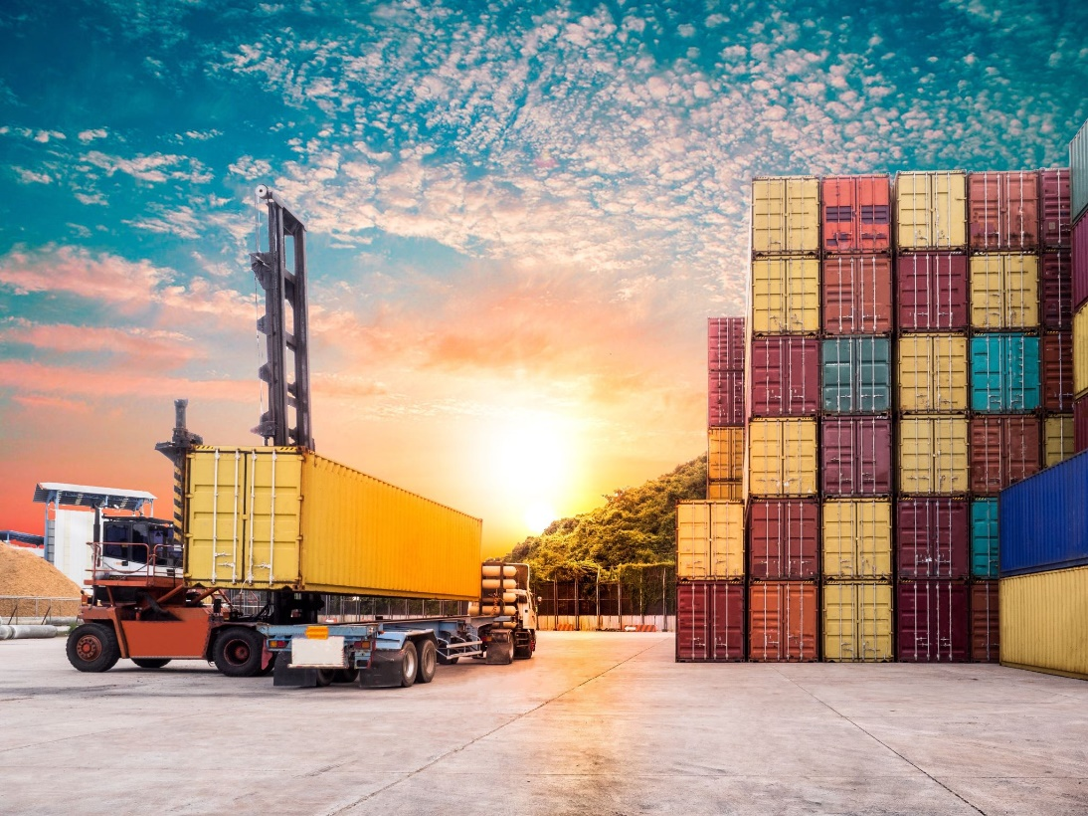
What is Cargo Liability?
Insurance product
Covers shippers of goods
Reduces risk exposure while goods are going from A→B
Coverage forms vary widely
Notes:
Nolan

Slide 5
Cargo Liability and Carrier Liability
Added layer of coverage, optional
Often insures full value of cargo
Shipper must prove carrier negligence
Cargo Liability
Carrier Liability
Required by law for carriers
Listed in the contract of carriage
Covers a limited amount of the total value of goods

Slide 6
Cargo and Carrier Liability Key Points for COVID Effects
Cargo
FOB vs. CIF
Carrier
Hague-Visby Rules

Slide 7
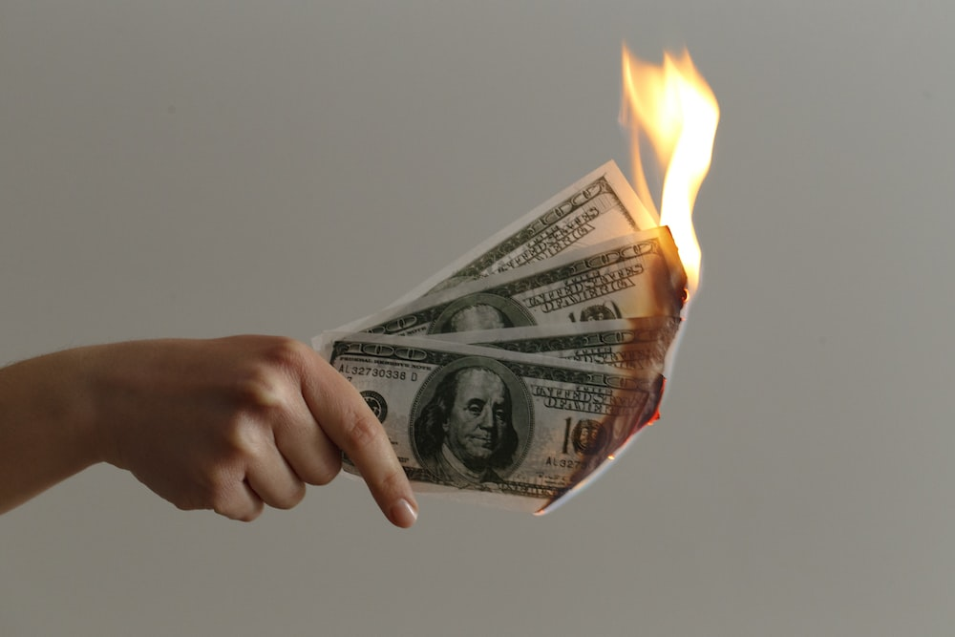
Why Does Possession or Language Matter?
Financial responsibility
Perils
Allowable deviations

Slide 8
Norfolk Southern Railway
20,000 miles of track
Three major train derailments
February 3, 2023: East Palestine, OH*
February 16, 2023: Van Buren Township, MI
March 4, 2023: Springfield, OH
$1.1 billion liability coverage insurance
*Hazardous material was spilled
Notes:
Tatiana

Slide 9
Freight Claim Trends
Theft and lost in transit
Damage to goods
Shortage of goods
Concealed shortage/damage
Notes:
Nate

Slide 10
Air Claim Trends
Damage/handling more of a concern
Relatively small fraction of total cargo transportation
Russia-Ukraine impact

Slide 11
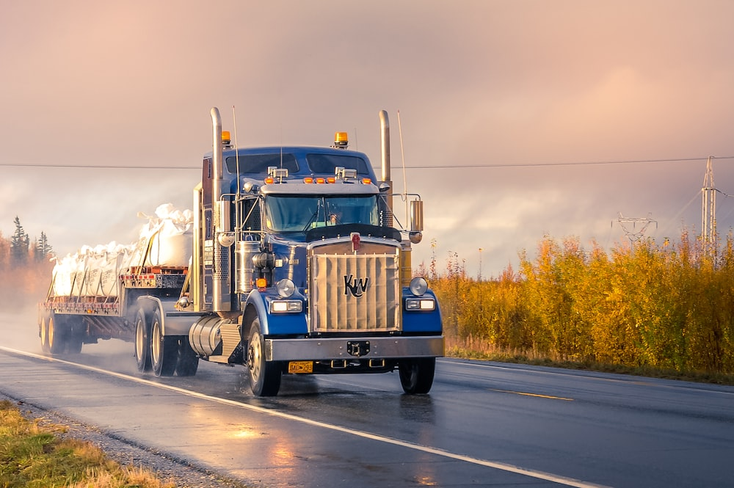
How COVID Altered Industry Norms
Trucking
“Pandemic purchases”
Like commercial auto trends?
Air
Pre-COVID rates of nearly 12x container
Paying for what is received?

Slide 12
Marine Claim Trends
Fire and explosions
Ships accidents/breakdown
Damage in transit
Natural disasters at sea

Slide 13
Where is the Action Domestically?
Notes:
Nate

Slide 14
Suez Canal - Background
Direct maritime link between Asia and Europe
12% of world trade
18,000 ships

Slide 15
Suez Canal – Ever Given 2021
March 23, 2021
Skyscraper sized
Cargo – 18,300 shipping containers
Lemons and tofu
Camping equipment and swimwear
Lenovo, Dixons, and Ikea
Six-day blockage
Notes:
Tatiana

Slide 16
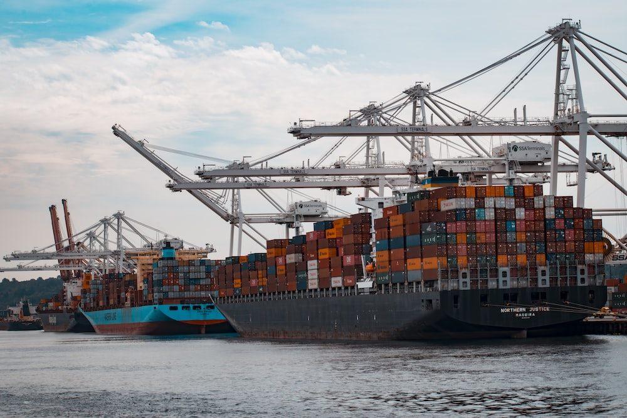
How COVID Altered Industry Norms
Water
80% of goods consumed
Supply and demand issues
Just-in-time

Slide 17
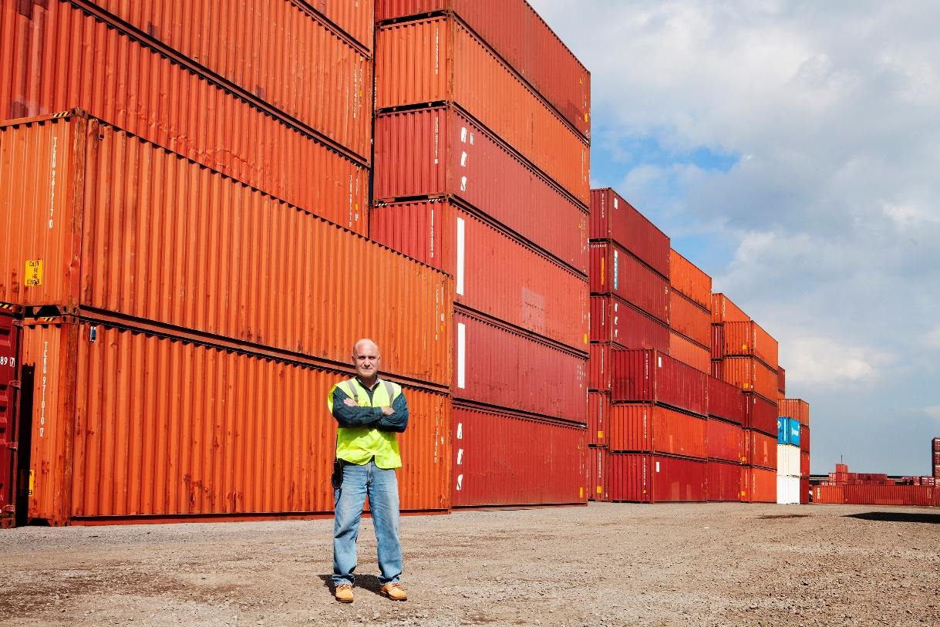
Available Cargo Liability Endorsements
Named perils
Burning, sinking, stranding, collisions
All risk cargo
Broadest and most comprehensive
Standard exclusions:
Negligence, war, delay, etc.
Notes:
negligence, war
civil commotions
loss of use
failure to pay/collect
loss over policy limit
Policyholder misconduct
Wear and tear
Insufficient packaging
delay
Carrier insolvency
Weapons of mass destruction
Cargo policy that excludes temperature damage → endorsement that provides coverage if its caused by damaged refrigeration unit

Slide 18
Russo-Ukrainian War
Began: February 2014
Major Escalation: February 24, 2022
90 merchant ships

Slide 19
Russo-Ukrainian War: A Year Later
40 – 60 ships
Black Sea Port – Odessa
$500M in estimated claims
War risk premiums = tens of thousands of dollars a day

Slide 20
What Does the Future Hold for Cargo Liability?
Per-shipment policies
Delivery drones
Safer transportation
Tunnels (Elon Musk’s Boring Company) and smart roads
Ports becoming autonomous
Electronification
Inflation
Value of goods
Environmentally friendly policies/energy

Slide 21
THANK YOU

Slide 22
Resources
https://www.reedsmith.com/en/perspectives/global-air-freight/2022/01/impact-of-covid19-on-cargo-related-claims
https://unctad.org/system/files/official-document/dtltlbinf2021d1_en.pdf
https://www.forbes.com/sites/willyshih/2022/01/30/from-just-in-time-to-just-in-case-is-excess-and-obsolete-next/?sh=1d1d0e664daf
https://www.stlouisfed.org/timely-topics/is-covid-19-sole-cause-of-shipping-disruptions-delays
https://unctad.org/news/shipping-during-covid-19-why-container-freight-rates-have-surged
https://www.ncbi.nlm.nih.gov/pmc/articles/PMC8883137/
http://ieomsociety.org/proceedings/2021rome/301.pdf
https://www.insurancejournal.com/news/international/2023/02/13/707662.htm
https://www.forbes.com/sites/roberthart/2023/01/09/ship-refloated-after-getting-stuck-in-suez-canal-the-latest-incident-hitting-worlds-trade-artery/?sh=3e5bf6ba852b
https://www.insurancejournal.com/news/international/2021/03/25/606953.htm
https://www.insurancejournal.com/news/international/2023/02/24/709489.htm
https://www.insurancejournal.com/news/midwest/2023/02/21/708885.htm
https://www.insurancejournal.com/news/midwest/2023/03/07/710578.htm
https://www.cnn.com/2023/02/22/investing/norfolk-southern-share-repurchases/index.html

