Slide 1
Cyber Insurance Analysis of Data Breach
Presented by
Nhu Nguyen, Grant Manley and Russell Miller
Notes:
In this presentation, we will discuss the history of the cyber insurance product and the market trends. We then examine the loss events that make up cyber claims, with an emphasis on data breach claims. Lastly, we will present a case study looking at how you can use time series modeling to analyze the dates of data breach, breach detection, and the breach notification.

Slide 2
Agenda
Background
Data Breach
Case Study
Conclusions

Slide 3
History
1834 – First “cyber” crime via telegraph
2003 – CA 1st Data Breach Notification Law
2017 – Equifax breach
1997 – 1st cyber policy issued by AIG
Notes:
1834 – Blanc brothers got details of previous day’s market direction via bribing a telegraph operator
1st Policy issued by AIG
CA law requiring companies report data breaches if personal info may have been lost
Equifax – 147 Million people settlement: $$425 Million
Equifax data breach settlement: https://www.ftc.gov/enforcement/refunds/equifax-data-breach-settlement

Slide 4
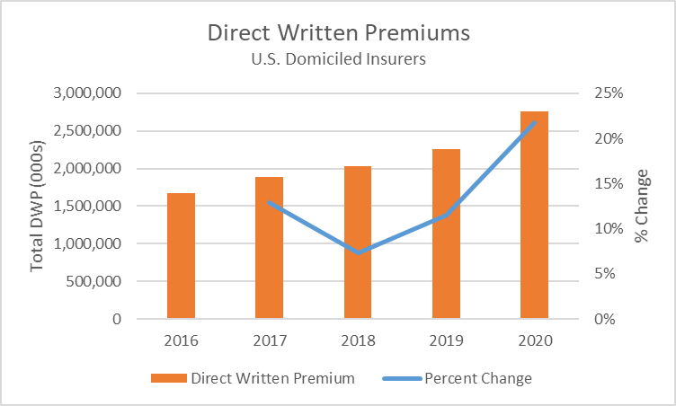
Industry
From NAIC Report on the Cyber Insurance Market
Notes:
Covid-19 and WFH led to increased need for cyber policies
Stand-alone policies growing at faster pace than packaged policies
Stand-alone: $0.89B to 1.63B from 2017-2020 (82% increase)
Package: $0.9B to $1.12B from 2017-2020 (25% increase)

Slide 5
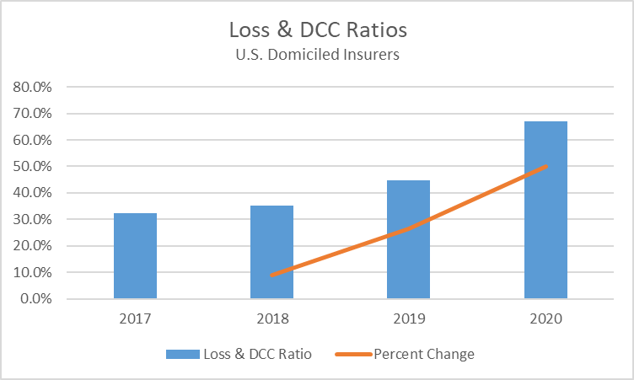
Industry
From NAIC Report on the Cyber Insurance Market
Notes:
55% increase in data breaches in the health care industry alone

Slide 6
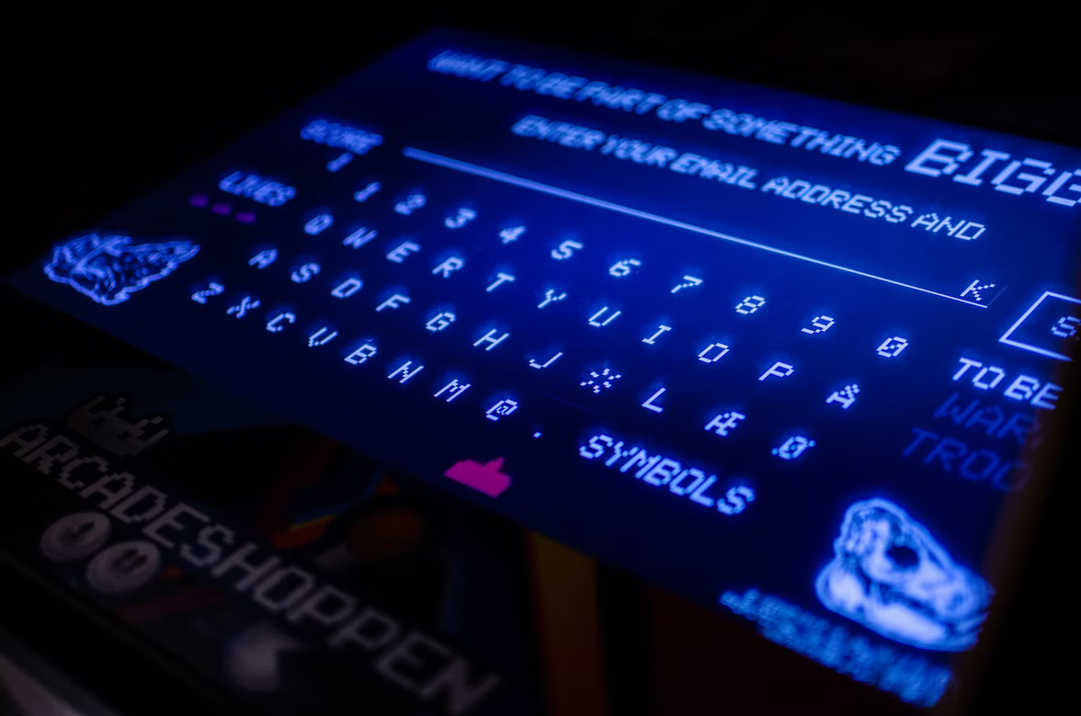
Types of Claims
Data Breaches
Ransomware/Business Disruption
Social Engineering/Fraud
Denial of Service Attacks
Notes:
Ransomware/Business Disruption – hackers take control of a system for ransom
Social Engineering – impersonation to illegally obtain funds
Denial of Service attacks – flood a system to crash it (chaos)

Slide 7
Costs
Data breach
10% of settled claims exceed $2.5M
71% covered by insurance
Ransomware/Business Disruption
High average severity
Social Engineering
Lower average severity
Denial of Service attacks (DoS)
Reputational damages
Notes:
From Willis report
Atlanta Ransomware demanded $51K, spent 2.7 million in 10 days in emergency contracts to take back control of their systems (spring 2018)
Social Engineering – impersonating vendors / executives to trick people into giving them money
Distributed Denial of Service attacks –
Atlanta ransomware: https://www.wired.com/story/atlanta-spent-26m-recover-from-ransomware-scare/

Slide 8
Data Breach
The average data breach has almost 700K records affected
$7.95 per record lost
The longer the breach goes undetected, the more data is lost, leading to higher losses
IT firms investigate once breach is detected
Data breaches often involve hefty settlement costs to compensate those impacted
Notes:
$5.5 Million average cost
Due to some costs involved being more fixed in nature the costs per record has a sharp decline until about 5,000 records breached

Slide 9
Case Study: Predicting Time to Identification and Notification
Purpose
Predict time from date of breach to identification
Predict time from date of breach to notification
When the breach day is unknown, the model helps to predict the breach day
Developing accurate estimate of the time to identify a breach for use in pricing cyber insurance

Slide 10
Case Study: Outline
Data exploration
Preliminaries
Model fitting and prediction evaluation
Findings and conclusion
Notes:
Work done in R

Slide 11
Case Study: Data Collection
Data was manually collected from the California Attorney General website
Period: January 20, 2012 to December 31, 2020
Total of n = 2,123 breach reports (will be splitting into training (1,505 cases) and testing (618 cases)

Slide 12
Case Study: Data Exploration
TTI: Time to identification (detection)
TTN: Time to notification

Slide 13
Case Study: Data Exploration

Slide 14
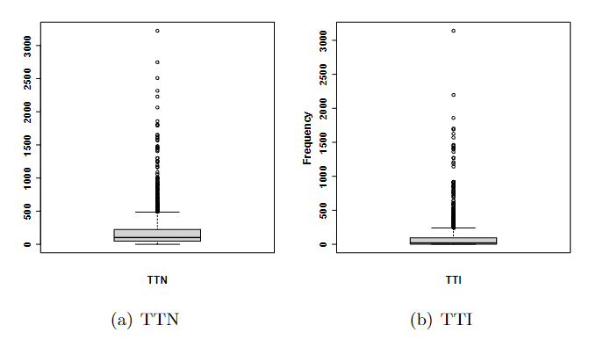
Case Study: Data Exploration

Slide 15
Case Study: Preliminaries
Copula: is an effective and popular tool for modeling high-dimensional dependence
Dynamic Conditional Correlation (DCC): provides a very good approximation to a variety of time-varying correlation processes
Vector Autoregressive model (VAR): are commonly used to investigate the dynamic interactions among multivariate time series
Accuracy metrics:
Mean absolute error (MAE)
Continuous ranked probability score (CRPS): The CRPS measures the difference between the predicted CDF and the empirical CDF of observed values. A smaller score indicates a better prediction

Slide 16
Case Study: Model Fitting and Prediction Evaluation
Means of CRPSs and MAEs of the models. The percentage is the % of the CRPSs of the Copula model that is less than that of the other models.

Slide 17
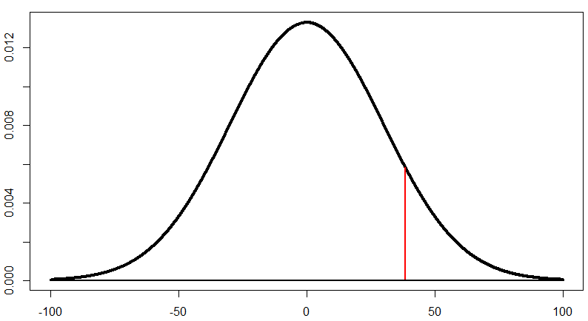
Case Study: Model Fitting and Prediction Evaluation
Value at Risk for model accuracy test
90th Percentile
VaR.90(t) means that there is only a 10% probability that the observed value is greater than the predicted value VaR.90(t)

Slide 18
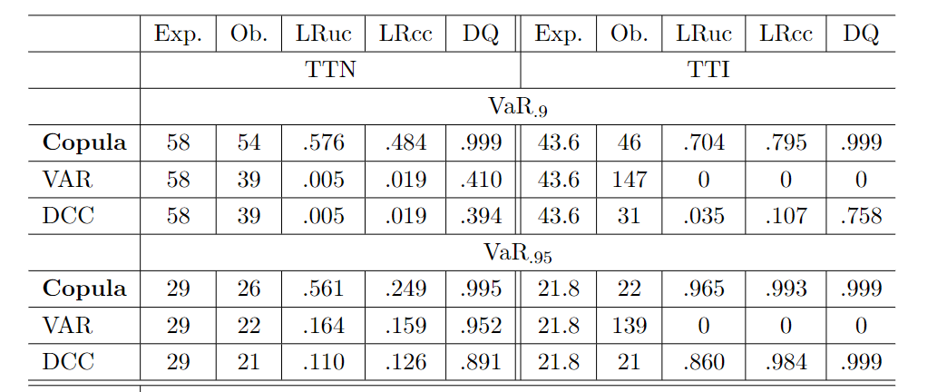
Case Study: Model Fitting and Prediction Evaluation

Slide 19
Case Study: Model Fitting and Prediction Evaluation
VaR plots of TTN and TTI

Slide 20
Case Study: Conclusion
Copula is superior to VAR and DCC
95% of TTNs are less than 620 days with a standard error 71 days in 2019, and it reduces to 535 days with a standard error 57 days in 2020
95% of TTIs are less than 457 days with a standard error 64 days in 2019, and it reduces to 324 days with a standard error 55 days in 2020

Slide 21
Thank You
Nhu Nguyen
Illinois State University
Grant Manley
Pinnacle Actuarial Resources
Russell Miller
Pinnacle Actuarial Resources

Slide 22
References
NAIC Report on Cybersecurity Insurance Market - https://content.naic.org/sites/default/files/index-cmte-c-Cyber_Supplement_2020_Report.pdf
NAIC Property 2020 Annual Industry Report - https://content.naic.org/sites/default/files/inline-files/Property%202020%20Annual%20Industry%20Report.pdf
Willis Towers Watson Cyber Claims Analysis Report
The Ever-Evolving Nature of Cyber Coverage - https://www.insurancejournal.com/magazines/mag-features/2014/09/22/340633.htm
https://www.schneier.com/blog/archives/2018/05/1834_the_first_.html
https://www.ftc.gov/enforcement/refunds/equifax-data-breach-settlement

