Slide 1
Nonparametric estimation of conditional VaR and expected shortfall
Notes:
Journal of Econometrics 147 (2008) 120-130
by Zongwu Cai and Xian Wang

Slide 2
Outline
Introduction
Nonparametric Estimators
Statistical Properties
Application

Slide 3
Introduction
Value-at-risk (VaR) and expected shortfall (ES) are two popular measures of market risk associated with an asset or portfolio of assets.
Here, ES is the tail conditional expectation, which has been discussed for elliptical distribution in our seminar.

Slide 4
Introduction
VaR has been chosen by the Basel Committee on Banking Supervision as the benchmark of risk measurement for capital requirements.
Both VaR and ES have been used by financial institutions for asset management and minimization of risk.
They have been rapidly developed as analytic tools to assess riskiness of trading activities.

Slide 5
Introduction
We have known that VaR is simply a quantile of the loss distribution, while ES is the expected loss, given that the loss is at least as large as some given VaR.
ES is a coherent risk measure satisfying homogeneity, monotonicity, risk-free condition or translation invariance, and subadditivity, while VaR is not coherent, because it does not satisfy subadditivity.

Slide 6
Introduction
ES is preferred in practice due to its better properties, although VaR is widely used in applications.
Measures of risk might depend on the state
of the economy.
VaR could depend on the past returns in someway.

Slide 7
Introduction
An appropriate risk analytical tool or methodology should be allowed to adapt to varying market conditions, and to reflect the latest available information in a time series setting rather than the
iid frame work.
It is necessary to consider the nonparametric estimation of conditional value-at-risk (CVaR), and conditional expected shortfall (CES) functions where the conditional information contains economic and market (exogenous) variables and past observed returns.

Slide 8
Nonparametric Estimation
Assume that the observed data {(Xt , Yt ); 1≤t≤n} are available and they are observed from a stationary time series model.
Here Yt is the risk or loss variable which can be the negative logarithm of return (log loss) and Xt is allowed to include both economic and market (exogenous) variables and the lagged
variables of Yt .

Slide 9
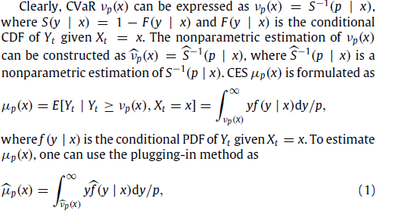
Nonparametric Estimation

Slide 10
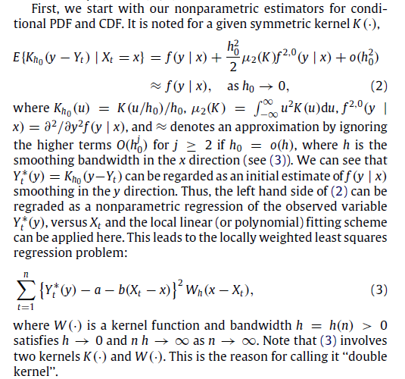
Nonparametric Estimation

Slide 11
Nonparametric Estimation

Slide 12
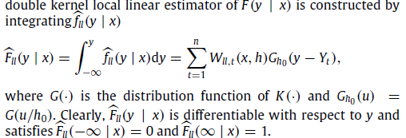
Nonparametric Estimation

Slide 13
Nonparametric Estimators

Slide 14
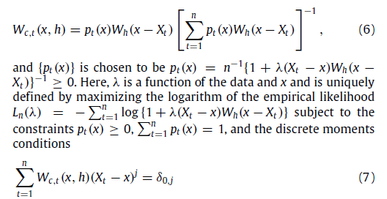
Weights

Slide 15
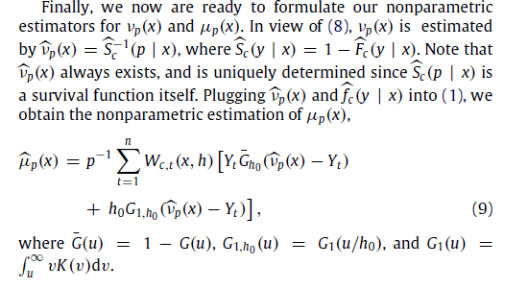
Nonparametric Estimators

Slide 16
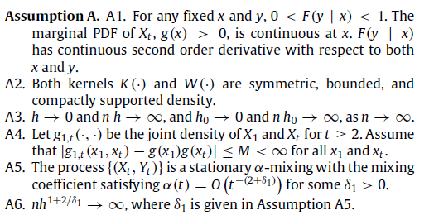
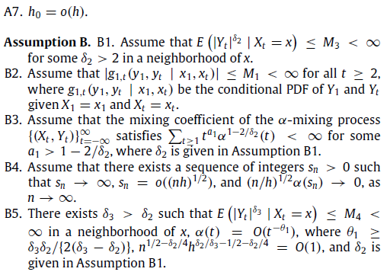
Assumptions

Slide 17
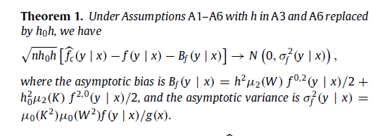
Statistical Properties

Slide 18
Statistical Properties

Slide 19
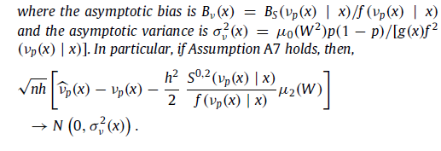
Statistical Properties

Slide 20
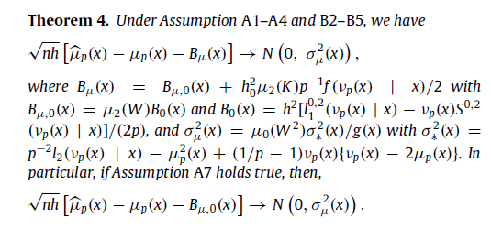
Statistical Properties

Slide 21
Application

Slide 22
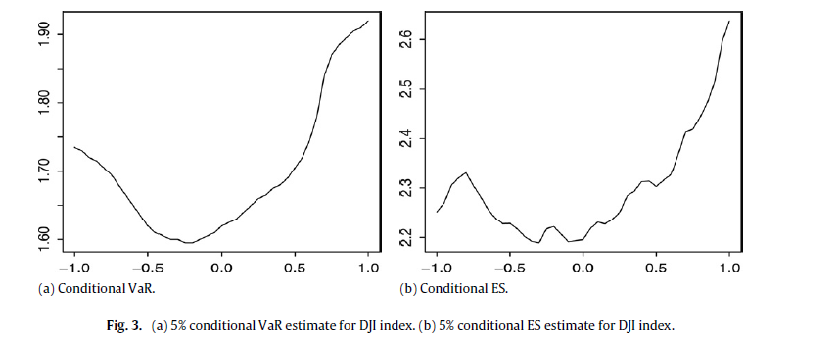
Application

Slide 23
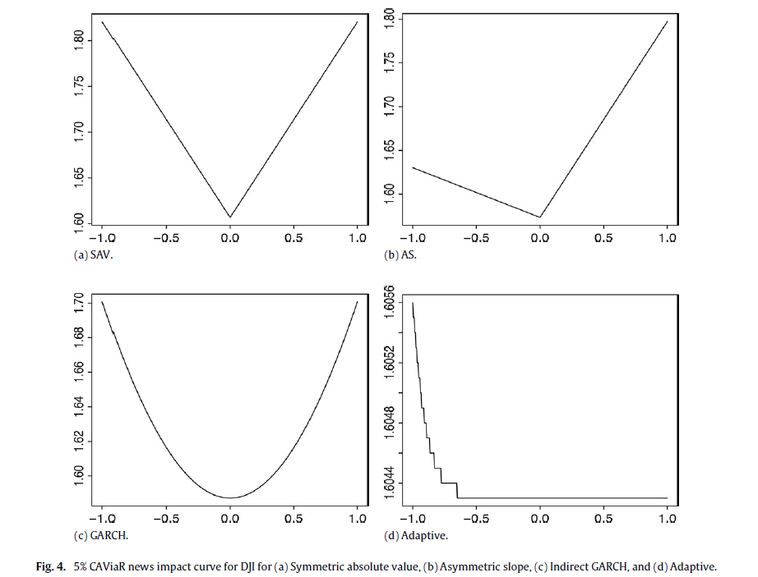
Application

Slide 24
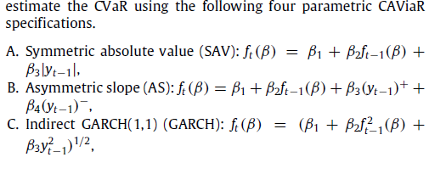
Application

