Slide 1
Climate Conscious Initiatives in the Insurance Industry
Presented by Katelyn Maner, Mark Murdoch, and Rishabh Mohta

Slide 2
Agenda
Data on Disasters
Costs to Insurers
Climate Conscious Initiatives in the Industry
Regulatory and Reporting
Recent Events

Slide 3
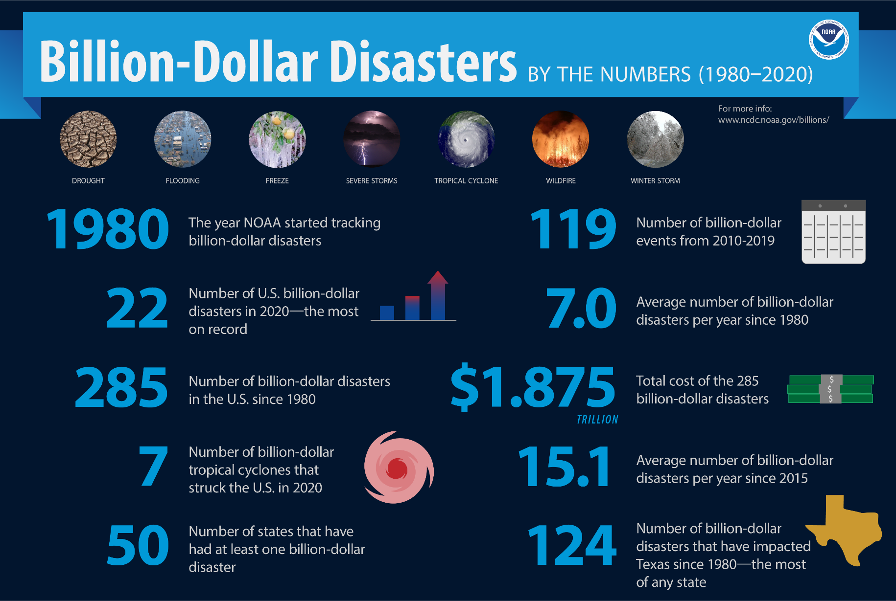
Data on Disasters
NOAA National Centers for Environmental Information (NCEI) U.S. Billion-Dollar Weather and Climate Disasters (2021). https://www.ncdc.noaa.gov/billions/, DOI: 10.25921/stkw-7w73
Notes:
-this IS adjusted for inflation
Average from 2010-2019 would be 11.9
https://www.ncdc.noaa.gov/billions/
Cite: NOAA National Centers for Environmental Information (NCEI) U.S. Billion-Dollar Weather and Climate Disasters (2021). https://www.ncdc.noaa.gov/billions/, DOI: 10.25921/stkw-7w73

Slide 4
Cost to Insurers
Solvency
Hurricane Andrew (1992) – 12 companies
Regency Insurance Company
MCA Insurance Company
Great Republic Insurance
Resulting Changes
Coastal exposures – management and government role
Reinsurance
Catastrophe modeling
Notes:
Sources on insurance companies that closed as result of hurricane Andrew:
https://www.upi.com/Archives/1992/09/24/Hurricane-Andrew-claims-another-insurance-firm/8067717307200/
https://www.nytimes.com/1992/10/27/business/company-news-2-insurers-are-liquidated.html
Resulting changes - https://www.iii.org/sites/default/files/paper_HurricaneAndrew_final.pdf
Consumers can look up company ratings and chose to change business if low rating
https://www.forbes.com/advisor/life-insurance/company-out-of-business

Slide 5
Cost to Insurers
Loss of business to another insurer
Environment as a whole
Be a responsible role model
Invisible hand of insurance
Notes:
Consumers can look up company ratings and chose to change business if low rating
https://www.forbes.com/advisor/life-insurance/company-out-of-business
Invisible hand: https://blogs.ethz.ch/math_phys_alumni/files/2011/08/Invisible_Hand_of_Insurance_Wuermli.pdf

Slide 6
Climate Conscious Initiatives in the Industry
Underwriting
Investment Portfolio
Internal Emissions
Product Offerings

Slide 7
Underwriting
Insurers are recognizing the implications of underwriting risks in industries that have large negative effects on the environment
Chubb, Allianz, Generali, AXA, Lloyds of London
“Unfriend Coal” campaign
Swiss Re advises the Global Maritime Forum on how to improve the sustainability of the global shipping industry
Notes:
Chubb, the first insurance company in the world to phase out its ties with companies that depend on coal (plants/companies that generate 30% or more revenue by coal mining or using coal in any form) by 2022 to support the UN global business ambition pledge.
Germany’s Allianz and Italy’s Generali limited underwriting for coal companies last year, while the French firm AXA tightened its policy further. Lloyds of London agreed to exclude coal from its investment strategy from April 2018.
The Unfriend Coal campaign said in a report last year that global losses had reached $337bn (£266bn) in 2017, including insured losses of $144bn.
For example, Swiss Re is also on the advisory board of the Global Maritime Forum, a nonprofit focused on improving the sustainability of the global shipping industry.

Slide 8
Investment Portfolio
Roughly 80% of insurers have considered climate change in their investment portfolios, more than half admit to not altering their strategy in response to those considerations
Swiss Re has announced it will stop investing in the top 10% of carbon-intensive oil and gas producers by 2023
Notes:
https://lcvalley.dailyfly.com/Home/ArtMID/1352/ArticleID/57372/US-Insurance-Departments-Report-Progress-toward-Consistent-Global-Standards-for-Measuring-Growing-Climate-Risks
.

Slide 9
Investment Portfolio
Stranded Assets
Between $1 trillion and $4 trillion worth of assets in the oil and gas sector
Potential for Growth
Global electricity demand is expected to drive $23 trillion in renewable energy investments over the next ten years
Notes:
2018 study published in the journal Nature Climate Change
meaning that they will no longer have value or produce income
-Lower premiums
-drag down investment returns

Slide 10
Internal Emissions
There are many ways insurers can reduce the emissions from their own operations:
Renewable Energy Guarantees of Origin Certificates
Reducing travel (air in particular)
More efficient energy use in offices
Reduce, reuse, recycle
Reducing single use plastic and excessive printing
Notes:
https://www.greenelement.co.uk/blog/reduce-business-carbon-footprint/
Switch to renewable energy sources with REGO certificates (Renewable Energy Guarantees of Origin). Reduce emission from air travel (companies have opted for use of software such as Zoom or Skype). Switch to the alternate greener energy sources.
Optimize the heating and cooling system (based on the temperature outside). Reduce, Reuse and recycle- the 3 R’s. They help in minimizing unwanted materials.
Avoid the usage of plastic and replace it with cloth bags as they are environment friendly. Print as minimal as possible, the usage of e-documents has reduced the amount of paper used for printing.

Slide 11
Product Offerings
Some insurers offer homeowners insurance add-ons or discounts to encourage homeowners to use sustainable building materials and conserve energy
Eco-friendly material replacement endorsements: If you have an eco-friendly material endorsement on your homeowners insurance policy, the insurer will reimburse you for the replacement cost of green alternatives, up to the policy limit
Paperless discount: A discount offered to incentivize insurance customers to receive policy documents and bills electronically
Notes:
Some insurers offer homeowners insurance add-ons or discounts that help save you money and to encourage homeowners to use sustainable building materials and conserve energy.
Eco-friendly material replacement endorsements: If you have an eco-friendly material endorsement on your homeowners insurance policy, the insurer will reimburse you for the replacement cost of green alternatives, up to the policy limit.
Paperless discount: If you’re willing to save some trees by going paperless, many insurers offer a discount. You’ll receive your policy documents and bills electronically.

Slide 12
Product Offering
Usage-based auto insurance: Tracks driving through cell phone or GPS technology, or through devices plugged into a car port. Premiums are calculated based on the miles driven. Lower miles driven benefits the customer and the planet.
Munich Re: Green Tech Solutions branch focuses on reinsurance for young green-tech companies
Notes:
Usage-based auto insurance. This type of policy offers drivers auto insurance based on the amount they drive and safe driving. Usage-based insurance tracks driving through cell phone or GPS technology, or through devices plugged into a car port. Since fewer miles on the road means a lower probability of an accident, you can get lower premiums along with reducing pollution. Similarly, pay-per-mile insurance saves you money when you’re not on the road a lot.
Green business property insurance endorsements: Generally, business property insurance covers the replacement cost of damage to a commercial property. In other words, the insurance policy will pay for similar materials that were used during the original construction.

Slide 13
Regulatory and Reporting
There is not a regulatory standard for disclosure of climate risks by companies in the US, but regulation is increasing in Europe after a few years of unprecedented droughts
Insurer Climate Risk Disclosure Data Survey
Action steps for financial regulators:
Affirmation and Research
Prudential supervision
Notes:
https://www.mckinsey.com/industries/financial-services/our-insights/how-insurance-can-help-combat-climate-change
The Insurer Climate Risk Disclosure Data Survey was adopted by the NAIC in 2010. The goal of the survey is to provide regulators with information about the assessment of risks posed by climate change to insurers and the actions insurers are taking in response to their understanding of climate change risks.
Action steps that the financial regulators should take, include:
Affirmation and Research: Agencies must affirm climate as a systemic threat to capital markets and conduct research to determine how climate change impacts the aspects of the economy they’re responsible for safeguarding.
Prudential supervision: Agencies must supervise the banks, insurance companies, commodities traders, and other financial institutions they have a mandate over to ensure they are operating in a way that plans for a changing climate and for the inevitable market and regulatory adjustments that come with that change, all while mitigating climate impacts and reducing risk.

Slide 14
Regulatory and Reporting
Action steps continued:
Disclosure
Collaboration
Insurers may find themselves needing to collaborate more with each other and with government entities as the climate exacerbates large or frequent losses (wildfires in CA, flooding in FL)
Notes:
Action steps that the financial regulators should take, include:
Disclosure: In order for financial regulators to supervise properly, they must have the right information. Regulators should mandate the assessment and disclosure of climate impacts—including carbon emissions from their lending and investment activities—from the bodies they supervise.
Collaboration: Federal regulatory agencies should collaborate and share findings to better understand the intersecting ways climate change relates to their respective mandates. Their efforts should align with and complement one another.
Insurers with large presences in CA who feel like they need to increase the rate more than regulations will let them may exit the state, FL Flood insurance is at a huge deficit

Slide 15
Recent Events
AM Best became signatory of the United Nations Environment Program (UNEP)
Zurich shows support for the United States rejoining Paris Agreement
Notes:
https://www.businesswire.com/news/home/20210316005650/en/
https://www.insurancebusinessmag.com/us/news/environmental/zurich-north-america-applauds-us-rejoining-paris-climate-accord-245274.aspx

Slide 16
Thank You for Your Attention
Katelyn Maner
KManer@pinnacleactuaries.com
Mark Murdoch
MMurdoch@pinnacleactuaries.com
Rishabh Mohta
RMohta@ilstu.edu

Slide 17
Sources
https://www.ncdc.noaa.gov/billions/
https://www.upi.com/Archives/1992/09/24/Hurricane-Andrew-claims-another-insurance-firm/8067717307200/
https://www.nytimes.com/1992/10/27/business/company-news-2-insurers-are-liquidated.html
https://www.iii.org/sites/default/files/paper_HurricaneAndrew_final.pdf
https://www.forbes.com/advisor/life-insurance/company-out-of-business
https://www.forbes.com/advisor/life-insurance/company-out-of-businessv
https://blogs.ethz.ch/math_phys_alumni/files/2011/08/Invisible_Hand_of_Insurance_Wuermli.pdf
https://www.theguardian.com/environment/2017/dec/12/insurance-giant-axa-dumps-investments-tar-sands-pipelines
https://www.theguardian.com/business/2018/jan/21/lloyds-of-london-to-divest-from-coal-over-climate-change
https://www.theguardian.com/environment/2018/dec/03/insurers-in-uk-and-us-lagging-behind-in-divesting-from-coal-report-finds
https://www.forbes.com/advisor/homeowners-insurance/
https://www.forbes.com/advisor/car-insurance/usage-based-insurance/
https://www.forbes.com/advisor/car-insurance/pay-per-mile/
https://www.businesswire.com/news/home/20210316005650/en/
https://www.insurancebusinessmag.com/us/news/environmental/zurich-north-america-applauds-us-rejoining-paris-climate-accord-245274.aspx

