Slide 1
Rate Changes and the Parallelogram Method
Presented by: Samuel Akinade, Joseph Alberts and Ashley Zhang

Slide 2



Presenters
Samuel Akinade
seakina@ilstu.edu
Joseph Alberts
JAlberts@pinnacleactuaries.com
Ashley Zhang
AZhang@pinnacleactuaries.com

Slide 3
Agenda
Rate Changes
  What Causes Them
  Examples
Adjustments for One-Time Changes
  Extensions of Exposures method
  Parallelogram Method
Parallelogram Method Examples

Slide 4
Why Do Premium Rates Change?
How are premiums determined?
In response to changing market
  Indication of claims experience across industry
  Increased litigation
Law changes
  State regulated
Court decision
Expense change

Slide 5

Examples of Rate Changes
Change from rate indication
  Florida insurers report that they must raise rates to cover the costs of handling lawsuits
Law change
  Michigan regulation change on July 1, 2020 no longer requires unlimited PIP Medical Benefits for auto insurance

Slide 6
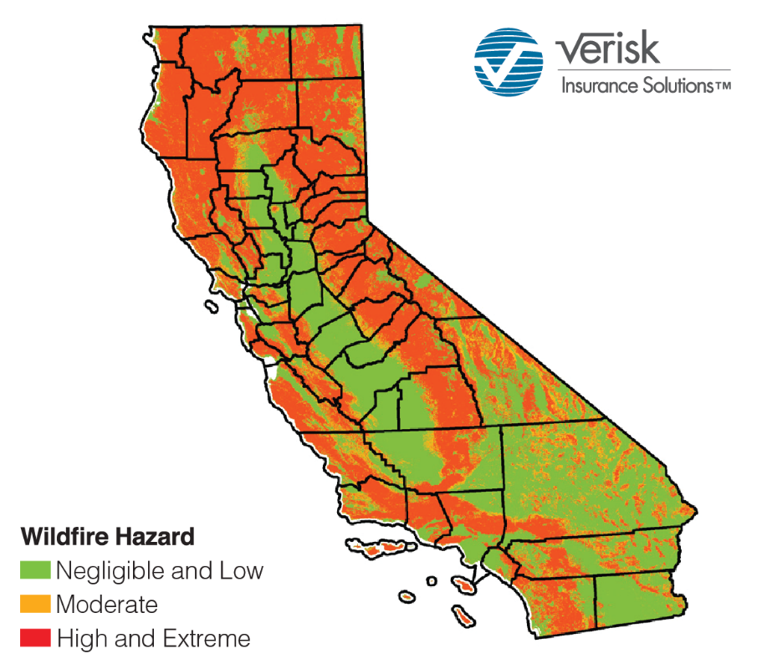
Continued…
Law change
  California legislation requires incorporation of “wildfire risk scores” in calculating homeowners’ and business owners’ insurance rates

Slide 7
Effects of One-Time Premium Rate Changes
Direct effects
  Immediate consequence
  Known before implementation
Indirect effects
  Delayed consequence
  Guessed, but not truly known before implementation

Slide 8
Premium Adjustments for One-Time Changes
Extension of exposure method
  More accurate
  Requires extensive data
Parallelogram method
  Less accurate in practice
  Suitable for limited data

Slide 9
Extension of Exposures Method: Key Terms
Exposure - the basic unit of risk that determines insurance premiums
Base rate - the rate applicable to the base risk
Base rate = Rate/Exposure
The extension of exposure method involves rerating every policy to adjust the historical premium to the current rates (on-level)
  Re-rate each historic individual policy with current rates
  Historic premiums restated at the current rate level
  Most commonly used in practice
  Require each current rating variable available for historic policy

Slide 10
Extension of Exposures Method: Simple Example
Initial premium for 5 exposure of class Y:
  1000 x 5 x 0.7 = $3,500
The on-level premium for 5 exposure of class Y:
  1366 x 5 x 0.8 = $5,464
Rate Level Group | Effective Date | Rate Change | Rate per Exposure | X | Y
1 | initial |  | 1000 | 1.00 | 0.70
2 | 01/01/2019 | 1.3% | 1013 | 1.00 | 0.70
3 | 05/01/2020 | 5.8% | 1072 | 1.00 | 0.70
4 | 09/01/2021 | 27.5% | 1366 | 1.00 | 0.80

Slide 11
Parallelogram Method
Geometrical approach used to find the on-level factor for a calendar/policy year to obtain the current on-level premium
  Assumptions
    Policies are written uniformly throughout the year
    Premium is written evenly throughout the time period

Slide 12
Parallelogram Rate Change Graph
Rectangle -> Calendar year (CY1 and CY2)
Diagonal line -> time of the rate change (T1 and T2)
The proportion of premium earned in each calendar year at each rate level is indicated by A1, B1, A2, B2 and C2.

Slide 13
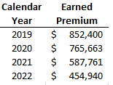
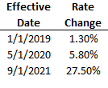
Parallelogram Method Example 1: Requested Rate Changes
Hypothetical company: Florida homeowners’ insurance
Data made up based on real companies’ annual reports
Earned premium
Rate changes

Slide 14
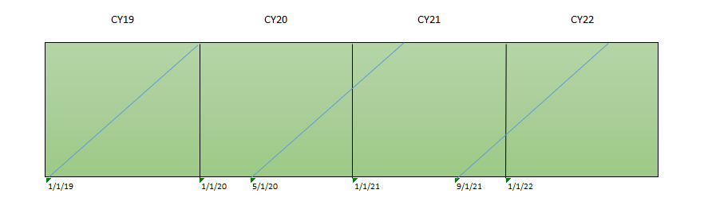
Parallelogram Method Example 1: Requested Rate Changes
Step 1: Visually represent the rate changes in the graph
  Each calendar year (CY) represented by a green box
  Each rate change by a blue line

Slide 15
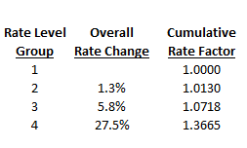
Parallelogram Method Example 1: Requested Rate Changes
Step 2: Calculate cumulative rate change factors
  E.g., a 1.3% increase followed by a 5.8% increase results in a cumulative 1.013 x 1.058 – 1 = 7.18% increase

Slide 16
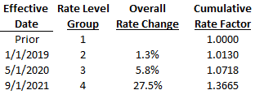
Parallelogram Method Example 1: Requested Rate Changes
Step 3: Find the area of each rate level

Slide 17
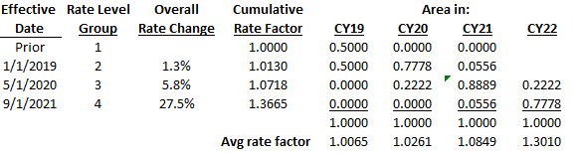
Parallelogram Method Example 1: Requested Rate Changes
Step 4: Calculate the average rate level factor
  E.g., for CY20, 1.0130 x 0.7778 + 1.0718 x 0.2222 = 1.0261

Slide 18
Parallelogram Method Example 1: Requested Rate Changes
Step 5: Calculate the on-level factor
-On-level factor = Current rate level factor/Average rate level factor of period
-E.g., for CY 19, on-level factor = 1.3665 / 1.0065 = 1.3577

Slide 19
Parallelogram Method Example 1: Requested Rate Changes
Step 6: Calculate the on-level earned premium
-On-level earned premium = Earned premium x on-level factor
-E.g., for CY 19, on-level earned premium = $852,400 x 1.3577= $1,157,271

Slide 20
Parallelogram Method Example 2: Legislation Changes
Florida Senate Bill 2D
  Premium reduction of 4% for in-force property policies (for insurers participating in the Reinsurance Assistance Program)
  Effective on May 26, 2022
The legislation change is represented by the red line below

Slide 21
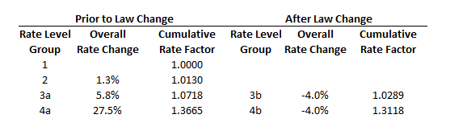
Parallelogram Method Example 2: Legislation Changes
Cumulative rate changes
Areas under each rate level

Slide 22
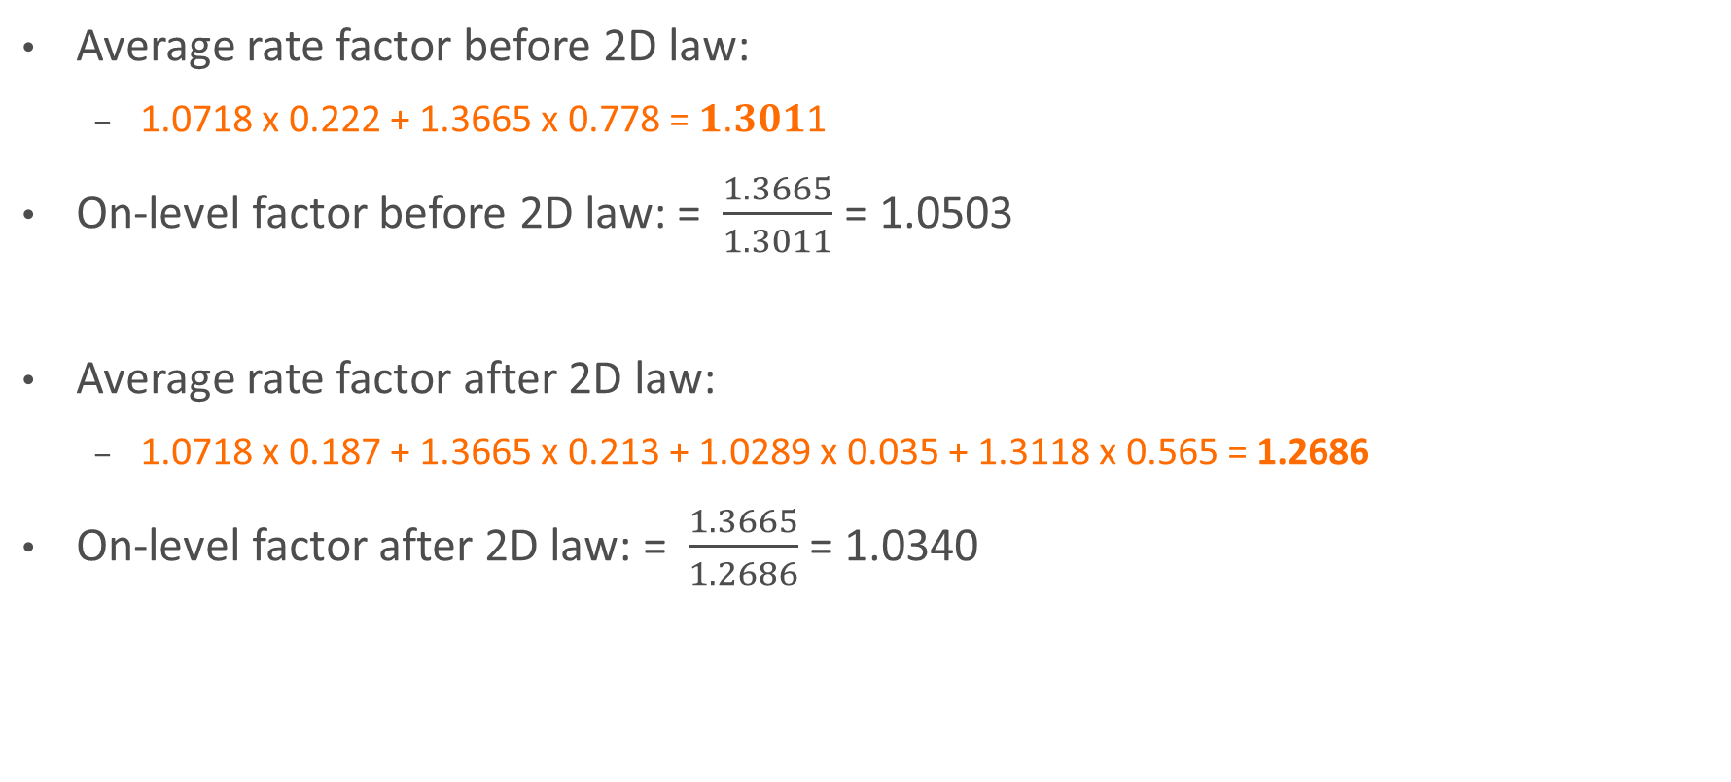
Parallelogram Method Example 2: Legislation Changes
Average rate factor before 2D law:
  1.0718 x 0.222 + 1.3665 x 0.778 = 𝟏.𝟑𝟎𝟏1
On-level factor before 2D law: = $\frac{1.3665}{1.3011}$ = 1.0503
Average rate factor after 2D law:
  1.0718 x 0.187 + 1.3665 x 0.213 + 1.0289 x 0.035 + 1.3118 x 0.565 = 1.2686
On-level factor after 2D law: = $\frac{1.3665}{1.2686}$ = 1.0340

Slide 23
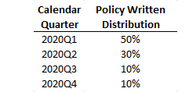
Parallelogram Method Example 3: Unevenly Written Policies
The two previous examples assume policies are written evenly throughout the year
Suppose in 2020 the policy distribution is as follows (with even distribution within each quarter):

Slide 24
Parallelogram Method Example 3: Unevenly Written Policies
Areas under each rate level for CY 20

Slide 25
Parallelogram Method Example 3: Unevenly Written Policies
On-level factors for CY 20
-E.g., for Q2 2020, average rate factor = 0.9444 x 1.0130 + 0.0556 x 1.0718 = 1.0163
on-level factor = 1.3665 / 1.0163 = 1.3446

Slide 26
Parallelogram Method Example 3: Unevenly Written Policies
On-level earned premium for CY 2020
-E.g., for Q2 2020, on-level earned premium = $765,663 x 30% x 1.3446
= $308,857
Total on-level earned premium for CY 2020 is $1,011,809
  0.8% lower than the total when assuming evenly written policies throughout the year ($1,019,698)

Slide 27
Conclusions
Parallelogram method
  On aggregate level
  Assumes evenly written policies
  Reasonability check for the extension of exposure method

Slide 28
Conclusions
Purpose of Parallelogram method
Adjust premium from historical to current level (Parallelogram)
Develop premium (at current level) to the prospective period
The fundamental insurance equation:
Premium= Losses + Expenses + Profit

Slide 29
THANK YOU

