Slide 1
The Risky Business of Social Media
Presented by
Sara Haouassia, Kristen Marshall, Tom Barnes and Jabari Washington

Slide 2
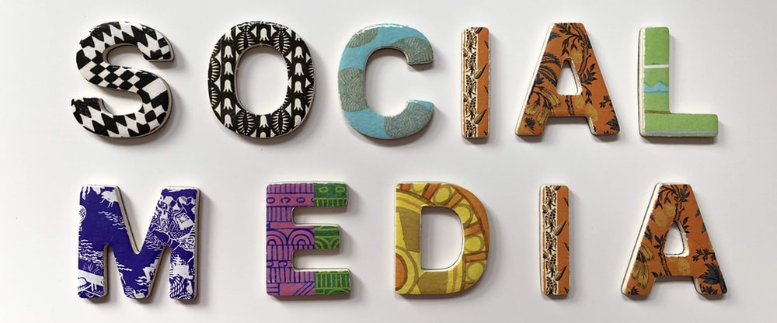
Agenda
The Rise of Social Media
How Influencers Cash In
Risks Influencers Face
Insurance to Mitigate Risk
Looking Ahead

Slide 3
The Rise of Social Media
3.4B Social Media Users
TikTok
Instagram
Reddit
Twitter
Pinterest
Snapchat
Facebook
YouTube
The Start
Myspace
Launched in 2003, reached 1M active users in 2004
In 1997, a profile uploading service was short-lived
LinkedIn
Launched in 2002
Facebook
Over 2.8B users globally
First launched in 2004
Notes:
https://online.maryville.edu/blog/evolution-social-media/#:~:text=In%201987%2C%20the%20direct%20precursor,social%20media%20platform%20was%20launched.
https://www.pewresearch.org/fact-tank/2021/06/01/facts-about-americans-and-facebook/

Slide 4
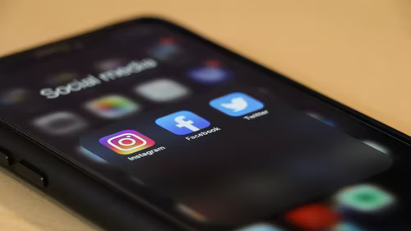
Social Media Statistics
3.4 billion people use social media
45% of the world’s population
Exponential growth over the last decade
424 million new social media users each year
Average individual uses 7.5 platforms per month
TikTok, Facebook, Twitter, Instagram, LinkedIn, Snapchat, MapMyRun, YouTube
93.4% of internet users

Slide 5
Who are Social Media Influencers?
Use one or more social media platforms
Knowledge and credibility
Regular posts
Generate large followings
Daniel Mac, Olivia Dunne, MrBeast
Notes:
A social media influencer is an individual who uses one or more types of social media to create posts about or relating to a topic or area of expertise. These topics can be as specific as weightlifting tutorials for men in their twenties, or as broad as the overall genre of comedy. These influencers hold a significant amount of knowledge and credibility in the topic that they create posts about. This knowledge and credibility, along with their frequent posts, draw in a large amount of followers. The followers view and interact with the posts for entertainment, for more knowledge regarding the topic, and a variety of other reasons. An example of a social media influencer who I personally follow is Daniel Mac. Daniel goes around wealthy areas of the United States looking for expensive cars. He then knocks on the window of the cars and asks the individual what they do for a living. Another example is Olivia Dunne, a gymnast at Louisiana State University. Olivia makes videos highlighting her experience as a college athlete to inform and entertain her followers. Last but not least, my final example is MrBeast, a social media influencer who started his career performing extensive stunts on social media and now has amassed over 23 billion views.

Slide 6
Types of Influencers
Mega-Influencers (1M+)
Macro-Influencers (40K-1M)
Micro-Influencers (1K-40K)
Nano-Influencers (<1K)

Slide 7
How Influencers Make Money
Sponsorships
Influencer paid to promote product/service
Business Promotion
Direct advertising by companies
User Donations
Third party source of income
Ad Monetization

Slide 8
Determinants of Payment
Types of sponsorship
Fully integrated vs sponsor mention vs affiliate sponsorship
Video composition, measures quality
Length, quality
Sphere of influence
One way is by subscriber count
Platform usage

Slide 9
How to Make Money on Instagram vs YouTube
Instagram
Influencers not paid through platform
Revenue measured by followers
Sponsorships from outside brands and companies
About $10 per 1000 followers
YouTube
Revenue measured by views
Partner program through Adsense
Paid per video viewed
$2 to $8 per 1000 views
Sponsorships, paid outside of YouTube
$10 to $50 per 1000 views

Slide 10
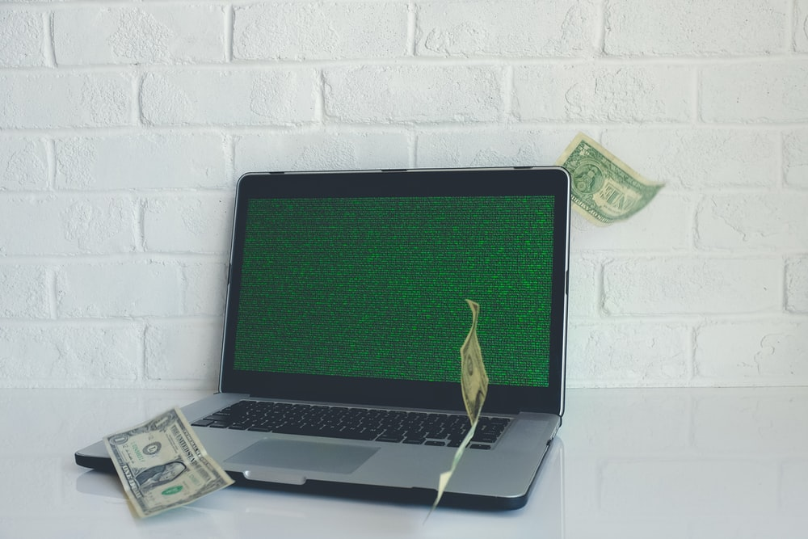
Risks Social Media Influencers Face
Loss of revenue from loss of followers
EX: Influencer X had posted a statement deemed offensive towards a situation in another country. This resulted in 1.2 million of their 21.3 million followers being lost on their platform.
Notes:
Location influencer may be located
Type of content being generated by influencer
The age that is being targeted
Risks associated with platforms
Shutdown of platform or sudden change in algorithm

Slide 11
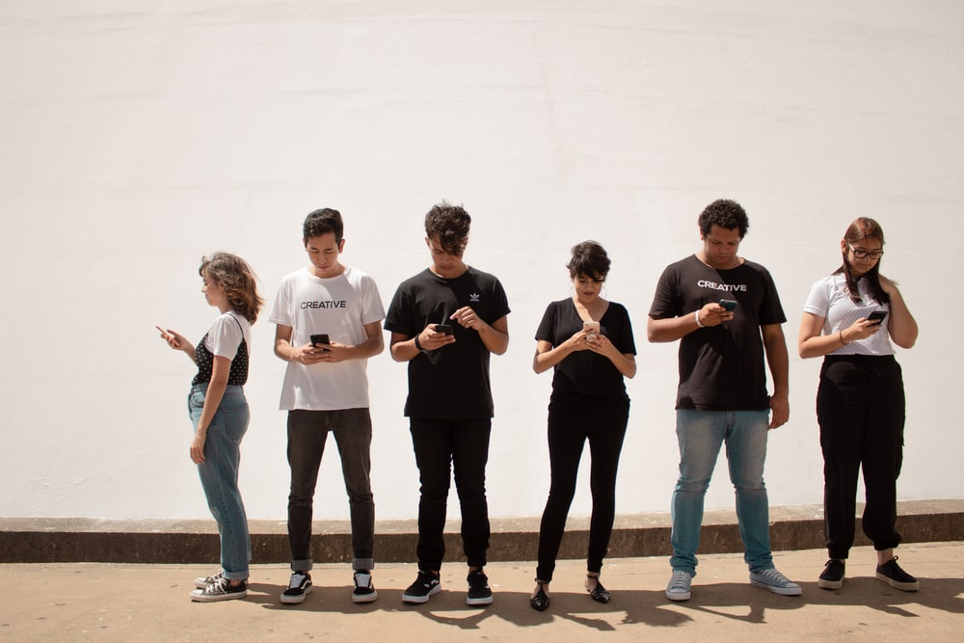
Risks Social Media Influencers Face (Continued)
Defamation: negatively affecting the reputation of a brand or entity
Personal injury: advertising injuries or dealing with side effects of trying a product may be of concern
Notes:
Defamation: claims related to negatively affecting the reputation of a brand or entity. Lack of transparency from the influencers side may fall under this risk.
Personal injury: advertising injuries or dealing with side effects of trying a product may be of concern. Personal injury may lead to customer termination and financial damage .

Slide 12
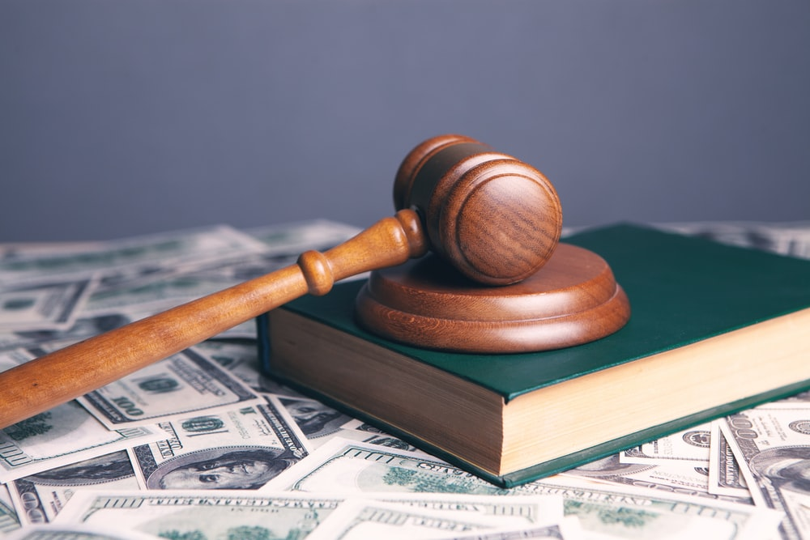
Risks Social Media Influencers Face (Continued)
Fines due to regulatory non-compliance – sponsored content must use #sponsored or #ad as required by the FTC (Federal Trade Commission)
Non-performance of contract – lawsuit potential against influencer
Copyright infringement/Financial fraud – for making false claims about a product/service
Notes:
Regulations: sponsored content must be communicated transparently, in simple and clear language and by using #sponsored , #ad as required by the FTC ( Federal Trade Commission).
Non-performance of contract – Influencers may be sued If they fail to deliver the content they are contracted to complete or if they negatively affect a brand’s reputation.
Copyright infringement/Financial fraud – for making claims about a product or service that aren’t true.

Slide 13
How Social Media Platforms are Regulated
Section 230 of the Communications Decency Act of 1996
"No provider or user of an interactive computer service shall be treated as the publisher or speaker of any information provided by another information content provider" (47 U.S.C. § 230)
Protects platforms from being held legally responsible for the speech of their users
Social media platforms have freedom to create their own rules to regulate content
Algorithms and restrictions can be seen as unclear or inconsistent
Notes:
Hence, the need for social media insurance.

Slide 14
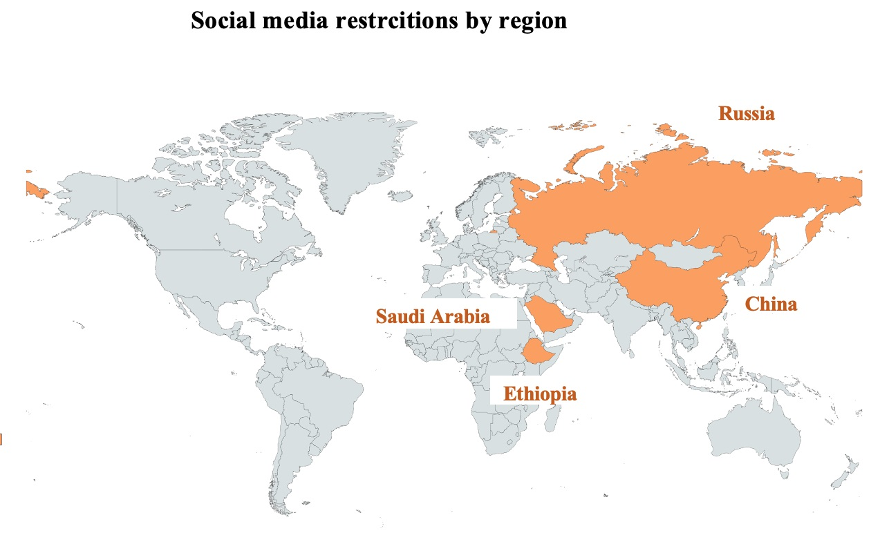
Social Media Restrictions by Region

Slide 15
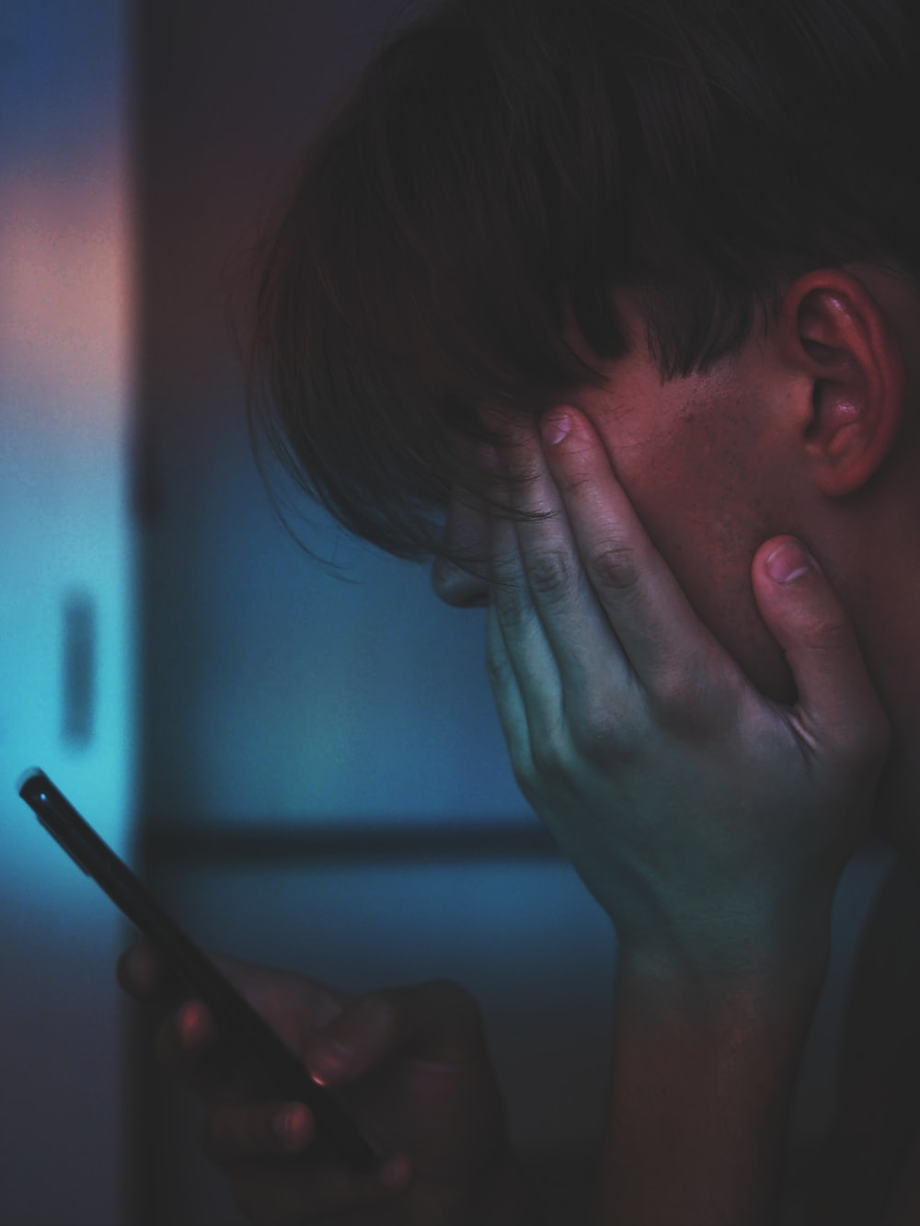
Why Social Media Influencers Need Insurance
Risky business
Possible contractual requirement
Adds credibility to professional endeavor of influencers, improving chances of receiving contract offer from brands

Slide 16
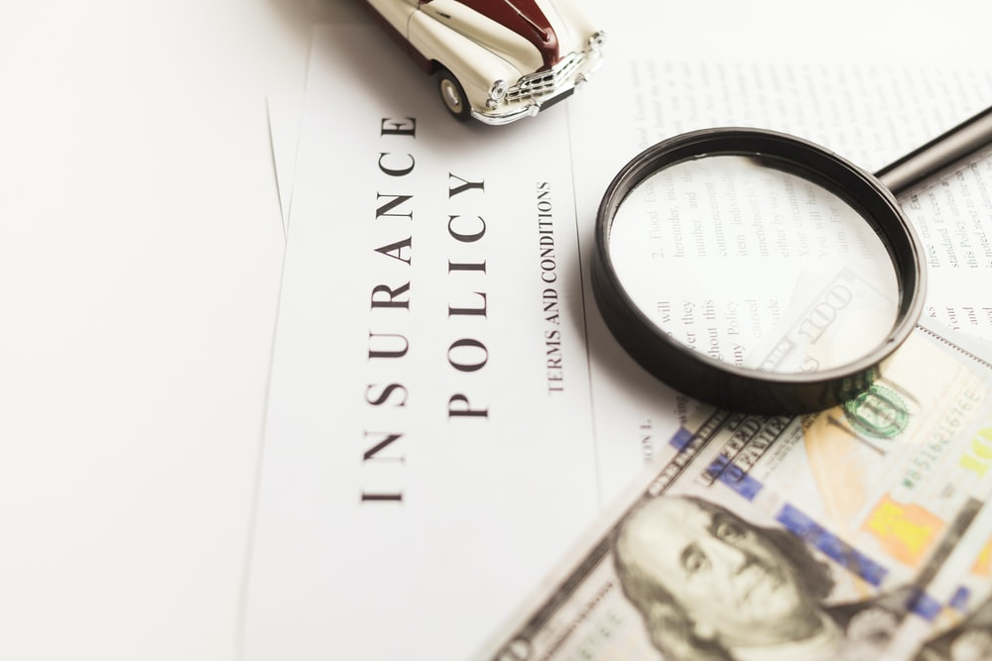
Available Insurance
General Liability, Professional Liability, D&O
Basic coverage to protect against lawsuits
Not specifically made for influencers
Does not cover loss of income
Significant exclusions
Founder Shield
More specific to social media influencers
Does not cover loss of income
Significant number of exclusions

Slide 17
Rate Filing
Notes:
Will switch screen to show page 317 of P:\Analysts Folders\Marshall\Presentations\Media Liability Rate Filing ME_08_2019_200910_1321076

Slide 18
Challenges in Insuring Social Media Risks
Differentiating risk potential
Moral hazard
Impact of adverse event across multiple brands
Difficult to quantify
Notes:
Insurers could use various factors to adjust a base rate
Social Media Income Level
Follower Count
Industry
Historical Incidents

Slide 19
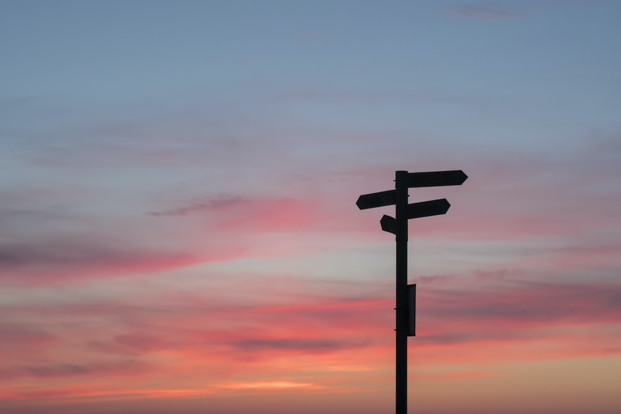
Looking Forward
Social Media Outlook
Influencer Career Outlook
Insurance Outlook

Slide 20
Thank You
Sara Haouassia
Illinois State University
Kristen Marshall
Pinnacle Actuarial Resources
Tom Barnes
Pinnacle Actuarial Resources
Jabari Washington
Pinnacle Actuarial Resources

