Slide 1
“To Some Arbitrary n, and Beyond!” The Ever-Evolving Role of Simulation Theory in the Insurance Industry
Presented by Taylor Daigle, Steve Jagodzinski and Mani Venkateswaran

Slide 2
Agenda
Simulation Introduction
Uses of Simulation
Common Simulation Techniques
Monte Carlo Simulation (MCS) Briefing
MCS Example 1 - Deductible Factors
MCS Example 2 – Aggregate Loss Distribution
More Industry Connections
Expected Adverse Deviation
Future of MC Implementation
Closing Remarks
Notes:
SWJ

Slide 3
Background - Simulation Introduction
General Procedure:
Outline possible outcomes
Link each outcome to a random number or set of numbers
Select a random number from source
Note the simulated outcome attached to number selected
Repeat steps 3 and 4 a lot
Analyze simulated outcomes, assess results
Notes:
SWJ
Incredibly large topic for such a short presentation - will start broad then quickly narrow in on what we wish to discuss/what we completed
In layman's terms, a proprietary goal of any simulation: Obtain some insight on real world events and their outcomes through the modeling of random events which closely match what ones that we are trying to perceive or discern in earnest
Step 0: doing historical research, coming up with a known model fit beforehand

Slide 4
Background - Uses of Simulation
Predictive analytics domain
New ASOP 56
Prevalence in the reinsurance industry
Impacts of catastrophes and adverse scenarios
Claim severity, frequency or aggregate loss distribution modeling
Stochastic reserving
Notes:
SWJ

Slide 5
Background - Conventional Simulation Techniques
Pseudo-random uniform number generation
Assuming an a, c, m and some X₀ or starting seed:
X_{n+1} = (aX_{n} + c) mod m
Inverse transform method
Assuming underlying probability distribution and parameters
Inverting CDF, solving for x given u: x_{i} = F ⁻¹(u_{i})
Acceptance/rejection method
Iterative process of accepting a y_{i} conditioned that some
$u_{i}≤\frac{f\left(y_{i}\right)}{c∗g(y_{i})}$ , where $c≥\max{ \frac{f\left(x\right)}{g(x)}}$
Monte Carlo - to be continued
Theoretical
Practical
Notes:
SWJ
Mani I think it would be good to chime in here where you feel comfortable
Going from most theoretical → most practical
Uniform Number Generation
Inverse Transform Method
Acceptance Rejection Method
Monte Carlo

Slide 6
History of MCS
Partially invented by Stanislaw Ulam
Polish scientist who participated in Manhattan Project
Playing solitaire while recovering from surgery, wanted to predict probability of winning a hand
Combinatorics was too complex so thought about the possibility of simulating the game
ENIAC computer made this computationally possible
Paper published on Monte Carlo in 1949
Notes:
From IRMI: “Simulation Risk Modeling Method — a risk modeling method that requires a large number of computer-generated "trials" to approximate an answer. These methods are relatively robust and flexible, can accommodate complex relationships (e.g., so-called path-dependent relationships commonly found in options pricing), and depend less on simplifying assumptions and standardized probability distributions. The principal advantage over analytic methods is the ability to model virtually any real-world situation to a desired degree of precision. Often called Monte Carlo method.”
Stanislaw Ulam
Polish Scientist
Manhattan Project
Created monte carlo - bored while sick and wanted to estimate probability of winning Solitaire
Assistant professor at UW Madison
Made substantial advancements in ergodic theory
ENIAC
Electronic Numerical Integrator and Computer
Designed primarily for military purposes for United States Army’s Ballistic Laboratory
Would take a few hours to run a simulation...now takes a few microseconds

Slide 7
Overview of MCS
Method of parameter estimation
Random sample information to make inferences about the population
Law of large numbers
“As the number of identically distributed, randomly generated variables increases, their sample mean approaches their theoretical mean”
As variance grows, we need a larger sample to have the same amount of confidence
$\overline{x} ±z∗\frac{s}{\sqrt{n}}$
Notes:
https://towardsdatascience.com/an-overview-of-monte-carlo-methods-675384eb1694

Slide 8
Advantages/Disadvantages of MCS
Advantages:
Incredibly powerful in data creation, analysis and visualization
Alleviates issues that may result from a small sample size
Disadvantages:
Difficult to replicate, can be computationally expensive
Still relies on distribution assumptions, parameters chosen
Notes:
Other disadvantages:
Choice of parameters and distributions used, results will heavily rely on these (could also be an advantage)
Should expand more on this slide

Slide 9
MCS Model Example 1
Deductible Factor
Proportion of claims above the deductible
Simulated n number of claims via LogNormal distribution
Expectation?
Discounts should converge at some number of iterations

Slide 10
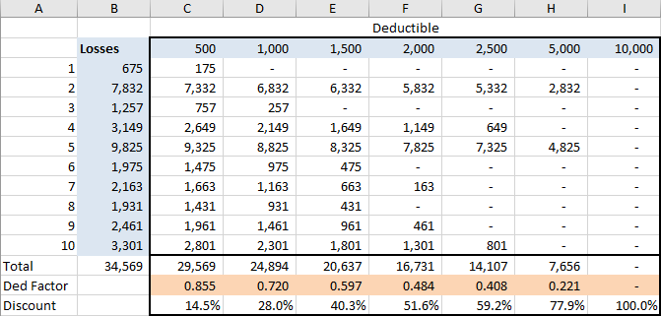
Example 1 (Cont.) - Deductible Factors

Slide 11
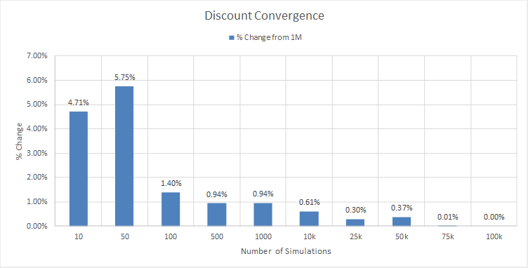
Example 1 (Cont.) - Discount Convergence
Discount convergence relative to n = 1M

Slide 12
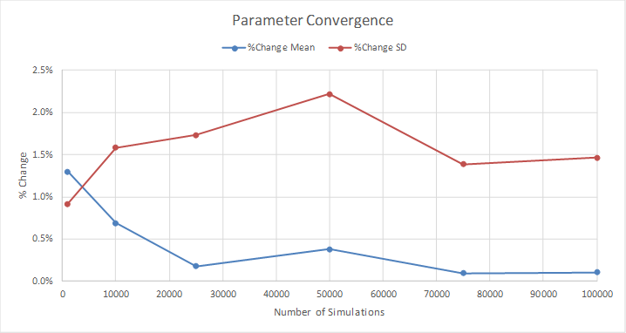
Example 1 (Cont.) - Parameter Convergence
Parameter convergence relative to theoretical
Notes:
Standard deviation does not converge well, until n really large
Sets up point in second example that n mutes the effect of variance

Slide 13
Example 1 (Cont.) - Parameter Convergence
Mean converges
“As the number of identically distributed, randomly generated variables increases, their sample mean approaches their theoretical mean”
Standard deviation does not readily converge
$s^{2}=\frac{{\sum_{1}^{n}{(x_{i}−\overline{x}}) }^{2}}{n−1}$
Notes:
Standard deviation does not converge well, until n really large
Sets up point in second example that n mutes the effect of variance
Reason it does not converge is that we have the squared term in the numerator...highly influenced by outliers

Slide 14
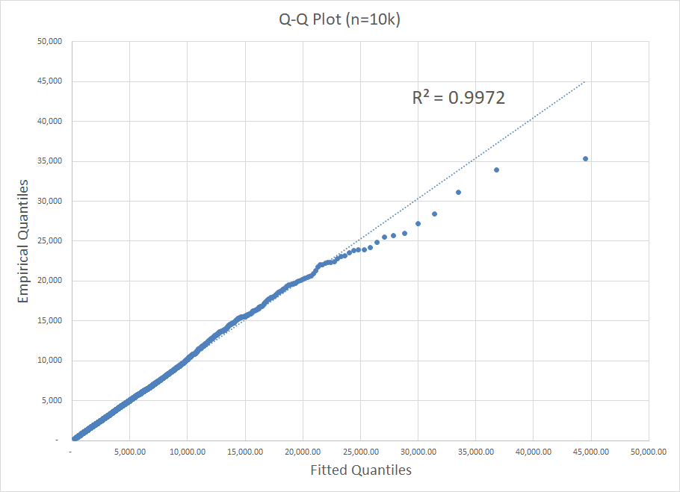
Example 1 (Cont.) - Model Evaluation
Q-Q plot at 10k iterations
Sampled data matches theoretical distribution
Notes:
*these could go if need be

Slide 15
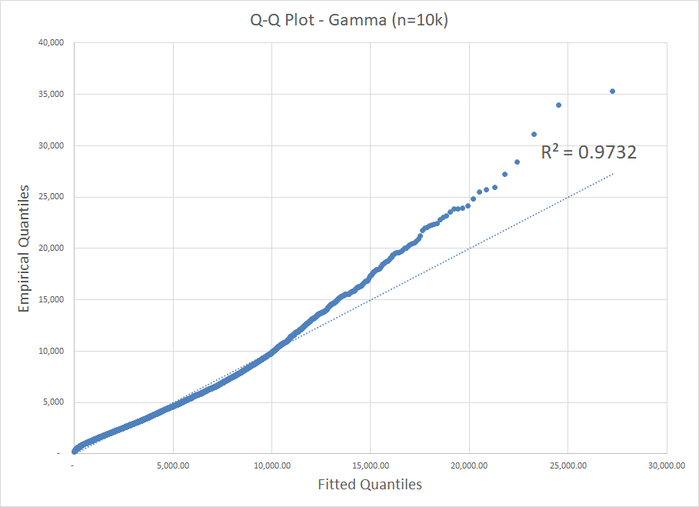
Example 1 (Cont.) - Model Evaluation
Q-Q plot at 10k iterations fitted to Gamma
Performs visibly worse than lognormal but still not a bad guess
Notes:
*these could go if need be

Slide 16
MCS Model Example 2
Aggregate loss distribution
Distribution of aggregate dollar loss of all events in a given year
Simulated n number of years of data
Number of claims simulated using a Poisson distribution
Severity simulated using LogNormal and Gamma distributions
Parameters chosen to equate the means and variances of LogNormal distribution to Gamma
Limit of $100k per occurrence
Expectation?
NO...EXPLORATION!
Notes:
The number of loss events in year i is drawn at random from the frequency distribution, and is denoted Ni.
Ni individual losses {l(1), ... , l(Ni)} are drawn from the severity distribution. The Ni losses are summed to obtain the aggregate loss for year I, representing one data point in the aggregate loss distribution.
This process is repeated for Z simulated years to obtain the aggregate loss distribution.
The Aggregate Loss Distribution is the distribution of aggregate dollar loss of all events that occurred over a one-year time horizon. It combines the results of its subcomponents, the frequency distribution, and the severity distribution

Slide 17
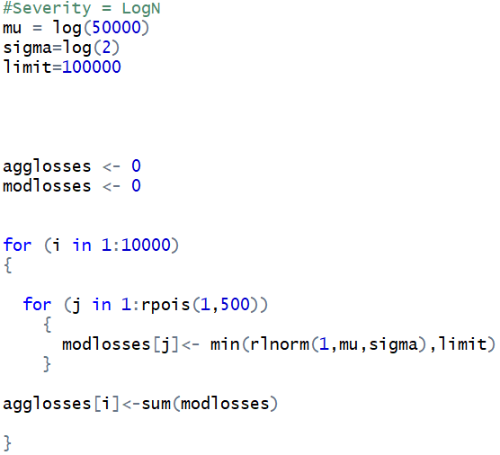
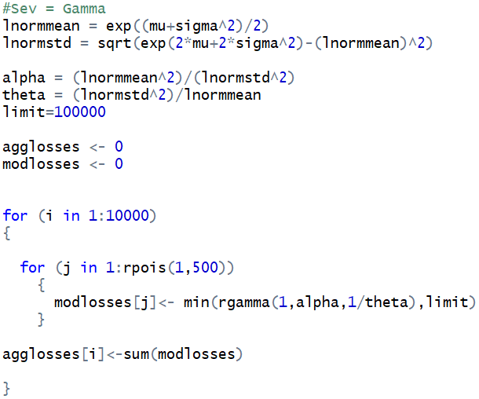
Example 2 (Cont.) - R Code
Notes:
Technical Person might ask about the seed...we should probably hybridize Mani code with mine
Also, do we even want a slide with code? Only point I see in having this is to show what our parameters were, and how easy it is to simulate data

Slide 18
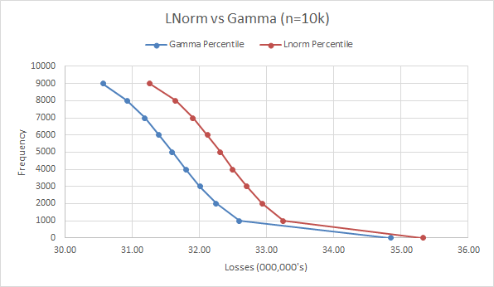
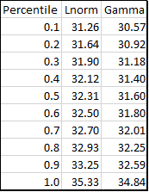
Example 2 (Cont.) - Percentiles

Slide 19
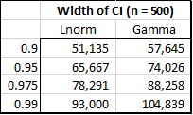
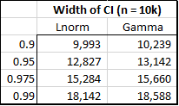
Example 2 (Cont.) - Variation Around the Mean
Uncertainty from variance diminishes as n becomes sufficiently large
80 to 82% decrease in CI width from 500 to 10,000 simulations
Notes:
The number of loss events in year i is drawn at random from the frequency distribution, and is denoted Ni.
Ni individual losses {l(1), ... , l(Ni)} are drawn from the severity distribution. The Ni losses are summed to obtain the aggregate loss for year I, representing one data point in the aggregate loss distribution.
This process is repeated for Z simulated years to obtain the aggregate loss distribution.
The Aggregate Loss Distribution is the distribution of aggregate dollar loss of all events that occurred over a one-year time horizon. It combines the results of its subcomponents, the frequency distribution, and the severity distribution

Slide 20
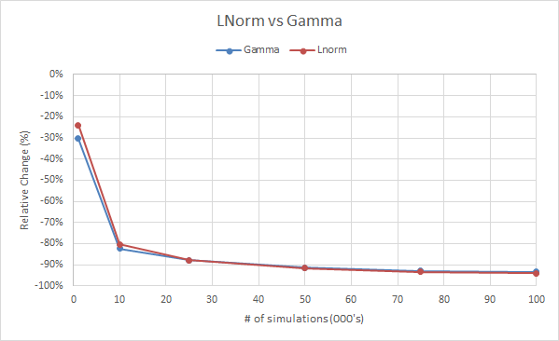
Example 2 (Cont.) - Variation Around the Mean
Notes:
Change in CI Width….chart from slide 19

Slide 21
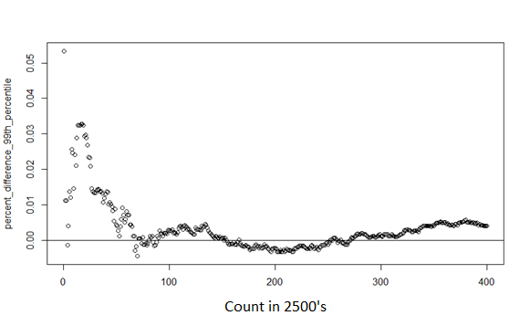
Example 2 (Cont.) - Variation in the Tail
Modeling error at the 99th percentile reduced to 1% at approximately 115,000 simulations
Notes:
*****Make white transparent when pull out of google slides*****

Slide 22
Findings
Power of the law of large numbers
MC is an efficient method of building confidence around data insights
Confidence around the mean converges rather quickly
Important to have a stable estimate of average losses from insurer’s perspective
Confidence in the tail takes a bit longer
Relevant to insurers (determining risk appetite) and reinsurers alike
Notes:
How our models we used would be implemented in industry
Get more generalize, broaden

Slide 23
More Industry Connections...

Slide 24
Expected Adverse Deviation
Def: Average amount of loss an insurance company incurs beyond its expected losses or amount of expected adverse deviation (EAD) an insurer is exposed to.
EAD = E[max(X - E(X),0)] EAD Ratio = EAD(X) / E(X)
Weighted average of outputs from MC simulation
Aims to quantify internal risk distributions
Ratio measures how much volatility and risk a company takes on
Notes:
SWJ
EAD March 2018 APEX notes
“EAD is Pinnacle’s solution to quantifying internal risk distributions based on the number of statistically independent risk units”
Solution to problem in captive insurance industry, metric that quantifies level of risk distribution, helps aim to reduce volatility of any one risk unit, comparable to ERD expected reinsurance deficit that is used to quantify risk transfer.
Risk transfer and risk distribution are joined at the hip - things you do to increase risk transfer will reduce risk distribution
Risk transfer - Shifting of pure risk from one party onto another
Risk distribution - the actuarially credible premiums of the many pay the expected losses of the few
Notable risk distribution case law
Most recently, Avrahami - Conclusion that reinsurance was not bona fide insurance - which was based on lack of independent risk exposures, not the corporate structure
Problem: There is no single objective way to determine/assess risk distribution. Some guidance from IRS (corporate structure wise), there’s some tax court decisions, but not always consistent in filings, and overall is just subjective in nature
Actuarial measure to try and solve this should focus on pool of statistically independent risk exposures, reduction in variability between expected losses and actual losses as a result of aggregating these risks
Criteria for evaluating metrics and tests as this solution
One-sided tests are preferred (exclude speculative risk)
Transparency - easy to explain to other parties
Acceptability - from all aspects of the industry
Less open to manipulation, something that would protect the industry from itself.
Measures considered:
VaR & TVaR - but the reliance on a loss distribution could lead to manipulation
Coefficient of variation - but it reflects all risks, not one-sided
Expected policyholder debt ratio - premium reliances lead to issues
EAD Ratio Solution
EAD is weighted average of all outputs that can be produced from a simulation model
EAD Ratio = EAD(x) / E(x) → scale of 0 - 100%
Normalize EAD ratio by dividing by expected losses
Measures how much volatility or risk an insurance company is taking on relative to expected losses
Higher the ratio, the riskier the company
As a company diversifies their risk, should expect to see the ratio to decrease
Ratio also tends to decrease as number of policies, independent risk exposures increases assuming all other things held equal
Other takeaways
EAD ratio will inherently be higher for reinsurance companies
In addition to relying on number of exposure units, the ratio also depends directly on number of expected claims
What is ‘correct’ threshold?
In testing, base exposure was >90%
Exposure then increased to satisfy risk distribution, found EAD ratio typically reduced by ⅔
EAD ratio of 30% guideline, seems reasonable intuitively when models were ran to identify risk distribution

Slide 25
Future of Monte Carlo
Continued use in predictive analytics
Stock price fluctuation
Time series combined with Monte Carlo
Stochastic reserving
Notes:
***NOTE TO SELF (TAYLOR) - read CAS monograph https://www.casact.org/pubs/monographs/papers/01-Meyers.PDF
Use this slide to conclude/wrap up

Slide 26
Questions?
? ? ?

Slide 27
Thank You for Your Attention
Taylor Daigle
tdaigle@pinnacleactuaries.com
Steve Jagodzinski
sjagodzinski@pinnacleactuaries.com
Mani Venkateswaran
“There is something irreversible about acquiring knowledge; and the simulation of the search for it differs in a most profound way from the reality.”
- J. Robert Oppenheimer
mv1492357@gmail.com

Slide 28
Works Cited
Ciesielski, Krzysztof, and Themistocles M. Rassias. “Stan Ulam and His Mathematics.” The Australian Journal of Mathematical Analysis and Applications, 2009, ajmaa.org/searchroot/files/pdf/v6n1/v6i1p1.pdf.
Meyers, Glenn. “Stochastic Loss Reserving Using Bayesian MCMC Models.” Casualty Actuarial Society, 2015, www.casact.org/pubs/monographs/papers/01-Meyers.PDF.
Pease, Christopher. “An Overview of Monte Carlo Methods.” Medium, Towards Data Science, 11 Sept. 2018, towardsdatascience.com/an-overview-of-monte-carlo-methods-675384eb1694.
Sigman, Karl. “Acceptance Rejection Method.” Columbia.edu, 2007, www.columbia.edu/~ks20/4703-Sigman/4703-07-Notes-ARM.pdf.
“Stat Trek.” Simulation in Statistics, stattrek.com/experiments/simulation.aspx.
Walling, Rob. “Expected Adverse Development as a Measure of Risk Distribution.” Pinnacle Actuarial Resources, 2018, pinnacleactuaries.com.
Wicklin, Rick. “The Inverse CDF Method for Simulating from a Distribution.” The DO Loop, 22 July 2013, blogs.sas.com/content/iml/2013/07/22/the-inverse-cdf-method.html.

