Slide 1
InsurTechs – The Future or a Fad?
Presented by
Julian Forero Beltran, Robbie Andrews, and James Wencil

Slide 2
Agenda
Defining InsurTechs
Analyzing the Market
Lemonade Case Study
Competition from Incumbents
Q/A

Slide 3
InsurTechs – Seeking to disrupt the traditional insurance market

Slide 4
Insurance in the Palm of Your Hand
Automating Insurance
Underwriting
Claims handling
Fraud detection
Telematics
Notes:
We assume that everyone has heard of Insurtechs at this point, but in case you haven’t, here’s a brief synopsis. InsurTechs are the newest emerging competitors and third party platforms in the intensely competitive and highly commoditized insurance industry. Some InsurTechs like Lemonade and … Insurtechs are aiming to disrupt the traditional nature of insurance. Despite the extreme competition, insurance often lags behind technologically. It’s seen as a people industry. While there may be some validity to this statement, when humans are left to their own devices, there are often inefficiencies. InsurTechs aim to improve these inefficiencies.
Attempting to takeout the human element to lower expenses

Slide 5
InsurTechs across all LOBs
Root
Car insurance
Tracks driving behavior, then assigns premium based on score
Hippo
Homeowners insurance
Smart home devices, loss control services, AI driven underwriting
Metromile
Car Insurance
Premiums assigned based on miles driven.
Notes:
Root classifies drivers by means a test, the test is taken through the mobile app; the app tracks speed, rapid acceleration , hard stops and swerves. From this information they compute a score, if the driver passes the test, they offer a premium based on the score.
Root: Car insurance
The claim that they can offer fairness into their pricing by capturing by the driving behavior of customers rather than their geographic location
Hippo: Homeowners Insurance
Smart home devices, loss control services, coverage catered to customer

Slide 6
Timeline of an InsurTech
Idea formed
Funding from venture capitalists
Building book of business
Renew/write new policies
Expand to new LOBs

Slide 7
How is it going currently?
Notes:
While it's true that insurtechs have seen incredible growth over the past decade, The profitability is has not. As we know, Pure premium Does not equate to profitability. Profitability can be quantified as premiums exceeding losses, Loss adjustment expenses, and other underwriting and administrative costs. The reality is, insurtechs have struggled to find themselves in the green. Take a look at some of the top insurtechs in the market right now.

Slide 8
In the Red

Slide 9
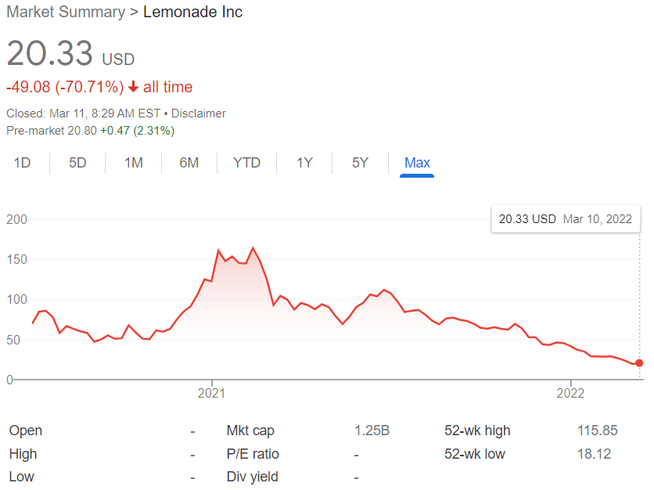
In the Red
Notes:
Lemonade

Slide 10
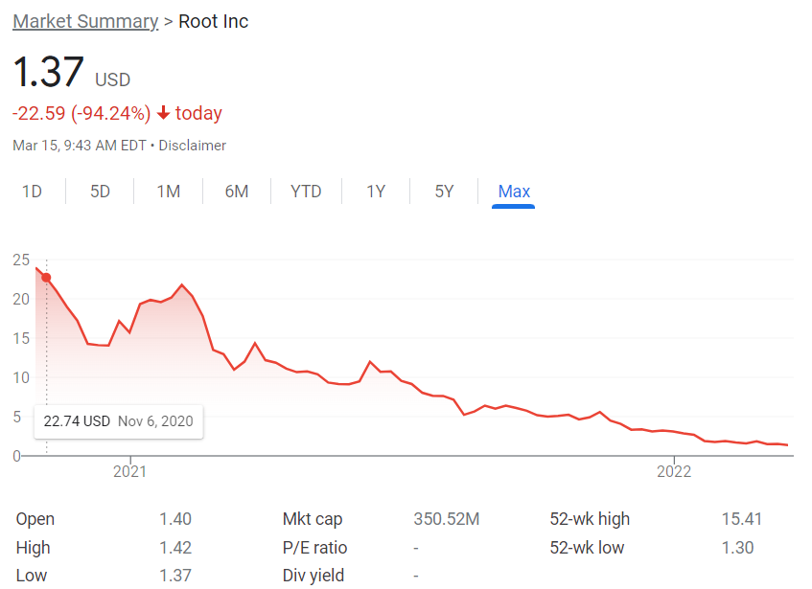
In the Red
Notes:
Root

Slide 11
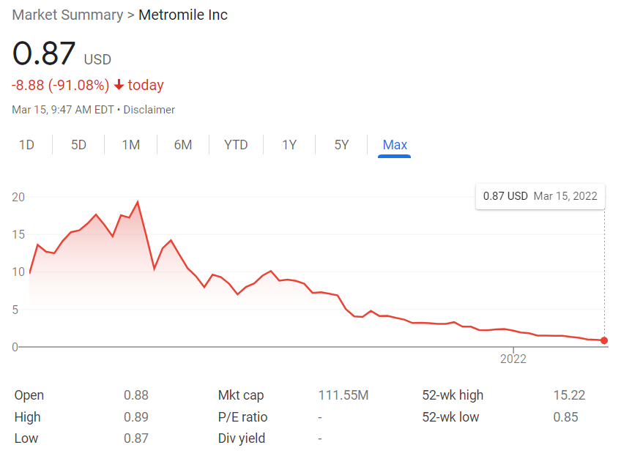
In the Red
Notes:
metromile

Slide 12
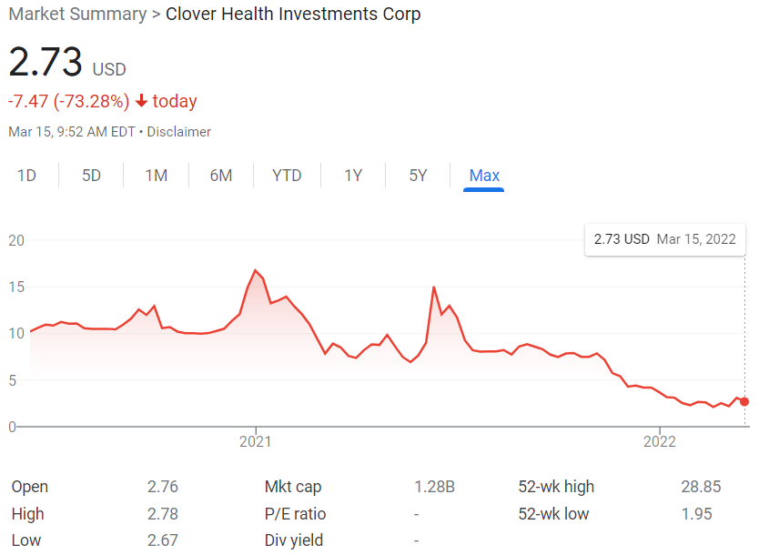
In the Red
Notes:
clover

Slide 13
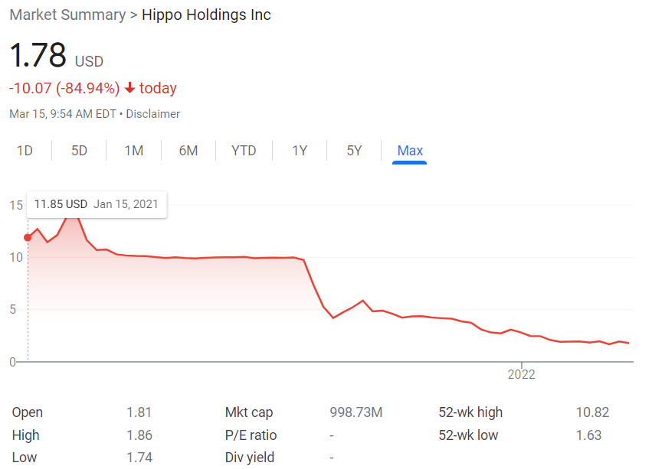
In the Red
Notes:
hippo

Slide 14
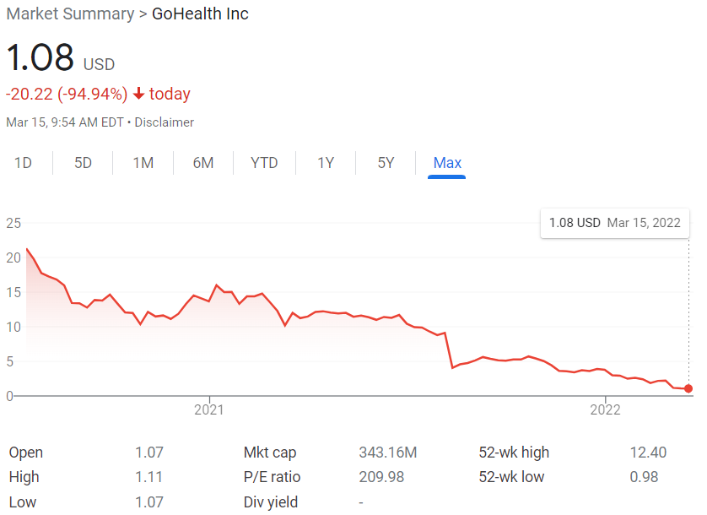
In the Red
Notes:
Gohealth. As you can see, they share one thing in common. Their stock price is plummeting. All of these companies had a promising start. Many of their IPOs opened much higher than expected. However, this is pretty typical of the market, especially for companies as touted as these. This is referred to as a market anomaly, and is taught on exam IFM. IPO's are usually Overvalued and begin to plateau the weeks after the initial opening. However, we have seen a universal drop in the whole insurtech market. To explore deeper why insurtechs have seen such poor results, we will take a look at lemonade, which is the top insurtech for renters insurance.

Slide 15
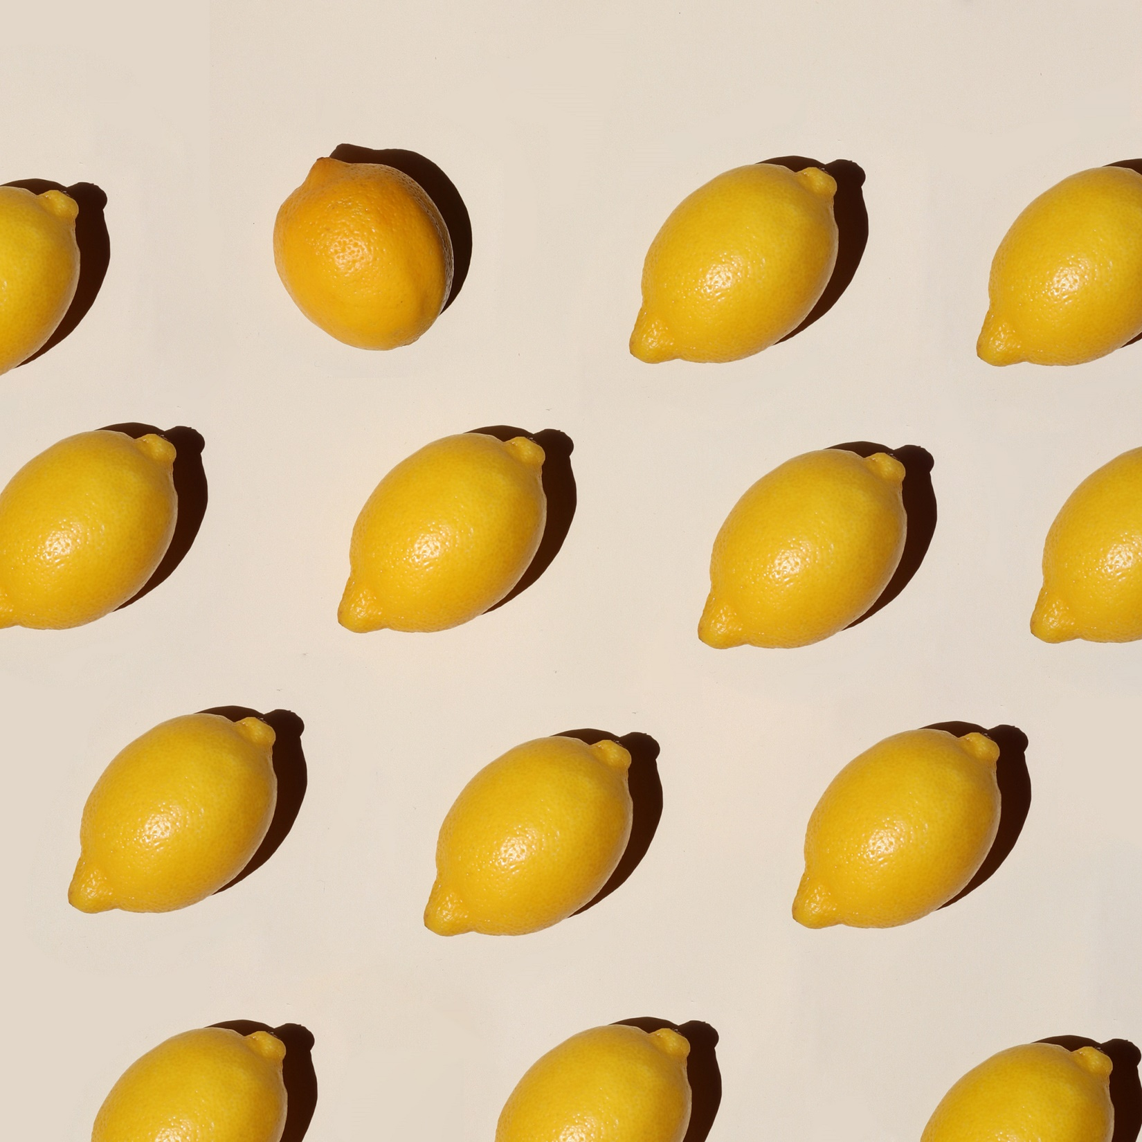
Lemonade Case Study

Slide 16
Lemonade – Leader in InsurTech
YoY Growth
43% in customers
78% in in-force premium
100% in total revenue
Aggressive Growth Strategy
Increased customer base
Increased gross premium
Increased market share
X
=
Notes:
As Julian has established, Insurtechs are still seeing incredible growth, and lemonade is a prime example of that. A 43% increase in customers 78% increase in in force premium and 100% increase in total revenue, Lemonade has had no problem building their book of business. These accomplishments are due in large part to their aggressive growth strategy. Lemonade has made it very clear in their Q4 shareholder letter that they intend to grow and diversify their book of business. Their goal is to take up more market share and expand their book of business to new products to not only renter's assurance, but homeowners insurance and pet insurance. They want to create a platform where all individual insurance needs are met by them, which would totally streamline insurance for individuals.
Quote from Q4 shareholder letter “2021 was a very productive year for us, and we ended it materially larger,
more diversified, and strategically stronger than ever”. Projected growth sustained into year 2022
Check rate filings. Did they apply for rate increase?
Define
Examples
what problems do they solve?
Timeline
Growth
Historical Context
Transition to bleak present
What tech improvements have big insurance companies made?
Do they now have the same capabilities as insurtechs?

Slide 17
Not all that Glitters is Gold
Notes:
As we saw in their stock price, they may be growing at an incredible rate, but that doesn’t necessarily mean that everything Is going great.

Slide 18
Not all that Glitters is Gold
Notes:
While their premiums are growing, so are their losses. Taking a look at their financials, we can see that their loss and LA E ratio has jumped to 93.3% this past year. They attribute this high loss ratio to their new products. This is not unusual for insurers. Similar to how a business initially operates at a loss in hopes of turning a profit later on. However it does not take away the fact that they are Seeing far too many losses in their current book

Slide 19
Not all that Glitters is Gold
Notes:
They're underwriting profit is seeing similar problems. 2020 actually saw some profit, but quickly went back down in 2021.

Slide 20
Not all that Glitters is Gold
Notes:
Finally, the combined ratio, which is one of the most important metrics for profitability, continues to rise. With such high losses, One can't help but wonder how they manage to stay in business. This is where proper actual reserving comes in handy

Slide 21
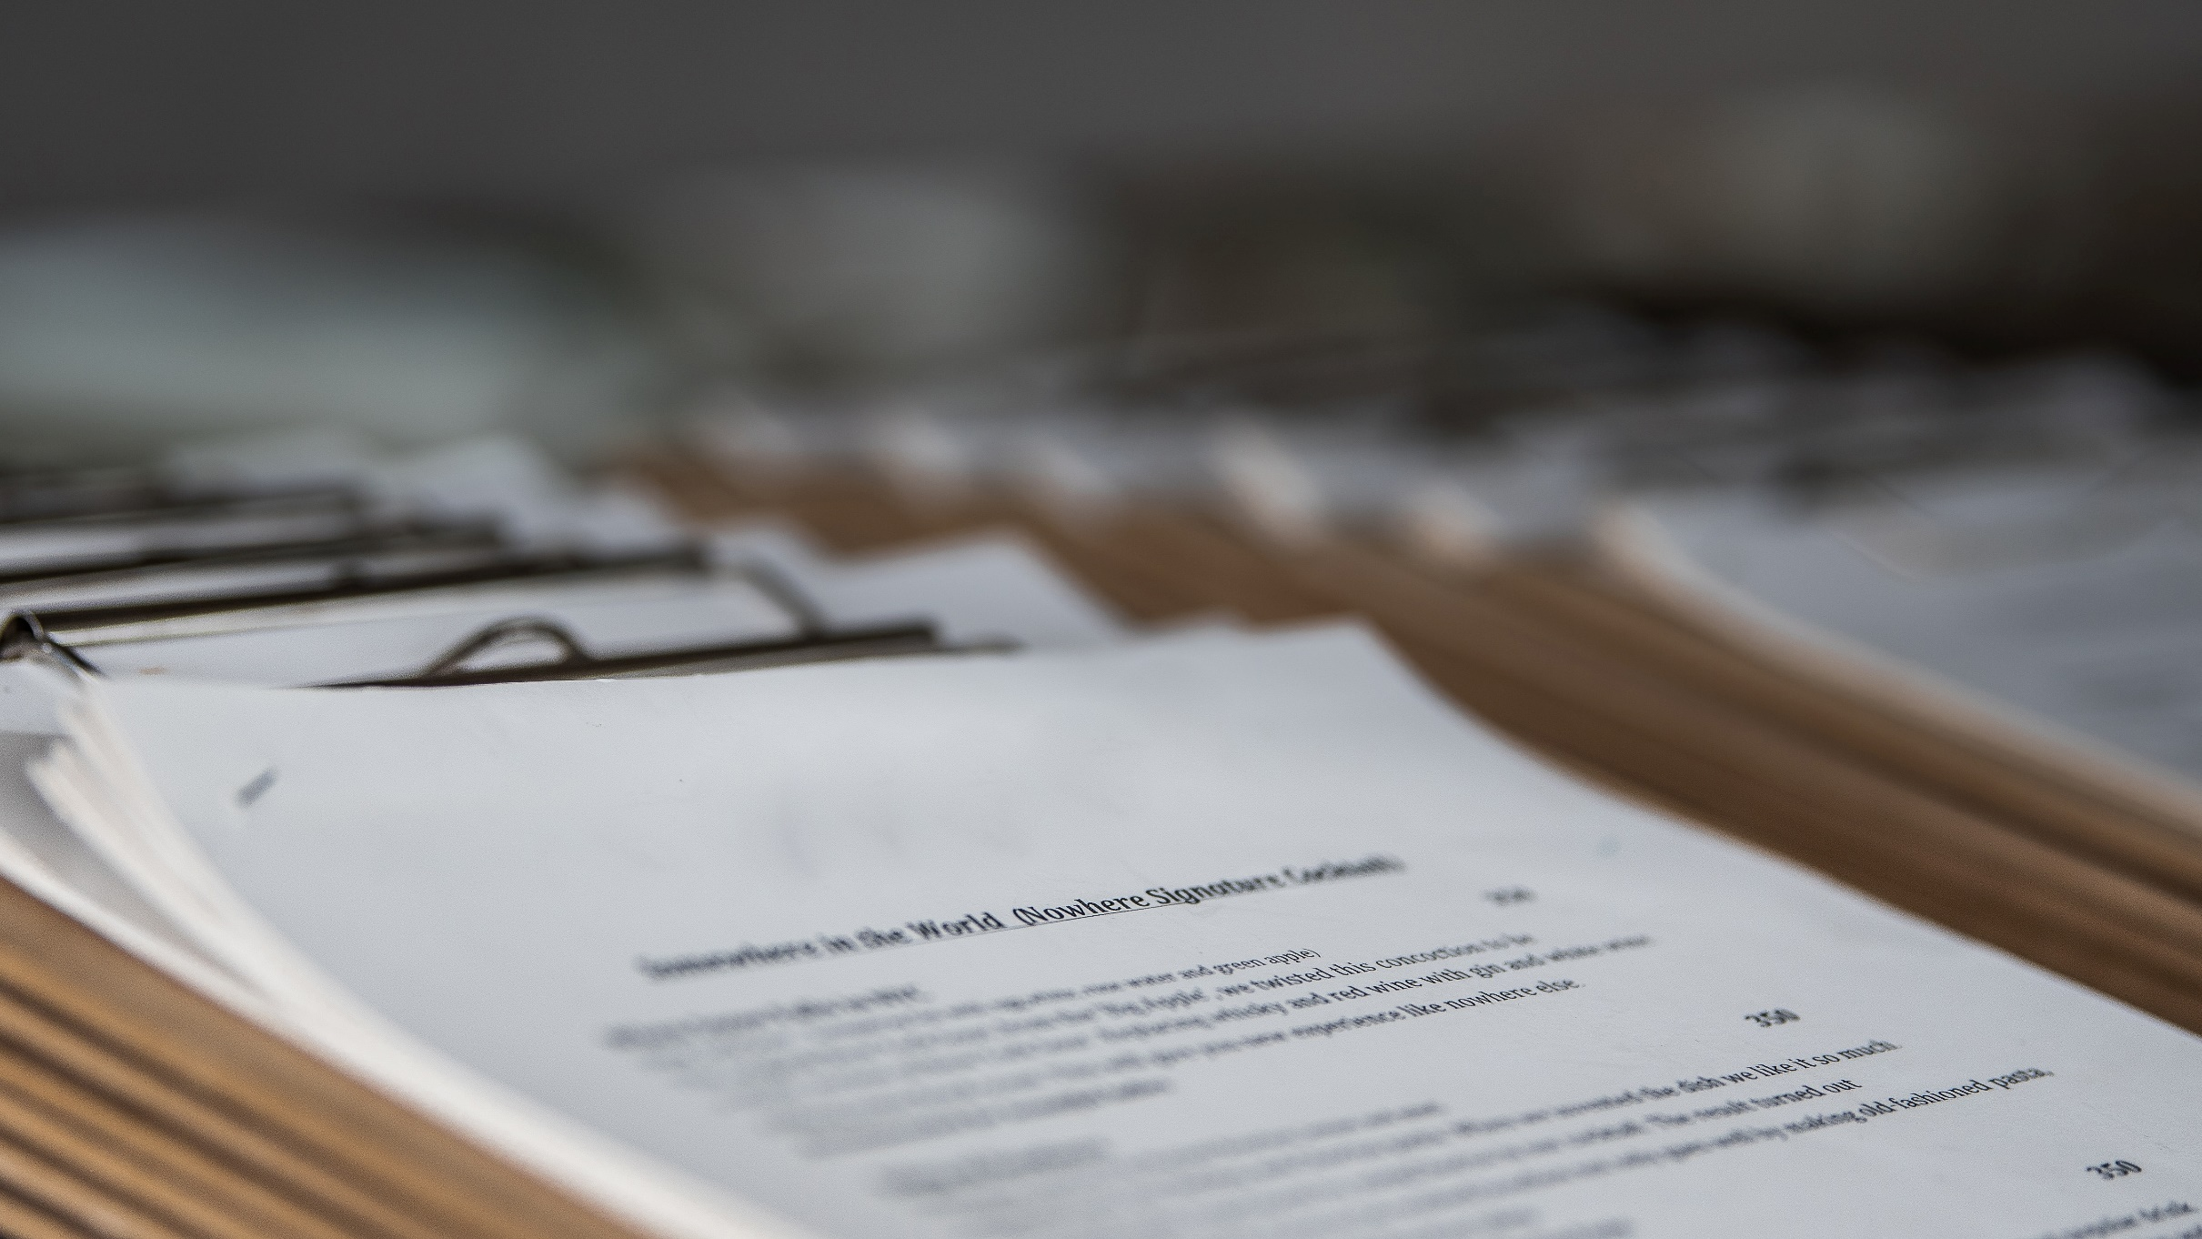
Solvency
Notes:
For the students, here at pinnacle we recently ended our actuarial opinion season. Every year on March 1st Insurance companies must receive a statement of actuarial opinion that confirms if the insurance company has enough in their reserves for expected losses.

Slide 22
Key Solvency Tests
Risk Based Capital (RBC)
Percent of held capital: 399.4%
(Surplus – RBC)/Held loss & LAE reserves
Trend Test: Passed
Is combined ratio < 1.2? OR…
Is surplus > 3 times RBC
Insurance Regulatory Information System (IRIS)
Ratio #11, #12, #13: Passed
Loss development and loss reserve deficiency compared to surplus
Notes:
As actuaries, we use key ratios to determine the quality of their reserves. Risk based capital is a key metric that indicates the required surplus. Surplus refers to shareholder surplus that you might’ve heard from accounting classes. RBC is a mixture of Lemonade’s risk, the asset risk (risk of default or decrease in value of assets), interest rate risk (risk of interest rate changing during policy period), and insurance risk (risk of mispricing products). This value is their risk based capital. We use this value to determine RBC levels. If the surplus is greater than the RBC, then no action is required. If it is below 100%, then varying levels of involvement is required from company action to regulatory takeover. As you can see lemonade has plenty of capital. Thus, they have no problem with solubility. The trend test ensures their combined ratio does not exceed 1.2 or ensures that surplus is at least 3 times the risk based capital. This slide is based off of lemonade's 2020 analysis, but going back to 2021, they get awfully close to a combined ratio of 120. CHANGE SLIDE If they exceeded that, they would still be would still be passed because they're surplus exceeds their RBC by a wide margin. The Iris ratios take a look at the historical loss development compared to their surplus. These ratios Indicate how well their reserves are meeting their loss development. Once again, Lemonade has no problems with this. What is the problem if lemonade is operating at a loss, but is perfectly soluble?
Notable things:
Loss ratio is average for year 2020
Percent of held capital is very high at 400% pass the test – more solvent
Pass the trend test which says combined ratio <1.2 and surplus at least 3x the authorized RBC
Do have enough, but well capitalized bc of outside venture capitalist
Not always going to have this support if hype dies down
Typical of a tech company
Add iris ratio slide
State comes in and regulates
Point of rbc and iris: theyre losing, but not going out of business. Plenty of capital. Growing. But is it good? Is their optimism misplaced?
Building an unprofitable book of business
They are using a tech business model similar to uber and facebook. Those companies were able to build their user base and figure out profitability later. The only problem is the core assumption to actuarial mentods and insurance is that past losses are indicative of a higher propensity of future losses. Growing at the expense of profitability leads to more unprofitability.
Building a book of risky business – adverse selection. Lack of good risks.

Slide 23
Not all that Glitters is Gold
Notes:
Finally, the combined ratio, which is one of the most important metrics for profitability, continues to rise. With such high losses, One can't help but wonder how they manage to stay in business. This is where proper actual reserving comes in handy

Slide 24
Key Solvency Tests
Risk Based Capital (RBC)
Percent of held capital: 399.4%
(Surplus – RBC)/Held loss & LAE reserves
Trend Test: Passed
Is combined ratio < 1.2? OR…
Is surplus > 3 times RBC
Insurance Regulatory Information System (IRIS)
Ratio #11, #12, #13: Passed
Loss development and loss reserve deficiency compared to surplus
Notes:
As actuaries, we use key ratios to determine the quality of their reserves. Risk based capital determines if they're surplus exceeds a threshold. The surplus refers to shareholder surplus from accounting classes. The threshold is a mixture of Lemonade’s risk, the asset risk (risk of default or decrease in value of assets), interest rate risk (risk of interest rate changing during policy period), and insurance risk (risk of mispricing products). This value is their risk based capital. We use this value to determine RBC levels. If the surplus is greater than the RBC, then no action is required. If it is below 100%, then varying levels of involvement is required from company action to regulatory takeover. As you can see lemonade has plenty of capital. Thus, they have no problem with solubility. The trend test ensures their combined ratio does not exceed 1.2 or ensures that surplus is at least 3 times the risk based capital. This slide is based off of lemonade's 2020 analysis, but going back to 2021, they get awfully close to a combined ratio of 120. If they exceeded that, they would still be would still be passed because they're surplus exceeds their RBC by a wide margin. The Iris ratios take a look at the historical loss development compared to their surplus. These ratios Indicate how well their reserves are meeting their loss development. Once again, Lemonade has no problems with this. CHANGE SLIDE What is the problem if lemonade is operating at a loss, but is perfectly soluble?
Notable things:
Loss ratio is average for year 2020
Percent of held capital is very high at 400% pass the test – more solvent
Pass the trend test which says combined ratio <1.2 and surplus at least 3x the authorized RBC
Do have enough, but well capitalized bc of outside venture capitalist
Not always going to have this support if hype dies down
Typical of a tech company
Add iris ratio slide
State comes in and regulates
Point of rbc and iris: theyre losing, but not going out of business. Plenty of capital. Growing. But is it good? Is their optimism misplaced?
Building an unprofitable book of business
They are using a tech business model similar to uber and facebook. Those companies were able to build their user base and figure out profitability later. The only problem is the core assumption to actuarial mentods and insurance is that past losses are indicative of a higher propensity of future losses. Growing at the expense of profitability leads to more unprofitability.
Building a book of risky business – adverse selection. Lack of good risks.

Slide 25
Key Solubility Tests
Risk Based Capital (RBC)
Percent of held capital: 399.4%
(Surplus – RBC)/Held loss & LAE reserves
Trend Test: Passed
Is combined ratio < 1.2? OR…
Is surplus > 3 times RBC
Insurance Regulatory Information System (IRIS)
Ratio #11, #12, #13: Passed
Loss development and loss reserve deficiency compared to surplus
They can take the hit…for now
Notes:
What is the problem if lemonade is operating at a loss, but is perfectly soluble? It’s important to consider the big picture here. As Julian mentioned, there has been a lot of excitement around these companies. They are touted as the insurance of the future. They are Silicon Valley based Tech companies that seek to revolutionize the insurance industry. Because of this, they have received plenty of capital from venture capitalists, which largely explains why they have plenty of reserves. The problem is that eventually these companies should turn a profit. That is the ultimate goal. But as it stands right now, they are building a very poor book of business. The core assumption of actuarial methods and insurance is that past losses are indicative of a higher propensity of future losses. Growing at the expense of profitability leads to more unprofitability. This is referred to as adverse selection. Insurance companies want to take on good risks. Ideally, they want to have more policies with no claim payouts. When an insurance company signs too many bad risks, they face the problem that these insurtechs are facing now. As a result, there's been speculation if underwriting can be accomplished effectively by an AI, both by investors and the insurance market. I want to bring your attention to a stark diagram of lemonade’s ceded premiums.
Notable things:
Loss ratio is average for year 2020
Percent of held capital is very high at 400% pass the test – more solvent
Pass the trend test which says combined ratio <1.2 and surplus at least 3x the authorized RBC
Do have enough, but well capitalized bc of outside venture capitalist
Not always going to have this support if hype dies down
Typical of a tech company
Add iris ratio slide
State comes in and regulates
Point of rbc and iris: theyre losing, but not going out of business. Plenty of capital. Growing. But is it good? Is their optimism misplaced?
Building an unprofitable book of business
They are using a tech business model similar to uber and facebook. Those companies were able to build their user base and figure out profitability later. The only problem is the core assumption to actuarial mentods and insurance is that past losses are indicative of a higher propensity of future losses. Growing at the expense of profitability leads to more unprofitability.
Building a book of risky business – adverse selection. Lack of good risks.

Slide 26
Overreliance on Reinsurance
Why it works
Protecting bottom line
Able to secure reinsurance contracts
Notes:
Looking at their financials from the past 5 years, we can see a drastic increase in reliance on reinsurance. This has worked out for lemonade since they were able to cede off a large portion of their losses. They have been able to form these contracts, but it will become harder if they continue posting poor loss ratios.
Look how dependent they are on reinsurance
When the reinsurance market becomes harder, profit will become more difficult
How long will these reinsurers do business with them out of goodwill
Could cause a downfall
Could find reins tower split in pg 14 footnote annual statement

Slide 27
Overreliance on Reinsurance
Why it works
Protecting bottom line
Able to secure reinsurance contracts
Harder Market
Increased costs
Less likely to find willing partners
Notes:
How much longer can they maintain these reinsurance contracts? Like regular insurance companies, re insurance companies would like to see some profit too. Some companies may be willing to take a hit now for profitability in the future, however, they will expect higher premium to compensate for that risk. Reinsurance is going to become more expensive for lemonade and they will become less likely to find partners to willing to take that risk. The market will continue to get harder especially with rising inflation. Similar to how investors in the stock market are turning from growth based stocks to value based stocks, Reinsurers would prefer to build a better book of business with less volatile and more profitable primary insurers.
Look how dependent they are on reinsurance
When the reinsurance market becomes harder, profit will become more difficult
How long will these reinsurers do business with them out of goodwill.
With an increasing loss ratio and inflating economic environment, how long before the excitement dies down and good reinsurers do business with more optimistic high potential insurance companies?
Could cause a downfall
Could find reins tower split in pg 14 footnote annual statement
The excitement for insurtechs is diminishing. Investors turning to value based stocks rather than growth based.

Slide 28
Can Lemonade rely on reinsurance this heavily long-term? Or will a new competitor rise?
Notes:
With their ever increasing lost ratio and inflating economic environment how long before the excitement dies down and reinsurers do business with more profitable insurance companies? Now, James will discuss the new competition that insurtechs will face in the near future.

Slide 29
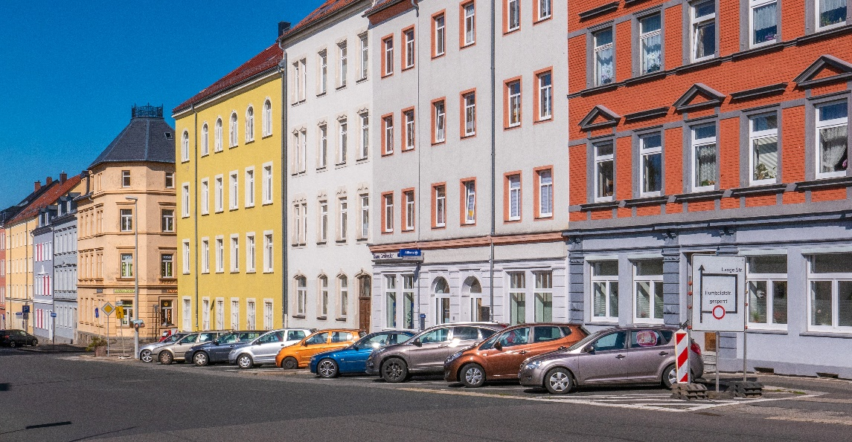
Landlord-Owned Captive Insurance
Designed for multi-unit property owners
Covers losses incurred by the landlord
Caused by the tenants
Captive is owned by the owner of the property
Captive reinsures a portion of the risk
Captures the underwriting profit and related investment income
Notes:
Sustainable profitable business model that may replace the potential of insurtech
Will these traditional captive insurers continue to find success over the insurtechs
More appealing during volatility
Transition to q/a open ended discussion

Slide 30
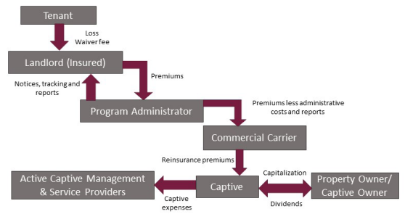
Landlord-Owned Captive Insurance
From: Active Captive Management
Notes:
Sustainable profitable business model that may replace the potential of insurtech
Will these traditional captive insurers continue to find success over the insurtechs
More appealing during volatility
Transition to q/a open ended discussion

Slide 31
Landlord-Owned Captive Insurance
Advantages
Coverage tailored to needs
Loss control implementation
Adverse selection and moral hazard
Stabilization of premium costs
Can they beat out InsurTechs?
Name recognition
Convenient for tenants and landlords
Reinsurance
Notes:
Sustainable profitable business model that may replace the potential of insurtech
Will these traditional captive insurers continue to find success over the insurtechs
While this kind of exposure has typically been handled through the HO-4 policy, this strategy is not without its own problems. For openers, the liability provisions of the typical policy may not adequately cover the damages that can accrue during a loss event. Secondarily, there is no guarantee that the renter will continue to remain insured, since they are able to cancel coverage at any time without notifying management.
More appealing during volatility
Transition to q/a open ended discussion

Slide 32
InsurTechs Vs. Alternative Insurance Markets
InsurTechs
Alternative Markets
Harness superior computing power
Behavioral economics
Automated cost efficiencies
Experienced insurance professionals
Market cycles
Claims Handling
Notes:
Tenant liability case we just went over is just one application of the larger question that will seen to be answer. Will outsiders from the tech world be able to harness the computing power at their disposal or will seasoned insurance professionals be better suited to profitably innovate as new situations arise.

Slide 33
Thank You
Julian Forero Beltran
Julian.forero91@gmail.com
Robbie Andrews
randrews@pinnacleactuaries.com
James Wencil, ACAS, MAAA
jwencil@pinnacleactuaries.com

