Slide 2
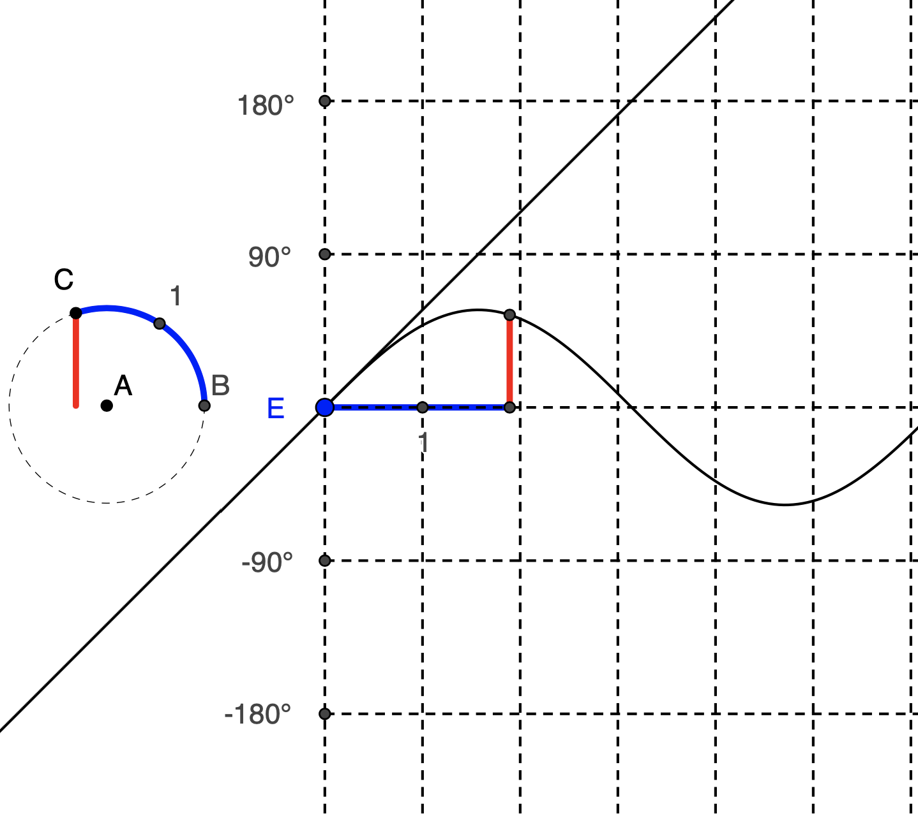
Craig Cullen Illinois State University
Comparing Radians and Degrees
ICTM Southern Sectional
February 15, 2024

Slide 3
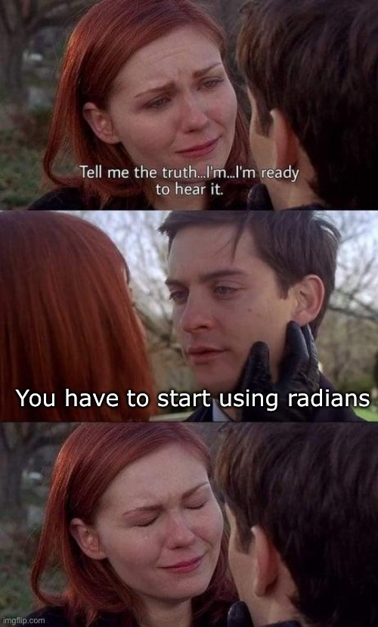

Slide 4
Comparing Radians and Degrees
Three main tasks
Describe radians and degrees, given vs. consequence
Measure an angle using the givens in each unit
Circle, arc, radius, ratio
Compare sine function graph using each unit
What are the consequences for each?
What are the units on the y-axis?

Slide 5
A GeoGebra Lesson
https://www.geogebra.org/classroom/e5xxxdth
Work through and discuss up through Task 4
Feedback, reactions, what would your students do?
Work through and discuss Tasks 5 – 9
Feedback, reactions, what would your students do?

Slide 6
The Big Ideas
To measure an angle, you need a circle…
Radians: arc divided by radius
Degrees: $\left(\frac{arc}{circumference}\right)$*360
Effects of units on graphs
Same units on each axis means slope = 1 (i.e., the derivative of the sine is cosine)
Radians for both axes is the ONLY way to also have max/min of 1 and -1.

Slide 7
Thank you! Questions/Comments/Reactions?
Craig Cullen (cjculle@ilstu.edu)
Alternative version of the angle measure activity
https://www.geogebra.org/m/npcs2sej

Slide 8
How to measure an angle
CCSS.MATH.CONTENT.4.MD.C.5.A An angle is measured with reference to a circle with its center at the common endpoint of the rays, by considering the fraction of the circular arc between the points where the two rays intersect the circle. An angle that turns through 1/360 of a circle is called a "one-degree angle," and can be used to measure angles.

