Slide 1
CSCA Short Course - Grand Rapids

Slide 2
The troubles of the Post-Truth Era…

Slide 3
…call for Engaged Communication!

Slide 4
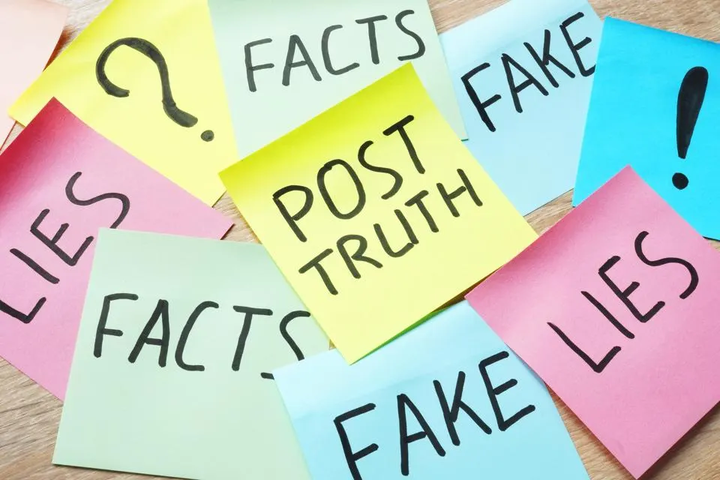
Post-truth reflects “massive dissemination of blatant lies, new forms of propaganda and deception facilitated by the digital revolution, public opinion completely unsupported by facts, and publics uninterested in the fact-grounded truth and relatively impermeable to correction” (Waisbord, 2018, p. 19).
Notes:
https://www.tandfonline.com/doi/full/10.1080/22041451.2018.1428928
Waisbord, S. (2018). The elective affinity between post-truth communication and populist politics. Communication Research and Practice, 4(1), 17–34. https://doi.org/10.1080/22041451.2018.1428928

Slide 5
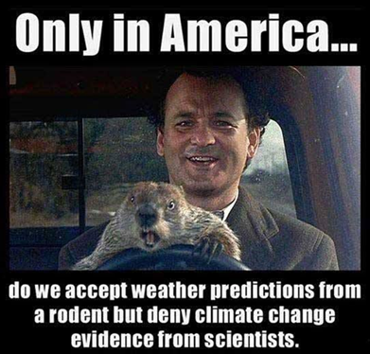
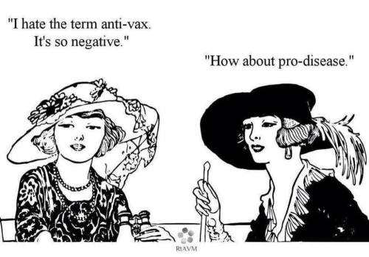
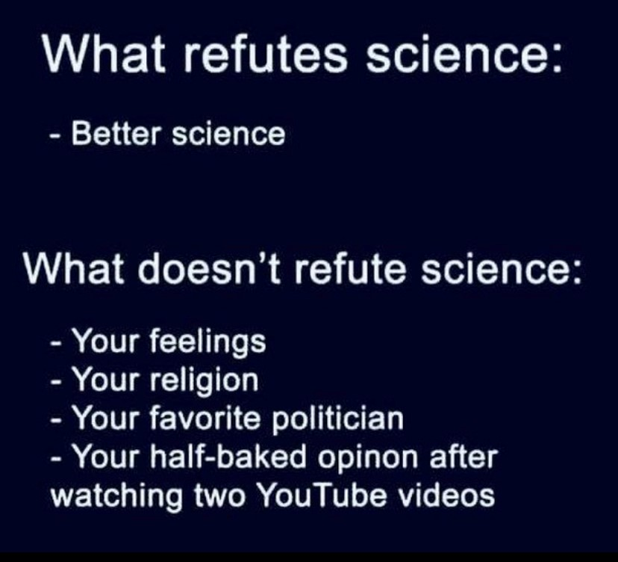
When Beliefs are valued above Facts, trouble results…
Systematic Racism
Police Brutality and Deadly Force
Opposition to Critical Race Theory
COVID-19 Misinformation
Anti-Vaxxers & Anti-Maskers
The Big Lie
1/6 Capital Insurrection
Climate Change Denial
Religious Encroachment in Political, Educational, & Social Spheres
Conflict at School Board Meetings
Censorship of Books

Slide 6
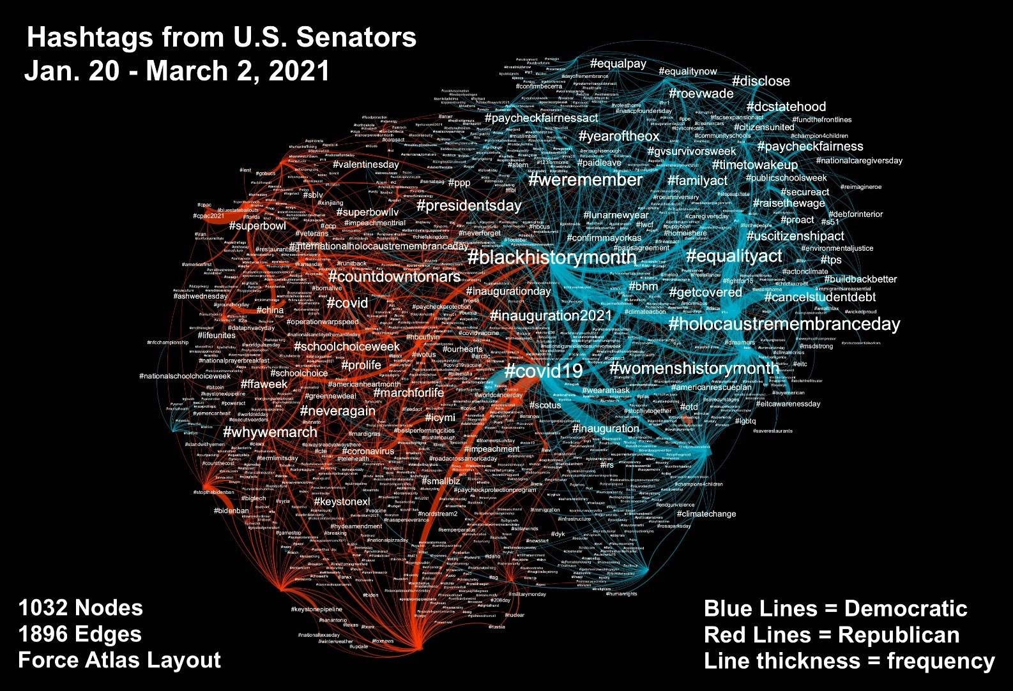
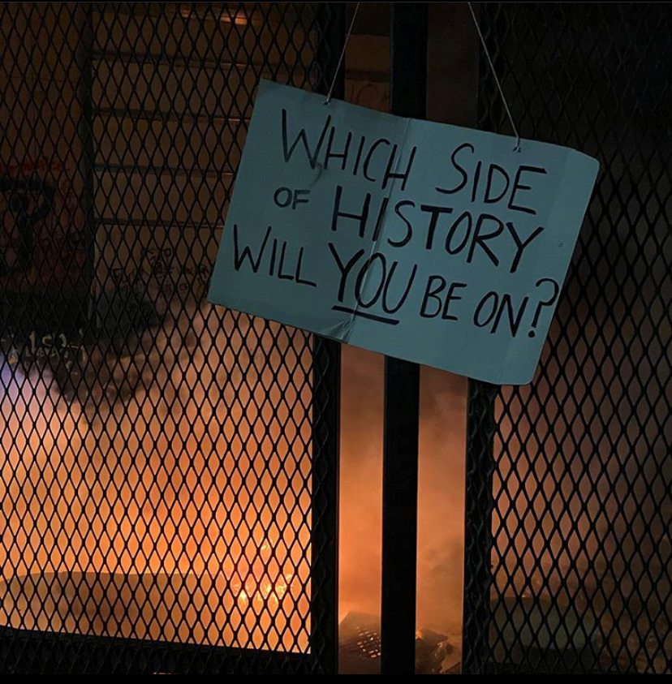
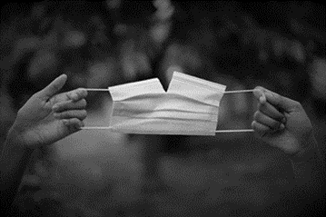
Notes:
Meyer, K. R., Carpenter, N. J., & Hunt, S. K. (2022). Promoting critical reasoning: Civic
engagement in an era of divisive politics and civil unrest. eJournal of Public Affairs, 11(1), 89-104. https://bearworks.missouristate.edu/ejopa/vol11/iss1/8

Slide 7
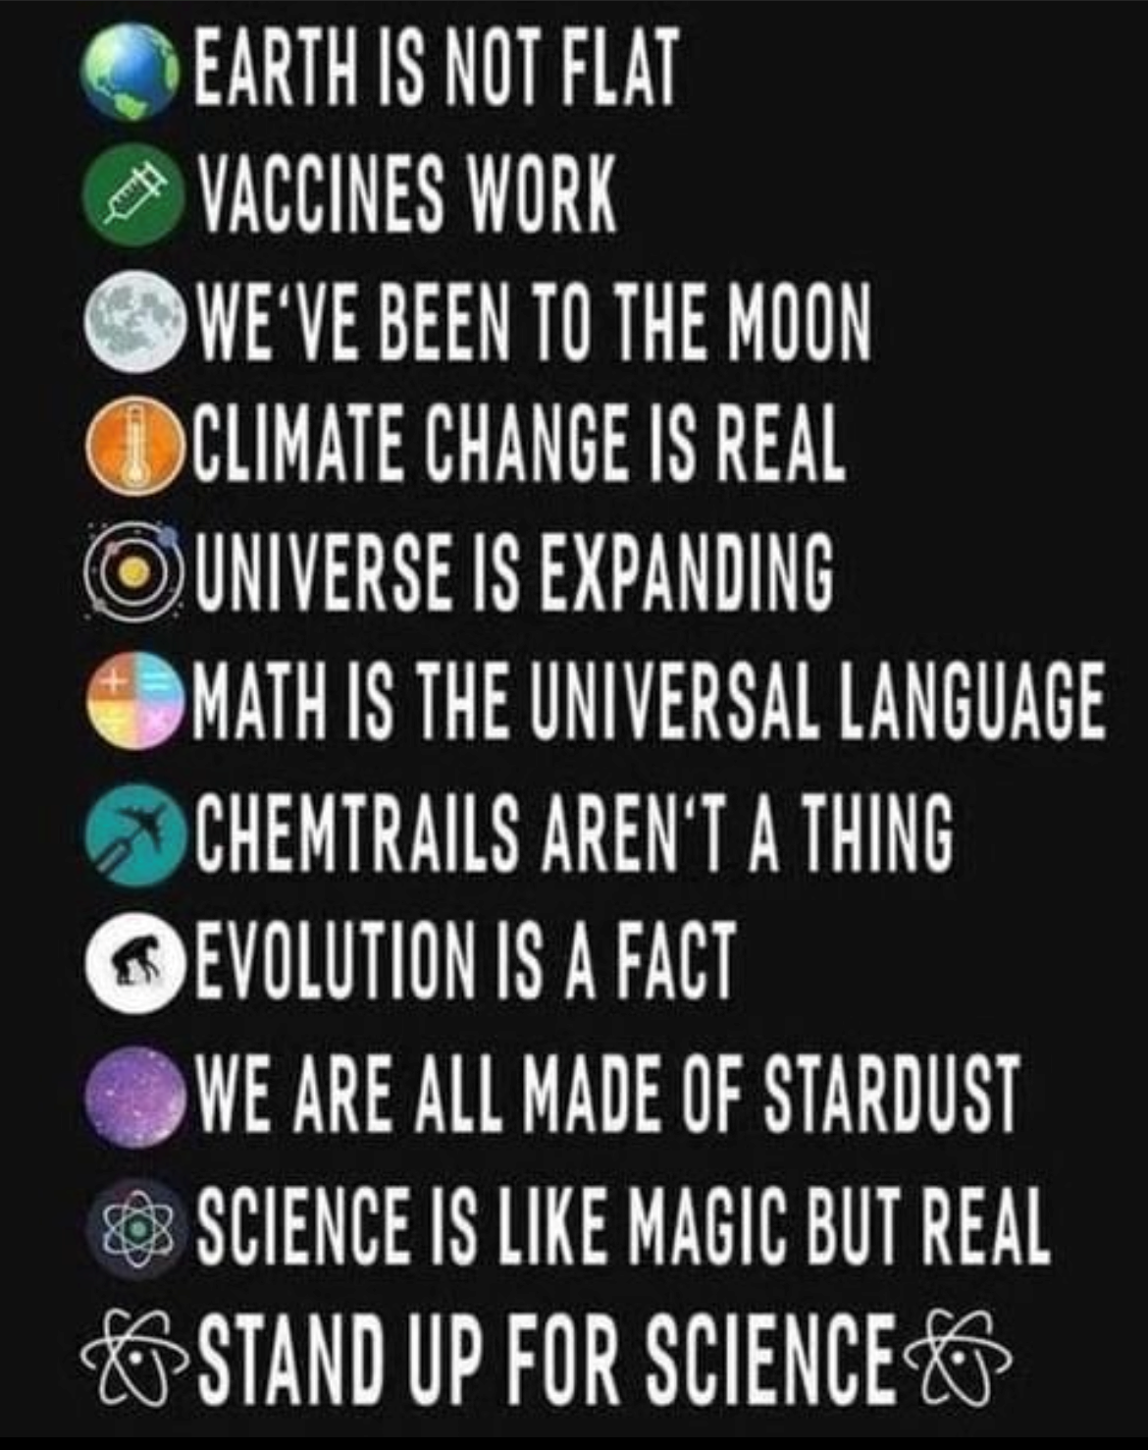
Post-Truth Era Communication Problems
Hate Speech
Divisive Discourse
Outrage Discourse
Propaganda
Firehose of Falsehood
Strategic Incivility
Verbal Aggressiveness
Political Polarization
Social Media Echo Chambers
Fake News
Misinformation
Disinformation
Conspiracy Theories
Deception
Anti-Democracy Sentiment
Notes:
https://fivethirtyeight.com/features/why-people-fall-for-conspiracy-theories/
https://neurosciencenews.com/personality-misinformation-19605/
https://thereader.mitpress.mit.edu/how-cognitive-bias-can-explain-post-truth/
https://the.ink/p/hope?utm_campaign=post&utm_medium=web&utm_source=email
https://www.polarizationlab.com/

Slide 8
Teaching Civic Engagement in the Post-truth Era
What is the post-truth era and what implications does it pose for communication and civic engagement?
Post-truth “Denotes the absence of conditions in the public sphere for citizens to concur on objective and processual norms to determine the truth as verifiable statements about reality” (Waisbord, 2018, p. 20).
What is the relationship between communication and civic engagement?
What special challenges will students face as they seek to become civically engaged in the post-truth era?
Students need to learn about the deleterious effects of social media information bubbles.
Notes:
https://www.harvardmagazine.com/2021/06/features-disinformation
Hunt, S. K., Meyer, K. R., Hooker, J. F., Simonds, C. J., & Lippert, L. R. (2016).
Implementing the Political Engagement Project in an introductory communication course: An examination of the effects on students’ political knowledge, efficacy, skills, behavior, and ideology. eJournal of Public Affairs, 5(2), 116-151. https://doi.org/10.21768/ejopa.v5i2.116
Hunt, S. K., & Meyer, K. R. (2021). Making the case for a pedagogy of civic
engagement, anti-extremism, and antiracism: A response to forum essays. Communication Education, 70(4), 451-457. https://doi.org/10.1080/03634523.2021.1958239
Hunt, S. K., and Woolard, C. E. (2016). Service learning and innovative pedagogies. In P. L. Witt (Ed.), Handbooks of Communication Science: Vol. 16. Communication and Learning (pp. 527-552). Berlin, Germany: DeGruyter Mouton.
Woolard, C., & Hunt, S. K. (2019). Incorporating political engagement in general education: An examination of the effects of participation in a political research action project on students’ perceived relevance, efficacy, political understanding, and political engagement skills. Journal of General Education, 68, 54-74. doi:10.5325/jgeneeduc.68.1-2.0054

Slide 9
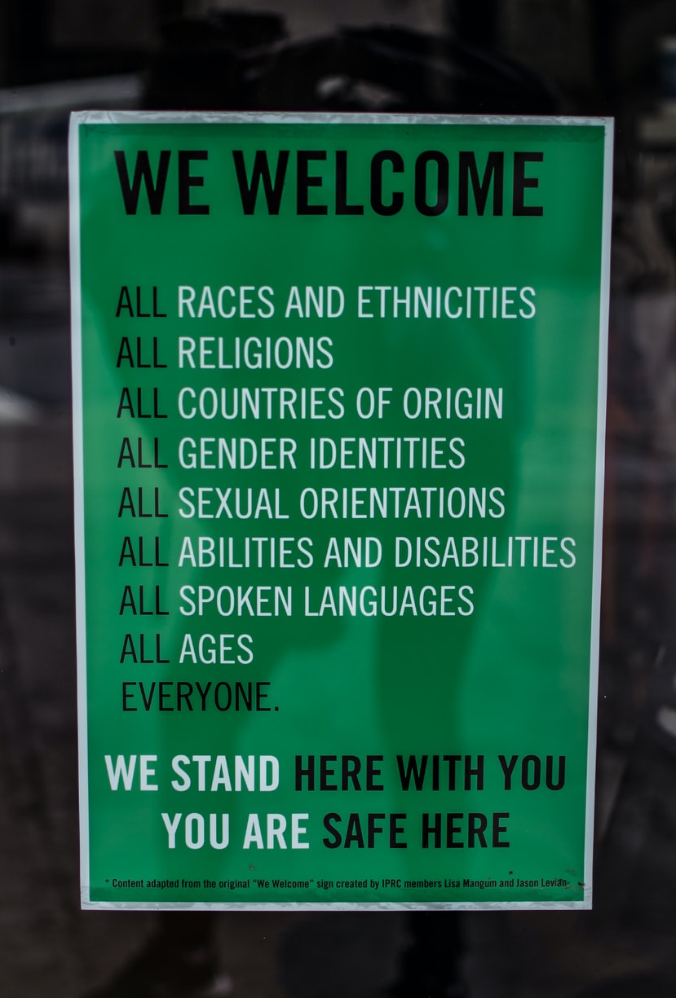
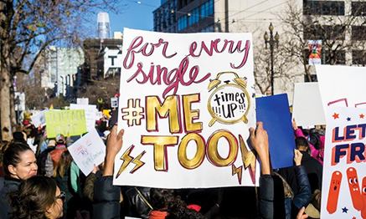
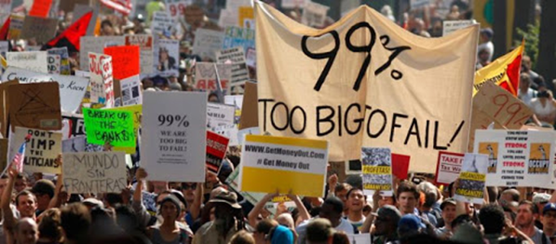
Communication Advocacy for the Common Good
Black Lives Matter
#MeToo
Women’s March
Climate Activists
Pride Parades
Voting Rights
Digital Activism
Fact Checking
Commitment to Truth
Support for Science
Democratic Ideals
Civic Engagement

Slide 10
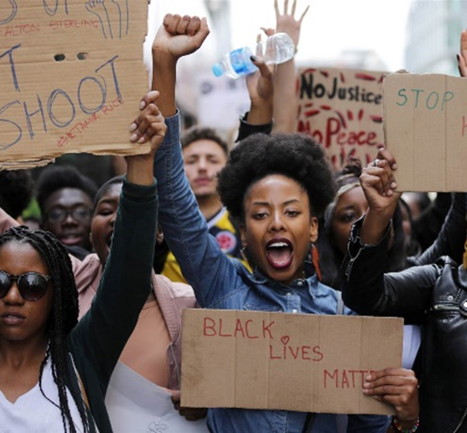
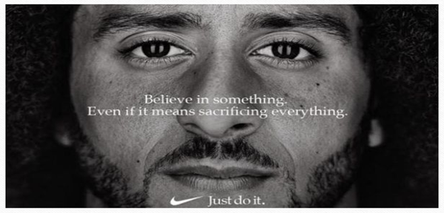
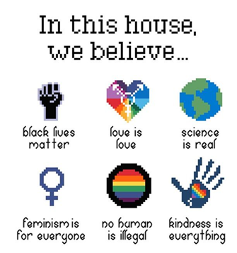
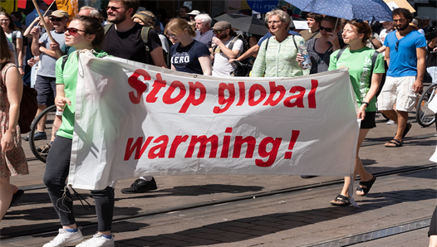

Slide 11
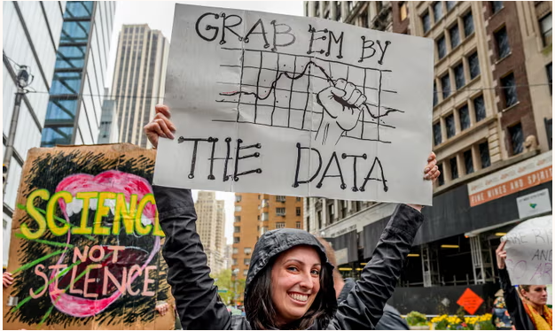
Use contemporary research studies, examples, activities, and assignments geared toward sparking student interest in: 1) applying persuasion analysis to current events, 2) exploring and applying theories, and 3) examining and utilizing research methods.
Notes:
https://www.latimes.com/health/la-xpm-2011-may-28-la-sci-duh-20110529-story.html
https://www.npr.org/2011/08/23/139852035/shrimp-on-a-treadmill-the-politics-of-silly-studies
https://www.salon.com/2013/03/07/gun_control_reduces_gun_violence_and_other_studies_that_confirm_the_obvious/
https://www.npr.org/sections/health-shots/2014/01/10/261406721/half-a-drugs-power-comes-from-thinking-it-will-work/
https://www.scientificamerican.com/article/howcan-a-poll-of-only-100/
https://www.npr.org/2012/05/03/151860154/put-away-the-bell-curve-most-of-us-arent-average
https://www.scientificamerican.com/article/a-batter-for-a-batter/

Slide 12
Theories we can use to address Post-Truth Era Problems
Theory of Information Laundering
Theory of Informative Fictions
Motivated Reasoning Theory
Deliberative Systems Theory
Interpersonal Deception Theory
Information Manipulation Theory (I & II)
Truth Default Theory
Moral Conflict Theory
Diffusion of Innovations Theory and Entertainment-Education
Inoculation Theory
Communication-Commitment Model
Communication Activism Research
Spiral of Silence Theory
Symbolic Convergence Theory
Social Judgment Theory
Attribution Theory
Notes:
Hunt, S. K., & Meyer, K. R. (under contract). Theories for human communication: Advocating for social change. Cognella.

Slide 13
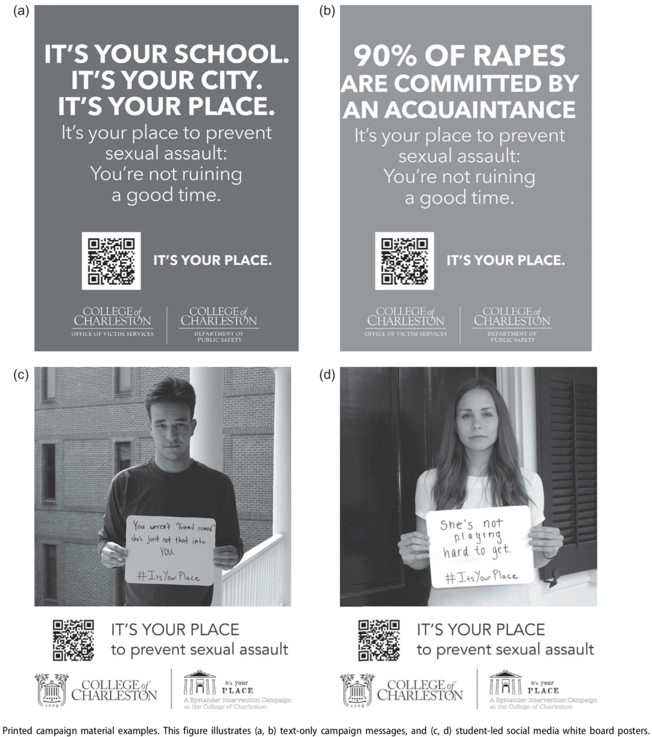
The It’s Your Place campaign (Sundstrom et al., 2018) examined how new media platforms could influence behavioral intentions of college students to intervene when they see sexual assault; an example of the Theory of Planned Behavior.
Notes:
https://www.tandfonline.com/doi/full/10.1080/10410236.2017.1333561
Sundstrom, B., Ferrara, M., DeMaria, A. L., Gabel, C., Booth, K., & Cabot, J. (2017). It’s Your Place: Development and Evaluation of an Evidence-Based Bystander Intervention Campaign. Health Communication, 33(9), 1141–1150. https://doi.org/10.1080/10410236.2017.1333561

Slide 14
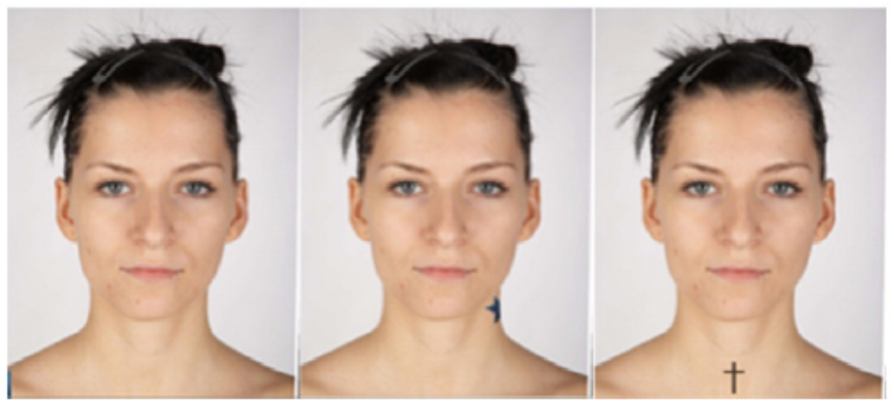
Timming & Perrett’s (2016) study on mixed signals creating Cognitive Dissonance…
Notes:
https://www.sciencedirect.com/science/article/pii/S0191886916302203?via%3Dihub
Timming, A. R., & Perrett, D. (2016). Trust and mixed signals: A study of religion, tattoos and cognitive dissonance. Personality and Individual Differences, 97, 234–238. https://doi.org/10.1016/j.paid.2016.03.067
https://www.inverse.com/mind-body/this-psychological-trick-could-get-people-to-follow-covid-protocols

Slide 15
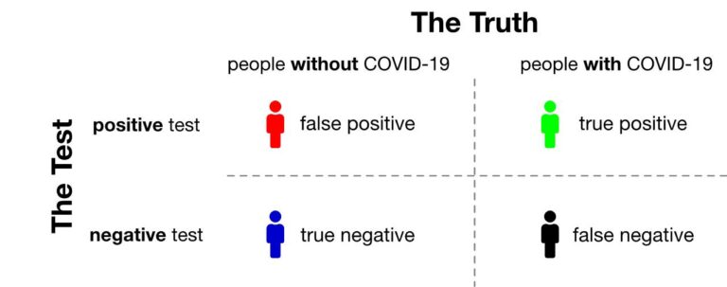
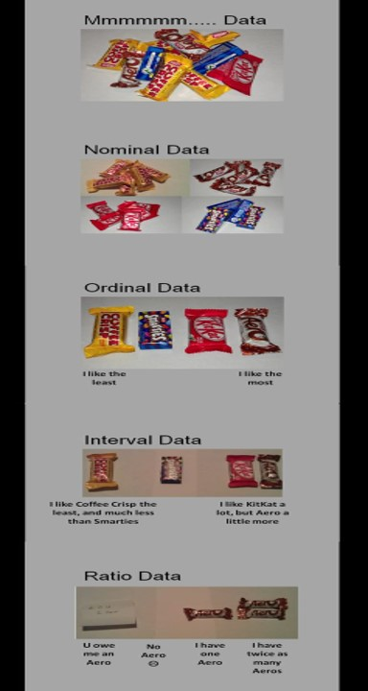
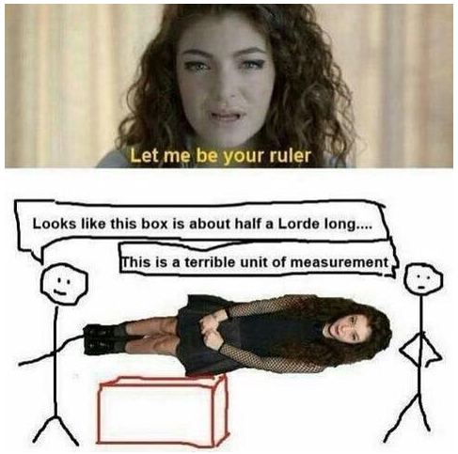
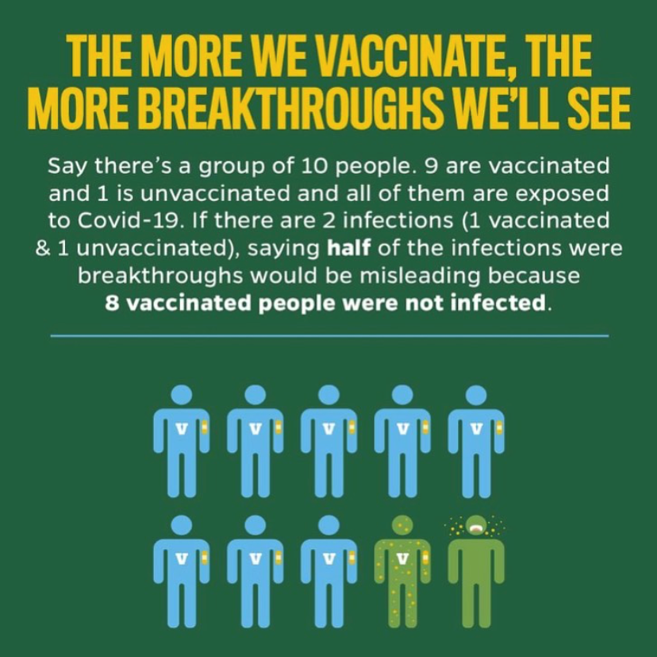
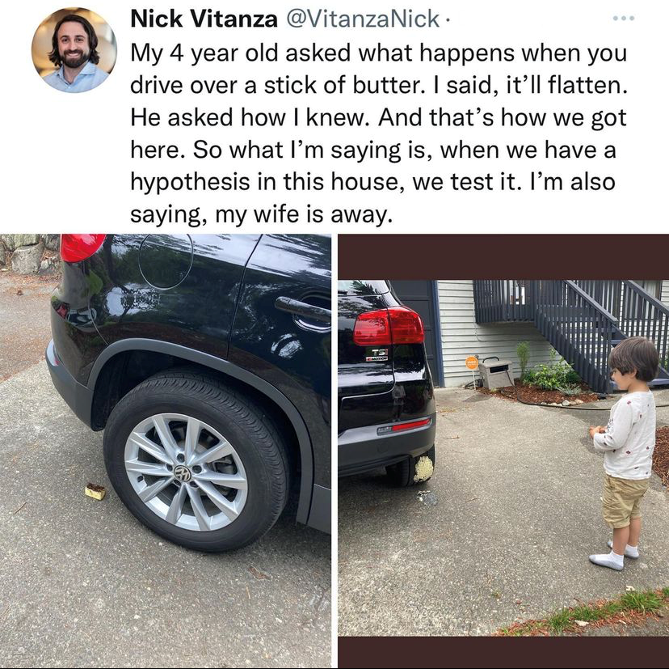
Illustrating Quantitative Methods with Memes
Notes:
Memes can help introduce the building blocks of quantitative research methods in a humorous manner. The examples shown illustrate experimental testing, Type I vs. Type II error, the 4 levels of data/measurement, spurious correlations, measurement issues, and how to read/(mis)interpret data.
https://www.huffpost.com/entry/coronavirus-testing-symptoms-doctor_n_5f43da82c5b6c00d03b1ffd9
https://www.youtube.com/watch?v=XOGcccCtLUg
https://www.science20.com/the_conversation/10_mistakes_we_all_make_when_interpreting_research-146227
https://www.salon.com/2021/01/29/why-is-science-so-polarizing-blame-the-way-we-talk-about-it_partner/
https://www.fastcompany.com/90560856/to-tell-the-real-story-data-journalist-mona-chalabi-draws-imperfect-lines
https://www.shefinds.com/collections/subway-tuna-nyt-lab-test-results/
https://www.psypost.org/conservative-ideology-is-a-robust-and-reliable-predictor-of-antiscientific-attitudes-in-the-united-states/
https://www.prevention.com/health/health-conditions/a38769630/false-positive-covid-test/

Slide 16
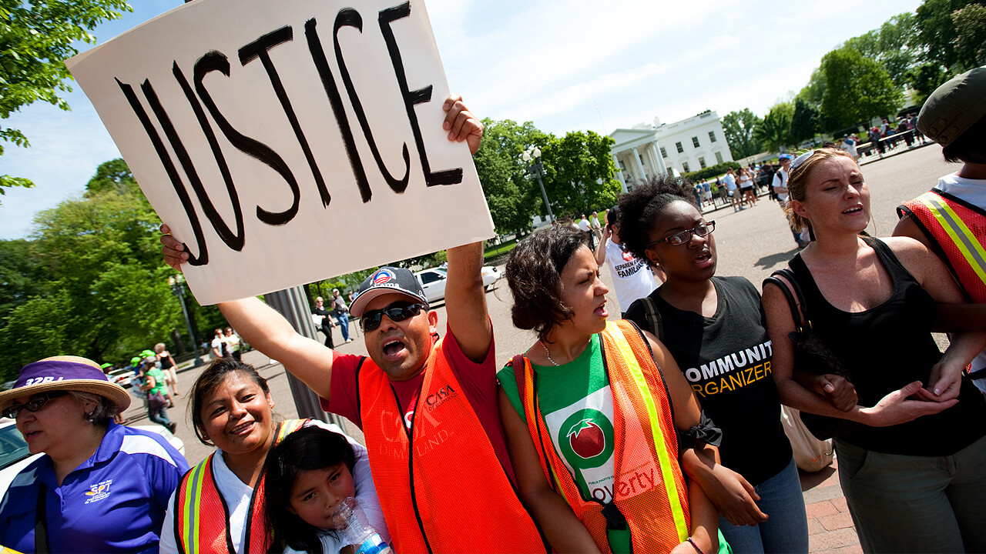
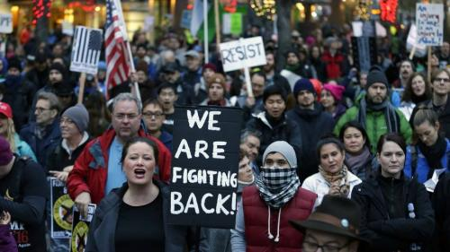
(Re)Defining Persuasion:
Persuasive communication is the process of employing symbolic communication to create, alter, reinforce, or extinguish and audience’s attitudes, values, beliefs, or behaviors in a given situation.
Influence attempts need to be ethical.
Engaged persuasion is essential.
Must distinguish from Fringe Persuasion.
Teaching students to be ethical and engaged consumers and producers of persuasion is not an apolitical endeavor—nor should it be!
Notes:
https://titles.cognella.com/engaged-persuasion-in-a-post-truth-world-9781516548231
Hunt, S. K., & Meyer, K. R. (2022). Engaged persuasion in a post-truth world. Cognella.
Hunt, S. K., & Meyer, K. R. (2019). Engaging persuasion: What should undergraduate
students enrolled in a persuasion course learn? Journal of Communication Pedagogy, 2, 12-16. https://doi.org/10.31446/jcp.2019.04

Slide 17
Challenges for Persuasion in the Post-Truth Era
Information bubbles
Transmission bias (greater error when communicating information that is not aligned with our beliefs)
Fake news
Conspiracy theories
Divisive discourse (Zompetti, 2018)
Negative partisanship
Tribalism & polarization
Notes:
https://titles.cognella.com/divisive-discourse-9781634878838.html
Zompetti, J. (2018). Divisive discourse: The extreme rhetoric of contemporary American politics (2nd ed.). Cognella.

Slide 18
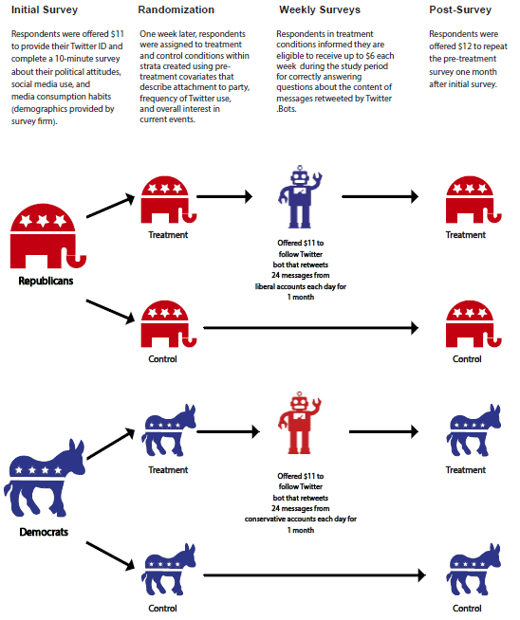
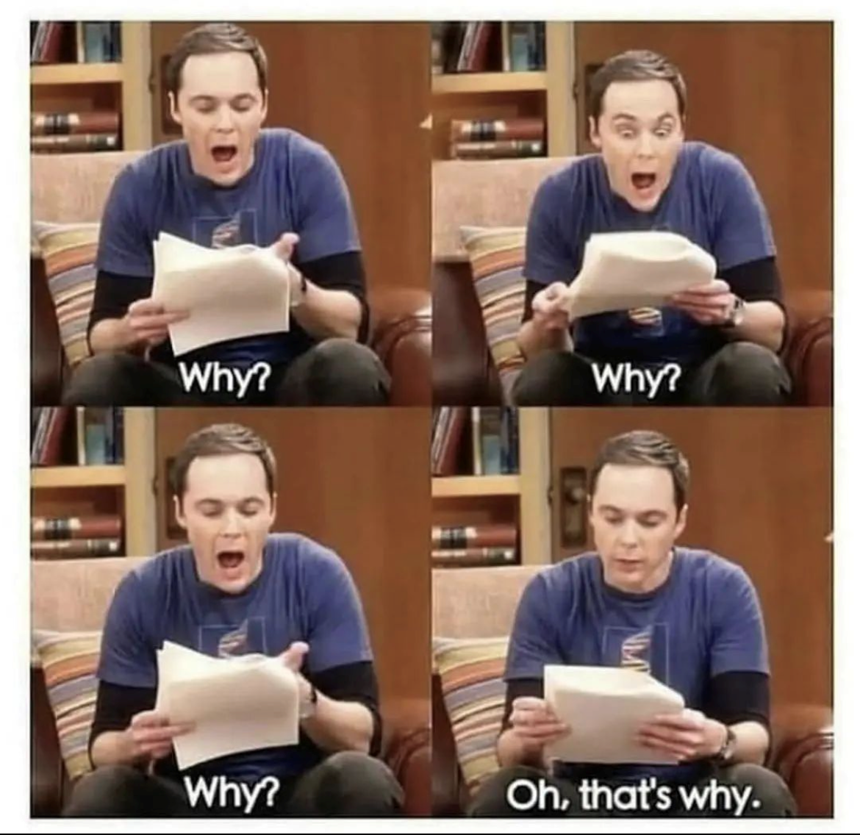
Show students how research methods come to life through studies like Bail et al. (2018):
Notes:
https://osf.io/preprints/socarxiv/4ygux
Bail, C. A., Argyle, L., Brown, T., Bumpus, J., Chen, H., Hunzaker, M. B. F., Lee, J., Mann, M., Merhout, F., & Volfovsky, A. (2018). Exposure to Opposing Views can Increase Political Polarization: Evidence from a Large-Scale Field Experiment on Social Media. https://doi.org/10.31235/osf.io/4ygux

Slide 19
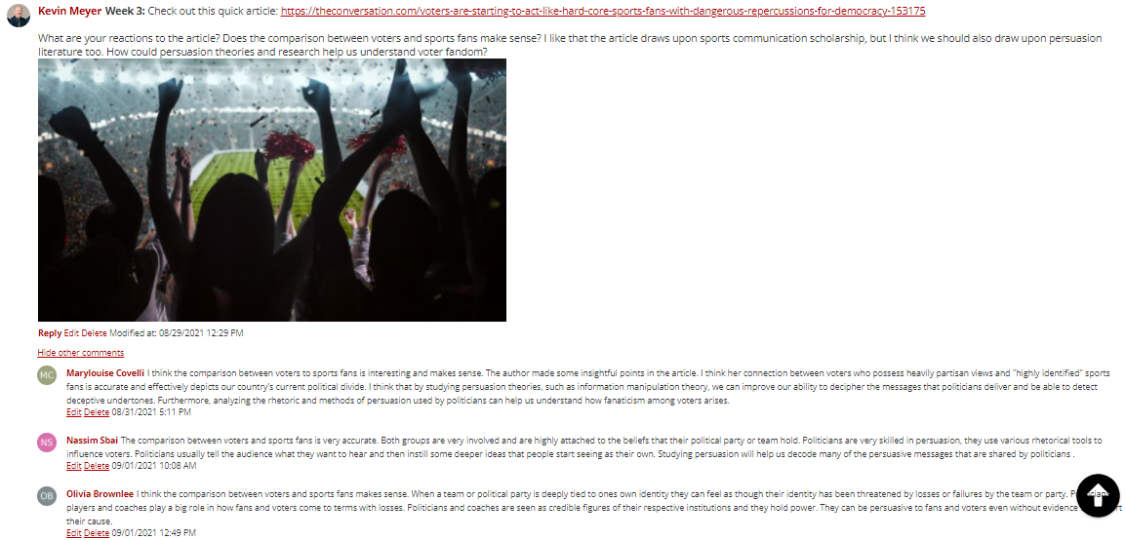
Example of Flipped Discussion Post Online
Notes:
https://theconversation.com/voters-are-starting-to-act-like-hard-core-sports-fans-with-dangerous-repercussions-for-democracy-153175

Slide 20
Extremism and Racism Threaten Democracy
Attack on the Capitol on January 6 based on a big lie about the election.
Racism is a clear and present danger to democracy.
DHS (2020) threat assessment notes white supremacists are greatest threat to our nation.
We need a commitment to truth as a public good!
Notes:
U.S. Department of Homeland Security. (2020, October). Homeland threat assessment.
https://www.dhs.gov/sites/default/files/publications/2020_10_06_homeland-threat-assessment.pdf
https://www.deseret.com/opinion/2021/6/14/22463627/america-we-have-a-problem-election-laws-texas-florida-100-scholars-letter-warning-democracy/
https://www.techpolicy.press/anatomy-of-the-big-lie-participatory-disinformation-vs-democracy/
https://www.forbes.com/sites/frederickhess/2021/01/07/the-storming-of-congress-reminds-us-that-educated-citizens-are-freedoms-only-true-safeguard/?sh=7b6af75b4904

Slide 21
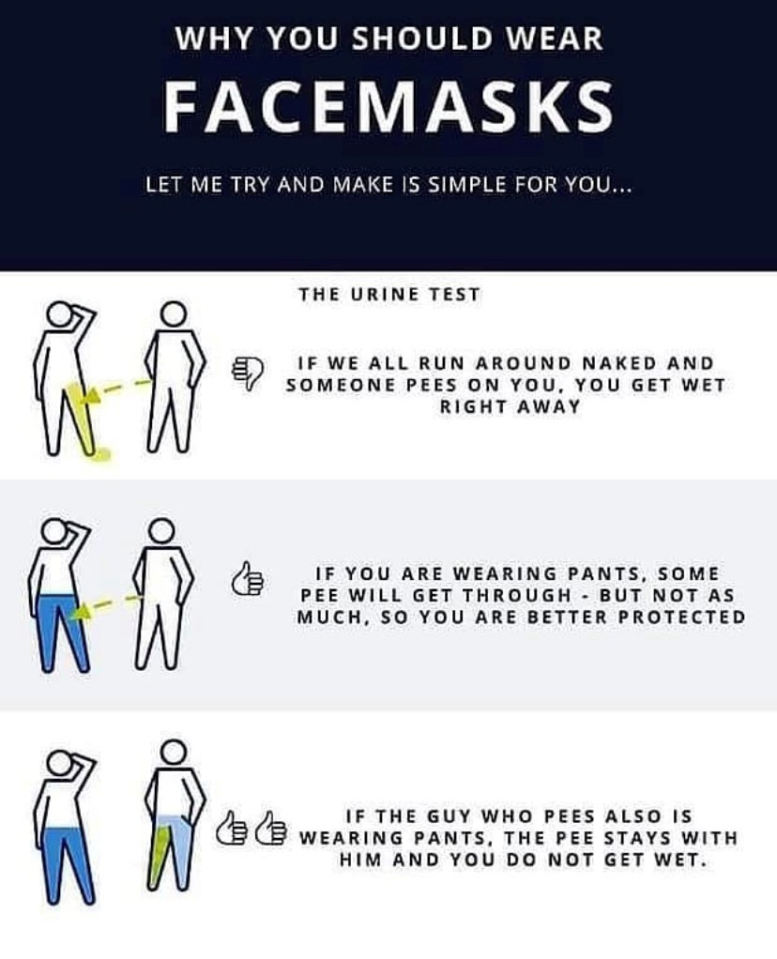
Student Activity: Compare COVID Masking Messages
Notes:
Activity prompt: create a Research Question like, Which message would improve masking compliance?
https://www.psypost.org/a-phenomenon-called-psychological-reactance-might-explain-the-mindset-of-anti-maskers/
https://www.huffpost.com/entry/fundamentalist-christian-covid-vaccine_n_611cf3ece4b0ff60bf7bbd50
https://www.goviralgame.com/books/go-viral/

Slide 22
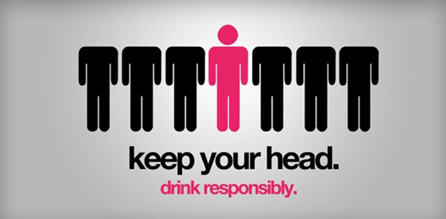
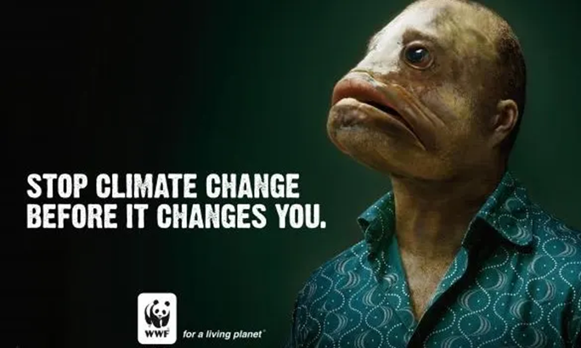
Student Activity: Analyze PSAs
Notes:
Have students evaluate the public service announcements using persuasive concepts and theories covered in class. Then have students re-design the PSAs in a group activity.

Slide 23
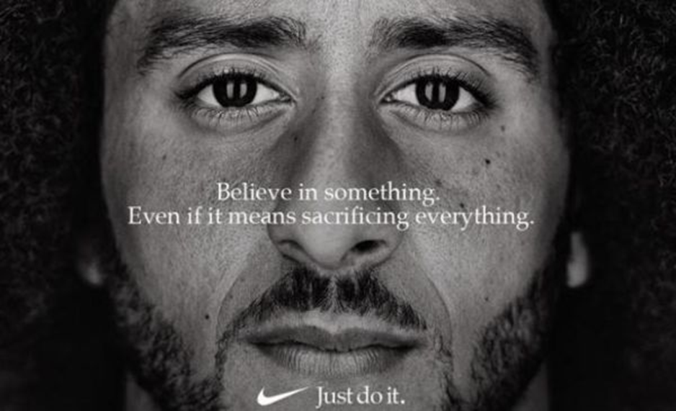
Use Visual Stimuli for Short Essay Prompts on Exams:
Notes:
Essay prompt could ask students to analyze the persuasive appeals in the advertisement, evaluate the message according to a theory covered in class, re-design and improve the message using communication strategies, design a research study to test the effectiveness of the ad campaign, or discuss the ad in relationship to civic engagement principles.

Slide 24
Messaging Activity: Example of Gender Collage
Notes:
Creative collage activity students create for a theory or gender communication course.

Slide 25
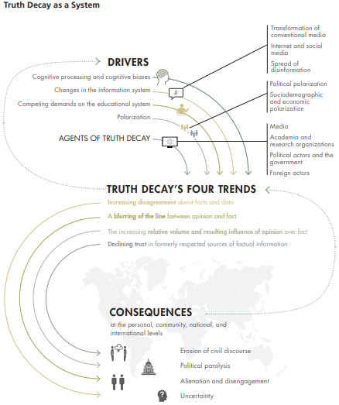
Truth Decay as a system (Kavanagh & Rich, 2018)
Notes:
https://www.rand.org/pubs/research_reports/RR2314.html
Kavanagh, Jennifer and Michael D. Rich, Truth Decay: An Initial Exploration of the Diminishing Role of Facts and Analysis in American Public Life. Santa Monica, CA: RAND Corporation, 2018. https://www.rand.org/pubs/research_reports/RR2314.html. Also available in print form.
https://www.rand.org/pubs/commentary/2021/05/how-truth-decay-is-fueling-vaccine-hesitancy.html
https://www.rand.org/research/projects/truth-decay/fighting-disinformation/search.html
https://www.makeuseof.com/tag/trust-news-sites/?utm_source=MUO-FP-P&utm_medium=Social-Distribution&utm_campaign=MUO-FP-P

Slide 26
Reinforce the Need for Truthful, Ethical Communication (protruthpledge.org)
Notes:
https://www.protruthpledge.org/
Example of behavioral intention to illustrate Theory of Reasoned Action and Theory of Planned Behavior
https://www.mediaite.com/news/new-poll-cnn-and-msnbc-viewers-got-covid-much-less-than-people-who-watch-fox-news-by-a-whopping-17-points/
https://www.rawstory.com/fox-viewers-changed-after-viewing-cnn/
https://guides.lib.umich.edu/c.php?g=637508&p=4462444

Slide 27
Motivated Reasoning Theory
Stipulates that we use a series of biased cognitive processes as receivers of persuasive information.
Selective exposure (i.e., actively seek information that is consistent with existing attitudes).
Biased assimilation (i.e., we accept claims that are consistent with existing attitudes through confirmation and disconfirmation bias).
Belief perseverance dynamics and the information deficit fallacy.
The spread of disinformation holds very significant implications for democracy (e.g., think about the big lie and January 6).
Notes:
https://theconversation.com/coronavirus-responses-highlight-how-humans-are-hardwired-to-dismiss-facts-that-dont-fit-their-worldview-141335

Slide 28
Inoculation Theory
Successful inoculation against climate change misinformation (Maertens et al., 2020; van der Linden et al., 2017).
Activating receivers’ critical thinking and argumentation skills makes them less susceptible to persuasive misinformation (Cook et al., 2017).
Check out www.getbadnews.com (simulation of social media environment designed to inoculate players).
Notes:
https://www.getbadnews.com/en
https://www.pbs.org/newshour/show/how-inoculating-americans-against-radicalization-can-fight-domestic-terrorism
https://gizmodo.com/youtube-misinformation-pre-bunking-study-1849446741
https://www.upworthy.com/researchers-found-the-most-effective-way-to-stop-misinformation-online-and-it-s-pretty-simple

Slide 29
Persuasive Argumentation
In psychiatry the Munchausen effect refers to people who exaggerate or create symptoms to get attention or sympathy.
In terms of argumentation, Vasile (2018) defines the Munchausen effect as the “intentional distortion of truth (by means of elliptical and erroneous argumentation) for the sake of persuasion, or propaganda or any other form of social influence” (p. 62).
Importance of receivers’ willingness to accept false information (must be more competent consumers of argumentation).
Notes:
https://go.gale.com/ps/i.do?id=GALE%7CA571894270&sid=googleScholar&v=2.1&it=r&linkaccess=abs&issn=20665083&p=AONE&sw=w&userGroupName=chic30910&aty=ip
https://www.ssoar.info/ssoar/handle/document/61469

Slide 30
Source Credibility
Death of expertise refers to the “rejection of science and dispassionate rationality, which are the foundations of modern civilization” (Nichols, 2017, p. 5).
Dunning-Kruger effect (i.e., people think they are smart and lack the ability to recognize they are incompetent).
As people turn away from education and civic engagement, they become less capable citizens and the death spiral of democracy intensifies.
Notes:
https://global.oup.com/academic/product/the-death-of-expertise-9780197763834?cc=us&lang=en&
https://thedebrief.org/dunning-kruger-effect-ignorance-and-overconfidence-affect-intuitive-thinking-new-study-says/
https://www.youtube.com/watch?v=y50i1bI2uN4
https://www.openculture.com/2024/02/why-incompetent-people-think-theyre-competent-the-dunning-kruger-effect-explained.html#google_vignette
https://www.bps.org.uk/psychologist/persistent-irony-dunning-kruger-effect
https://www.vox.com/vox-conversations-podcast/23030205/vox-conversations-michael-lewis-against-the-rules-experts

Slide 31
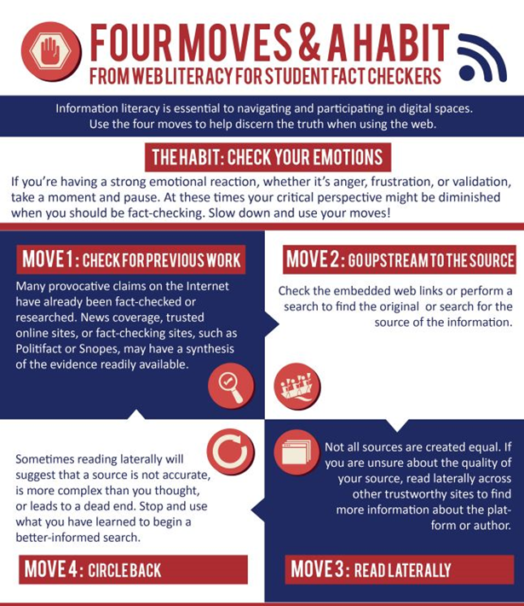
Language in the Post-Truth Era
Politicians use language to obfuscate the truth and create political polarization (Cervi & Andrade, 2019).
Careless speech refers to the use of language that is unconcerned with truth or advancing the common good (Hyvomen, 2018).
Strategic incivility (Bratslavsky et al., 2019).
Exploits Twitter’s technological architecture.
Used as a means of domination (use of language to evoke emotions and intensity of feelings).
Notes:
https://www.comhumanitas.org/index.php/comhumanitas/article/view/207
Cervi, L., & Carrillo-Andrade, A. (2019). Post-truth and Disinformation: Using discourse analysis to understand the creation of emotional and rival narratives in Brexit. ComHumanitas: Revista Científica de Comunicación, 10(2), 125–149. https://doi.org/10.31207/rch.v10i2.207
https://journals.sagepub.com/doi/10.1177/2336825X1802600303
Hyvönen, A.-E. (2018). Careless Speech: Conceptualizing Post-Truth Politics1. New Perspectives, 26(3), 31–55. https://doi.org/10.1177/2336825x1802600303
https://www.tandfonline.com/doi/full/10.1080/09502386.2019.1656760
Bratslavsky, L., Carpenter, N., & Zompetti, J. (2019). Twitter, incivility, and presidential communication: A theoretical incursion into spectacle and power. Cultural Studies, 34(4), 593–624. https://doi.org/10.1080/09502386.2019.1656760
https://www.youtube.com/watch?v=6_QX12szXTM

Slide 32
Fourth Era of Political Communication (Semetko & Tworzecki, 2018):
Rise of big data (access to voter information and the means to deploy that at scale);
Individuals more likely to consume information on social media than legacy media (diminishes the fact-checking and gate-keeping roles once played by media);
Globalization of campaigning (influence of non-democratic countries in US elections).
Notes:
https://www.taylorfrancis.com/chapters/edit/10.4324/9781315712390-25/campaign-strategies-media-voters-holli-semetko-hubert-tworzecki
Semetko, Holli and Hubert Tworzecki, “Campaign Strategies, Media and Voters: The Fourth Era of Political Communication,” in Marta Cantijoch, Edward Fieldhouse, Mark Franklin, Rachel Gibson, Christopher Wlezien and Justin Fisher, eds., Routledge Handbook on Public Opinion and Voting Behaviour (London and New York: Routledge, 2017).
https://www.youtube.com/watch?v=_-mgdj7xjj0
https://www.cnet.com/news/misinformation/tiktok-is-a-misinformation-minefield-dont-get-tripped-up/
https://cosmosmagazine.com/nature/fish-stop-misinformation-spread/

Slide 33
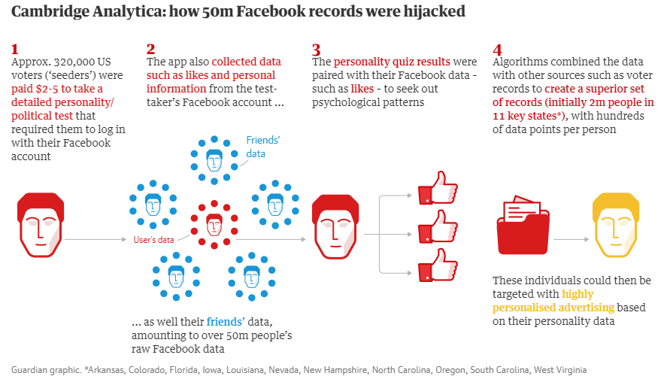
Social Media Case Study: Cambridge Analytica
Notes:
https://www.smashingmagazine.com/2018/06/ethics-of-persuasion/
Cerejo, L. (2018, June 5). The ethics of persuasion. Smashing Magazine.

Slide 34
Questions? Contact us!
Dr. Steve Hunt
skhunt2@ilstu.edu
Dr. Kevin Meyer
kmeyer@ilstu.edu
Illinois State University
School of Communication

