Slide 1
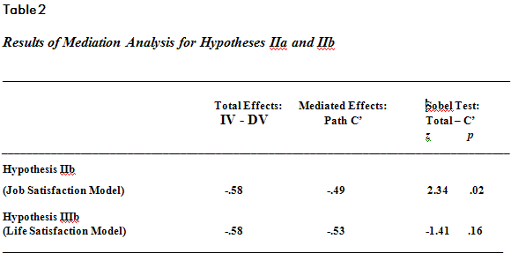
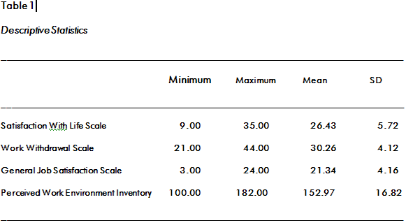
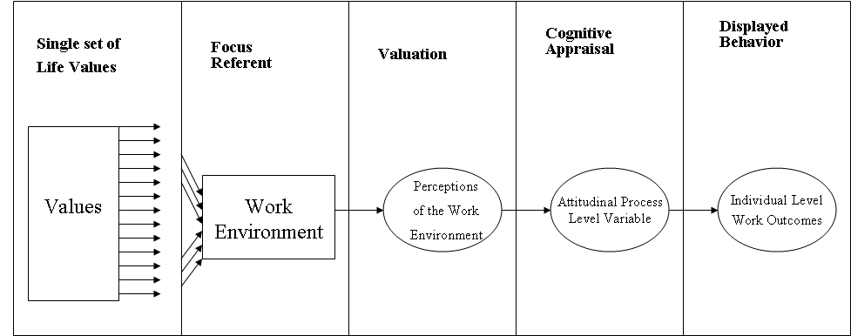
A New Model of the Perceived Work Environment:
Conceptualization and Instrument Validation
Jared C. M. Bartels, Kimberly T. Schneider, and John F. Binning
Illinois State University and Memorial Health System
Nicholas Strong
Illinois State University
Abstract
Perceptions of the Work Environment (PWE) have been studied since the early days of I/O psychology with little consensus regarding the structure of the construct. This study examines the theoretical underpinnings of the construct, presents a conceptual model and proposes a new operational definition for PWE.
Problem/Hypotheses
Employees’ perceptions regarding their work environment and the dimensions, antecedents, and consequences of the environment have been the focus of many empirical studies reported in the I/O psychology literature (Carr, Schmidt, Ford, & DeShon, 2003; Parker et al., 2003). Recently, much progress has been made via two meta-analyses (Carr et al., 2003, Parker et al., 2003) in terms of the theoretical structure of the construct’s relationship with outcome variables. The ideas and research offered by these two meta-analyses support the idea of a molar or universal construct underlying perceptions of the work environment and may support a single theoretical delineation of the concept.
Based on the research described above, the current study seeks to expand the literature on PWE. Though several taxonomies of PWE are discussed in the literature very little has been done since James and James’ (1989) seminal paper to gather all of the converging taxonomies together and interpret their values based on an agreed- upon conceptual framework. Parker et al. (2003) suggest that a large number of dimensions exist to define PWE. Though they chose not to collapse the measures into a single taxonomy for fear it could dilute important relationships, they posit a universal conceptual model of PWE. This suggests that a single representation of the construct space exists; it is not that collapsing dimensions of PWE will dilute the conceptual waters, rather, the focus should be on separating molar PWE dimensions from measures the theory does not, explicitly or implicitly, imply. This should reduce the “staggering number of dimensions” (Parker et al, 2003, p. 392) associated with molar PWE.
A PWE inventory (PWEI) created in this way should model similar relationships to those discussed by Carr et al. (2003) and Parker et al. (2003). Conceptually, this PWEI will fit into a mediated model in which psychologically distal perceptions of the work environment are mediated through an attitudinal process level variable to influence behavioral outcomes (see Figure 1). Theoretically, a molar PWEI should be a representation of individual values combined with a situational referent (the work environment). Based on this we predict:
Figure 1. PWEI Mediated Model
Figure 1. Conceptual model of the Relationship Between Values, Situational Referents, Perceptions, Attitudes and Outcomes.
Hypothesis 1a: Because higher scores on the PWEI represent a higher level of well-being and because the PWEI will represent perceptions of the work environment that have an indirect relationship with work correlates through their association with attitudinal process variables, the PWEI will be negatively related to a work correlate, specifically, work withdrawal.
Hypothesis 1b: Because perceptions of the work environment have an indirect relationship with outcome variables through a process level attitudinal variable, the relationship between PWEI scores and work withdrawal scores will be fully mediated by job satisfaction.
Hypotheses (cont.)
Values that are specifically cued by the work environment create perceptions of that same work environment. These perceptions then have an effect on attitudes related to a specific aspect of the environment and thereby affect outcomes. Given this, values cued for the work environment and expressed as perceptions via the PWEI should not affect attitudes related to specific aspects of anything other than the work environment. This is important because it shows that the PWEI specifically measures work perceptions as opposed to perceptions in general. To examine whether the PWEI has some degree of discriminant validly, we predict that:
Hypothesis 2a: The PWEI will not affect process level variables unrelated to the work environment and therefore will have no relationship with an attitudinal measure of life satisfaction.
Hypothesis 2b: Because life satisfaction is a process level variable that is not related to the work environment it will not mediate the relationship between PWEI and a measure of work withdrawal.
Method
Measures: Development of the PWEI
Searching the published literature for measures of global climate, work perceptions and work environment resulted in 9 separate measures. A total of 34 first ordered dimensions were evident in this literature along with 38 second ordered descriptors (not all scales had two levels per factor). Each dimension and the definition given in its seminal publication were reviewed and redundancies were eliminated. Next, the dimensions were reviewed for fit with the molar construct detailed above, and those that did not fit, were eliminated. More specifically, two inclusion rules were used. First only taxonomies that explicitly or implicitly use individual level perception as their psychological basis were used. Secondly, measures that clearly indicated that they have their theoretical roots in a concept called “social constructionist perspective” were also excluded. This perspective specifies that perceptions of the work environment are related almost exclusively to interactions with people inside the organization and the organizational context around those meetings (Burke et al., 2002). As this study seeks to explain molar perceptions that are generalizable to most work environments, these measures were excluded.
All remaining first-order dimensions were reviewed in regard to their second- order descriptors. Descriptors that overlapped with other dimensions were eliminated. Finally, a review of the remaining first-order dimensions and second-order descriptors was done to ensure complete coverage of the universal construct described in this paper. This was done by reviewing published theoretical postulations of dimensions and descriptors needed to cover the entire conceptual space of perceptions of the work environment. If agreement was found between two or more authors for a dimension or descriptor they were added to the PWEI model if that conceptual space was not already present.
The PWEI consists of 38 statements, which participants rated on a scale from 1 (never) to 5 (almost always). Other instruments used include the Abridged Job in General Scale (Russell et al., 2004) to assess general job satisfaction. Work Withdrawal was measured using a fifteen item measure to assess intentions to withdraw cognitively and behaviorally from the job (Ringler, Binning, & Schneider, 2007). The final individual level construct, Life Satisfaction, was measured by the Satisfaction with Life Scale (Diener, Emmons, Larsen, & Griffon, 1985).
Participants and Procedures
Data was gathered from a large Midwestern healthcare organization. Individual level data was gathered from staff members of the healthcare system. Both clinical and non-clinical professionals with four year degrees (e.g., nurses, recruiters) as well as non-professionals or those without four year degrees (e.g., administrative staff, nurse technicians) were included. An online survey was delivered via email to approximately 500 staff members. Surveys were completed by 157 individuals and 128 of these surveys were usable. The final return rate for usable surveys was 25%. The majority of the sample was female (79.6%) which closely matches the gender representation of the organization.
Method (cont.)
Analytical Procedures
Confirmatory factor analysis was used to indicate that the a priori assumptions about the hierarchical structure of the construct were represented by the sample data. In this case CFA can demonstrate a type of convergent validity by showing that the PWEI’s first order descriptors load onto the appropriate second order dimensions, and that the second order dimensions load onto a single latent variable that is a representation of perceptions of the molar work environment (Gorsuch, 1983). First ordered descriptors were specified in LISREL (Joreskog & Sorbom, 1989) and forced to load onto the second order dimensions (see Figure 1). Oblique rotation was used because theory indicated that all of the factors should be correlated.
A fully mediated model of PWE was tested. To show mediation, three regression models were tested as described by Baron and Kenny (1986). Baron and Kenny’s method has been criticized for its inability to address suppression effects as well as higher than expected rates of Type 1 error (MacKinnon, Lockwood, Hoffman, West & Sheets, 2002). For this reason the Sobel test was also performed as a more rigorous procedure for testing mediation. The Sobel test measures the indirect effects of the mediating variable on the outcome variable. Specifically the Sobel Test divides the mediating effect by its standard error to produce a z score. Z scores greater than 1.96 indicate that the mediating effect is significant at the .05 level.
Results
Table 1 indicates the descriptive statistics for all scales used. Scale and dimension coefficient alpha reliability indices demonstrated that the PWEI and its three dimensions (i.e., Perceptions of Relationships, Perceptions of Environmental Structure, and Perceptions of Self-Involvement) showed high levels of internal consistency (α = .93, .90, .75, and .86 respectively). Ten factors that related to the three dimensions of PWEI were factor analyzed using principal factor analysis with oblique rotation. The analysis shows that the data is a reasonably good fit for the three dimension model.
The Chi-square test for significance (χ² = 74.75, p < .00) showed no significant differences between the factor model and the observed data. In addition, all fit indices reached acceptable levels (NFI = .89, NNFI = .90, CFI = .93, IFI = .93, RFI = .84, GFI = .90, AGFI = .82) indicating support for the hypothesized structure of the PWEI. Further, these three dimensions loaded onto the single latent PWE variable (factor loadings; Perceptions of Relationships = .92, Perceptions of Environment = 1.02 and Perceptions of Involvement = .89); this model was a good fit to the data (RMSR = .08, GFI = .91, AGFI = .84). Overall the CFA indicates support for the proposed measure of a molar or universal PWE construct.
Hypotheses 1a and 1b
To test the predicted meditated relationship work withdrawal was regressed on the PWEI as the first model in a stepwise multivariate regression analysis. The relationship between the independent variable (PWEI) and the dependent variable (work withdrawal) was significant β = -.58, t(118) = -7.61, p <.001; R² = .33, F(1, 118) = 57.91, p < .001. In Baron and Kenny’s model for mediation this relationship should become non-significant after controlling for the mediator (job satisfaction). Here, the relationship remained significant, β = -.49, t(118) = -5.05, p <.001, indicating a lack of complete mediation. However, the Sobel test, (z = 2.34, p = .02) indicated a significant indirect mediation effect.
Hypothesis 2a and 2b
To demonstrate that the PWEI is predictive of perceptions related to work and not perceptions in general, life satisfaction was regressed on the PWEI. This test indicated that life satisfaction was not predicted by the PWEI, R² = .01, F(1,115) = 1.00, p = .32, a finding that demonstrates initial evidence of discriminant validity.
Results (cont.)
Further demonstrating this concept, the fully mediated model was again tested, this time with life satisfaction as the mediating variable. As reported in Hypothesis 1a the relationship between the PWEI and work withdrawal was significant. Additionally, this relationship did not become non-significant when controlling for the mediating variable life satisfaction, β = -.53, t(118) = -6.87, p <.001, indicating a lack of complete mediation. However, in this model, the Sobel test was non-significant as well, z = -1.41, p = .160. This is different from the model using job satisfaction in which the Sobel test indicated at least some support for partial mediation. Table 2 gives the direct effect, mediated effect and the Sobel z-score and significance level for this analysis.
Discussion
The support found from the confirmatory factor analysis of the model posited here adds evidence that a single latent variable can be used to describe perceptions of the work environment. Aside from the theoretical implications, the fit of this data to the proposed model lends a level of validation to the Perceived Work Environment Index, newly created for this project.
Convergent validation can be found in the results of Hypotheses 1a and 1b. These results showed support for the theorized relationships between PWE, the process level variable (i.e., job satisfaction) and, most importantly, a measure of work-related correlates in the form of work withdrawal. Hypotheses 2a and 2b also provide validation evidence for the PWEI by showing a form of discriminant validity. The PWEI is theorized to capture perceptions of the work environment and only perceptions of the work environment. The valuations activated in the work environment, which react with the attitudinal process variable from that environment and eventually lead to behavioral differences as indicated by some work outcome are different from those valuations activated by, for instance, life in general. Therefore, the finding that PWEI is unrelated to a measure of life satisfaction is an indication that this inventory measures a specific subset of perceptions useful to the work setting. When the findings from all four of these hypotheses are combined, the result is a solid base from which to further study the validity of the PWEI in other samples and occupations.
A limitation of the study has to do with the underspecification of the process level variables examined. Because the study focused on the relationship between PWE and work outcomes, it did not dive deeply into the literature surrounding attitudinal variables and their varied relationships with outcome variables (Parker et al., 2003). Although this study gives support to the hypothesized structure of the relationship between PWE and outcome variables, it seems that more work is needed to clarify the space around said process level variable. Both Parker et al. and Carr et al. attempted to explain this middle level between the deeply rooted psychological phenomenon for values and perceptions and the observable behaviors that produce most outcome variables. Parker et al. indicated that motivation plays a role in this process while Carr et al. argued that different states - cognitive and affective - channel information from perceptions into various outcomes. These authors used job satisfaction to represent the cognitive attitudinal construct and organizational commitment to represent the affective domain. Future research could produce clarity by delineating how different attitudinal variables interact differently with both PWE and outcome variables.
Selected References
Carr, J. Z., Schidt, A. M., Ford, J. K., & DeShon, R. P. (2003). Climate perceptions matter: A meta-analytic path analysis relating molar climate, cognitive and affective states, and individual level work outcomes. Journal of Applied Psychology, 88(4), 605-619.
James, L. A., & James, L. R. (1989). Integrating work environment perceptions: Exploration into the measurement of meaning. Journal of Applied Psychology, 74(5), 739-751.
Parker, C. P., Baltes, B. B., Young, S. A., Huff, J. W., Altman, R. A., Lacost, H. A., Roberts, J. E. (2003). Relationships between psychological climate perceptions and work outcomes: A meta-analytic review. Journal of Organizational Behavior, 24, 389-416.

