Slide 1
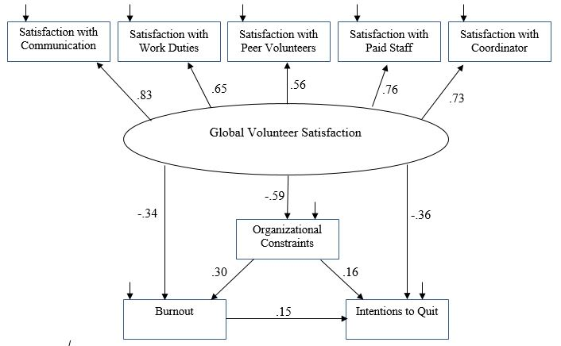
Problem
Burnout and job satisfaction have been shown to be related to each other as well as turnover (Lee & Ashforth, 1996). Burnout is primarily viewed as a 3-factor multidimensional construct consisting of emotional exhaustion, depersonalization, and reduced personal accomplishment, though some researchers advocate that emotional exhaustion is the most important dimension of burnout (e.g.,Wright & Cropanzano, 1998).
Hobfoll’s (1989) conservation of resources (COR) theory is used frequently to model the process of burnout. COR theory states there are four types of resources that individuals strive to gain, maintain, and protect: object resources (e.g., housing, clothing), condition resources (job security, seniority), personal characteristics (traits, skills), and resource generating energy (time, money). Burnout occurs when resources are not adequate to meet job demands. Job satisfaction, as a condition resource, should serve as a deterrent to burnout.
Hypothesis
We explore and propose a model that investigates the relationship between global volunteer satisfaction, burnout, and intentions to quit.
Results
We generated and tested a structural equation model with good fit ($χ^{2}$[15] = 1.94, p = .016 CFI = .979, PCFI = .52, RMSEA = .061) that indicated that global volunteer satisfaction predicted perceived organizational constrains, burnout, and intent to quit the volunteer position (see Table 1). Additionally, perceived organizational constraints served as a mediating variable between global satisfaction with the volunteer experience and both burnout and intentions to quit (see Figure 1).
Table 1
Model Regression Parameters
A Model Examining Volunteer Satisfaction, Burnout, Constraints, and Turnover Intention
Parameter Estimates | Unstandardized | SE | Standardized | p-value
Global Satisfaction --> Organizational Constraints | -.64 | .07 | -.59 | .00
Global Satisfaction --> Burnout | -.42 | .09 | -.36 | .00
Org. Constraints --> Burnout | .30 | .08 | .28 | .00
Global Satisfaction --> Satisfaction with Communication | 1.00 |  | .83 | n/a
Global Satisfaction --> Satisfaction with Paid Staff | .99 | .09 | .73 | .00
Global Satisfaction --> Satisfaction with Peer Volunteers | .72 | .08 | .59 | .00
Global Satisfaction --> Satisfaction with Volunteer Duties | .67 | .07 | .66 | .00
Global Satisfaction --> Satisfaction with Volunteer Coordinator | .16 | .11 | .72 | .00
Org. Constraints --> Intention to quit | .20 | .09 | .17 | .03
Resources --> Intention to quit | -.47 | .11 | -.36 | .00
Burnout --> Intention to quit | .17 | .08 | .15 | .03
Error Correlations
Satisfaction with Coord. & Satisfaction with Peer Volunteers | -.05 | .03 | -.14 | .06
Satisfaction with Coord. & Satisfaction with Paid Staff | .05 | .03 | .16 | .09
Method
Sample
Volunteers (24 males; 193 females) from two animal shelters in the Pacific Northwest were recruited for this study. They were recruited through participation in the Volunteer Program Assessment process.
The average age of volunteers was 43.33 years (SD = 15.82).
62.2% of volunteers indicated they had been volunteering at the shelter for 2 years or less.
Aaron Whitely, Andy Eichler, Kailey Perez, Anthony Czesak, Ashley McCarthy, Kamila Gabka, & Kimberly T. Schneider
Illinois State University
Discussion
Global volunteer satisfaction predicted burnout and intentions to quit. Organizational constraints mediated this relation and predicted burnout and intentions to quit. Using this information, volunteer organizations could benefit by focusing resources on specific components of job satisfaction or alleviating organizationally imposed constraints. These actions may, in turn, reduce burnout and intentions to quit. For example, organizations may provide adequate training and ensure enough quality equipment and supplies are available for volunteers.
The measured constructs that are predicted by the latent variable of global volunteer satisfaction are satisfaction with communication, work duties, peer volunteers, paid staff, and the coordinator. Working to improve satisfaction with these areas may also decrease an organization’s level of volunteer burnout and intentions to quit.
Future researchers should apply the current model to more diverse work samples beyond animal shelter volunteers.
The temporal relation between current volunteer satisfaction and longitudinal burnout is not yet established. We strongly recommend longitudinal analyses and an assessment of actual turnover behavior.
References
Hobfoll, S. E. (1989). Conservation of resources: a new approach at conceptualizing stress. American Psychologist, 44(3), 513–524.
Lee, R. T., & Ashforth, B. E. (1996). A meta-analytic examination of the correlates of the three dimensions of job burnout. Journal of applied Psychology, 81(2), 123.
Wright, T. A., & Cropanzano, R. (1998). Emotional exhaustion as a predictor of job performance and voluntary turnover. Journal of Applied Psychology, 83(3), 486.
Measures and Procedures
A link to an online questionnaire was delivered to volunteers by their volunteer coordinator and was open for completion for two weeks. Volunteers were reminded of the survey one week into data collection. Alphas for the scales below ranged from .80 to .95.
Satisfaction with Communication, Volunteer Work, Paid Staff, Volunteer Colleagues, and Volunteer Coordinator. Items were rated on a 5-point Likert scale (1 = Strongly Disagree, 5 = Strongly Agree). Each type of satisfaction was measured using a 4-item scale (e.g., “Communication with volunteers seems to be good within this organization,” “I like doing the things I do at my volunteer organization,” “Paid staff and volunteers get along well with one another,” “I enjoy working with the other volunteers,” “My volunteer coordinator is quite competent in doing his/her job”).
Organizational Constraints. Organizational constraints were measured using a 12-item scale asking participants how often they were affected by specific constraints (e.g., poor equipment or supplies, other employees, incorrect instructions). Items were measured using a 5-point frequency scale.
Burnout. Burnout was measured using a 5-item scale based on emotional exhaustion component of the Maslach Burnout Inventory. Items were rated using a 5-point frequency scale ranging from Never to Always. Example items include: “I feel emotionally drained from volunteering,” “I feel used up at the end of the volunteer session.”
Intentions to Quit. Intentions to quit were measured using a 3-item scale (e.g., I do not intend to keep volunteering with this organization). Items were rated using a 5-point Likert scale.
Note. Model based on N = 230. As all error terms were significant at a p < .05 level, they were omitted from table to conserve space. The default model indicates adequate fit, $χ^{2}$(15) = 1.94, CFI = .979, RMSEA = .061.
Figure 1. Model illustrating the relation between our global volunteer satisfaction latent variable, perceived organizational constraints, burnout, and volunteers’ intention to quit. N = 230. All presented parameters are significant at p < .05. The default model indicates adequate fit,${ χ}^{2}$(15) = 1.94, CFI = .979, RMSEA = .061.

