Slide 1
Social Meaning in Linguistic Structure: Code-Switching in Norway
Jan-Petter Blom and John J. Gumperz
1972
ENG 342 - Laura Edwards

Slide 2
Code Switching:
Use of more than one language within one communicative episode across sentence or clause boundaries
Code Mixing:
One word mixed into a full sentence of a different language

Slide 3
This is a study about:
meaning of linguistic choice
social constraints and linguistic rules
the potential for change in speech patterns in a community
stability of a valued local form of speech
values expressed through language variety (self-identity and pride)
rules of alternations that govern a linguistic repertoire of a community

Slide 4
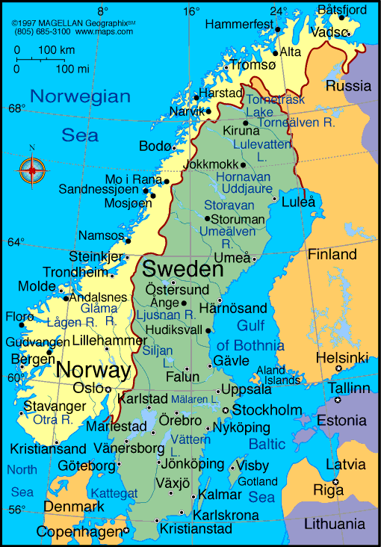
Hemnesberget

Slide 5
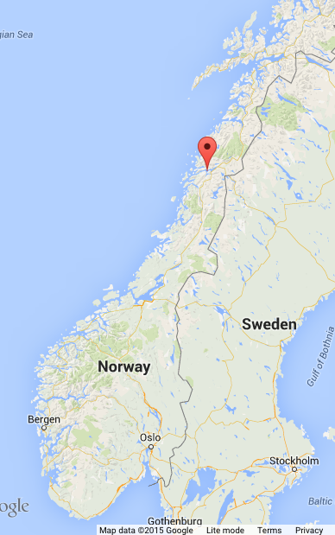
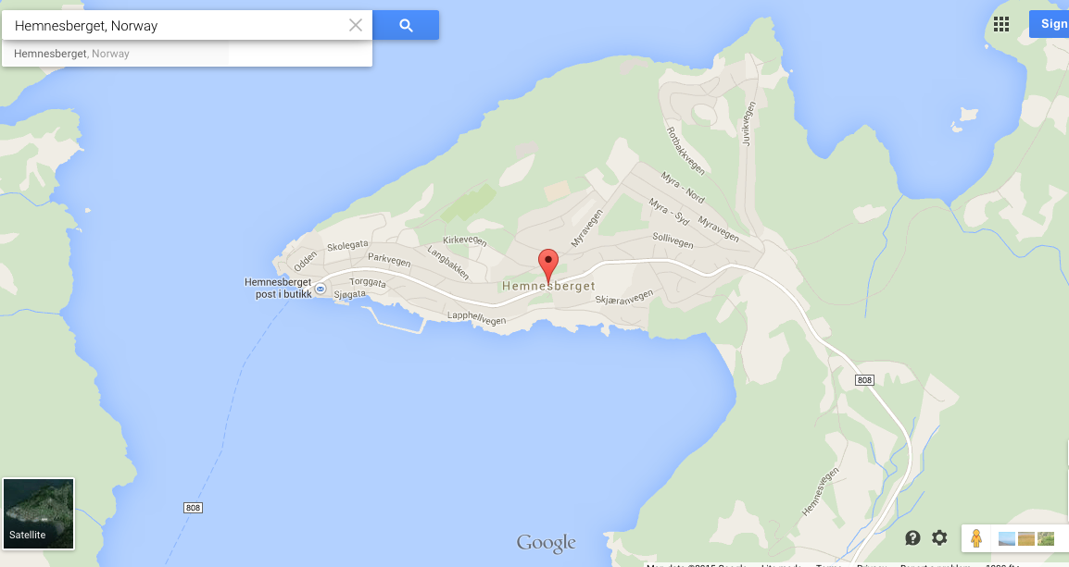
Hemnesberget – a small industrial town in Ranafjord with appx. 1300 inhabitants
From Middle Ages to 1858 – dependent on merchants and landholding families with connections to southern Norway. Communications and commercial center. There were great differences in wealth, culture and education between farmers, fisherman, laborers and servants who were the majority of the population.

Slide 6
Today in Hemnesberget…
Most of the former elite have moved away
Many are craftsmen (boat builders or lumber processors)
It’s an area of major source of wood products and fishing equipment.
No longer a major communication and commercial center
Mo i Rana has now taken that place because of steel and iron production as well as because of (newer) rail and highway systems do not go to Hemnesberget, but do go through Mo i Rana.
Most residents stay in Hemnesberget for work and vacation
They do not go to Mo i Rana to socialize
“Like Martha’s Vineyard, Hemnesberget remains an island of tradition surrounded by other areas of change.”

Slide 7
There are two official languages in Norway: Bokmål and Nynorsk
There are many dialects in Norway but they are geographically divided into four main groups, nordnorsk, trøndersk, vestnorsk and østnorsk. Sometimes innlandsmål and sørlandsk are also included.
Ranamål (the dialect of Hemnesberget) is one of the dialects of northern Norway (nordnorsk)
All citizens of Hemnesberget understand both Ranamål and Bokmål completely.
During various everyday interactions they select from the two varieties depending on the situation and see them as distinct from each other in that they are never mixed.

Slide 8
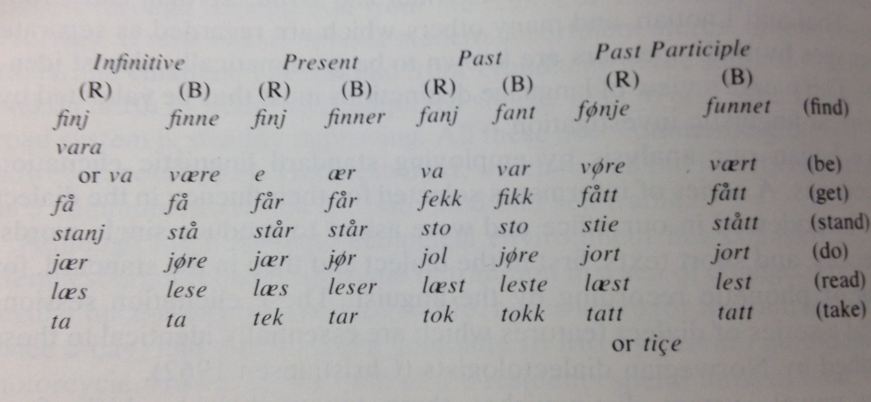
Ranamål (R) and Bokmål (B) side by side
Ranamål has:
Phonology similar to conditions like in Labov’s 1966 study on New York speech
Changes in morphology/syntax – esp. endings of verb conjugations, singular/plural words, past participles and order of pronouns and verbs:
(R) ke du e ifrå? (B) vor ær du fra? (hvor er du fra)
and vowel patterns such as (B) till (R) tell, (B) fikk (R) fekk, (B) hest (R) hæst (B) men (R) mænn

Slide 9
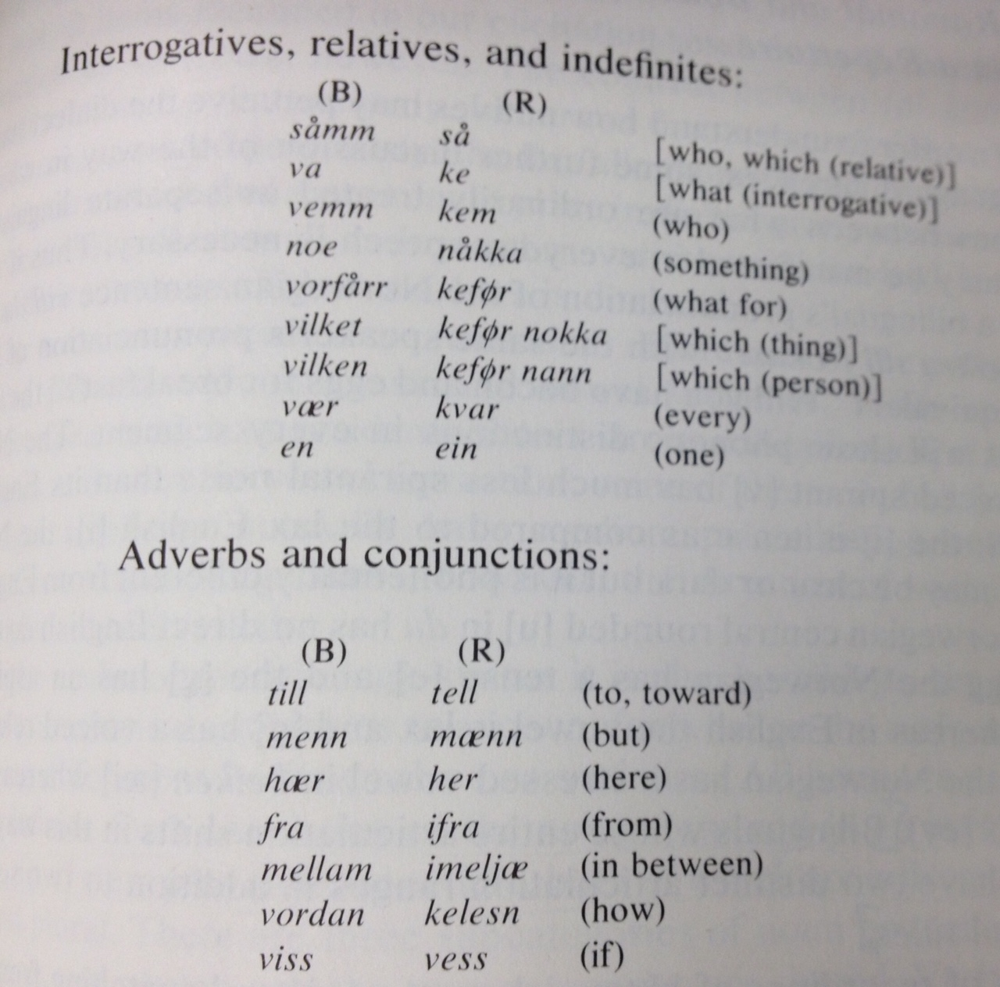
Dialect continued:
The lowering of vowels found in Ranamål is also in other dialects in Norway. Ranamål differs not because of completely different features but because of the way it combines features from elsewhere.
Dialect is learned in homes, used in friendships and family relations at home and in public places. It is influenced by local values.
Standard Norwegian is used in schools and at church and in business transactions where citizens are introduced to Norwegian values.

Slide 10
Values and local team sentiment
One’s dialect is an integral part of one’s background and a sign of one’s identity. It symbolizes at once pride in one’s community and distinctiveness of one’s community to society.
If you are a hæmnesværing (Hemnes resident), you are on the local team of people from the same descent. Dialect marks this.
There are often jokes and comments about others’ dialects.
Historically the land-owning elites spoke standard Norwegian, which was associated with inequality of status. If someone speaks in standard, this is an expression of social distance and contempt for the local team. This is considered to snakk fint “to put on airs” or “speak nice”.
There are 3 categories of people in the local social system: Categories 1 and 2 are made up of people who were born in Hemnesberget. They live, work and marry there. Category 3 has people of varied sociocultural background. They have family all over northern Norway. Others are doctors, dentists or priests who come from southern Norway who have elite values.
Most people from Hemnes do not go on to higher education. Those who do, leave Hemnes and probably end up getting a job elsewhere too.

Slide 11
Setting, social situation and social events
According to Blom and Gumperz, these three terms are part of how the speaker processes contextual information used to choose which variety to speak in.
Setting- the way natives classify their environment into distinct locales. There are many settings such as home, work, restaurants, the public dock, local schools, the church, the meeting hall.
Social situation – Activities carried on by particular people gathered in particular settings during a particular span of time. (teacher at school, workers at plant)
Social event - Events center around one or a limited range of topics and are distinguishable because of their sequential structure.

Slide 12
Situational and Metaphorical Switching (Terms Blom and Gumperz associate with different switching)
Situational switching assumes a direct relationship between language and social situation (standard vs. dialect in the wrong situation violates norms and may end the conversation or result in shame)
An example of situational switching: Schoolteachers lecture in in Bokmål and students are not allowed to interrupt. When finished and discussion is finally encouraged, the speakers will switch to Ranamål.
Metaphorical switching is based on the choice of use of either standard or dialect depending on situations during which individuals who are interacting have two or more different relationships with each other.
An example of metaphorical switching: Official community affairs are considered nonlocal. When locals step up to clerks’ desks, greetings are in dialect, but business is conducted in standard. This switch is about particular kinds of topics and not a change in social situation.

Slide 13
The Experiment
First, ethnographic observation, then, controlled text elicitation.
The hypothesis
Gatherings among friends and family implies local identities and must be carried out speaking in dialect. If this is true, variety will not change regardless of subject matter of the discussion (local, national, official matters).
Two gatherings of local acquaintances were planned. Local people extended the invitations.
Blom and Gumperz recorded the discussions.
Group 1: two sisters and a brother and their spouses. One of the men was a shopkeeper, the others were craftsmen. All three are literate and well read in public affairs, local politics and committee work.
Group 2: three craftsmen, friends and neighbors who worked in the same plant and their wives. One person had been a sailor on a Norwegian merchant vessel and spoke English.
Strategy
To introduce topics likely to motivate discussion among the group.

Slide 14
Discussion
Based on the idea of local/non-local, home team vs. elite, what variety do you think people spoke at these first gatherings?
Do you think there was a switch when Blom and Gumperz interjected comments or new questions?

Slide 15
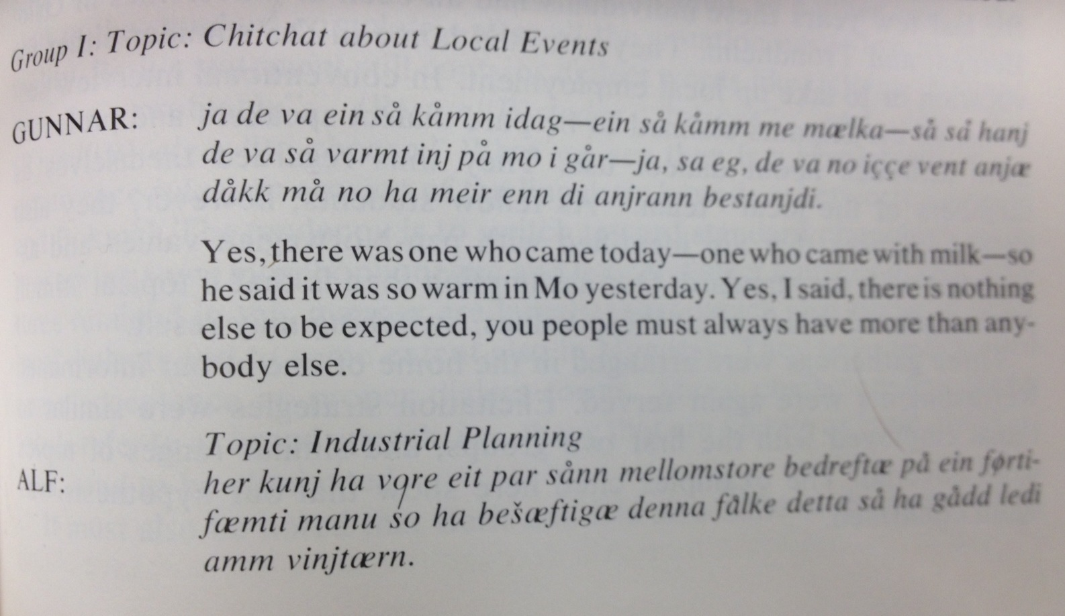
Item 1 is a local topic discussed in a humorous way

Slide 16
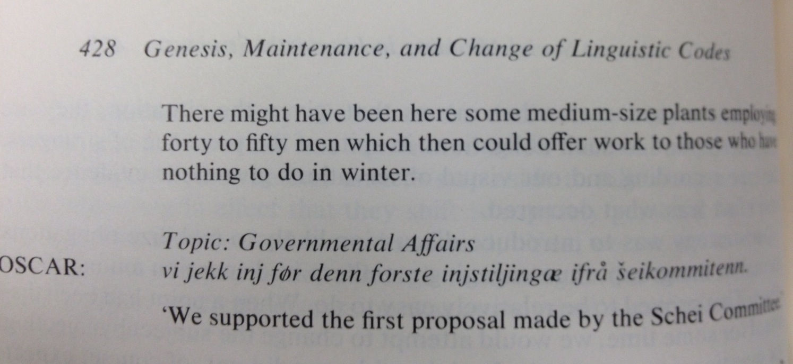
Items 2 and 3 were about planning and government affairs
Everything is clearly in dialect. A few lexical borrowings (instiljing-proposal, bedreftæ-plants) from standard Norwegian were still phonologically and morphologically in dialect. This pattern remained throughout all of the recorded conversations.

Slide 17
Second Hypothesis/Second Gathering
Second hypothesis
Switching is constrained when people of local relationships speak together. However, when people of local and nonlocal relationships speak together, a change in topic may elicit code switching.
Second gatherings
Three gatherings of participants, again with refreshments, were arranged in the home of one of Blom and Gumperz’s informants. Participants were a formerly quite active peer group of people who had for several years been at universities in Trondheim, Oslo and Bergen. They would return home over the summer for vacation or for summer jobs. They also professed to be local dialect speakers and hold local identities and views. As students, they also identified with pan-Norwegian values associated with use of standard Norwegian.

Slide 18
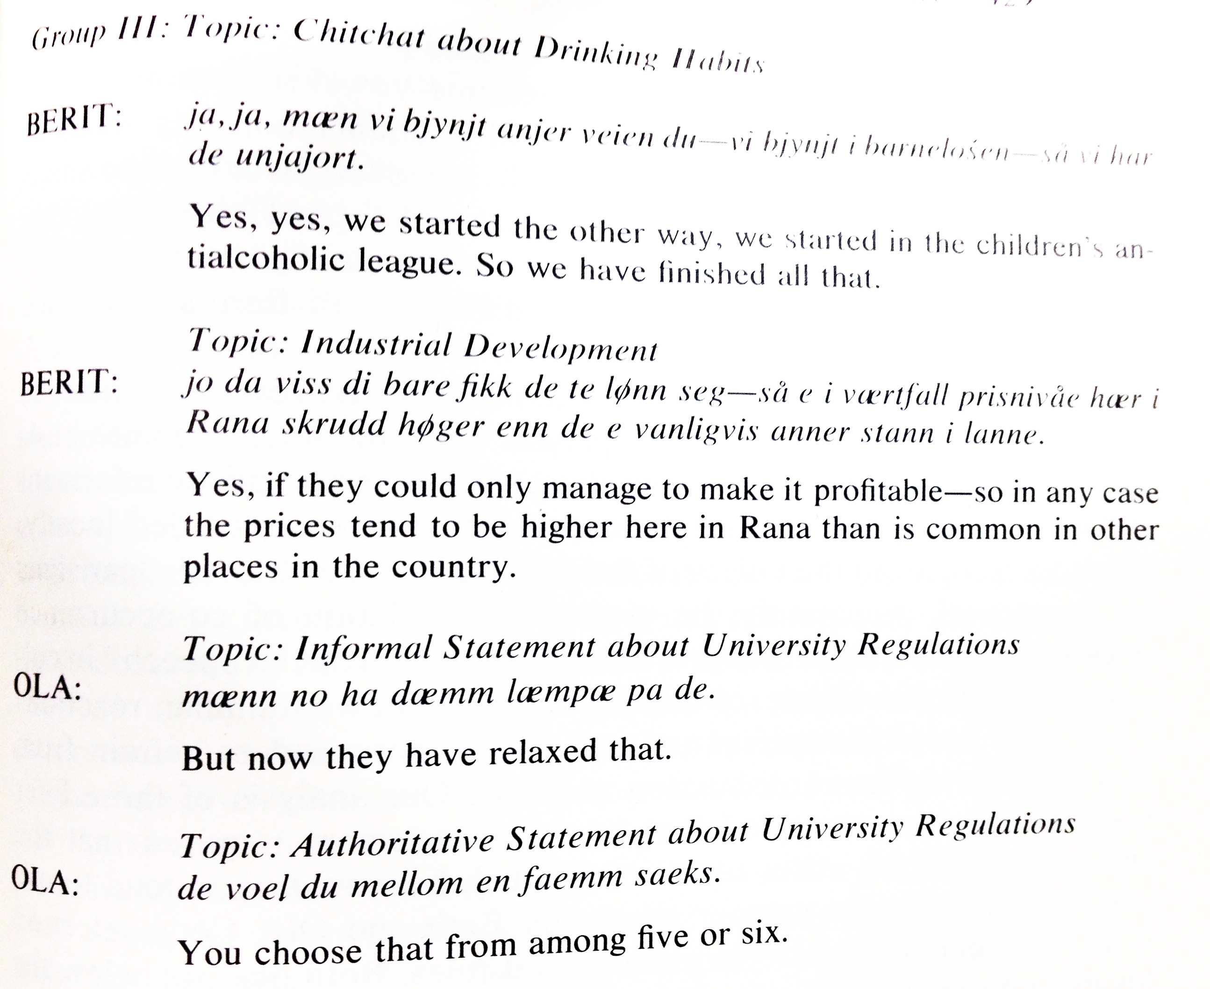

Slide 19
Blom and Gumperz’ hypothesis was confirmed: when topics were introduced that elicited standard values, switching resulted.
Berit switched from Ranamål anjer in statement 1 to anner (B) in statement 2. She uses fikk (B) vs. fekk (R) viss (B) vs. vess (R) i værtfall vs i kværtfall (R) in statement 2
Ola’s second statement shows his use of (B) mellom vs imelja (R) and (B) en vs ein (R)
However, neither shift shows a complete shift to standard. Berit’s statement still contains dialect words like (R) lønn vs. lønne (B) (part of an expression “to be profitable”)
(R) stan vs steder (B) (places) and Ola uses (R) væl vs. velger (B) (to choose).
This shows a breaking down of co-occurrence (semantic proximity) rules - of linguistic boundaries between Bokmål and Ranamål.

Slide 20
Shame and embarrassment from the results
One of Blom and Gumperz’ informants listened to the recorded conversations and reacted negatively, showing disapproval to hearing speakers violate the co-occurrence rule. This is called knot (artificial speech) in colloquial Norwegian. When other participants listened to the recording, they reacted similarly and promised not to switch in future sessions, but admitted that when an argument required that the speaker use his status as an intellectual, he would still tend to use standard forms.

Slide 21
Conclusions Code selection rules seem to be similar to grammar rules because they operate below the level of consciousness and may not be able to be influenced by the speaker’s intentions.
All groups speak both dialect and standard. Switching does occur situationally. When speaking formally, this is only shown through a shift in lexicon, not through pronunciation or morphology. The groups shift to (B) phonology and grammar when speaking with Blom and Gumperz.
The locals see Bokmål and Ranamål as two distinct varieties and insist on keeping them separate depending on local and nonlocal values.
The students have a more difficult time keeping the distinction between dialect and standard Norwegian. While they do have the same attitude about dialect, their behavior shows variation, rather than alternation. It may reflect the fact that they have some nonlocal identity, too.
Ranamål has social value signaling distinctness and identity with the local people. Bokmål is associated with education and power and also shows differences in status and rank unacceptable in local relations.
In order to interpret speech, the investigator must have background knowledge of local culture and those areas which generate social meaning in order to look into the social implications of dialect differences.

Slide 22
Discussion
Do you or anyone you know code-switch?
Which languages are used?
Does code-switching have social meaning to you or to those who you know who do it?

