Slide 1
Adjustments to Income (AGI)

Slide 2
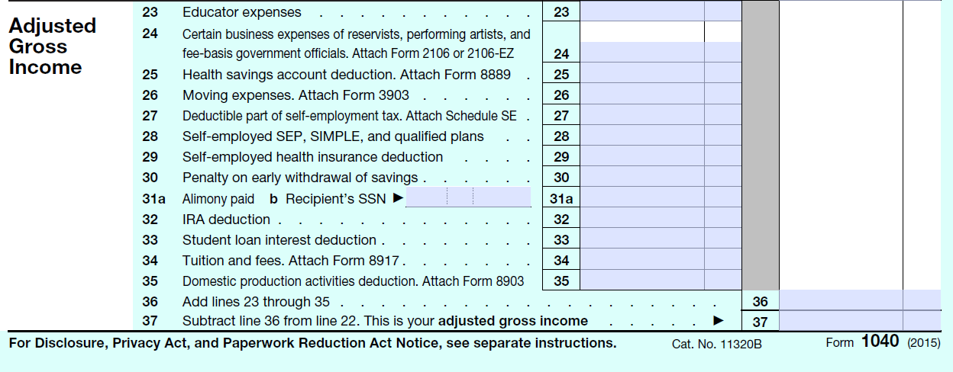
Form 1040
Notes:
We have already covered the penalty on early withdrawal of savings (Line 30) when we discussed interest income. The only other adjustment we will cover for the Basic certification is the student loan interest deduction on Line 33. Remember that the previous section of the tax return ends with total income on Line 22. The adjustments in this section of the tax return are totaled up on Line 36 and then subtracted from gross income to arrive at the amount on Line 37, Adjusted Gross Income or AGI. The AGI is then transferred to Line 38 on the back of the Form 1040.

Slide 3
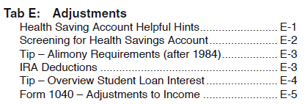
Tab E
Notes:
Tab E covers adjustments to income. We will look at Student Loan Interest.

Slide 4
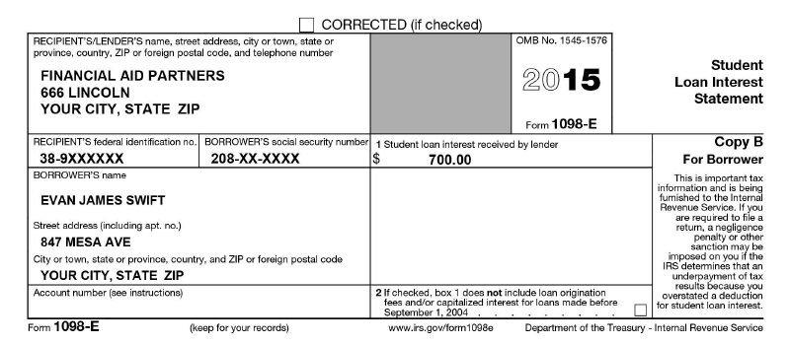
1098-E
Notes:
If a person paid interest on a student loan, they should receive a form 1098-E. Box 1 will show the amount of student loan interest.

Slide 5
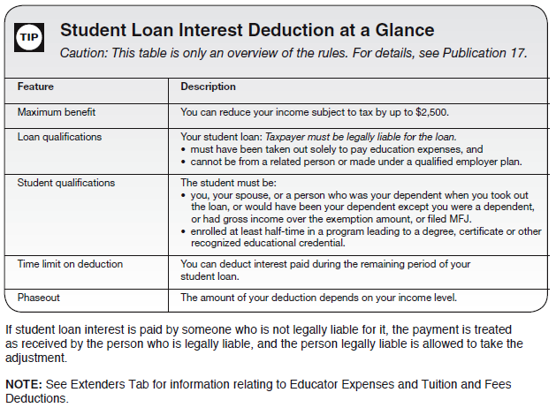
E-4
Notes:
Page E-4 in Pub 4012 provides an overview of the rules related to the student loan interest deduction. Notice that it refers you to Publication 17 for details. Pub 17 is the Tax Guide for Individuals. The information in Pub 4012 is simply a summary of key pieces of information from Pub 17, presented in easier-to-read tables and charts. If you ever need additional information that is not in Pub 4012, you should look in Pub 17.

Slide 6
E-4
Notes:
Generally, the amount of student loan interest that can be deducted is the smaller of $2,500 or the amount of interest paid (remember these amounts are for 2015, they may change slightly for 2016).
Two key things to remember are 1) there is a maximum of interest that can be deducted, up to $2,500, regardless of how much interest was paid and 2) The taxpayer may not be able to deduct 100% of the interest paid even if it is less than the maximum of $2,500 if their income level is too high. The tax software will calculate the amount that is phased out if the income level is too high.
The amount of the student loan interest deduction goes on Line 33 of the tax return.
If you’re an accounting nerd (like me) and you’re curious about the phase-out, you can look it up in Pub 17, which I did. If you’re not interested in looking into the details right now, you can stop the video. Otherwise, keep watching.

Slide 7
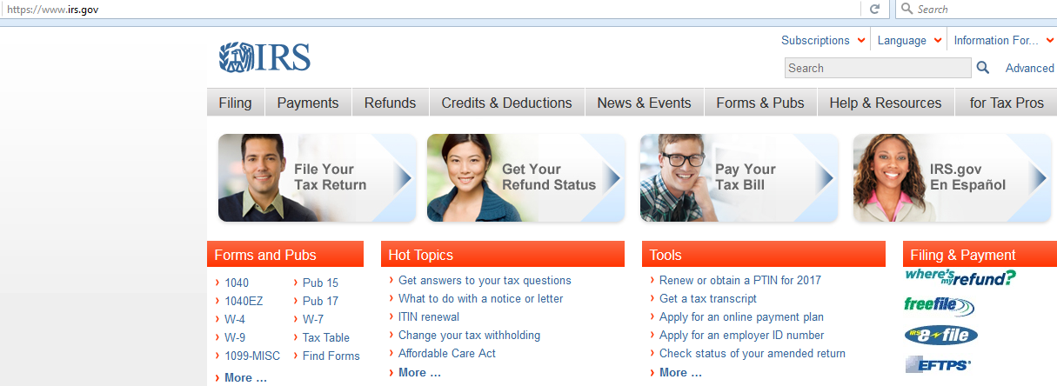
Finding Forms and Pubs at www.irs.gov
Notes:
If you need to get a form or publication, such as Pub 17, you can go to the IRS website. If you go to www.irs.gov, you will see this screen.

Slide 8
Finding Forms and Pubs at www.irs.gov
Notes:
Click on Forms and Pubs

Slide 9
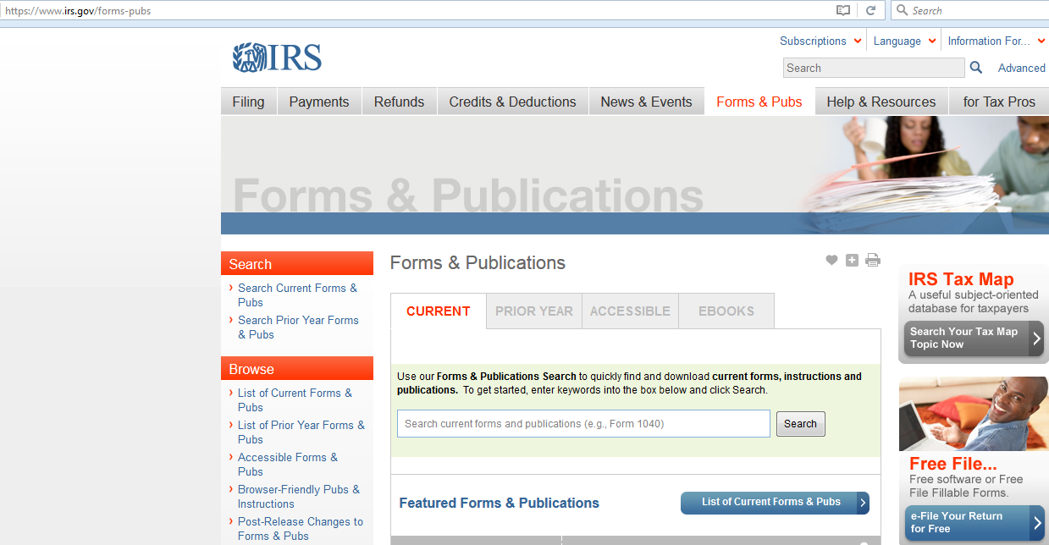
Notes:
That will take you to this screen,

Slide 10
Notes:
, where you can click on List of Current Forms & Pubs

Slide 11
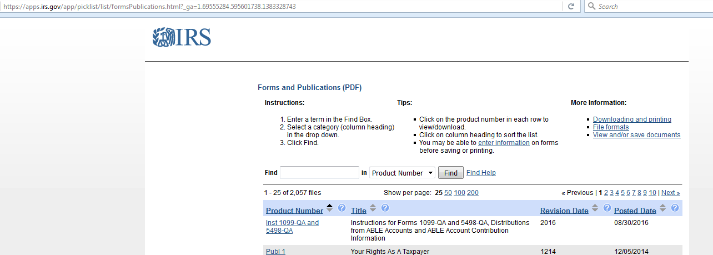
Notes:
Which will take you to this screen. You can then enter the number of the form or pub in the Find box.

Slide 12
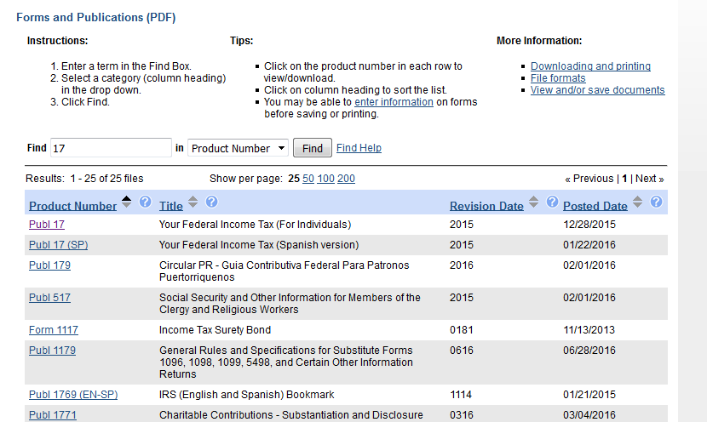
Notes:
If you type “17” in the Find box, this is what you will see. If you click on Publ 17, you will be able to download the pdf of Publication 17.

Slide 13
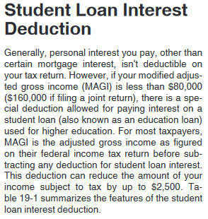
Pub 17, page 136
Notes:
If the taxpayer’s modified adjusted gross income is more than $80,000 ($160,000 if filing a joint return), they will not be able to deduct any of the student loan interest.

Slide 14
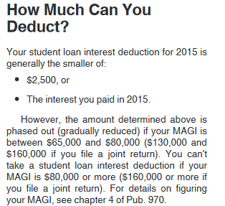
Pub 17, page 137
Notes:
If income is between $65,000 and $80,000 ($130,000 and $160,000 if filing a joint return), the amount that can be deducted will be gradually reduced. Pub 17 refers you to the Student Loan Interest Deduction Worksheet in the Form 1040 instructions.

Slide 15
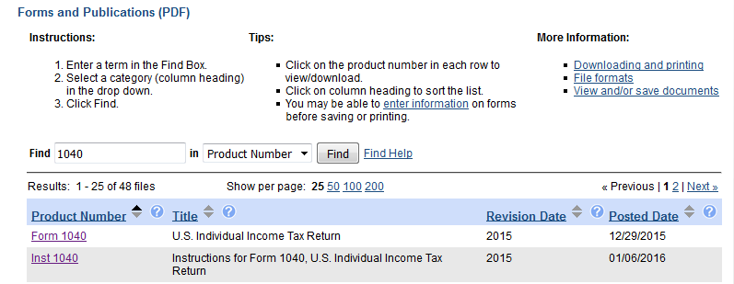
Notes:
To find the instructions for Form 1040, go the irs page for current forms and pubs and enter 1040 in the Find box. The second item on the list is Inst 1040.

Slide 16
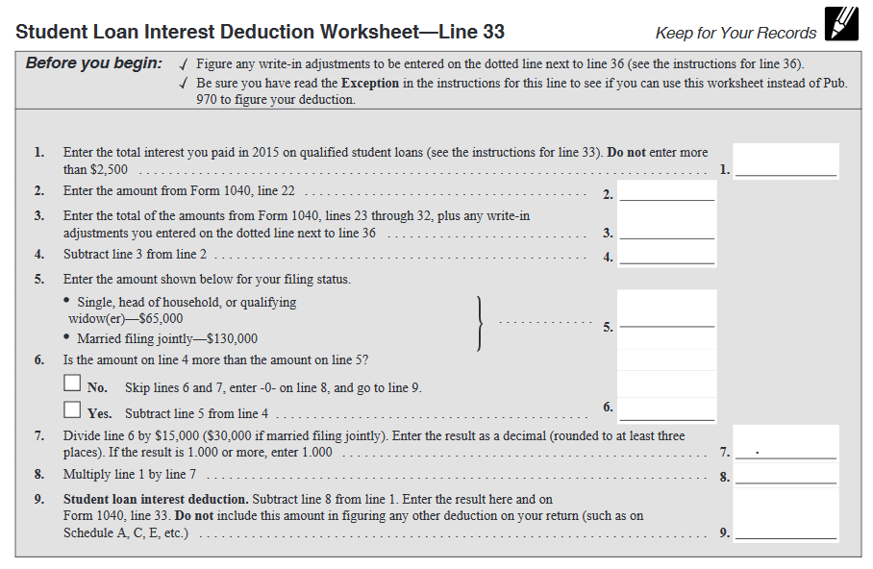
Student Loan Interest Deduction Worksheet
Notes:
The Student Loan Interest Deduction Worksheet can be found on page 37 of the Form 1040 instructions for 2015 tax returns.

Slide 17
Student Loan Interest Deduction Worksheet
Notes:
The amount of student loan interest is entered in Step 1 (but no more than $2,500).
Modified adjusted gross income is Gross income minus all adjustments (except for the student loan interest deduction). This is what is calculated in Steps 2 through 4. If MAGI (modified adjusted gross income) is above $65,000 ($130,000 if filing jointly), then the difference between MAGI and the $65,000 is entered on Line 6 and then divided by $15,000 ($80,000 total phase-out minus $65,000 beginning of phase-out). This decimal or percentage is used to calculate the % of the student loan interest that can be deducted.
Now you know exactly how to calculate the student loan interest deduction (even though the tax software will do most of the work for you) and you know how to find forms and publications on the IRS’ website.

