Slide 1
Retirement savings contribution credit
Notes:
This video covers the Retirement Savings Contribution Credit, a nonrefundable tax credit.

Slide 2
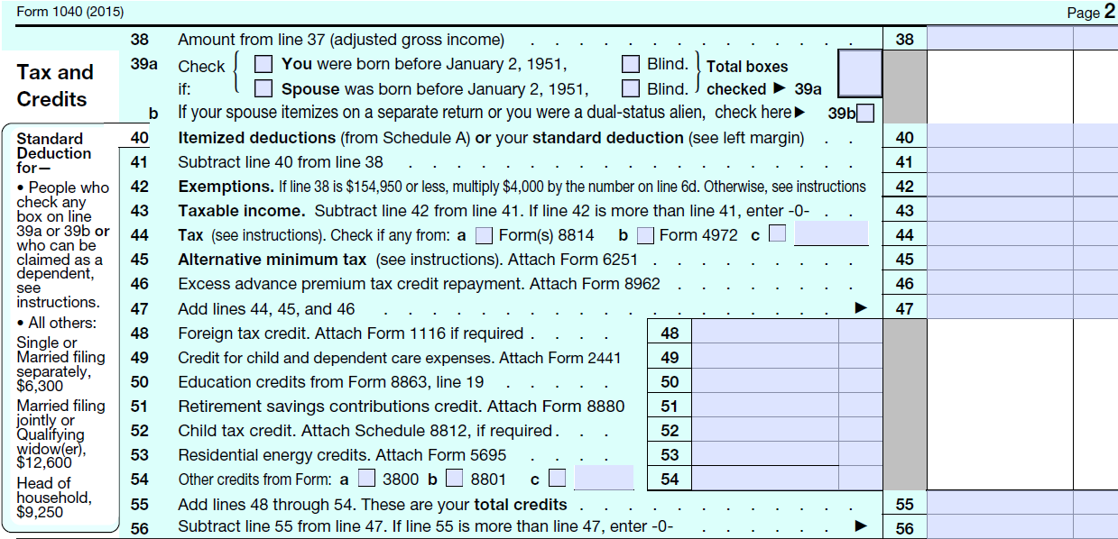
Form 1040
Notes:
This credit appears on Line 51 in the Tax and Credits section of the Form 1040. Note that Form 8880 must be attached.

Slide 3
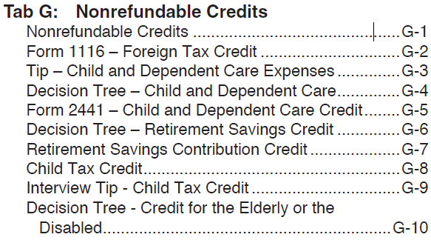
Tab G
Notes:
Tab G, page 6 covers this credit

Slide 4
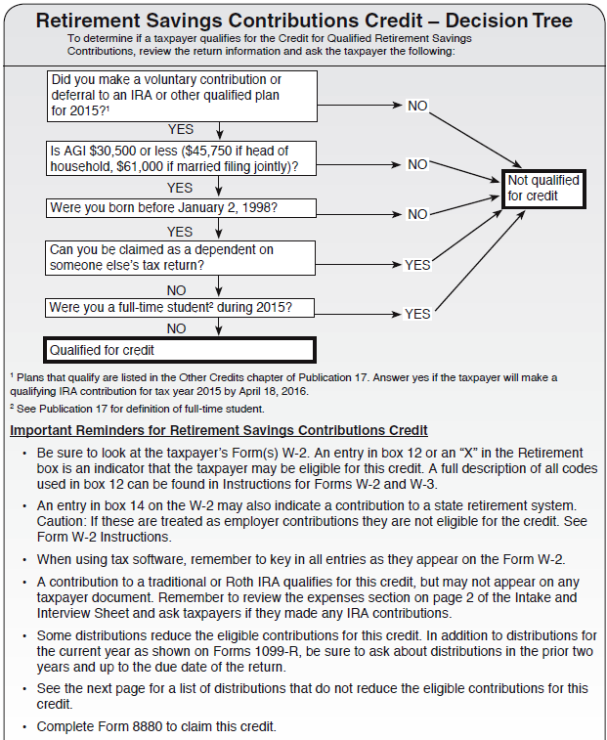
G-6
Notes:
Page G-6 provides a flowchart and important reminders about the credit

Slide 5
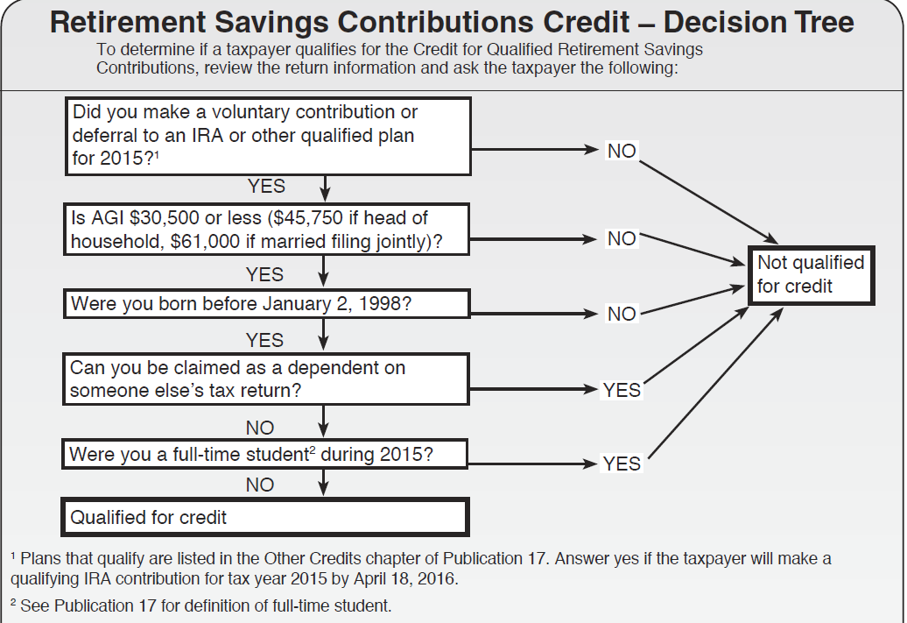
G-6
Notes:
The first question asks if the taxpayer made a contribution to a retirement savings account. Of course, if they didn’t, there is no credit to take. They may have made it directly to an IRA or it may have been deducted from their paycheck. For example, if Code D was entered in Box 12 of their W-2, it indicates that they made an elective deferral to a section 401(k) cash or deferred arrangement. If you correctly entered all the information from the W-2 including the code and the amount, the tax software will know that it was a contribution to a retirement plan.
The footnote lets you know that you can find additional information in Publication 17. Also note that a contribution to an IRA can be made up until the due date of the tax return (April 18, 2016) and still count for the previous tax year (2015).

Slide 6
G-6
Notes:
The next question asks for the taxpayer’s AGI (from Line 37 or 38 of the Form 1040). The AGI must be below the limit given for the taxpayer’s filing status in order for them to be able to take the credit.

Slide 7
G-6
Notes:
The next question determines if the taxpayer meets the minimum age requirement. They must be born before Jan 2, 1998 for the 2015 tax year.

Slide 8
G-6
Notes:
If they can be claimed as a dependent by someone else, they cannot qualify for the credit.

Slide 9
G-6
Notes:
If they were a full-time student they cannot take the credit. Footnote 2 refers you to Publication 17 for the definition of full-time student.

Slide 10
G-6
Notes:
If they meet all the requirements, then they qualify for the credit.

Slide 11
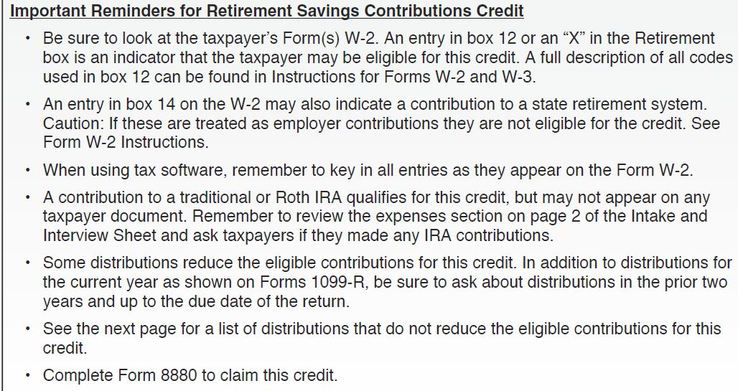
G-6
Notes:
A number of reminders are provided at the bottom of page G-6. I have already mentioned some of them. In addition to box 12 on the W-2, you need to also look to see if there is an X in the Retirement box and at box 14. Notice the highlighted item. If the taxpayer contributed to an IRA, there may not be any paperwork. However, you can look at the Intake Interview sheet to see if they marked that they made a contribution.
Form 8880 must be completed to take the credit.

Slide 12
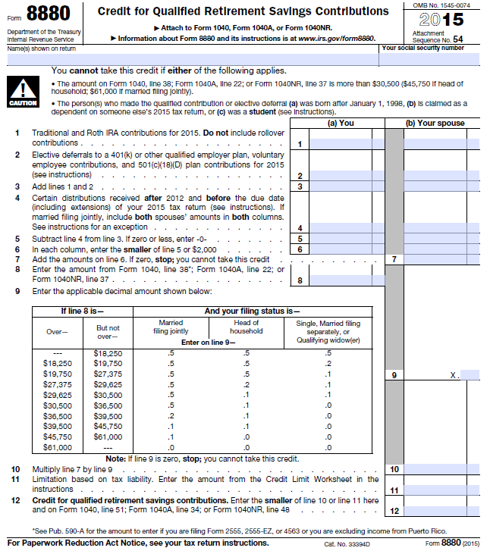
Form 8880: Credit for Qualified Retirement Savings Contributions
Notes:
Here is Form 8880.

Slide 13
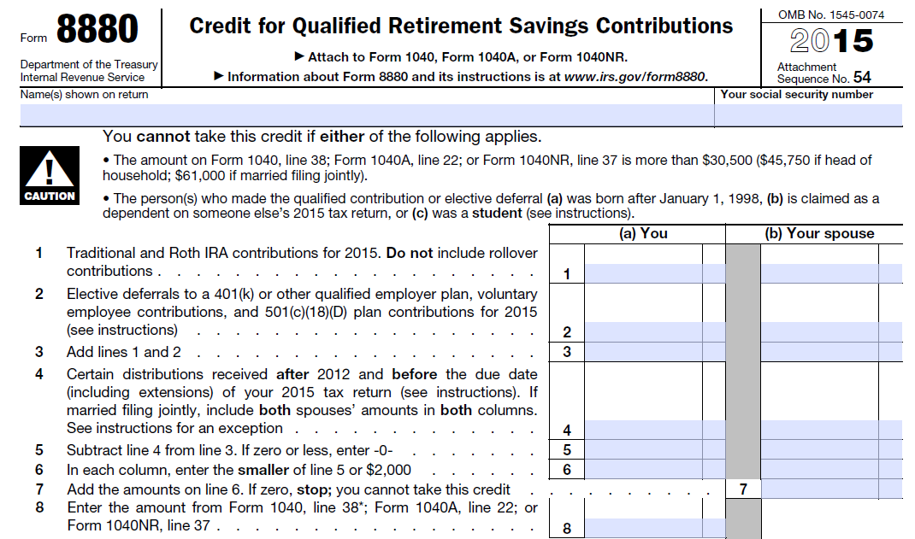
Form 8880
Notes:
The Caution at the top of the form takes you through the same requirements as the flowchart on page G-6 to identify if someone CANNOT take the credit.

Slide 14
Form 8880
Notes:
The amount of contributions by the taxpayer and/or spouse (if filing jointly) to IRAs and other qualified plans are entered in the appropriate columns on Lines 1 and 2 and the amounts are totaled on Line 3.

Slide 15
Form 8880
Notes:
If the taxpayer (or spouse) received certain distributions from their retirement account(s), this is entered on Line 4 and then subtracted from contributions with the difference entered on Line 5.

Slide 16
Form 8880
Notes:
Line 6 compares the contribution on Line 5 (for each spouse) to a limit of $2,000. The smaller of the two amounts is entered on Line 6. Line 7 combines the amounts for the taxpayer and the spouse.

Slide 17
Form 8880
Notes:
Line 8 asks for the AGI from Form 1040, line 38.

Slide 18
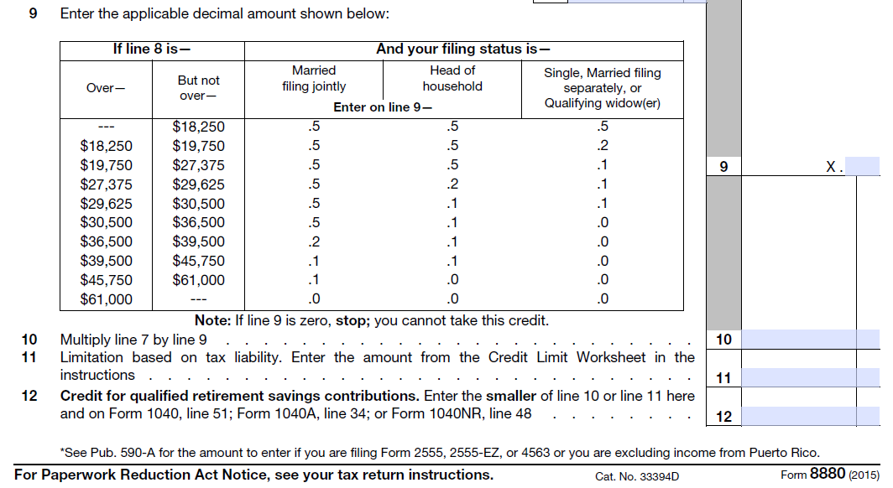
Form 8880
Notes:
Line 9 provides a table to look up the decimal amount or percentage to apply to the contribution. This is similar to what we saw on Form 2441 for the Child and Dependent Care credit. Make sure you look in the correct column depending on the taxpayer’s filing status. The percentage will be 50%, 20%, 10% or zero. Notice that the zeros are when the AGI is over the limits given at the top of the form and on page G-6.

Slide 19
Form 8880
Notes:
Line 7 was the amount contributed by the taxpayer and/or spouse or the limit of $2,000 per person. This amount is multiplied by the decimal identified on Line 9. The resulting answer is entered on Line 10.

Slide 20
Form 8880
Notes:
Again, like we saw for the Child and Dependent Care credit, since this is a nonrefundable credit, Line 11 asks for the limitation based on the tax liability. The tax liability can be reduced to zero by this credit but not below.

Slide 21
Form 8880
Notes:
Either the amount from Line 10 or from Line 11, whichever is smaller, will be entered on Line 12 of this form and on Line 51 of the Form 1040.

Slide 22
Form 1040
Notes:
The amount of the credit is entered on line 51 and will be combined with the other credits on Lines 48 through 54.

