Slide 1
Social Learning and Imitation
Vicarious Reinforcement Effects

Slide 2
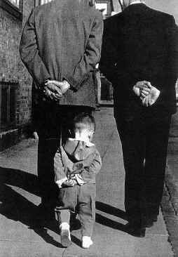
Albert Bandura
Observational or
Social Learning

Slide 3
Divided imitative behavior into 3 categories
Same behavior:
Copying behavior:
Matched-dependent behavior

Slide 4
Divided imitative behavior into 3 categories
Same behavior:
Occurs when 2 or more individuals respond to same situation in same way
All individuals involved learned independently to respond in particular way to particular stimulus
Behavior triggered simultaneously when that S+ or related S+ occurs in environment

Slide 5
Divided imitative behavior into 3 categories
Copying behavior:
Guiding of one individuals behavior by another individual
Provide guidance and corrective feedback
Copying behavior the final copied behavior is reinforced and thus strengthened

Slide 6
Divided imitative behavior into 3 categories
Matched-dependent behavior
Observer is reinforced for blindly repeating actions of model
Behavior of both individual maintained by reinforcement, but each individual’s response is associated with different cues
Original cue
Eliciting cue for copied behavior
Often occurs in group settings when not know what to do, so follow

Slide 7
Skinner’s view: It’s nothing special!
Agrees: Several steps to imitative learning
Model’s behavior is observed
Observer matches the response of model
Matching response is reinforced
States: Must be maintained by some kind of reinforcer
Model’s behavior acts as discriminative stimulus:
imitation = discriminative operant

Slide 8
Types of animal mimicry
Animals show strong imitation and social learning
Several kinds of low-level and innate forms of imitation
Mimicry: copying physical appearance of one species by another
Batesian or Mertensian mimicry: Relatively defenseless animal takes on the appearance of an animal that has better defenses
Palatable viceroy butterfly mimicking the unpalatable monarch butterfly
Note this is a genetic/morphologic adaptation, not a behavior change.

Slide 9
Types of animal mimicry
Contagion. Two or more animals engage in similar behavior and that behavior is species typical
Used to describe certain courtship displays when they involve coordinated movements between the male and female that are can sometimes appear to be virtual mirror images (Tinbergen, 1960).
Behavior of one animal appears to serve as a releaser for the unlearned behavior of others (Thorpe, 1963).
Are several kinds of contagion:
Antipredatory
Aggressive
Appetitive

Slide 10
Types of animal mimicry
Antipredatory behavior
involves coordinated movement of group of animals for defensive purposes
herding or flocking
Aggressive contagion
Coordinated movement of animals for aggressive purpose
Mobbing in ducks/fowl
Appetitive contagion
One animal eating elicits eating behavior from another animal
Satiated animal in presence of food will often resume eating upon the introduction of a hungry animal which begins eating (Tolman, 1964).

Slide 11
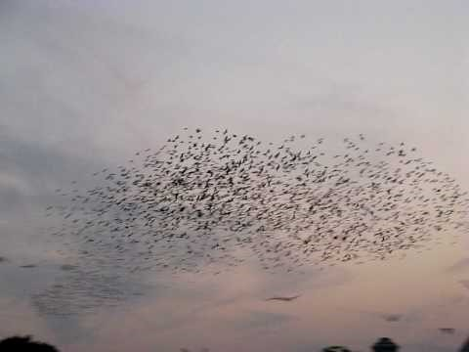

Slide 12
Motivational factors in animals:
Social facilitation: animals “Get things” via imitiation
Mere presence effect (Zajonc)
“mere presence” of a conspecific is motivator
The presence of a conspecific leads to increase in arousal which can lead to the retardation of acquisition of a novel (to-be-learned) response.
But leads to stronger existing response
Mere presence of a conspecific facilitates the acquisition of a new response (Gardner & Engel, 1971) or
Conspecific may have the ability to reduce fear in the observer (Davitz & Mason, 1955; Morrison & Hill, 1967).

Slide 13
Why imitate?
Incentive motivation
Observation of aversive conditioning.
Watch conspecific learning about a novel response that results in avoidance of painful stimulation (e.g., electric shock)
Motivation to Imitate that novel response to avoid the painful stimulation (e.g., electric shock)
Emotional cues provided by conspecific either escaping from or avoiding shock provides emotional cues of pain or fear that could instill fear response in observer.

Slide 14
Perceptual Factors
Stimulus Enhancement:
Activity of the demonstrator draws attention of observer to a particular object
Partial explanation for facilitated acquisition of an observed discrimination.
If demonstrator required to make contact with the positive stimulus:
The positive stimulus is likely to attract observers attention
Responding to it may be facilitated

Slide 15
Perceptual Factors
Local Enhancement.
Facilitation of learning is due to the drawing attention to locale/place associated with reinforcement
Lorenz (1935): Ducks enclosed in pen may not react to a hole large enough for them to escape unless they happen to be near another duck as it is escaping from the pen.
The sight of a duck passing through the hole in the pen may simply draw attention to the hole.

Slide 16
Perceptual Factors
Local enhancement: Great tits and milk bottles
Drinking from opened bottles readily generalized to an attempt to drink from a sealed bottle, which in turn led to trial-and-error puncturing of the top.
The technique of pecking through the top of the bottle learned through observation
But also likely that attention was drawn to the bottles by the presence of the feeding birds.
Once at the bottles, the observers found reward and consumed it.
Learning to identify milk bottles as a source of food readily generalize to other open bottles.

Slide 17
Observational Conditioning
Observation of a performing demonstrator draws attention to the object being manipulated (e.g., the lever)
BUT because observer's orientation to the object often followed immediately by food presentation to demonstrator:
A Pavlovian association is established.
Orient to Object → food
Observer learns relation between some part of the environment and the reinforcer (e.g., that the top of a box can be removed to reveal what is inside).

Slide 18
Observational conditioning
Socially-transmitted food preferences (e.g., Galef, 1988a; Strupp & Levitsky, 1984)
Eat what others in your species eat
Canine Study: Lupfer Johnson & Ross, 2007
Model dog ate a particular flavor of food
Played with subject dog for 10 minutes
Subject dog given choice between food the model ate and a novel food
Subject dogs ate the model dog’s food on over 80% of occasions.
Interestingly, poisons not as strongly social transmitted

Slide 19
Imprinting & Discriminated Following
Imprinting.
Occurs primarily in species w/o nest/den in which to protect young (e.g., fowl and grazing mammals),
Young hatched (or born) in precocious state: allows them to move about following very brief period of inactivity.
To compensate for their mobility (and increased predation risk): predisposition to follow first moving object they see.
Generally mother
But: laboratory experiments show almost any moving object can function as the object of imprinting
Combines strongly predisposed behavior (following) with
Considerable flexibility (learning) in the nature of the object that is followed.

Slide 20
True imitation
True imitation = the copying of a novel or otherwise improbable act or utterance, or some act for which there is clearly no instinctive tendency (Thorpe, 1963, p. 135).
Must control for
Motivational effects on the observer
produced either by the mere presence of the demonstrator or
by the mere consequences of the behavior of the demonstrator.
Observer’s attention to that object
Possibility that the demonstrator's manipulation of an object merely draws the observer's attention to that object (or one like it),
Thus making the observer's manipulation of the object more probable.
The simple pairing of a novel stimulus with a consequence
e.g., a lit response key or the movement of a bar with the presentation of inaccessible food).

Slide 21
True imitation
The target behavior cannot be already be part of the observing animal's repertoire (Clayton, 1978).
Important test: Deferred imitation.
Bandura : is an important difference between immediate imitation and deferred imitation (observational learning)
Immediate imitation = reflexive response that is genetically predisposed
Deferred imitation = more cognitive process.

Slide 22
Enculturation: Important factor in animal Imitation
Enculturation.
Degree to which the animals have had extensive interactions with humans
Important for imitative learning by primates, dogs
Enculturated chimpanzees and orangutans, domesticated dogs readily show signs of imitative learning
Why?
Reduces anxiety during human interactions?
Increases attentiveness to social cues.
Allows them to experience a form of learning to learn).
For dogs, gets them acceptance into human societies, food, warmth, shelter, protection, etc.

Slide 23
Types of observational learning
Gestural Imitation: gestures of a model are copied.
Found in chimpanzees, dolphins, dogs and a parrot (Moore, 1992).
Models were human rather than a conspecific.
Little similarity between corresponding body parts of the observer and the demonstrator.
Because objects were not involved, local and stimulus enhancement should be irrelevant.
Each imitated gesture serves as a control for the others because it is the topography of the response that is important.
A broad range of gestures have been shown to be imitated within a few seconds of demonstration

Slide 24
Types of observational learning
Generalized imitation: Imitation of broad class of imitative behavior.
Hayes and Hayes (1952) : Chimpanzee (Viki) learned to respond correctly to the command "Do this!" over a broad class of behavior.
The establishment of a “do as I do” concept verifies that chimpanzees can imitate,
Also in dogs
Demonstrates that are capable of forming a generalized behavioral-matching concept
Have acquired an imitation concept.

Slide 25
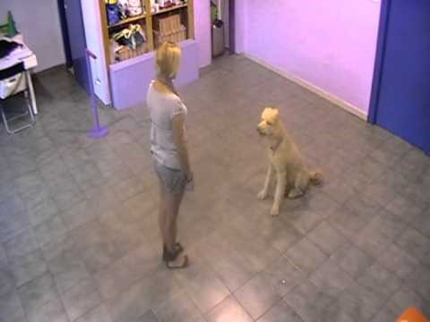
Claudia Fuggazza: Do as I do!

Slide 26
Types of observational learning
Symbolic imitation.
Highest level of imitative behavior,
Behavior of the observer both
Does not match that of the demonstrator
Has differences which are explicit and produced for purpose of drawing attention to certain characteristics of the model.
Human use of parody and caricature.
Some evidence in chimps, great apes, dogs again

Slide 27
Bandura’s explanation
Makes big distinction between basic imitation and observational learning
Importance of information obtained by animal
Why repeat behavior? Observing behavior allowed you to acquire information about outcome
Not just mimicking, but learning about outcomes

Slide 28
Four Mechanisms of Modeling
Attentional Processes
the person doing the modeling must pay attention
distinctiveness/characteristics of observer and model important
Retentional Processes
must be able to remember what happened!
Cognitive abilities play a role here
Motoric Processes
must be able to physically reproduce behavior
physical status important here
Reward Processes
reinforcement and punishment for continuing the behavior
intrinsic (internal) vs extrinsic (external) reward play a role

Slide 29
Attentional processes
Subject must attend to model
Several influencing factors:
Distinctiveness of model: age, sex, status
Affective valence
Complexity
Prevalence
Functional value to subject
Characteristics of the observer important:
Sensory capabilities
Arousal level
Perceptual set
Past reinforcement history

Slide 30
Retentional processes
Must be able to remember what was observed
Two types of remembering
Imaginal
Verbal
Several influencing factors
Symbolic coding
Cognitive organization
Symbolic rehearsal

Slide 31
Motoric or Behavioral Production processes
Must be able to physically reproduce the behavior
Several influencing factors
Physical capabilities
Availability of component responses (do you know how to put the behaviors together)
Self-observation and feedback
Accuracy of the feedback

Slide 32
Reward or motivational processes
Two functions of reinforcement: Informational and Rewarding!
Creates expectation in observers that if do modeled behavior, they will get reinforced
Acts as incentive for translating learning into performance
Must have some motivation for repeating the behavior
Must be rewarded yourself after you do the behavior
Doesn’t explain the motivation for the first try, but explains what maintains it
Several factors
External reinforcement
Vicarious reinforcement
Self-reinforcement

Slide 33
Bobo doll study
Subjects:
36 boys and 36 girls enrolled in the Stanford University Nursery' School;
ranged in age from 37 to 69 months;
mean age of 52 months.
Models: Male and a female adult served in the role of model.

Slide 34
Bobo doll study
Experimental Design
Subjects were divided into 8 experimental groups of 6 subjects each plus control group consisting of 24 subjects.
Half of experimental subjects exposed to aggressive models
Half exposed to models that were subdued and nonaggressive
Groups further subdivided into male and female subjects.
Half the subjects in the aggressive and nonaggressive conditions observed same-sex models
remaining subjects in each group viewed models of the opposite sex.
The control group had no prior exposure to the adult models ; was tested only in the generalization situation.
subjects in the experimental and control groups were matched individually on the basis of ratings of their aggressive behavior in social interactions in the nursery school.

Slide 35
Bobo doll study
Subjects were rated on four five-point rating scales by the experimenter and a nursery school teacher.
Measured the extent to which subjects displayed
Physical aggression
Verbal aggression
Aggression toward inanimate objects
Aggressive inhibition.
The latter scale provided a measure of aggression anxiety.

Slide 36
Experimental procedure
Room contained a small table and chair, a tinker toy set, a mallet, and a 5-foot inflated Bobo doll.
Children brought individually by experimenter to experimental play room
After seating the child at a small table, the experimenter demonstrated how the subject could design pictures with potato prints and picture stickers provided, a familiar activity
After settling subject in his corner, the experimenter escorted model to the opposite corner of the room and showed them the toy materials
Experimenter explained that these materials = for the model to play with
After the model was seated, the experimenter left the experimental room.

Slide 37
Bobo doll study
Nonaggressive condition:
Model assembled the tinker toys in a quiet subdued manner
Totally ignoring the Bobo doll.
Aggressive condition:
Model began by assembling the tinker toys ,
After approximately 1 min elapsed, the model turned to the Bobo doll and spent the remainder of the period aggressing toward it.

Slide 38
To improve effectiveness of modeling:
Model performed sufficiently novel patterns of responses which were unlikely to occur independently of the observation of the behavior of a model
Thus, if a subject reproduced these behaviors in substantially identical form, could verify model

Slide 39
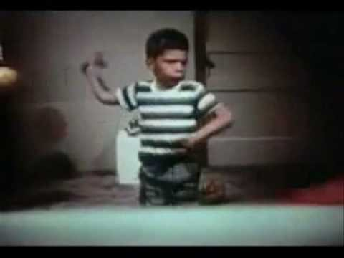

Slide 40
Aggressive Acts of Model
Model exhibited distinctive aggressive acts : used to score imitative responses.
Laid the Bobo doll on its side, sat on it and punched it repeatedly in the nose.
Raised the Bobo doll, pick up the mallet and struck the doll on the head.
Following the mallet aggression, the model tossed the doll up in the air aggressively and kicked it about the room.
This sequence of physically aggressive acts was repeated approximately three times,

Slide 41
Aggressive Acts of Model
Aggresssion interspersed with verbally aggressive responses such as
"Sock him in the nose…,"
"Hit him down...," “
Throw him in the air…,"
"Kick him…,"
"Pow…,"
Also two consistent non-aggressive comments:
"He keeps coming back for more"
“He sure is a tough fella.“

Slide 42
Testing conditions: Aggression Arousal
Prior to the test for imitation, all subjects (experimental and control) were subjected to mild aggression arousal to insure that they were under some degree of instigation to aggression.
Would this get past IRB today?

Slide 43
Bait and Switch
Following the exposure experience: Experimenter brought subject to an anteroom that contained relatively attractive toys:
Experimenter explained that toys were for the subject to play ….BUT….
As soon as the subject became involved with the toys, the experimenter remarked that these were her very best toys
Experimenter remarked that she did not let just anyone play with them, and that she had decided to reserve these toys for the other children.
Essentially making toys off limits AFTER the kids started to play with them.
Told subject they could play with any of the toys that were in the next room.

Slide 44
Toy Set up
The experimental room contained variety of toys including
some that could be used in imitative or nonimitative aggression,
others tended to elicit predominantly nonaggressive forms of behavior.
Aggressive toys:
3-foot Bobo doll
a mallet and peg board
two dart guns,
tether ball with a face painted on it which hung from the ceiling.
Nonaggressive toys:
tea set
crayons and coloring paper
a ball
two dolls
three bears
cars and trucks
plastic farm animals.

Slide 45
Test for Delayed Aggression: 3 measures of Imitation Responses
The subject spent 20 minutes in experimental room
Imitation of physical aggression:
acts of striking the Bobo doll with the mallet
sitting on Bobo and punching it in the nose
kicking the Bobo and tossing it in the air.
Imitative verbal aggression:
Subject repeats the phrases,
E.g., "Sock him," "Hit him down," "Kick him," "Throw him in the air," or "Pow"
Imitative nonaggressive verbal responses: Subject repeats,
"He keeps coming back for more"
"He sure is a tough fella"

Slide 46
Non-imitative aggressive responses
Punches Bobs doll: Subject strikes, slaps, or pushes the doll aggressively.
Nonimitative physical and verbal aggression: This category included:
physically aggressive acts directed toward objects other than the Bobo
any hostile remarks except for those in the verbal imitation category; e.g., "Shoot the Bobo," "Cut him," "Stupid ball," "Knock over people," "Horses fighting, biting"
Aggressive gun play: Subject shoots darts or aims the guns and fires imaginary shots at objects in the room.
Ratings were also made of the number of behavior units in which subjects played nonaggressively or sat quietly and did not play with any of the material at all.

Slide 47
Results
Subjects in the aggression condition reproduced more physical and verbal aggressive behavior resembling that of the models
Imitation was not confined to model's aggressive responses.
Approximately 1/3 of the subjects in the aggressive condition repeated model's nonaggressive verbal responses
None of the subjects in either nonaggressive or control groups made such remarks.
No overall differences in nonimitative aggression:

Slide 48
Gender differences
Influence of Sex of Model and Sex of Subjects on Imitation
Hypothesis: boys are more prone than girls to imitate aggression exhibited by a model only partially confirmed.
Boys reproduced more imitative physical aggression than girls,
But the groups did not differ in their imitation of verbal aggression.
Behavior of the male model exerted a greater influence than female model on the subjects' behavior in the generalization situation
True for all groups
Not just aggressive group.

Slide 49
Gender Differences
Nonaggressive Behavior differences
With the exception of expected sex differences, data from the nonaggressive response scores yielded few significant differences.
Female subjects spent more time than boys in playing with dolls, with the tea set, and coloring
The boys devoted significantly more time than girls to exploratory play with guns
No sex differences were found in subjects use of the other stimulus objects, i.e., farm animals, cars, or tether ball.

Slide 50
What does this mean?
Aggressive responses WERE modeled when given opportunity
Exposure to inhibited models both decreased the probability of occurrence of aggressive behavior and restricted the range of behavior emitted by the subjects.
Suggest that mere observation of aggression is a sufficient condition for producing imitative aggression in children
regardless of the quality of the model-subject relationship

Slide 51
Why model aggression?
"Identification with aggressor" (Freud, 1946)
“Defensive identification" (Mowrer, 1950)
Person presumably transforms himself from object to agent of aggression by adopting the attributes of an aggressive threatening model
May serve to allay anxiety
Was widely accepted as an explanation of the imitative learning of aggression

Slide 52
Clinical uses
Acquisition of new responses
Inhibition
Disinhibition
Abstract modeling
Develop common rule or heuristic for behaving
Teaching strategies
Different ways to use models:
Use of single vs. multiple models
Direct (live) vs. symbolic (non-live) modeling
Modeling with participation
Desensitization therapy

Slide 53
Research on Social/Observational learning and modeling
Other studies:
Television violence:
Live action
Cartoon
News/live
Which was worse? Live action or real footage
The more realistic the characters, the more likely a child is to imitate
Not just aggression
Sexual behavior
Prosocial behavior such as helping
Can use as therapy!
We model good and bad behavior!

Slide 54
Educational implications of social learning theory:
We learn large proportion from simply by observing other people.
Modeling provides alternative to shaping for teaching new behaviors
May be faster
May be more efficient
Must utilize all four essential conditions: attention, retention , motor reproduction, and motivation.
Must provide individuals who model appropriate behaviors
Expose students to a variety of models.
Breaks down traditional stereotypes
Helps with generalization
Provides more opportunities for social learning

Slide 55
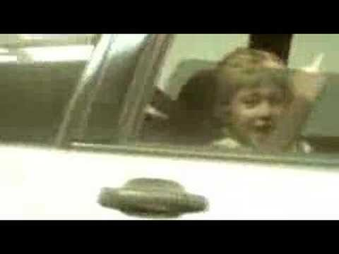
Implications
Children learn what they live
Children will model behavior that they see
Even if “socially unacceptable”

