Slide 1
Defining and studying Learning?

Slide 2
What is learning?
Definition of learning:
Dictionary definition: To gain knowledge, comprehension, or mastery through experience or study.
Psychology definition: A relatively permanent change in behavioral potentiality that is not due to maturation or typical physical growth, but is due to (reinforced) practice or experience.
Which is better description? Why?
Behavioral potentiality:
Obviously, must be measurable behavior change
But when must behavior occur? Immediately after learning? Within 1 year?
Issue of learning vs. performance- is this an important distinction?
Must learning result in behavioral change?
Define permanent and define behavior
Instinct- may emerge at different time periods
Importance of critical periods
Walking- learned or instinct?
Memory issues
How much cognition is necessary? Can bacteria learn?
Definition of behavior: If a dead man can’t do it…….

Slide 3
Definitions of learning?
Learning: experience, practice or performance?
Reflexes: Are they important for learning?
Instincts: imprinting and critical periods
Practice vs. Experience
Performance as an issue
Modified definition of learning: learning is
a relatively permanent change in behavior or behavioral potentiality
that results from experience and
cannot be attributed to temporary body states (e.g., fatigue, altered states of consciousness)
Types of learning:
Classical conditioning
Instrumental or operant
Cognition
Learning = survival or our strongest instinct

Slide 4
Approaches to study of learning
Systematic study
Science defined: combines 2 ancient philosophical positions on origins of knowledge:
Rationalism: assumption that one gains knowledge by exercising the mind
Empiricism: assumption that sensory experience is basis of all knowledge.
We typically engage in rational empiricism:
exercise or expand the mind via gaining knowledge through our sensory experiences
But doesn’t EVERYONE do this? What makes scientists different?

Slide 5
Aspects of theory:
Scientific theory: two critical aspects
Formal aspects: Words and symbols of the theory
Empirical aspects: physical events that theory attempts to explain
Can you have one aspect without the other?
Scientific Law: consistently observed relationship between two or more classes or events
All science seek to discover laws!

Slide 6
Goal of Science
The goal of science is to:
Discover laws
Group laws into coherent units
In psychology, might add one more goal
To improve the condition of humans and animals
Clinical applications that emerge from science
Coherent grouping has at least 2 functions:
Synthesizing function: systematically explains large group of observations (reinforcement)
Heuristic function: points to further research (theoretical building blocks).

Slide 7
The Principle of Parsimony
KISS: Keep It Simple, Stupid!
Principle of Economy or Morgan’s Cannon
When 2 equally effective theories can explain the same phenomenon, but one explains it more simply and economically, use the simpler explanation.
Unfortunately, science often ignores Morgan’s Cannon!
Why is this important?

Slide 8
Approaches to study of learning
Learning experiments
Remember tenets of experiments: IV and DV
Arbitrary set ups
What is arbitrary?
We often do it because it is “easy”
Techniques:
idiographic vs. nomothetic
Lab vs. naturalistic observation
Human vs. animal
Correlation or experimental
Choosing IVs and DVs
Data and interpretations
We will be discussing single subject designs as a special characteristic of learning theories in a few lectures!

Slide 9
But does science ever change?
Kuhn’s views : Paradigms:
a point of view shared by a substantial number of scientists
The school of theory or theoretical school of view
Are schools or paradigms good or bad?
Paradigm shifts in normal science:
Innovations occur when scientists who use a particular paradigm are consistently confronted with events inconsistent with their point of view
Emerges only with great resistance
Scientific revolutions: science occurs through paradigm shifts
Book suggests that paradigm shifts most applicable in physical sciences
Less applicable to social sciences
Do you agree?

Slide 10
Does science change?
Popper’s views: Science often starts with theory, not data collection!
Scientific theory = proposed solution to a problem
Principle of refutability or Principle of falsification
must show that the proposed solution is not correct
Einstein’s theory- wonderful theory, but we now know it has wrong solutions
Which is better approach: Kuhn or Popper?
Kuhn stresses sociological/psychological factors playing strong role in emergence of science and theories
Popper stresses logical refutation of problems as playing stronger role
Is it really one or the other?

Slide 11
How do we evaluate theories?
Testability (Falsifiability)
theory should make unambiguous predictions that can be tested against the facts.
Falsifiability: a good theory is one that, in principle, can be proven wrong
is a poor theory if is untestable, or unfalsifiable
Simplicity or Parsimony:
given two theories that are equal in testability, one that uses fewer hypothetical constructs and assumptions is the preferred theory
Generality:
theories that deal w/more phenomena with a greater range of observations are usually judged to better than those w/less
Fruitfulness:
theories that stimulate further research and further thinking about a particular topic are usually judged to be better
Agreement w/data:
theories that are supported by data (obviously) are better theories

Slide 12
Learning theory depends upon:
Epistemology:
Branch of philosophy that deals with nature of knowledge
The study of knowledge
Asking and examining answers to several critical questions:
What is learning?
What can we learn?
What are limits of learning?
What does it mean to learn?
What are origins of learned behavior?

Slide 13
A Brief History of Learning Theory

Slide 14
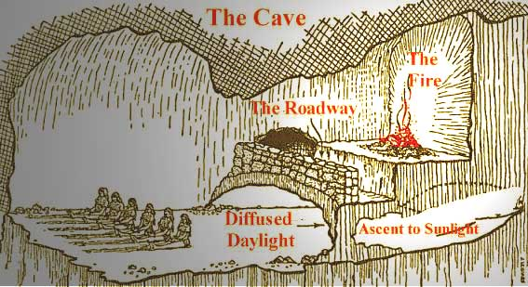
Early history of learning theory
Plato:
Nativism: Knowledge is inherited and a natural component of the human mind
Every object in physical world has corresponding abstract idea or form that causes it
We experience a “tree” but not “treeness”
Rationalism: One gains knowledge by reflecting on the contents of one’s mind:
The mind’s eye
Turn inward to ponder what is innately available
Believes in a soul
Reminiscence: recollection of our experience that our soul had in heaven which is beyond heaven
Plato’s Cave analogy
Getting out of the cave is important
But our duty to go back into the cave- and problems that creates for us- is equally important

Slide 15
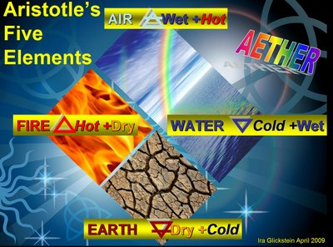
Early history of Learning Theory
Aristotle:
Empiricism: Knowledge derived from sensory experiences; was NOT inherited
Rationalism: mind is actively involved in attainment of knowledge
Nativism: Mind must actively ponder the information provided by the senses to discover the knowledge contained within the information
Described in detail the human senses
Laws of association: experience or recall of one object will elicit recall of things
Similar to that object (similarity)
Opposite that object (contrast)
That were once originally experienced with that object (contiguity)

Slide 16
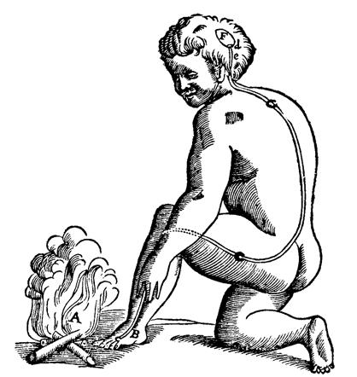
Early History of Learning Theories
DesCartes
Knowledge is innate
Mind versus body problem
Separate laws govern each
Only humans have souls (mind)
Body has “animal spirits”
Two do influence one another
Reflex arc:
Why important? Showed mechanisms of body

Slide 17
Early History of Learning Theories
The British Empiricist include:
Thomas Hobbes (1651)
John Locke (1690)
James Mill (1829)
John Stuart Mill (1843)
Source of all knowledge was sensory experience
people born knowing nothing
gradually gather knowledge via experience
Tabula rasa or blank slate idea (Locke)
opposite of Kant's Nativism
extreme position = Empiricist position

Slide 18
Set hypotheses for Associationism:
Outlined how old concepts become associated in memory/how new concepts are formed
direct correspondence between experience and memory
experience = sensations
memory = ideas
one-to-one correspondence between simple sensations and simple ideas
idea = form of a sensation
Complex ideas: James Mill
two or more simple sensations repeatedly presented together, product of union may be complex idea
once complex idea formed, can also be evoked by process of association from simple sensations or ideas

Slide 19
Set hypotheses for Associationism:
Thomas Brown (1982): Secondary Principles of association: attempt to make Mills theory more complete
length of time 2 sentences coexist determines strength of association
liveliness or vividness of sensations also affects strength
frequency of pairings
recency of pairings
freedom from other strong associations
constitutional differences
current emotional states
momentary state of body
individual prior habits

Slide 20
Variations on Associationism
George Berkely:
we can experience only secondary qualities
Nothing exists unless it is percevied
To be is to be perceived
David Hume:
We know nothing for sure about ideas
We can be sure of nothing
Mind = stream of ideas, memories, imaginings, associations, feelings
We experience empirical world only indirectly through our own ideas
“Habitual order of ideas” give rise to general concepts like causation
Immanual Kant (1724-1804)
Innate categories of thought:
Careful analysis of our experiences reveals certain categories of thought
Causality, unity, totality, reality, existence, necessity, reciprocity, (and 5 more)
Mental faculties superimposed over our sensory experiences, providing them with structure and meaning
John Stuart Mill:
Associationist
Most important contribution: The whole is different from the sum of its parts (Wait, didn’t the Gestaltists say this!?!!?)

Slide 21
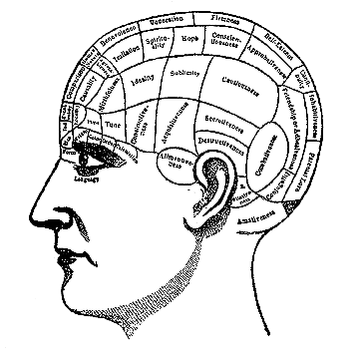
Historical influences
Thomas Reid: Naïve Realism
What we perceive = naïve realism
Mind has powers of its own which strongly influence how we perceive world
Faculty of psychology: mixture of nativism, rationalism, empiricism
Franz Joseph Gall
Faculties housed in specific brain locations
Phrenology: two lasting effects
Led to emerging neuroscience research
Belief that faculties become stronger with practice- the mental muscle

Slide 22
Other Historical influences
Charles Darwin (1809-1882):
Biological evolution
1859 book: Origin of Species
argued species originated from other species and eventually become distinct from their ancestors
thus: many animals have common, but very distant, ancestors
Evidence from domesticated plants and animals
Breeding programs; hybrid plants, purebred dogs, cats, etc.
Great similarity in body parts across animals: paws, arms, etc.
Embryology: most embryos look HIGHLY similar
Fossil records:

Slide 23
Natural Selection: Darwin’s 5 major premises:
the members of particular species have characteristics that vary
some of these variable characteristics are passed on from parents to siblings
some of these variable characteristics aid survival
species produce more offspring than survive to become adults
those characteristics that aid survival will become more common across generations, those that impede survival will die out.

Slide 24
One of earliest influences on Learning Theory: first “human” studies
Hermann Ebbinghaus (1850-1909)
First empirical test of associationist hypotheses
used nonsense syllables to avoid prior associations
served as own subject
measured length of time took to learn, amount remembered after some passage of time
Results: Several major findings
list length: the greater the list- the greater the time to learn PER item
effects of repetition: over-learning and mastery
Effects of time on remembering and forgetting:
discovered forgetting curve
serial position curve
role of contiguity: more contiguity = greater learning
also supported associationist principles
backwards associations:

Slide 25
Several Schools or Systems of Psychology
School or system is a systematic method of study guided by a set philosophy or theoretical viewpoint
Defines the subject matter to be studied
Great Systems or Schools of Psychology led us to where we are theoretically and philosophically today!

Slide 26
Volunteerism or Introspection
Wilhelm Wundt (1832-1920)
German rationalist tradition
Goals: study consciousness as it was immediately experienced
Could study consciousness scientifically, as systematic function of environmental stimulation
Find basic elements of which all thoughts consist
Interestingly, VERY interested in how culture affected our consciousness:
Volkerpsychology: critical book on cultural or group psychology
Interested in studying people’s mental experiences.
Studied human will and selective attention or “apperception”

Slide 27
Structuralism
Edward Titchner (1867-1927)
brought Wundt’s teachings and methods to US.
Used method called introspection:
subjects trained to report immediate experience as they perceived object
Not report interpretations of that object
“raw” sensory experiences
Learning = hindrance!
Structuralists stressed laws of association,
not of human will
Passive human mind, in contrast to volunteerists

Slide 28
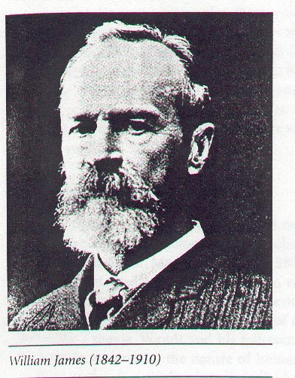
Functionalism
William James (1842-1910) founded the school of psychology known as functionalism.
Focused on the roles or functions that underlie mental processes
Utility of consciousness and behavior in adjusting to the environment
Why we do what we do
Behavior, thoughts, feelings have function
Interested in what the function of mind is
Highly influenced by Darwin

Slide 29
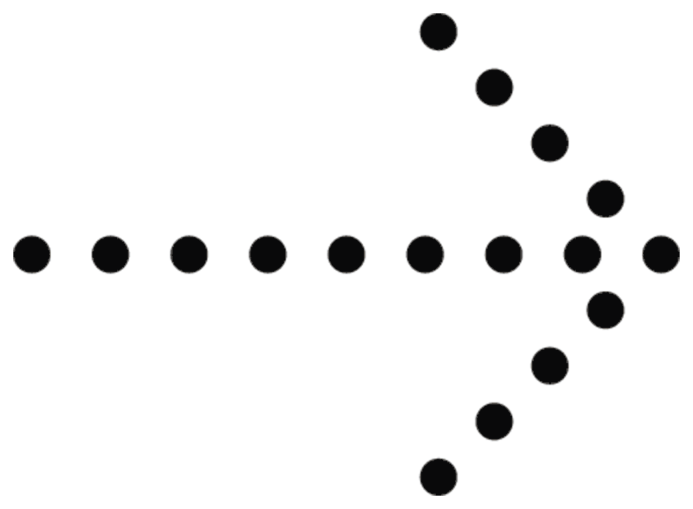
Gestaltism
Wertheimer (1880-1943) was fascinated by the illusion of movement by objects in the distance.
How does the brain organize and structure our perceptions of the world
Whole is greater than the sum of its parts
Perception psychologists, but laid groundwork for modern cognitivists, sensation/perception
Most of theories later supported by the other great schools

Slide 30
Behaviorism
Watson (1878-1958) founded the school of psychology known as behaviorism.
Psychology should be a science of behavior only.
Believed that environment molds behavior
By 1920s, behaviorism became dominant force in American psychology
E.L. Thorndike (1897-1949)
Original Law of Effect
Examined role of rewards and punishers on behavior
Did so in absence of knowledge of Pavlov’s work.
Ivan Pavlov (1849-1936)
Classical conditioning: the effects of predictive stimuli on behavior
Conditional not conditioned!
idea of "conditioning" as an automatic form of learning
B.F. Skinner (1904-1990)
Studied how behavior is shaped by rewards and punishments
Principles of learning apply to animals and humans alike
Edwin Ray Guthrie (1886-1959) went against Watson and Skinner:
One-Trial Learning : all learning is done within a single exposure to a situation.[
The Principle of Association :
The Principle of Postremity :
The Principle of Response Probability :

Slide 31
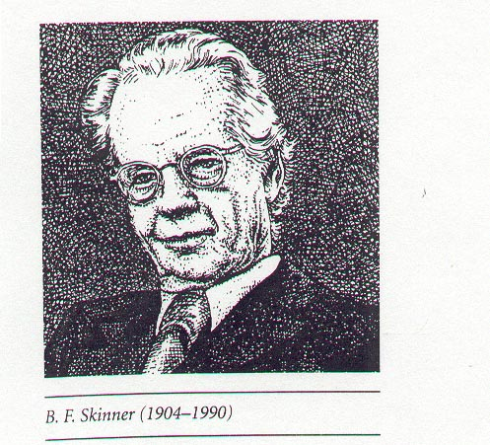
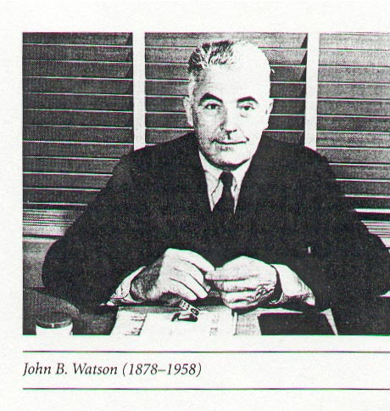
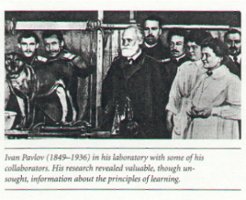

Slide 32
Psychoanalysis
Understanding behavior by understanding unconscious
Sigmund Freud
Founded view of psychology called the psychodynamic perspective
Focused on the unconscious mind
Emphasized importance of early childhood experiences
Led to form of psychotherapy known as psychoanalysis
Many of newer psychoanalytic folk moved into Humanistic Psychology
Idea that everyone has the potential to be self-actualized (be the best they can be)
Everyone has the right to be loved, regardless of their behavior
Is an important area of Psychology because unlike ALL other schools, humanistic psychology assumes that people are essentially good and treatable.
Is NOT a deterministic approach.

Slide 33
But what is psychology today?
No overarching paradigm guides psychology
Several dominant “camps” today
Cognitive
Behavioral
Physiological
Humanistic
Intro textbooks focus on the biopsychosocial approac
Biological: brain and body
Psychological: behaviorism, cognitivism, humanism
Social: social influences (societal influences)

