Slide 1
Behavioral Economics!
Yep, another theory used to predict reinforcement effects
This theory = Nobel Prize for Richard Thaler!

Slide 2
Behavioral Economics
Application of economic theory to predict and control behavior
Microeconomics
Assumes law of supply and demand applies to behavior and reinforcement
Is an outgrowth of unidimensional explanations of reinforced behavior
Matching law
Molar maximizing
Disequilibrium models

Slide 3
Four Major Premises
A behavioral experiment is an economic system. As such, the characteristics of the experiment can strongly determine the results
Reinforcers can be distinguished by a functional property called “elasticity of demand” that is independent of relative value
Reinforcers may interact as complements as well as substitutes
Because reinforcers differ in elasticity and because reinforcers can be complementary, no simple unidimensional choice rule can account for all choice behavior

Slide 4
Define the Terms
Demand: How much of a product (commodity) will be purchased” by the organism at a given price
Product or Commodity: the Reinforcer
How Purchase Commodities?:
A contingent behavioral response
e.g., bar press, turn in homework, a dog must sit
Price: Schedule of reinforcement or more commonly
Response/reinforcer (cost): e.g. for a FR5: 5/1
Budget: Total number of responses allowed per session

Slide 5
Changing Price alters behavior:
Changes in price = changes in the reinforcement schedule
E.g. Fixed Ratio schedules:
FR1: one response = 1 commodity or reward
FR 5: five responses = 1 commodity or reward
Changes the COST or PRICE of the Commodity
This can both effect and be affected by
Demand elasticity,
Substitutability and
Open vs. closed economies

Slide 6
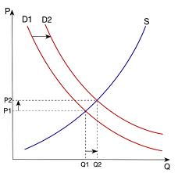
Supply, Demand, and Equilibrium
Supply curve:
D = demand
S = S^{r} schedule or environmental constraint for obtaining the commodity
Q = Quantity per unit time provided at given price
P = Price of the commodity (reinforcer)
As price per unit increases, rate of production (responding) increases

Slide 7
Supply, Demand, and Equilibrium
Demand curve
Amount that the subject will consume at a given price or the price that will be paid for a given rate of consumption
As price increases, consumption generally decreases
Measured in terms of consumption

Slide 8
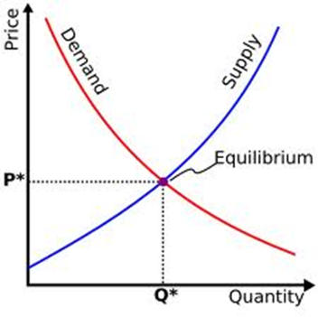
Supply, Demand, and Equilibrium
Equilibrium:
Stable outcome of these two curves
Where they intersect

Slide 9
Budget Lines
Changes the amount the organism is allowed to “spend”
Compares how much the subject will “buy” of commodity X versus commodity Y
Alters the number of responses allowed across the session
Yields different “constraint” or budget lines
In a sense: Shows PREFERENCE for buying X vs. Y
Differs from price:
Is not just the price of an individual item
But the total amount the animal has to “spend”.
These factors (price and budget) interact with the animals “preference” or demand

Slide 10
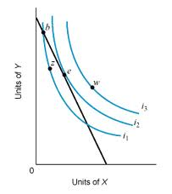
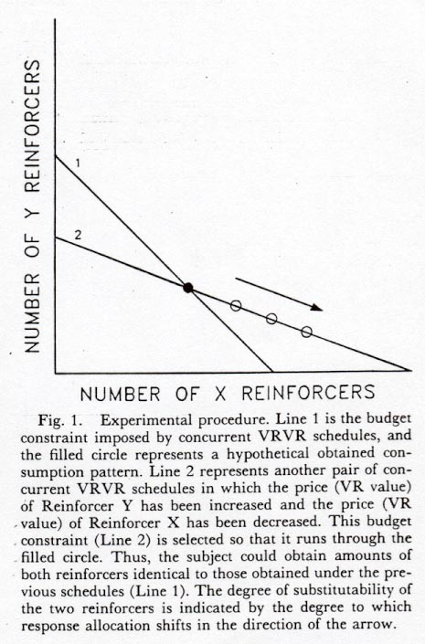
Hypothetical Budget Lines

Slide 11
Demand interacting with Price: Elasticity Curves.
INELASTIC:
Quantity demand decays gradually with increases in price.
Note that R-rate will be an increasing function of price
ELASTIC:
Demand decays steeply with increases in price.
Note that R-rate will be a decreasing function of price
A UNIT demand curve
Generates a precisely flat level of expenditure or R-rate with increasing price
Each increase in price is precisely balanced by a decrease in consumption

Slide 12
Curvature of Demand
ELASTICITY COEFFICIENT = absolute value of that slope
<1 for inelastic demand
= 1 for unit demand
>1 for elastic demand
The closer the curve comes to the axes, the more demand there is for the commodity
Deep curvature = more demand
Less curvature = less demand

Slide 13
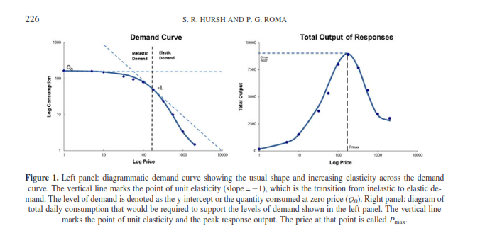

Slide 14
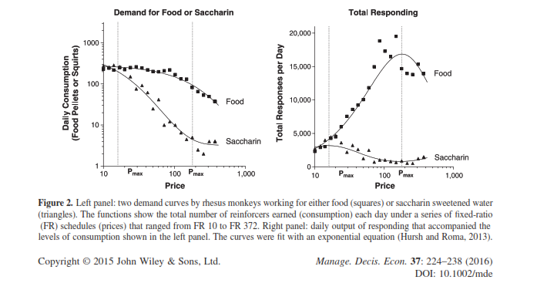

Slide 15
Hursh’s Exponential Model of Demand
Equation:
IV = C or cost
Log of consumption = log Q
Function of cost and responding’s (buying the commodity) maximum at 0 cost (log Q₀)
Specifies highest demand
α = constant: determines the rate of decline in relative consumption (log Q) with increases in cost (C)
Value of k = scaling constant that reflects range of data (range of costs used in experiment)

Slide 16
Hursh’s Exponential Model of Demand
The rate of change in demand elasticity, when K is constant, is determined by the rate of α
The value of α = sensitivity of consumption to changes in cost
Is inversely proportional to the ESSENTIAL VALUE (EV) of the reinforcer
EV = theoretically constant reinforcing value of the commodity, regardless of the unit size

Slide 17
Several important predictions
The form of the demand curve depends on the dimensions of the goods purchased (reinforcers earned)
Differences in size of the reinforcer
Differences in the amount of the reinforcer
Even differences in the quality of the reinforcer
For example: when commodities differ in size, it takes varying amounts of each to reach satiation
E.g., if twice as big, takes half the time/amount
This is reflected in Q₀
This means that there are differences in true cost required to defend baseline demands differ
Takes more small packages to reach satiation than large packages

Slide 18
Several important assumptions
Standardized price: Q₀ x C
Separates cost factors from the essential value
Hursh: like providing unit price rather than just package price
True price can be raised by:
Charging more for same package
Making package smaller, selling at same price
And vice versa for lowering price

Slide 19
Several important predictions
Essential value = EV
EV =
Is linearly related to price at which demand elasticity = -1 and overall responding is maximal
Pmax =
Defined for demand in normalized units of consumption
All levels of consumption are expressed as a percent of maximal consumption (Q₀ = 100%)
Price is normalized units of cost per 1% units of consumption (C x Q₀/100)
Varies with value of K
Exact estimate obtained by replacing the constant of 100 in the Exponential demand equation and adjusting for the value of K

Slide 20
Can now compare different “reinforcers” and “prices
Winger, et al. (2002)
Three drugs self administered by monkeys
Differed in time of onset to peak drug effect
Ketamine 1 min
Phencyclidine 10 min
Dizocilpine 32 min
Used several doses and changed “price” across each dose
Wanted to determine of elasticity of demand would vary for the three drugs

Slide 21
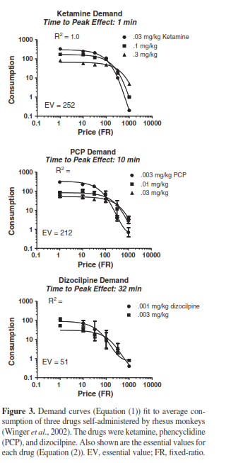
Results
Note could isolate dose differences using Pmax, so could equate across doses
Makes sensitivity to price a constant across doses
Found distinct differences in demand curves
More importantly, look at EV for the three drugs

Slide 22
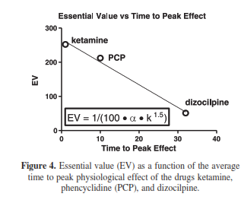
Results
EV not directly related to potency
Lowest potency = ketamine:
was 10x more reinforcing by unit dose than dizocilpine!
Sensitivity to price was 25% of that for dizocilpine and had a higher EV
This study and others by Roma suggest that EV may be related to potential of abuse
Higher EV and lower sensitivity increases potential for abuse!
Also note that this relates to time to peak effect: sooner the peak effect, the more reinforcing the drug!
EV is an inverse to delay of reinforcement!!!!!!

Slide 23
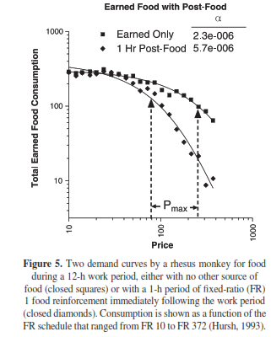
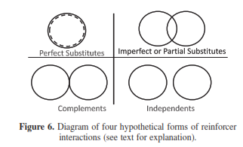
What else affects Elasticity of Demand?

Slide 24
Reinforcers interact as substitutes or complements
Substitutes: Reduction in demand of one commodity as the supply for a second commodity increased
Complete substitutability suggests the two reinforcers are equivalent
One commodity is as good as another
Pepsi vs. Coke ?
Store brand vs. generic brand?

Slide 25
Reinforcers interact as substitutes or complements
Complements: Increase in demand of one commodity as supply for a second commodity increased
Complete complementarity suggests the two reinforcers are nonsubstitutable or complements
Peanut Butter and Jelly
Water vs. food

Slide 26
Own-price vs. cross-price elasticity
Own price elasticity of demand
Slope of demand curve for commodity when plotted using typical equation
Reflects proportional changes in consumption of commodity with proportional changes in its own price
Cross-price elasticity of demand:
Slope of the function relating the consumption of a second commodity at a fixed price to changes in price of an alternative commodity
If function has positive slope: second commodity= substitute
If function has a negative slope: second commodity = compliment
Q_{alone} = level of demand for constant price commodity B at infinite price (C) for commodity A
I = interaction constant
β = sensitivity of commodity B consumption to the price of commodity A
C_{A} is the cost of commodity A

Slide 27
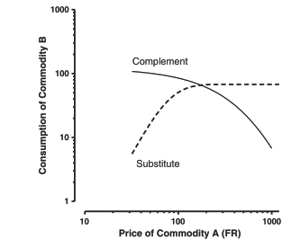
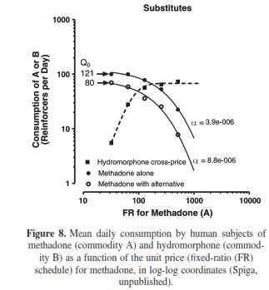
Substitutes!
Human subjects chose between methadone (increasing FR schedule from FR30) and hydromorphone (FR 30)
Even at lowest price of methadone, some hydromorphone consumed
As price increased, consumption of hydromorphone increased, methadone decreased
This true even compared to price increases when methadone offered alone!
When hydromorphone was available:
Sensitivity to methadone doubled (price comparing!)
Level of demand (Q_{o}) reduced 33%
How could this be used in drug treatment?

Slide 28
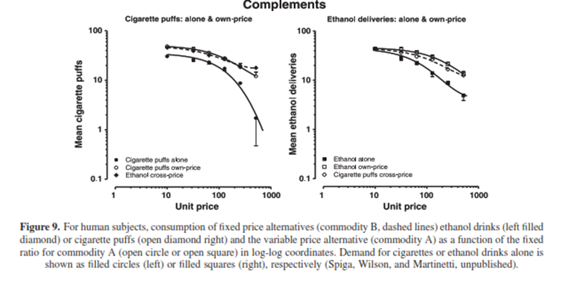
Compliments
Ethanol vs. cigarette puffs:
Did alone and own-price comparison
Ethanol offered at constant price
Cigarette puffs price varied

Slide 29
Open versus Closed Economies
Open Economy:
Extra sources of reward are available outside the experimental (or real) session
Can get more commodities outside your budget
Rats are supplementally fed after the daily session
You can call your parents when run out of money at end of month

Slide 30
Open versus Closed Economies
Closed Economy:
Extra sources of reward are available outside the experimental (or real) session
Can NOT get more commodities outside your budget
Rats must work for all of their food during an experimental session
Your monthly budget is as it is: no extra sources of income

Slide 31
Differences in consumption for Open versus Closed Economies:
Open economies and closed economies have different effects on consumption
Response rates in closed economies INCREASE as price increases; Must respond more to maintain consumption
Response rates in open economies DECREASE as price increases; Do not maintain consumption

Slide 32
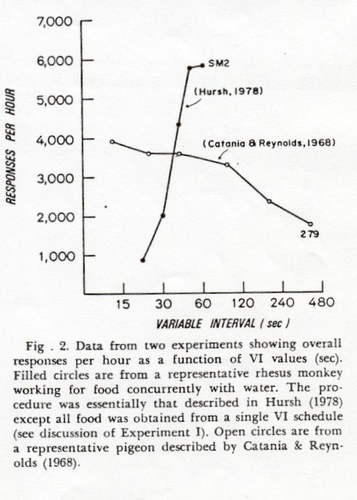
Responding on Open versus Closed Economies

Slide 33
Why is this distinction important?
Drug addict behavior in open vs. closed economies
Open Economy:
Many outside sources of “commodities”
Parents will enable, pay rent
Can beg, steal, rob for money
No reason to allocate money for food, as can always get more
As a result, spend more of $$ on drugs

Slide 34
Why is this distinction important?
Drug addict behavior in open vs. closed economies
Closed Economy:
No or limited outside sources of “commodities”
No one to enable, pay rent
No opportunity to beg, steal, rob for money
Must allocate money for food, must eat
As a result, spend little to no $$ on drugs

Slide 35
Hursh, 1980
Gave baboons choice between food and heroin infusion:
Early data sessions shown both commodities relatively inelastic
When no restriction on income: Open economy
Supplemental feeding at end of session
Responding roughly equal for both
Relatively inelastic
Would choose to take heroin infusions
When restriction income: # of R's/day: Closed economy:
When price = low: baboons still choose roughly equal
When price = high:
Demand for heroin dropped
Demand for food increased

Slide 36
Animals make “bad” choices based on “good” decision making!
Anchoring: we value things more highly when we have them in hand (own them).
Loss aversion:
Organisms experience the negative feeling of loss more strongly than they feel the positive sense of a gain of the same size
We avoid losing, even if it will gain us something more

Slide 37
Animals make “bad” choices based on “good” decision making!
Planning and doing
Organisms are good at planning
Not was good at executing the response
Issues of self control
Availability heuristic:
Organisms choose based on how readily the reinforcer is to them.
Temporal discounting!
Status quo bias:
Organisms tend to keep making the same choice
Issue of Behavioral Momentum

Slide 38
Summary
EV (essential value) may be hugely affected by availability of alternative reinforcers!
When substitutes are available: EV of a reinforcer declines compared to when no other reinforcer is available
Low priced concurrently available substitutes lower EV the most
Compliments INCREASE Essential value
These types of interactions are not included in linear models of reinforcement efficacy like the matching law!

Slide 39
Summary
Evidence suggests that behavior of animals in conditioning experiments conforms to economic predictions
Implies that operant conditioning constitutes a kind of economic decision making
We think we are logical, but we respond based on our reinforcement history, not necessarily logic.
Like other modern theories in operant conditioning, allows prediction of reinforcement effect

