Slide 1

Reasoning

Slide 2
Canines, corvids, sea mammals and apes can do many cognitive tasks!
Contingency reversal learning:
Can learn A→ B and then B→ A
Ashton& DeLillo, 2011
Object permanence:
Can find hidden object when observe object hidden
Some data ((Gagnon & Dore, 1992, 1994) suggests can find when NOT see the object being hidden
Object learning (Framl & Frank, 1985)
Categorizing and inferential learning: Range, et al, 2008

Slide 3

Tool Use

Slide 4
Several other tasks, too!
Object manipulation (Topal, et al, 1997)
Means-end task (Osthaus et al, 2005)
Quantitative tasks
More vs. less
Some counting
Search order
Spatial navigation: Cattet & Etienne, 2004 and solving detour problems (Pongracz, et al, 2001)

Slide 5
Importance of tool use.
Question: Does tool use = cognitive ability?
Adaptive specialization for tool use and complex object manipulation = enhanced or impaired performance for other tool use situations?
Tool use allows assessment of problem solving behaviors
Need to parcel out several factors:
Pre-functional development
Associate experience
Affordance learning
Self control
Planning and reasoning about invisible forces

Slide 6
Crows vs. Parrots
2 competitive foragers
Parrot: Kea, nestor notabilis
Corvid: Corvus moneduloides
both have large encephalization quotients, innovation scores
Both show strong manipulation and tool use
Both are social and known for problem solving abilities

Slide 7
Task:
Again crows vs. parrots
Multi-access box:
  Food reward is in center of transparent box
  Four different routes to food
  Train on one, then block; see if birds adapt

Slide 8
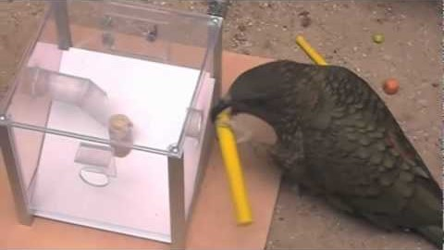

Slide 9
Results
First session:
Differences in behavior and number of solutions discovered:
NCC = 0.75 solutions
Rarely touched the apparatus (except string)
Kea found 2.33 solutions
All touched all four opening devices and both tool types
Entrance manipulation:
Kea directly manipulated opening devices more frequently
Crows showed only brief pecking actions at opening with beak or tool
Keas: violent pulling, tearing, rocking, probing, scratching, levering of physical parts of box

Slide 10
Results
Sequence of solutions discovered/established
  All birds ended up focused on string solution
  This was then blocked
But: order of solutions established differed between crows and parrots:
  Crows: stick tools, then ball tool then window hook; tended to touch window with stick rather than use stick to pull window open
  Kea: ball tool then window hook option; tried the stick option, but failed (can’t hold stick straight given curved beak)

Slide 11
Results
Speed of switching between solutions:
  Kea was faster than the crows
Tool preference:
  All preferred string
  Crows = thin sticks
  1 parrot = thick stick
  Other parrots: ball

Slide 12
What does this mean?
At least one bird in each group able to solve all 4 tasks: shows that birds could solve the tasks
Differences between species:
Keas faster learners, faster switchers, tried more solutions on first trial, showed more individual variation, preferred different tools
Keas also more destructive!: pulled and tore box apart
Crows do use pulling/tearing, but use it for nest building and tool building, not for food retrieval
First evidence of tool use in parrots!
Why the one bird? Differences in
Exploration patterns
Affordance learning
Balance between neophilia and neophobia
Kea showed more haptic exploration
Crows (also more neophobic) used more visually guided methods
Neophobia interrupted crows exploratory behavior

Slide 13

Insight

Slide 14
Gestaltism
Group of German psychologists, and in particular Max Wertheimer, Kurt Koffka and Wolfgan Kohler
The term ‘gestalt’ means a whole, a total composition.
According to this theory, an individual learns an object as a whole, a single entity, not in parts or bits. •
This theory can be summed up in the succinct statement: ‘The whole is greater than the sum of its parts.’

Slide 15
Several laws regarding how organisms perceive the world
Law of figure ground
Law of continuation
Law of proximity
Law of similarity
Law of closure
Law of continuity
Law of common region
Law of pragnanz

Slide 16
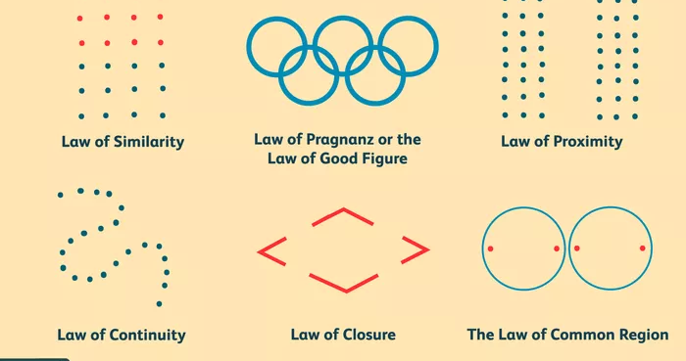

Slide 17
Believed that Insight was important way animals and humans learned
When the solution to a problem comes to you in an all-of-a-sudden manner, it can be considered insight.
More specifically, insight can be defined as the sudden and often novel realization of the solution to a problem.
This is the opposite type of solution to trial-and-error solutions.

Slide 18
Stages of Insight
Preparation:
Can’t solve problem initially
Data Gathering
Incubation
Problem put on hold
Work on problem unconsciously
Insight
Sudden mental representation of a solution
Engage in solution
Verificaiton
Solution checked

Slide 19
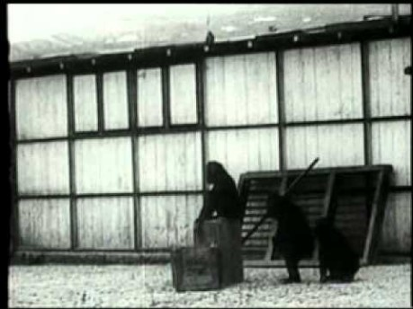
Kohler’s Chimps

Slide 20
Characteristics of Insight
Insight is sudden.
Insight alters perception.
Old objects appear in new patterns and organization by virtue of insight.
Insight is relative to the intellectual level.
  The higher species of animals including human beings have more insight than the members of lower species.
In insight, understanding is more useful than dexterity of hands.

Slide 21
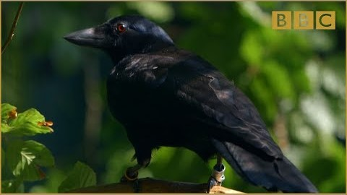
Problem solving in crows

Slide 22
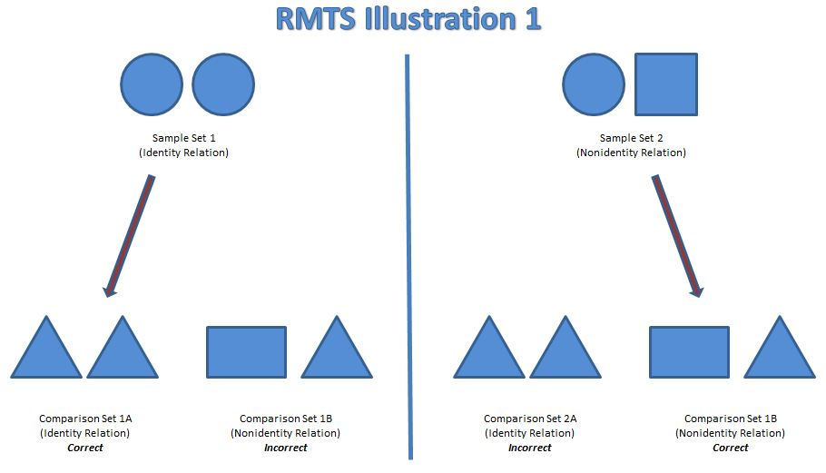
Reasoning by Analogy
Recognize relationship between 2 objects can imply same relationship between 2 other objects
  A is to B as C is to D
  Dog is to puppy as cat is to kitten
Humans and non-human great apes are able to show reasoning by analogy in various forms
  Also, possibly other animals: Alex the parrot
  Gillan, et al. (1981)
    Used relational matching to sample
    Able to show his chimp, Sarah, could show RMTS
  Capuchins, baboons and gorillas, too!

Slide 23
Transitive Inference
More difficult than relational matching
Solution requires animal to infer answer from the givens
  A=B, B=C, therefore A=C
  Mary is taller than Susan, and Susan is taller than Jane. Who is the tallest?
McGonigle & Chalmers (1977): Squirrel monkeys could do this
  Pair 1: Blue-peanut; red-nothing
  Pair 2: Green-peanut; blue-nothing
  Pair 3: Yellow-peanut; Green-nothing
  Pair 4: Violet-peanut; Yellow-nothing
  Then given mixes: Green-Blue trial, choose green but on Green-Yellow trial, choose Yellow
Lorenzo, et al (1991): Similar study with pigeons
Questions whether other animals can do analogies, as well.

Slide 24
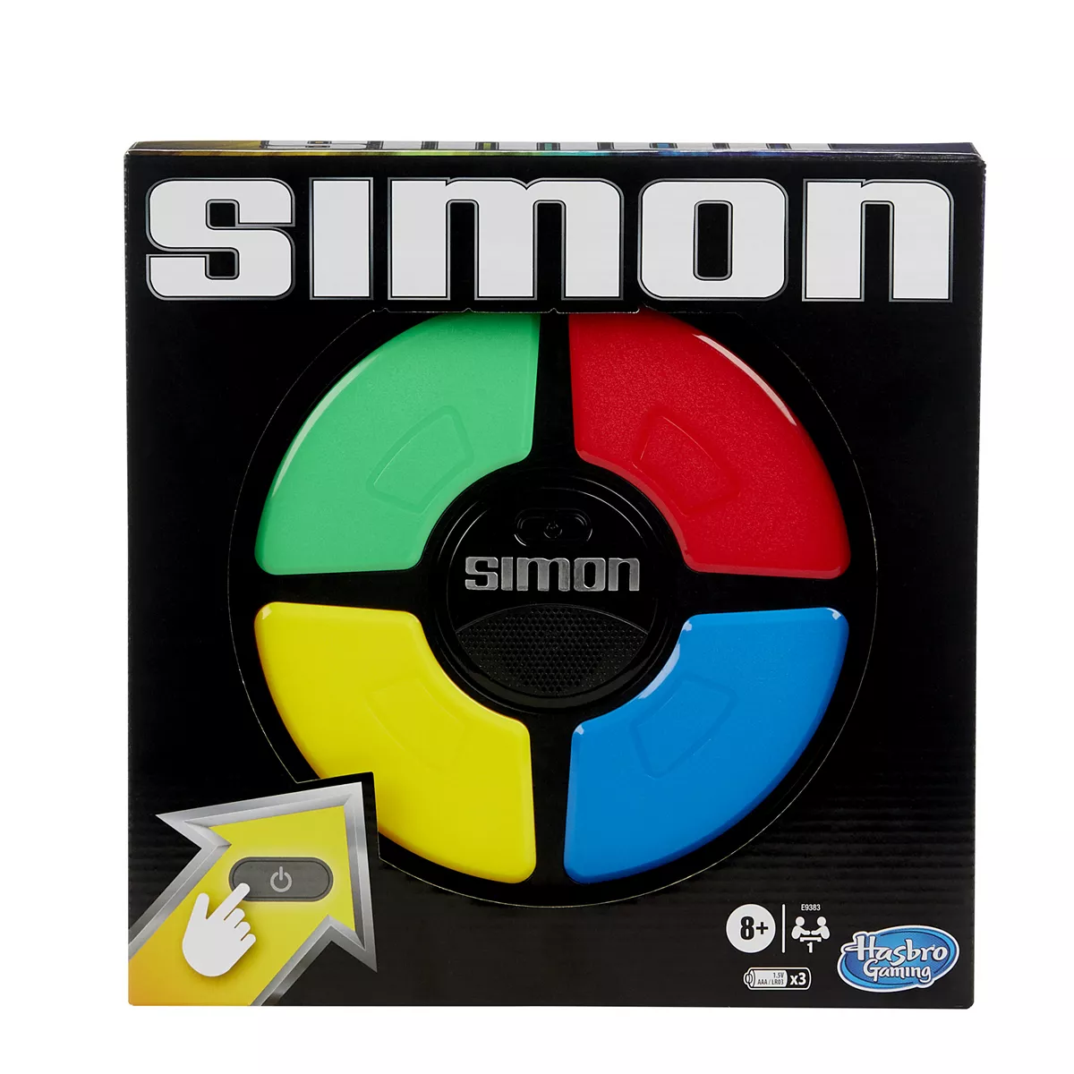
Linear ordering
Engage in behavior in learned order correctly when given an array of stimuli
Terrace (1984, 1993):
  Simultaneous chaining
  Pigeons given 8 pecking keys of different colors; had to learn correct sequence of 5 colors in correct order
D’Amato & Colombo (1988): Cebus monkeys tested on Terrace task
Terrace suggests animals can do this because they have learned an associative chain

Slide 25
Fairness

Slide 26
Expectancy violations
Tinkelpaugh (1928) task
  Show food item
  Cover it up with a cup
  Slide to animal
  Animal lifts up cup- but tricked: another lesser preferred food is there
  Look to see if animal is surprised/upset
Dogs show strong expectancy violation
  So do chimps, corvids
  Tend to react strongly when tricked
  And so do monkeys!

Slide 27

Fairness
Frans De Waal
Inequity aversion:
  The willingness to sacrifice material pay-offs for the sake of greater equality between yourself and another organism, usually from the same social group
  Inequity aversion is when the animal protests when it gets a lesser reward than another animal
  Observed, in varying degrees, in capuchin monkeys, chimps, macaques, marmosets, dogs, wolves, rats, crows and ravens.

Slide 28
Fairness
Studies using inequity aversion carefully show that it is not due just to the reduction in reinforcer value but is the reduction in reinforcer value in comparison to what the “other guy” got.
Shows that social animals are able to compare what they are getting and what their companion is getting- and to judge the value of each
Some suggestion that
  Animals may be examining greatest number of treats total
  Gender differences with females more likely to engage in inequality aversion
  Requires an understanding of value of the items and an understanding of conservation of mass in situations where treats are split or divided

Slide 29
We will end on a TED talk by Frans de Waal
Cooperation
Empathy
Fairness

Slide 30
