Slide 1
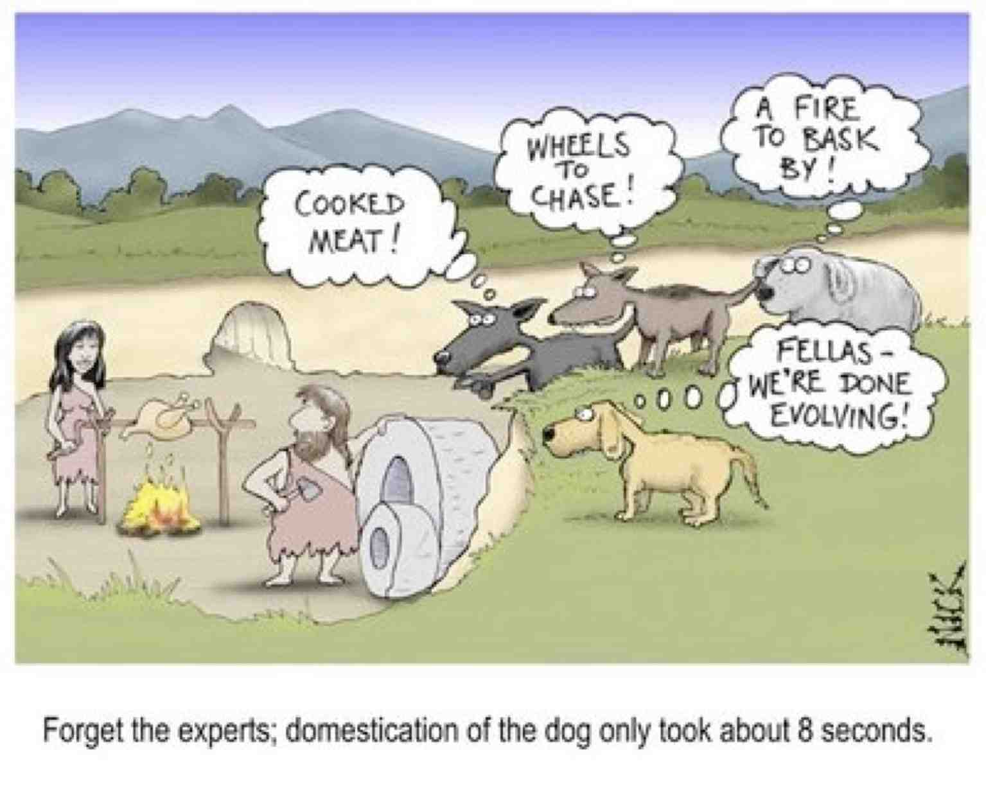

Slide 2
INNATE BEHAVIOR AND LEARNING
Have to start here!

Slide 3
Romanes: One of First “Animal” Theorists
Was a student of Darwin's
  very interested in evolution and intelligence
  not a psychologist- more a philosopher/biologist
Remember its 1878
  No real data
  Lots of anecdotes
  Not really defined variables
  His is psychology at the beginning

Slide 4
Romanes
Attempting to distinguish between learned and innate
Assume ability to learn represents higher intelligence
Stated that “Lower animals” can only survive with INNATE behavior patterns-
  cannot adapt (that is learn) to deal with new situations.
Ranked animals by intelligence (so did Thorndike)
(but Thorndike says dogs smarter than cats!)

Slide 5
What is Innate or Learned?
Innate:
  Animal born w/ability to do behavior
  Behavior is NOT learned
  E.g.- born w/feature detector neurons, ability to see
Traditionally, psychologists had little interest in innate behaviors
  Today: realize the importance of them
  Many learned behaviors = derivations, extensions, or variations of innate behavior patterns

Slide 6
What is Innate or Learned?
Many of the features of learned behaviors have a parallel behavior in innate behavior
  Innate behaviors may place limitations on what can learn
  Forms the basic behaviors from which new behavior is built
Focus on goal-directed or goal-oriented behavior:
  Purposive: No behavior occurs “just because”
  Characteristic of both learned and unlearned behaviors
  Need to look at control systems theory to understand

Slide 7
Discovering Neural Mechanisms
DesCartes and the Reflex Arc
A Model = proposed mechanism for how something works
  Can be a theory
  Can be an example
  Can be a figure, chart or prototype
Rene Des Cartes proposed hydraulic model of brain function
  Nerves = hollow tubes that carried fluid from brain to muscles and back
  This fluid = “animal spirits”
  Pumped by the pineal gland (due to it’s location, not observed function!)
Pineal gland = seat of the “soul”: place where mind interacted with the body
He was obviously wrong, but on the right track

Slide 8
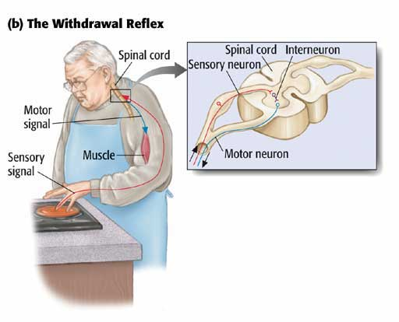
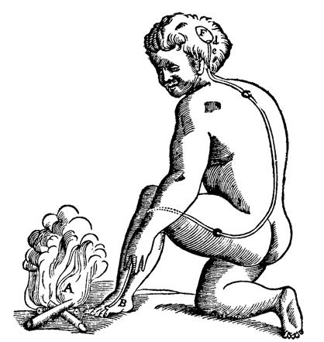
DesCartes’ Reflex Arc
Reflex arc is communication between spinal cord and target muscle.
Forms a reflex “arc”: sensory input-action output

Slide 9
What IS a Reflex?
Reflex: involves 2 closely related events:
  An Eliciting stimulus
  A Corresponding response
  Two are paired together:
    Eliciting stimulus always elicits the corresponding response
    Corresponding response appears innate
Mediated by minimum of three neurons:
  Sensory neuron: responds to eliciting stimulus
  Motor neuron: activates muscles involved in response
  Interneuron: connects the two to form a circuit; not a direct connection

Slide 10
Goal Directed Innate Behaviors
Sherrington's Principles of Reflex action
  Threshold of stimulus intensity to elicit response
  As increase intensity of stimulus, the latency between the stimulus and response decreases
    IRRADIATION EFFECT
  The bigger the eliciting stimulus, the more neurons and thus muscle/joint reactions are involved.

Slide 11
Goal Directed Innate Behaviors
RECIPROCAL INHIBITION:
  Coordination between the muscles during reflexes
    As you extend your arm, one set of muscles relaxes as the other contracts.
  Reflexes there for a reason:
    Remember….Goal directed behavior
    E.G. withdrawal reflex when put hand on hot stove

Slide 12
Why are reflexes important?
Contribute to well-being of the animal
  Protection
  Help with feeding, maternal behaviors, etc.
Reflexes can elicit another reflex in another organism:
  Baby’s suckling reflex stimulates release of milk in nursing mother
  Milk is released via let down reflex
  Baby then gets milk

Slide 13
Goal Directed Innate Behaviors
Modal Action patterns: Innate SEQUENCES of behavior
Fixed Action Patterns
  Behavior is a part of repertoire of all members of that species
  Is not due to prior learning
  Series of behaviors occur in a rigid order
  Once started, the entire sequence must finish
  Sign stimulus needed to initiate fixed action pattern
    A sign that gets the action pattern started
    Releasing stimulus
Example:
  Bird mating dances: No dance, no sex!
  Stickelback fish and fighting: Responds to red belly of the male
  Kelp gull babies: Spot on mom’s beak

Slide 14
The Pinciples of Learning and Behavior , 6e
by Michael Domjan
Copyright © 2010 Wadsworth Publishing, a division of Cengage Learning. All rights reserved.
Notes:
Figure 2.4 – Feeding of herring-gull chicks. The chicks peck a red patch near the tip of the parent’s bill, causing the parent to regurgitate food for them.

Slide 15
Goal Directed Innate Behaviors
Reaction chains:
  Similar to fixed action patterns
    Fixed order
    Need a Sign or Releasing stimulus
  Different in that:
    Not have to keep going once start (can stop if sufficient stimuli not there)
    Progression from one behavior to next in series depends on presence of appropriate stimulus
Examples
  Migration behavior
  Hermit crab and finding new shell home

Slide 16
Several Kinds of Eliciting Stimuli
Sign stimulus or releasing stimulus:
  Stimulus required to elicit the behavior
    Remember this is an innate stimulus, not learned
  As in the herring-gull chicks for feeding
  Also many sexual stimuli are releasing stimuli

Slide 17
Several Kinds of Eliciting Stimuli
Supernormal stimulus:
  Exaggerated form of a sign stimulus
  According to Sherrington: releases BIG behavior
  E.g., tornado hitting your house creates bigger reaction than a simple thunderstorm
  May explain PTSD:
    Supernormal stimulus elicited prolonged and exaggerated behavior
    Now hypersensitive to similar stimuli and low-threshold stimuli!

Slide 18
Sequential organization of behavior
All motivated behavior organized into functionally effective behavior sequences
Appetitive behavior or consummatory behavior
  Eating, drinking, sex, etc.
  Consummatory = completion of a species typical response sequence (not just eating)

Slide 19
Sequential organization of behavior
Organized into functional modes or groups of behavior
  General Search mode: generalized “looking for something”
  Focal Search mode: Focused search for specific stimulus, leads to capture and consumption
  Consumption or ingestion: actually catching and eating/consuming the item
Many Types of modes:
  Appetitive: eating, drinking, sex, comfort/housing
  Defensive modes: Hiding, fleeing, fighting

Slide 20
Habituation
Effects of
repeated stimulation:

Slide 21
Habituation
Learning not to respond to a previously meaningful stimulus
The stimulus used to predict something.
Now the stimulus loses its predictability and you ignore it
Allows efficiency in learning

Slide 22
Habituation
Learning not to respond to a previously meaningful stimulus
The stimulus used to predict something.
Now the stimulus loses its predictability and you ignore it
Allows efficiency in learning

Slide 23
Habituation
Learning not to respond to a previously meaningful stimulus
The stimulus used to predict something.
Now the stimulus loses its predictability and you ignore it
Allows efficiency in learning

Slide 24
Habituation
Learning not to respond to a previously meaningful stimulus
The stimulus used to predict something.
Now the stimulus loses its predictability and you ignore it
Allows efficiency in learning

Slide 25
Dishabituation
When the stimulus changes
Signals a change in the situation or setting
No longer appropriate to ignore, as changed stimulus may have meaning
Why? Something has changed in environment
  check to see if it is meaningful
  react to new situation, adapt!

Slide 26
Characteristics of Habituation
Response decrement: Response strength decreases with repeated stimulation.
Spontaneous recovery: If the stimulus is withheld and then re-presented, the organism will react to the stimulus
Repeated series: With repeated series of exposure, response strength is less ad less
Generalization: Similar stimuli may exhibit habituation when presented
Dishabituation: What has been habituated can be dishabituated

Slide 28
Examples of habituated behavior
Salivation responses:
  The more we eat, the less we salivate in anticipation of that food during a meal
Visual attention in human infants:
  Show baby the “Skye” Paw patrol character
  At first, lots of attention to toy
  After several seconds, reduced looking
Startle response in rats (or other organisms)
  Each time (within a session) you get startled, it is reduced.
Attention to your mother:
  You stop paying attention to her “requests” to take the garbage out.
Reaction to fire alarms in college dorms!

Slide 29
Sensitization
When (over) aroused, even light stimuli elicit strong reactions
In a way sensitization is the opposite of habituation
  Over-react to stimuli
  Over vigilance or hypervigilance
When do we see this?
  Overly hungry/thirst
  Sexual behaviors
  Aggression
  Fear

Slide 30
WHY do we show habituation and sensitization?
It is adaptive! (well, generally)
Ignore what is irrelevant
Attend or hyper-attend to what is important
Is habituation and sensitization passive or active learning?

Slide 31
Isn’t this just fatigue or excitement?
Is habituation/sensitization the same or different from sensory adaptation or response fatigue?
Sensory Adaptation:
  Occurs when you overstimulate a sense system
  Overuse the sensory receptors; must wait our refractory period
Response fatigue: The muscles are tired from responding
How is learning to habituate or become sensitized different than this?

Slide 32
Example: Visits to a Nudist Colony
When first get there:
  S (naked people) --> R (lots of blushing)
Staring behavior decreases over your stay: Repeated exposure
If leave and come back (repeated series) gets easier with each trip: you adjust faster the more often you leave and come back
The more nude bodies- the easier to habituate: Frequency of stimulation
Might generalize: less embarrassed in locker room, etc.
Some one comes in with a camera- suddenly embarrassed again: Dishabituation

Slide 33
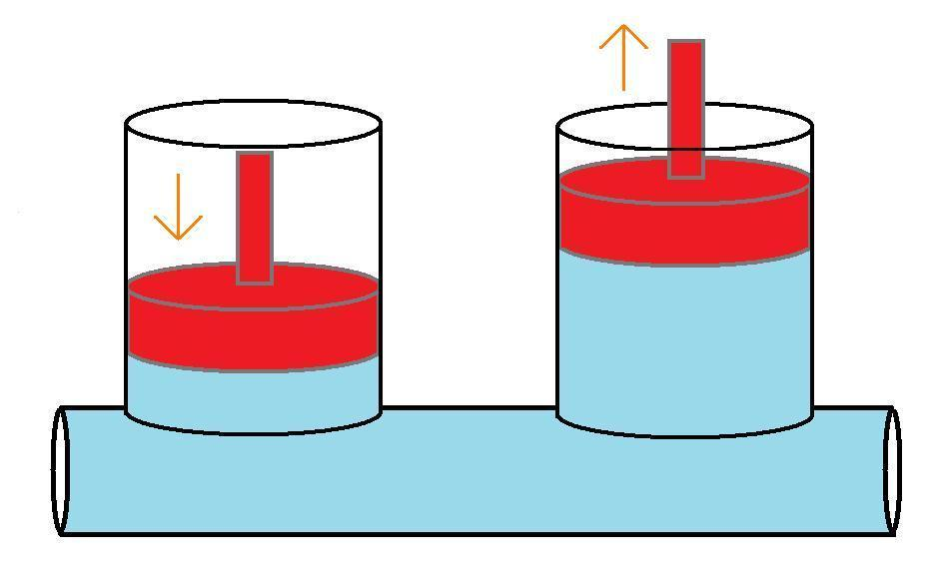
Dual Process Theory
Think of hydraulics: If push down on one side, other goes up
Habituation and Sensitization are opposites: if one, then not the other

Slide 34
Dual Process Theory
Simple Learning is a Dual process:
  Habituation and Sensitization
  As you habituate you are desensitized
  As you become sensitized, you dishabituate
  May involve changes in similar or even identical neural pathway

Slide 35
Dual Process Theory
Solomon’s research with dogs:
  Dogs administered 10-second shock treatments during each session.
  Initially, dogs were fearful and panicked.
  Once the shocks stopped, the dogs wary and guarded (sensitization)
  As the experiment continued, dogs began to tolerate the shocks (habituation)
  After the experiment finished, dogs eventually returned to their previous state, no longer wary and guarded

Slide 36
Other Examples:
Visual attention in infants
  Depending on size/complexity of stimulus
  Infants showed simple habituation to simple visual stimuli
  But: when shown stimulus again, showed increased sensitization (looked at it more)
Drug addiction: will talk about this with classical conditioning
Thrill seeking: go from frightened to adrenaline rush then recovery

Slide 37
Why is this Important?
More than one behavior may occur to a given situation
  The initial reaction: e.g., Fear to a scary object
  The AFTER reaction: relief when the scary object goes away
May be that the AFTER reaction is reinforcing
  Why go on a scary ride or watch a scary movie? It should be aversive!
  But: after reaction is relief…that may be reinforcing.

Slide 38
Context is important
Depends on how/when/where stimulus is presented
  That is, reaction varies depending on context
Example: Startle response:
  Sitting talking with friends
  Knowing that someone is about to jump out at you and beating them to the “boo”
  Watching a scary movie
  A startle will produce different levels of reaction across these settings

Slide 39
Context is important
Touch and sexual responses are another good example
  “Good” touch vs. “Bad” touch
  Touch by a doctor
  Touch by your mom
  Touch by your lover
  Touch by a stranger
All can touch your face, ear, arm, etc., but it is context that regulates how you react to it.

Slide 40
So Why habituation and sensitization?
Adaptive: Learn what to attend to and ignore
Things are more exciting the first time they happen!
Can’t attend to everything: need to learn what the important stimuli are
  Important stimuli change depending on context and experience
  If don’t learn, die!

Slide 41
Now for a brief aside….explaining behavior physiologically!

Slide 42
What happens physiologically during Habituation and Dishabituation?
Simple Systems Approach:
  Eric Kandel
  Look for similarities in process of habituation across species
  See strong similarities in terms of behavior
  Are physiological correlates also similar?
  Can we explain the behavior physiologically?

Slide 43
Why is this important?
If there are strong physiological AND behavioral similarities, suggests that there are generalizable principles and structures that underlie habituation
Suggests that habituation/dishabituation and sensitization are very basic and critical types of learning
    If all organisms show it, must be very robust
    Must be necessary for survival

Slide 44
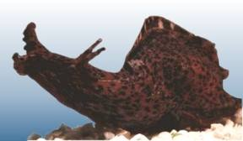
The Sea Aplysia
A large marine snail
Contains only a few thousand neurons so can map the neurons much more easily than larger animal
Examine siphon or fleshy spout withdrawal response
When you poke the siphon, it withdraws into the snail
https://www.youtube.com/watch?v=P7Qjjl-CN4U&feature=youtu.be

Slide 45


Slide 46
Gill-withdrawal reflex
Siphon contains
  24 sensory neurons that respond to tactile stimulation
  6 motor neurons control the gill-withdrawal response
Each sensory neuron has a monosynaptic connnection
  Direct connection that involves just one synapse
  1:1 connection
  1 sensory neuron connects to ONE of the 6 motor neurons
Axons from other sensory neurons involved in polysynaptic connections
  Indirect connections mediated by 1 or more interneurons
  Also connect to these motor neurons

Slide 47
Habituation of the Siphon
Stimulate by touching once every minute for 10-15 trials
  Get habituation within this time
  Animal seems to anticipate touch and gill withdrawal is faster
  Habituation lasts about 1 hour but can extend to 24 hours
If continue this stimulation for 3-4 days: long term habituation
  Lasts several weeks
  Change in way withdrawal reflex occurs
  Think of the parameters of habituation: what would you expect?

Slide 48
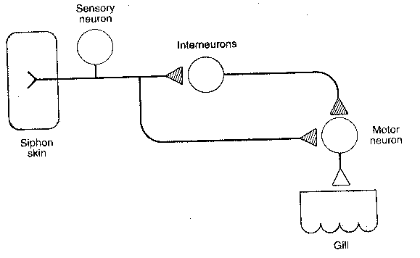
Three kinds of neurons:
Sensory neuron: input neuron, senses the touch
Motor neuron: output or action neuron, withdraws the gill
Interneuron: mediates the input and output to that there is a smooth reaction

Slide 49
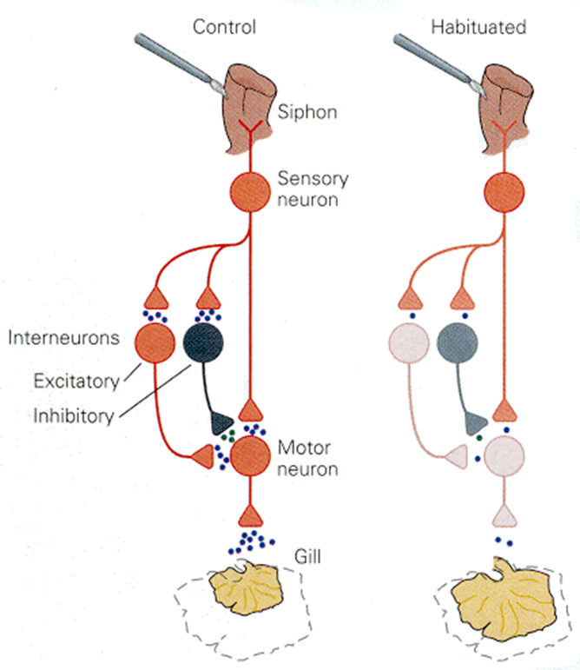
What is happening to neurons?
During habituation:
  Decrease in excitatory conduction
  But: NO change in postsynaptic neuron’s sensitivity to the neurotransmitter
  It isn’t the postsynaptic neuron that is habituating!

Slide 50
What is happening to neurons?
What changed?
  Amount of transmitter released by presynaptic (sensory) neurons
  With repeated stimulation: LESS transmitter released into synapse
  Similar process found in other animals as well

Slide 51
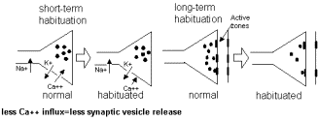
Chemical mechanisms in Habituation?
Each time a neuron fires there is an influx of calcium (Ca+) ions into the axon terminals
Calcium responsible for release of neurotransmitter
Calcium current into axon terminals becomes progressively weaker with repeated stimulation

Slide 52
Why important?
Physiological demonstration of learning
  Later work shows LTP and LTD of axons
Able to pinpoint neural changes responsible for habituation
Habituation does not necessarily involve long term anatomical changes, but temporary chemical changes
Thus appears that learning is flexible:
  In short term, is likely due to chemical changes
  For more permanent memories: anatomical changes

Slide 53
So why is all of this important for applied psychologists?
Eric Kandel won Nobel prize for this work in 2000!
Even some human behaviors are likely to be “innate” or biologically based
Understanding underlying biology helps understand, predict and control human behavior (particularly “misbehavior”).
Context matters: What is “optimal” in one setting may not be optimal in another- environment interacts with biology!

