Slide 2
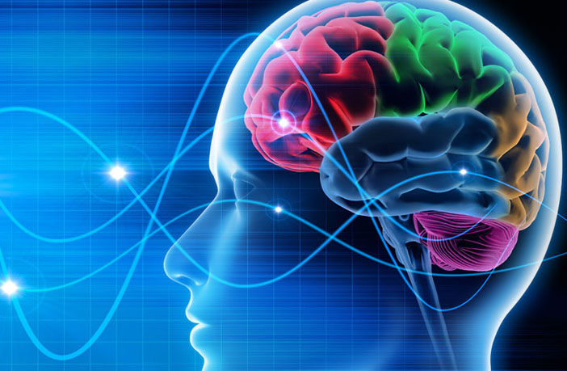
Biological Boundaries on Learning
Why knowing about biology is critical for learning theorists!

Slide 3
Biological boundaries of behavior
Let’s set up a straw man argument:
We present some premises
Show how they are false
But we knew that when we started!
Old-school behaviorists
Emerged as a reaction against the Structuralists.
Rejected biology in error

Slide 4
The Equipotentiality Principle (remember it is wrong!)
The choice of any CS, US, R, S^{r} or P is arbitrary
Any CS can be paired with any US
Any response can be governed by any S^{r} or P
Once a reinforcer or punisher, always and for everyone in the organism’s class
Biology is irrelevant; anything can be learned
(Oh,and this principle is WRONG)

Slide 5
Obviously, the Equipotentiality Principle is WRONG!
Let’s look at evidence that shows this: remember, in science we must refute with data!
Garcia effect or conditioned taste aversion
John Garcia: 1958, 1963
SSDR’s: Species Specific Defense Reactions
Bob Bolles, 1967
Superstition:
Skinner, 1948; Staddon and Simmelhag, 1974; Timberlake’s body of work
Form of the Operant Response depends on terminal event
Wolin, 1959
All lead to a Preparedness or Behavior Systems Model of learning

Slide 6
Garcia Effect or Conditioned Taste Aversion
Grp I: Tasty Water--> Nausea
Good Conditioning
Grp II: Bright Noisy Water-> Shock
Good conditioning
Grp III: Tasty Water--> Shock
No conditioning
Grp IV: Bright Noisy water--> Nausea
No conditioning

Slide 7
A “biological boundary” may explain this phenomenon:
Look at the TYPE of stimuli that are being used:
Categorize each as an internal or external event
Grp I: Tasty Water--> Nausea
Internal Internal
Grp II: Bright Noisy Water-> Shock
External External
Grp III: Tasty Water--> Shock
Internal External
Grp IV: Bright Noisy water--> Nausea
External Internal
Can’t learn ACROSS modalities very well!

Slide 8
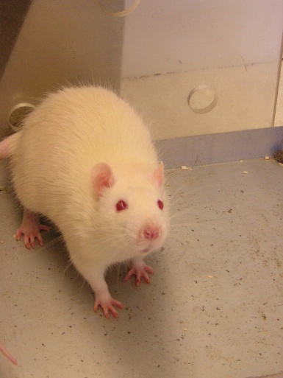
Important Properties of Taste Aversion
One trial conditioning
General phenomenon: most species show it
Tolerates long delay
Novel stimuli condition more readily than familiar stimuli
Occurs differently for different species:
Quail: color of food
Monkeys: texture
Rats: taste and smell
In social animals- can transmit stimulus socially

Slide 9
Uses for Taste Aversion
Humans:
Dietary restrictions
Smoking cessation programs
Can develop CTA with Chemotherapy- must watch pairing good food with nausea
Most important use: Wildlife Management:
Coyote management
Wolf management
Bear management

Slide 10
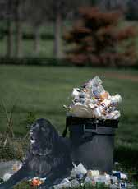
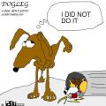
Application: How can you keep your dog out of the garbage?

Slide 11
Species Specific Defense Reactions (SSDRs)
Bob Bolles, 1967
Defense behaviors
Organisms have specific behaviors that do to escape or avoid punishment
Species Specific
Fear/Fight/Fight
Which behavior we do depends on proximity of the threat

Slide 12
Species Specific Defense Reactions (SSDRs)
These behaviors override our learned responses UNLESS we over teach the operant response
Acting almost as a CR in an operant contingency!
Application Question: WHY is it SO important that we practice emergency procedures over and over?

Slide 13
Superstitious Behavior
Skinner, 1948; Staddon & Simelhag, 1976; Timberlake, 1980
Sometimes an organism connects a response to the reinforcer that is NOT the contingent response
Assumption: This occurs through Accidental conditioning
“Flap your wings and turn around 3 times after shutting down the interface, it will work again”
You were doing a behavior when you got reinforced, so you did that behavior again
Assumption: Can be ANY R-S^{r} pairing

Slide 14
Must be reinforced to be maintained
Superstition can be maintained accidentally even IF the real contingency is still in effect
Engage in superstitious behavior and the consequence occurs:
Dog and the Mailman!
Each time this happens, reinforces “belief” that the response and consequence are tied together

Slide 15
Examples
Good luck behaviors and symbols
Baseball players
Wearing lucky shirt
Behavior when playing Wii or other video games
Can be detrimental:
Accidental behaviors can interfere with the real contingency or cause harm
Obsessive compulsive behavior

Slide 16
Superstition & Skinner
Skinner: shaping and superstition
Paired food with cue light
Notice got autoshaping
Noted several characteristics of behavior
Always spun around
Response was fixed and stereotyped
Sequence to pigeon
“Superstition”: animal makes causation where there is not causation between the R and Sr
Animal accidentally paired inadvertent responses with reward
This became basis of superstitious conditioning
Extended to humans

Slide 17
Pigeon Superstition

Slide 18
And People!

Slide 19
Are Superstitious Behaviors Really Random?
Evidence suggests NOT necessarily random
Set of similar characteristics that most superstitious behaviors share
Responses are almost innate responses or previously learned responses
Responses are related to the Reinforcer
Looks like biology may be important!

Slide 20
Biology is important
Superstitious Responses are biologically relevant
That is: relate to the reward situation
Must be part of animal’s natural repertoire
Not just any random pairing of responses with reward, but may be predictable
Wolin, 1959
Another Skinner student
Looked at pecking pigeons as they pecked for food and water reinforcers
Used food rewards compared to water rewards to see if the different rewards elicited different “behaviors”

Slide 21
Water pecks vs. food pecks
Discovered “pecking” was different between the two:
Food peck:
rapid, powerful thrusts of head with beak OPEN
head bounces off key
Much faster
Water peck:
slower extension of head
beak almost closed
remains immersed in water
drinking = pumping action of tongue
scooping motion of beak

Slide 22
Factors affecting Superstition
Interval between response & reinforcement
Short interval between response and reward less likely to produce superstition
Why?
Staddon and Simmelhag, 1974: Examined effects of short and long response-reinforcer delays on topography of behavior.
With short delays between food deliveries:
Sharp movement of head from middle position to left
More energetic
Whole body turn; Hopping step in front of wall
Became fixed and rigid in its form
Longer delays:
More walking and wider pacing
Less energetic; Less rigid in form

Slide 23
Misbehavior of Organisms (1961)
Marion and Keller Breland
Students of B.F. Skinner
Went to Hollywood to train animals for films and commercials
In process of training, discovered consistent “misbehavior” of animals
Called this misbehavior instinctive drift.

Slide 24
Some of first researchers to contradict/ disagree with Skinner publically
First report: 1951 in American Psychologist
Suggested that operant behavior not WHOLE explanation for emerging behavior
Wanted to include biology as part of mechanism
Biology of the animal could interrupt R-Sr contingency
Still strong behaviorists
But also are ETHOLOGISTS

Slide 25
Characterized several instances of animal “misbehavior”
Sammy the Dancing Chicken
The Miserly raccoon
Prize releasing chickens
Baseball playing chicken
Priscilla the Pig
Smart horses

Slide 26
A dog that spins

Slide 27
A special example of “instinctive drift”

Slide 28
Superstitious Behaviors can interfere with operant behavior
Interferes with contingency:
Behavior DELAYS the reinforcer
Almost as if the animal cannot control it
Likely to have some eliciting stimulus
Because are biological, difficult to eliminate
Strong contingencies with short R-Sr intervals
No opportunity to emit biological response

Slide 29
Why? Instinctive Drift
Instinctive behavior drifting into R-Sr relationship and disrupting operant response
Note that delays reward
Law of “least effort”
Hebb: first to discuss neural networks: suggested prewiring
Animals do not come to conditioning situation tabula rasa!

Slide 30
Rewatch the Pigeon in a Skinner box

Slide 31
Pigeon Mating Behavior

Slide 32
Pigeon Juvenile Behavior

Slide 33
Why doesn’t Instinctive Drift ALWAYS Occur?
Whenever situation permits, specifies specific behavior patterns intruded
Tight contingencies that consider biological responses reduce the opportunity
Sloppy contingencies and training increase the opportunity for instinctive drift
Instinctive behaviors compete with operant behaviors
Not random, but predictable

Slide 34
How to Rectify Biology and Learning?
Accept that learning is a biological behavior
Learning may be impacted by other biological mechanisms
Determine the relationship between learning and biological boundaries
Our biggest instinct is to learn!

Slide 35
Behavioral Systems of Behavior: Biological Preparedness
Bill Timberlake’s model (1995, 2005): Are boundaries or systems of behavior
Behaviors are clustered into groups of relevant behaviors
These may be biologically relevant
May be hard wired in many animals
Several “modes” of behavior
Feeding mode
Sexual mode
Aggression mode

Slide 36
Behavior Systems Modes

Slide 37
Perhaps more importantly: Explains animal misbehavior
Several recent examples
Tigers, cougars, lions attacking keepers
African elephants killing their keepers
Sea World issues
“Nice dog” bites owner, child, etc.

Slide 38
Consequences of Instinctive Drift

Slide 39
What DO whales do in the wild?

Slide 40
What DO whales do in the wild?

Slide 41
Why did Tilly Attack
Tilly was an intact male
Wild caught as a young whale
Taken from his pod and raised in isolation with other strange whales
Tilly had a history of being abused:
Housed with other females; not typical in the wild
Females would attack/beat up Tilly
Basically diagnosed with PTSD
Tilly had history of behavioral issues:
Previously killed 2 others:
Trainer in 1990s
In early 2000s, man snuck in and got in tank, was killed by whale

Slide 42
Why did Tilly Attack
Trainer missed a cued behavior and failed to reinforce a behavior chain
Trainer then got close to Tilly; laid down in submissive position
Trainer had no fish left to reward Tilly
All of these were a set up for disaster for the trainer (and Tilly)

Slide 43
Rarely, if ever, do animals “just go psycho”
Almost always incidents involving instinctive drift
Something triggers the instinctive response
captive Wild animals are WILD first, captive second
Not domesticated; WILL engage in species typical behavior
We cannot ever “trust” a captive wild animal to NOT engage in aggressive, species typical responses

Slide 44
Ethical Questions
Should we house captive wild animals
Trade off of avoiding extinction vs living life in captivity
How much contact should be allowed with these animals?
How deal with psychological issues we create when housing animals in nonnative habitats?

Slide 45
Conclusions
We are animals and we behave in ways that are consistent with other species.
There are biological boundaries or constraints in how we learn and react to our environment
Our biggest Human instinct: to learn, predict and control our environment
Animal models allow us to investigate these boundaries and help explain human learning and choice behavior!

