Slide 1
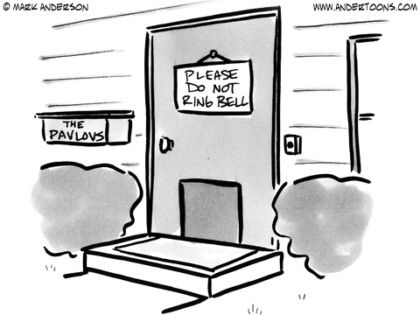

Slide 2
Classical Conditioning
Predictability Matters!

Slide 3
Classical Conditioning
Remember the Reflex Arc
Reflex is elicited by a stimulus
If that stimulus becomes predictive, organism will react to predictor
Classical conditioning is learning to react to a predictive stimulus
The predictive stimulus predicts the eliciting stimulus
The eliciting stimulus elicits the reflex/response
Learn to anticipate what elicits the reflex behavior → respond ahead of time to the predictive stimulus

Slide 4
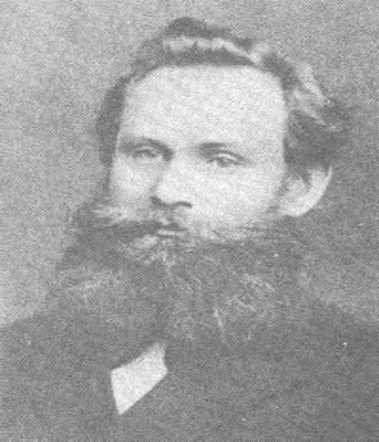
Pavlov’s Contribution
Ivan Pavlov
Russian physiologist: Studied salivation
1901: discovered and wrote about classical conditioning
Found that his dogs reacted to both his presence and the time of day for feeding/experimentation

Slide 5
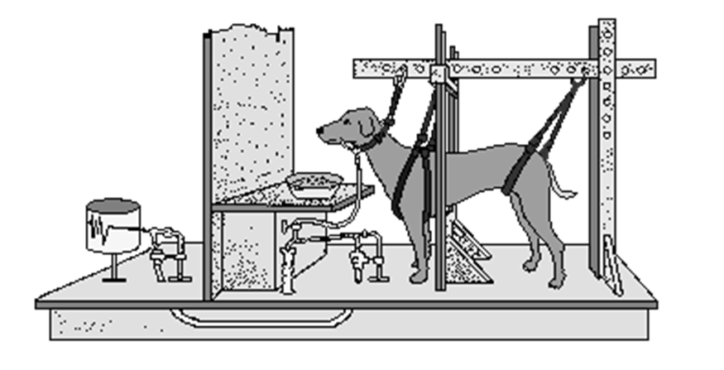
Pavlov’s Contribution
Researched this:
Measured amount of salivation during baseline:
Present food to dogs
Measure slobber
Then added a predictive stimulus: a Bell (actually it was a buzzer!)
Presented the Bell→Food
Measured slobber to see if dogs would begin to slobber to the bell

Slide 6
Labeled each part of these events:
Unconditioned stimulus or US:
The stimulus that automatically elicited the behavior (usually innate)
E.g., the food elicited the slobber
Unconditioned response or UR
The behavior that is automatically elicited
Unlearned; often reflexive
Conditioned stimulus or CS:
The stimulus that predicts the US
Is a learned (thus conditioned) stimulus
Conditioned response or CR:
The behavior that occurs to the CS
Often very similar to the unconditioned response
Occurs because the CS predicts the US

Slide 7
Classical Conditioning Procedure

Slide 8
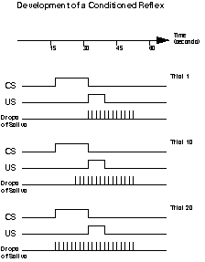
The CR does not just suddenly appear, rather it takes several trials or sessions to learn the connection between the CS and the US

Slide 9
Characteristics or Parameters of Classical Conditioning
Relationship between UR and CR is critical
CR MUST predict UR or no conditioning
Sometimes the UR and CR are the same, or so it seems
The UR and CR are not always identical!
Often are similar, or in similar family of behavior

Slide 10
Characteristics or Parameters of Classical Conditioning
The CR can be opposite of the UR:
Compensatory response
If predicted to go up, you respond by going down!
See this with drugs:
Morphine = lower BP, heart rate, feeling of cold, less pain
CR to morphine= higher BP, HR, feel hot, more pain
What could be predictive CS for morphine?

Slide 11
Why Opposite? Opponent Process Theory
Based on research on classical conditioning of emotions
Three common characteristics of emotional reactions:
Are biphasic: primary reaction followed by after-reaction
Primary reaction becomes weaker or habituates with repeated stimulations
Weakening of primary reaction with repetition is accompanied by strengthening of after reaction

Slide 12
Solomon and Corbit, 1974
Homeostatic theory
We like to be in balance, or at homeostasis
If we have a primary reaction in one direction, need a second reaction in the opposite direction to bring back to homeostasis

Slide 13
Solomon and Corbit, 1974
Look at the two reactions:
Primary process or a process: physiological system that is responsible for quality of initial emotional state
Secondary or opponent process or b process: generates opposite emotional reaction to reduce primary process back to homeostasis
One offsets the other
Can apply to many physiological behaviors: eating, drinking, fear, etc.

Slide 14
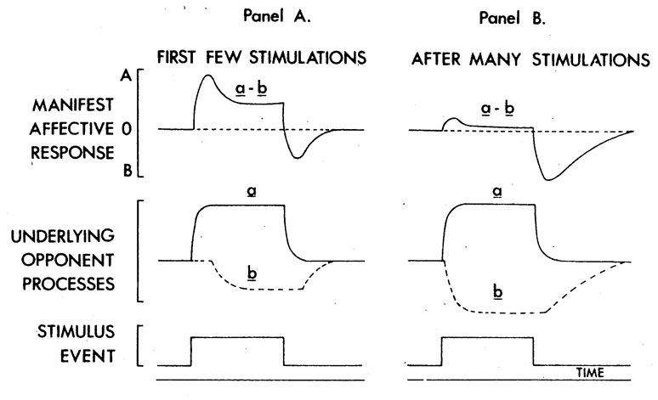
Opponent process theory

Slide 15
Characteristics or Parameters of Classical Conditioning
Strength of CR
Strength gradually increases with trials
E.g., slobber more after each CS-US pairing
Monotonically increasing curve: increases in a single, climbing trend line
Reaches an asymptote: some maximum amount of CR
Why does the CR reach asymptote….why does it not increase infinitely?

Slide 16
Characteristics or Parameters of Classical Conditioning
Extinction
If stop CS-US pairing (CS→ nothing), then the CR will also fade away
Again, must be unlearned, or habituated!
Spontaneous recovery
Sometimes, when conditions are similar to CS, the animal shows the CR
Unpredictable; almost as if they “suddenly remembered”
More likely to occur when animal is stressed, tired, hungry, etc.

Slide 17
Characteristics or Parameters of Classical Conditioning
Relearning:
Relearning is faster than original learning
True if extinction occurred AND if just haven’t had the experience for a while
Important for drug, fear reactions!

Slide 18
Characteristics or Parameters of Classical Conditioning
Generalization and discrimination:
Generalization: CR will occur to stimuli that are similar to the original CS
Discrimination: Can train the animal so the CR only occurs to very specific CSs

Slide 19
Characteristics or Parameters of Classical Conditioning
Higher Order Conditioning:
Chaining of CSs: e.g., CS3→CS2→CS1→US
Respond most to CS1; least to CS3
Essentially is a chaining of CSs
Each CS predicts the next
Strongest learning (CR) to CS closest to US

Slide 20
Four procedures for classical conditioning
Remember:
CS should predict US or no CR; Predictability of CS is critical
Four procedures: (Use the words to remember!)
Simultaneous conditioning:
CS and US presented at same time
Delayed conditioning
CS turns off; US immediately turns on
US is delayed until end of CS

Slide 21
Four procedures for classical conditioning
Four procedures: (Use the words to remember!)
Trace conditioning
A delay is inserted between CS and US
Can test “memory” for pairing this way
Backward conditioning
US is presented BEFORE CS

Slide 22
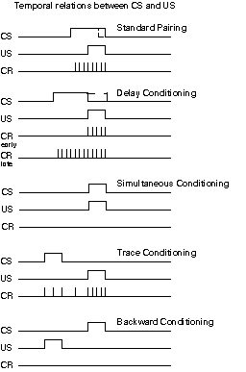
US starts before CS ends
US starts AFTER CS ends
CS and US occur AT SAME TIME
Is a break between CS and US
US starts BEFORE CS

Slide 23
How study CC?: Experimental Paradigms
Obviously, salivation can be one response
Considered an appetitive response
Can use other appetitive responses as well
Fear conditioning
Pair previously neutral stimulus with fear-eliciting stimulus (often shock)
Usually get chain of fear responses
Freezing
Fleeing
Fighting

Slide 24
Eyeblink conditioning
CS paired with something that makes you blink (e.g., puff of air)
Now CS elicits eyeblink
Often do use air or spring on eyelid
Like at eye doctor!
Easy to use and reliable in humans and animals

Slide 25
Eyeblink conditioning
Many animals have a nictitating membrane or 3rd eyelid:
Rabbits, dogs, birds, cats, reptiles, fish…..even camels.
Membrane keep the animals' eyes moist in the face of wind, sand or dirt without them having to blink.
Easy to condition and measure!

Slide 26
Galvanic Skin Response, changes in respiration, Blood pressure, etc.
Galvanic skin response:
usually used for humans
CS may be in most any modality
CR = degree of sweating
takes few trials in most instances

Slide 27
Galvanic Skin Response, changes in respiration, Blood pressure, etc.
Respiration and blood pressure may change, too:
Both for habituation and classical conditioning
CS predictive and thus get change in respiration
This is basis for lie detector tests

Slide 28
Sign Tracking
Sign Tracking: Heart and Jenkins, 1974
The hot dog study: Companion dogs
Octagon room: mounted near ceiling of each side was a light
On 1 wall was light AND feeder
Light basically circled around until the light above feeder lit, then a hot dog was delivered.
Light moves around room, ends at feeder:
What would be smartest position for dogs to take?
Yes, sit at feeder and wait for light to get there
That’s not what happened: dogs followed the light or “tracked the sign”

Slide 29
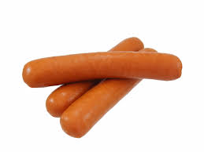
6.
1.
5.
2.
4.
3.

Slide 30
Sign Tracking
Why “track the sign”?
Note: animal does not “have to” make this response (so is a CR)
Animals learn to follow the best predictor of the CR

Slide 31
Sign Tracking
Evolutionarily advantageous……
It is the sign that predicts event
Not necessarily the location or path
Thus: follow sign

Slide 32
Neural components?
Pavlov suggested: Each environmental event corresponds to some point on cortex and deeper brain areas
These are either excitatory or inhibitory effects
Cortical mosaic: complex pattern of excitation/ inhibition

Slide 33
Neural components?
Today we know this does occur and becomes a relatively stable configuration:
Brain centers that repeatedly activated form temporary connections
Arousal of one area results in activation of related area
Excitation may spread as well (remember Sherrington)
Neural networks

Slide 34
Applications of Classical conditioning
It can be therapeutic!

Slide 35
Remember:
Pairing one stimulus with another event
Predictive relationship
Typically pair a neutral stimulus to some event
BUT: can take a non neutral stimulus and re-pair it with another event
Change what that stimulus predicts!
The longer the behavior has been established, the longer it takes to undo and redo!

Slide 36
Applications of Classical Conditioning
Learning Emotional Reactions
Learn that certain stimuli predict certain events
Learn to anticipate upcoming emotion
Show emotion to predictive stimulus
E.g., learn to be afraid of tornado watches, not just the tornado:
CS_{tornado watch}→US _{tornado}→UR_{fear}
CR_{fear}

Slide 37
Little Albert Study
Watson and Raynor (1920)
Conditioned young child- Albert (about 18 mos old)
CS_{white rat} →US _{loud noise}→UR_{fear}
CR_{fear}
Then showed generalization to other objects with white fear (NOT Santa Claus!)
Were going to impose extinction, but Albert moved away!

Slide 38
How “undo” a learned fear?
Systematic desensitization
Teach client to relax first
Develop a “hierarchy” of fear-related stimuli and situations
The substitute predictive CS and CR as introduce to fear hierarchy
CS_{white rat} →US _{relaxing cue}→UR _{relax}
CR_{relax}

Slide 39
Also use in pain control
Replace negative thoughts/cues with relaxation
Meditation
Yoga
Lamaze
Each uses a “cue”
The rosary
The mantra
A fixation point

Slide 40
Other uses
Can use it for “Avoidance”
Pair noxious stimuli with behavior; make afraid
Pair taste with nausea; won’t eat or smoke that again!
Sexual deviations:
Classically conditioned: weird sex stimulus is paired with sexual arousal (e.g., young girls)
So…..pair image of young girls with shock- not like anymore
Problem: generalization: switch to little boys!

Slide 41
Other uses
Can also use flooding:
Flood with the CSs you are afraid of
Massed trials: quickly learn that CSs are now meaningless
Problems with this????

Slide 43
Other uses
Drug abuse:
Contextual cues are extremely strong
Predictive cues = friends, environment, the drug and setting itself
If take these cues away- can overdose
If cues return: cravings come back
Important to change friends and neighborhood when overcoming addiction

Slide 44
Other uses
Advertising
Pair your product with a nice feeling
Why do we use puppies and kitties to sell toilet paper?
Relationship of CS to US?
CS = “nice” stimulus
US is the product
Good feelings increase buying behavior
Disney uses smells as cues
Food smells around bakery
Water smells around water ride stores

Slide 45
Behavior Adjustment Therapy
What is Sensitivity to a stimulus?
Organism is quick to detect or respond to slight changes, signals or influences,
Accompanied by conditioned response of having acute mental or emotional sensitivity.
Often observed with dogs: Dogs with severe behavior problems (aggression, fear, separation anxiety) are often overly and abnormally sensitive to a stimulus (person, dog, noise).
Over reactivity
dog reacts inappropriately with excessive fear or aggression toward the stimulus in question.

Slide 46
Behavior Adjustment Therapy
Desensitization
Means of lessening the sensitivity to a CS until the response is small in proportion to the initial response, or until there is no response at all.
Desensitization works GRADUALLY:
slowly exposes the dog to low and controlled levels of the stimulus that he is aggressive to or fearful of
Replace reactivity and aggressive behavior with calmness and appropriate social behavior

Slide 47
Counter Conditioning
Obviously: form of classical conditioning
But: Must UNDO a CS-US relationship and reestablish a new CR
Introduce CS-new US pairings
Have learned Bad guy→ scary things happen
Bad guy→ high value treat
Over time the “bad guy” elicits cravings for treats, not fear
Very time consuming:
Longer the behavior has been established, longer to undo
a great deal of repetition and trust from the dog.
Great deal of patience and repetition for trainer.

Slide 48
Why do dogs (and others) need desensitization?
Some have had traumatic experiences.
Distressing experience during the puppy fear stage
Experienced Dog Fights or abuse
Genetic predisposition to oversensitivity or phobias
Lack of socialization during the crucial puppy fear stages.

Slide 49
Always use counter conditioning?
DO NOT USE If cannot control levels of anxiety/fear (e.g., in severe cases)
May need to artificially reduce anxiety and fear
A veterinarian/physician can diagnose and prescribe medication that can help with the process of helping the dog to desensitize.
Really needs to be a combination of training with the drug; drug alone will not work.

Slide 50
Always use counter conditioning?
Not inhumane to give dogs or humans a drug as a co-treatment
When humans have a severe phobic or anxiety disorder, we would typically medicate.
Yet, dog owners often are I adamantly against medication
Need to use what ever helps dogs, just like we would with humans

Slide 51
Signs and symptoms of stress in dogs
Slow Tail Wag.
Tail tucked between hind legs. (extreme stress)
Ears back or low
Blinking
Lip licking, yawning
Whale eye
Tight lips
Being unable to eat.
Being unable to play, toy refusal, disinterest in toys normally are interested in

Slide 52
Signs and symptoms of stress in dogs
Holding Breath.
Puffing.
Puffing is when the dog rapidly exhales a small amount of air, that causes her cheeks to puff out.
Puffing is a precursor to aggression.
Stiffness of body:
Rigid position
May be low to ground, may be high
Often a precursor to aggression.

Slide 53
An Example
A client is referred to you: Dog that is abnormally terrified of and slightly aggressive with men.
The stimulus in question is “Men”.
This is an abnormal fear.
It doesn’t matter if the dog was not socialized as a puppy, had a genetic predisposition toward fear, or had a traumatic experience
What is important and what does matter is to take control of the situation and begin desensitization.

Slide 54
How to begin
Find a willing, small (I wouldn’t ask someone 6’5 just yet) and kind man and ask him to help.
Trainer MUST, at least in beginning, control the stimulus “Man”.
Work is conducted in confined and controllable environment
Don’t go to park and work with someone you didn’t know or somewhere that a person could come up and traumatize the dog.

Slide 55
How to begin
Step 1: Lowest level of the stimulus
get the dog close enough to the man, who is standing still making no noise and not turned in the direction of the dog
How close? Dog shows no signs of stress at all and is able to complete simple tasks such as sit.
This may mean the dog needs to be 150 or 200 feet away.
The man will never turn around or even speak to the dog at this stage.
Next steps: When dog is fluent at each step, move closer
Fluency? Dog should show no signs of stress at all, can respond to simple cues such as sit for at least 3 sessions

Slide 56
BAT: Behavior Adjustment Training
http://info.drsophiayin.com/training-aggression/?utm_campaign=Bite-Prevention---Training-Aggression&utm_content=9425424&_hsenc=p2ANqtz-880u4BGaLkPRi0Wys4dJ-UBuVd99cMn9lTWXccJHLYNcjHq0GzgEFAWLqtvLjgMGnBjAFRtcrVSlvk6cS3mgninHANESy9wd8AxzggD7SF9BtcElc&_hsmi=9425424

Slide 57
How would you treat:
Fear of a vacuum cleaner
Fear of another dog
Fear of the vet
Fear of thunderstorms
Others?
How apply to humans? Other animals?

