Slide 1
Reinforcement Schedules

Slide 2
Let’s go over Assignment #3
1. Define classical conditioning. Define operant conditioning. What is the fundamental difference between these two types of learning?
2. Describe the difference in extinction behavior for classical vs. operant conditioning. Why might this be important in an applied setting?
3. For each of the following, determine if the example is operant or classical conditioning, and why. If it is operant conditioning, is it an example of positive reinforcement, negative reinforcement, positive punishment, or negative punishment.
Jon got a new toy, a spiny lizard plastic model. For a month, every time Jon picked up the spiny lizard toy his sister yelled and startled him. Now, whenever he sees the toy he feels scared.
Stella came home in a grumpy mood. As she walked in she slammed the front door. Her mother made her go back and close the door 100 times quietly. Now, she is very careful to close the door quietly even if she IS grumpy.
Zoomba dog barks at the mailman walking up to the front door, and of course the mailman leaves after dropping off the mail. Now Zoomba's barking is increasing each time the mailman comes to the door.

Slide 3
Schedules of Reinforcement:
Continuous reinforcement: CRF
Reinforce every single time the animal performs the response
Use for teaching the animal the contingency
E.g., when shaping a response
Problem: Satiation
Organism gets “full” and won’t work any more

Slide 4
Schedules of Reinforcement:
Solution to satiation: only reinforce occasionally
Only some of responses are reinforced
Can reinforce using time or number/quantity
Partial reinforcement: PRF
Can reinforce occasionally based on time
Can reinforce occasionally based on amount
Can make it predictable or unpredictable

Slide 5
Partial Reinforcement Schedules
Fixed Ratio: every nth response is reinforced
Example: FR5
Animal must respond 5 times to get a reinforcer
If fall short of the requirement, no reinforcer
E.g., candy sales: sell so many boxes and a prize
Results in a break and run pattern:
Work hard, take a break
Higher the requirement, longer the break

Slide 6
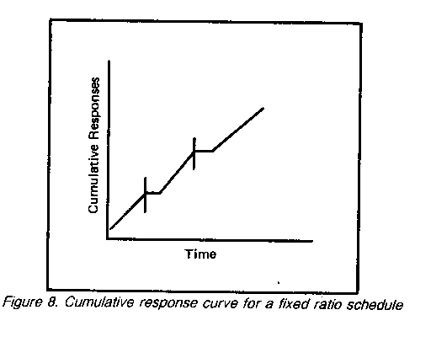

Slide 7
Partial Reinforcement Schedules
Fixed interval: the first response after x amount of time is reinforced
Example: FI 60 sec schedule
First response that occurs after 60 seconds has passed is reinforced
MUST make a response to get reinforcer
Can wait longer, but won’t be rewarded for early responses
Tests scheduled every 4 weeks
Only study when test is close
Slack off when test is distant
Wait then hurry pattern
Results in a fixed interval scallop pattern

Slide 8
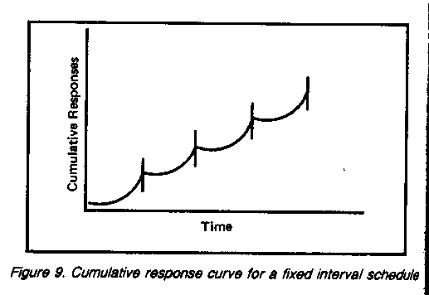

Slide 9
Partial Reinforcement Schedules
Variable ratio: on average of every nth response is reinforced
Example: VR5
Reinforced after 1, 8, 2, 7, 3, 6, 4, 5, 9 responses
Averages 5 responses/reinforcer
Random element keeps organism responding
Slot machines!
Results in a fast and steady rate of responding
Actually the fastest responding of any basic schedule
Why? Animal has control of rate of reinforcement: faster responding = more reinforcement

Slide 10
Partial Reinforcement Schedules
Variable interval: the first response after an average of x amount of time is reinforced
Example: VI30sec
Reinforced after 5,30,20,55,10,40,30 seconds
Averages 30 seconds per reinforcer
Random element keeps organism responding
Pop quizzes!
Results in a fast and steady rate of responding
Not as fast as VR schedules
Why? Animal cannot control passage of time so faster responding = more reinforcement

Slide 11
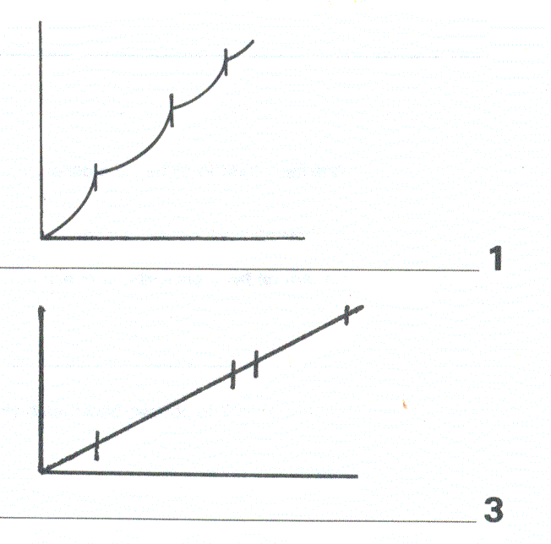

Slide 12
Differential Reinforcement Schedules
Only reinforce some TYPES of responses or particular RATES of responses
Often reinforce the opposite or alternative to the “bad” behavior you would like to reduce
Is an alternative to extinction
Is a criteria regarding the rate or type of the response

Slide 13
Differential Reinforcement Schedules
Several examples:
DRO: Differential reinforcement of OTHER behavior
DRA: Differential reinforcement of ALTERNATIVE behavior
DRL: Differential reinforcement of LOW rates or responding
DRH: Differential reinforcement of HIGH rates of responding

Slide 14
DRO: Differential Reinforcement of Other behavior (responses)
Use when want to decrease a target behavior (and increase anything BUT that response)
Reinforce any response BUT the target response
Often used as alternative to extinction
E.g., SIB behavior
Reinforce anything EXCEPT hitting self

Slide 15
DRA: Differential Reinforcement of Alternative behavior (responses)
Use when want to decrease a target behavior (and increase the alternative to that response)
Reinforce the alternative or opposite of the target response
Often used as alternative to extinction
E.g., out of seat behavior
Reinforce in seat behavior

Slide 16
DRH: Differential Reinforcement of High rates of responding
Use when want to maintain a high rate of responding
Reinforce as long as the rate of reinforcement remains at or above a set rate for X responses per amount of time
Often used to maintain on-task behavior
E.g., data entry: must maintain so many keystrokes/min or begin to lose pay
Use in clinical setting for attention: as long as engaging in X academic behavior at or above a certain rate, then get a reinforcer

Slide 17
DRL: Differential Reinforcement of Low rates of responding
Use when want to maintain a low rate of responding
Reinforce as long as the rate of reinforcement remains at or below a set rate for X responses per amount of time
Often used to control inappropriate behavior
E.g., talking out: as long as have only 3 talk outs per school day, then earn points on behavior chart
Use because it is virtually impossible to extinguish behavior, but then control it at lowest rate possible.

Slide 18
Variations of Reinforcement Limited Hold (LH) Schedules
There is a limited time when the reinforcer is available:
Like a “fast pass”: earned the reinforcer, but must pick it up within 5 seconds or it is lost
Applied when a faster rate of responding is desired with a fixed interval schedule
By limiting how long the reinforcer is available following the end of the interval, responding can be speeded up or miss the reinforcer: take it or lose it.

Slide 19
Multiple (MULT) Schedules
Two or more basic schedules operating independently and alternating in time
Organism is presented with one schedule, and then the other
MULT VI 15 VI 60:
Presented with the VI 15 schedule (for 2 min),
Then the VI 60 sec schedule (for 2 min),
Then it repeats.

Slide 20
Multiple (MULT) Schedules
Two or more basic schedules operating independently and alternating in time
You can choose to go to your first class, and then choose to go to the next class (but not really do both at same time)
Provides better analog for real-life situations

Slide 21
Concurrent (CONC) Schedules
Two or more basic schedules operating independently at the same time for two or more different behaviors
Organism has a choice of behaviors and schedules
Choose to respond on Schedule A OR
Choose to respond on Schedule B
Again, can’t respond on both schedules at the same time.

Slide 22
Concurrent (CONC) Schedules
CONC VI 15 sec VI 60 sec:
Can choose to respond to the VI 15 second schedule OR the VI 60 sec. schedule
Both available, organism must make a choice
You can take notes or daydream (but not really do both at same time)
Provides better analog for real-life situations

Slide 23
Concurrent or Multiple Schedule Responding:
When similar reinforcement is scheduled for each of the concurrent or multiple schedule responses we can predict that:
The response receiving higher frequency of reinforcement will increase in rate
The response requiring least effort will increase in rate
The response providing the most immediate reinforcement will increase in rate
Important in applied situations!

Slide 24
Conjunctive Schedules
The requirements for two or more schedules must be met simultaneously
For example, an FI and FR schedule
Must complete the scheduled time to reinforcer on the FI, then must complete the FR requirement before get reinforcer
Similar to a chain

Slide 25
Conjunctive Schedules
Task/interval interactions
When the task requirements are high and the interval is short, steady work throughout the interval will be the result
When task requirements are low and the interval long, many non task behaviors will be observed

Slide 26
Chain schedules
2 or more simple schedules presented sequentially and signaled by an arbitrary stimulus
Ending one schedule requirement can serve as a cue for the next
The stimulus signaling the next chain component serves as a conditioned reinforcer

Slide 27
Chained Schedules
Two or more basic schedule requirements are in place:
One schedule at a time
But in a specified sequence
E.g. first a VR 60 then a FR 10 schedule CHAIN:
must complete the VR 60,
then presented with an FR10 schedule- 10 more responses to get the Sr
Could also be with behaviors: Sit, stand, spin, bark, sit→ Sr

Slide 28
Chained Schedules
Usually a cue is presented to signal specific schedule in effect:
The S+ is present as long as the schedule is in effect
Then the next S+ is presented to note the change in the schedule
Sometimes TIME is used as the cue!

Slide 29
Chained Schedules
Reinforcement for responding in the 1st component is the presentation of the 2nd
Reinforcement does not occur until the final component is performed

Slide 30
Several kinds of Chain Schedules
Tandem schedules:
Two or more schedules
Components are NOT signaled
Unconditioned reinforcement programmed in after completing the schedules
Is an unsignaled chain:
FR50→FT 120→R→Food Sr
Homogeneous chains: all responses along the chain are identical (e.g., lever pressing)
Heterogeneous chains: Different types or forms of a response are required for each link in the chain
Sit-walk-spin-down-walk-sit-Sr
Each new behavior serves as a reinforcer for last response and a cue for the next event in the sequence

Slide 31
Backward and Forward Chains
Backward Chain:
Start with the last response in the chain
Teach it in a backwards sequence
Results in high rate of reinforcement, as always have organism emit last response→ then get the reinforcer
Forward Chain
Start with the first response in the chain
Add links in a forward direction
Use for tasks that require a completion for the next link
E.g., baking a cake: more difficult to end with last link
Typically, most behaviorists favor backward chains, due to higher rate of reinforcement

Slide 32
Information and Stimulus Cues
Informativeness of a stimulus cue = type of information it carries
“Good news” or “bad news” is important, but NO as important as predictability
PREDICTABILITY or reliability of the cue is most important
Most stimulus cues provide information regarding “good news”- that is they
Cue the next response towards a reinforcer or
The occurrence of the reinforcer itself

Slide 33
Information and Stimulus Cues
Organisms prefer “bad news” over “no news”
Animals and people prefer to have the upcoming bad event predicted than not predicted
Question of efficacy of the stimulus = is it useful (does it provide information)?
Cues closer to the terminal event (e.g., the reinforcer) are linked more strongly to the actual reinforcer than more distant cues
Tend to get less delay in response, stronger response, more reliable response and faster response as get closer to the reinforcer
Why?

Slide 34
Contingency-Shaped vs. Rule-Governed Behaviors
Contingency-Shaped Behaviors—Behavior that is controlled by the schedule of reinforcement or punishment.
Rule-Governed Behaviors—Behavior that is controlled by a verbal or mental rule about how to behave.
Humans often believe their behavior is rule-governed when it is actually contingency governed.

Slide 35
Operant Behavior can involve BOTH
Obviously, reinforcement schedules can control responding
Organisms can form “rules” about reinforcers:
Heuristics
Algorithms
Concepts and concept formation
“Respond as fast as you can and you get the most reinforcer”
Act nice only when the teacher is looking at you; if she doesn’t see you she can’t reward you.
Operant conditioning can have rules, for example, the factors affecting reinforcement.

Slide 36
Parameters of Reinforcement Schedules

Slide 37
Rate of Reinforcement
In general, the faster the rate of reinforcement the stronger and more rapid the reinforcement
Peaks at some point: asymptotic
Can no longer increase rate of responding
Do risk satiation and habituation

Slide 38
Amount of Reinforcement
In general, the MORE reinforcement the stronger and more rapid the responding.
Again, at some point increasing the amount will not increase response rates- at asymptote
Again, worry about habituation/satiation

Slide 39
Delay of Reinforcement
When Shaping: Critical that reinforcer is delivered ASAP after the response has occurred.
Important for establishing contingency
Is really a contiguity issue
Doesn’t HAVE to be contiguous, but helps
Why?
Responses occurring between the target response and the reinforcer may become paired with the reinforcer or punisher
Inadvertently reinforce or punish in between responses
Example: Child hits sister, mother says “wait till your father gets home”
Child is setting table
Father walks in, hears about misbehavior, and spanks
Child connects table setting with spanking

Slide 40
Reinforcer Quality
Better quality = more and stronger responding
BUT: Inverted U-shaped function
Too poor a quality = low responding
Too high a quality = satiation
Think of the tenth piece of fudge: As good as the first one or two?

Slide 41
Response Effort
More effortful responses = lower response rates
Must up the reinforcer rate, amount or quality to compensate for increased effort
Again, an optimizing factor:
Low quality reinforcer not worth an effortful response

Slide 42
Post-Reinforcement Pause
Organism must have time to consume the reinforcer
Longer pauses for more involved reinforcers
M&M vs. salt water taffy!
This is not disruptive as long as plan for it
Remember: type of schedule can alter the post-reinforcement pause!

Slide 43
Satiation Hypothesis
Responding decreases when animal “full”
Satiation or Habituation?
Satiation = satiety: animal has consumed as much as can consume
Habituation = tired of it
BOTH affect operant behavior often hard to tell which is which

Slide 44
Extinction of Intermittently Reinforced Behavior
Resistance to extinction = takes a response longer to extinguish
The less often and the more inconsistently behavior is reinforced, the longer it will take to extinguish the behavior, other things being equal

Slide 45
Extinction of Intermittently Reinforced Behavior
Behaviors that are reinforced on a “thin” schedule are more resistant to extinction than behaviors reinforced on a more dense schedule
Behavior that is reinforced on a variable schedule will be more resistant to extinction than behavior reinforced on a fixed schedule

Slide 46
Reducing Reinforcer Density
Large amounts of behavior can be obtained with very little reinforcement using intermittent schedules
Initially, behavior needs dense schedule of reinforcement to establish it
Preferably continuous reinforcement
As the behavior is strengthened, reinforcement can be gradually reduced in frequency
Start with as low a density as the behavior can tolerate and decrease the density as responding is strengthened

Slide 47
Schedule or Ratio Strain
Ratio Strain: When reinforcement is reduced too quickly, signs of extinction may be observed:
Response rate may slow down
Inconsistent responding may be seen
May see an increase in other responses
If this happens, retreat to a denser reinforcement schedule
Adding a conditioned reinforcer in between reinforcements can help bridge the gap

Slide 48
Conditioned Reinforcement
There’s power in those
reward contingencies!

Slide 49
Conditioned Reinforcement
Unconditioned reinforcer = primary reinforcers
Things or activities that are innately reinforcing
Food, water, sex, warmth, shelter, etc.
Organism does not need to learn value of these (although more experience does result in more learning about these reinforcements
Conditioned reinforcer = learned reinforcer
A reinforcer that has been learned
E.g., the click in clicker training PREDICTS the upcoming food; takes on value of its own
Money, praise, grade points, etc.

Slide 50
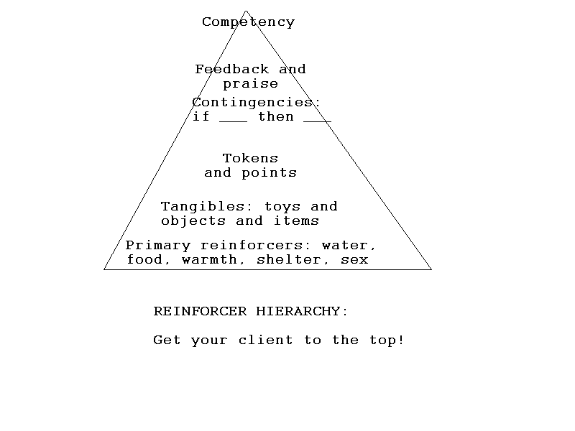
Reinforcer Hierarchy
Goal is to get the client as far up the hierarchy as possible.
But: this process is learned

Slide 51
Token Economies
Use conditioned reinforcers with differing values to create an “economy”
Often use “poker chips” or other symbol for counting economy
Earn a particular poker chip for contingent behavior
May earn more for additional behavior
Can trade tokens up/in
Our money system is a token economy
Dimes have no real “value” (well, they do is we melt them down)
Earn “money” for different behavior
Different “reinforcers” cost different amounts
We can spend our money as needed- we have choice
We can engage in additional behavior for more money, choose to no engage in a behavior and not earn money, etc.
Commonly used in schools, institutions, etc.

Slide 52
Generalized Social Reinforcement
Approval, attention, affection, praise
Most organisms find generalized social reinforcement highly reinforcing
Remember that praise, etc., must be LEARNED
Pair praise words with attention/food/comfort, etc.
Some organisms come into setting with no history of social reinforcement, or negative history
Can’t assume that all organisms react to social reinforcement in similar manners

Slide 53
Research on “Bad News” stimuli
“Bad” attention (social reinforcement) better than NO attention
Organisms will work to get any social reinforcement, even if it is “Bad”
E.g., kids will work for teacher attention, even if that attention is being yelled at
Will learn to “misbehave” to get teacher attention
Often, only time teacher attends to child is when the child is “bad”
Are actually shaping up the child to engage in unwanted behavior

Slide 54
Remember work on “Bad News” stimuli
Stockholm syndrome may be explained in this manner:
Captive held against will
Contingency = Do what I say or no ________
Victim gets attention from captor for complying with requests
This is actually a form of social reinforcement
Begins to pair captor with attention
Develops positive attitude towards captor (as predictor of reinforcement)
This may explain why victims stay with abusers
Any attention is better than no attention
Also shows why it is SO important to provide positive attention for socially appropriate responses

Slide 55
Bottom Line:
Reinforcers can be provided continuously or on many different schedules
Important part is what information the reinforcers provide to the organism as to
When
Where
How
How often you are reinforced
The way the reinforcer is delivered is important to determining the size of the reinforcement effect
Reinforcers can be conditioned….or indirect (think money!)
We would rather know about bad things than have no information

