Slide 2
Errorless Learning and the Feature Positive Effect

Slide 3
Transferring stimuli
Once establish one cue, can add a second cue for the same behavior
Again, use only for THAT behavior
Keep stimuli separate.
E.g., does down mean stop jumping on me or lie down on the ground?

Slide 4
Prompting
Prompts are used to increase probability that organism will engage in correct response
Use during discrimination training
S^{D} or S⁺: in presence of this stimulus, do the behavior
S or S-: in the presence of this stimulus, do NOT do the behavior
Function of prompts is to produce instance of correct behavior so it can be reinforced

Slide 5
Types of Response prompts
Response prompts: behavior of another evokes desired response in presence of S^{D}
Verbal prompts: voice command
Gestural prompts: physical movement or gesture of trainer
Modeling prompts: observe model and imitate (not really used with rats)
Physical prompts: physically assisting rat to engage in behavior

Slide 6
Types of Stimulus prompts
Stimulus prompts: change in stimulus or addition/removal of stimulus increases likelihood of desired response in presence of S^{D}
Within-Stimulus prompts: change the salience of a prompt
Bigger or smaller
Louder or softer
More or less
Extra-stimulus prompts:
Adding a stimulus to increase likelihood of correct discrimination
Picture prompts
Putting line of food pellets for rat to follow

Slide 7
Behavior chains
One behavior can be a cue for the next response
This is a behavior chain
E.g., run through the tunnel, over the balance beam and then through the weave poles
Can teach forward chain:
Start with first, then add second, third, etc.
Reinforce after successful behavior for criterion
Or backwards chain:
Start with last response, then next to last, and so on
Reinforce after successful behavior for criterion

Slide 8
Fading prompts
Several ways to fade prompts
Transferring stimulus control
Remove one stimulus cue, then another
Fading across different types of prompts or fading across prompts
Least to most: fade least invasive prompt first
Most-to-least fading: fade most invasive prompt first
Prompt delay
Delay the prompt
Increase delay until behavior occurs before prompt would have been given

Slide 9
Errorless Discrimination Learning:
Herb Terrace: Criticized way most discrimination learning or training is conducted:
Subjects allowed to make many, many errors
Often get aggressive behavior occurring soon after transition from S+ to S-
Even after many, many training sessions, subjects till make many errors
Alternative suggestion: Errorless learning
Subjects typically make fewer or no responses to S-
Differs from traditional approach in two major ways:
Rather than waiting for steady responding to S+, introduces S- early in learning
Fading procedure used to make it unlikely that subjects will respond to S-

Slide 10
example: teach S+ = red; S- = green
Teaching red vs. green discrimination
S- presented for only 5 or so seconds
S+ presented for 3 minutes
S- begins as unlit (dark) key: pigeons much less likely to peck it
S- gradually fades to green key
Human example: teaching MR children sight words
Word + picture on slide
Gradually fade the picture, leaving only the word

Slide 11
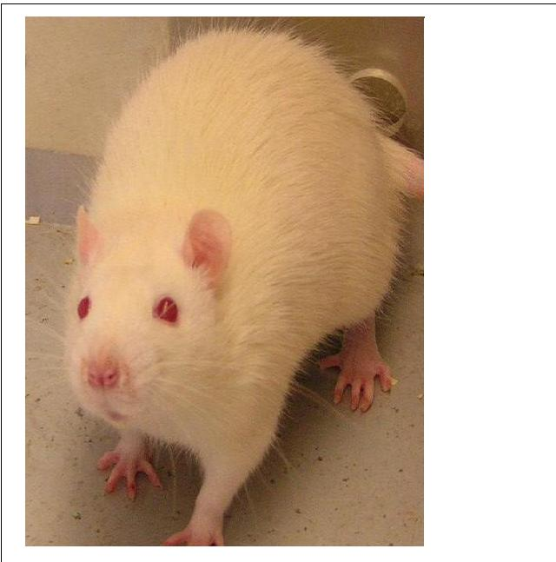

Slide 12
RAT

Slide 13
RAT

Slide 14
RAT

Slide 15
RAT

Slide 16
RAT

Slide 17
RAT

Slide 18
RAT

Slide 19
Several important characteristics about procedure:
Is very effective in reducing number of responses to the S-
Improves long term discrimination
Terrace claims not get aggressive behaviors w/fading procedure
S- not develop inhibitory properties- thus eliminates peak shift effect
Not get behavioral contrast

Slide 20
Feature Positive Effect
Several limitations on effectiveness of discrimination training:
Discrimination will not occur if animal cannot detect difference between stimuli
Animal won't form discrimination if not attend to proper stimuli
The stimulus that an animal attends to is determined by many factors, including:
Species differences
Salience of stimuli
Past experiences: learning history

Slide 21
Feature Positive effect: Jenkins and Hearst
Basic experiment:
Pigeons given 2 stimuli simultaneously
S+ = lighted key w/dark spot
S- = lighted key w/no dark spot
Looked at discrimination ratio:
key pecks to S+/ total key pecks S+ S-
thus: perfect discrimination ratio = 1.0
no discrimination = 0.5
Results of initial experiment: pigeons quickly learned to discriminate

Slide 22
Feature Negative Effect
Then: switched stimuli around:
S+ = lighted key w/NO dark spot
S- = lighted key w/dark spot
S+ S-
Found NO discrimination in this case
Why? Feature Positive Feature Negative effect!
We remember and attend to the positive aspects of the stimuli, not the “negative” or “what’s missing”!!!!

Slide 23
Feature Positive Effect

Slide 24
S+

Slide 25
S-

Slide 26
S+

Slide 27
S-

Slide 28
S+

Slide 29
S-

Slide 30
S+

Slide 31
Feature Negative Effect

Slide 32
S+

Slide 33
S-

Slide 34
S+

Slide 35
S-

Slide 36
S+

Slide 37
S-

Slide 38
S+

Slide 39
One more try!

Slide 40
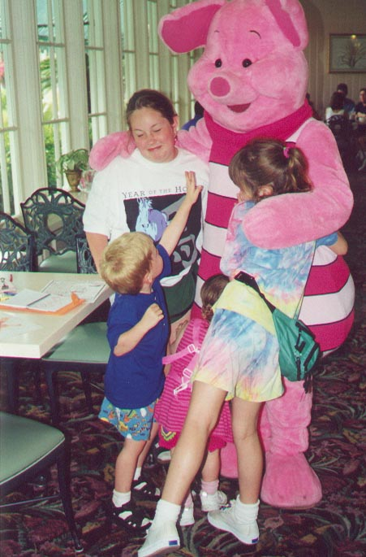
S-

Slide 41
S+

Slide 42
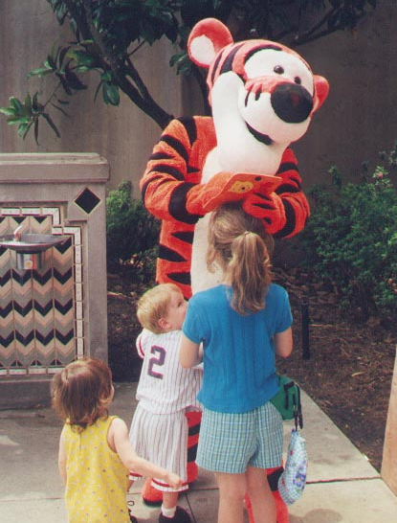
S-

Slide 43
S+

Slide 44
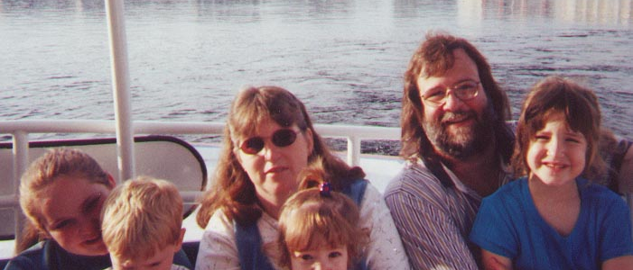
S-

Slide 45
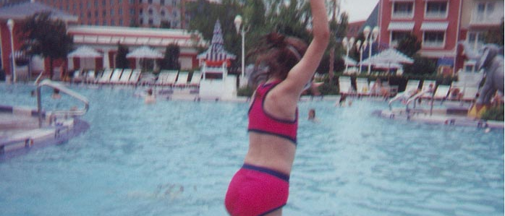
S+

Slide 46
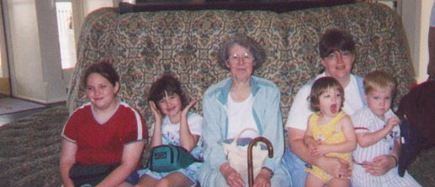
S-

Slide 47
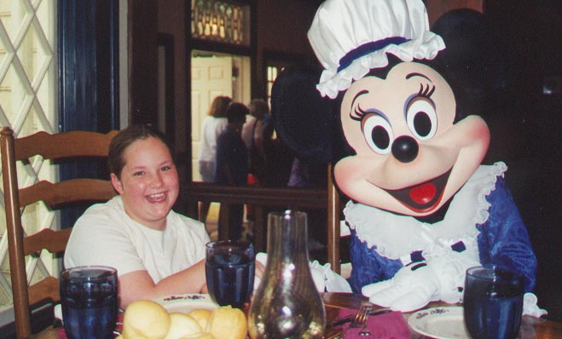
S+

Slide 48
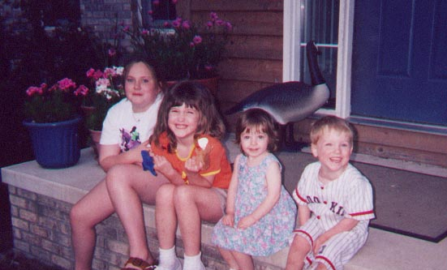
S-

Slide 49
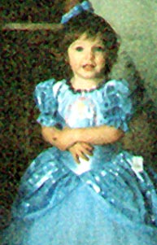
S+

Slide 50
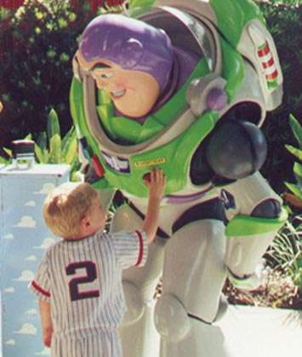
S-

Slide 51
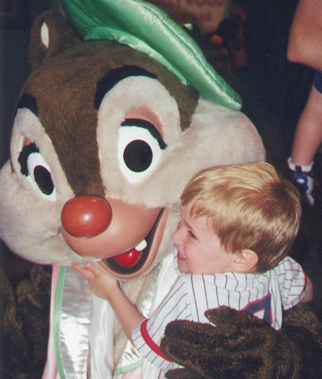
S-

Slide 52
So, what is the concept?

Slide 53
An Unusual Paragraph!
How quickly can you find out what is so unusual about this paragraph? It looks so ordinary that you would think that nothing is wrong with it at all, and, in fact, nothing is. But it is unusual. Why? If you study it and think about it, you may find out, but I am not going to assist you in any way. You must do it without coaching. No doubt, if you work at it for long, it will dawn on you. Who knows? Go to work and try your skill. Par is about half an hour.

Slide 54
A Clue
The author, Eliot Hearst, could not add his name to the paragraph and maintain the concept!

