Slide 1
Classical Conditioning of Instrumental Conditioning?
Whoa…they are supposed to be SEPARATE!

Slide 2
Thorndike’s role in CC-OC connection
Thorndike wrote that instrumental conditioning occurs in context of specific environmental stimuli
Cues involved that tell you “contingency in effect”
Really a THREE term contingency: S,R and O
Stimulus
Response
Outcome
S: R→Consequence
Stimulus can be an S+
Stimulus can be an S-
Can predict a reinforcer OR a punisher

Slide 3
S-R association and LAW of EFFECT
Contextual stimuli (S) predict the instrumental response contingency
(R or R→O).
Is an association between the S and the R: S→R
Is an association between the R and the O: R→O
According to THORNDIKE: Role of the reinforcer is to “stamp in” or “strengthen” the S-R connections
NOT the R→O contingency
Motivation for engaging in R→O contingency are the setting contextual stimuli (S)
Data did NOT support this model
Association IS formed between the R and O
However, contextual cues are VERY important in operant conditioning
(O is the outcome)

Slide 4
Expectancy of Reward
Reward expectancy can be a motivator for the operant response!
Cues for this expectancy are classically conditioned
Expectancy cues can be highly varied and complex
The situation
The individual(s)
Signal learning
Cues paired with R→O contingency because they predict the contingency
Clark Hull and Kenneth Spence:
Behavior is result of interaction between organism and its environment.
Environment provides the stimuli; The organism responds (all of which is observable)
Hull’s theory = drive reduction theory

Slide 5
Expectancy of Reward
Basic premise of their Drive Reduction theory
Instrumental response increases during conditioning because
Presence of S evokes instrumental response through CC
Instrumental response is emitted because of operant contingency
In a nutshell: Environmental cues “drive” the response; making the response (and getting the O) reduces the drive
The animal works for food because it reduces the drive for food.
What cues the animal that it is hungry?
Environmental or contextual stimuli
Including internal stimuli

Slide 6
Two process theory of Operant Conditioning
Assumes 2 distinct types of learning:
Pavlovian/CC
Instrumental/Operant
Presence of stimuli (S) come to predict R-O relationship
R-O relationship is also strengthened
Thus S-O become connected
Rescorla and Solomon assume S-O association activates emotional state
Motivates the operant behavior
This emotional state assumed to be positive or negative depending on the consequating stimulus
(They must have read Hull’s model!)
Related together in special way:

Slide 7
Test of 2-process theory
Pavlovian Instrumental Transfer experiment:
Can counterbalance phase 1 and phase 2
Critical transfer phase is the transfer test: Will the rat lever press to tone alone?

Slide 8
What do the data say?
Large research area: Data are mixed in support of theory
Organisms respond more in presence of S if S is positive (appetitive)
Organisms respond less in presence of S if S is negative (aversive)
BUT: Still respond in absence of the S
Response interactions occur in Pavlovian Instrumental Transfer
Evidence suggests that animals do develop emotional responses to the S
Also develop sign tracking behavior (now sign tracking begins to make sense!)
Let’s look at some specific experiments to help this make sense.

Slide 9
Krank, et. al., 2008
Rat study!
2 response levers, 1 on either side of water bottle
Trained to press either response lever for drop of sweetened water, then ethanol
CONC VI 20 sec VI 20 sec schedule
8 Pavlovian sessions:
No response levers
CS (light) of 10 sec on either left or right side (above lever hole) → 0.2 ml of ethanol
Unpaired group: CS and ethanol separated by 10 sec.
Paired group: CS just before ethanol:
GOT sign tracking when light predicted ethanol for paired group, as you would expect
Replaced levers and added Pavlovian Transfer Test
CS light periodically presented while rats responding for ethanol; alternated over both levers

Slide 10
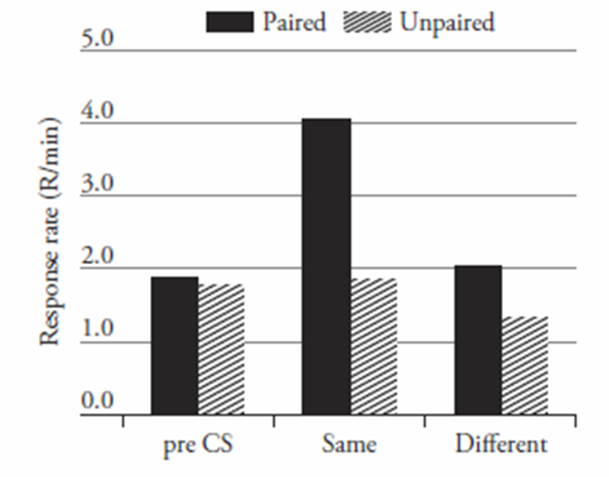
Krank, et. al., 2008
What happened?
Rats pressed each response lever about 2x/min prior to CS
Unpaired group: Did not change much when CS added
Paired group: Significant increase in lever pressing during CS presentation IF presented to same side as training trials
Why is this important?
Shows that CS facilitated lever pressing
Demonstrates importance of classical conditioning in operant conditioning contingencies
Fairly specific as well- not just any CS, but the close or predictive CS

Slide 11
Conditional Emotional States? Reward Specific Expectancies?
2-process theory assumes classical conditioning mediates instrumental conditioning through conditioning of positive or negative emotions
Learn CS-US relationship first
THEN learn R→ O relationship
BUT: Also develop specific reward expectancies
These reward specific expectancies can undermine the emotional conditioning
Can manipulate responding:
Expect shock→ get shock
Expect shock→ get reinforcer
Expect reinforcer→ get reinforcer
Expect reinforcer→ get shock!

Slide 12
Conditional Emotional States? Reward Specific Expectancies?
Reward specific expectancies can undermine the emotional conditioning
Kruse, et. al., 1983:
Food pellets vs. sugar solution
Expect food pellet→ get sugar
Expect food pellet→ get food pellet
Expect sugar→ get food pellet
Expect sugar→ get sugar
CS+ for food pellets elicited more instrumental responding when pellets were the rewarded than when sugar and vice versa
Suggested rats formed specific expectancies about what the reward would be.

Slide 13
R-O and S(R-O) Relationships Important
In addition to the simple associations of 2 elements (i.e., S-R, S-O, R-O), organisms can develop hierarchical associations
The (S) signals the relationship between a response and its outcome
S -> (R -> O)
The (S) becomes an occasion setter that signals when a specific response will be followed by a specific reinforcer
(S) can be a context or a specific cue

Slide 14
Wanting vs Needing
Wanting is the motivational consequences of rewards
Is an underlying incentive salience: Motivation to get the reward
Need is a physiological state of deprivation
Wanting and Needs usually go together: Needing the food that you Want
Wanting can be separated from needs
Drug addiction, gambling and overeating: Wants or physiological needs?
Impulse control disorders where wanting has much more intensity
Remember the Self-control study with children: Incentive Salience
Get one marshmallow now or two later
Incentive salience is the psychological process underlying temptation
Produces “surges of motivation to obtain and consume the reward”
This Photo by Unknown Author is licensed under CC BY-NC-ND

Slide 15
Wanting vs Needing
Incentive salience intensity modulated by wants and needs
Needs: really are hungry
Wants: setting conditions eliciting motivation for outcome
If needs are paired with emotional arousal and stress: Now stress cues “need seeking” behavior
Needs can become “wants” when paired with emotional arousal
Individual personality differences important
Different people have different levels of emotional arousal and stress
Individual differences in types of pairing history.
Individual differences in levels of need

Slide 16
Wanting vs Needing
Incentive salience of specific rewards changes with experience
Foods such as chocolate
Drugs such as cocaine
Reward system becomes sensitized
High levels of responding to reward cues
If the reward provides a large change in system over time, begin to see sensitization
The sight of food, drugs or other incentives may cue the “want” rather than the need

Slide 17
Wanting vs Needing
Sensitized incentive salience produces impulsive behavior
Difficult to exercise self-control
External conditions such as stress reduce self-control
Organism no longer can detect “want” versus “need”
High levels of relapse in drug addicts
Not well explained by pleasure “liking” to get high
Not well explained by withdrawal “avoiding” the discomfort
Mostly cues with incentive salience that produce excessive wanting

Slide 18
What is addiction?
Physiologic dependence and withdrawal avoidance do not explain addiction
Neurobiology of addiction attempts to explain the mechanisms by which drug seeking behaviors are consolidated into compulsive use:
Long persistence of relapse risk
Drug-associated cues control behavior

Slide 19
Although addictive drugs are pharmacologically diverse…share a common action
Variety of drug agents that become addictive:
Stimulants (act as a serotonin-norepinephrine-dopamine reuptake inhibitors)
Cocaine, amphetamines, MDMA
Opioids (agonist action)
Heroin, morphine, oxycodone, fentanyl
GABAergic agonists/modulators
Alcohol, benzodiazepines, barbiturates
Cannabis (binds cannabinoid receptors)
What do they all share?
Hijacking of dopaminergic system
Altering the want vs. need system

Slide 20
…They all lead to a common pathway
All addictive drugs pharmacologically release dopamine in the nucleus accumbens
Why?
Addiction is essentially a learned process
Predictive cues along with operant response
On of best examples of associative learning with instrumental conditioning.

Slide 21
Reinforcement and Dopamine?
Olds and Milner: Electrical Brain Stimulation (EBS)
Brain stimulation = lots of behavior
Animals would work until death to gain access to this brain stimulation
Thought had discovered pleasure center:
Nucleus accumbens
Mesolimbic pathway
Dopamine (DA) was neurotransmitter involved in these areas

Slide 22
Reinforcement and Dopamine?
EBS = electrical brain stimulation
Releasing LOTS of dopamine (DA)
Results in lots of locomotion or exploratory behavior
Salamone and Schultz’ modern work has shown this release
DA release modulates “appetitive behavior”
Occurs in modes or modules related to terminal event
E.g., food modes, sex modes
Which mode depends on context of environment
Search, capture, prepare, consume
DA not affect consummatory behavior

Slide 23
The dopamine system
Notes:
Note that stimulants reverse the DA transporter, opioids disinhibit dopamine release, and gabaergic drugs disinhibit VTA and LC neurons to increase firing.

Slide 24
The Dopamine Reward Pathway How Dopamine leads to behavior change
Dopamine required for natural stimuli (food, opportunity for mating, etc) to be rewarding and drive behavior
Natural rewards and addictive drugs both cause dopamine release in the Nucleus Acumbens
Addictive drugs mimic effects of natural rewards and thus shape behavior

Slide 25
The Dopamine Reward Pathway How Dopamine leads to behavior change
Survival demands that organisms find and obtain needed resources (food, shelter) and opportunity for mating despite risks -survival relevant goals
These goals have natural “rewards” (eating, safety, sex)
Behaviors with rewarding goals persist to a conclusion and increase over time as they are positively reinforcing
Dopamine is a “feedback” system”:
If it is a rewarding behavior….then do it again!
If it is not a rewarding behavior, don’t do it.

Slide 26
How relate to Choice?
The value of the choice should affect the size of the DA burst
Small rewards = less DA release than larger rewards
Large rewards = more DA release
Drugs = artificially large release (overrides and hijacks the system)
Experience can affect DA release
Use to large rewards; less responsive to smaller rewards
Becomes a problem with gambling, other addictions
Used to large bursts of DA via your gambling, drug, etc.
More typical rewards such as a paycheck, family, friends, etc., no longer elicit a response or as large a response as the “addictive” responses
Question: can we reshape/retrain the brain?

Slide 27
Dopamine Gating Hypothesis: Berringer
Because drugs cause dopamine release (due to pharmacological actions),
Dopamine firing upon use does not decay over time → brain repeatedly gets positive predictive error signal: “better than expected!”
Drug cues become ubiquitous (drug cues difficult to extinguish)
Cues that predict drug availability take on enormous incentive salience (consolidates drug seeking behavior)
Drug cues will become powerfully over-weighted compared to other choices (contributes to loss of control over drug use)

Slide 28
Clinical Implications
Addictive behaviors are an important and normal part of human behavior
Addictive drugs pharmacologically modify functioning of reward circuits to overvalue drug rewards and reduce the comparative value of other rewards
Intention to stop use is not enough to stably quit substance use.

Slide 29
So: Treatment of addiction
First: detox…..get drugs out of system
Next: work on breaking
The operant response of seeking
The cues that predict the drug
Easy-peasy, correct?

Slide 30
Is relapse higher for drug addiction?
Yes, it is up there and comparable to other “behavioral” diseases
How are addiction, hypertension and asthma behavioral disorders?

Slide 31
What does work?
Understanding the importance of environmental setting cues and conditions
Drug paraphernalia itself
Environmental cues: location, time of day, activities etc.
People: Family, friends, etc.
Stressors: what stressors are related to drug addiction
For example: Two potential types of alcoholism:
Excitement seeking
Risk/aversion avoidance
Treatment of “triggers” will be very different

Slide 32
What does work?
Must rebuild new cues linked to positive behavior
New rules for living
New friends
New social skills
New skills for dealing with stressors, etc.
Sober Living House programs are very effective
Allow slow transition back into life
Allows for learning to fluency the new skills and cues

Slide 33
Is this just true for addiction?
What about other “habits”?
Takes 2-3 weeks to change a habit
That is about how long it takes to change neural circuits
Any long term behavior change must involve change of cues as well as change in behavior
Thinking = behavior AND a cue
Think of dieting, etc.
Transitioning of treatment programs: special schools placement back to regular schools
Others?

