Slide 1
Stimulus Control

Slide 2
Stimulus Control of Behavior
Having stimulus control means that the probability of the behavior varies depending upon the stimuli present.
If a behavior is under stimulus control then
  The behavior happens when the stimulus is present
  The behavior doesn’t happen when the stimulus is absent
Most of our behavior is under stimulus control
  A person that contributes to charity generously while in church may watch every penny spent while at work

Slide 4
Stimulus Control: Discrimination
Definition: Degree to which antecedent stimuli set the occasion for particular responses
Precise degree of stimulus controlling responding
E.g., Man has beard and is Daddy; Man has beard and is Uncle Eddie: Child only responds to bearded Daddy as Daddy
Stimulus discrimination is taught by using discrimination training procedures such as differential reinforcement

Slide 5
Stimulus Control: Generalization
Definition: When a response is reinforced in the presence of one stimulus there is a general tendency to respond in the presence of new stimuli that have similar physical properties ore have been associated with the stimulus.
Loose degree of stimulus controlling a response
E.g., All men with beards are Daddy
Stimulus generalization is taught by using generalization training procedures: Reinforce any stimulus within the class of related stimuli.

Slide 6
Development of Stimulus Control
Stimulus discrimination training requires
  One behavior
  Two antecedent stimulus conditions: the S^{D} and the S^{Δ}
    Or the S+ and the S-
Responses that occur in the presence of the S^{D} are reinforced (thus, the response increases in the presence of the S^{D})
Responses that occur in the presence of the S^{Δ} are not reinforced: The response decreases in the presence of the S^{Δ})
Example: Reinforcing a child’s saying “red” when someone asks “What’s your favorite color?” and witholding reinforcement if they said “red” when asked “ What’s your name?”

Slide 7
S^{D}:
“What’s your favorite color?”
Response:
“red”
Reinforcer:
“Super! You said red!”
S^{Δ}:
“What’s your name?”
No praise

Slide 8
Differential Responding
When a child’s behavior comes under the control of the S^{D}, the S^{D} has acquired stimulus control over the child’s behavior
So the verbal stimulus “What’s your favorite color?” gains stimulus control over the response “red” – why?
And the child is discriminating or responding differentially

Slide 9
Stimulus Generalization
When a response is reinforced in the presence of one stimulus as well as similar stimuli
The same behavior response tends to be evoked by stimuli that share similar physical properties with that controlling antecedent stimulus
Stimulus Generalization is more likely when stimuli that are highly similar to the original stimulus are presented
You stop at first traffic light you come upon in driver’s ed, but you generalize your responding so you stop at any red traffic light in any city or town.

Slide 10

Stimulus Generalization
  If you teach “green” using this color circle …
Student’s most likely to say “green”
Student’s less likely to say “green” (discrimination)
Student’s less likely to say “green” (discrimination)

Slide 11
Stimulus Generalization
Respond to similar stimuli to the original stimulus
E.g., similar people, materials, or settings
Generalization is more likely when the novel stimulus is similar to the training stimulus

Slide 12
Stimulus Discrimination and Stimulus Generalization are a Continuum
Stimulus
Discrimination
Stimulus
Generalization
Generally, as the training and test stimuli become more different responding will decline
Produces a generalization gradient
The gradient shows the degree to which discrimination or generalization has occurred.

Slide 13
How to test generalization
Train
GeneralizationTest
T+
No reinforcers
Present tones of varying frequencies and examine keypecking rate in response to each tone
For example, train a pigeon to detect T = 1000hz tone

Slide 14
Generalization Gradient
Guttman & Kalish (1956)
  Pigeons reinforced for pecking a 580 nm lit key (orange-yellow) (S+) on a VI schedule
  A test session was then given where many different colored key lights were presented in extinction
S+

Slide 15
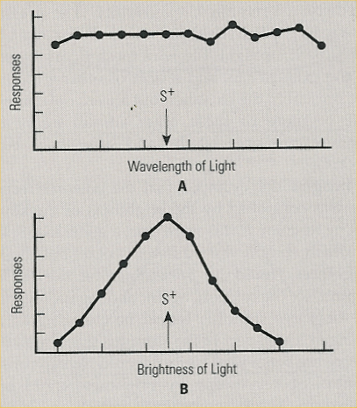
Interpreting Generalization Gradients
Pigeons trained to peck a moderately bright light (S+) to get food.
(S- = dim light)
After asymptote is reached, present occasional non-reinforced probe trials at various wavelengths or levels of brightness.

Slide 16
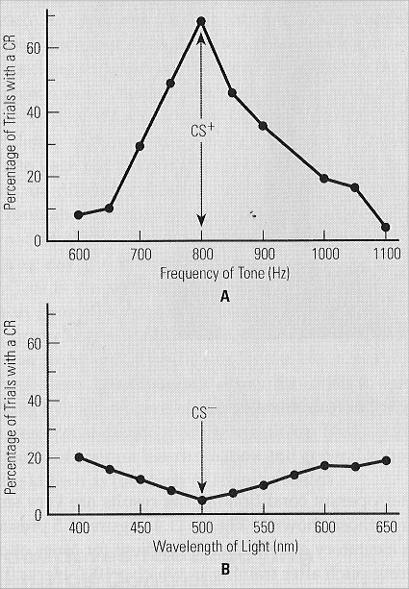
Excitatory and Inhibitory gradients
Excitatory gradients form around the CS+; show where responding is MOST likely
Inhibitory gradients also form; show where responding is least likely
e.g., Pigeons trained to peck at a 800 hz tone (S+), with a 500 nm light S-.

Slide 17
Peak Shift
Phenomena where the peak of the generalization curve shifts AWAY from the S-
Means that the most responding does not occur for the S+, but slightly offset from the S+ and away from the S-
The peak of responding shifts AWAY from the S-
Question is WHY!

Slide 18
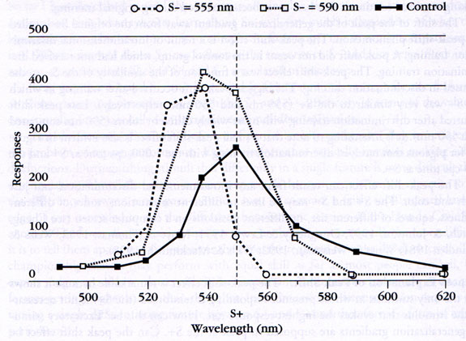
Peak Shift Effect – Hanson (1959)

Slide 19
Let’s do an example of Discrimination Training
Two choices: 1 4
4 is the correct answer

Slide 20
Now what is the correct answer?
Using the last question and correct answer, which is the “best” answer for each of the following?
3.9 -1
-1 5
0.9 3

Slide 21
Second problem: Think about it:
4 16
Again, 4 is the answer
Now which is the best answer?

Slide 22
Now which is the “best” answer?
Using your answer from the last slide: Which is the answer for each of the following?
16 48
8 32
100 400

Slide 23
Examine your answers:
First set of slides: Tend to pick answer that is closest to 4
Second set of slides: Tend to pick the smaller (1/4 of the second answer)
Why?
Two theories may explain
Spence’s Summation Theory
Kohler’s Interdimensional Theory

Slide 24
Spence’s Theory
Peak shift occurs because of the summation of the excitatory and inhibitory curves
Result is that the most responding is slightly in favor of the S+
Not as strong of suppression for S-; thus, get a slight shift away from S- when sum the two curves
Just a math phenomenon

Slide 25
Spence’s Theory to Account for Peak Shift
S+
S-

Slide 26
Kohler’s Tranposition Interdimensional theory
The animal learns a conceptual rule: When given stimuli, choose whichever fits the characteristics of S+ to S-
  E.g.: S+ is always larger
  E.g.: S+ is the most green
Thus, when given generalization stimuli, look for whatever is the most “S+” compared to what should be “S-”
”.

Slide 27
Kohler’s Tranposition Interdimensional theory
Shift away from S+ occurs because the organism compensates for “not S-”, and overcompensate PAST the S+ but away from the S-
Learning a concept: Always choose larger or greener, etc.
  Given a large and small stimulus, choose large even if it is too large
  If S+ is read and S- is green, choose the “reddest” but the least “green”.

Slide 28
Interdimensional discrimination
Discrimination: S+ = 555nm Light; S- = Tone
Notes:
Increase in peak height and sharpness, but no peak shift.

Slide 29
Test of Theories
Choose between squares:
S+ S- Situation:
100 cm² 50 cm² Original training
125 cm² 62.5 cm² Test 1: Spence’s test
500 cm² 250 cm² Test 2: Kohler’s test
1000 cm² 500 cm2 ??????
Spence's prediction: Will choose closest to original S+
Transposition or interdimensional: choose larger

Slide 30
Which is correct?
Tests for summation yield evidence supporting Spence’s theory
When using stimuli close to the original stimulus
Animal tends to make errors towards the original stimulus
Tests for transposition/interdiminensional yield evidence supporting Kohler’s theory
When using stimuli highly different from original stimulus, error towards original stimulus
But show “concept” rule in that keep the relation of the difference constant (e.g., choose the smaller one)

Slide 31
So, which theory is “right”?
BOTH!
When the test includes stimuli close to the original S+, animal tends to choose the one closest to the S+
As differences become increasingly larger, animal tends to choose the stimulus consistent with the type of difference between the S+ and S-
  E.g., larger or red-er
Why?

Slide 32
Teaching Stimulus Discrimination
Discrimination is a fundamental process that controls behavior.
Discrimination allows us to differentiate when reinforcement is available for specific responses.
Many essential tasks require discrimination skills
  Reading.
  Labeling Objects.
  Following directions.
  Following activity schedules.
  Greeting people.
  Self-care skills.
Notes:
For example, saying the word book when the teacher points to a book will result in reinforcement. Saying car when the teacher points to a book will not result in reinforcement.
Also red light on the soda machine example.

Slide 33
Basic Problem of Discrimination Training
Discrimination training teaches learners to
Perform a specific response in the presence of a specific stimulus and
Not to perform that response in the presence of other stimuli.
Most stimuli are compound (they consist of different elements)
It may be difficult to control which element(s) of the stimulus exert control over behavior
We must be careful how we teach and what stimuli we use!

Slide 34
Stimulus Compounding
All stimuli are compound.
They consist of many different elements.
Modality (visual, auditory, tactile)
Size, color, shape, etc.
It is difficult to control which element or elements of the stimulus exert control over behavior.
Need to be careful how we teach and what stimuli we use.
Have organism attend to critical aspects of the S+

Slide 35
2 Types of Discriminations.
Simple Discriminations.
Non-Conditional Discrimination.
Simple association
Conditional Discriminations.
Matching-to-sample.
Arbitrary Discrimination.
Involves complex associations
A = B

Slide 36
Simple Discrimination
Stimulus is present or not present
Simple association: If red then apple
One picture on the table that’s a “cat” Say touch “cat” and they do
Cue dog to “sit”; sitting is the only correct response
Not “real life” for most human tasks (or for dogs for that matter).

Slide 37
Conditional Discrimination
A response to a given stimulus is followed by a reinforcer if and only if another stimulus is present
Said another way…a stimulus is discriminative for reinforcement or no reinforcement depending on (conditional on) the presence of another particular antecedent
Often taught via Match-to-Sample procedures
  If a picture of a dog, then say dog; if a picture of a cat, then say cat
  Vary the answer for the same reinforcement depending on conditional cue (dog or cat picture)
Many programs consist of Identity Matching (matching identical stimuli):
  Objects Pictures
  Letters Shapes
  Colors Numbers

Slide 38
Match-to-Sample
Learner 1st responds to sample (conditional stimulus)
Sample
Then responds to one of the comparison stimuli
S^{D}/S+
S^{Δ}/S-
S^{Δ}/S-

Slide 39
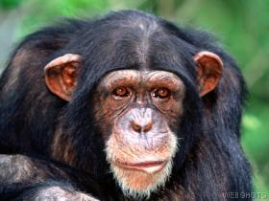

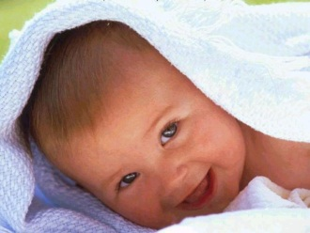
Match-to-Sample
S^{D}/S⁺
S^{D}/S⁺
Sample (Conditional Stimulus)
Sample (Conditional Stimulus)

Slide 40
Establishing New Forms of
Conditional Stimulus Control
Identity matching (single mode)
  Visual: visual
  Auditory: auditory
Arbitrary matching (multimodal)
  Visual: auditory
  Auditory: visual
  Auditory: tactile

Slide 41
Arbitrary Matching
Stimuli are not physically identical
  Different modalities (visual/verbal)
  Different types of stimuli: story problem; number answer
Examples
  Match non-identical visual stimuli
    Object to pic, printed word to picture, object to printed word
  Match auditory stimulus to visual stimulus (“Receptive Identification”)
  Others?

Slide 42
Receptive Picture ID
SD/S+
SD/S+
“flower”
“baby”
Sample
Sample

Slide 43
Concept Formation
Complex stimulus control that results in:
  Generalization within a class of stimuli and
  Discrimination between classes of stimuli
Two procedures for teaching concept formation:
  Simultaneous Discrimination: The concurrent presentation of multiple stimuli
  Successive Discrimination: The successive presentation of multiple stimuli
Teaching elements of a stimulus class!

Slide 44
Stimulus Class
Stimulus Class: set of stimuli that have a common effect on behavior (evoke the same response class)
These would probably be in the same stimulus class for most people

Slide 45
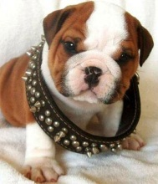
Stimulus Equivalence
Emergence of accurate responding to untrained and nonreinforced stimulus-stimulus relations following the reinforcement of responses to some stimulus-stimulus relations
3 aspects
  Reflexivity
  Symmetry
  Transitivity
A
B
C
DOG
“dog”

Slide 46


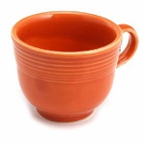
Reflexivity
In the absence of training, person selects an identical stimulus (AKA Generalized identity matching)
Logic is…A = A
For example: Without specific training, the person matches

Slide 47
Symmetry
After being taught to match A to B, person can match B to A (without training)
Logic is…If A = B, then B = A
For example
  After being taught to match to
  Person can match to
DOG
DOG

Slide 48

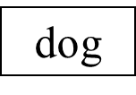
Transitivity
Critical test for stimulus equivalence – if you get transitivity, the stimuli are members of an equivalence class
After being taught to match A to B and B to C, person can match A to C (without training)
Logic is…If A = B and B = C, then A = C
For example…
  After being taught to match to
  AND being taught to match to
  The subject can match to
DOG
dog
DOG

Slide 49
Factors Affecting the Development of Stimulus Control
Reinforcement
Differential reinforcement with rich schedules of reinforcement
Preattending Skills
Looking at type of instructor or materials, sitting up tall, no stereotypy or other misbehavior

Slide 50
Factors Affecting the Development of Stimulus Control
Specificity of directions for responding to stimuli
Should relate to discrimination
Touch the correct response; say the correct word
If ask for response unrelated to setting, get more errors
Opportunity to respond
Frequent, active opportunities to respond leads to higher rates of correct responses
More opportunities for making conditional responses
Pacing of response opportunities
Higher pace often leads to superior performance and less off-task behavior
Not lose attention during/between trials

Slide 51
Factors Affecting the Development of Stimulus Control
Salience of the stimuli
  Influences attention and ultimately the development of stimulus control
  Dependent on the capabilities of an individual, the past history of reinforcement, and the situation
  Be aware of modality of presentation:
    E,g, Visual vs. auditory animals
    The more modalities the stimuli are presented, the better the concept formation.

Slide 52
Factors Affecting the Development of Stimulus Control
Masking and overshadowing
Masking –Even though one stimulus has control over behavior, another stimulus blocks that control from being expressed
E.g., Student knows answer but won’t answer in front of peers
Dog will only respond if there is a treat
Overshadowing –The presence of one stimulus condition interferes with the acquisition of control by another stimulus
E.g., hallway may be more interesting that teacher’s presentation in the front of the classroom
Ways to overcome include
Make changes to physical environment
Make instructional stimuli as intense and centrally located as possible
Reinforce behavior in the presence of the relevant stimuli

Slide 53
Four Tests for Assessing Stimulus Control
Behavior occurs immediately upon presentation of the cue stimulus
Behavior never occurs in absence of stimulus
Behavior never occurs in response to another stimulus
No other behavior occurs in response to the stimulus

Slide 54
To what do dogs attend?
Gave dogs 3 cues: Sit, down and stay
Cues given with a gesture or no gesture
Cues given with
Open face (no occlusion)
Eyes covered
Mouth covered
Whole face covered
Measured
Accuracy of responding
Latency to respond

Slide 55
Accuracy

Slide 56
Latency

Slide 57
Take home Message:
We learn to discriminate and generalize stimuli depending on our reinforcement history
When discriminating, we tend to shift AWAY from the S- and overcompensate past the S+
Two theories explain this: Spence’s summation theory and Koehler’s tranpositional/interdimensional theory
We learn to discriminate in several ways, particularly by matching to sample
  We learn identity and arbitrary concepts
  We learn transitivity, symmetry and transitivity
  We can learn to form concepts through discrimination learning
Our reinforcement history is important when learning discriminations
Stimulus control is essential for organisms to survive in their world.

