Slide 1
Behavioral Economics!

Slide 2
Behavioral Economics
Application of economic theory to predict and control behavior
Microeconomics
Assumes law of supply and demand applies to behavior and reinforcement
Is an outgrowth of unidimensional explanations of reinforced behavior

Slide 3
Four Major Premises
A behavioral experiment is an economic system. As such, the characteristics of the experiment can strongly determine the results
Reinforcers can be distinguished by a functional property called “elasticity of demand” that is independent of relative value
Reinforcers may interact as complements as well as substitutes
Because reinforcers differ in elasticity and because reinforcers can be complementary, no simple unidimensional choice rule can account for all choice behavior

Slide 4
Define Terms
Demand:
How much of a product (commodity) will be purchased” by the organism at a given price
Product or Commodity:
The Reinforcer
How Purchase Commodities?:
A contingent behavioral response
E.g., bar press
Price:
Schedule of reinforcement or more commonly
Response/reinforcer (cost): e.g. for a FR5: 5/1
Budget:
Total number of responses allowed per session

Slide 5
Changing Price alters behavior:
Changes in price = changes in the reinforcement schedule
E.g. Fixed Ratio schedules:
FR1: one response = 1 commodity or reward
FR 5: five responses = 1 commodity or reward
Changes the COST or PRICE of the Commodity
This can both effect and be affected by
Demand elasticity,
Substitutability and
Open vs. closed economies

Slide 6
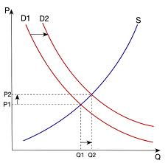
Supply, Demand, and Equilibrium
Supply curve:
S^{r} schedule or environmental constraint for obtaining the commodity
Quantity per unit time provided at given price
As price per unit increases, rate of production increases
P1 = Response cost for Choice 1
P2 = Response cost for Choice 2
Q1 = Quantity purchased for Choice 1
Q2 = Quantity purchased for Choice 2
S = Supply of the commodity
D1 = Demand curve for P1
D2 = Demand curve for P2
Intersection is point where get most quantity/responses given the supply

Slide 7
Supply, Demand, and Equilibrium
Demand curve
Amount that the subject will consume at a given price or the price that will be paid for a given rate of consumption
As price increases, consumption generally decreases
Measured in terms of consumption

Slide 8
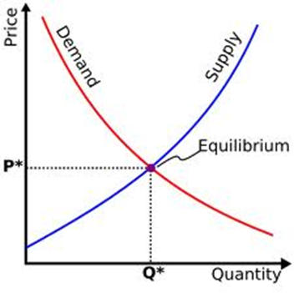
Supply, Demand, and Equilibrium
Equilibrium:
Stable outcome of these two curves
Where they intersect

Slide 9
Budget Lines
Changes the amount the organism is allowed to “spend”
Alters the number of responses allowed across the session
Yields different “constraint” or budget lines
Differs from price:
is not just the price of an individual item
but the total amount the animal has to “spend”.
These factors (price and budget) interact with the animals “preference” or demand

Slide 10
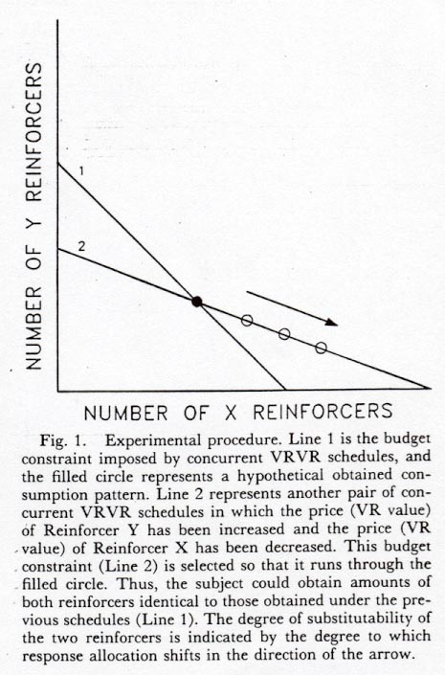
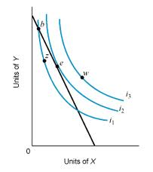
Hypothetical Budget Lines

Slide 11
Demand interacting with Price: Elasticity Curves.
INELASTIC: Quantity demand decays gradually with increases in price. Note that R-rate will be an increasing function of price
ELASTIC: Demand decays steeply with increases in price. Note that R-rate will be a decreasing function of price
A UNIT demand curve generates a precisely flat level of expenditure or R-rate with increasing price:
Each increase in price is precisely balanced by a decrease in consumption

Slide 12
Curvature of Demand
ELASTICITY COEFFICIENT = absolute value of that slope
<1 for inelastic demand
= 1 for unit demand
>1 for elastic demand
The closer the curve comes to the axes, the more demand there is for the commodity
Deep curvature = more demand
Less curvature = less demand

Slide 13
Differences in demand alter behavior on a given budget

Slide 14
Reinforcers interact as substitutes or complements
Substitutes: reduction in demand of one commodity as the supply for a second commodity increased
Complete substitutability suggests the two reinforcers are equivalent
One commodity is as good as another
Pepsi vs. Coke ?
Store brand vs. generic brand?

Slide 15
Reinforcers interact as substitutes or complements
Complements: increase in demand of one commodity as supply for a second commodity increased
Complete complementarity suggests the two reinforcers are nonsubstitutable or complements
Peanut Butter and Jelly
Water vs. food

Slide 16
Calculating Substitutability:
Substitutability is obtained by a linear regression between relative price and relative allocation
Price
How you spend your $$
The slope of the regression equation is then used to estimate substitutability or s
Reinforcers are substitutable if s>0
s=1 is completely substitutable
Complementary: s<0

Slide 17
Open versus Closed Economies
Open Economy:
Extra sources of reward are available outside the experimental (or real) session
Can get more commodities outside your budget
Rats are supplementally fed after the daily session
You can call your parents when run out of money at end of month

Slide 18
Open versus Closed Economies
Closed Economy:
Extra sources of reward are available outside the experimental (or real) session
Can NOT get more commodities outside your budget
Rats must work for all of their food during an experimental session
Your monthly budget is as it is: no extra sources of income

Slide 19
Differences in consumption for Open versus Closed Economies:
Open economies and closed economies have different effects on consumption
Response rates in closed economies INCREASE as price increases; must respond more to maintain consumption
Response rates in open economies DECREASE as price increases; do not maintain consumption

Slide 20
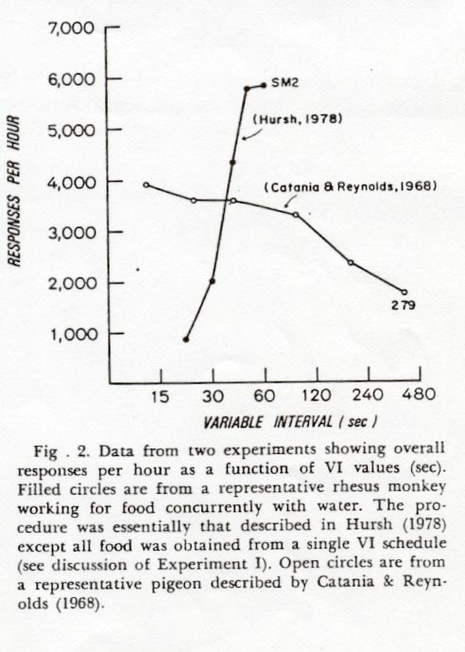
Responding on Open versus Closed Economies
In an open economy, responding can increase with price increases
In a closed economy, as price increases, responding may decrease for that commodity.

Slide 21
Why is this distinction important?
Drug addict behavior in open vs. closed economies
Open Economy:
Many outside sources of “commodities”
Parents will enable, pay rent
Can beg, steal, rob for money
No reason to allocate money for food, as can always get more
As a result, spend more of $$ on drugs

Slide 22
Why is this distinction important?
Drug addict behavior in open vs. closed economies
Closed Economy:
No or limited outside sources of “commodities”
No one to enable, pay rent
No opportunity to beg, steal, rob for money
Must allocate money for food, must eat
As a result, spend little to no $$ on drugs

Slide 23
Hursh, 1980
Gave baboons choice between food and heroin infusion:
Early data sessions shown both commodities relatively inelastic
When no restriction on income: Open economy
Supplemental feeding at end of session
Responding roughly equal for both
Relatively inelastic
Would choose to take heroin infusions
When restriction income: # of R's/day: Closed economy:
When price = low: baboons still choose roughly equal
When price = high:
Demand for heroin dropped
Demand for food increased

Slide 24
What does this suggest for Drug Treatment programs
How design an inpatient unit?
How transition to outpatient?
How control drug flow into country; how deal with accessibility to drugs?

Slide 25
Summary
Evidence suggests that behavior of animals in conditioning experiments conforms to economic predictions
Implies that operant conditioning constitutes a kind of economic decision making
Like other modern theories in operant conditioning, allows prediction of reinforcement effect

