Slide 1
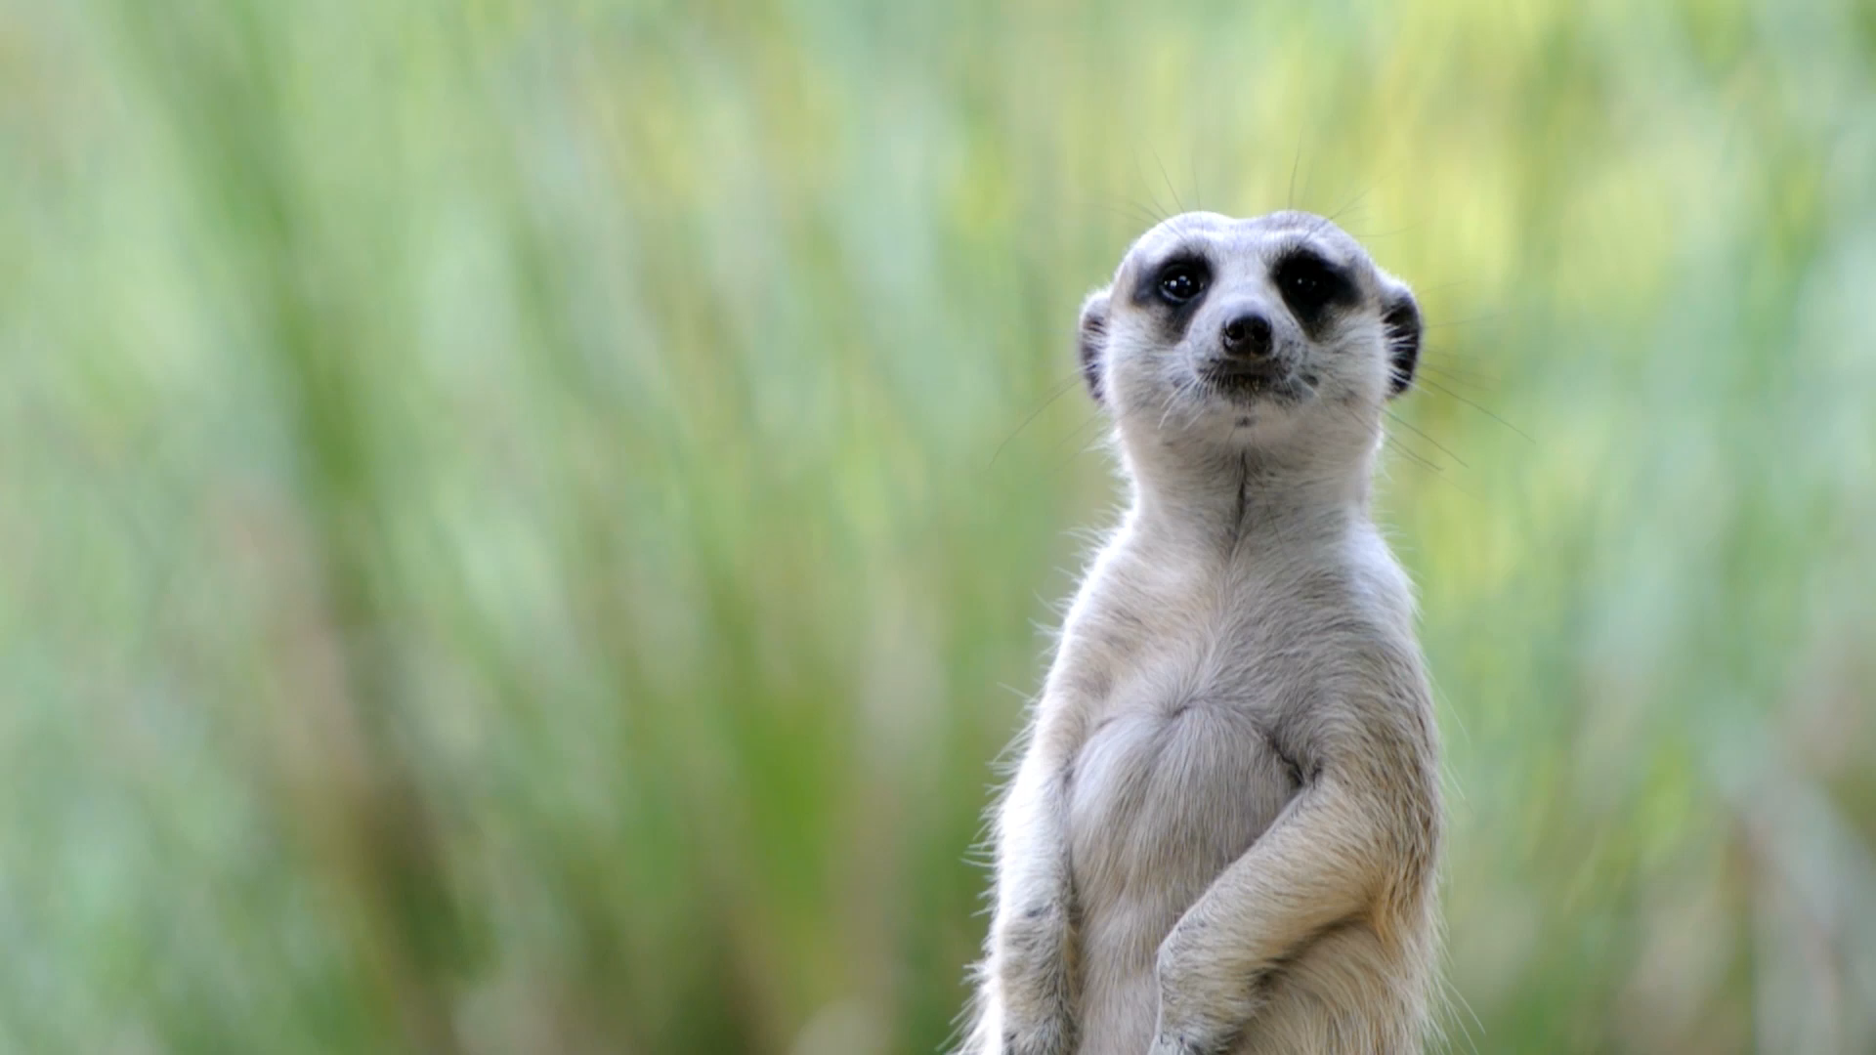
Can Animals think?
A behaviorist perspective on comparative cognition

Slide 2
Comparative Cognition
Evolutionary approach:
Cognitive mechanisms evolve in response to selective pressures peculiar to each species’ ecology, physiology and morphology
Thus cognitive processes differ across species
Comparative cognition:
compare abilities across species
Analyze performance of different species on same set of tasks
Focus on species-specific mechanisms and strategies that underlie problem-solving performance
Better to understand how different animals problem solve rather than
Try to determine which animal is “smarter”
Must use a set of tasks, not a single task

Slide 3
What behaviors to study?
Relearning
Altering habits and adapting to change by switching to different solution routine
Behavioral flexibility
Neophilia
Exploration strategies
Attention
Motivation
Affordance learning
Physiological constraints

Slide 4
Experimental Psychology
Experimental psychologists use comparative cognition in more limited way
“Objective evidence cannot give a demonstration either of the existence or the nonexistence of consciousness, thus consciousness is precisely that which cannot be perceived objectively.”
Comparative cognition = theoretical constructs and models used to explain aspects of behavior that cannot be readily characterized in terms of simple S-R mechanisms

Slide 5
What is the problem?
When causal inferences about “rich mental life” of an animal is made, one may be projecting own thoughts/emotions/intentions on that animal
Anthropomorphism = projecting human qualities onto animals
Remember that cognitive mechanisms involving internal representations are theoretical constructs inferred from the behavior of organisms
This is true for both humans AND animals!
We must be careful when making causal inferences and tying them to internal states when all we have is behavior as our data

Slide 6
Morgan’s Canon:
Accept the lowest level of intentional explanation that works:
KISS: Keep it simple, stupid!
Natural selection: What matters is that the animal achieves goals such as finding food, mates, and safety.
Using Morgan’s canon to choose among alternatives assumes that natural selection has always produced the lowest level intentional system that can do the job.
But doesn’t answer the question of how the animal does this!

Slide 7
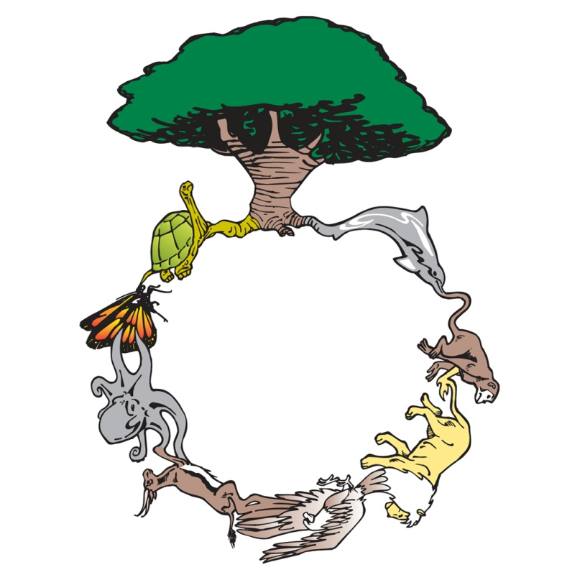
Why is this relevant?
Functional concerns of behavioral ecology and ethology often lead to mechanistic questions -- which are the realm of cognition.
Cognitive ethologists are frequently concerned with the diversity of solutions that living organisms have found for common problems.
  Emphasize broad taxonomic comparisons
  Do not focus on a few select representatives of limited taxa (we hope).
Looking for general principles of behavior or cognition.

Slide 8
Why is this relevant?
Animal cognition research begins with “I wonder if/how/when animals can do _______?”
Problem then becomes HOW to ask that question of the animal without becoming anthropomorphic.
Example: How do guide dogs perceive affordances for their human?
  Many questions must first be answered.
  DO dogs show affordances?
  DO dogs perceive social information from humans?
  Does this social information include affordances?
  How do dogs enact on this information?
  WHY would guide dogs (or any dog) perceive affordances/social behavior for a human?
Research must begin programmatically, answering each question in turn
  No sudden answers
  Each must be demonstrates beyond reasonable doubt, using scientific methods
  Must be DATA driven
  We are back to our empiricism again!

Slide 9
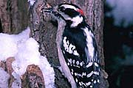
Behavioral ecology can inform questions of cognition
Optimal Foraging Theory: Maximize rate of energy intake and fitness.
Example: Woodpecker takes longer on some trees than on others when foraging.
Assume: adaptive, optimal, maximizing energy, maximizing fitness.
Function: avoid depleted food, avoid predation, stay close to nest.
Mechanism: how know depleted, what info tells bird to change behavior, how does it know where its nest is?
Measure: distances between trees, prey repletion rates, prey energy, etc.

Slide 10

What about memory?
Do animals show evidence of “memory”
  If so, do they show different KINDS of memory
  How are different animals’ memory similar or different:
    Across species
    In comparison to human memory
How is an animal’s memory altered?
  What factors impact the formation of memory?
  What kinds of things are remembered?,
How can animal memory be explained in terms of function?

Slide 11

Compare to Human memory: Kinds of Memory
What kinds, how is it altered, and how can it be explained?
Do animals show evidence of “memory”
What Types of “human memory” might animals show?
Reference: Information that is procedural and long term.
How to dial phone
Working: event specific and short term.
What number to dial.

Slide 12
Vaughan and Greene (1973):
Pigeons trained to classify slides as positive or negative
Random order- no concept involved
Just had to remember which was positive, which was negative
Like the random letters task
After 10 sessions, could classify 80 slides (40 + and 40-)
Learned next 80 even faster
Eventually worked up to 320
Tested the pigeons some 20 years later: scored about 70% accuracy

Slide 13
Herrnstein, 1976:
Wanted to see if pigeons could categorize
Three categories:
Trees
Water
Person
Found that pictures being seen for first time (novel) discriminated as well as training pictures
Interestingly- similar patter of errors and correct discrimination across the pigeon subjects

Slide 14
What does this mean?
Ability to discriminate open-ended classes of stimuli poses problems at two levels:
  Analysis of features enabling subject to tell whether object is member of particular class
  Analysis of properties of classes that render them discriminable

Slide 15
What are they responding to?
Too complex to be common elements
Cluster of features that are more or less isomorphic-probabilistic conjunctions and disjunctions
Look like semantic categories of generalization

Slide 16
Herrnsteing: Experiment 2
Trained to a pseudo concept discrimination
Discriminate 2 arbitrary groups of paintings
Contained both Monet and Picasso pictures
2 pigeons
Same manipulation of stimuli
Both easily learned the task

Slide 17
What does this mean?
Pigeons’ discriminative performance could be controlled by different styles of paintings
No identified single cue for discrimination of paintings
Some decrease in responding for reversed or upside down paintings
Note: paintings had little if any ecological significance for pigeons-
Distortion tests:
More disruption when painting displayed real object (Monet) than abstract (Picasso)
Evidence that could discriminate both individual paintings and group them into categories
Evidence of Flexibility of categories

Slide 18
Gorillas and Natural Concepts
Several species of animals show ability to form concepts:
Pigeons
Parrots
Crows
Dolphins and whales
Seal lions
Dogs
Etc.
Question: is this a perceptual ability or cognitive ability?
Obviously, must have perceptual characteristics
To show cognitive ability must show ability to transfer learning to novel exemplars
These must vary across several dimensions
Evidence in nonhuman primates that they attend to local features, not global features (of concept)

Slide 19
Abstract vs. concrete concepts
Concrete concepts:
Share many features
Easily discriminated along perceptual lines
Abstract concepts:
Share fewer features
Defined in terms of breadth of category to be learned
Fewer perceptual overlaps
Adult Humans easily perform abstract concept formation
Question: do great apes also show this (since are our closest relatives)

Slide 20
Method
Subject = 4 year old captive female lowland gorilla (Zuri)
Materials:
Photo sets: 10 S+ and 10 S- category exemplars
S+ and S- shared similar backgrounds, matched on as many features as possible
Minimized similar perceptual features across S+ and S-
Procedure:
Used Apple computer
10 S+ and 10 S- per session
Photo pairs randomly presented
Many sessions per day
Basically had to discriminate great apes vs. humans
Used first 2 sessions with novel photos to indicate transfer
Coded photos across several dimensions

Slide 21
Phase 1: Concrete Discriminations
Gorillas or orangutans vs. humans
Orangutans versus other primates
Orangutan color test
Could examine transfer by errors:
E.g., If responding by color: not show transfer to black and white photos

Slide 22
Phase 1: Results
Gorillas vs. humans
  Reached criterion in 14 sessions
  Showed transfer
Orangutans vs humans
  Reached criterion in 7 sessions
  Showed transfer
  Better at pictures of adults than young apes
Orangutans versus other primates
  Reached criterion in 19 sessions
  No immediate transfer
  Took 25 sessions on second trianing
  Third set only 3 sessions
Orangutan color test
  Reached criterion in 7 sessions
  No transfer
  Mastered second set in 2 sessions
  Showed transfer to third
Gorillas vs other primates
  Reached criterion after 16 sessions
  High degree of transfer

Slide 23
Phase 1 results
Could examine transfer by errors:
  E.g., If responding by color: Not show transfer to black and white photos
Could detect gorillas and orangutans vs humans
Not as good on orangutans vs other primates
Gorilla vs other primates discrimination was good
Did not appear to be discriminating on basis of single feature, but instead was using multiple features
Still: could be concrete concepts rather than abstract

Slide 24
Phase 2: Intermediate discriminations
Primates vs. nonprimates
Mammals, reptiles, insects, birds, fish
Primate controls:
Used stimuli that she made many errors with
Results: Primates vs. non primates
Reached criterion after 12 sessions
Not show transfer
23 sessions on second set
3 sessions on third set, with some transfer
Only age affected discrimination (as before)
Correct if primate photo was young animal
Incorrect if non primate photo was young animal

Slide 25
Phase 2: Intermediate discriminations
Zuri had more trouble with intermediate discriminations relative to concrete
  Age of the animal in the picture affected ability to discriminate
  More likely to select photos of species she had seen before or served as S+

Slide 26
Phase 3: Abstract Discriminations
Animals vs. non animals (Non animals = landscapes with neutral background)
Food vs. Animals
Results:
Animals vs. non animals
12 sessions to criterion on first set
Showed transfer on all subsequent photo sets
Food vs animals
Quick to criterion
Good discrimination on initial transfer

Slide 27
Better at abstract discriminations!
Suggests may have been relying on perceptual qualities for concrete and intermediate, but could not for abstract
Why better at abstract than intermediate?
Within class and between class similarities interact to determine relative difficulty of discriminations at various levels of abstraction
Also: were artificial “human” discriminations…..don’t know meaning to gorillas
Showed excellent transfer, unusually so for a non human primate
Could not have been just memorizing
Some effect of experience: “learning to learn”

Slide 28
Does evolution play a role:
Are pigeons prewired to see trees, water, people?
Are gorillas prewired to see particular animals?
Presence of static features can be discriminated
More likely that are prewired to form a “schema” or prototype
Examine behavior of other species to determine how behavior may be “prewired” and learned

Slide 29
Canines, corvids, sea mammals and apes can do many cognitive tasks!
Contingency reversal learning:
Can learn A→ B and then B→ A
Ashton& DeLillo, 2011
Object permanence:
Can find hidden object when observe object hidden
Some data ((Gagnon & Dore, 1992, 1994) suggests can find when NOT see the object being hidden
Object learning (Framl & Frank, 1985)
Categorizing and inferential learning: Range, et al, 2008

Slide 30
Several other tasks, too!
Object manipulation (Topal, et al, 1997)
Means-end task (Osthaus et al, 2005)
Quantitative tasks
More vs. less
Some counting
Search order
Spatial navigation: Cattet & Etienne, 2004 and solving detour problems (Pongracz, et al, 2001)

Slide 31
Expectancy violations
Tinkelpaugh (1928) task
Show food item
Cover it up with a cup
Slide to animal
Animal lifts up cup- but tricked: another lesser preferred food is there
Look to see if animal is surprised/upset
Dogs show strong expectancy violation
So do chimps, corvids
Tend to react strongly when tricked
And so do monkeys!

Slide 32
Nonsocial counting:
Dogs can count?
Numerical competence and ability to discriminate more and less
Dogs about as good at numerical competence as the great apes!
West and Young (2002) from Pepperberg (1994)
Dogs shown three problems
1+1 = 2;
1+1=1;
1+1=3 (all in dog biscuits; shown problem then solution)
Dogs gazed longer when the expected solution was wrong
Similar to Tinklepaugh studies in chimps and monkeys

Slide 33
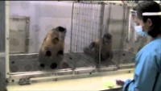
Frans de Waal
Unequal payoff experiment
2012

Slide 34

Spatial Memory

Slide 35
Spatial Memory
Spatial memory = memory for places
Why might this be important for animals?
How can we test spatial memory in the laboratory?
Morris Water Maze:
Typically used with rats or mice
Large water tank
Spatial cues placed around the room (decals on walls, location of doors, windows, etc.)
Placement of platforms (start and finish) are tied to different “landmarks”
Data show that rats and mice do indeed use the landmarks
https://www.youtube.com/watch?v=LrCzSIbvSN4

Slide 36


Slide 37
Spatial Memory
Radial Arm Maze
  A maze with many arms: typically use 8 in labs
  Food hidden at end of the arms
Examine search strategies
https://www.youtube.com/watch?v=LU36985DlMk

Slide 38
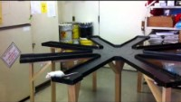

Slide 39
Spatial Memory
Can examine prospective and retrospective memory
Prospective = imagining the future
Retrospective = remembering the past
Using radial arm maze: do rats look forward or backward?
  Do they remember where they have been or where they have yet to be?
  For first few arms: retrospective
  After 4-5 arms: prospective
  In a sense, they use whatever is less to remember!
Why might spatial memory be more important for animals such as rats than concept formation?

Slide 40
Spatial Cognition
How do animals remember where the food comes from?
How do animals remember where they left their food?
What environmental and internal stimuli are animals using during search behaviors?

Slide 41
Food Storing Behavior
Animal creates a resource distribution tha only it knows/has awareness of.
Reference Memory: storage sites, what is in the site, territory
Working Memory: which site did I empty today?
Information: spatial layout, site contents, etc.

Slide 42


Do Nutcrackers form Geometric relations between objects?
How does the Nutcracker remember where it hides its food?
Clark’s Nutcrackers: Birds use general principle to find a goal located between two landmarks.
  relationship between landmarks
  not between a goal and the landmarks
Goal
2)
1)

Slide 43
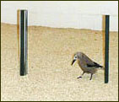
Two Landmarks

Slide 44
How form spatial relationships?
Clark's nutcrackers can learn to find the point halfway between two landmarks that vary in the distance that separates them.
General principle: Birds must correctly find the halfway point when the landmarks when presented with varying distances between the landmarks.
The ability to find a point defined not by the relationship between a goal and a landmark, but by the relationship between landmarks.

Slide 45
Two distinct processes:
Direction: The use of directional bearings to find the (hypothetical) line connecting the landmarks
North, south, east, west
Must use landmarks to mark direction
Distance: Finding the correct place along that line.
Must use landmarks to mark distance

Slide 46
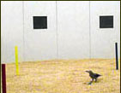
Three Landmarks
Now the bird must triangulate the food cache
Not just 2 and find the middle, but 3-D

Slide 47
Set up a Test:
Nutcrackers were trained to find a location defined by its geometric relationship to a pair of landmarks.
  Distance relationships: Two groups trained to find positions on the line connecting the landmarks
  Constant Direction: Two groups trained to find the third point of a triangle
Four inter-landmark distances and a constant spatial orientation were used throughout training.
Result:
  Constant distance group learned more slowly with less accuracy: Showed less transfer to new distances
  Relational group was able to use concept rather than exact location

Slide 48
Spatial Relations:
When tested with a single landmark
  Birds in the half and quarter groups tended to dig in the appropriate direction from the landmark
  So did birds in the distance group
Nutcrackers CAN learn a variety of geometric principles:
  Directional information may be weighted more heavily than distance information
  Can use both absolute and relative
  Concepts include configural information about spatial relationships.

Slide 49
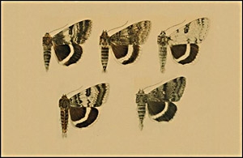
Hunting by search image
Five known forms (or "morphs") of the North American underwing moth, Catocala relicta.
Note the variable fore-wings and the relatively uniform hind wings.
Corvids, particularly the Blue Jay, hunt these moths by searching image.

Slide 50
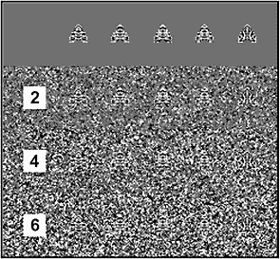
Stimuli
Artificial moths on artificial backgrounds.

Slide 51
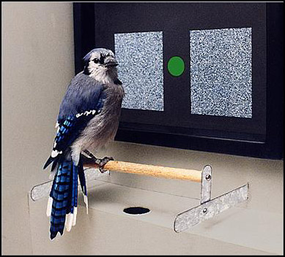
Testing
Operant trials
Included Moth and no moth trials
Either peck “moth” key or the key saying “no moth”

Slide 52

Results
Runs of the same type of prey resulted in “search image” effects
Interference effects:
  Directing a jay to search for one type of moth actually reduced likelihood of its finding an alternative type.
This study represented the first clear demonstration of attentional interference in visual search in animals.

Slide 53
So what do we know so far?
Animals can
Form both concrete and abstract concepts
Can use concept rules when presented with novel stimuli
Use prospective and retrospective memory when remembering when they remember where they have been
Animals use relationships between stimuli to solve problems
They use the relationship between distance or color or shape
They form expectancies about outcomes
They are pissed when their expectancies fail!

Slide 54

Social Behavior

Slide 55
What about social behaviors?
Do animals use behavior to manipulate other animals behavior?
Does this involve intentionality, or is it just innate?
Moths using disguise; birds pretending to be hurt? Really!?!

Slide 56
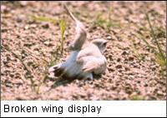
Broken-wing display in plovers
Can birds use their behavior to alter the behavior of a predator?
Plover: leads a predator (such as a fox) away from the plover’s nest.
Plover behavior:
  Act hurt, so looks like easy prey,
  Move away from nest
  Does this require “intentionality” and thinking? Why or why not?
  https://youtu.be/X2xeW6_5dlA

Slide 57


Slide 58
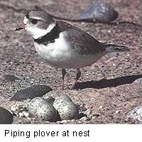
Evidence from plovers
Several levels of this behavior
Flexible behavior: In 87% of staged encounters with a human, plovers moved in a direction that was away from the nest.
Knowledge of other: plovers moved further away for “dangerous” intruders than “nonthreatening” intruders
Should monitor intruder: Starts display when intruder can see it, if the intruder stops following, plover intensifies display, and approaches intruder.
But can more hard-wired behaviors (ethological approach) explain these changes in behavior?
  Sign stimuli and vectors? Eye direction?
  Series of if/then statements based on combinations of sign stimuli?

Slide 59
Elephant Behavior and Language
Recent research with African elephants shows strong evidence of language in these animals!
Evidence of syntax, semantics and even developmental course
https://www.youtube.com/watch?v=C5RiHTSXK2A
https://www.youtube.com/watch?v=owXlAQ4-4o0

Slide 60
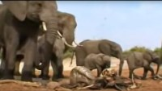

Slide 61


Slide 62
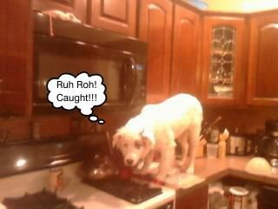
Social Learning
Dogs can selectively avoid forbidden food, but grab it when the owner is not looking
Beg from an individual that can see them, rather than their owner who cannot.
Learn via Social learning and Imitation
  Watch human for cues to obtain food/toy
  Can be taught to imitate: “do it”
Follow a human point: sensitive to
  Arm point
  Head turning
  Nodding
  Bowing
  Glancing in direction of target
  Miklosi & sporoni, 2006; Agnette et al, 2000; Udell, et al, 2008

Slide 63
Dogs show Perspective Taking
Can do perspective taking
Change reaction to forbidden food (Call, et a, 2003; Tomasello, 2008)
Change where drop ball depending on position of human
Begging responses change depending on actions of human
Attempt to communicate with humans:
Move objects closer
Indicate location of items
Ask for help with problem
Occurs as early as 8 weeks
Service dogs are better!
Miklosi, et al, 2003; Viranyi, et al, 2006; Topal, et al, 2006

Slide 64
Dogs show social modeling
Can model other dogs
Not as good as model humans
Snout contact provides information (Lupfer-Johnson)
Very good at modeling off of humans
Action matching: Do as I do
Topal, et al, 2006; Huber, et al, 2009; Range, et al, 20070

Slide 65
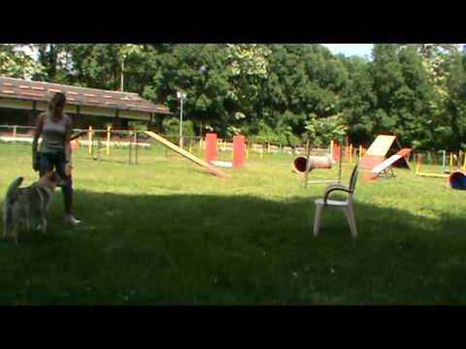

Slide 66

Choice of Target when Begging (Povinelli and Eddy, 1996):
Dogs were trained to beg from a human for food
Offered choice of a blindfolded human or a human that could see them
(for control, also a human with the blindfold over the mouth, nose, around the neck)
Dogs preferred the human with no blindfold over the eyes; no difference between this and person with blindfold who could see
Only chimps, bonobos also do this
Povllelli, et al, 1990; Heyes, 1993
Dogs, like chimps, use human behavior for cues to food location
Humans pointed, turned head or just turned eyes to look at location of hidden food
Dogs could use all three cues to determine where the food was located

Slide 67
NOT a Clever Hans Trick: Dogs really Reading Us!
Held, et al., 2001; Ashton and Cooper (in Cooper et al, 2003)
Dogs could use errors as clues, as well
Dogs blindfolded or not
Watched/not watched model get a hidden food
Those who could watch did better
Had other dogs watch the blindfolded dogs find the food
Blindfolded dogs made many mistakes before found food
Those dogs who watched avoided the areas that the food was not and went more directly to the final food location, avoiding the errors

Slide 68
Dogs can tell Which Human saw the Treat!
Cooper, et al 2001
Dogs able to choose which observer they preferred:
Three locations in which the food could be hidden
One human was in room (with the dog) when the food was hidden; human could see the location of the hidden food (watched the “hider”); dog could not
Second person entered room after food was hidden
Both humans sat in chairs, dog was to choose who to approach to get the food for them
Overwhelmingly chose the individual who was in the room at the time the food was hidden

Slide 69
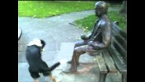

Slide 70
Dogs understand fairness (Range, et al., 2009)
Dogs taught to shake hands to get a reward
Two dogs at a time
Dogs had to shake hands with experimenter
One dog is rewarded, the other is not
Dogs who got rewarded kept responding to cue
Dogs who did NOT get rewarded
Hesitated longer before responding
Quit responding
Remember those monkeys?

Slide 71
Dogs can feel a “moral dilemma”:
Is your choice my Choice?
Study by Prato-Previde, Marshall-Pescini and Valsecchi (Italians!).
Interested in how dogs’ owners may influence how dogs choose between bigger and smaller choice
Food choice is particularly strong
Most dogs food driven
Choose bigger (evolutionary drive, too!)
But, also want to “please” their owners

Slide 72
Why choose owner’s preference?
What has years of socialization selected dogs to do?
Attend to owners
“please” owners by obeying commands, doing what owners desire
Dogs are selected to both
Attend to humans
Choose most food

Slide 73
Method
54 dog-owner dyads
Mostly pure breeds
Some mixed breeds
Three different tasks:
Bigger smaller choice
Bigger smaller choice with human pointing to smaller
1:1 choice with human pointing to a particular choice
Also gave the CBARQ assessment
Several subscales on aggression, excitation, separation anxiety, general fears
Did not feed dogs for several hours before study

Slide 74
Results
1:1 condition:
82% chose owners choice
6% chose opposite plate
12% showed no preference
Bigger/Smaller owners’ preference
32% chose larger
32% chose owner’s choice
36% chose both equally often
Dogs with stronger human attachment showed more ambivalence

Slide 75
Why should dogs show sensitivity to human social cues
Dogs show sensitivity to human social stimuli when they reliably alter behavior to obtain reinforcement in the presence of stimuli that depends on instruction or mediation by a human companion
Theory of Mind and dogs: Heyes (1998): “…an animal with a theory of mind believes that mental states play a causal role in generating behavior and infers the presence of mental states in others by observing their appearance and behavior under various circumstances”.
DO dogs have a theory of mind?

Slide 76
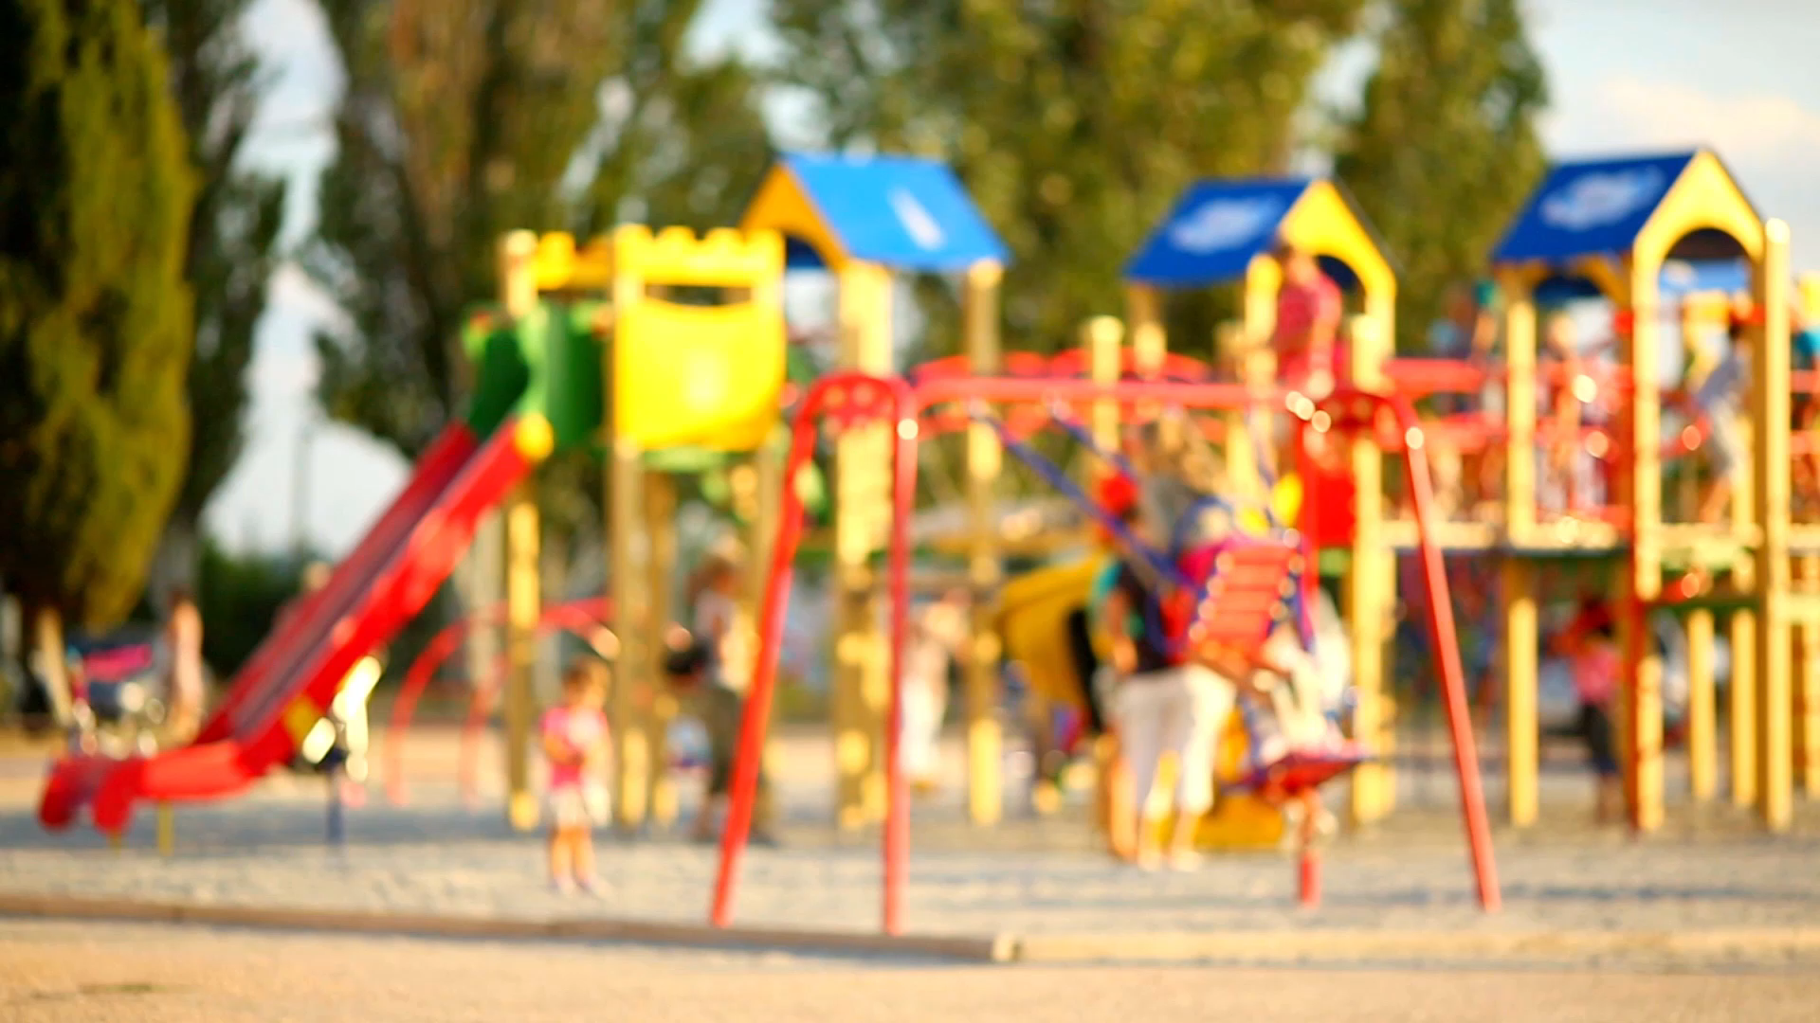
Play!

Slide 77
Purpose of Play
Serves as a means of social interaction between dogs.
Provides a means of developing and refining motor behaviors, practicing role taking and developing self-control behaviors.
Behavioral repertoire required for play is complex.
includes a variety of behaviors such as chasing, play fighting and tug of war.
These behaviors, while also observed during predation and other aggressive interactions, have different meanings when emitted within the context of play (Bekoff, 1998).
Horowitz (2008): Dogs appear to understand that they must get the attention of another dog when signaling intent to play, and that intent to play must be understood by the attending dog.

Slide 78
Play Behavior:
When is it Play and when it is Other Behavior
Play behaviors may mimic many elements of
Predatory behavior,
Escape behavior,
Sexual behavior,
But without the serious intent of these behaviors that would occur in “reality” situations.
Behavioral play sequences rarely include the final element of a predation, escape or sexual sequence.
Dogs might chase and grab, but rarely kill.
Cats play with pieces of paper, and even real mice, but if well fed rarely kill and eat.
Some elements of the natural sequence may become exaggerated while the rest of the body stays relaxed.
Bite response remains inhibited
But biting may be implied by an exaggerated and symbolic manner via a wide open, toothy mouth (Kaufer. 2013).

Slide 79
Burghard (2005): 5 criteria/ preconditions of play
Play must occur in a familiar and emotionally safe environment (relaxed field).
Play has no specific aim other than play itself. That is, it has limited immediate function.
Play is both voluntary and self-reinforcing. Burghard considers this the endogenous component of play.
Play does not parallel reality in either structural or temporal sequences.
Play behaviors show repetitive behavior patterns.

Slide 80
Evidence in support of Burghard: Dog Play
Social play between dogs contains a repertoire of behaviors and behavior patterns that are only observed during interactive play, including, for dogs:
The play bow,
The play slap,
The play nip or
Play paw, and the
Tag and run sequence.
The play bow is particularly important.
Limited to play encounters
This behavior is used to signal intent for all following behaviors:
A bite that follows a play bow is rarely interpreted as an aggression
Play bow signals that any following responses are under the setting condition of “play”.

Slide 81
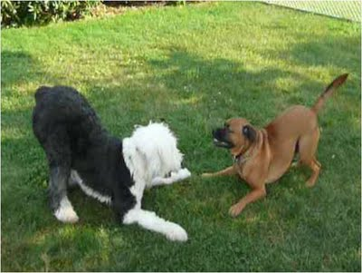
Play Bow as a Signal for Play
Bekoff: Play bow is used more often before and after actions that could be misinterpreted as non-playful
  Infant and adult dogs used the play bow directly before and after mock bites 74% of the time,
  Juvenile wolves 79% of the time,
  Young coyotes 92% of the time.
Play bow “frames” the biting behavior as play rather than aggression

Slide 82
Vocalizations during Play
Include a bark that appears acoustically different than barks that occur in non-play situations (Federson-Peterson, 2008),
Federson-Peterson (2008: play barks take two typical forms:
Slow rhythmical, tonal pattern occurring at regular intervals:
Distance-reducing function
Come play with me
Atonal, disharmonious and arrhythmical pattern:
Distance increasing function
Go away
(Meyer 2004)

Slide 83
Vocalizations during Play
Developmental sequence to the emergence of the play bark.
Tonal barking in juvenile dogs
Adult dogs combine tonal barking with the play bow to form a play solicitation.
Atonal barking occurs primarily during rough and tumble play and play fighting,
Indicates an escalation of excitement or even stress (Fedderson-Peterson, 2008).

Slide 84
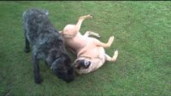

Slide 85
Honesty and Fairness in Play
Bekoff (2008): Play signals important for showing clear and honest intent for play:
Dogs that consistently violate the rules of play (e.g., engage in bite aggression after a play bow signal) are avoided by other dogs,
Often are unable to successfully engage other dogs in play.
Rare that play signals are violated.
Shyan (2003) found less than 0.5% of play fights developed into actual aggression during extensive observations in American dog parks.
Bekoff’s work with wild coyotes revealed only 5 or 6 episodes of “cheating” during over 1,000 observations (Bekoff, 2010).

Slide 86
Role-Taking
Dogs engaging in social play exhibit clear role reversals during play,
There are no “losers” or “winners” (Aldis, 1975, Zimen, 1971).
The chaser may be chased; the attacker may become the defender.
Older dogs, a larger or more physically superior dog may take on the “underdog”,
Will “lose” voluntarily, and thus self-handicap.

Slide 87
Role-Taking
Self-handicapping
Involves bigger, stronger, more skilled dog assuming a disadvantageous position when interacting with a less able dog
Burghardt, 2005; Bekoff & Byers, 1998
Well-socialized dogs play by the play rules/follow the behavioral signals critical for framing play sequences.
Experience playing appears to be integral to the development of appropriate play interactions.

Slide 88
Is Play Learned or Innate?
Bekoff (1995) suggests that the play bow is an inherited fixed motor pattern:
Remember: Signals that “everything that follows is play, not real”.
The play bow tends to occur at the beginning of a play sequence to initiate play,
Also during play when the play sequence has become too rough (Bekoff, 1995).
Dogs that have been blind since birth and dogs that grew up in social isolation still show the play bow,

Slide 89
Is Play Learned or Innate?
Other play behaviors modified through the practice and experience of play.
Dogs, and in particular, puppies, learn consequences of their own behavior through repetition of loosely organized behavioral sequences during play.
Dog may interact repeatedly with another dog or a toy, but how it interacts with the toy may change.
Experience appears to play a strong role in the development of many play behavior and reinforces the rules of social play

Slide 90
Many animals engage in “Purposeless Activities”
Heinrich and Smolker: Ravens (Corvus corax):snowboarding.
https://www.youtube.com/watch?v=mRnI4dhZZxQ
Ravens in Alaska and Northern Canada are also known to slide down steep, snow-covered roofs
When they reach the bottom, they walk or fly back to the top, and repeat the process over and over again.
In Maine, ravens were observed tumbling down small mounds of snow, sometimes while holding sticks between their talons. “
There appears to be no obvious utilitarian function for sliding behavior
DOES look highly similar to playground behavior in children: they also show repetitive sliding activity.

Slide 91
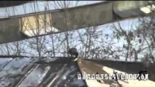

Slide 92
Other Animals Play, too!
Herring gulls (Larus argentatus): play with clam shells
Feed on clams by dropping them onto hard surfaces such as rocks or paved roads.
If they drop them from high enough, the clamshell might crack, providing access to the juicy snack waiting inside.
Sometimes, rather than letting clams drop to the ground, herring gulls try to catch the clam in mid-air.
Other shorebirds play this game of catch as well, including black-backed gulls, common gulls, and Pacific gulls.

Slide 93
Other animals show rules for Play
. Gamble and Cristol noted “rules” of the game in gulls
Younger gulls played drop-catch more often than mature gulls.
Drop-catch was performed over soft ground more often than over hard or rocky surfaces.
Drop-catch behavior far more likely to occur when the gull was carrying an object that wasn't a clam.
Drop-catched clams were less likely to be eaten than dropped ones.
Most interesting: drop-catches were more common when the wind was stronger,
Suggests that gulls engaged in more challenging taskss
Are drop-catching gulls are simply having fun.

Slide 94
So WHAT is the Purpose of Play?
We may misunderstand play behaviors because these behaviors seem to lack of any adaptive or evolutionary function- but we are missing the point!
Play = practice for “adult behavior”
  young animals borrow actions from aggressive, hunting, foraging, or sexual behaviors
  Appears that play may serve as a form of practice.
  Play might help animals become more psychologically flexible.
Fagen: "the distinctive aspect of playful practice and learning is that they are generic and variational, requiring varied experiences and stressing interactions between simple components."
The variation within “play actions” may better prepare an animal to respond adequately in future aggressive or sexual encounters.

Slide 95
So what does this all mean?
Most animals show evidence of memory, thus memory itself is not necessarily tied to language
Many animals can learn to classify complex stimuli
Language or symbol use is tied to higher level cognitive tasks
Language/symbol use interacts with memory
Many animals do not seem to have an awareness of their memories or how their memory works.
Animals with greater symbolic memory seem to have greater metamemory and awareness of how their memory works.

Slide 96
So what does this all mean?
Social behavior in animals is complex
Biological/innate component
Much social behavior is learned….learned to use hardwired behaviors in novel ways
Highly social animals such as dogs behave in ways similar to humans
Can imitate and model
Follow social cues
Eyes and face seem to be important communicators
Play is the foundation of social behavior….for all of us
Play is the building blocks of adult behavior
Allows animals (including humans) to perfect some adult behavior
And it is just fun!

Slide 97
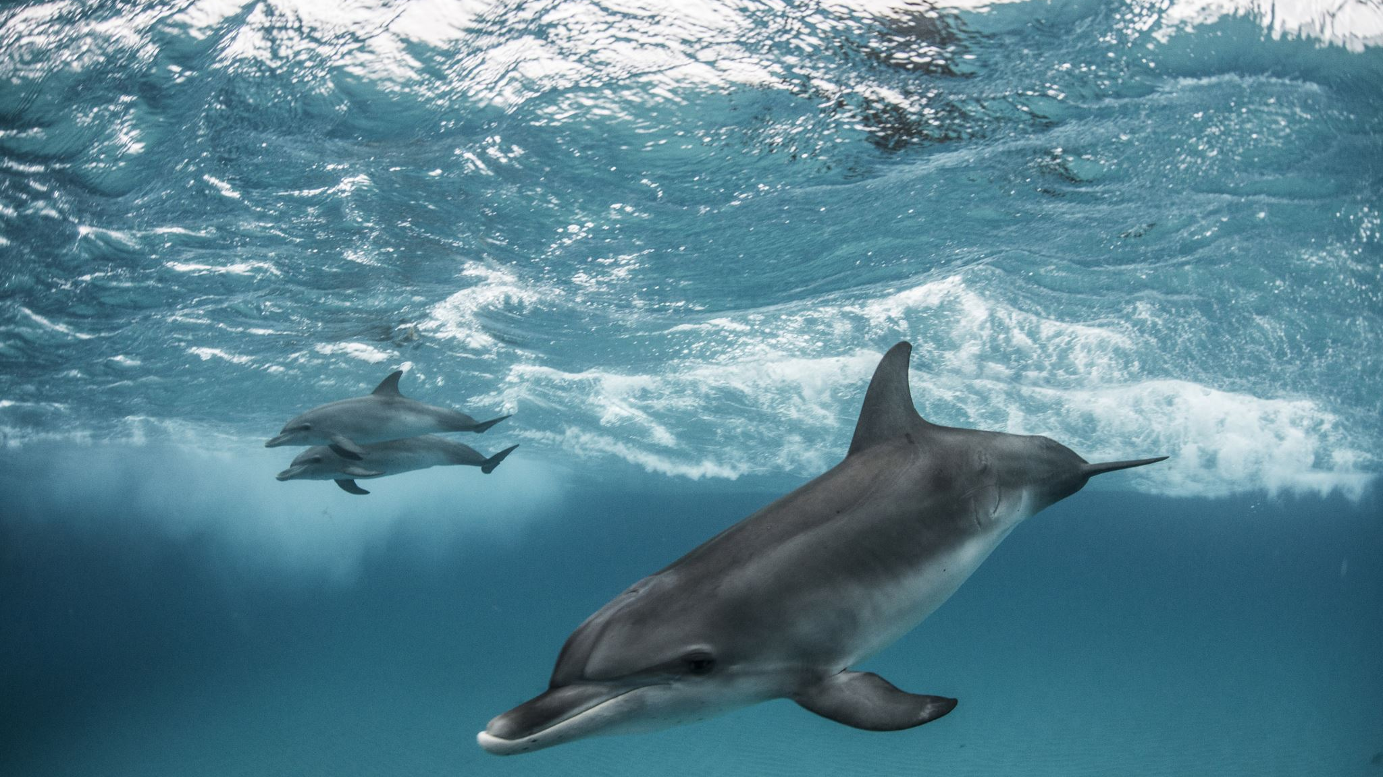
MORE animal cognition!
Animal Language

Slide 98
What is Linguistics?
It is the scientific study of human language.
Scientific (empirical/theoretical)

Slide 99
Language?
How do languages work? Are there rules? What are these rules?
What do we know when we know a language?
Linguistics- Internal Knowledge of Language.
Knowledge of sound system
Knowledge of words
Knowledge of sentence

Slide 100
Important questions
Each and every human language can express any thought the human mind can devise.
Is it possible that a creature may learn to communicate with humans using language?
Does human language have special properties that make it unique and different than any other communication systems found in nature?

Slide 101
The Properties of Human Language
Unique system of communication
Informative signals: signals which you have not intentionally sent → body language
Communicative signals: signals you use intentionally to communicate something

Slide 102
Properties of Human Language: Displacement
Human language refers to the past, present and future-
last night, at school, I’m flying to Paris next week
Things that do not exist in real life, e.g. superman, batman, Santa Claus
Animal communication- immediate moment (we think)
Bee language: dance routine to communicate the location of nectar

Slide 103
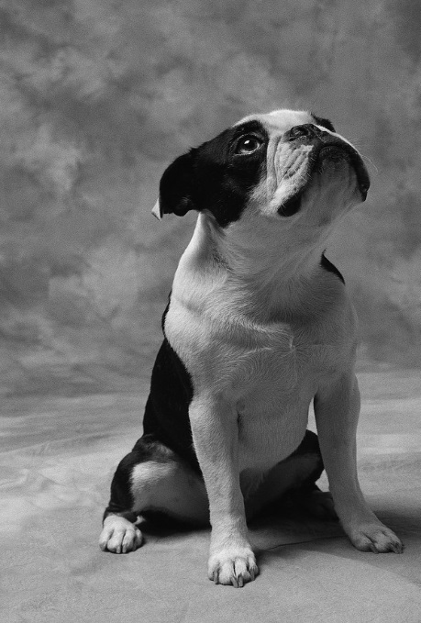
Properties of Human Language: Arbitrariness
Arbitrary Relationship: When there is no natural connection between a linguistic form and its meaning=
  Dog in English and كلب in Arabic.
In animal communication- we assume there is only a connection between the message and the signal used to convey the message.
  Consists of a fixed and limited set of vocal forms
  Problem: we only study how animals learn our language!

Slide 104
Properties of Human Language: Productivity
Humans are capable of creating new expressions for new objects- infinite
a language user can manipulate his linguistic resources→ open endedness
We assume animals have a limited set of signals to choose from- fixed reference
Cannot produce any new signals to describe novel experiences
Or so we thought!

Slide 105
Properties of Human Language:
Cultural Transmission
We acquire language with other speakers → not from parental genes
The first language is acquired in a culture
A Korean child living in USA.
Animal communicative signals are produced instinctively (or are they!?!)
Tamarin work suggests otherwise
Non human primates of the same species who live in different locations show dialects
Birds’ songs differ depending on their location!

Slide 106
Properties of human language: Duality
Two levels: Distinct sound & Distinct meaning
Physical level at which we can produce individual sounds e.g. n, b, i.
Meaning level: when we produce sounds in combination e.g.: nib, bin
Economical feature
Have always assumed that animal communicative signals are fixed and cannot be broken into parts-
Meow is not m+e+o+w
Recent evidence suggests this may be at least partially incorrect

Slide 107
Talking to animals
Is language the exclusive property of human beings?
Are the communication systems used by other creatures at all like human linguistic knowledge?

Slide 108
The controversy
Can animals speak human-like languages? NO
Terrace argues → Researchers over-interpreted their results
Animals produce a particular behavior in response to a particular stimulus or ‘noise’, but do not actually understand what the words mean.

Slide 109
Animal Language
Why study Animal language:
  Intrigues us: We want to know whether we have any company “at the top,”
  Trace the evolutionary roots of language.
  Allows us to determine if language is a universal across species or just in certain species
  Is a window into cognition and behavior

Slide 110
Animal Language
The rationale behind animal language research:
  Any behavior or brain mechanism we share with genetically related animals must have originated in those common ancestors.
  Evidence of language in other animals?

Slide 111
Animal Language
Many animals studied:
  Dolphins, elephants, whales, and gorillas
  Major contender for a co-possessor of language has been the chimpanzee because is closest genetically
  That not necessarily best organism , however.

Slide 112
Alternative Approach to Language
Examine animal language from their point of view
See if can determine syntax, semantics from recordings of ongoing language
Good evidence for language in several animals
  Tamarins
  Sea mammals
  Elephants
  Domestic dogs
  Corvids and parrots

Slide 113
Alternative Approach to Language
Can determine whether other animals share brain organization associated with human language.
But remember: Presence of similar brain structures in other animals does not mean that they use those structures for language.
Correlation does not equal Causation
Must proceed with caution

Slide 114
Alex the Grey Parrot
Alex was an African grey parrot who could imitate human speech and understand the concepts behind the words
Can distinguish between two objects and name what varies in respect to:
Color
Shape
Material
Number
Alex responds with the appropriate category label as to which attribute is "same" or "different" for any combination;
If nothing is same or different, he replies "none".
https://www.youtube.com/watch?v=7yGOgs_UlEc

Slide 115
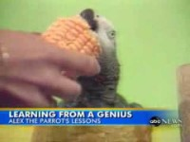

Slide 116
Chimpanzees and Language
Some researchers devoted their time to teach a chimpanzee how to use human language- not successful
  1930s → Gua- was able to understand 100 words but did not produce any
  1940s → Viki- produced poorly articulated versions of mama, papa, and cup
Result → non-human primates lack a physically structured vocal tract needed to produce sounds

Slide 117
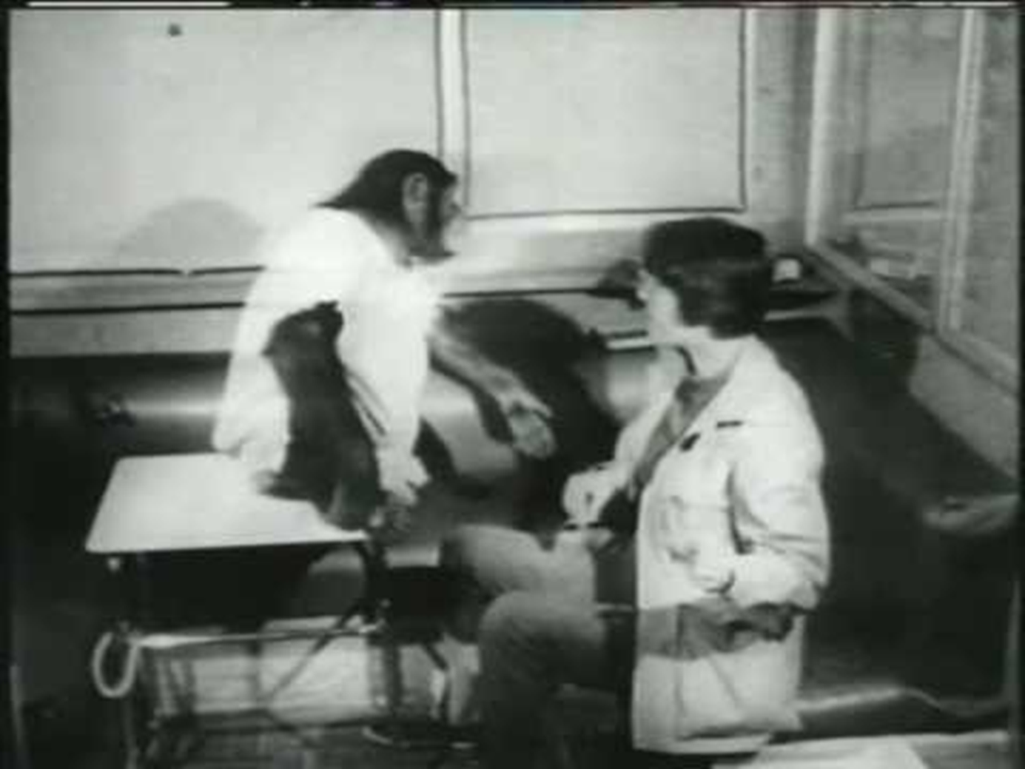
Talking to animals
Washoe
  Use a version of American Sign Language
  Raised like a human
  After 3 and half years → came to use more than 100 words
    Airplane, baby, banana
  Combine them to produce sentences
    More fruit

Slide 118
Talking to animals
Sarah and Lana
  They both use word symbols
  Use a set of plastic shapes that represent words to communicate with humans
  Trained to associate shapes with objects or actions
  Was capable of producing sentences
    Mary give chocolate Sarah

Slide 119
Other Chimps: Kanzi
Learned the symbols, not by being taught, but by being exposed to it in an early age.
Kanzi and his group were capable of taking part in interactions by using symbols chosen by humans and not chimpanzees
But: Never were able to perform linguistically more than on a level of a young child.
Humans possess a natural, inborn facility to be creative with symbols
  Traditionally we have assumed animals do not
  Work with Kanzi shows that this is not true: Animals can be creative with symbols.

Slide 120
Koko the Gorilla
Koko is a 32-year old female gorilla who has stunned the world by being able to learn and use human language.
Dr. Francine "Penny" Patterson was Koko’s keeper for over 30 years and taught her how to use sign language.
https://www.youtube.com/watch?v=SNuZ4OE6vCk
https://www.youtube.com/watch?v=I9I_QvEXDv0

Slide 121
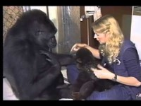

Slide 122
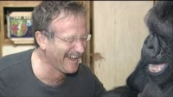

Slide 123
So….
Do animals other than humans have
Language?
A sense of self?
A theory of mind?
Are some other animals sentient beings, and if so, what does this mean for humans?

Slide 124
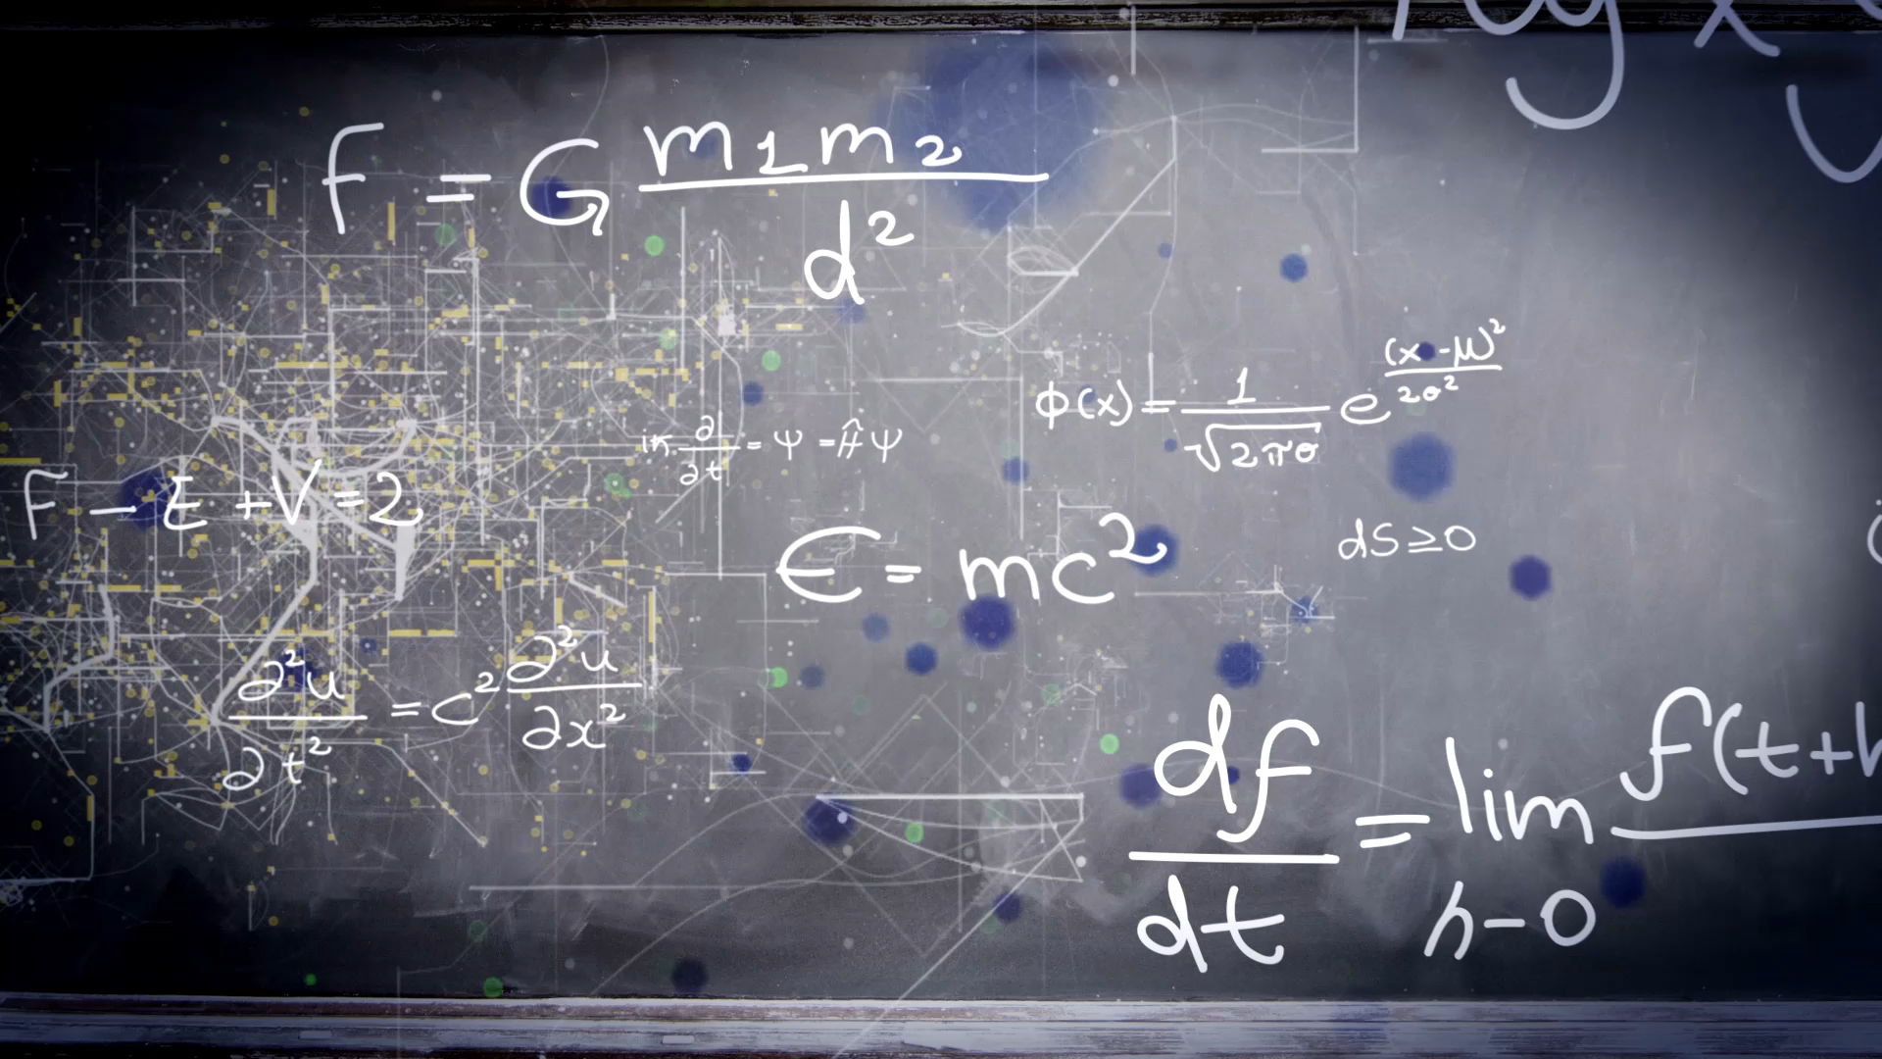
Class Summary
We have accomplished
a lot this semester!

Slide 125
This brings a “take home” for the entire course!
We THINK we are rational organisms
But we too often are not!
We THINK we are in charge of our own contingencies
But too often we are not!
We THINK we have mastered something but too often we did not
We are not really aware of our own learning behavior
BUT: We are ALWAYS learning and adapting

Slide 126
Do we HAVE to be Rational,
In charge of our contingencies and
Aware of our own mastery?
Answer appears to be a resounding NO!
We have to be “GOOD ENOUGH”
Adaptability, generalization and discrimination appear to be much more important
We need to be “good enough” get the job done.
We don’t need to necessarily analyze it to do it
We don’t necessarily have to be perfect- in fact perfection can be detrimental
And being “good enough” is OKAY!

Slide 127
Levels of selection
Evolution and Natural Selection affect behavior, too!
Contingencies of survival: Survive to reproduce or be left behind!
Contingencies of behavior: Behavior or be left behind!
BEHAVIOR may be selected as well as physical traits
Behavior is selected on the level of the individual
Situation by situation
Contingency by contingency
Generalized rule by rule
Behavior is selected on the level of the Species
Species that adapt their behavior tend to live and reproduce
The biology that led to that adaptability is then passed on
Behavioral flexibility is critical for us humans

Slide 128
Levels of selection
Selection by reinforcement:
Contingencies rule our behavior
We respond to contingencies consciously and unconsciously
Trick is to respond to “best” or “optimal” options
Issues such as
Environmental selection
Self control
Differences in organisms’ reinforcer sensitivity due to environmental and biological backgrounds

Slide 129
Additional level of selection
Selection and evolution of CULTURE
There is also GROUP selection
As social organisms, we are reinforced by group contingencies as well
Cultural practices:
A need to fit in, belong
Culture “evolves” as well
Adopt novel behaviors
Transfer of cultural norms across groups/situations
Culture practices may persist as well
Culture is shaped by both our biology and our environment…..
Remember it is a 2-way street
Our culture reinforces us
We reinforce cultural practices
We have demonstrated this over and over again throughout the semester!

Slide 130
History of Learning Theories
Since time began, humans have tried to understand how we learn
Two main ideas:
We have innate knowledge
We must learn our knowledge from experience
Each new paradigm rehashes these issues
We still don’t know THE answer
Data appear to suggest: BOTH!

Slide 131
Many Types of Learning
Habituation
Classical Conditioning
Operant Conditioning
Modeling and Social Learning
Problem Solving
Optimizing of Learning and Choice
Cognition and Language

Slide 132
But, many similarities across the types of learning
Learning curves
Extinction
Generalization
Discrimination
Development of learning “rules”
Chaining of behaviors into more complex responses
Importance of biological boundaries

Slide 133
Comparative Psychology
Compared animals to other animals
Compared people (we ARE animals) to other people and animals
Discovered that:
Animals learn in much the same way we do.
Animals show abilities to think, problem solve, optimize, predict and control their environment
Just like people!

Slide 134
Take home message #1:
“Learning” occurs constantly….not a stagnant “thing” but a continuous behavior.
Organisms that learn are organisms that can adapt and change as the environment changes
We all learn in different ways, but there are some basic rules or algorithms that we can use to predict how animals learn.
Biology is IMPORTANT
Can help learning
Can interfere with learning
Biology may guide how and what we learn!

Slide 135
Take home message #2:
Animals are much more similar to people than we would like to believe!
It is not that humans aren’t special, it that we aren’t unique!
We are specialized to learn in our environment, using our biology, according to our perceptual world.
Animals are specialized to learn in their environments, using their biology, according to their perceptual world
Humans are the best at being human!

Slide 136
Take home message #3:
Humans are not especially “special”
Maybe we are not so different from animals!
After all, we ARE animals!
We are SPECIALIZED, not necessarily special.
We are superb at what we do, and that is adapt and change our behavior, often through learning

Slide 137
Take home message #4:
Learning
Learning = humans biggest “instinct”
We are born to learn, to adapt, to predict and control our environment
This makes us a strong species!
Living
Living = Learning
Hope you have developed an understanding of how organisms learn
That you have an appreciation for other animals’ learning abilities
That you will treat your own learning as a very special talent that will take you VERY far in life- but only if you use it!

