Slide 1
Avoidance:
It’s just negative REINFORCEMENT!

Slide 2
What is avoidance behavior?
Avoidance contingencies INCREASE the rate of an operant response
NOT punishment, but actually negative reinforcement
Remember, punishment DECREASES the response
But with both avoidance and punishment the organism reduces contact with an aversive stimulus!
Increasing periods of safety
Avoidance procedures = ACTIVE avoidance
Punishment procedures = passive avoidance

Slide 3
Avoidance Tests: Discriminated Avoidance
Discriminated Avoidance:
Procedure for studying negative reinforcement and avoidance
A response CANCELS a shock
Organism is responding for food reinforcers
When light comes on, must press another lever to AVOID the shock
IF the response does not occur during the S+ the stimulus is followed by a shock
IF the response does occur during the S+, the shock is cancelled
If this were an escape: response could also occur DURING the shock to shut off shock
Thus: signal or sD for shock

Slide 4
Shuttle Avoidance
1-way shuttle avoidance:
Animal on one side of a shuttle
Cue comes on: Must jump to other (safety) side or receive a shock.
Placed back in original side for each trial.
2-way shuttle avoidance
Animal on one side of a shuttle
Cue comes on: Must jump to other (safety) side or receive a shock.
But: previously SAFE side then becomes shock side
Animal must jump back into “shock” side to get away from shock.
VERY Difficult for animal to learn.

Slide 5
Theories of Avoidance: Two Factor theory
Assume TWO things happen during avoidance conditioning: CC and then OC
Animal learns to fear S+ via class. conditioning
CS (light)---> US (shock): UR (fear)
animal learns to fear light via pairing with shock
Animal will then learn a response to AVOID shock and thus remove/lessen their fear
Thus: not getting shocked reduces fear that was signaled by the CS

Slide 6
Theories of Avoidance: Two Factor theory
Experimental evidence:
On initial training trials: light/CS produces physiological symptoms of fear
Escape response results in decrease in these physiological symptoms
On later trials:
Little or no evidence of physiological fear with CS presentation
Suggests fear has been reduced/replaced by the escape response
In sense: forms a negative feedback loop

Slide 7
Problems with 2-factor theory:
Signs of fear dissipate w/time:
As animal gets "better" at avoidance response
Thus: no fear to be avoided
The CS is not as important in avoidance learning as 2-factor theory states:
Animals can learn to avoid in a discriminated avoidance situation long before there is any sign that they are responding to/detecting the CS

Slide 8
Two Avoidance Procedures:
Sidman Avoidance:
The response POSTPONES or DELAYS the shock
Thus: only temporary solution
Must keep responding to keep delaying the shock
Results in lots of responding
Again: some signal may be used to signal when must respond
Why important? If fear was necessary, would “freeze” and be unable to respond to delay the shock

Slide 9
Two Avoidance Procedures:
Herrnstein and Hineline Procedure:
The response reduces the rate of the shock
Does NOT delays or cancel, just slows down rate of delivery
The response switches the schedule of shock to a lower rate
Note: cannot entirely AVOID shock in this procedure:
Once animal receives shock on lowered schedule, reverts back to original schedule
Animal must respond again to switch schedule again

Slide 10
Herrnstein and Hineline: Test of 2-factor theory
Test of 2 factor theory:
1
Two groups of rats used
Group 1: Can turn off light, but still get shock
Group 2: Can turn off shock, light still on
2-factor theory would predict:
2
Group 1 should respond more
Why? This would be cancelling the CS that produces fear
Results:
Group 2 responds much more accurately, faster
3

Slide 11
Alternative: One-Factor Theory
ONLY operant conditioning occurs: Responses occur whenever they reduce the rate at which aversive events occur
When a CS is present: only providing information about the effectiveness of a response
Fear may be a by-product of avoidance training, but not crucial to learning/ maintaining an avoidance response

Slide 12
Evidence for One-Factor theory
Almost postulating a "cognitive" theory of avoidance:
Seligman and Jonston (1973) did postulate cognitive theory:
like Rescorla Wagner theory in that deals with predictability
Basic premise:
Learning occurs only when there is a discrepancy between observation and expectation
Subjects' behavior will change in avoidance task whenever there is a discrepancy between expectancy and observation

Slide 13
Evidence for One-Factor theory
Two important expectations in avoidance task:
Expectation about consequences of a response
Expectation about consequences of not responding
Data support One-factor theory
On trial 1: No expectations
On trial 2 (and more): Expectation about what will happen
No shock will occur if response is made
Shock will occur if no response is made
Animal prefers no shock to shock- so responds
Contingency is what is important in avoidance, fear is by-product!

Slide 14
Safety-Signal Hypothesis
In avoidance: Cannot forget that there is positive reinforcement through conditioned inhibition of fear
That is, are rewarded for reducing fear through the avoidance response
Thus avoidance response is (obviously) reinforced
But so are signals that occur with that response

Slide 15
Safety-Signal Hypothesis
Conditioned safety signals!
Performance of an avoidance behavior reduces conditioned fear
Safety signals associated with this avoidance behavior are then signals for reinforcement
These safety signals may not be “outside” or external cues, but feelings and behaviors within the organism
Feeling of relief is reinforcing!

Slide 16
Characteristics of Avoidance Behavior
Negatively reinforced behavior is difficult to extinguish:
Escape behaviors take long time to go away
E.g.: rat in 1-way shuttle still runs when light comes on-even after hundreds of EXT trials
BUT: Will extinguish quickly if animal/human can detect change from conditioning to EXT situation

Slide 17
Characteristics of Avoidance Behavior
Extremely variable:
From subject to subject
From session to session with SAME subject
Procedure to procedure
Choice of response is important
Determines how quickly will learn contingency
How well learning is maintained
Example: 1-way vs 2-way shuttle avoidance tests:
Rat learns to run to the safe side shuttle box when the light comes on to avoid shock
1-way shuttle: run to other (always the same) area when light comes on
2-way shuttle: run to opposite (changing) area when light comes on
Why do animals have a difficult time learning 2-way shuttle avoidance?
No clear safety signal

Slide 18
Biological Boundaries on Avoidance Behavior
Different animals “avoid” in different ways, using different behaviors
BUT: Highly similar pattern of FEAR-FREEZE-FLIGHT-FIGHT sequence
Suggests that avoidance has highly biological organization, but that contingency is learned

Slide 19
Species specific Defense reactions
SSDR’s
Bob Bolles (1970, 1971)
Behaviors which animal does naturally in time of danger
Includes: freezing, fleeing, fighting
Why?
Animal has innate behaviors does when avoiding noxious stimulus-
Can't make it go against its nature

Slide 20
Examples of SSDR’s
Rat in shuttle box:
If shock back feet: it easily escapes and jumps over barrier
If shock front feet: Avoidance behavior greatly reduced
Rats when shocked bite/grab, defensive burying
Pigeons when shocked WING flap, then peck

Slide 21
Negative Reinforcement in Humans
Most often "reinforcement" technique used in real world
Often used because is cheaper, easier, more natural
Produces "bad" side effects: avoidance responses to S^{D} = boss, principal, spouse, etc.
Data show it is a highly ineffective reinforcement procedure with many side effects

Slide 22
Negative Reinforcement in Humans
People develop interesting behaviors towards signals of the aversive:
Avoidance
Anger/frustration
Negative thoughts and feelings towards that individual/situation
Given uneven and unpredictable behavior with avoidance techniques, avoid them in applied situations.

Slide 23
Avoidance behavior in Humans
Humans have many ineffective and/or irrational fears
Often involve avoidance responses due to original fear
Develop odd avoidance behaviors as a result
Maintained by decrease in fear
E.g., banging two sticks to keep the tigers away
Symptoms of obsessive/compulsive disorders:
Compulsions = repeated, stereotyped, ritualized actions
individual feels compelled to engage in them
Obsessions = compulsive thoughts (no actual actions)
Many, many examples of this
Can begin to interfere in life

Slide 24
An Aside: Flooding as an aversive:
To extinguish an inappropriate response: must make contact with "changed reinforcement or punishment" situation
Flooding is sometimes used as alternative to systematic desensitization
Flood with presentation of fear-provoking stimulus
Again, no actual consequence occurs
Continue presentations until the response is extinguished
Problem: may "scare the patient to death"

Slide 25
Perceived Control and Avoidance
Significant side effects may be produced by avoidance tasks
Animal psychosis or experimental psychosis
Animal stops eating, drinking
Animal may engage in self injurious behavior
Appears to be due to implementation of an avoidance contingency under certain conditions
Most severe: Learned Helplessness

Slide 26
Learned helplessness Marty Seligman
Four groups of dogs
Training I and II result Lasting effects
Grp I Escapable/escapeable run None
Grp II Inescapable/inescapable not run None
Grp III Escapable/inescapable not run None
Grp IV Inescapable/escapable not run Severe
Remember, Seligman’s hypothesis was that NONE of the dogs would be significantly harmed.

Slide 27
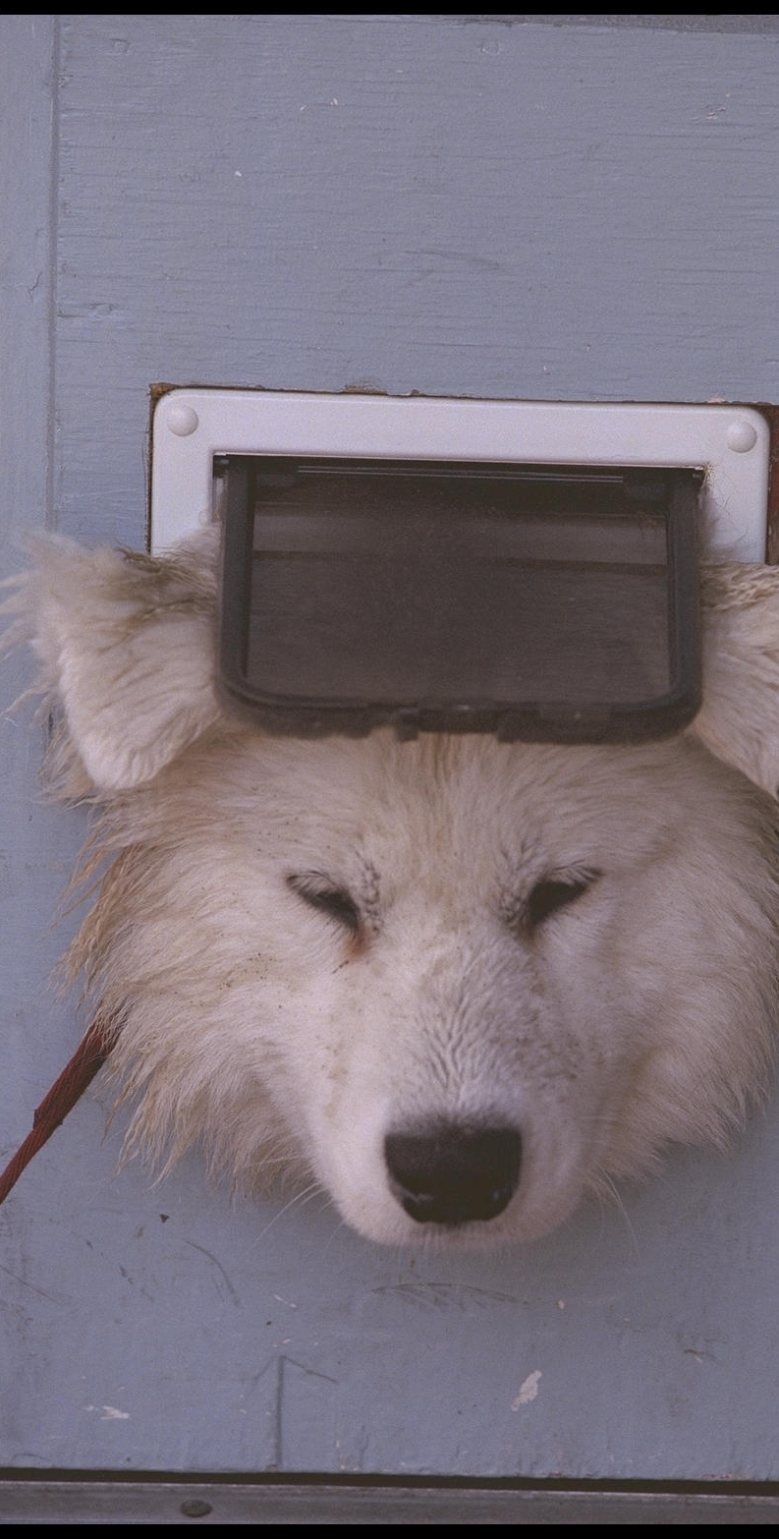
Key Factor = inescapability
Once learned not to escape (learned to be helpless)= not change
Characteristics of L.H.
Inescapability that produces phenomenon, not the shock itself
Works under variety of procedures, conditions
Very generalizeable, transferable
If take far enough, can make it a contingency rule for the animal, rather than specific contingency for specific situation(s)

Slide 28
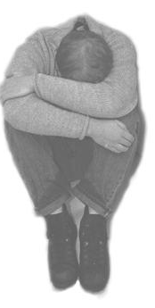
Symptoms of L.H.
Passivity
Learned laziness
Retardation of learning
Somatic effects
Reduction of helplessness with time

Slide 29
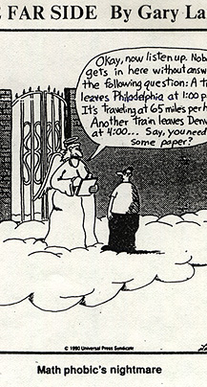
Clinical expressions of Learned Helplessness
School phobias
and math anxiety
Abusive Relationships
Depression
Cultural learned helplessness

Slide 30
“Curing” or eliminating learned helplessness
Unlearn the rule
Reshape or recondition
Must be done in situation where organism cannot fail
Difficult to do- animals can “not” respond
UPenn program on relearning thoughts during test taking

Slide 31
Why?
Only when shock is contingent on behavior do animals develop LH
Animals in no control/no control condition do not develop
Showed generalization very quickly
In situations where there WAS a contingency, the lack of behavior sabotaged results

Slide 32
How is this an example of the importance of contingency?
Got themselves into contingency trap
If they don’t respond, no reward, only punishment
This reinforced contingency rule that THEY were the cause of the bad consequences
Self sabotage
And it was true!
Thus: treatment must be to learn better contingencies and eliminate the bad (and in their head) contingency rule

Slide 33
Why is this important for humans?
Helps explain the “misbehavior” of humans with some disorders
Drug addicts and those with schizophrenia and other MI make “poor” choices
May be due to physiology of the addiction or disease
“Bad choices” may be due to effect of DA
Real changes may be occurring in the brain which prevent the addict from being sensitive to changes in his or her life rewards
May also explain some of the perseverative and off-task behaviors observed in these individuals

Slide 34
What “causes” LH?
Newer research: Original theory of learned helplessness NOT account for people's varying reactions to situations that can cause learned helplessness
Learned helplessness sometimes remains specific to one situation
At other times generalizes across situations
At first, difficult to predict which will occur in a given situation

Slide 35
Attributional Style
Attributional style/explanatory style:
Key to understanding why people respond differently to adverse events
Refers to how individuals attribute cause to an outcome
Group of people all experience same or similar negative event, but differ in how react to that experience
Experience of individuals differ
How each person interprets cause of event will differ
HOW one attributes causes to event will appears determine likelihood of LH

Slide 36
Pessimistic explanatory style
Sees negative events as
Permanent : "it will never change“
Personal: “it's all my fault“
Pervasive: "I can't do anything correctly“
These individuals most likely to suffer from learned helplessness and depression
“Eeyore's”

Slide 37
Optimistic explanatory style
Sees negative events as
Out of the ordinary: “tomorrow is a new day! “
Impersonal: “it's NOT really my fault“
Temporary: "I can do most things correctly“
These individuals least likely to suffer from learned helplessness and depression
“Pooh” personality

Slide 38
Other Styles?
Anxious style?
Academic or Knowledge-based style?
Maternal style?
In a way, the characters of Winnie the Pooh seem to capture the various coping styles!
But, can use attribution theory to explain many of these styles

Slide 39
Attribution Theory
Bernard Weiner (1979, 1985, 1986)
Examines how people attribute a cause or explanation to an unpleasant event.
Includes the dimensions of
Globality/specificity:
Stability/instability
Internality/externality

Slide 40
Global vs. specific Attributions
Specific attribution: individual believes cause of a negative event is unique to a particular situation.
Global Attribution: individual believes the cause of a negative event occurs across situations

Slide 41
Stable vs. Unstable
Stable attribution: individual believes the cause to be consistent across time.
Unstable attribution: individual thinks that the cause is specific to one point in time.

Slide 42
External vs. Internal
External attribution: assigns causality to situational or external factors
Internal attribution: assigns causality to factors within the person

Slide 43
How develop positive thinking styles?
Cognitive Behavioral therapy: Teach a new thinking style
Innoculation programs
Teach to deal with failure!
Must experience failure to learn to frame it appropriately
Who is more likely to get depressed?
Straight A valedictorian receiving first C
B average student receiving first C
Why?
You aren’t learning if you don’t make “mistakes”
Mistakes are exploring the boundaries of a contingency!

Slide 44
Conclusions
We are animals and we behave in ways that are consistent with other species.
There are biological boundaries or constraints in how we learn and react to our environment
Our biggest Human instinct: to learn, predict and control our environment
HOW we attribute causes influences the development of rules or heuristics for causation
Animal models allow us to investigate these boundaries and help explain human learning and choice behavior!

