Slide 1
Welcome to Psy 331.03
Advanced laboratory in operant conditioning
But more importantly
Rehabilitation of Shelter dogs and Puppies

Slide 2
Why study the Domestic Dog (Canis lupus familiarus)?
Because they tell us a whole lot about humans and human social behavior!
Valeri Farmer-Dougan, Ph.D.
Director, Canine Behavior and Cognition Laboratory
Illinois State University
Pet Central Helps Animal Rescue and Shelter
Normal, IL
vfdouga@ilstu.edu
http://About.illinoisstate.edu/vfdouga

Slide 3
Domestication of Dogs
Involves both natural and artificial selection
Natural selection:
Natural selection developed individuals who more likely tolerant of humans
Remain closer in, live with humans
Those who could get close to humans were more likely to survive!
This led to changes in wolf/coyote/fox morphology and behavior
Morphology = body shape and body characteristics
These canines showed reduced fear and aggression in presence of humans
Humans noticed this and began to breed dogs for certain uses:
Herding
Hunting
Protection
Companionship
Service Dogs

Slide 4
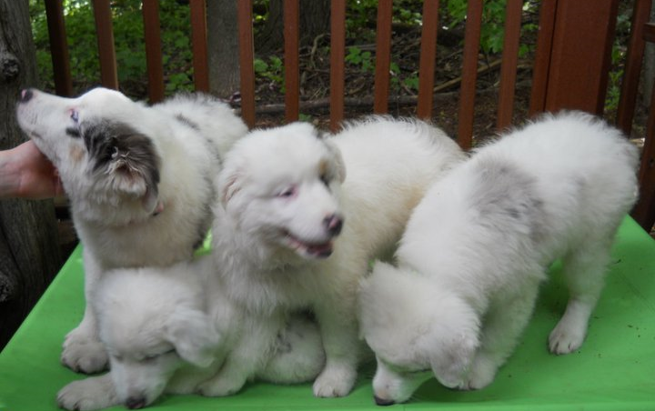
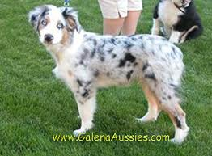
Ontogeny of Dog Social Behavior
Domestication results in both physical and behavioral changes
Physical changes include:
Larger size variation: big dogs and little dogs
Spotted and many-colored coats
Changes in hair length
Shortened tails
Floppy ears
Social changes:
Lack of development of fear to humans
Exhibiting play behavior in adulthood
Prolonged juvenile period

Slide 5
Scientific Term for theses changes:
Most important: Paedomorphosis
Retention of juvenile traits into adulthood
Physical characteristics
Behavior characteristics
Important:
Changes in head: muzzle, ears, coat, eyes, tail
More juvenile signaling and extended play behavior in place of adult aggression/antagonistic signaling
Extended play
Reduced need for adult-type signaling

Slide 6
These changes are important to understand because…..
It allows us to understand the psycho-bio-social aspects of human-canine interactions
It helps us develop programs which benefit both dogs and humans
It teaches us a bit about ourselves

Slide 7
So This course is about the domestic dog: Canis familiaris This course is 3-fold
To learn and understand basic learning theory including:
Classical conditioning
Operant conditioning
Modern Behavior Analysis
To understand the behavior of the domestic canine:
Behavioral signaling and communication
Development of the species and the individual dog
Social behavior of the domestic dog, including dog to dog and dog to human interactions
To apply basic learning theory through applied behavior analysis (ABA) to:
Teach basic obedience skills
remediate behavioral issues
prepare shelter dogs for adoption

Slide 8
As Psychologists, We must protect The Rights of Dogs
Freedom from hunger and thirst
Freedom from pain
Freedom from discomfort
Freedom from avoidable or treatable illness and disability
Freedom to be themselves
Freedom to express normal behavior
Freedom to exercise choice and control
Freedom to frolic and have fun
Freedom to have privacy and “safe zones”
Mark Bekoff & Jessica Pierce, “Unleashing Your Dog: A Field Guide to Giving Your Canine Companion the Best Life Possible” 2019

Slide 9
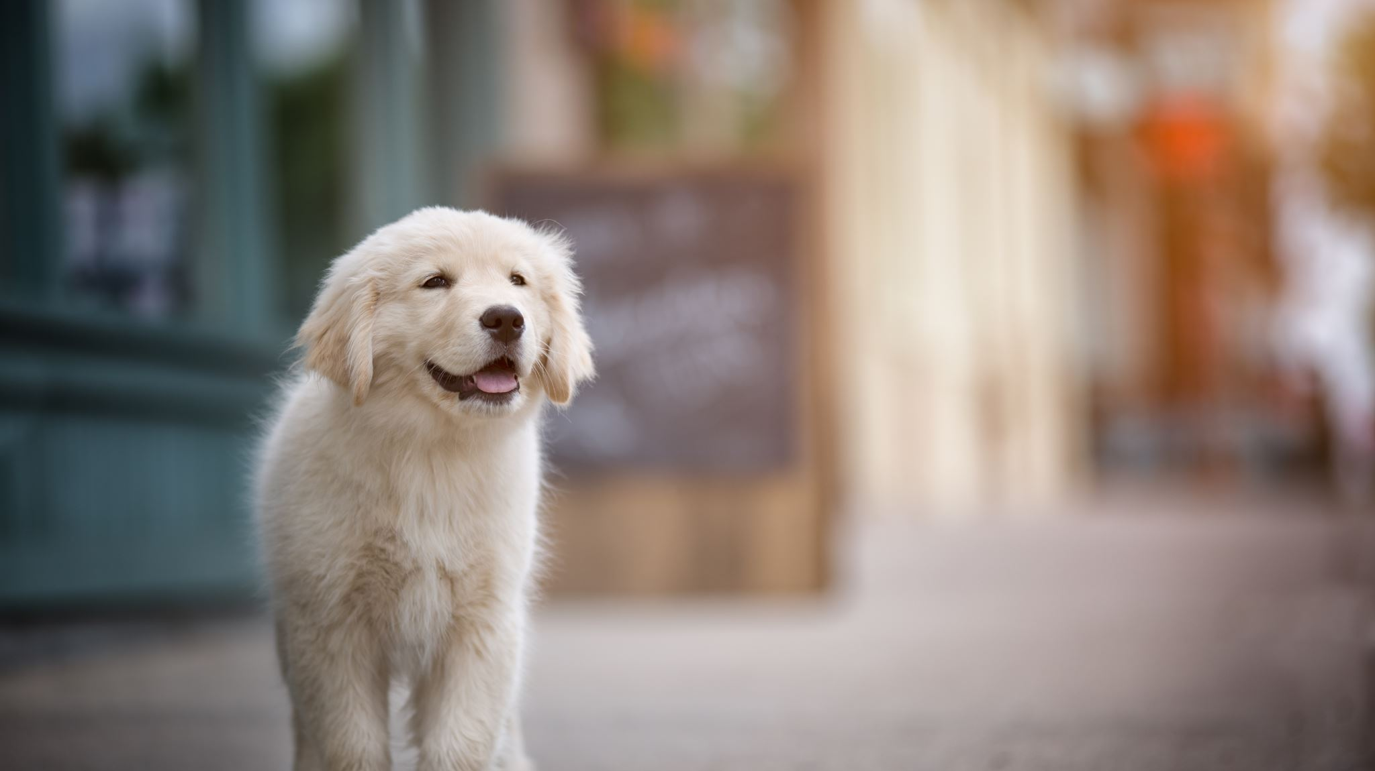
How do we do this?
Begin with an overview of learning theory
Learn the techniques of positive reinforcement-based teaching and Clicker training
Begin to interact with our dogs and apply our lecture-based and readings-based knowledge as we assist our dogs in becoming adoption ready!

Slide 10
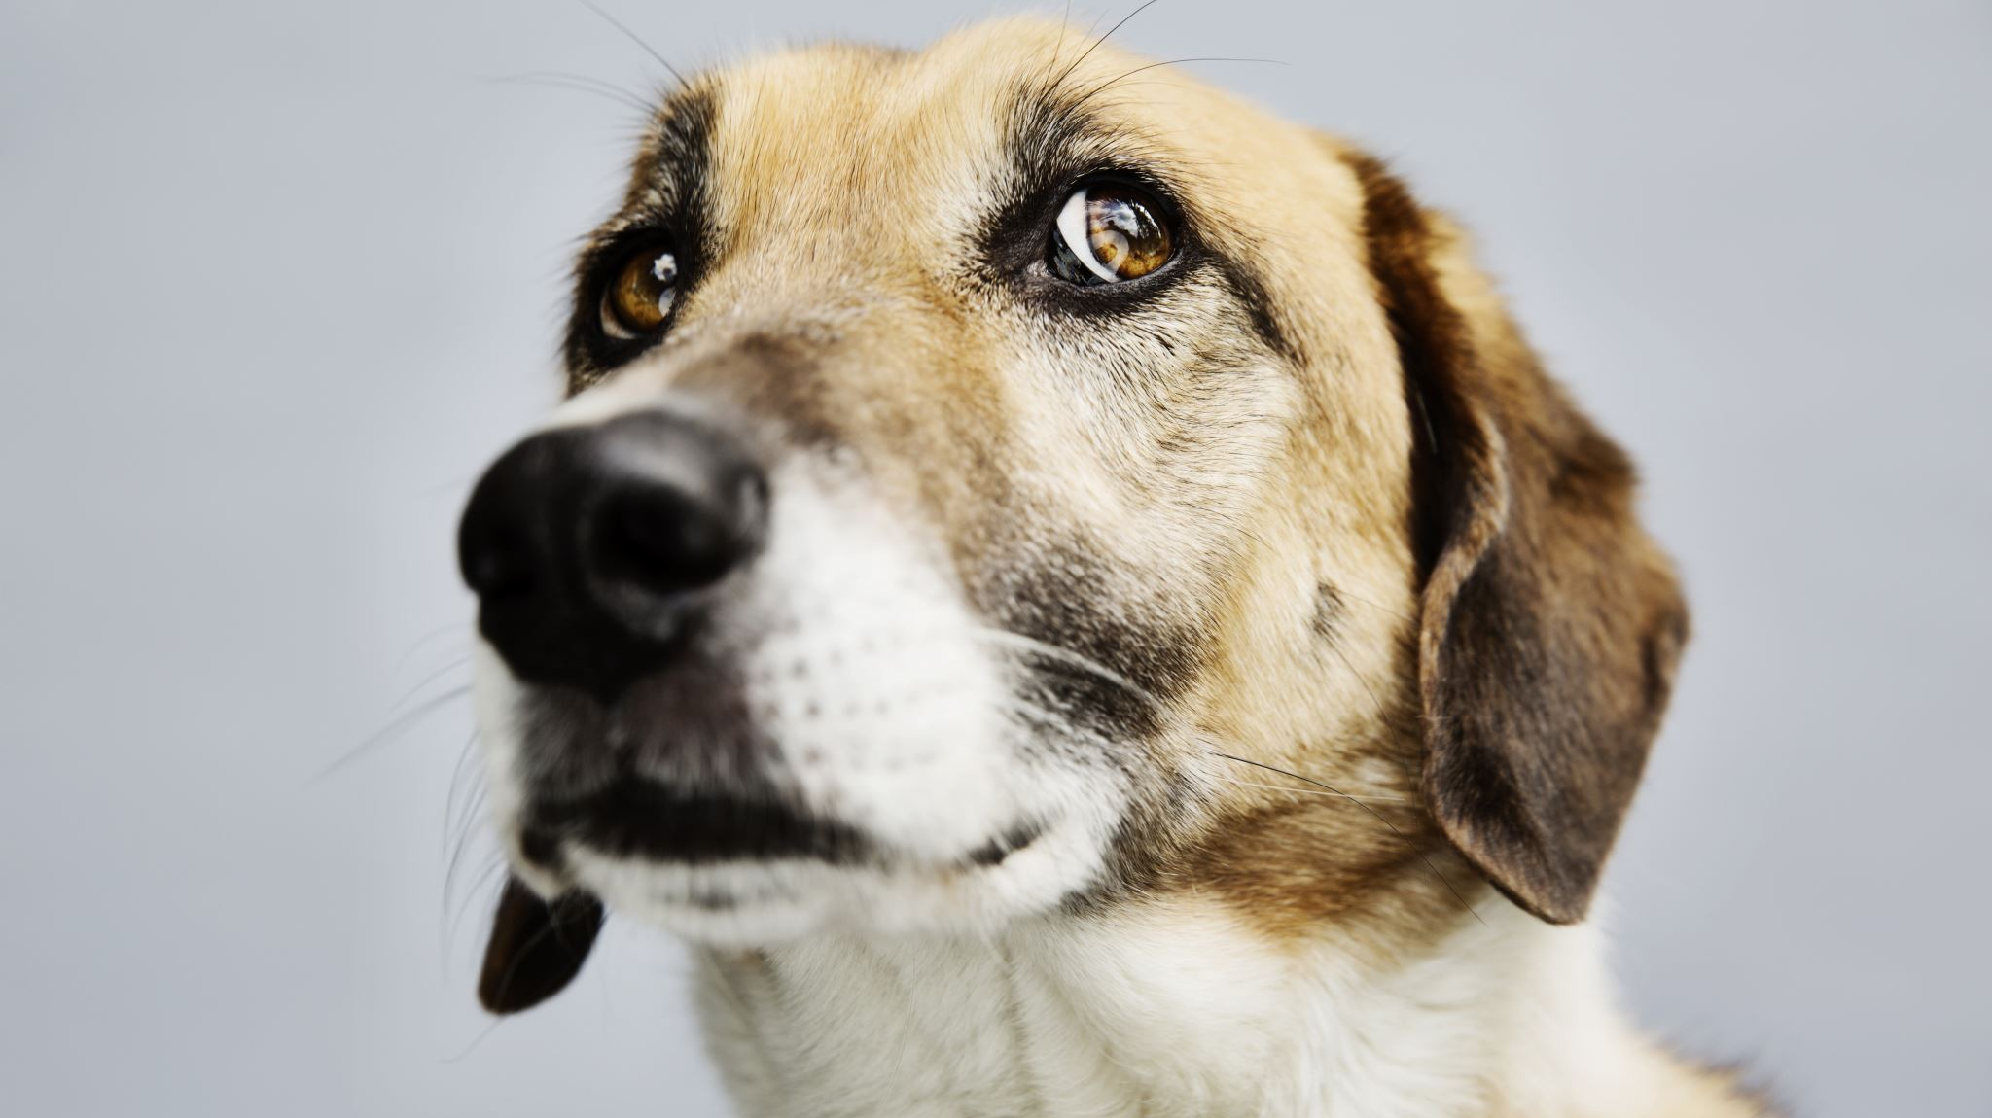
Why shelter dogs?
Let’s begin with a little research on shelter dogs and an introduction to Pet Central Helps.

Slide 11
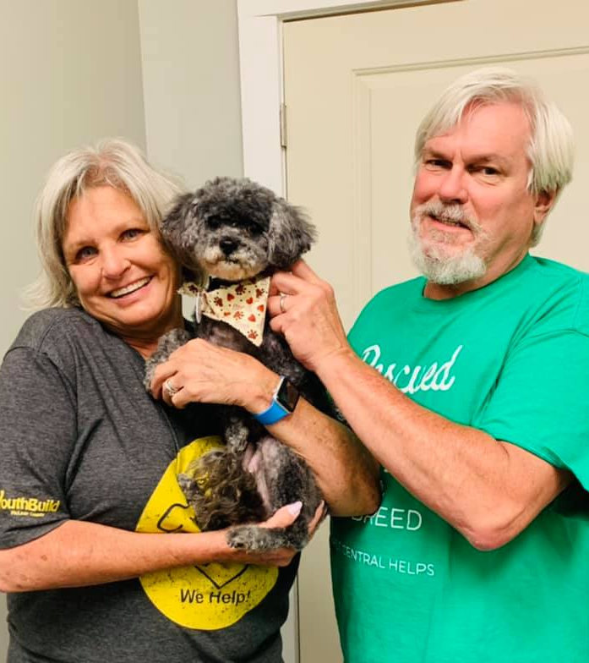
Shelter Love
What we know about Shelter Dogs and Best Treatment Packages

Slide 12
Pet Central Helps (PCH) is a 501(c)3 nonprofit organization founded in 2017 by Lisa Kitchens.
PCH is a comprehensive shelter for dogs, cats and occasionally other small animals. It is comprehensive in that we provide
Rescue and shelter for dogs and cats
Foster program for most of our animals
Food and cat litter bank program
Low cost spay/neuter and some low-cost vet care
FREE training classes and behavior support for as long as you have your PCH pet
Emergency animal abuse/neglect investigator

Slide 13
Where do YOU all come into the picture?
Yes, you will be learning vital skills that will help you in your future career with people
Operant Conditioning
Classical conditioning
Social learning
Consulting skills
Patience, kindness, tolerance
And you all allow our training program to provide services to many, many more of our dogs and cats.
Let’s talk why this is so important!

Slide 14
Shelters
Estimated that 4-4.5 million dogs enter the shelter system each year(Woodruff & Smith, 2017)
14% or about 800,000 of those dogs will not leave the shelter, but will be euthanized
Reasons for euthanasia include
Age
Illness
Behavior
Length of stay

Slide 15
Dogs entering shelter experience variety of stressors:
Disruptive sounds
Restrictive movements
Loss of social attachments
Other animals in close proximity
Lack of exercise
Lack of mental stimulation
Social Isolation

Slide 16
Stressors have critical impact on welfare of dog
Weight loss
Hearing loss
Muscle atrophy due to lack of exercise
Lack of positive social interaction with other dogs
Lack of positive social interaction with people
Little control over daily lives results in learned helplessness
Increased cortisol: Stress hormone indicative of negative stress on the dogs

Slide 17
Shelter dogs show a variety of “inappropriate” behavior
Aggression
Remaining at back of kennel
Jumping at gate to kennel and on people
Barking
Apathetic behavior including lack of interest in treats and toys
Reactive behaviors to noise, outdoors, the leash
Poor attachment to adopters

Slide 18
Goal is obviously to get these dogs adopted
Problem:
Determining the best way to prepare dogs for adoption
Determining what behaviors get dogs adopted
Improving social skills of these dogs
Preventing or reducing learned helplessness and apathy
Variety of interventions have been tried
Behavior modification programs
Changes to shelter environments: Noise control, social housing, enrichment
Short term foster programs
Long term foster programs

Slide 19
So: What behaviors get the dog adopted? Protopopova & Wynne, 2014
Prior to this work, only 3 studies evaluated dog’s likelihood of adoption
Luescher & Medlock (2009): in- and out-of-kennel obedience training improved adoption chances
Protopopova, et al. (2012): Trained shelter dogs on eye gaze and staying close to adopters, and this increased chance of adoption
Herron, et al. (2014): trained in-kennel behaviors such as being near front of cage, lying down or sitting at front of cage, and not barking to increase chances of adoption
But: No one ever looked at what potential adopters do and how dogs interact with those adopters

Slide 20
So: What behaviors get the dog adopted? Protopopova & Wynne, 2014
Examined 250 interactions between dogs available for adoption and potential adopters
151 dogs; 154 potential adopting individuals or families
Dogs housed in kennel rows in singles or pairs; could be viewed via outdoor alleyway
Cage card noted each dog’s ID, age, potential breed, mode of intake, and possibly history of dog
Research assistant escorted individual, family and any kennel staff from row to row.

Slide 21
So: What behaviors get the dog adopted? Protopopova & Wynne, 2014
Questionnaire:
family and individual demographics,
intended purpose of visit (Adopt, just looking
intended purpose of dog under consideration,
reason for adopting/not adopting a dog chosen from list of reasons/behaviors of dog
Behavior of dogs coded using ethogram of behaviors in 5 sec bins
Demographics and history of dog also obtained

Slide 22
Results: Reasons for adopting/not adopting a dog.
88/250 interactions resulted in adoption (35.2%)
Demographics of potential adopters
Mostly female (57.6%); more were <25 (37%); 54% lived with more than 1 person
47.2% reported not having intention of adopting a dog on that day
155 families or individuals (47.2%) interacted with a dog by having it moved from its kennel
64.5% only interacted with 1 dog; 21.9% with 2

Slide 23
Results: Reasons for adopting/not adopting a dog.
Reasons reported for adopting the dog
Looks, age and breed were all important for majority
88.8% also wanted certain behaviors:
Playful,
Attentive
Friendly and mellow
Reasons for NOT adopting a dog:
Looks, breed, age, very low
Behavior included in about 1/3 of reasons
BUT almost half reported that dog was aloof

Slide 24
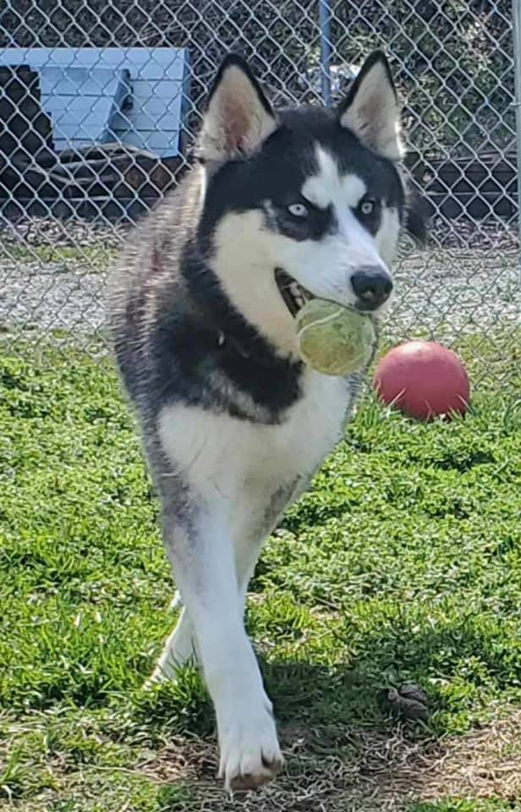
Results: Shelter dog demographics
155/250 dogs taken out of kennels
Average time of interactions was 7.9 minutes (range of 1-40.7 minutes!)
61.6% taken out only 1x
22.5% taken out 2x
10.6% taken out 3x

Slide 25
Results: Shelter dog demographics
Majority of dogs were
Male (56.4) and adult (60.0)
Puppies: 9.6; juveniles 30.4
Medium sized (64.8%) or small (30%
Largest color category was red (48.8%); smallest was gray (0.08%)
Most had short coats (77.2%)
Most frequent breeds were fighting breeds (32.8%) and sporting (26.4) (Most common breeds in shelters)
Majority were strays (64.4); 28% were owner surrender

Slide 26
Predictors of Adoption
Dogs that not adopted
Ignored play initiations by potential adopter 2x as much as dogs that were adopted
Laid in proximity to adopter half as much as adopted dogs

Slide 27
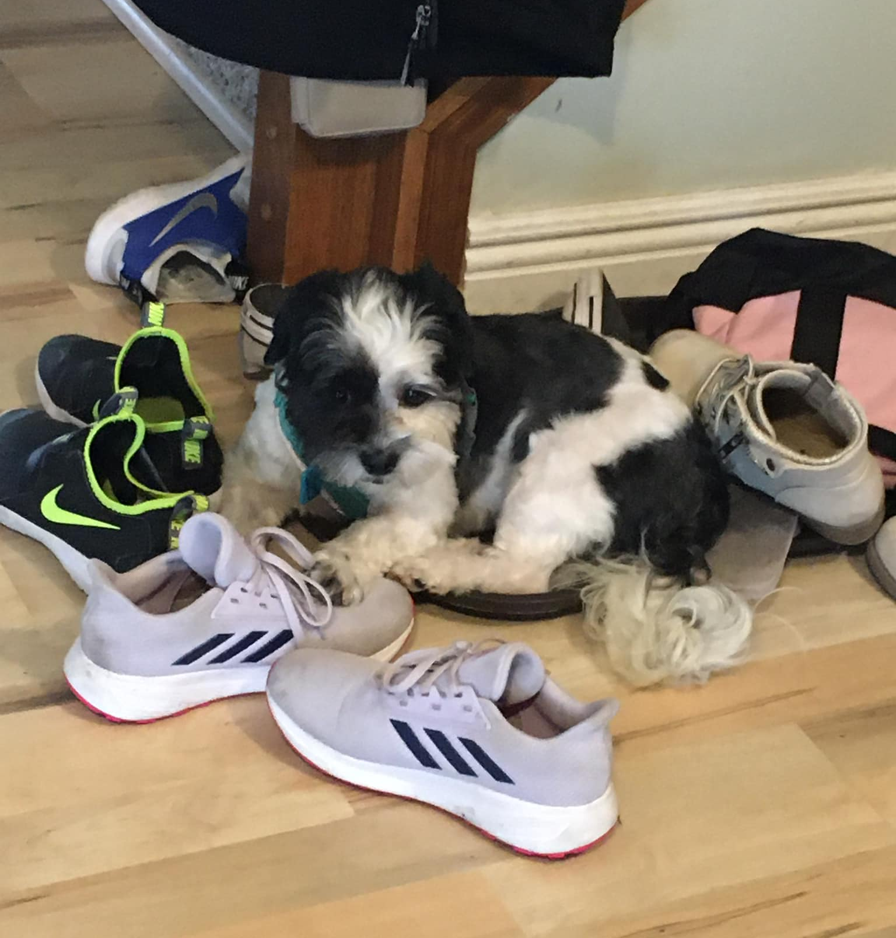
What about attachment?
Dogs have attachment styles very similar to humans
Human attachment divided into 3 types:
Secure attachment: dogs show signs of distress when separated from owner, seek proximity and contact when owner returns)
Insecure-avoidant attachment: infant does not show distress when separated from owner and does not seek proximity/contact when owner returns
Insecure-resistant attachment: Very distressed when owner leaves; not calmed when owner returns and avoids/resists contact
Thielke and Udell (2020) examined these attachment styles in shelter dogs

Slide 28
Method
Subjects:
21 dogs in foster homes and 31 dogs in shelter
All dogs spayed/neutered
Shelter dogs selected by volunteers
Foster dogs assigned to foster homes by staff
Human participants: 20 foster parent volunteers and 20 shelter volunteers that interacted regularly with the shelter dogs
Testing
Foster dogs tested 3 days after arriving in foster home; shelter dog selected by volunteer that had interacted with it at least 3 times
Secure Base Test
Paired Attachment Test
Lexington Attachment to Pets scale for Human volunteers

Slide 29
Dogs given 1 of 4 attachment styles (notice addition of 1 style)

Slide 30
Paired Attachment Test
Several 2-min phases:
Phase 1 : Alone
Phase 2: Passive: Caretaker and stranger sat neutrally, instructed to pet each dog twice if and only if it entered circle
Phase 3: Active: Both humans called dog and provided continuous attention and petting
Behavior Coding:

Slide 31
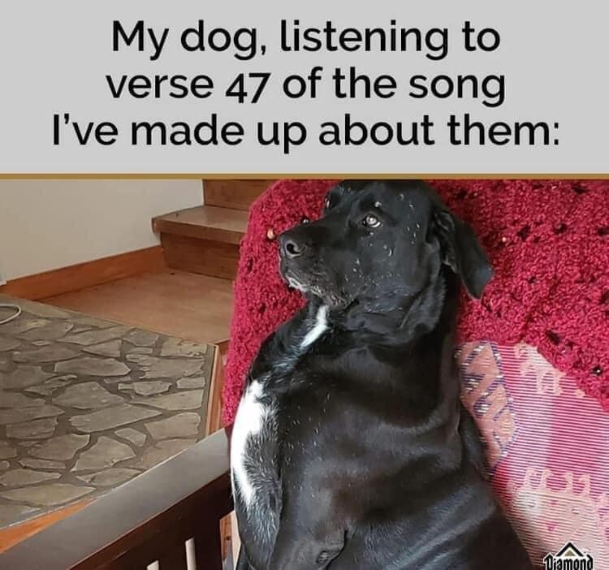
Coded disinhibited attachment
Ranked each dog based on proportion of return phase of SBT that the dog spent seeking proximity to familiar person
Ranked by total time spent to unfamiliar person for both phases of Paired Attachment test
Low proximity seeking = low ranking on attachment scale

Slide 32
Results:
Foster dogs Attachment:
57.14% secure
Shelter dogs Attachment:
38.71% secure
61.29% insecure
of those 51.61% were insecure-ambivalent
3 dog was insecure disorganized
Not statistically significant difference between shelter and foster dogs…but statistical difference between types of attachment

Slide 33
Compared against expected pet attachment
Using previously published literature, compared current results to expected pet dog attachment
Significant differences! Foster/shelter dogs less securely attached

Slide 34
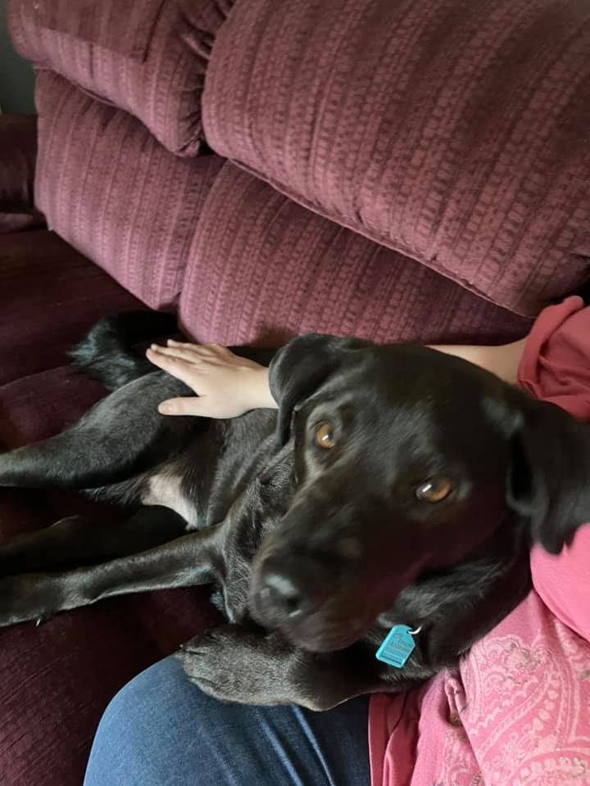
Paired Attachment
Shelter dogs spent more time with both familiar and unfamiliar person in active phase compared to passive phase
Foster group:
Spent more time with familiar than unfamiliar person
Particularly in active phase
And spent more time in contact with familiar person

Slide 35
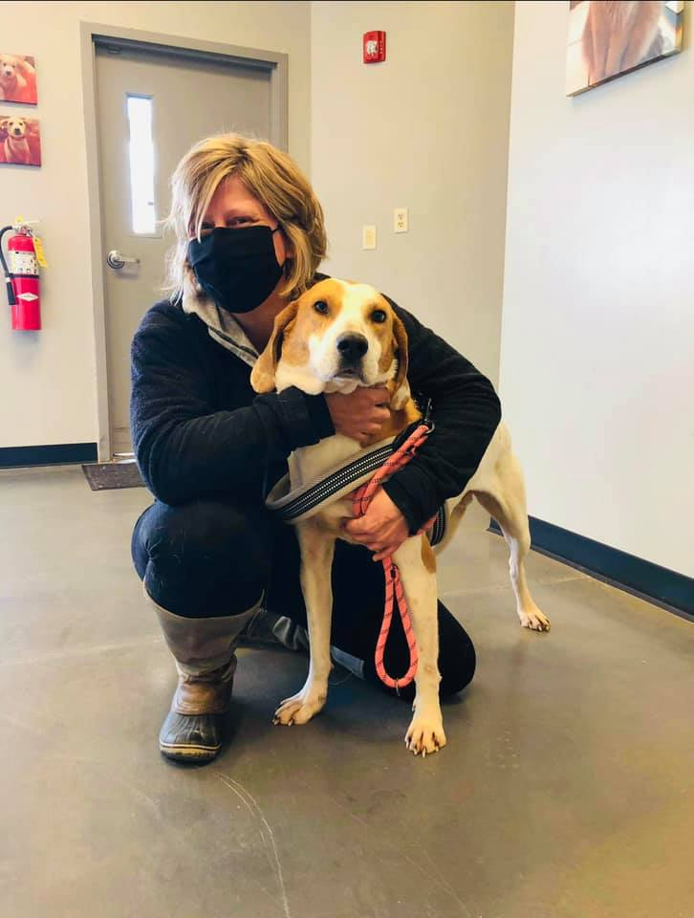
Foster programs for shelter dogs
We have learned so far that
Behaviors such as staying near the potential adopter and playing/interacting with the potential adopter greatly increases a dog’s chance of being adopted
Dogs in foster homes form better relationships/attachment with their humans
Shelter dogs may appear “social”, but are highly seeking social interactions due to insecure attachment
Foster homes may help develop positive behaviors and reduce negative behaviors
What ARE foster homes?
Homes that take in a shelter dog and treat it “as one of their own”
Can be for a very short time: Weekend visit
Can be until the dog is adopted

Slide 36
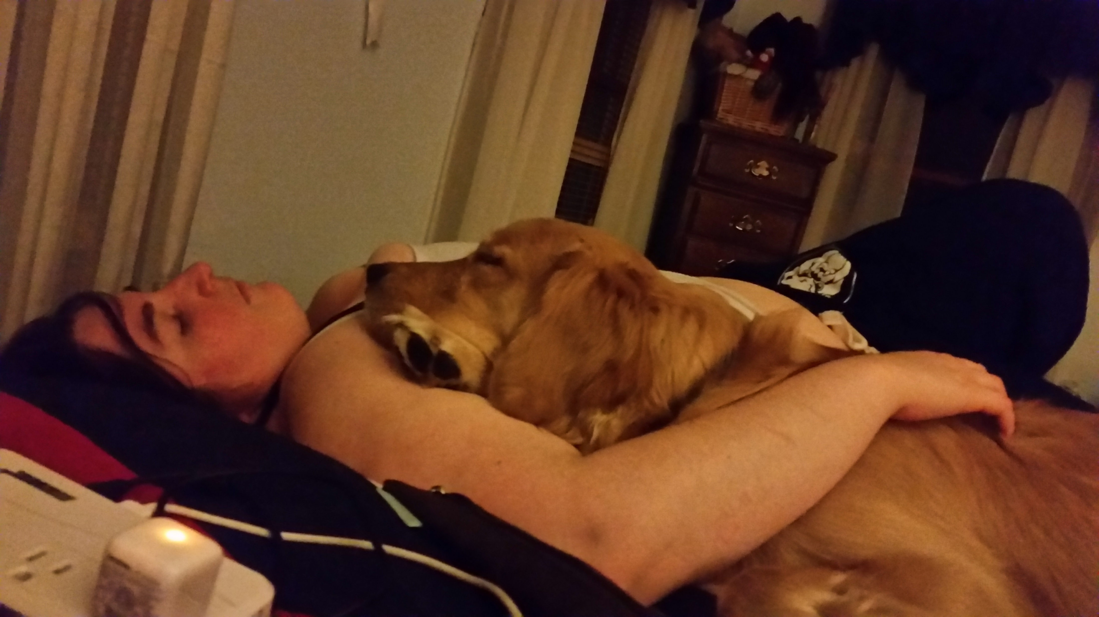
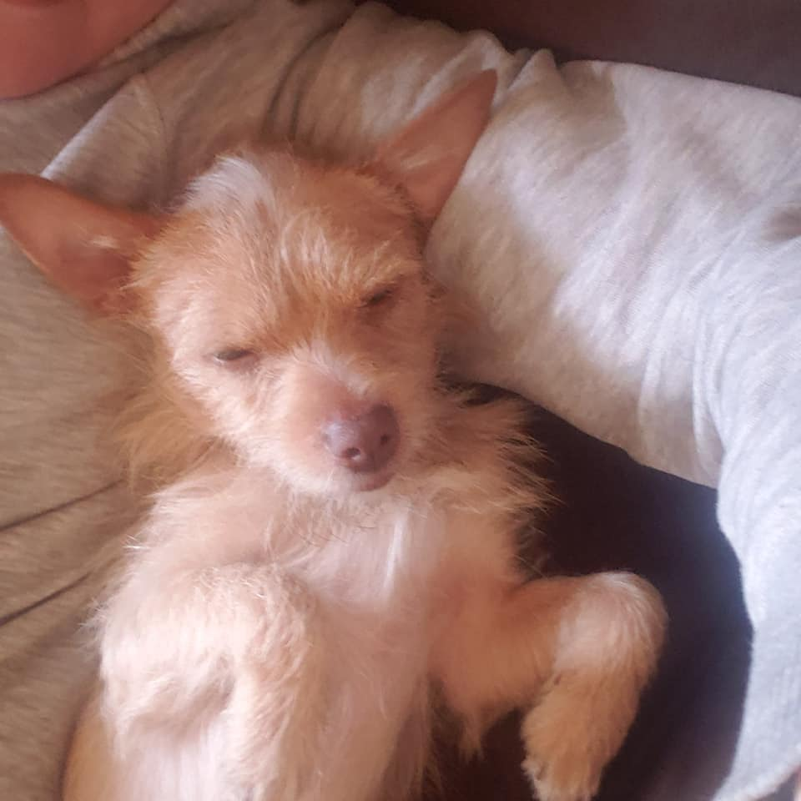
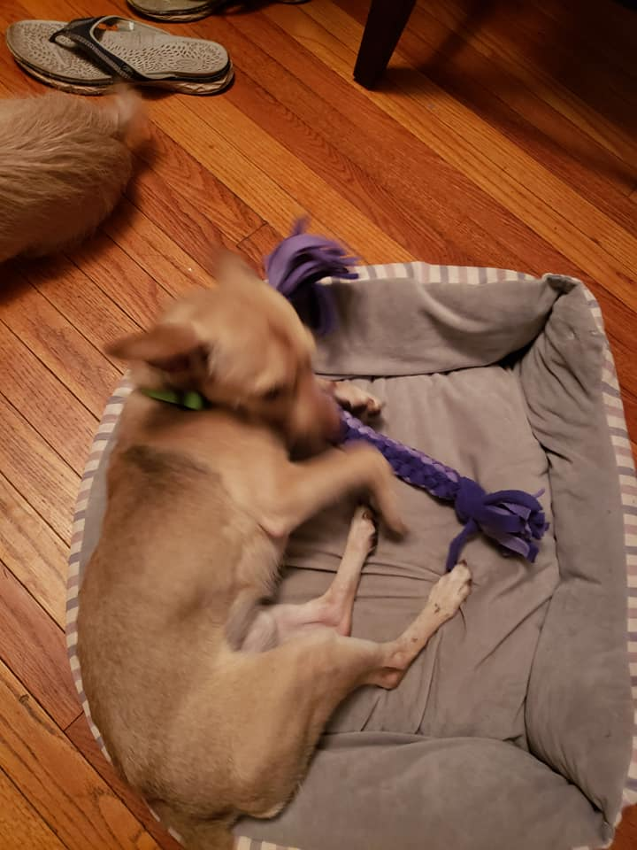
“Sleepover” Research shows:
Sleepovers reduced cortisol levels, but had no lasting effect upon return to the shelter
Dogs had longest rest period during sleepovers….suggests dogs do not rest well at shelter but could during sleep over
Also suggests that dogs do not need to be active during sleepover, but given a chance to “relax”
Even a short sleepover away from the shelter is beneficial for shelter dogs.

Slide 37
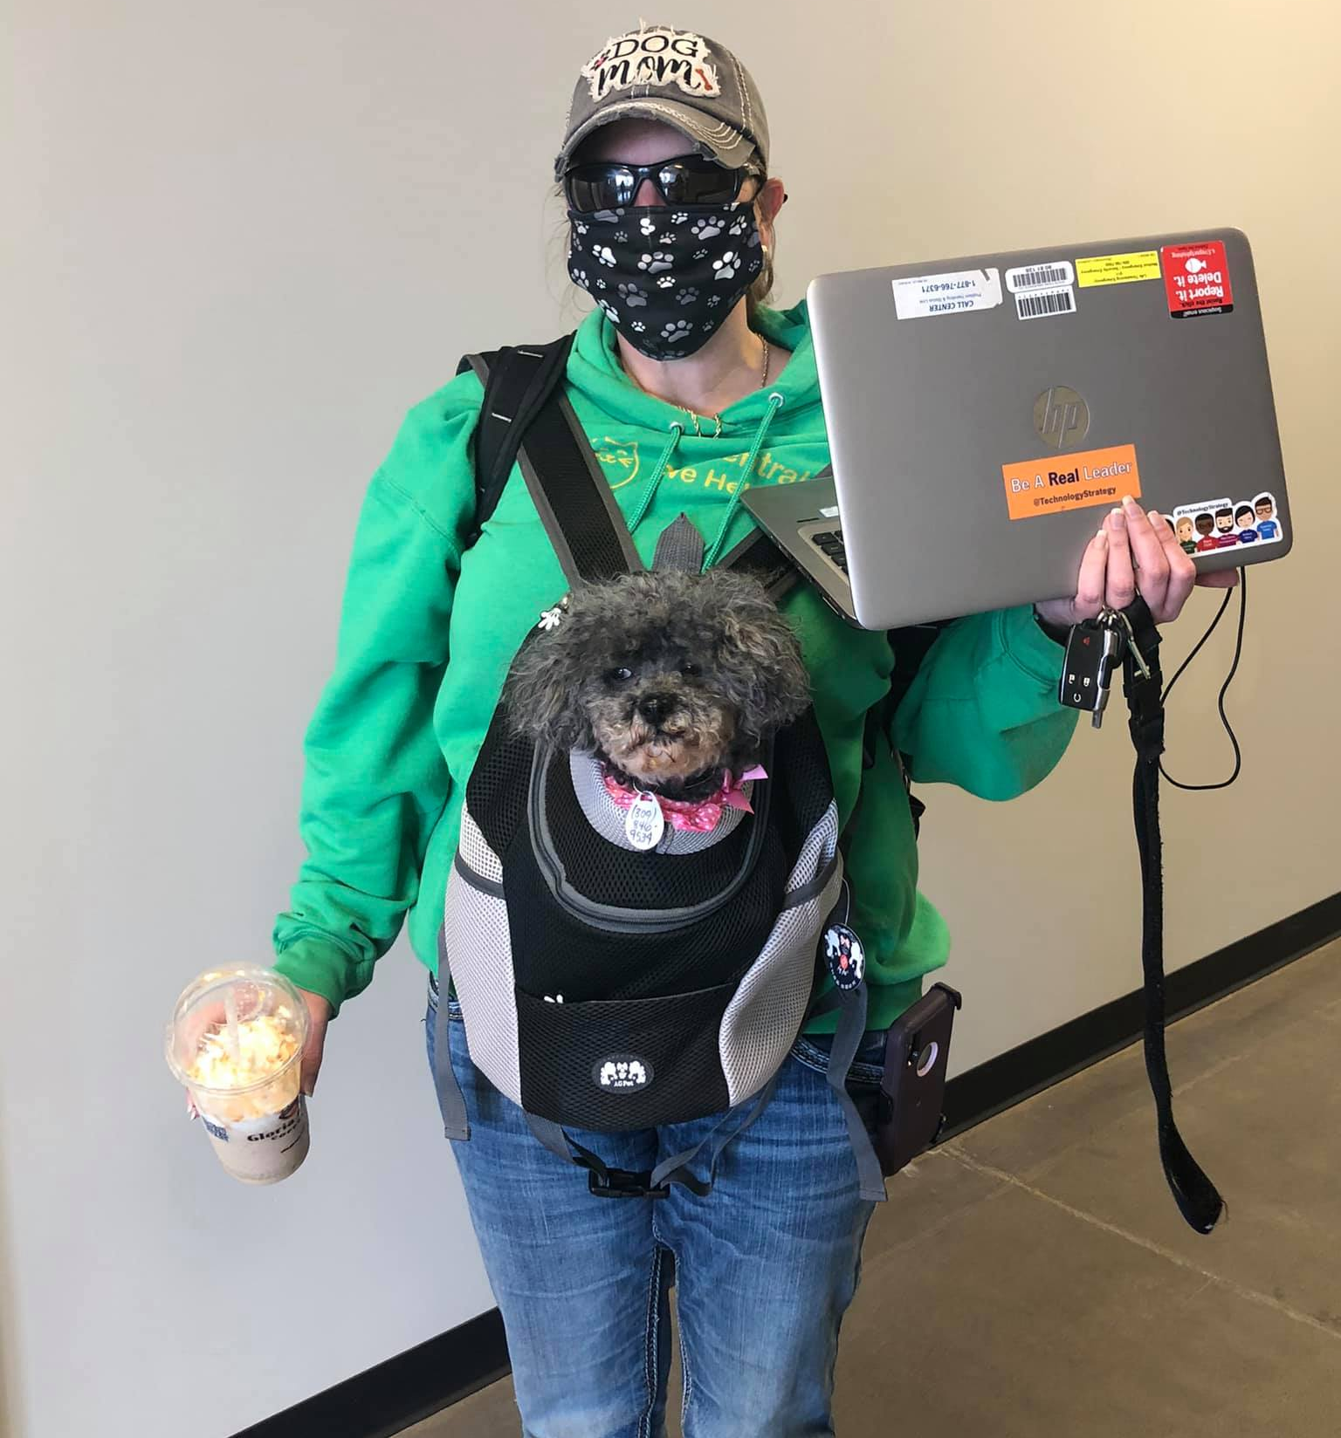
At Pet Central Helps
Almost all dogs in foster homes
Free family manners and reactive dog classes offered to
Foster families
New adopters
Focus on social skills in the dogs
Adopters do not visit the shelter to adopt; must view bio online, then a meet and greet is arranged prior to adoption decision
Currently our return rate is about 7% with over 900 adoptions per year! (and we get our dogs from some of the worst shelters in the south, from hoarding situations, backyard breeder situations, with very few owner surrender)

Slide 38
So….what does this tell us about building the Psy331.03 class
Students must gain a good understanding of canine behavior, canine development and understand socialization, play and canine cognition.
Students must learn to use basic operant/classical conditioning techniques as well as newer models of reinforcement to get the shelter dogs to
Learn to be around people
Learn to PLAY with people
Then….learn basic manners skills (sit, down, come, wait, etc.)
Students must work with the foster parents and adoptive parents to meet the needs of EACH dog: This is accomplished through
Functional analysis
Development of an individualized plan
Teaching the foster/adoptive parent ways to build a positive relationship with their dog

Slide 39
Dogs Depend on YOU!
We will have some “resident” lab dogs that will help us learn techniques
YOU will be working primarily with rescue dogs (ages 8 weeks to elderly)
We have an exciting opportunity to work with Pet Central Helps on Wiley Drive
YOUR job is to prepare these dogs for adoption!
During Monday lectures we will:
Learn the theory of operant conditioning
Learn about our organism: the domestic dog
During our labs :
We will apply our information that we learn in the classroom with each other and with the dogs.
We will have some “resident dogs” that we can use for teaching advanced behaviors
Deaf and deaf/blind dogs for a challenge
Rescue dogs to apply our basic skills
Are you ready to do this?

Slide 40
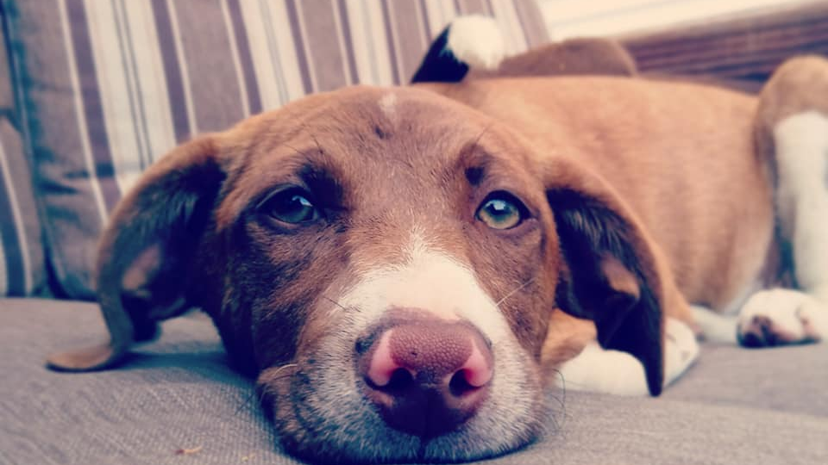
Final conclusions
We can reduce the number of shelter dogs euthanized- at least in our program.
We can identify the needs of the dogs and the behaviors that tend to get them adopted…and help the dogs build these skills.
We can create a positive environment in which fosters and adopters build lifelong positive relationships with their dog….and that is why our dogs love us!

