Slide 1

Behavior Adjustment Therapy
Using Classical Conditioning and Systematic Desensitization
to help your dog focus and reduce its fear!

Slide 2
Hiby, Rooney & Bradshaw, 2004
Surveyed pet owners regarding the training methods they employed with their dog
In this survey, examined effectiveness of the different methods
Why? Because previous studies find mixed results:
Some authors found NO relation between training and behavior issues: they suggested it was mostly due to genetic/breed differences
Other authors (well, even some of the same) found that positive reward methods were more effective.
Hiby, et al., assumed it was the method of the survey that was “defective”

Slide 3
Hiby, et al.’s survey
Three different sites around England
High concentration of dog walkers
Also surveyed some local vet clinics
Dog must be over 1 year of age
Questionnaire examined
Training methods and obedience
Obedience: Rate on scale of 1 to 5 (most obedient)
Training: Reward only, punishment only or combination
Problematic behaviors: Given list of 16 problematic behaviors; asked to note which that their dog showed in the past, currently or never
Demographics of the owners and the dogs

Slide 4
Hiby, et al.’s survey
Demographic results:
Most respondents were female (70% to 30%)
Did find some differences across the 3 sites: more females and more owned dogs
Nice mix of owned breeds
Problematic Behaviors:
Top 3: Barking at people, aggression at people, barking at dogs
After that: Aggressive interactions with dogs (nipping, growling)
Fear
Overexcitement
Separation
Inappropriate Mounting/repetitive behavior/pica

Slide 5
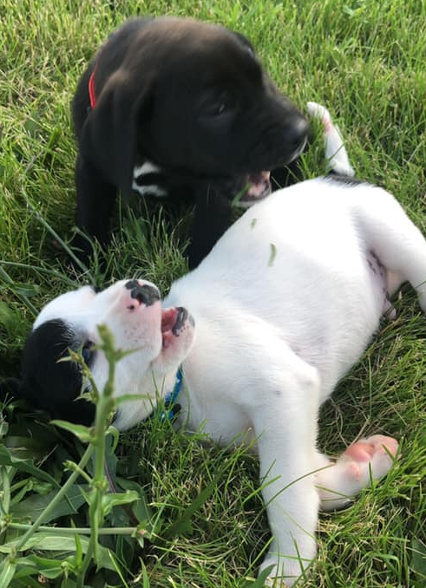
Training methods used
Used punishment for stealing, chewing,
Used rewards for sit or come.
20% used reward only
10% punishment only
60% used combination
No correlation between punishment and obedience rating BUT highest obedience scores found for those using reward
  Data showed that play, praise and redirection worked well
Punishment DID correlate with the number of problem behaviors (but not reward)
  Owners relying on punishment had dogs with more behavior problems, higher excitement levels, and highest separation related problems

Slide 6
Classical or Operant Conditioning?
Both are types of learning (as defined by learning theorists)
Both involve cues and responses to those cues
Classical conditioning: Ability of a cue to PREDICT some event
Only predicts the event
Animal does NOT have to make a response; response is usually “preparatory”
Operant conditioning: Cue predicts that IF you make a response, then a certain consequence will occur
Cue tells you that the IF/Then contingency is in effect
Animal MUST make response to get predicted consequence

Slide 7
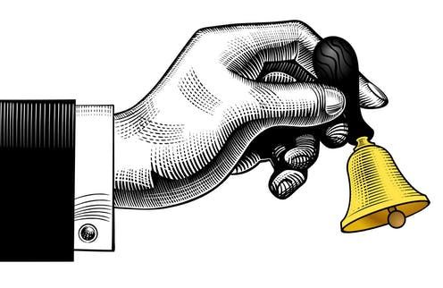
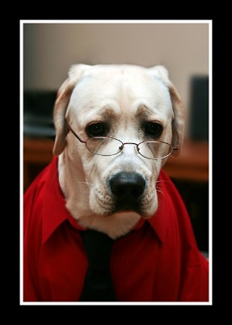

Basic Set up of Classical Conditioning
4 parts:
CS: Conditioned stimulus
US: Unconditioned stimulus
CR: Conditioned response
UR: Unconditioned response
Based on Predictability:
CS→US→UR
CR

Slide 8
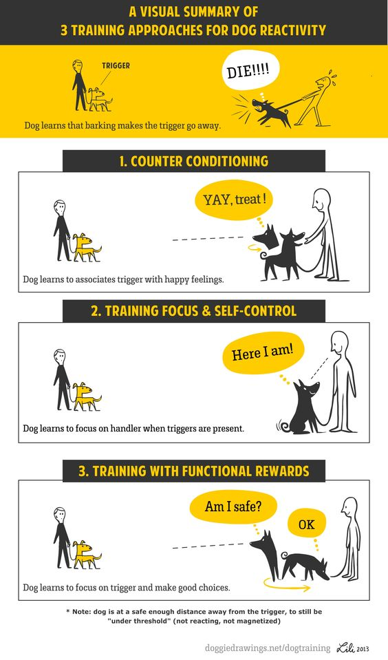
Applications of Classical Conditioning
Learning Emotional Reactions
  Learn that certain stimuli predict certain events
    Learn to anticipate upcoming emotion
    Show emotion to predictive stimulus
    E.g., learn to be afraid of tornado watches, not just the tornado:
    CS_{tornado watch}→US _{tornado}→UR_{fear}
    CR_{fear}
  Demonstrates that most fears and many emotions may be learned
    NOT learning what fear feels like
    Learning WHEN to be afraid and to WHAT to be afraid
    You are afraid of spiders because your mother startled you when you picked it up!
    We ominous music with upcoming startle!

Slide 9
Little Albert Study
CS_{white rat} →US _{loud noise}→UR_{fear}
Cr_{fear}
Then showed generalization to other objects with white fear (NOT Santa Claus!)
Watson and Raynor
Conditioned young child- Albert (about 18 mos old)
Were going to impose extinction, but Albert moved away!

Slide 10
Behavior Adjustment Training (B.A.T.)
Considered to be a fairly new behavior therapy approach developed by Grisha Stewart, MA, CPDT-KA
She started to publicly practice BAT as early as 2009
She argues it has a “short history”
We know it is really a form of systematic desensitization
Joseph Wolpe described this in 1958
Regardless of what we call it, this technique is widely used around the world and appears highly effective.

Slide 11
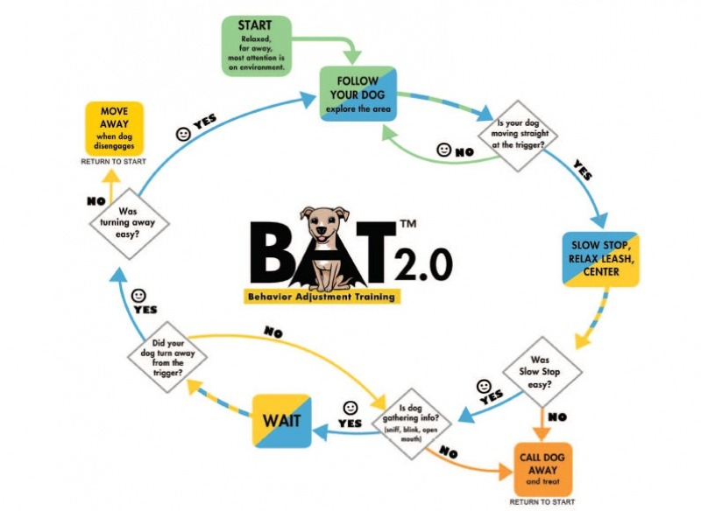
How “undo” a learned fear?
Human Systematic desensitization
  Teach client to relax first
  Develop a “hierarchy” of fear-related stimuli and situations
  The substitute predictive CS and CR as introduce to fear hierarchy
  CS_{white rat} →US _{relaxing cue}→UR _{relax}
    CR_{relax}

Slide 12
Wolpe’s Systematic desensitization
The client is exposed to the anxiety-producing stimulus at a low level and once no anxiety is present a stronger version of the anxiety-producing stimulus is given.
This continues until the client no longer feels any anxiety towards the actual stimulus.
There are three main steps
Teach the client relaxation techniques
Client and the therapist create a hierarchy of anxieties.
The therapist has the client make a list of all the things that produce anxiety in all its different forms.
With the therapist, the client makes a hierarchy:
Starts with what produces the lowest level of anxiety
Ends with what produces most anxiety.
Client is fully relaxed while imaging the anxiety producing stimulus.
Depending on their reaction, the stimulus will then be changed to a stronger or weaker one.
Issue with this: Dogs can’t talk and tell us what is going on in their head.
Wolpe’s rationale: you cannot be both relaxed and anxious at the same time.

Slide 13
What Exactly is BAT
Involves:
Systematic desensitization
Functional communication training
Constructional Aggression Treatment
BUT: relies heavily on reward training principles:
Clicker (marker) training
Negative reinforcement
Multiple rewarding systems
Must understand several aspects of dog’s life:
Environmental factors
Dog’s personality
How the dog uses canine signals and body language.
Must create many scenarios and engage in many, many repetitions for this to work!

Slide 14
How do you start?
Find the baseline space
The distance from the trigger where your dog displays a mild reaction to the stimulus
Point at which you get a small reaction, not the big reaction
CRITICAL that you keep the dog under threshold.
Wait for your dog to offer an alternative behavior to the fear/aggressive response
Looking around
Sniffing the ground
Looking at YOU!
At that moment you “mark” that new behavior (clicker training principle) and reward your dog.
Use a functional reward:
May NOT be treats, but going back to safety of barrier, U-turn, etc.
Say “yes”
Click for behavior
Turning around and leaving may be a reinforcer
You acknowledging the dog
A treat if the dog has lower stress

Slide 15
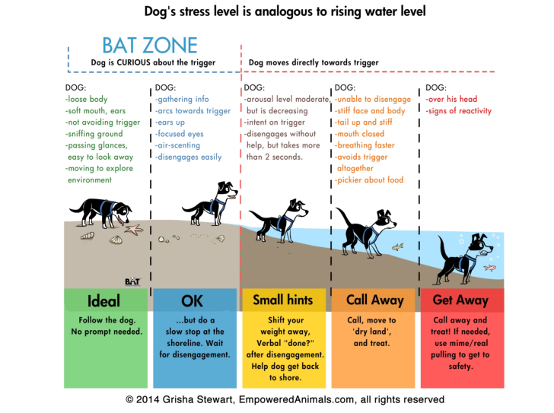
Must determine your dog’s stress level
And keep dog under aggression threshold

Slide 16
Functional Rewards
Type of rewards (given contingently on that alternative response) that are directly related to a certain situation, scenario or environment.
NOT always a food reward
Escape or Aggression is rewarding! (we won’t encourage aggression!)
How can we work with this?
Examples:
An aggressive behavior towards people results in people moving away: Reinforcement is reduction of fear because the people moved away
As Grisham states: “Most attention seeking behaviors exist because you do something that your dog “requires” at that moment which serves as a functional reward”
Dog is pulling you on a leash: Reinforcement is getting to go in the direction/speed that the DOG wants to go.

Slide 17
How can WE use functional rewards with BAT?
First: locate the triggers and locate what the functional reward is for that particular behavior.
Most aggression occurs because it results in the person/animal LEAVING or moving away from the dog
Seeing the trigger leaving is the functional reward that comes after the aggressive behavior.
Alternatively: Aggression may occur to GET something: A toy, a person, food, etc.
This is resource guarding
The functional reward is getting the desired object/space
Why are aggression behaviors so difficult to reduce or eliminate?
These behaviors are “highly rewarding” for the dog
S/he quickly learns that by displaying this type of behavior he can control the environment in the way s/he wants.

Slide 18
With BAT, want to replace the aggressive behavior with an appropriate behavior!
Dog displays aggressive responses → people/others move away
Dog is reinforced because the fearful stimulus goes away
Replace that behavior:
Dog displays alternative response→ people/others move away
Dog is reinforced because the fearful stimulus goes away
Gradually, we also work on making the fearful stimulus less fearful

Slide 19

BAT follows a simple sequence:
Environmental cue
(the trigger in the environment to which the dog reacts; e.g., another dog)
Behavior
(the response that the dog offers in that situation; e.g., an aggressive response)
Functional reward
( trigger leaves or you end up removing your dog from the situation: Both reinforcing to the dog)
Work towards a new scenario
Expose the trigger at a distance where the dog doesn’t react (low arousal level)
Wait for your dog to look at the trigger (stimulus) and to offer an alternative behavior (looking at you, sniffing, etc.)
Mark that behavior AND turn around and leave (functional reward).
You can also offer additional treats to your dog after that, as well (second reward)

Slide 20
Use the BAT flow chart

Slide 21
Notice we actually are using NEGATIVE reinforcement:
NE-PO-PO
FIRST: Negative reinforcement:
Response of looking at you increases when unwanted stimulus is removed
So: In our example Dog has THREE reinforcers (NE-PO-PO or negative-positive-positive reinforcement).)
1. Negative reinforcement (fear response: look at you and you move dog away)
2. Positive reinforcement (praised for look behavior and allowed to move away contingent on look behavior)
3. Positive reinforcement (treat)
Stress that the dog is exposed to when facing another dog at a low arousal level (this is the negative reinforcement) is relieved/shut off by dog offering a more appropriate behavior rather than the aggressive response

Slide 22
Really just relearning
Dog learns that offering new alternative behavior results in same environmental control as aggression did.
Relatively fast behavior rehabilitation process
Dog learns an alternative and likely easier way to control its environment
BUT: now you must teach the dog to generalize this response in several ways.
With increased intensity of the fearful stimulus (person/dog gets closer)
In MANY situations, not just the training situation

Slide 23
How to do generalization
TAKE DATA!
Dog should be able to look at fearful stimulus on at least 8/10 presentations for three 10-presentation sessions at a given threshold before increasing that threshold.
As Karen Pryor has noted: when working on generalization, introduce one change at a time
Decrease distance to the fearful stimulus
Change the type of setting (inside, outside, going through doors, walking on sidewalk, etc.)

Slide 24
How to do generalization
Observe
You MUST observe your dog and watch for signals that your dog is becoming aroused
Goal is to NEVER go over threshold.
Look at ears, eyes, body posture, etc.
Don’t forget
Don’t forget what YOU are signaling to the dog
Are you tightening up on the leash?
Slowing or speeding up your rate of walking
Holding your breath or breathing more quickly?
Be sure to signal CALM behaviors to the dog
Goal
Goal: Signal to your dog that YOU are safe and in charge and you will always keep your dog safe…s/he needs to learn to trust you!

Slide 25
Using BAT in Small Spaces:
Use Mark & Move and the accompanying Diagram
A marker signals that a behavior has earned a reinforcer.
Mark any behavior in the first column with any marker in the second column
Then move away and give any consequence in the third column
There are other behaviors and markers, so be creative.
If you use a marker normally associated with food or toys, provide those after moving away

Slide 26
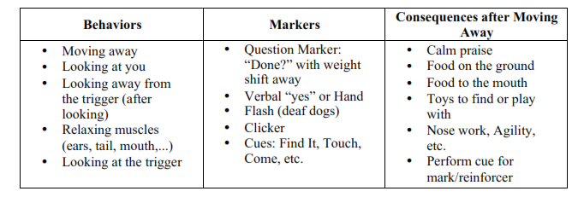
Mark and Move

Slide 27
Important components of the chart:
Behaviors are listed from least to most intrusive, or most to least effort/choice for the dog.
For example, marking for moving away is less distracting than having the dog see the trigger then move away
If dog is more relaxed: use behaviors near the top of the chart.
If you are in a tight space or the dog is tense: use behaviors near the bottom of the chart.

Slide 28
Generalization and the Real World!
Remember to set up your dog for success
Do NOT allow your dog to go over threshold
If your dog does go over threshold, retreat to a quiet place and begin to mark and move at a low intrusion level…..build back up.
You can’t control triggers in the public environment, but you CAN control where you go and what you do

Slide 29
Generalization and the Real World!
If you see the trigger before your dog does, proactively arrange your distance to the trigger so that your dog will stay relaxed when he sees it.
  Cross the street or move behind a car until the trigger passes, so that when your dog notices the trigger, he can make his own choices without needing more help.
  Make a U-turn to remove dog from the trigger
  Take walks in places without off-leash dogs, change your walking time, etc.
  If your dog is “in over his head” (or soon will be), call or Mark & Move without shouting or tugging on the leash.

Slide 30
Generalization and the Real World!
Sometimes you can’t move far enough away. In that case, you are in survival mode
  Distract your dog from the trigger.
    Use the Scatter technique: Drop a small handful of treats to the side, behind you, etc. and tell your dog “Scatter”….s/he looks for the treats.
  Make a U-turn and get out of the area, if necessary.
  Remember YOU need to RELAX to signal dog to relax!!!!

Slide 31

Distraction is NOT learning to deal with the trigger UNLESS you teach alternative skills
When you use distraction, stress may still build up.
Distraction doesn’t necessarily give your dog any active coping skills or teach the dog that the situation is safe.
  Is better than have your dog over threshold and aggressing, however!
  Do what you must do to keep everyone safe.
  It’s okay to go home!

Slide 32
Distraction is NOT learning to deal with the trigger UNLESS you teach alternative skills
NEVER punish your dog for being afraid! Instead, help him or her relax
Having your dog emit the alternative behavior IS teaching him how to deal with the stressor…
...work on having him or her do these behaviors to get the reward of leaving and/or getting treats.

Slide 33
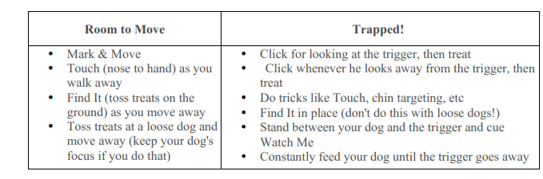
Different Behaviors for Different Settings!

Slide 34
We take data to make sure our dog is shaping and improving!
During each session you will take data.
After the session, evaluate and brainstorm to avoid getting trapped again in the future.
Go back to your functional analysis:
What were the eliciting stimuli and conditions?
What behaviors did the dog AND you show?
What were the reinforcers for each of you?
Develop an intervention plan that addresses that situation.
How are you going to deal with those eliciting stimuli and conditions?
What alternative behaviors should you and your dog show?
What reinforcers will you implement for engaging in the alternative behaviors?
Remember not to be continuously in survival mode.
set up scenarios where the dog can be relaxed,
Don’t be afraid to use visual barriers, different locations, relaxation techniques, and even medications for your dog (and perhaps you!).

Slide 35
How do we record our data?
Plenty of room to record several sets of data!
Level: Beginner: Almost no target or goal behavior
Intermediate: Can do target behavior with luring or 50% of time
Advanced: No luring, approaching 80%
Goal behavior: The Final behavior you are shaping/training
Target behavior: The behavior you are currently shaping/training
Click point: The exact behavior that will receive a click.
# correct: X/total number (usually 10 trials)

Slide 36
Conclusions?
MANY dogs have aggression problems
MOST aggression is learned.
If it was learned, dogs can be taught an alternative response
Through punishment contingencies
Through reward contingencies
APDT, Karen Pryor Trainers, etc., require Least Invasive, Minimally Aversive methods
Punishment = learned helplessness and increased aggression long term
Reward methods shown to be better, more effective in initial learning and overall
We will use BAT method with our dogs

Slide 37
Conclusions:
Keep your dog under its arousal threshold!
Watch for fear signs
Watch for over-arousal signs: high excitation; forward body posture; panting, etc.
Have a plan for reducing arousal!
Depends on your dog and its functional analysis results
Redirect; move away; get out of there!!!
YOU are your dog’s teacher…..be a responsible behaviorist and identify over-arousal and aggression BEFORE it starts!!!!!

