Slide 1
Shaping
The best tool you will ever learn!

Slide 2
Pavlov’s Contribution
Ivan Pavlov
Russian physiologist: Studied salivation
1901: discovered and wrote about classical conditioning
Found that his dogs reacted to both his presence and the time of day for feeding/experimentation
Researched this:
Measured amount of salivation during baseline:
Present food to dogs
Measure slobber
Then added a predictive stimulus: a Bell
Presented the Bell→Food
Measured slobber to see if dogs would begin to slobber to the bell

Slide 3
Labeled each part of these events:
Unconditioned stimulus or US:
The stimulus that automatically elicited the behavior (usually innate)
E.g., the food elicited the slobber
Unconditioned response or UR
The behavior that is automatically elicited
Unlearned; often reflexive
Conditioned stimulus or CS:
The stimulus that predicts the US
Is a learned (thus conditioned) stimulus
Conditioned response or CR:
The behavior that occurs to the CS
Often very similar to the unconditioned response
Occurs because the CS predicts the US

Slide 4
Classical Conditioning Procedure

Slide 5
Skinner’s version of Law of Effect
Now defined reinforcement and punishment:
A reinforcer is any stimulus which increases the probability of a response when delivered contingently
A punisher is any stimulus which decreases the probability of a response when delivered contingently
Also noted could deliver reinforcers and punishers in TWO ways:
Add something: positive
Take away something: negative

Slide 6
Reinforcers vs. Punishers Positive vs. Negative
Reinforcer = rate of response INCREASES
Punisher = rate of response DECREASES
Positive: something is ADDED to environment
Negative: something is TAKEN AWAY from environment
Can make a 4x4 contingency table

Slide 8
Shaping
What is shaping
Differential reinforcement of successive approximations of a target behavior until organism exhibits target behavior
Differential reinforcement = Reinforcing one particular behavior but not all others.
Touching nose to red end of stick = reward
Any other behavior not get reward
Successive approximations:
Break behavior into individual components or building blocks
Reinforcer each step or block until organism can complete all steps/blocks in order = target behavior

Slide 9
Methods vs. Principles
Methods:
Behaviors to be shaped or developed
Sequence of steps used to develop them
Principles
Theory
Rules governing how, when, why particular behaviors are reinforced
Equally as important to understanding shaping as method!!!!!!!!

Slide 10
Ten Laws of Shaping
Raise small
Raise criteria in small increments
Train One
Train only one aspect of any particular behavior at a time
Put on VR
During shaping, put current level of response onto variable schedule before adding/raising criteria
Relax Criterion
When introducing new criterion, temporarily relax older ones
Stay ahead
Stay ahead of your subject
Don’t change
Don’t change trainers in midstream!
Find Alternative
If one shaping procedure not working, find another
Don’t interrupt
Don’t interrupt a training session gratuitously- that is punishment
Take A Step Back
If behavior deteriorates, take a step back (go back to kindergarten)
End Happy
End each session with success (even if must go back to earlier behavioral step)

Slide 11
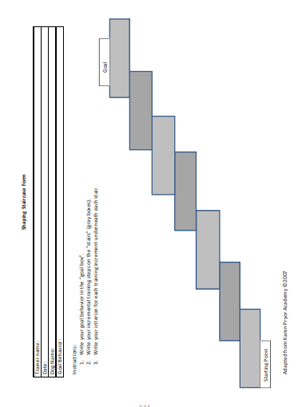
The Shaping Staircase
Make a shaping plan:
Where should you start
-what can the dog do already?
2. Break into small, manageable steps
3. Devise a plan for getting from step to step
4. Have back up plans!

Slide 12
Raise Criteria in small increments
Define target behavior and Identify starting behavior
Target behavior = final behavior
Starting behavior = beginning of final behavior
Choose shaping steps (this is critical)
Each step must be closer approximation than last
Make steps discriminable, but not too big
This is the hard part!
Be careful of ratio strain
Too big a jump in behavioral criteria
Too big a jump in partial reinforcement
What are steps to tying your shoes? Setting the table?

Slide 13
Train one behavior at time
Focus on ONE aspect at a time
Karen Pryor gives example: Training a dolphin to splash:
Two criteria: SIZE and DIRECTION of the splash
Only work on one criteria at a time
When BOTH are at fluency, put together
We will work on DISTANCE or DURATION or DISTRACTIONS
Then combos of 2: Distance + duration
Then all three together!
Be consistent
Can train more than one behavior, just in separate sessions with clear S+ to differentiate
For example: Two partners: one works on 1 behavior, other works on other behavior
Move around, change up location, work on or off mat

Slide 14
Establish behavior before changing criteria
Develop FLUENCY: During shaping, put current level of response onto variable schedule before adding/raising criteria:
Use continuous reinforcement at first to establish behavior
When meet criteria (e.g., 10 trials in a row correct), then move to partial reinforcement
Try every other; then gradually increase
Every other behavior; Then every third; Then every 5^{th;} Then randomly every 7th or 8th
Be VERY careful of ratio strain.
If lose the behavior, GO BACK
Set criteria
Must perform 20 trials at set reinforcer schedule before move to next
Tedious, but necessary
Makes sure the behavior is set before moving on, otherwise send confusing messages.

Slide 15
When introducing new criterion, temporarily relax older ones
Don’t be surprised that your dog may “forget” what was doing when you introduce a new task
If taught to sit and now working on down, just focus on “down” and not sit!
Once the new behavior is established, go back and “chain up”
That is, put the behaviors together
Puppy pushups!!!!

Slide 16
Stay ahead of your DOG!
Know the steps, don’t make it up on the fly (I will contradict this in a second)
What do you want the dog to do next?
The dog may surprise you and learn faster than you originally planned.
The step may be too small and needs to be combined with the next step
The dog outwits you (and he or she will!)- what is your plan B?
Shaping “Breakthroughs” or ah-ha’s
Sometimes the organism “Gets it”
Behaviors come together in fluid sequence without further shaping
GO WITH IT!

Slide 17
If one shaping procedure not working, Find another!
Don’t give up
Don’t give up too soon- give it 5-10 tries
Try
Try different variations of your procedure:
Different reinforcers: pets, treats, back rubs, etc.
Different cues or ways of delivering a cue
Different steps in your shaping plan
Change
Change ONE THING AT A TIME
Only way to evaluate if it is working
Write down what you tried
Again, give it several trials, then switch to new strategy

Slide 18
Don’t change trainers in midstream!
Train 1 task at a time
Stick to one task, take a break, THEN start another task
You each have slightly different ways of training
Dog can tolerate difference in training, IF training for different behaviors
Make sure dog knows that you changed tasks
Can also switch trainers if having trouble….but make it clear what the trainer expects the dog to do.

Slide 19
Don’t interrupt a training session gratuitously- that is punishment
Pay attention to your dog!
If you are distracted, you miss a behavior and it doesn’t get reinforced
What is the message to the dog?
If you stop and start talking to others, read a text, etc., and the dog engages in the behavior- you just missed reinforcing it
This will induce extinction at best
Induce punishment of the desired response at worst

Slide 20
If behavior deteriorates, take a step back
Don’t be afraid to go back to earlier step
Change was too big
Reinforce ratio was too high
Re-establish the earlier behavior, then try again
Don’t let dog “Get away” with not performing response
Sometimes training is 2 steps forward, 1 step backward- SLOW progress
Listen to your dog! Watch behaviors and nonverbal signals

Slide 21
End each session with success
Always end on a reinforcer, even if must go back to earlier behavioral step
Ending with a reinforcer teaches dog that must engage in behavior when YOU ask it
Last thing dog will experience = reward

Slide 22
Quit while you are ahead
How long?
After several sessions, you will begin to have a sense of how long your dog will work (session duration)
Quit if frustrated
Quit before dog stops working- that way you are establishing contingencies, not the dog
Don’t start a new task at the end
Don’t start a new shaping criterion at end of a session
End with FUN!!!!
End the session with some playtime!

Slide 23
Shaping Shortcuts
Teach “look at me”
Teach the dog to look at you
Makes sure dog is paying attention
Allows you to give direction for behavior
Also use:
Mimicry
Modeling

Slide 24
Let’s think about teaching a somersault
What steps might be involved?
How can we get our dog to do this?
What will we consider “success” at each step?
Let’s look at Dr. Sophia Yin teaching this behavior!

Slide 25
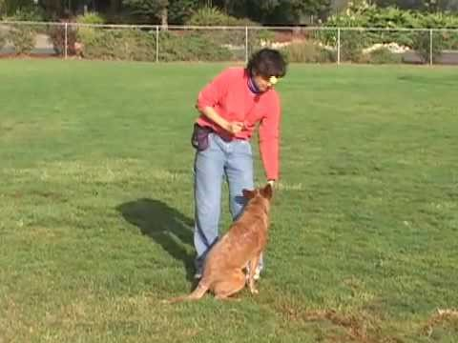

Slide 26
Problem Solving with your dog!
Anticipate problems and be willing to ask for help/advice from
Other students
TAs and ME!
Keep track of methods you have tried….
can look back and see what was successful in the past
THIS is why your data are so important!
Think of alternative strategies….here asking for others’ input REALLY helps.
Make sure you have an initial task analysis and are willing to revise it as necessary……
What is the task analysis for your target behavior?
Ask yourself what BEHAVIORS do you want your dog to do, and what do those behaviors look like!

Slide 27
Questions and Concerns?

