Slide 1
Canine Development
Important behavioral and cognitive periods

Slide 2
Why is dog development important?
We know that dogs have exceptional abilities to respond to human behavior
HOW did dogs develop these abilities?
Why do dogs have extended puppyhood in comparison to other animals?
What is the evidence? Udell, et al., 2010

Slide 3
Domestication of Dogs
Involves both natural and artificial selection
Natural Selection:
Natural selection developed individuals who more likely tolerant of humans
Remain closer in, live with humans

Slide 4
Domestication of Dogs
Several sub-categories of domestication
Tame domesticated
Genetically domesticated but wild (feral)
Wild type but tame
Interestingly, 75% of world’s dogs are feral

Slide 5
Domestication of Dogs
Domestication involves both natural and artificial selection
Domestication: 15,000+ year history of domestication
As humans entered more agricultural lifestyle, wolves scavenged food from humans
This led to changes in wolf morphology and behavior
Reduced fear and aggression in presence of humans = exploitation of more food sources
Later, humans began to selectively breed dogs

Slide 6
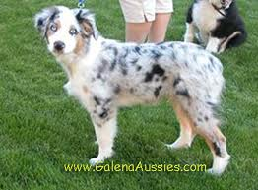
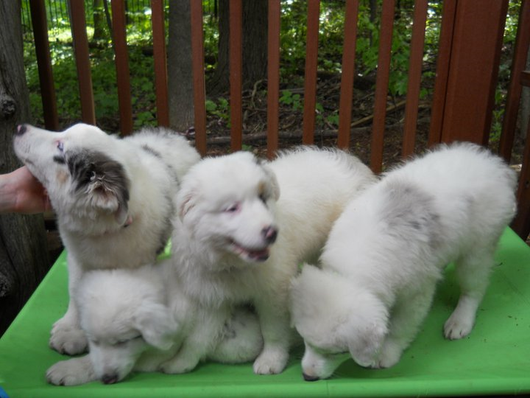
Ontogeny of social behavior in Canids
Domestication results in both physical and behavioral changes
Physical changes include:
Larger size variation: dwarf and giant
Piebald coat color
Reproductive cycle changes
Changes in hair, shortened tails, floppy ears
Social changes:
Lack of development of fear to humans
Exhibiting play behavior in adulthood
Prolonged juvenile period

Slide 7
Ontogeny of Social Behavior in Canids
Most important: Paedomorphosis
Retention of juvenile traits into adulthood
Physical characteristics are retained: still look like babies
Behavior characteristics are retained: ACT like babies!

Slide 8
Ontogeny of Social Behavior in Canids
Important physical and behavioral changes:
Changes in head: muzzle, ears, coat, eyes, tail
More juvenile signaling behavior in place of adult aggression/antagonistic signaling
Extended play
Reduced need for adult-type signaling

Slide 9
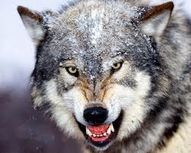
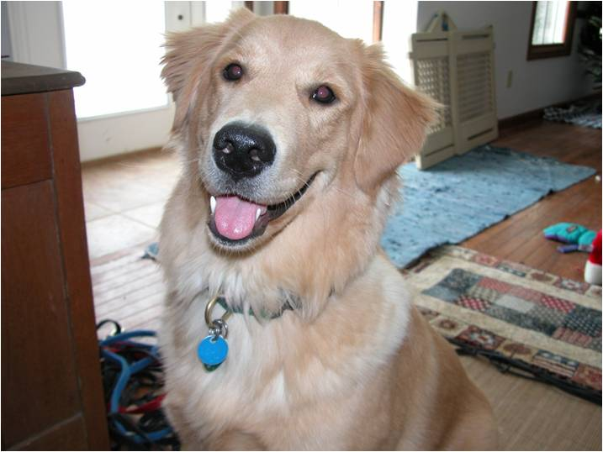
Physical and Behavioral differences
Sharpness of features
Pointy ears, eyes, snout
Intense eyes
https://www.youtube.com/watch?v=1QqsSw5BDA8&feature=related
Roundness of features
Rounded eyes, floppy ears, “smiling”
Softened eyes
http://www.youtube.com/watch?v=B4Z9dUkbq1g&feature=related

Slide 10
Paedomorphosis alters developmenta period!
Wolf pups have much shorter development duration
Good motor by 3 weeks of age
Domestic dogs: good motor control comes around 10-12 weeks
Wolf pups show complex social behavior much sooner than domestic dogs
https://wolf.org/wolf-info/basic-wolf-info/biology-and-behavior/pup-development/

Slide 11
Paedomorphosis alters developmental period!
Dog development is much slower and extendend
At 10-12 weeks, finally gaining good motor control
At this point, wolves are out starting to hunt.
Dogs begin socialization once begin to walk (about 3 weeks)
Earlier they are just heating and food seeking organisms
Continue to form primary relationships until at least 12 weeks to 16 weeks (best time for adopting a puppy is 8-12 weeks)
Socialization to both dogs and humans is critical for dog development
Shelter dogs and COVID pups show results of deficits in social contact
Dogs weaned/adopted too soon
Working dogs: avoid human contact, want them to bond to cattle or sheep

Slide 12
Farm Fox experiment
Dimitri Belyaev: 1959 to today (Tut, 1999)
Manipulated breeding of foxes on fox farm
Selected breeders based on behavioral characteristics: mostly sensitivity to humans
Only about 3% of males, 10% of females selected in first generation
Not reared with humans, just a 1-time test
Rapid effects on behavior and morphology
By 6th generation: begin to see domestication elite: no fear of humans
By 8th generation: morphological changes begin
By 42 generations: about 70% meet criteria for domestication elite

Slide 13
Farm Fox experiment
Interesting physical changes: Note, NOT selected for these traits
Physical Trait changes:
Floppy ears; Rolled tails; Splotchy coats
Shorter tails and legs
Correlated with “tameness”

Slide 14
Farm Fox experiment
Behavioral Changes
Extended developmental period for bonding/attachment
Exhibit juvenile play traits in adulthood
Slower to develop adult behavior repertoires
Hormonal changes correspond with this: delay in onset of innate fear response
Lengthened developmental periods
Typical fox: 45 days or about 5/5 weeks.
Marked by onset of fear and avoidance and reduction in exploratory behavior
Generations 28-30: Increased to about 12 weeks and often longer
Similar to domestic dogs

Slide 15
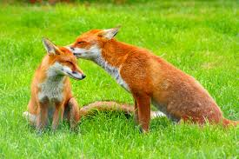
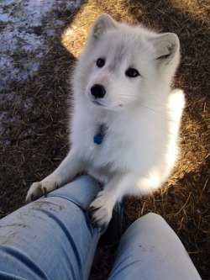
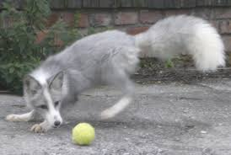

Slide 16
Two Hypotheses attempt to explain Paedmorphosis in Dogs
Domestication Hypothesis: Suggests it is just changes in biology (Nature only)
Two-stage Hypothesis: Suggests it is changes in biology interacting with differences in environmental experience.

Slide 17
Domestication Hypothesis (see Hare, Alexandra , Kaminski, Brauer, Call & Tomasello, 2010):
Domestication = sufficient cause of canid’s sensitivity to human social behavior
Humans and dogs experienced convergent evolution of advanced social cognition in response to similar social selection pressures
Genetic changes SUFFICIENT to produce physical and behavioral Changes

Slide 18
Domestication hypothesis (see Hare, Alexandra , Kaminski, Brauer, Call & Tomasello, 2010):
Brian Hare: Compares wolves versus dogs and domesticated foxes:
Hare argues against ontogeny as important factor
Ontogeny = the entire sequence of events involved in the development of an individual organism
Domestication hypothesis argues genetic changes sufficient

Slide 19
Problems with Domestication Hypothesis
Not account for differences in developmental windows
With shorter window, shorter set of experiences and less opportunity to learn
Can’t test dogs/wolves of same chronological age, but must compare at same developmental age
Dogs exposed to experimental manipulation while still in sensitive period of socialization require less experience to produce greater effect

Slide 20
Note important differences:
Dogs | Wolves
Better at following several human gestures | Only good at point/gaze
Feral dogs and dogs reared in shelters show same unsocialized behavior as wolves | Socialized wolves improve in wolf-human social interactions over unsocialized wolves
As get older, dogs prefer to be with humans | As get older, wolves prefer to be with another wolf
Are these differences due to domesticity or experience?

Slide 21
Proximity to humans = important factor
Domestication correlates with proximity to humans
But: Domestication theory does not account for exposure effects
Hard to research genetic vs. social differences:
Hard to get proper comparison group
Wild wolves with no contact with humans (dangerous)
If use tame wolves, have the human contact issue
Wild dogs also hard to work with!
Studies which have attempted to account for human proximity have found that contact with humans is an important factor
Shelter dogs show more “wild-like” behavior; increased fear and aggression
Dogs socialized after sensitive period show similar patterns

Slide 22
Conditioning/Learning Experiences:
With human contact comes opportunity to become conditioned to human behavior
Serendipity in learning human social cues: Get reinforced more often!
Domestic dogs learn human cues faster than wolves

Slide 23
Conditioning/Learning Experiences:
Domestic dogs are reinforced for appropriate response to humans almost constantly
Learn how to “manipulate” owners
“Guilty look” = I look “guilty” then I get back with the family
Not necessarily have human emotion with it, but show appropriate response due to conditioning

Slide 24
Further Arguments against Domestication hypothesis
Domestic dogs have smaller brains than wolves, but show more social cognition
Wolves raised with humans can learn human signals, similarly to dogs, but not as well.

Slide 25
Further Arguments against Domestication hypothesis
Improbable that dogs have innate ability to exploit behavior of humans
Not conspecifics (same species)
Different morphology and behavior
E.g., the “hat” problem: not seem to understand morphology of humans vs. their clothing
Must be experience with humans: Ontogeny plays crucial role in development of effective conspecific social interactions in canids (and many other species)

Slide 26
Two stage hypothesis
Udell and Wynne: Argue that physical/behavioral changes in the domestic dog are due to 2 different but equally important sets of changes:
Genetic changes
Effects of socialization
Specifically: Sensitivity of canid to human social cues depends on TWO types of ontogenic experiences
Interactions with humans during sensitivity developmental period leading to acceptance of humans as social companions
Learning that is not restricted to one phase of development
Learn to use location and movement of human body parts to locate sought-after objects

Slide 27
Two stage hypothesis
Domestication does
not qualitatively change behavior,
but has changed quantity and duration of certain behaviors
These behaviors must then be reinforced to be maintained.
Dogs come with a set of genetic “opportunities” that, if exposed to socialization with humans, emerge and allow distinctive ability to interact with humans.

Slide 28
Predictions of Two-Stage theory
Both wild and domestic canids have
Phylogenetic prerequisites to respond to human social signals
Mutually beneficial interactions with humans
That is, they are innately prepared to interact with other species
Concept of Preparedness (Seligman, 1967; also Bolles 1967; Timberlake, 2001)
Biological boundaries
Prepared to attend to certain cues because these increase probability of survival
Dogs come “prepared” to interact with humans

Slide 29
Predictions of Two-Stage theory
But: this preparedness to respond requires experience to elicit and shape beneficial behaviors
Dog will become socialized to whatever it is around:
Other dogs
Sheep or cattle
Humans
Learns behavior that works the best

Slide 30
Why is this important?
Drives research questions:
Is it nature or nurture that is more important
How does nature interact with nurture
Suggests need to examine developmental stages more closely
Authors caution: standardization of methods
Several research questions begin to emerge:
Breed differences?
Experience Differences? Shelter vs. fostering dogs for adoption
Deaf, blind or deaf/blind versus typical dogs: What is effect on socialization?
What cognitive abilities do dogs have?

Slide 31
Canine Development
Parallels human development!

Slide 32
Neurological Development
Puppies mature slowly after birth (like humans)
NOT precocial
Implies structured/caring parental environment is critical
Behavioral epigenesis: development of neuro system
At birth, very immature
Requires sensory experiences to develop
Too much hyperstimulation can produce overdevelopment
Stages = “simplified classification system where the classifier traces a straight line through a continuum” (Bateson, 1981).

Slide 33
Critical neurological stages
Break domestic dog development into periods:
Neonatal: 0-14 days
Transitional: 14-21 days
Starts when eyes open
Ends when animal reacts to noise (is hearing)
Socialization: 21-70 days
Juvenile: 70 days and older to 1 in smaller dogs; about 3 yrs in larger dogs

Slide 34
Prenatal period and NeoNatal periods
Prenatal: Pregnancy
Typical dog pregnancy is 63 days, or about 9 weeks
Environment for mother can alter pups behavior
Petting and soothing of mother = more docile litter
Stimulates parasympathetic nervous system which is critical for growth, relaxation and attachment
Neonatal period
Birth to 13 days
Eyes closed, no real hearing
Completely dependent on mother
Heat and food seeking organisms

Slide 35
Three to Seven Weeks
Tremendous growth and begin Homeostatic functions:
Regulate own temperature
Start to feel the urge to pee/poop all by himself
A 'toddler' : busy learning how to interact with others
Learn basic canine manners
Learn from mom and littermates
Most important: learn BITE INHIBITION by 8 weeks

Slide 36
Three to Seven Weeks
Start to wean: Mom will refuse to let pups nurse for long periods after about 5 weeks.
Important to expose pup to different experiences
Different textures, sounds, smells etc.
Give short periods away from their momma and siblings to help them get used to being separated.
Losing immune protection from mom: start first shots
NOT ready for adoption yet.

Slide 37
8 to 16 weeks:
Between 8 and 12 weeks: placed in new home:
9 to 10 weeks is best
Longer wait for some breeds
Depends on development
Incredible amounts of learning:
Curious, outgoing and intelligent.
Eager to please his/her people.
Start basic obedience and puppy social skills NOW!

Slide 38
8 to 16 weeks:
Socialization CRITICAL during this stage:
The more new sights, sounds, smells etc. that he can experience the better.
Puppies who have lots of socialization experiences and stimulus less likely to develop behavior problems and fears
BUT: Don’t take pup out to places where lots of dogs until fully immunized!

Slide 39
8 to 16 weeks:
First 'fear period' around 8 weeks of age:
Pup may seem scared of his own shadow, becomes very Velcro to pawrent
Critical to socialize at this time!!!!!
Again at 12 weeks or so, and again at 16 weeks or so
Develop both stranger fears and separation fears

Slide 40
The teen period: 17-40 weeks
Develops a ‘bratty' attitude: Your nicely behaved pup goes bad!
Can be very demanding and challenging for both pup and you
Pup will test limits
Consistency and continuity is key!
Needs discipline, exercise, lots of chew toys
Pup looks like a teenager ... long limbs, slender, maybe a bit awkward and ungainly.
Still growing
May need more/less food as it grows

Slide 41
The teen period: 17-40 weeks
At about 7-9 mos: lose last baby teeth
The front 'fangs' or upper canines
Will have a full set of adult teeth after this
CHEWING comes back as lose the last baby teeth!
Sexual maturity occurs:
Traditional to spay or neuter before 6 mos, but this may interfere with bone development!
Today vets recommend waiting until at least 9 mos; data say it is better to wait 12-18 mos.

Slide 42
40-52 weeks
Still a teenager: Still needs lots of discipline, sturdy chew toys, patience
Small breed pups may reach maturity
Larger breeds: Adulthood at 2 or 3 yrs.
More noticeable difference between the development of small and large breed pups.

Slide 43
1 year to 3 years
Large and Giant breeds
Still growing.
Gaining full height first, then continuing to put on weight until they reach their full adult size.
Pups of this age tend to be more combative with puppies or dogs of the same sex as themselves

Slide 44
1 year to 3 years
With guardian/herding breeds: Start to see instinctive behavior appear
May try to act brave while hiding behind your legs
Resource guarding may become pronounced!
NEVER, EVER encourage a pup to 'guard' or to act aggressively or defensively.
Will confuse and frighten him and could cause a lot of problems later on.
Correct him gently but firmly if he growls inappropriately though

Slide 45
Sensitive periods
Windows of opportunity
Point in maturing process when events are susceptible to leaving long term effects
When learning is easier and knowledge gained is stored in LTM
Small number of determining experiences have major affects (or damages) on future behavior

Slide 46
Identification phase
Assume that pup must learn it is a dog
Species identification means that the pup can
Recognize parents (filial imprinting)
Develop preference for dog-dog relations (fraternal imprinting)
Develop sexual preference for dogs (filial and sexual imprinting)

Slide 47
Identification period
Play-fighting among puppies (litter-mates) is important for identification as a dog
Begins about the 3± weeks, Ends somewhere around 12 ± weeks
At this point dogs lose their ability to play with unfamiliar dogs and become "serious" in defending their group.
In the absence of siblings, a puppy establishes identification through:
Care-giving, care-searching, playful interaction with its parents or other dogs.
This interaction must last until at least, if not beyond, the 6th week.
The presence of other species during this period does not hamper identification with one's own species.

Slide 48
Identification period
End of this phase varies depending on factors that are include
Internal development: breed, line of descendants, individual
External factors: behavior of the mother, other dogs, quality of the surroundings
A stressful environment (e.g., feral dog) will close this phase ahead of time (probably around 7 to 9 weeks).

Slide 49
Identification phase
If inappropriate identification, then:
May become Isolated from other dogs:
not get along with other dogs or recognize itself as a dog
Other dogs will attack/reject it
Can remediate if isolation or inappropriate isolation is altered soon enough(by 7 to 9 weeks)
Identification with people and other dogs is being set
Is stable, rigid and persistent
Easily acquired (or not acquired)
Sexual imprinting also co-occurs

Slide 50
Risk Factors for Identification
The total absence of other dogs (own species) between 3 and 12±5 weeks fosters identification with another species that is closest
In general humans become a substitute
Can be other species: Cats, rabbits, sheep, etc
.
Could even be an inanimate object: Stuffed animal, vacuum cleaner bag, etc.
This identification is persistent, occasionally for life.

Slide 51
Risk Factors
Inappropriate Identification can yield inappropriate sexual behavior:
Attempts to copulate with the identification species (despite activation by pheromones of one's own species),
No behavior oriented towards own species or only awkward attempts with a sexual partner of the same species
Social preference for the identification species
Rejection (flight or fight) of one's own species

Slide 52
BUT: Not an all or none
The relative absence of other dogs between 3 and 12 ± 5 weeks leads to relative, total or no handicaps depending on circumstances:
Possible recovery of the dog's species identity at 9 weeks when it plays with other puppies
Depends on quality of interactions both early and later
Worst result: Attachment to an alternative identification species and disinterest or aggression towards canines

Slide 53
Socialization period.
A puppy is not “programmed” to interact socially with another species.
Over 12,000 years of domestication: Special bond with humans possible
But, Puppy must learn to identify its own species
This can serve to foster socialization with other species
Called domestication when it involves interaction with humans

Slide 54
Socialization period.
Puppies demonstrate an investigation-attraction behavior towards the unfamiliar very early on:
At about 3±½ weeks.
Very curious, interested in anything
Important for them to explore and be exposed to many socialization experiences

Slide 55
Socialization period.
Investigative behavior DECREASES in an almost linear manner after the fifth week through 9 weeks.
Remains wary for longer periods as it grows older.
At 12 weeks socialization requires active manipulation (e.g., play-fights with humans or other dogs)
After 14 weeks: if not had prior experience, socialization extremely difficult
Degree of fear is highly variable across breeds and lines within a breed

Slide 56
Socialization period
Interspecies socialization
Different from within-species attachment
Often easily acquired
But requires permanent reinforcement to avoid de-socialization;
It is not generalized to all individuals of the other species but remains relatively limited to a particular individual

Slide 57
Socialization period
Infra-species type of socialization
Become socialized to a man, woman, child, beard or no beard, apron or no apron, etc.
Capacity to generalize varies across species; dogs tend to be very good if experienced
Who and what the pup experiences will set the tone for its socialization for the rest of its life

Slide 58
Socialization period
The threshold of necessary socialization (number of interactions) is variable:
Depends on factors that are
Internal (breed, individual) AND
External (mother's fearful behavior, quality of the surroundings, etc.).

Slide 59
Socialization Risk Factors
Domestication depends on the presence of humans between 3 and 12 ± 2 weeks in the surroundings in which a puppy develops
This socialization must be continued throughout the animal's life.
The lack of human contact between 3 and 12 ± 2 weeks fosters the development of fear/wariness of humans.
The relative absence of human contact leads to relative handicaps, such as fear/wariness/phobia towards a type of human (children, men,...).

Slide 60
Advantages of Socialization Period
The interactive presence of different types of humans between 3 and 12 ± 2 weeks facilitates a puppy's generalized socialization to humans.
The interactive presence of other animals leads to interspecific socialization and attachment, and it counters predatory behavior

Slide 61
Fearfulness:
Fear = situational;
Fearfulness= temperament trait
Can further divide into social vs. nonsocial fearfulness and dog vs. human fearfulness
Examined data from almost 6000 dogs
Age, sex, breed, neuter status
Socialization experiences
Urban vs. rural

Slide 62
Findings: Fearfulness of Dogs
Less socialization = more fearfulness of dogs
Small dogs more fearful (Chihuahua most fearful; terriers the least)
Dogs ages 2 to 6 most fearful; decreases after that
Neutered = more fearful of other dogs
Less exercise, urban environment, little training = more fearfulness

Slide 63
Findings: Fearfulness of People
Females more fearful of strangers
Dogs living in small families more fearful
Level of socialization between 3-14 weeks determined fearfulness
Later weaning: fewer social interactions: Later adoption, less socialization, poorer social behavior

Slide 64
Overall Findings
Urban environments = greater fearfulness
Possibly more stressful
More noise, strangers, etc.
More activity and training = less fearfulness
Neutering did increase probability of fearfulness, females more fearful
Breed, age and size differences
Puppy socialization most important! Weighted as most important factor!!!!!!!

Slide 65
Bottom Line:
Just like human children, puppies must be exposed to a wide variety of stimuli during their critical developmental phases
Otherwise normal development doesn’t occur
Poor socialization =reason why many dogs have social issues
Rescue kennels show consequences of inappropriate socialization
Supports Dual-hypothesis Model
Need innate characteristics acquired through selection
Need experience to cement these characteristics.

