Slide 1
Punishment and Learned Helplessness

Slide 2
Definition of Punishment
Lay Definition: Learning from the consequences that produce pain or discomfort.
The loss of reinforcers: reaction to this has survival value for the individual and for the species.
Punishment teaches us not to repeat responses that cause us harm

Slide 3
Definitions of Punishment
Positive or Type I Punishment :
Presentation of a stimulus (or an increase in the intensity of an already present stimulus) immediately following a behavior
Results in a decrease in the frequency of the behavior.
Negative or type II Punishment:
Termination of an already present stimulus (or a decrease in the intensity of an already present stimulus) immediately following a behavior
Results in a decrease in the future frequency of the behavior.

Slide 4
Also Known as Aversive Control
Aversive events are associated with BOTH positive punishment and with negative reinforcement
Term aversive control is often used to describe an intervention involving either or both of these two principles.
This makes concepts confusing:
Positive punishment: decreasing responding
Negative reinforcement: increasing responding

Slide 5
Discriminative Effects
Stimulus condition in the presence of which a response has a lower probability of occurrence than it does in its absence
Response-contingent punishment: Delivery in the presence of the stimulus.
If punishment occurs only in some stimulus conditions and not in others: the suppressive effects of punishment will be most prevalent under those conditions

Slide 6
Punishment Effectiveness
Punishing only the reinforced response is often not an effective procedure.
If you give organism an alternative, unpunished route to reinforcement, then effects of punishment are enhanced.

Slide 7
Punishment
Is defined by NEITHER
The actions of the person delivering the consequences
NOR
By the nature of those consequences..
A decrease in the future frequency of the occurrence of the behavior must be observed before a consequence qualifies as punishment
Note that if you REMOVE a punisher, the behavior will return to baseline or higher levels
(If you move a reinforcer, what happens?)

Slide 8
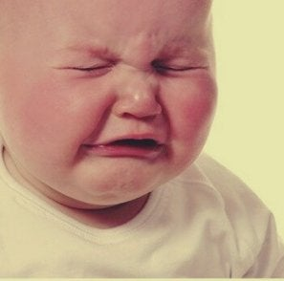
Aversive but not contingent?
Aversive stimuli can also affect operant behavior when that behavior neither produces nor prevents them
When aversive stimuli occur independently of responding.
Really classical conditioning to that stimulus
Most famous example is conditioned emotional response (CER).

Slide 9
Conditioned Emotional Response (CER)
Demonstration of CER:
Rat must lever press to obtain food.
Rat receives periodic pairings of tone with electric shock.
Rat eventually press lever at a lower rate when tone is on than when it is off.
Rat shows an emotional reaction to the tone, as demonstrated by the decrease in responding
Phenomenon is called conditioned suppression or conditioned emotional response (CER; Estes & Skinner, 1941).
Human examples?

Slide 10
PUNISHMENT is not just the opposite of Reinforcement
Is all we learned about positive reinforcement true, in mirror-image form, of punishment?
Perhaps not.
Any operant punishment situation is really a punishment plus reinforcement situation.

Slide 11
Punishment + Reinforcement?
For punishment to suppress operant responding, responses must already be occurring with some frequency.
For responses to occur, they must be producing reinforcement.
So, effect of punishment reflects interaction of two contingencies--reinforcement and punishment.
Jointly operate in most situations.

Slide 12
Punishment Intensity:
As intensity of punishing stimulus increases, degree of suppression of reinforced behaivor increases.
If very intense shock is used, then suppression may be virtually complete.
(think about it!)

Slide 13
Role of past experience! Context and experience matter
Suppressive effect of an intermediate shock intensity depends on animal’s past experience with shock.
If animal has experienced intensities going from mild to intermediate, then there will be substantial suppression.
If animal has experienced intensities going from severe to intermediate, then there will be little suppression.

Slide 14
Immediate is Best!
For punishment to be maximally effective, it must immediately follow operant response.
As delay interval between response and punishment increases, amount of suppression decreases.

Slide 15
Probability of a punisher
Should be certain (as close to 1.0 as possible) and follow each operant response.
Probability of punishment should be 1.0 (IF you make a response, THEN you get punisher)
When responses are punished intermittently, effectiveness of punishment procedure is reduced.
Is this different than what observe with reinforcement? Think about it!

Slide 16
Recovery from Punishment: Extinction
When punishment is discontinued, suppressive effects on responding may not be permanent
Changes in the rate of responding after punishment is discontinued
Get immediate suppression effect then
Not just recover but
Briefly exceed level at which it was occurring prior to punishment

Slide 17
Unconditioned Punishers
Unconditioned punisher: stimulus whose presentation functions as punishment without having been paired with any other punishers.
Innate
Biologically relevant
Still, all organisms not respond the same!
Unconditioned punishers will suppress any behavior that precedes their onset.
Again, is this similar to reinforcement?

Slide 18
How are conditioned punishers different?
Conditioned punisher is a stimulus (cue) that functions as punishment as a result of a person’s conditioning history.
The cue acquires the capability to function as punisher through stimulus-stimulus pairing with one or more unconditioned or conditioned punishers.
Examples?

Slide 19
Extinction of Conditioned punisher
If responses occurs in absence of punisher, the response will return, potentially, to pre-punishment levels
If the conditioned punisher is repeatedly presented without the punisher with which it was initially paired, effectiveness as punishment will diminish until it is no longer a punisher.

Slide 20
Generalization and Discrimination
Generalized conditioned punisher: A stimulus that has been paired with numerous forms of unconditioned and conditioned punishers
Discriminated punisher: A stimulus that has been paired with only one specific conditioned or unconditioned punisher becomes a.
Examples?

Slide 21
Other factors influencing effectiveness of punishment:
Schedule or frequency of punishment
Availability of reinforcement for the target behavior
Availability of reinforcement for an alternative behavior.

Slide 22
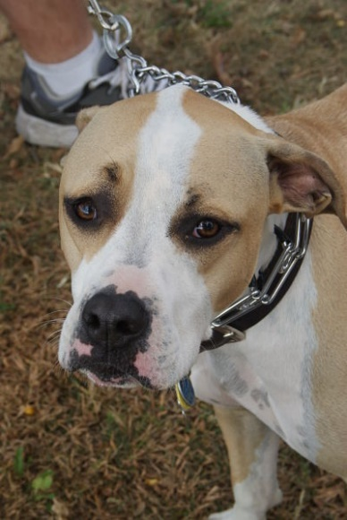
Punishment can result in death
Grohmann, Dickomeit, Schmidt, & Kramer 2013
A 1-year-old, male intact, German shepherd dog presented to the emergency Vet clinic with incoordination and circling to the left was
Four hours before presentation, the dog had been disciplined by the owner because of misbehavior during training.
The dog was suspended a few feet in the air by its choke chain collar, a common form of punishment among dog handlers (Miller, 2008).
By the owners’ reckoning, the action was terminated after approximately 60 seconds when the dog panicked and finally lost consciousness for a few seconds.
At first, the dog appeared normal to the owner.
During the next few hours, the dog became increasingly ataxic on all 4 limbs and was circling to the left.

Slide 23
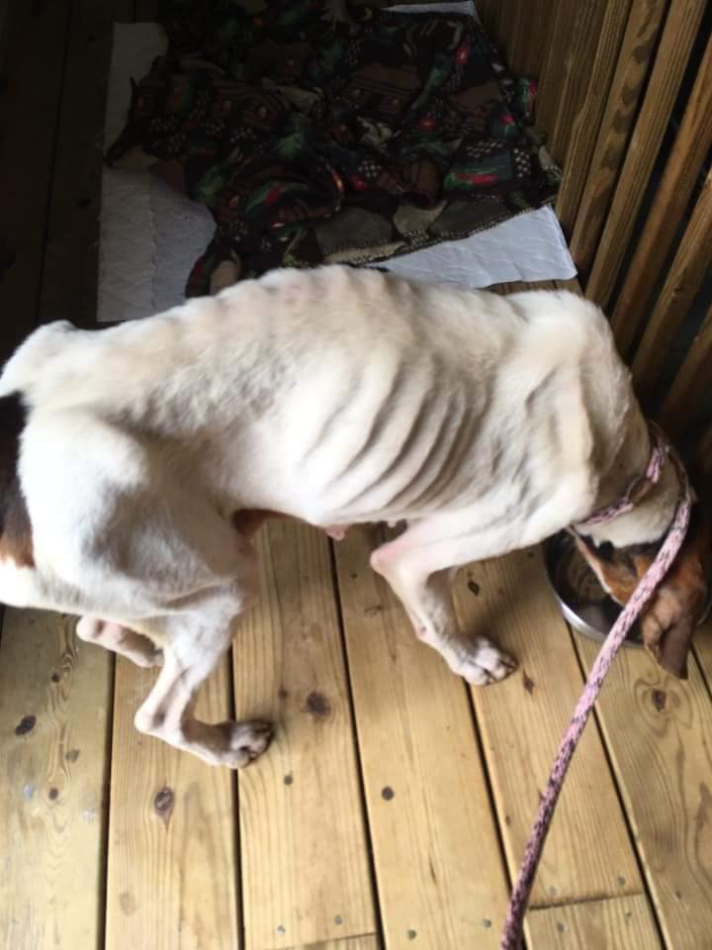
Punishment can result in death
The initial investigation of the referring veterinarian showed no abnormalities on general physical examination.
For further evaluation of the neurological status, the dog was referred to veterinary school
On presentation, the dog was anxious, panting, tachycardic (heart rate, 140 beats per minute), showing a body temperature of 40.0C, capillary refill time of 2 seconds, as well as dark pink and tacky mucous membranes.
The neurological examination revealed severe disorientation, left-sided pleurothotonus, and circling. The hopping reaction was slightly reduced in all 4 limbs.
As a sign of blindness, the menace response and the direct and indirect pupillary light reflexes were negative in both eyes.
A bilateral mydriasis was present.
The dog showed a variable nystagmus and a left-sided facial motor paralysis.

Slide 24
Punishment can result in death
From the study:
The neurological findings were consistent with a multifocal brain lesion.
Differentials include diffuse axonal injury, vascular ischemia, increase in intracranial pressure, and hemorrhage.
The results of the complete blood count and serum biochemistry were within the laboratory reference ranges.
The dog was treated with a shock bolus (20 mL/kg for more than 20 minutes) of crystalloid intravenously, and after 30 minutes showed a physiological body temperature, normal heart rate, normal pink mucous membranes, and a capillary refill time of below 1.5 seconds.

Slide 25
Punishment can result in death
A Magnetic resonance (MR) tomography was performed
The T2-weighted scans showed a diffuse, nonhomogeneous, poorly demarcated hyperintense lesion within the dorsal and ventral aspect of the thalamus, both hippocampi, the lamina tecti of the midbrain and the splenal, suprasplenal,and marginal gyrus.
The lesion was slightly more pronounced on the left side. A mild rostrotentorial herniation of the lamina tecti was noticed.
In contrast to the rest of the brain, the thalamus, and could not be delineated.
The ADC measures the magnitude of diffusion within the cerebral tissue. In the resultant ADC maps, this area appears hypo-intense compared with the diffusion weighted images.
The presumptive diagnosis of a severe cerebral edema resulting from ischemia was made.
As a result of the neurological findings and magnetic resonance imaging(MRI) findings, the owners chose to euthanize the dog.

Slide 26
Learned Helplessness

Slide 27
Learned helplessness Marty Seligman
The Original Study:
Four groups of dogs
Group Training I and II Result
I Escapable/escapable run No lasting ill effects
II Inescapable/inescapable not run
No lasting ill effects
III Escapable/inescapable not run
No lasting ill effects
IV Inescapable/escapable not run Severe
Remember, Seligman’s hypothesis was that NONE of the dogs would be significantly harmed.

Slide 28
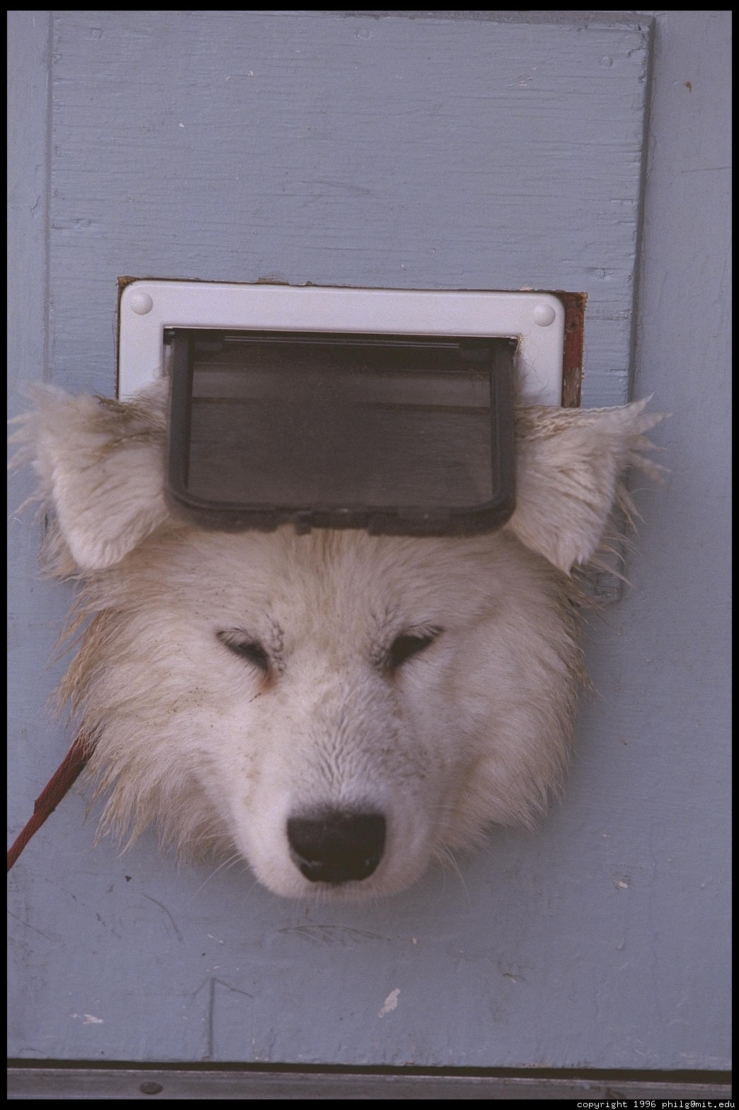
Key Factor = inescapability
Once learned not to escape (learned to be helpless)= not change
Characteristics of L.H.
Inescapability that produces phenomenon, not the shock itself
Works under variety of procedures, conditions
Very generalizable, transferable
If take far enough, can make it a contingency rule for the animal, rather than specific contingency for specific situation(s)

Slide 29
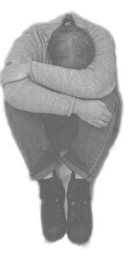
Symptoms of L.H.
Passivity
Learned laziness
Retardation of learning
Somatic effects
Reduction of helplessness with time

Slide 30
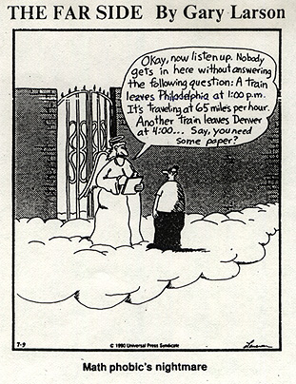
Clinical Expressions of Learned Helplessness
School phobias and math anxiety
Abusive Relationships
Depression
Cultural learned helplessness

Slide 31
“Curing” or eliminating learned helplessness
Unlearn the rule
Reshape or recondition
Must be done in situation where organism cannot fail
Difficult to do- animals can “not” respond
UPenn program on relearning thoughts during test taking

Slide 32
Two theories to explain Learned Helplessness
Competing response hypothesis
Dog learned motor responses which alleviated or attenuated shock
Those were used in shuttle situation, but ineffective
Thus learn the wrong responses
Adaptation hypothesis
Organisms sensitive to independence of events
Most situations: understand that shock is not dependent on their behavior
In LH: not make this distinction, rather shock WAS dependent on their behavior

Slide 33
Treatment of LH in dogs
Original Attempts: 2 separate shock locations:
harness
alley-way/shuttlebox
Then conducted several additional procedures:
Inescapable shock exposure
instrumental escape/avoidance training
Testing for chronic failure to escape
TREATMENT
Removed barrier between sides
Opened observation windows on opposite side of box
Humans called dogs to safety side
Forced escape/avoidance
Recovery: testing again for LH

Slide 34
Results: What treatment worked?
Learning contingency was critical
When learned that contingency was to escape- could overcome the first “learning rule”
If did not learn that the contingency was to escape, then did not recover from LH
Was one of first attempts at treatment
Why so important? One of first studies to suggest that you could be TAUGHT to overcome aversive events in your life!

Slide 35
Why is learned helplessness important to dog training and our dogs?
Many of our foster, shelter and rescue dogs show symptoms of learned helplessness
Misunderstanding their behavior for obstinacy, aggression, or other misbehavior will lead to worsening behavior
Must understand that much of their misbehavior elicited due to LH

Slide 36
Reminder
Over 15 million dogs turned out as strays or relinquished to shelters each year
Small percentage are lost dogs
Smaller percentage are homeless dogs
Most are unwanted
Relinquishment = stress
Elicits stress hormones
These, in turn, tied to aggression
Soon aggression and stress become linked

Slide 37
In shelters: Tuber, et al., 1999
Plasma levels of stress-related adrenal cortisol elevated in dogs at least during first 3 days in shelter
Tied to anxiety, depression, etc. in dogs and humans
AND a sign of developing LH
20-min of human contact reduced these levels to near normal

Slide 38
Brief contact of only 20 min between humans and dogs significantly REDUCED stress cortisol

Slide 39
Treatment
1977: Tuber and his colleagues began shelter interventions
What did they find most productive in alleviating stress symptoms?
Supportive environment
This Photo by Unknown Author is licensed under CC BY-ND

Slide 40
Supportive Environment
Living room: looks like a humans’ home living room
Not a cage
Most likely paired with good human-dog interactions
Living room provides place for
Social interaction
Behavioral assessment
Training
Make human interactions contingent on appropriate social behavior in dogs

Slide 41
Again, even brief contact significantly helped both puppies and older dogs.

Slide 42
Noncontingent interaction with humans was best Contingent interaction with toys was better VERY low latency to greet familiar person!

Slide 43
What kind of training works?
Non-Contingent attention
Stroke-handling: touching all over; petting
Crate training and adaptation
Safety issues for when adopted
Make crate a safe and supportive place
Introduction to noise, different people, etc.

Slide 44
So, what about extending this?
Foster care
In a “living room” 24/7
Get used to sights/sounds of living in a home
Experience daily routines
Morning, evening, staying home alone
Learn changes in routines
Varied experiences and introduction to many novel stimuli
Development of generalization of social behavior
Best simulation of where will go in adoptive home

Slide 45
Why is this socialization so important?
Makes the dog adoptable!
Accepts humans
Acts appropriately when greeting
“looks like a normal dog”
Avoids development of learned helplessness
Shelter considerations
Makes shelters less aversive
Not smelly or scary or full of aggressive dogs
Foster homes communicate caring and well-being
Avoids over-arousal, which increases chances of being adopted

Slide 46
Who should be involved in socialization efforts?
Directors and direct-care staff
Volunteers
Everybody!
Must be systematic training program
Teach people the correct behavior to expect and demand from dogs
Continuity and caring critical

Slide 47
What else important for adoption?
Must remain in contact with adopter
Check for any adjustment issues
Offer behavioral/medical advice
Give support
Goal is to NOT have the dog return

Slide 48
Why isn’t this done more systematically and in a more widespread manner?
Time expensive
Volunteer expensive
Author suggests we use……universities and psychology/biology/agriculture departments!!
Of course- why!!!!!?????

