Slide 1
Stimulus control
Cueing, Poisoned Cues and Faulty Cues
Thanks to Karen Pryor for the slide info!!!!!

Slide 2
Cue or Command?
Why do we use “cue” and not “command”?
Okay partially because it is PC
BUT: meaning behind it
Command suggests requiring or forcing dog to do something
Cue is a term that “cues” the animal.
Suggests animal has a choice
Fits in with LIMA programs

Slide 3
Cueing Basics
A cue is like a green light
Tells the animal that it has an opportunity to earn reinforcement
How? By performing the behavior that is associated with the cue.
There are five criteria for an effective cue. The cue should be: 1. Easy to give consistently 2. Easily perceived by the animal 3. Not confused with praise or other meanings 4. Distinct from other cues the animal already knows 5. Easy to transfer to others

Slide 4
Cueing Basics:
A fluent cue response is:
Precise: animal performs the behavior exactly as you had envisioned
Performed with low latency
Performed with optimal speed
Shows resistant to distraction
Performed at any distance from the handler
Performed for the duration required by the handler

Slide 5
Cueing Basics
A cue is properly trained when
It meets the conditions for fluency, and
When the criteria for stimulus control are met.
Criteria for fluency are: The animal
Performs the behavior when it perceives the cue.
No longer offers the behavior in the absence of the cue.
Does not perform the behavior in response to some other cue.
Does not perform some other behavior when it perceives he cue.

Slide 6
Ferguson and Rosalez-Ruiz (2001)
Trailer loading = critical horse behavior
Horses often not like trailers
Small, dark, confined
Aversive methods often (usually) used
Too much negative reinforcement and punishment, which often escalates to increasingly aversive treatment

Slide 7
Horse Loading Behaviors
Back up
Move Forward
Turn left/right
Step up
Loading problems = leading problems
Horse not going where led
Balks, turns away, etc.

Slide 8
Method
5 horses with poor loading history
2-horse straight load step-up trailer
Butt chain instead of butt bar
Side windows and rear doors left open
White inside and outside
Railroad tie used as extension of trailer deck
Target: Red pot holder
Reinforcers = typical horse treats
15 min training sessions

Slide 9
Method
Baseline compared to training
Loading behavior chain: horse approach trailer:
Within 3 meters (about 10 feet)
Within 1.5 meters
With head/neck in trailer
With front legs in trailer
With ½ body in trailer
With 3 legs in trailer
With 4 legs in trailer; less than 5 sec
4 legs in, allowed butt chain to be fastened, door to be closed.

Slide 10
Behaviors Recorded:
Inappropriate responses/stress responses:
Amount of horse in trailer (using 8 step chain)
Freezing
Head toss
Standing
Turning
Loading:
Getting into trailer (less than 5 sec)
Loading and staying in trailer
Number of prompts
New leads (re-approaches)
Latency to respond to cue:
Within 5 sec
Greater than 5 sec
No response
Also obtained interobserver agreement (IOA)

Slide 11
Procedure:
Baseline: 1 day of repeated 5 min baselines
Target training: 2 days; 20-30 trials/day
Touch target
Criteria: 80% of prompts
Trailer training:
Trials to touch (just inside trailer)
Upon entry, lead back to start and another trial
Started at each horse’s baseline distance
Added then faded trailer extension
Trained to load on left/right sides
Added limited hold with Fancy: gave several steps to move forward
Multiple baseline design across horses

Slide 12
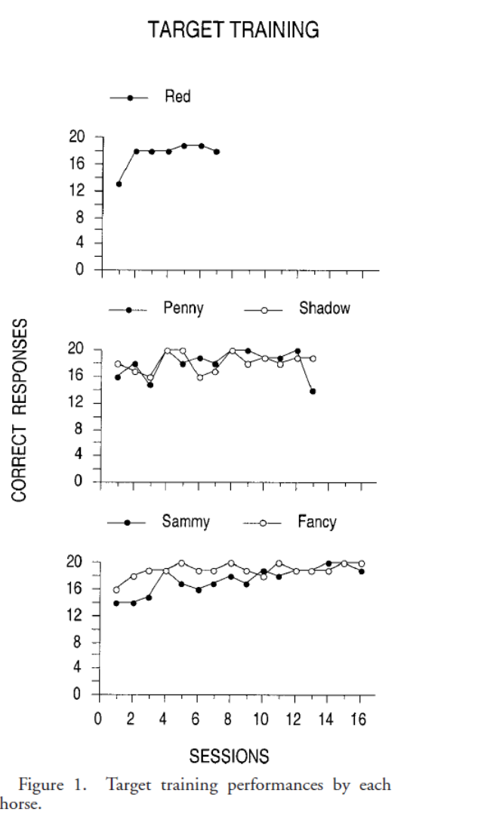
Results
All horses learned to target during first training session
First session: average of about 60% accuracy
Second session: average of 80%
Sammy took 3 sessions, but reached 90%

Slide 13
All horses able to be loaded
Baseline: no horse able to get beyond step 4 (front legs in trailer)
After initial target training: Range of step 6 to step 8 (3 to 4 legs in trailer)
Fancy: 5 to 6 mastered
When added extension: all but Fancy reached criterion performance
Fancy outwitted researchers: could stretch to touch target even with extension
Had to add the limited hold condition to outwit him.

Slide 14
Combined horse data
All horses maintained loading behaviors when extension removed
Loading left and right and new trailers produced some disruption but quickly recovered
All reached 90%

Slide 15
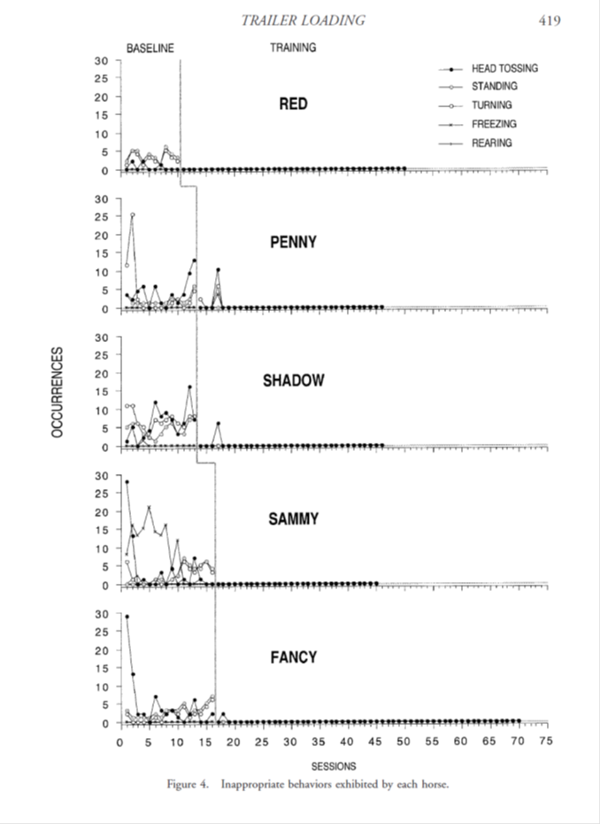
Inappropriate Responses
Most common:
Standing
Turning
Head toss
Immediately decreased with training
Note: not targeted
Suggests these are stress responses

Slide 16
Leads and Prompts
During baseline: Few leads and LOTS of prompts
During training:
Fewer prompts
Leads were about 1:1 with prompts

Slide 17
Summary: Target Training
Target training decreased inappropriate responses secondary to increasing trailer loading
Target training established stimulus control
This allowed stimulus control during situations which usually elicited problem behaviors
Horses so busy focusing on target that they ignored poisoned cues

Slide 18
WHY does target training work?
Avoids learned helplessness
Dogs learn to “move” or “do something else” to get a reward when NOT clicked
Gives organism control over the environment
Opposite of LH, where learn that their behavior has no power
Not so much that it is “all positive”, as it is teaching the rule that you either must
Do what you just did to get the click
Or if that doesn’t work, do something different
“not” behavior is not an option
Teaches “creativity”, “persistence”, “resistance”
With punishment for inappropriate response, dog learns to “not move”

Slide 19
Most Common Cueing Problems
Poisoned cues—cues that have a negative connotation or negative emotions for the learner
Faulty/Unintentional cues—cues that are not clear to the learner, the trainer, or both

Slide 20
Poisoned Cues
Poisoned Cue = cue that has negative connotations or negative emotions associated with it for the learner.
A cue can become poisoned when
It is enforced or taught with force or punishment (even inadvertently),
Resulting in an animal that feels conflict or fear when it perceives the cue.
Poisoned cues = useless as tools for operant conditioning because they have no positive reinforcement value

Slide 21
Conditioned Positive Cues
Conditioned Positive Cue = cue taught with positive reinforcement
The basis for success and reliability when teaching and working with complex behavior chains.
Poisoned Cue = cue taught or paired with punishment.
An example of how a Positive Cue can become Poisoned:
Green light to a driver is good news—”yes you can go now.”
Over thousands of repetitions drivers feel happy to see the light change to green.
A certainty develops: You CAN proceed through a green light.
Foot moves to the gas pedal automatically as we see the light turn green.
What happens if another driver runs a red light and we are injured as we are responding to the green light cue?
Taints or poisons the cue
Will be hesitant, anxious, uncertain

Slide 22
Poisoned cues and dogs
Animals show same ambivalence to a cue that has been poisoned.
Cue is no longer guarantee of good things to come.
In fact, may result in adverse consequence.
Uncertainty causes emotional distress
Result: Deterioration in performance.
Common myth among dog trainers:
Once a dog “knows” a behavior and for some reason does not respond as instructed, the dog should be corrected.
Problem: It taints or poisons the cue!!!!!!

Slide 23
Unintentional Cue
A very common unintentional cue: Hand signal that tells the animal “food Is coming!”.
Cue develops from the trainer’s unconscious habit of reaching for the food before clicking.
Not only does this create a faulty cue, but the movement of the hand can actually supersede the click and weaken the power of the click.
This ¡s also a surefire way to teach your dog to be a dedicated hand or treat pouch watcher!

Slide 24
Faulty Cues
Faulty cues = cues that are not clear to the trainer and/or the learner.
Commonly, cues become faulty when:
Unintentional extraneous elements (movements, sounds, etc.) have become part of the animal’s perception of the cue.
A trainer makes a cue different
(louder, bigger gestures)
and these extraneous elements become part of the trainer’s perception of the cue
but are confusing the animal.

Slide 25
Other Unintentional Cues
Trainers will often unconsciously speak more loudly or give more expansive hand gestures if the animal does not respond to the cue.
The dog learns “say it really loud before I comply”
Repeating the cue: Dog learns “say it three times before I comply!”
Dog learns “repeat it several times before I do the behavior”
These extra aspects can become part of the cue from the trainer’s perspective
BUT: are irrelevant or, even worse, confusing to the animal.

Slide 26
Caution: Don’t poison your cue!
Trainer’s error:
Believe that at some point dog has learned it well enough that it should “Just do it”.
Decide to punish noncompliance.
Actions will likely create a poisoned cue, and the dog will lose at least some of its faith in the cue
Many people believe that they must tell the dog when it has done wrong,
Believe that dog will actually learn faster if It has a clear choice:
Comply and get a cookie,
Disobey and get a verbal or physical reprimand
But actually poisons the cue!

Slide 27
Data to support this position
Dr. Jesus Rosales-Ruiz of the University of North Texas and his graduate students have been conducting experiments to determine just how cues actually work.
According to the work of Dr. Rosales-Ruiz:
Even a small (seemingly inoffensive) physical correction can become associated with a positively trained cue
Can cause emotional distress in a dog
Result: Deterioration in performance of a previously fluent cue

Slide 28
Murrey and Rosales-Ruiz:
The Study:
Condition #1:
Condition #2:
Then returned to positive reinforcement.
ABA design:
17 sessions of baseline
12 sessions of poisoned cue
Ven: C/T
Punir: Tug if not react within 2 seconds of cue; C/T if did
50 sessions: C/T for both cues
Why use an ABA and not an ABAB?
train using positive reinforcement:
Two cues: “Ven” and “Punir”
Poisoned “Punir”: Used a slight jerk of leash

Slide 29
PHASE I: Initial Training
Two cues, “ven” and “punir,”
Both cues meant the same thing: come to the square on the floor ¡n front of the handler.
Both cues were trained to fluency with shaping and positive reinforcement.
All training sessions were conducted ¡n the same room, with the same dogs, and with the same trainer.
17 sessions: Both cues were trained to 100% accuracy with shaping and positive reinforcement

Slide 30
Phase II
“Poisoned” the “punir” cue.
Dog received a gentle tug on its leash if it failed to comply within 2 seconds of perceiving the cue.
Note that the dog still received a click and treat when It arrived in the proper location
ONLY used leash correction for 12 trials!
After 12 trials with mild punisher, returned to TREAT ONLY for another 50 trials
Cue | Goal Behavior | Consequence
Ven | Touch briefcase in right corner | Correct? Treat Incorrect? Nothing
Punir | Touch trash can in left corner | Correct? Treat Incorrect: mild leash tug

Slide 31
Results:
Significant differences in the speed and accuracy of the target touch
Dogs in Ven condition are faster and more accurate
Dogs in punir condition are slower and show shyness
Significant difference in the attitude of the dog even though there is no more tugging in final phase
Dog in punir tug condition shows conflict
Dogs in ven condition rapidly approach new task
Dogs in punir condition are slow and hesitant

Slide 32
Signs of a Poisoned Cue
Obviously, impossible to know what our animals are thinking, BUT IS possible to observe their behavior.
Signs that an animal is working under a poisoned cue are obvious:
SluggIsh response
Lack of response
Default to a favored behavior (often “sit” or “down”)
Looking for an escape
Displacement behaviors (licking, sniffing, head down)
Submissive behavior
Anxious facial expression

Slide 33
Causes of a Poisoned Cue
According to Dr. Rosales-Ruiz, trainers can poison cues in the following three ways:
Add aversive stimulation to a positive reinforcement program.
Teach with aversive stimulation for errors, and positive reinforcement for correct behavior.
Elicit behavior with aversive stimulation, and capture it with positive reinforcement (e.g., tying a ribbon to a cat’s tail to elicit a spin behavior).

Slide 34
The Name Problem
One area in which many trainers unwittingly put the poisoned cue phenomenon to use:
The dog’s name!.
Use a nickname or pet name when they are happy with the dog
Use a more formal name when the dog is in trouble! (Keno Bernard!)
Some people do this with their children as well.
Though it’s often unintentional on the trainer’s part, it is actually a good way to avoid poisoning the dog’s name.

Slide 35
Common Events that can produce Poisoned Cue
Shelter dogs with poor training histories
A well-trained dog forced to comply in a stressful situation (at a field trial for example)
Painful or uncomfortable veterinary or grooming procedures become associated with the cue
Accidental pairing of an aversive as you give the cue:
E.g., car backfiring at the same time as the dog is picking up a dropped object could poison the “pick it up” cue for a noise-phobic dog.
Threats from other dogs can poison cues for sensitive dogs in multi-dog settings.

Slide 36
Cures and Preventions
PREVENT a cue from being poisoned in the first place!
Can be very easy to get rid of poisoned cues:
Simply reshape the behavior and then add a new cue.
With a clicker savvy dog this can happen in a matter of minutes.
Changing the cue is essential,
The poisoned cue will always have some negative emotions attached to it.
Shelter dogs often come with a lot of baggage left over from poor, abusive,or confusing training.
Giving the dog a new name and retraining basic behaviors from scratch, with new cues ,may be just what the dog needs to become a confident and well-mannered canine
Use a different cue! (Lay instead of down)

Slide 37
Prevent and Solve Poisoned, Faulty and Unintentional Cues
Practice good clicker mechanics.
When using prompts and lures to jump-start a new behavior, fade lures as quickly as possible.
Minimize cues when possible—”smalIer” cues are easier to give consistently.
Identify and “clean up” any cues that contain extraneous elements.

Slide 38
What is your dog learning?
Sit taught with C/T and correction:
Sit now means maybe a good thing
And maybe a bad thing.
Even if the dog responds correctly, he is fearful of the aversive consequence
Sit taught with C/T and reinforcement only:
Sit means always a good thing
If the dog fails, nothing happens.
The cue become carries important information,
Serves as a powerful (secondary) reinforcer
https://www.youtube.com/watch?v=hb4ceRjLVnw
May be hesitant to try a new response because of risk of punishment with failure

