Slide 1
CANINE ATTACHMENT
Dogs REALLY Love Us

Slide 2
Dogs show strong attachment to people
Strong and large body of evidence that shows dogs show social attachment to people
What is social attachment?
An enduring bond between two organisms
Asymmetrical social relationship
Dependency of attached individual on “object” of attachment
This can be a person, another dog, even an object
Here we are discussing attachment to humans
Dogs use their human as a secure base

Slide 3
Why attachment? What benefit to the organism?
Supplies the offspring with resources for survival
Provided defense against predators by ensuring that offspring remain near the parents (Bowlby)
Basic organizational factor for social structure for a species
Allows group formation
Establishes an organizational structure
Elicits predictable behavioral preferences and patterns of behavior between attached individuals
But why cross-species attachment? What benefit do dogs get from being attached to humans?

Slide 4
Why might an animal be attached to a human?
Imprinting studies (Lorenz)
Imprinting during critical period to first caretaker, regardless of species
Produces proximity seeking and proximity preference to their human
Again, allows increased chance of survival
In humans and dogs, no imprinting, but attachment
Do observe proximity seeking and proximity preference
These behaviors form basic components of parent-infant attachment
Other researchers suggest human attachment is more complex

Slide 5
Complex Human-like Attachment
Organism must be able to
Discriminate and respond differentially to an object of attachment: Secure-base
Show preference for the attachment figure: Proximity and contact seeking
Show distinct behavioral responses when separated or reunited with attachment figure

Slide 6
Complex Human-like Attachment
Test these behaviors using the Strange Situation Test (SST)
Ainsworth and Wittig, 1969
Infant and mother enter a “strange room”
Series of separations and reunions with mother
Measure types and degree of behaviors shown during these events
Non-human infants show similar responses to humans
Chimpanzees
Dogs

Slide 7
Four basic types of attachment:
Secure attachment:
Dog uses human as home base from which to explore
When dog becomes distressed is calmed by parent
Anxious attachment
Dog uses human as home base
But dog and human remain anxious even when reunited or stressor is removed
Avoidant attachment
Dog avoids human, is not calmed by them
When stressor is introduced, dog does not use human to be calmed but avoids the human
Approach/avoidant attachment
Dog uses the human as the base, but seems to both approach and avoid the human
Seems ambivalent as to how to react to human.

Slide 8
Evolutionary development of Canine Attachment
Attachment appears to have co-evolved in dogs and humans (Paxton, 2000; Shleidt, 1998)
Parallel behavior to human complex attachment behaviors emerged in dogs
Period of domestication resulted in increased duration of “puppyhood”
Allowed development of critical periods
During these critical periods, ability to attach to humans in parallel ways emerged
Why? Increased chances of survival and created co-dependency
Dogs depend on/attach to humans
Humans depend on/attach to dog!
Intriguing evidence
Dog development closely parallels humans in pattern and time periods
Loss of attachment figure results in similar psychological disorders

Slide 9
Evidence for development of attachment to humans
Puppies develop attachment to BOTH their mother and human caretaker
Unrelated to food reinforcement
Not altered by punishment (still seek attachment)
Can attach to other animals, as well
Separation distress relieved by human contact
When move puppy from litter/mother to human- humans can comfort
Think of new puppy- can be consoled by humans when upset
Dogs show strong attachment to family
Separation anxiety; stranger anxiety
In novel environment, dogs show more stress when alone; less when with family member

Slide 10
But: Variability in attachment across dogs
Variability across individuals and breeds of dogs
In how strong they show attachment
In who they show attachment (1 person, family, everyone)
Ability to form new attachment after loss
Udell and Brubaker argue dogs are “social generalists”
Dogs can thrive in many different settings
Have an ability to adapt to wide variety of social environments
Have an ability to adopt many social strategies
Dogs are facultatively social
The degree to which form social groups with other dogs depends on their environmental conditions
Resource availability
Quality of interactions
Not much data on how dogs alter social strategies across different human groups!

Slide 11
The Dog as a Social Generalist
Dogs are not alone in their responsiveness to humans
Human raised wolves, dingoes, coyotes, foxes respond to human social cues
These species respond to human pointing, gaze and body posture
BUT: subpopulations of dogs also show differences!
Pet dogs respond better to human signaling than dogs reared in shelters or kennels
Agility trained dogs, when presented with unsolvable task, gaze longer at owners than pet dogs or search/rescue dogs!
Obedience dogs are better independent problem solvers than pet dogs; pet dogs look at owners more
Kennel dogs look at humans less than pet dogs when presented with unsolvable task
Common factor: differences in experience!

Slide 12
Domestication and experience interact!
Domestication sets the stage for attachment and social intelligence
Greater behavioral plasticity with increased juvenile period
Udell calls these longer development times opportunity periods
Increased time for initial socialization
Makes it easier for domestic dog to attach to human
Much longer in domestic dog: 12-14 wks; wolves, around 4 weeks
Why does this matter?
Greater time for social interactions
Greater diversification of social strategies in comparison to other wild canids
Highly dependent on exposure to humans during sensitive period!
Interaction between domestication and socialization – predictor of social phenotype an individual adult dog will show
What? Genetics + experience = degree of socialization for individual dog

Slide 13
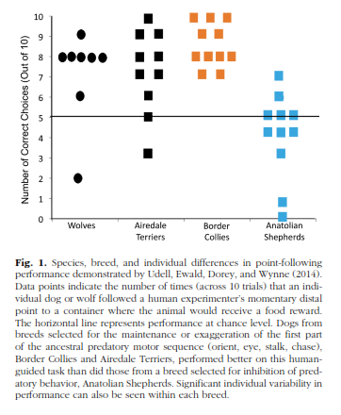
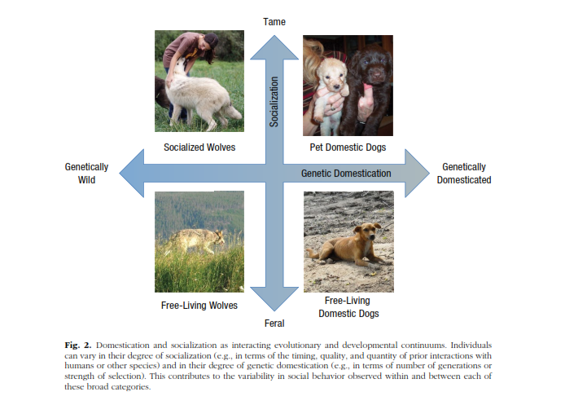

Slide 14
Attachment styles
Ainsworth described 3 styles or types of attachment
Experience and behavior as young animal predicts future adult behavior
In humans, type of attachment predicts
Quality of future relationships
Risk of depression and anxiety disorders
Degree of aggressive behavior exhibited
Social competence
Risk taking
Problem solving and motivation behaviors

Slide 15
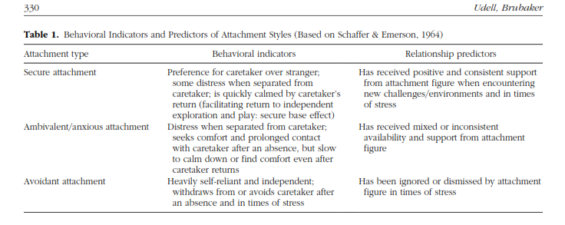
Attachment styles
With dogs (and now children, add the approach/avoidant form of attachment as well.

Slide 16
So, what does this tell us about dogs?
Dogs should show the same three similar types of attachment
What would a securely attached dog look like?
An anxiously/ambivalent type?
An avoidant attached dog?
What types of experiences might shape which attachment type a dog develops?

Slide 17
Giasci, Topal, Miklosi, Doka & Csany, 2001
Most of research has examined adult dog attachment by surveying the owners- questionnaires
These might be very accurate...but we need other data to support
Need measurable indicators of attachment
Strange situation test is “gold standard” for human attachment; could it be used in dogs?
Authors examined shelter dogs
These authors hypothesized that
Dogs’ demand for social contact with humans increases in dogs living without possibility of forming relationships for longer period of time
Even a short duration of human handling would evoke attachment behavior

Slide 18
Method: Subjects
60 shelter dogs from 2 rescue centers
Dogs kept in big packs in very large yards
30-60 dogs per yard
No contact with humans other than caretaker
Caretaker gave food and cleaned yard daily
Little, if any individual human contact
Little record keeping on dogs
Age estimated
Shot records kept
Grouped dogs into control and experimental groups of 30 each
Balanced as well as could by gender, size, likely breed, etc.

Slide 19
Method
Procedure
20 dogs handled; 10 control at each center
The handling time familiarized dogs to the individual who would play the role of owner
Nonhandled dogs were led to the SST by both individuals to avoid a more familiar person; these dogs tested first
During Handling:
Dogs handled in open area adjacent to large pen, but visually hidden
Dogs caught, taken to area by the respective handler
Put dog on leash, pet, attempted to teach basic obedience skills such as sit, down, walking; played fetch
Handled on 3 consecutive days for 10 minutes
Location | Handled | Control
Shelter 1 | 20 dogs | 10 dogs
Shelter 2 | 20 dogs | 10 dogs

Slide 20
Method
Attachment Test: Room Set up:
Two chairs facing each other in an enclosed area off of main area
Variety of Toys on floor
Seven episodes: 2 min each
Owner (OW) and dog in room; OW ignores dog for 1 min, then interacts with dog.
OW and dog: UP enters, UP greets OW, UP has 30 sec conversation with OW, UP plays with dog for 30 sec, then OW leaves for 1 min.
UP and dog: UP tries to play and pet dog for 2 min.
OW, UP and dog: OW calls dog, attempt to interact for 1 min., the UP leaves, OW plays with dog for 1 min.
OW and Dog in room: OW leaves, dog is alone for 2 min.
Dog alone in room: UP enters, greets dog, attempts to interact, then play with dog for 2 min.
Dog alone in room: OW enters, greets dog, attempts to interact and play with dog for 2 min.

Slide 21
Method: Behavior Recorded
Coded behaviors in presence of OW and UP, as applicable
Behaviors:
Exploration
Passive behavior
Playing
Stand by door
Physical contact
Greeting coded as
Contact seeking
Delay of contact seeking
Duration of physical contact while greeting
Follow (the person to the door)

Slide 22
Results
Calculated relative percentage time spent in each behavior category
Compared handled vs. nonhandled dogs using sum of behavior for OW and UP
Some data did not meet criteria for normal distribution, so used nonparametric tests to examine differences
 | Time with | Time with
Handled | “Owner” | Unfamiliar person
Non-Handled | “Owner” | Unfamiliar person

Slide 23
Results
Gender, Size and Rescue Center
No significant effect of gender or size
Were differences between centers
Dogs at Vasadi showed increased delay in approaching UP
AND spent more time in physical contact with entering UP

Slide 24
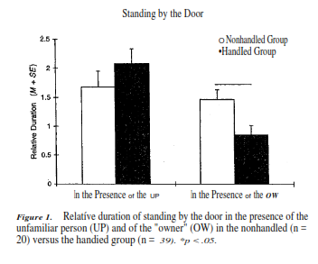
Results: Effects of Handling
No significant differences between handled and non-handled on overall behavior in test situation
Significant differences in specific behaviors displayed to OW and UP
Dogs in handled group stood by door less in presence of OW than non-handled dogs
No significant difference in standing by door in non-handled dogs

Slide 25
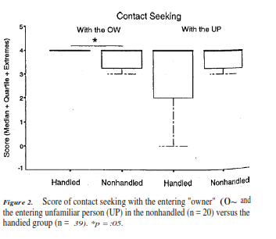
Results: Effects of Handling
Significant differences in greeting behavior
Handled dogs showed higher levels of contact seeking towards OW
Touched OW more
Showed Less avoidance to OW
No differences for the unhandled dogs for the OW and the UP

Slide 26
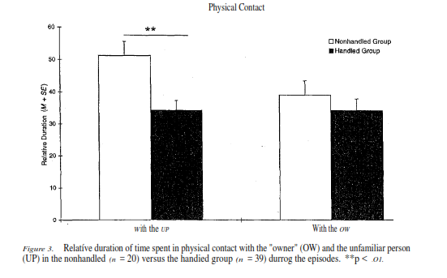
Results: Effects of Handling
Handled dogs had less physical contact with UP than nonhandled dogs
Both groups spent similar amounts of time with the OW
Both groups followed OW in presence of UP
Handled dogs less likely to follow UP in presence of OW

Slide 27
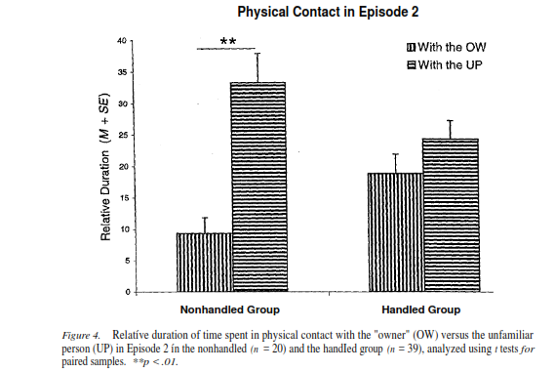
Results
Checked to see if the dogs were avoiding UP
Examined data from Episode 2
(OW, unfamiliar person (UP), dog: UP enters, greets OW, 30 sec conversation with OW, play with dog for 30 sec, then OW leaves)
NOTE: More time spent with UP than OW
All dogs approached UP during test
All spent several seconds in physical contact with UP
Handled dogs spent more contact with OW even though UP has more interaction time during this episode.
Seems that the dogs preferred the OW, even given the brief 3 10-min handling episodes

Slide 28
Did the dogs show attachment to the “OW”
Dogs’ behavior in handled group met criteria for attachment
Were able to discriminate and respond differently to the OW
Used the OW as a secure base: More time in physical contact
Showed a distinct response when OW left or returned: more frequent approach, less avoidance
Non-handled dogs did not meet the criteria.
Stood by door more with orientation towards the exit- ignoring OW or UP
Did not follow OW to door anymore than UP when one left the room

Slide 29
Was it the OW or the UP?
Separational distress elicits two emotional reactions
Distress due to absence of caretaker
Distress due to fear of stranger
Data suggest it was absence of OW that was more important:
Dogs met UP first in episode 2: both OW and UP present
Nonhandled dogs preferred UP
Handled dogs preferred OW
Physical contact data:
Dogs in both groups showed interest in friendly UP
But handled group showed less interest
For Handled Dogs: When unfamiliar person left
Dogs moved and stayed near the OW rather than following UP to door
This is identical to what is observed in humans and chimps

Slide 30
Why attachment so quickly for these dogs?
Living in shelter situation, dogs become more response to humans
These dogs were mostly over 1 year of age, well past critical period
But, dogs may have hypersocialibility: readiness to form attachments
Suggests that there may be innate, genetic propensity to form attachment to humans, even when older
Behavioral , as well as physical paedomorphism
Dogs that retain this ability are more likely to “get a human”
Did observe significant individual differences- suggests not all dogs readily form attachments

Slide 31
What is the take home lesson for those of us working with shelter dogs?
Dogs are highly adaptable, and may retain ability to form attachment well beyond the critical period
Form attachments very quickly
Implications for handling
Implications for fostering, and then moving to adopted family
What factors would make a dog less likely to form attachment, and are these factors “treatable”?
Remember: Older dogs can form attachments, too!

