Slide 1
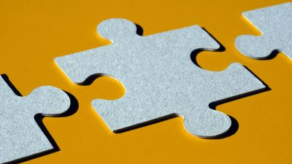
Strategic Reinforcement and Chains!
How to set yourself up for success and put behaviors together!

Slide 2
Rewards = powerful tool
EVERY reward is a “delivery event”
This event greatly influences behavior
Must be strategic in delivery of reinforcers
That is: Each reward delivery should involve a plan!

Slide 3
Strategic Reinforcement does NOT ask for additional behavior
After the click: “delivery event” must flow smoothly and NOT require more behavior before the dog receives his/her reward.
Example: Click for sitting
Dog gets up
You require dog to sit back down to get the reward
This is requiring an EXTRA behavior
How to avoid this? Strategic Reinforcement!

Slide 4
Defining Strategic Reinforcement
TWO components make for very powerful training:
Effective reward location
Effective delivery method
These two components
Assist training progress
Avoid hindering training progress
Support preventing undesired behavior!
Lack of strategic reinforcement: The trainer lowers success.
Has no reward strategy
The animal controls the delivery event = not so powerful training

Slide 5
Many Reasons for Using Strategic Reinforcement
Safety:
Open hand vs. fingers accessible
Must use a reward strategy that includes a safe and comfortable method of reward delivery for both trainer and the dog
Convenience:
Easy for the trainer to deliver
Easy for the dog to get the reward
But: doesn’t ask for additional behavior OR disrupt the target response

Slide 6
How to Introduce Reinforcement Strategy into your training
Several considerations:
Your animal
Your relationship with the animal
Value of different reinforcers available
Mechanics of giving/taking reward
You as a trainer
Your ability
The training goals
Each behavior may have a different reward strategy

Slide 7
Reward Location
Location resets dog: places dog in best location for next repetition
Rewards where the dog was at the time of the click (adding value to that location)
Rewards at specific location (moves the dog) which supports the goal behavior
Rewards where the dog is at time of delivery (may be different location from where click happened)

Slide 8
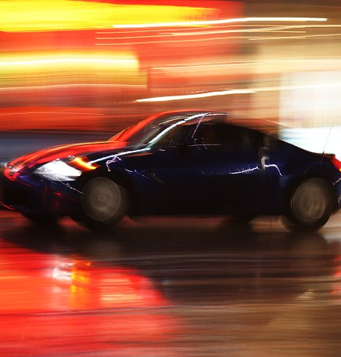
Reward Speed of Delivery
Speed of Delivery:
Too fast: may startle the dog with the movement
Too slow: not relate the reward to the behavior
A Powerful reward “event” begins AFTER the click and is “smooth” from start to delivery
This Photo by Unknown Author is licensed under CC BY-SA-NC

Slide 9
Other Delivery Strategies:
Relocating Animal via Preset Rewards
Prompts the dog to move to the reward
Remote controlled feeding machine
Preplaced reward on a “trained” target (cue for taking reward)
Reward Stationing:
Use a frequently used reward location
Place or position from which most behaviors are cued and/or most behaviors are reinforced
E.g.: head position, in front of handler, on platform
Protected contact:
Physical set up limits animal’s access to reward
Reward delivery supports desired behavior: Waiting for delivery
E.g., remaining behind a barrier to deliver the reward: animal waits for you to approach barrier and delivery safely

Slide 10
Delivery Strategies
Pizza Delivery!
Make it so there is NO NEED to TRAVEL to get the reward
Direct Delivery: Prompts the dog to remain at the “click” location
Come and Get It!
Upon click: dog comes to reward at its location (usually handler)
Reset dog for next repetition: Initial movement towards goal behavior is heavily reinforced
Reset dog for Completion Point: final behavior position is more heavily reinforced
“Longer” delivery Events: Distance Clicks
Extend “reward event” time
Reward is delivered to that distant location

Slide 11
Examples:
Promoting a goal behavior: Down
Dog lies down, click
Where should you give reward to reinforce that position?
Promoting goal behavior: Back up
Dog backs up, click
Where should you give reward to reinforce that position?
Promoting heel position (dog on left side)
Dog heels, click
Dog moves to in front of you
Where should you reinforce to keep dog in position?

Slide 12
Examples:
Promoting a goal behavior: Ignore distractions
Dog is walking along, not looking at distraction
Click for this behavior
Where should you give reward to reinforce that position?
Promoting goal behavior: Dog comes off A-frame, must make contact with lower part of board
Dog moves down ramp, hits yellow area
Where should you give reward to reinforce that position?
Promoting 4-feet on platform
Dog gets x feet on platform, click
Where should you reinforce to keep dog in position?

Slide 13
Chains
When 1 behavior just isn’t enough.

Slide 14
Chains and Cues
Remember: When we give a cue, we say it ONE TIME!
No repeating yourself (while the dog shapes you!)
Give the cue
Wait 3-5 seconds for the first behavior
If no response: record as error and give cue again!
REMEMBER When shaping:
Work on 1 cue at a time until fluency
Dog should be getting 8/10 cues correctly three sets of 10 in a row.
But…this is boring….so let’s mix it up a little

Slide 15
Chains and Cues
A chain is a group of cues that lead to a primary reinforcer
E.g.: Sit-Down-roll over-sit-up
Each cue is a secondary reinforcer
Many behaviors lead to a single primary reinforcer!
Each cue in the chain:
Serves as a (Secondary) REINFORCER for the previous response
Serves as a CUE for the next behavior
E.g.: Down reinforces sit and asks dog to down; roll over reinforces down and asks dog to roll over…..

Slide 16
Timing in Chains is IMPORTANT
Did I say that timing in chains is important?
Timing in chains is important
When you give your cue is critical!
Timing in chains is important!
Give the cue as animal BEGINS behavior
E.g., as dog sits, cue “Down”
If you wait until the end of the behavior, dog will have a pause as he waits for the next cue
Must give the dog enough time to DO the next behavior
Most problems with chains involve poor cue timing!

Slide 17
Two basic kinds of chains:
Forward chains:
Start from first behavior and work towards the end
E.g.: Shoe tying:
Start with putting your foot in
End with the final pull on the bow
Backward chains
Start from the terminal (ending link) and work backwards to the start
E.g.: Shoe tying:
Start with the final pull on the bow
Work backwards to the beginning

Slide 18
Two basic kinds of chains:
Which is better? Forwards or Backwards?
Generally backwards chains are better
End closest to the reinforcer
Instant success
More easy to work backwards and build duration
Forward chains are unavoidable:
Consumable behaviors: e.g., potty training
Problem: more distant to reinforcer
So: reinforcer beginning steps and then add more steps before the reinforcer

Slide 19
Problems with Chains!
The Animal Anticipates the Cue
Blending of behaviors
Poison cues
Superstitious chains
All can screw up your chain
Must deal with issues carefully or you will destroy your chain.

Slide 20
Problems Chains! Anticipating the Cues
Problem: The Animal Anticipates the Cue:
After a few repetitions, an animal may anticipate the next cue and act before the cue is given.
Common problem.
Because the trainer sees the desired behavior, he or she doesn’t realize that there is a cueing problem that will eventually jeopardize the chain.
Without a cue reinforcing behavior #2, the behavior will begin to shorten and then to blend with behavior #3, and eventually will be lost from the chain.

Slide 21
Animal Anticipates the Cue: The FIX
Always practice portions or subunits (2 to 4 behaviors) within a chain much more often than the whole chain.
Make sure EACH behavior in a chain is fluent by practicing them individually as needed.
Don’t over practice the chain in order…or animal will anticipate and even blend.

Slide 22
Problem: Animal Anticipates the Cue: The FIX….Break up the Chain!
When having a problem: Take three behaviors out of the chain:
The one giving trouble,
The one BEFORE it, a
The one AFTER it.
Give Cue #1, then cue #2 while #1 is going on, C/T.
Then do the same with #2
And #3,
Then with all three.
If a behavior has completely broken down,
Reshape the behavior
Bring it under stimulus control with a new verbal cue or hand signal.
Even in chains cues can become faulty and poisoned.

Slide 23
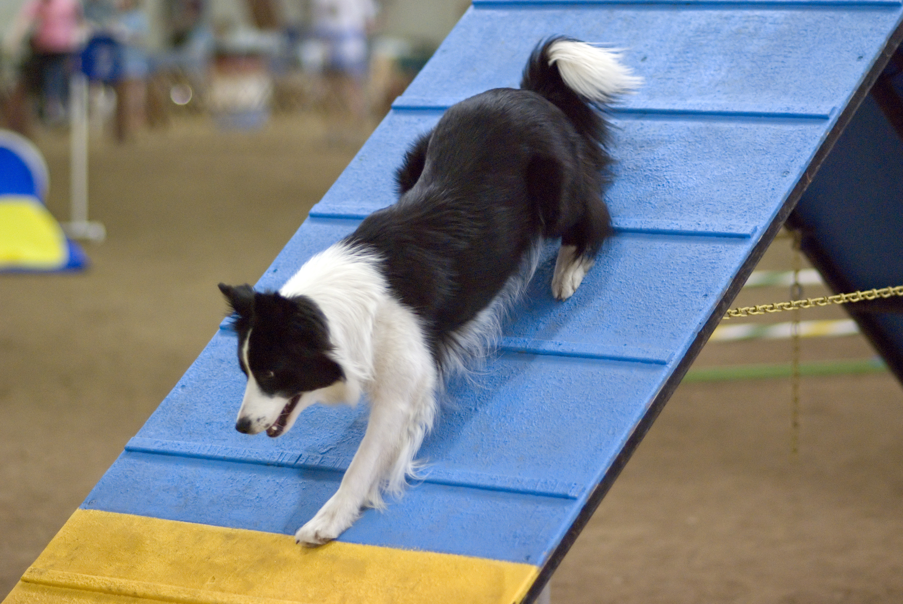
An Example: Navigating an A Frame
Teaching a dog to navigate agility equipment is often done by leading, luring, targeting, or shaping the dog through the process.
For example: A-frame
Might use a low version is used to start.
The dog is shaped to go
Near it,
Touch it,
Go part way up,
Then a little farther,
Until he goes all the way over.
This Photo by Unknown Author is licensed under CC BY-SA

Slide 24
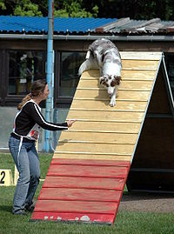
Common problem: Jumping off too early
If the dog jumps off partway, the trainer starts again.
In this process there is a lot of reinforcement for the going up part, but not much for the going down part—which in actuality is the part we want to strengthen.
The Solution: Start on the downward side
Backward chain
Work just on touching the contact zone and coming off, would be a way to teach the last part of the chain first.
At this point the dog would be walking up the down side, turning and coming down.
End behavior become MOST reinforced behavior
This Photo by Unknown Author is licensed under CC BY-SA

Slide 25
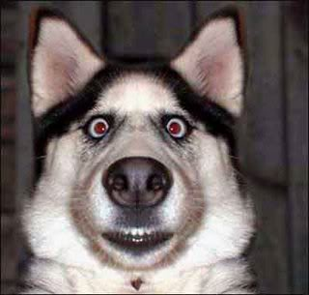
Hazards of Praise and Clicks During the Chain
Don’t make your chain a poisoned cue!
Many people don’t realize that if you interrupt a well-established chain with a conditioned reinforcer that is not a cue (a click, or cheers and applause, for example), the animal will
Expect and be looking for a primary reinforcer—the treat, game, or other desired event usually received at the completion of the chain.
But….An animal who is well skilled will do the chain in performance or competition without flaws, despite your cheers.
Practice or build in interruptions and cheers if they will be environmental cues that may distract your dog.
Why? Because even a few such interruptions may cause inexplicable breakdowns in future performances
This Photo by Unknown Author is licensed under CC BY-SA

Slide 26
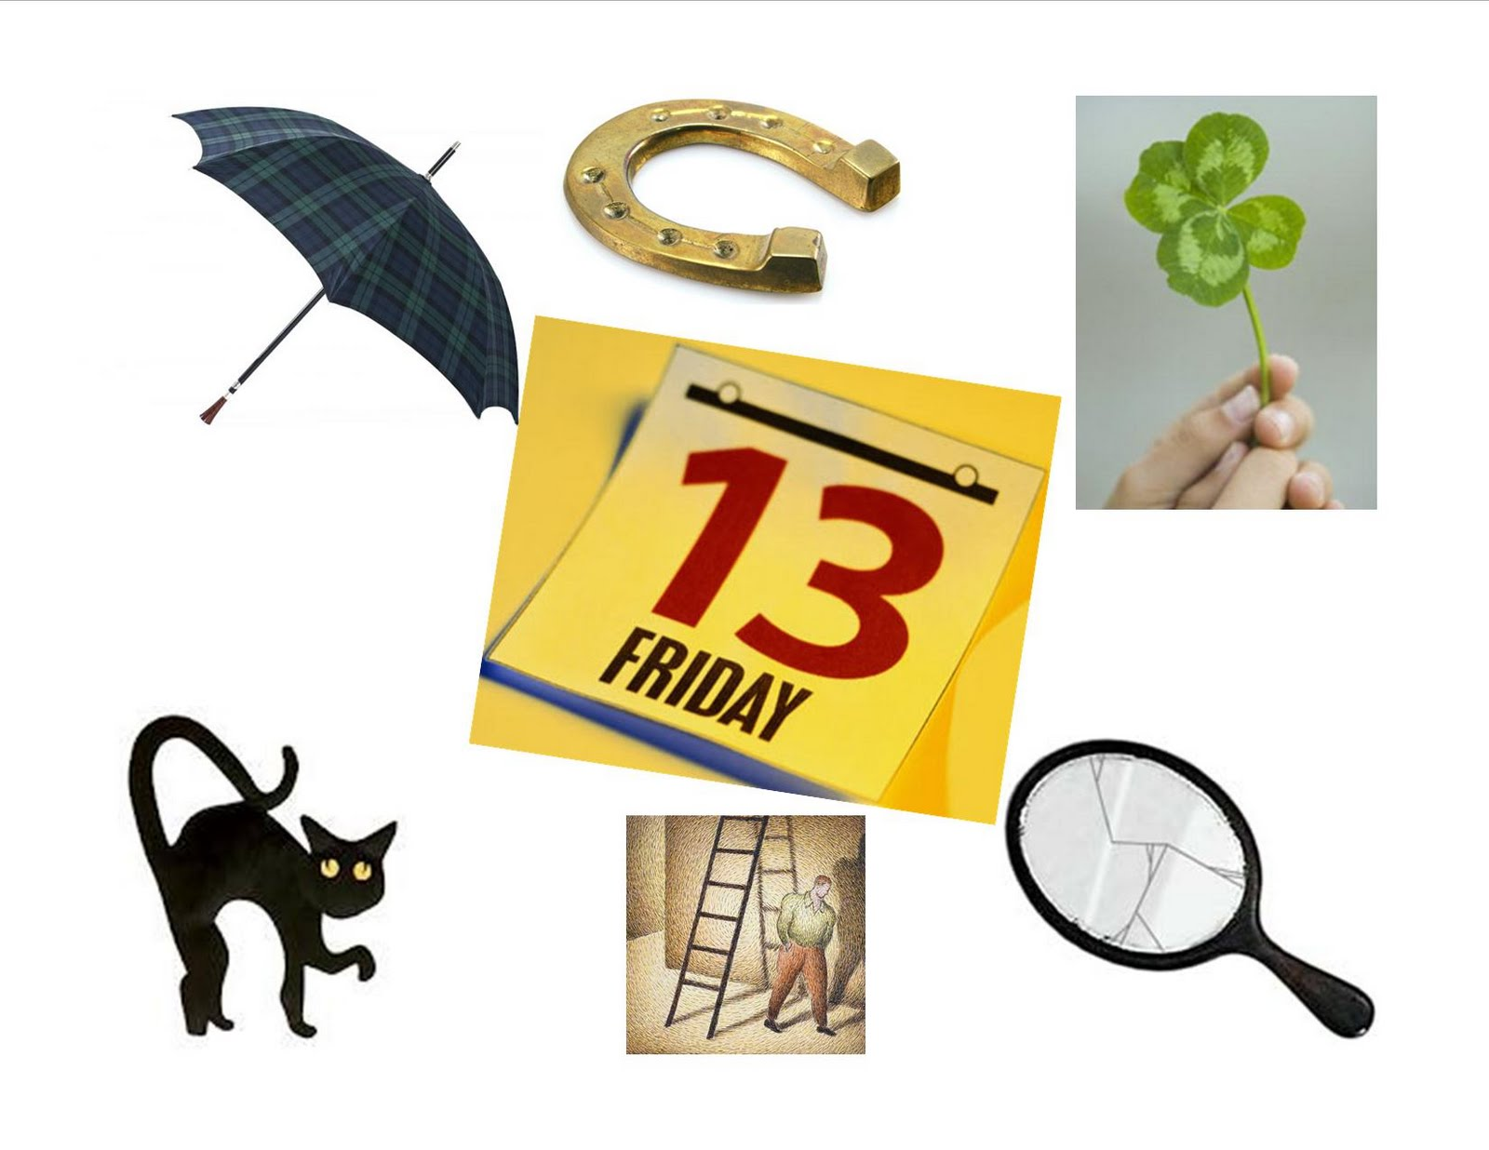
Superstitious Chains
Superstitious chains = string of behaviors that the animal believes are linked and lead to reinforcement
In actuality there is no contingency between the behaviors and the reinforcement
In some cases these superstitious behaviors are true chains,
Behaviors are linked by stimuli the animal perceives as cues.
Sometimes strings of behaviors that develop are simply a pattern or series of behaviors that the animal has strung together.
To the animal, they are essentially one behavior.
Becomes a fluent behavior rather than a bunch of individual behaviors
Harder to change the order of the cues because of fluency of the blended behavior.
This Photo by Unknown Author is licensed under CC BY-NC-ND

Slide 27
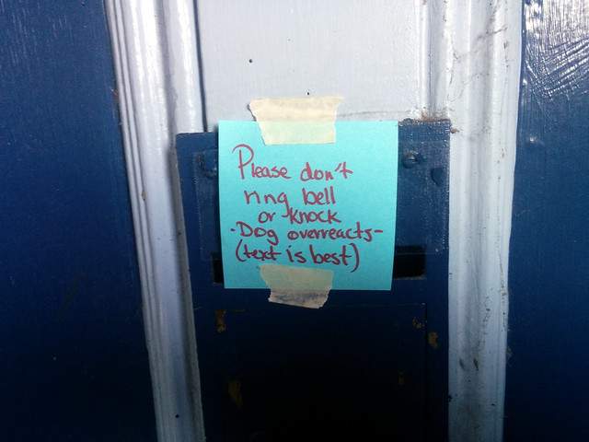
Superstitious Chains
Example: Dog runs to the door at the sound of the doorbell, then spins and jumps
The dog may pair running/spinning/jumping with what makes the door open (the reinforcement),
In fact the door opening is not contingent on the dog’s behavior at all.
Another example: A dog hears doorbell, sees a toy and grabs it, and runs to the door
Developed a chain that ¡s held together by environmental cues:
Door opening is the cue for grab the toy
Toy is the cue for run to the door.
The chain is then reinforced by attention and a tossed toy from the person entering.
Solution: If the toy Is not available or In sight when the dog hears the door opening, this superstitious chain will quickly break down…..and dog “misbehaves”.
In this case, the dog stops running to the door because you have interrupted his or her chain.
NOW you use the superstitious chain against him, so to speak….break up the superstitious chain and it stops the behaivor.
Question: Do you want this behavior or not? If you do….reinforce it explicitly!
This Photo by Unknown Author is licensed under CC BY-SA

Slide 28
But What Does the Research Say About Training Procedures?
Three studies:
Meyer and Ladewig (2008) show how much training is necessary
Chiandetti, Avella, Fongaro & Cerri 2016: Examines clicker vs. Voice vs. Just food
Thorn, Templeton, Van Winkle & Castill0, 2006: Examined quick and dirty training program for shelters

Slide 29
Pfaller-Sadovsky, et al, (2017)
Investigated the efficacy of using backward chaining to increase the frequency of alternative responses when the dog either delivered and then released a preferred item to the presented hand of the owner
Hypothesis: Backward chaining the delivery and release would result in a decrease in the frequency of inappropriate responses
Category II (e.g., hovering over object and/or ears flattened) and
Category III (e.g., staring and/or stiffening up) behaviors.

Slide 30
Owners have difficulty
Identifying appropriate behaviors from inappropriate behaviors
Often do not recognize stress, aggressive or affiliative behaviors in their dog
This creates significant issues when dealing with resource guarding
Is the dog okay with invasion into its space?
Is the dog willingly giving up an item or place?
Can the owners identify when a dog is about to bite?

Slide 31
It is Mine!
Subjects: 4 human-dog dyads (in Austria)
9 yr old Golden Retriever (Male, neutered) and 1st author’s husband; dog was very clicker savvy
Setting and procedure:
All training occurred in living room of dogs’ residence
11 mos old Belgian Malinois (Female, intact) and male owner; dog had been trained with verbal marker
2 yr old Border Collie (Female, Intact) and 1st author’s husband (was foster dog). Had lots of stereotypical behaviors and some training
18 mos old Austrian Pinscher (Male, intact) and female owner; 4 mos of clicker training
Used a combination of single case designs where each new case serves as replication of prior case
To do this:
All start with baseline
Introduction of Intervention is staggered across the dogs with different behaviors measured for each dog (all in Cat II or Cat III)
Provides internal reliability and validity—is an experimental design

Slide 32
It’s Mine
Used Multiple Probe design:
this uses mini reversals to baseline
allows a “test” for intervention versus no intervention
Dependent variables:
Percent of successful trials (dog completed chain correctly within 3 seconds of the verbal cue)
Percent of trials where a Category II or Category III behavior occurred.
Category II
Ears flattened
Hovered over object
Category III
Growling
Snarling
Staring (With sclera clearly visible)
Independent variable:
Backward chaining procedure (start with last step; when at criterion move to next to last step, etc.)
Goal: Deliver item to the owner’s hand within 3 seconds of a vocal cue with no Cat II or III behaviors occurring (or Cat IV)

Slide 33
IT’s Mine
Baseline
Dog given item; wait 10 seconds, then approach dog and hold on to item gently
Intervention
Backward chain the picking up and delivering of a neutral object
Give verbal cue to release while holding on (Physical prompt)
Successful trial: Dog released item within 3 seconds
Unsuccessful trial: Aggression response occurred and/or dog did not release
If dog did not release: 10 second ITI; if did release, also got toy for 10 sec.
10 total trials no more than twice daily
The backward chaining procedure comprises 5 sequentially ordered steps/conditions (i.e., task analysis), which are listed
Number of steps Task Description
1. Release Opening mouth and releasing item while owner was sitting on a chair and delivering a verbal vocal cue
2. Place, sit Taking item from the owner’s hand, which was located approximately 10 cm above the floor, placing item into owner’s hand, and releasing it on the height of the sitting owner’s lap
3 .Place, stand Same as condition 2, only the owner was standing
4 .Pick up, sit Picking up the item from the floor, placing it into owner’s hand at lap height, and releasing it while owner was sitting on a chair
5. Pick up, stand Same as condition 4, only the owner was standing
The aim was to establish the target response, that is, releasing the Safestix on cue without displaying category II or III behaviors.
Table 2

Slide 34
IT’s Mine
IF the dog completed the step(s) within 3 sec of the verbal cue (Verbal cue started the trial)
Probe Trials
Reinforcement
Criterion for moving to next step in chain (remember, going backwards): 90% of trials (9/10) for two consecutive sets of 10
Reinforcement was a treat during intervention trials; access to the toy in the baseline trials
A click was given for a correct response, then the dog received a treat
Incorrect behaviors included keeping the stick in the its mouth, refusing to pick up the stick or refusing to hang on the stick
On each trial: a 0 or 1 recorded for success and the inappropriate behavior(s) were recorded.
Probe Trials were conducted throughout the experiment. These were baseline trials that were introduced after training to determine the success of training.
Generalization was also included: Used the preferred toy as part of the training.

Slide 35
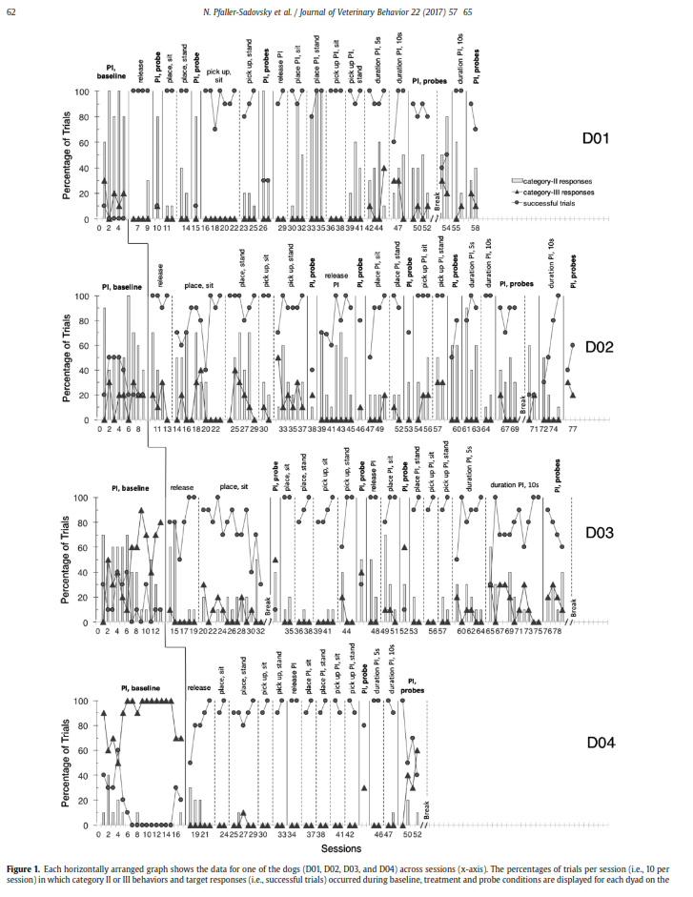
Legend
Bars on the graph are Category II responses
Triangles are Category III responses
Circles are correct responses
Each dividing line represents a treatment phase change
The baseline-to-treatment phase change continues in a staggered manner across the 4 dogs
What you should see?
A decrease in CAT II and III responses
An increase in correct responses (remember, must be at 90% or higher to move to next step phase)
Did intervention work?

Slide 36
Take Home Message:
We are preparing our dogs for adoption or helping them stay in their homes.
You are a critical training manager for these dogs
Without it they might not get adopted or stay in their homes!
USE CLEAN chains of behavior.
Break up your chain if it breaks down
Practice its components
Carefully rebuild
Watch out for unwanted superstitious chains
Reshape and retrain right away if a behavior is disintegrating/blending
BE consistent
USE positive Reinforcement: BOTH food and PETTING/TOUCH
But be aware of each dog’s needs
Shy dogs may refuse both
Less secure dogs may want more physical touch
Securely attached dogs may prefer food

