Slide 1
Are All Dogs the Same?

Slide 2
Dog Genome Project
Wayne & Ostrander 2007
Why dogs?
Important species:
Lots of phylogenic diversity
Relatively known course of development
Can divide into segregated phenotypes that correlate with breeds

Slide 3
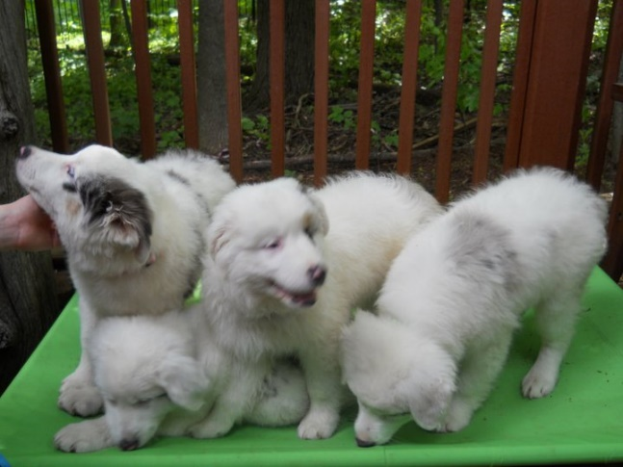
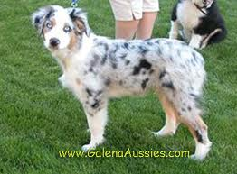
Ontogeny of social behavior in Canids
Domestication results in both physical and behavioral changes
Physical changes include:
Larger size variation: dwarf and giant
Piebald coat color
Reproductive cycle changes
Changes in hair, shortened tails, floppy ears
Social changes:
Lack of development of fear to humans
Exhibiting play behavior in adulthood
Prolonged juvenile period

Slide 4
Several close relatives
Phenotypically divergent taxa (animals)
Wolf
Fox
South-American canids (most close to current dogs genetically)
Current dogs most close relative: Grey wolf
Line of canids may go back as far as 50 million years
Current “dogs” about 10-15,000 years

Slide 6
Modern breeds
Closed gene pools
Real breeding began in Victorian era
Selective breed breeding began
Huge phylogenic diversity
Result: loss of much of genetic diversity
More diversity across breeds
But less overall genetic diversity with other close relatives
In way: Breeds are becoming different “species”

Slide 7
Organization of modern breeds
Distinct evolutionary hierarchy
Four or five primary groups:
Ancient
Herding
Mastiff
Modern European
Mountain
Most divergent of these groups = nine ancient breeds from Artic, Asia, Africa, Middle East
Most modern breeds = European
Share single exclusive common ancestor
Show little difference across phylogenetic structure
This indicates recent origin and limited interbreed hybridization

Slide 8
Where did dogs come from?

Slide 10
Why is this so important
Discovery of new disease genes
Metabolic and endocrine disorders
Blindness
Cancer
Deafness
Hip dysplasia
Osteoarthritis
Give distinct clues for human genetics and treatments of humans as well as dogs

Slide 11
What about behavior
Just beginning to investigate behavior of dogs across breeds
Examine how breed and behavior correlate
Examine how behavior disorders interact with breed
OCD, separation anxiety, etc.

Slide 12
The C-BARQ
James Hsu and his colleagues at the Center for the Interaction of Animals and Society of the University of Pennsylvania [35], [36].
The C-BARQ®: Canine Behavioral Assessment and Research Questionnaire
Designed to provide dog owners and professionals with standardized evaluations of canine temperament and behavior.
Undergone extensive testing to establish reliability and validity using large samples of many dog breeds
The questions asked of dog owners target behavioral traits, aggression and general temperament of the dogs.

Slide 13
C-BARQ
101 items that ask owners to indicate how their dogs have responded “in the recent past” to a variety of environmental events and stimuli.
Owners use a series of 0–4 rating scales.
The wording of individual rating scales differs depending on the questions.
For example, Owners may be asked to note the
Frequency of a behavior (0 = never, 1 = seldom, 2 = sometimes, 3 = usually, and 4 = always)
Quality of the behavior (0 = no signs of the behavior, 1–3 =mild to moderate signs of the behavior, and 4 = severe signs of the behavior).
A brief explanation is included for the qualitative items (e.g., “Typical signs of moderate aggression in dogs include barking, growling, and baring teeth. More serious aggression generally involves snapping, lunging, biting, or attempting to bite”.

Slide 14
C-BARQ subscales
5 main subscales:
Aggression
Fear/anxiety
Excitability
Separation-related behavior
Attachment
Other subscales include
Stranger-directed behavior
Owner directed behavior
Object-directed behavior.
Additional items on the questionnaire evaluate trainability
Also a subset of 21 items that appear to predict canine behavior but do not load on the main 5 subscales.

Slide 15
How can the CBARQ be used?
Examine behavior across different populations of dogs
Predict which breeds might be prone to particular behavioral issues
Genetics studies as well!
We have used it in our lab to examine deaf vs. hearing dogs

Slide 16
WHY Deaf and Blind Dogs?
Hearing and vision impaired (HVI) are an increasing population in animal shelters, foster programs, breed rescue organizations.
The number of blind dogs estimated at approximately 300,000, but very little reliable data
Estimates of the deaf dogs in the US in 2010 suggest about 35,000 bilaterally deaf dogs, and approximately 120,000 dogs with unilateral loss.
Approximately 5% of canine pets are hearing or vision impaired (Deaf Dogs forever, 2010).
Notes:
List serves such as lethal whites and deaf dogs forever, as well as informational websites that give training and general care tips regarding deaf and blind dogs are beginning to proliferate. Because of the internet, owners are able to share information and identify deaf, blind or deaf/blind dogs in need of rescue.

Slide 17
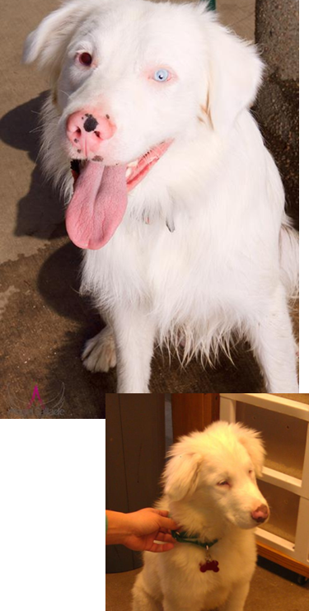
WHY HVI dogs?
Variety of congenital conditions that result in blindness and deafness
Several eye disorders have become dominant in certain breeds, esp. Collie Eye, cataracts, lenticular sclerosis
Congenital deafness typically result when two recessive genes are passed on from the parents.
Double Merle mutation
Too much color removed from hair cells, particularly those in the inner ear, resulting in deafness.
No action potentials possible on cochlea
Results in sensorineural hearing loss
Also commonly affects eye development
Notes:
List serves such as lethal whites and deaf dogs forever, as well as informational websites that give training and general care tips regarding deaf and blind dogs are beginning to proliferate. Because of the internet, owners are able to share information and identify deaf, blind or deaf/blind dogs in need of rescue.

Slide 18
How are HVI Dogs Different?
HVI dogs, unlike normal hearing/vision (NVI) dogs, are unable to benefit from early experience regarding vocalized or positional social interactions,
Otherwise appear to develop normally.
Lots of folklore about HVI dogs: suggest are more aggressive, startle more easily, cannot be trained and cannot make good pets
AKC and breed clubs mandate euthanasia for HVI dogs
Suggest are too dangerous to keep as pets
But- no data to support these assertions.
Notes:
Deaf dogs are unable to hear warning growls or other verbal signals provided by older dogs or other pups and thus may play too roughly or not back off when taking a food or toy item. Similarly, blind dogs do not process the nonverbal signaling provided by a typical dog.

Slide 19
How are HVI Dogs Different?
Uncovering behavioral differences between HVI and NHV dogs:
Helps gain an understanding of how HVI dogs compensate for the loss of vocalized or visual cues during social interactions.
Allows us to examine effects of early experience on canine behavior
Provides data from which to evaluate folklore assertions
Provides a basis for understanding innate versus learned socialization patterns in the domestic canine.
But where to start? Perhaps looking at data for deaf and blind humans.
Notes:
Deaf dogs are unable to hear warning growls or other verbal signals provided by older dogs or other pups and thus may play too roughly or not back off when taking a food or toy item. Similarly, blind dogs do not process the nonverbal signaling provided by a typical dog.

Slide 20
Social Skills Deficits in Deaf/HOH children
Social interactions and social skills deficits
Vocal volume control
Interpreting vocal nuances (sarcasm, emotions, intent )
More isolation and solitary play
Unemotional responses to social situations
Poorer empathy development
Greater negativity and more immature and neurotic behavior
(Barchara, Raphael & Phelan,1980; Goetzinger & Proud, 1975) Odom, Blanton &Lauichuf, 1973; Reinvich & Rothrock, 1977)
Children with visual or hearing impairments often engage in self-stimulatory behaviors (Wright (2008):
Rocking or self-soothing behaviors,
Higher degrees of oral stimulation,
Tendency to seek tactile stimulation

Slide 21
The Deaf Dog Project
Question: Do HVI dogs show similar social behavior deficits to deaf and blind children?
Compared the behavior of HVI dogs to NHV dogs
Behavioral traits
Cognitive and social abilities
Use deficits in deaf and blind children as a starting place for examining differences
Notes:
We have both undergraduate research assistants and I teach an operant conditioning course in which students work with the deaf/blind dogs, as well as dogs with behavioral issues from our local rescue agencies.

Slide 22
Survey Study Deaf vs. Hearing Dog Behavioral Traits Undergraduate assistants: Mandy Quick, Kelsey Harper and Kristin Schmidt
CBARQ survey (Serpell and Hsu, 2003): 5 main subscales:
Aggression
Fear/Anxiety
Excitability
Separation-related behavior
Attachment
Also a subset of 21 items that appear to predict canine behavior but do not load on the main 5 subscales.
Online survey
International Owners of 183 HVI dogs
277 dogs with no disability
Notes:
CBARQ = canine behavioral assessment research questionaire; developed by James Hsu and James Serpell at the University of Pennsylvania vet school

Slide 23
Results
A multiple analysis of variance (MANOVA) was conducted on the data using breed, age and hearing/vision status as the independent variables.
No breed or age differences found
No differences between blind and deaf dogs, thus combined into single category
WERE significant differences in aggression,anxiety and attachment

Slide 24
HVI dogs rated as significantly LESS aggressive
HVI dogs rated as significantly LESS anxious

Slide 25
HVI dogs rated as having slightly more separation anxiety
HVI dogs rated as significantly LESS excitable

Slide 26
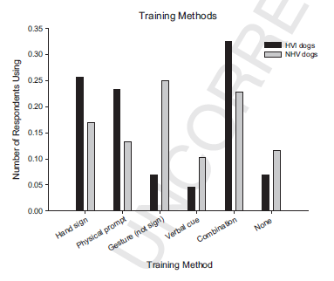
HVI dogs rated as attached to their owners as NHV dogs
HVI dog owners more likely to use hand signs, physical prompts and combinations of training methods
Also more likely to provide training.

Slide 27
Individual Behaviors
NHV dogs more likely to
Roll in feces
Eat feces
HVI dogs more likely to engage in self stimulatory behavior: inappropriate and/or excessive
Chewing
Barking
Licking

Slide 28
Summary of Survey Data
Data suggest that HVI dogs show no more to somewhat less problematic behavior than NHV dogs.
Deficits that are found are consistent with those found in deaf and blind children
Separation anxiety
Perseverative behavior
No more aggression, excitability or general anxiety
But perhaps the owners are underestimating the degree of problems?
Conduct behavioral assessments of HVI and NHV dogs.

Slide 29
Need to examine actual behavior!
Surveys are great, but need to examine actual behavior between deaf and hearing dogs
Support survey data
Allows experiments to examine differences in behavior across deaf and hearing dogs.

Slide 30
CANINE-ALITYTM AND SAFERTM ASSESSMENTS AS BEHAVIORAL PREDICTORS TO DISTINQUISH DEAF AND HEARING DOGS
Participants: 9 HVI and 5 NHV Australian Shepherd dogs, ages 1 to 5, mean age 2.8.
Procedure: Two assessments were given to the dogs:
Canine-alityTM Assessment:
6 item personality assessment: Left Alone, Greeting, Crate, Play test, Food motivation, Manners
SAFERTM assessment:
7-item canine aggression assessment
Look; Sensitivity; Tag; Paw Squeeze; Food Behavior; Toy Behavior; Dog-to-Dog behavior
Scores are used as prescriptive for behavioral intervention.

Slide 31
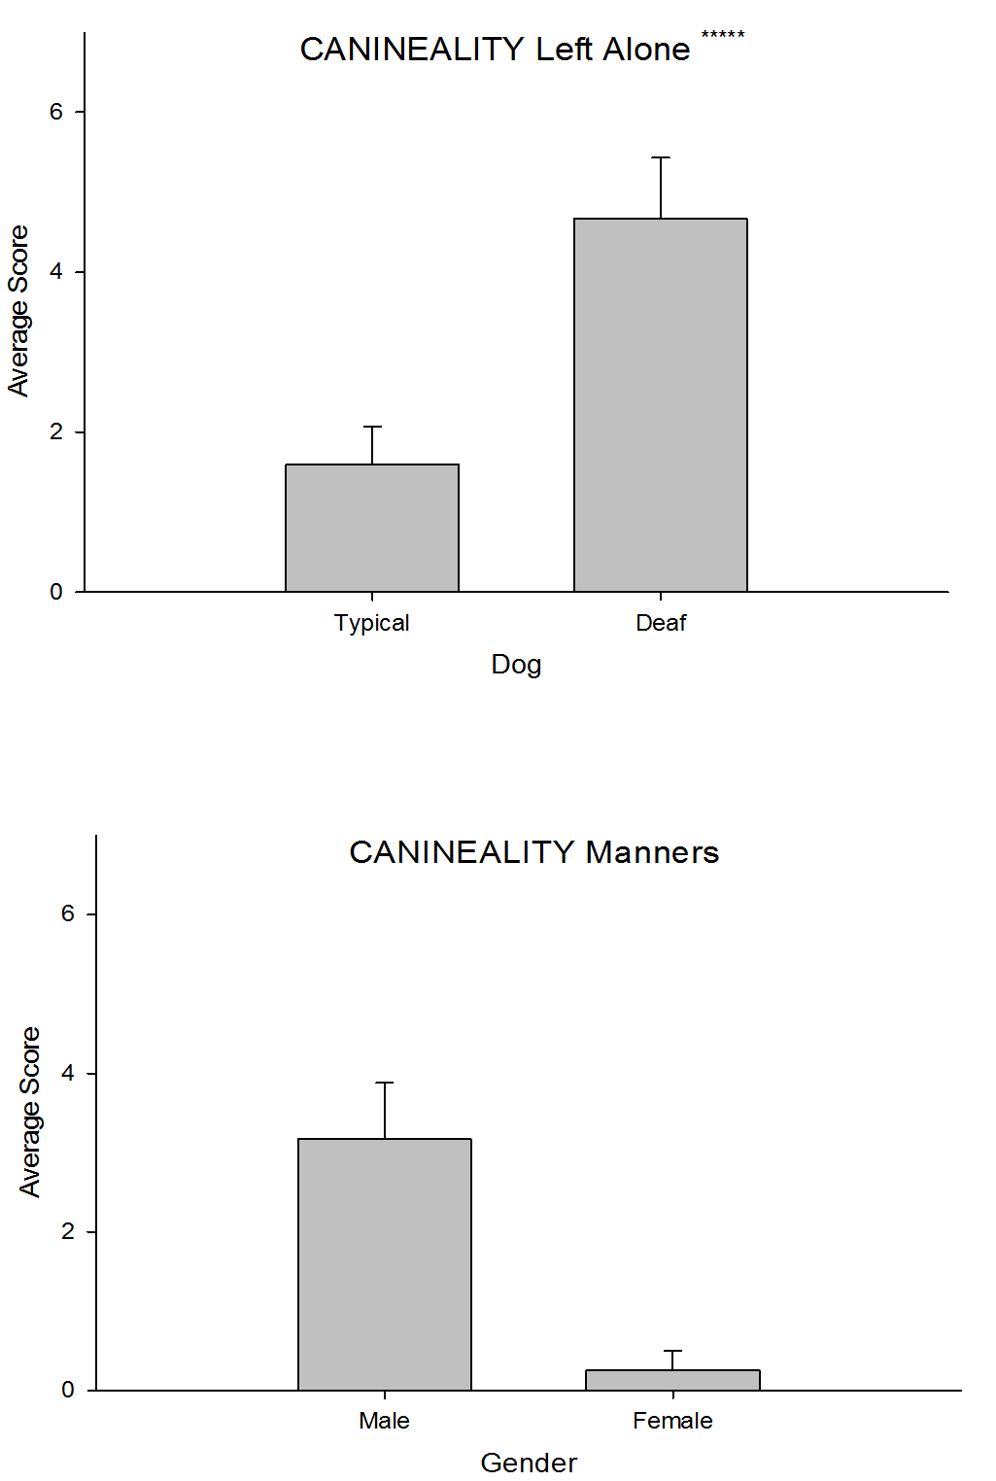
Results
HVI dogs showed greater anxiety on LEFT ALONE subscale
R=.702, F(1,14)=12.64, p=.004, ß=.702.
Male dogs were more likely to receive a higher (poorer) score on the Manners subscale.
R=.593, F(1,14)=7.06, p=.02, ß =0.593.

Slide 32
Summary of Behavioral Assessments
Only Australian Shepherds were examined to control for breed differences
this breed has a a high rate of HVIs (approximately 18%).
HVI dogs did differ from NHV dogs in terms of separation anxiety, confirming the trend found in the survey study
Does confirm, again, that HVI Australian Shepherds do not appear to exhibit the severe behavioral problems cited by breed-specific clubs or the AKC.
Next: examine differences across specific social settings

Slide 33
ACQUIRING FOOD PREFERENCES FROM INTERACTION WITH HVI vs. NHV CONSPECIFICS
Participants: 8 HVI and 6 NHV dogs.
Australian Shepherds, Labs, Golden Retrievers, Boxers, Pit Bulls
Ages 1 to 11; mean for HVI = 2.8; mean for NHV = 5.5
Dogs served as both the demonstrator and the recipient. Each dog was tested at least three time for each condition.
Four conditions:
HVI demonstrator to HVI recipient; HVI demonstrator to NHV recipient
NHV demonstrator to HVI recipient; NHV demonstrator to NHV recipient
The demonstrator dog given a specifically flavored food;
Dog pairs then allowed to socialize for 10 minutes.
Recipient dog presented with same and different food choices.
Replication of: Lupfer-Johnson, G. & Ross, J. (2007). Dogs acquire food preferences from interacting with recently fed conspecifics. Behavioral Processes, 74, 104-106.

Slide 34
RESULTS
Significant difference for same/different food, F(1,12)=45.91, p=.049
Significant difference in
amount consumed by HVI
or NHV dogs, F(1,12)=29.66,
p<.001.
Dogs ate more of the food presented to the demonstrator dog, regardless of whether they were HVI or NHV but HVI dogs ate more overall.

Slide 35
Why are these results important?
HVI and NHV dogs should not necessarily differ in their scent experiences.
Both dogs use scent as social signals
No impairment in HVI dogs for scent cues
Demonstrates that in non-involved sensory areas, HVI and NHV dogs show similar social patterns.
But what about areas that HVI and NHV dogs DO differ?

Slide 36
DIFFERENCES IN PLAY BETWEEN HVI and NHV DOGS
Subjects: 7 HVI dogs and 7 NVH dogs
Australian Shepherds, boxers, labs, goldens, mixes, pit bulls
Ages ranged from 1 to 8; mean for HVI = 3.5; mean for NHV = 3.7
Dog play dyads were videotaped during 5 minute free play
Dogs paired in same (e.g., HVI to HVI) or different (HVI to NHV) conditions
Data analysis:
Videotape sessions analyzed using 10-sec point in time sampling.
Horowitz’s play scale
Play signals:
Attention getting play behavior
Non-attention getting play behavior
Other non-play behaviors
Replication of: Horowitz, A. (2009). Attention to attention in domestic dog (Canis familiaris) dyadic play. Animal Cognition, 12, 107-118.

Slide 37
HVI dogs engaged in more overall play than NHV dogs particularly when playing with other HVI dogs. This decreased, but not significantly, when playing with NHV dogs.

Slide 38
HVI dogs engaged in more attention getting behavior NHV dogs particularly when playing with other HVI dogs. This decreased, but not significantly when playing with NHV dogs.

Slide 39
HVI dogs engaged in more ignoring of attention getting behavior than NHV dogs particularly playing with other HVI dogs. This decreased when playing with NHV dogs.

Slide 40
HVI dogs showed more physical interactions than NHV dogs. This decreased during mixed play.
HVI dogs barked significantly more than NHV dogs, and this increased during mixed play.
Both HVI and NHV dogs showed reduced non-play behavior during mixed play conditions.

Slide 41
Play differs!
As expected, HVI dogs show different play patterns than NHV dogs.
More attention getting, less responding to attention cues
More physical interactions such as leap on
Similar to deaf and blind children, who are also very tactile
Much more and louder barking
Again, similar to deaf children.’s vocal control difficulties
HVI showed more and NHV dogs showed less physical play when playing with a similarly-abled dog than when playing with a differently-abled dog
But how do HVI dogs interact with humans?

Slide 42
OWNERS’ EFFECT ON PET DOGS’ CHOICE
Participants: 10 HVI and 10 NHV dogs.
Australian Shepherds, Labs, Goldens, Boxers, Pit Bulls, Mixes
All ages 1 to 10; average age was 2.8 for HVI; 5.4 for NHV
Procedure: 2 quantities of food or balls
Small: single piece of food or single ball.
Large: 8 pieces of food or 4 balls.
Three conditions:
Free choice test: Dog was free to choose either plate.
Owner showing clear preference for one plate, equal amounts
Owner showing clear preference for small quantity compared to the larger quantity of food.
Replication of: Prato-Previde, E., Marshall-Pescini, S., & Valsecchi, P. (2008). Is your choice my choice? The owners’ effect on pet dogs’ (Canis lupus familiarisis) performance in a food choice task. Animal Cogntion, 11, 167-174.

Slide 43
RESULTS
Both HVI and NHV dogs showed general preference towards bigger reward
Both HVI and NHV dogs chose owner preferred during 1:1
HVI dogs were more easily swayed to choose the smaller than typical dogs
Confirmed this preference for human signals with one last study.

Slide 44
HEARING STATUS AS A VARIABLE PREDICTING SOCIAL LEARNING PERFORMANCE IN DOGS
Subjects: 5 HVI and 4 NHV dogs and their student trainers.
All trainers were familiar to the dogs
Australian Shepherds, Golden, Lab, Pit Bull, Boxer and Mixes
Mean age of HVI dogs=4; Mean age of NHV dogs = 6.7
Apparatus: A V-shaped opaque fence forming a 90 degree angle
Procedure:
Condition 1: The experimenter placed a toy behind the fence by tossing it over the upper edge. The dog was prompted to go retrieve the toy.
Condition 2: Dog models the retrieval of toy first
Condition 3: Human models retrieval of item first
Replication of: Kundey, S.M.A, De Los Reyes, A., Royer, E., Molina, S., Monnier, B., German, R., & Coshun, A. (2011). Reputation-like inference in domestic dogs (Canis familiaris). Animal Cognition, 14, 291-302.

Slide 45
Results:
HVI dogs less accurate at solving the barrier task than NHV dogs: t(7)=2.43, p=.05.
All dogs solved the barrier task after a human modeled the solution.
HVI dogs were less likely to follow the dog model than NHV dogs; this difference approached significance: t(7)=-2.45, p=.07.

Slide 46
What do the data tell us?
Data clearly demonstrate that HVI dogs as a group show differences in social behavior compared to their normal cohorts.
Differences include:
More physical behavior during play
Perseverative/loud barking during play
Difficulty interpreting social signals from other dogs
Greater separation anxiety for their human
More reliance on human signaling compared to dog cohorts

Slide 47
Can these deficits be remediated?
Large literature showing social skills deficits in deaf children can be remediated.
Braton and Osborne’s (1978); Lemanek, et al. (1986) social skills positive practice program
increased target responses for individual children
increased appropriate responses during role playing activities.
Dyck (2003): Emotional Literacy program enhanced understanding of receptive and expressive emotional responses.
Can we teach HVI dogs to improve social skills? First question- how to train!?!

Slide 48
But: Intriguing data from domestic dogs
Dogs like people best:
Dogs will choose to interact with humans over other dogs
Dogs will maintain rates of playing with humans even if are allowed to play with other dogs
Owner-to-dog play is typically of better quality than dog-to-dog play
Brings up a question: DO dogs need to play well with other dogs?
Is it okay for dogs to just play with people?
Not play with other dogs?
Need basic manners, but not “have” to enjoy being with other dogs
Similar question for people: Do children who are asocial or who prefer the presence of adults, being alone, etc. HAVE to learn to play with other children?
Makes us rethink our approach to social skills:
Need basic set
Do we need to be fully fluent?

Slide 49
Muttmix project
Part of the Darwin’s Dogs
Project of the Broad Institute out of Harvard, MIT, and U-Mass Medical School
Over the last 5 or so years, has been conducting ancestry research on thousands of dogs
Analyzes DNA saliva samples to tell us the genetic history of our canine companions.
Tells us the story of our dogs
Provides tremendous information on how humans and dogs co-evolved
Gives insight into a number of diseases and disorders common to both humans and dogs
https://iaabcprojects.org/

