Slide 1
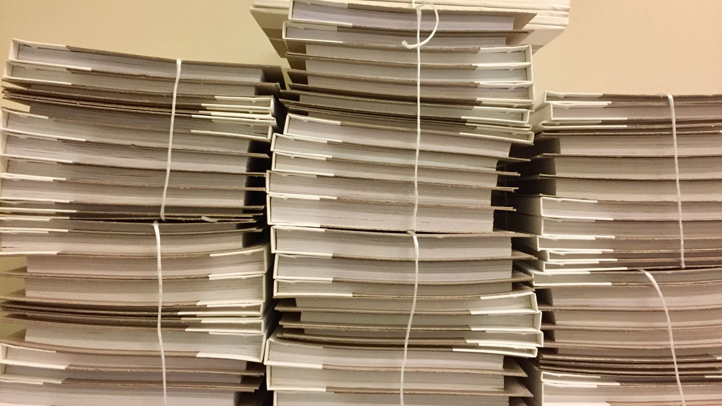
The Final Paper

Slide 2
The FINAL PAPER is due NO LATER THAN 5 pm Friday of Finals week (December 16th, 2022). NO EXCEPTIONS (of course, I will take EARLY papers!).

Slide 3
The final paper should be written as an APA style research paper with data reports.
The paper should be written in paragraphs; there should be a transition between paragraphs and topics.
It will be written with a general introduction, and then a series of “projects” or case studies.
For each lab assignment project, you will tell me:
Who the dog was and its background (age, breed, background)
Referring behavior description
Specific method for what you did for the dog (or what you would do for the dog for the case study)
Results in words and a table/graph.
Conclusion about the success or lack of success for your training program.
The paper MUST cite the source of your ideas throughout the paper.
This is where students have the most difficulty.
Use the readings we have used in class.
DO NOT just reference lectures of the books but reference the actual research articles whenever possible.
Use APA style referencing, not MLA or other referencing styles.

Slide 4
Your PAPER must include the following sections:

Slide 5
Abstract
Hint: write this when you are all done
It should be NO MORE than 200 words
It should be a summary of the paper
Look at examples from the literature we read in class for guidance.

Slide 6
SECTION I: Literature review.
You MUST include a minimum of 5 references; only 1 can be from the book and 1 from lecture.
Begin with A BRIEF introduction to operant conditioning and shaping: You should include a brief discussion of:
Definition of operant/classical conditioning and the difference between the two.
Reinforcement vs. punishment and why to use positive reinforcement
Shaping (definition) and rules for shaping
Cues, poisoned cues and stimulus control
Behavior Adjustment Training (BAT) or systematic desensitization
Give the definition and explain why this is classical conditioning
Give an example of how it might be used and what kind of behavior issue it might be appropriate to treat.
Why mastery or fluency of a behavior is important

Slide 7
SECTION I: Literature review.
A Brief Introduction to Dogs
A brief outline of dog developmental stages and why it is important to know the stage your dog is in when training
Individual differences in dogs: sex, age, breed or disability and why it is important to understand these differences when training
Dogs attachment/attention to humans: how and why is it special
Define and describe Functional analysis
Define it and give an example from the literature we read in class.
Explain how it is used and why/when you might use it to help one build an intervention program. Again, refer the literature we read in class.
Now a transition to the next section of your paper: The present investigation/case study applies operant conditioning and functional analyses to a _____________ (describe your dog) and write a brief paragraph about what you did.

Slide 8
SECTION II: You will report on a minimum of THREE of the lab assignments. Each project should have a subjects, location, a brief apparatus and procedure section, and a results section.
For EACH of the lab assignments your paper must include:
A description of each of the dog(s) you will report on (you may only have 1 dog but may have 3 or 4).
AGE, breed, sex, referring behavior problem
Any other important information about its history, the owners, etc.
The lab assignments you may use include:
Functional analysis that you conducted on your dog, and what you concluded from that analysis.
Shaping program: You may include one or more shaping training assignments (look, sit, walking, etc.) with one or more dogs.
Systematic desensitization for fear, etc.

Slide 9
SECTION II: You will report on a minimum of THREE of the lab assignments. Each project should have a subjects, location, a brief apparatus and procedure section, and a results section.
For EACH lab assignment, you must include procedure section which describes
Exactly what you did with the dog.
Remember to tell me:
Who you worked with.
Exactly what you did: The steps for training
When and where you conducted the training
What was your final goal and what were your individual goals at each step: What were your fluency goals at each step?
This is your “method” or procedure section: It should be specific enough that I can understand what you did and continue the training.

Slide 10
SECTION II: You will report on a minimum of THREE of the lab assignments. Each project should have a subjects, location, a brief apparatus and procedure section, and a results section.
A results section for each lab assignment:
Describes the results of each of your projects in both words and in a table or graph.
Includes a graph and/or table of your data for of the three assignments
NO stats are needed for any of these projects…just describe what your dog learned and what evidence shows that this is true.

Slide 11
SECTION III: Conclusions
Describe briefly your three projects in a summary paragraph (tell the reader what you just told them!)
Tie your summary back to the literature and your introduction!
Did the functional analysis provide sufficient data?
Did the treatments/training work? Why or why not and how did you know?
Did your dog act like you expected? Why or why not?
How did your dog’s disabilities or history (e.g., shelter) affect your dog’s behavior, and how did this influence your “treatment”?
Be sure and site at least five of the articles we discussed in class to support your analyses of your projects
Next: Critique your work across the semester:
What was well done what was NOT well done, and why?
What would you change about how the class was run and why? (yes, really...let me have it!)
Final conclusion: Summarize your project (kind of like the abstract but a summary!)

Slide 12
SECTION IV: REFERENCES
These should be written in APA style.
These should be presented in alphabetical order
If you do not know how to cite a particular reference, go to: https://owl.purdue.edu/owl/research_and_citation/apa_style/apa_formatting_and_style_guide/general_format.html

Slide 13
SECTION V: GRAPHS OR TABLES
You may use excel or SPSS to generate your tables and graphs, if you would like.
You may also hand draw your graphs, take a picture of that graph, and upload the picture of the graph into your paper.
Graphs and tables may also be embedded into the text, if you prefer.

Slide 14
Final Comments:
There is no page limit for this paper.
Rather, I am looking for a paper that thoroughly describes the literature we have covered in the course, demonstrates that you completed, took data and carefully assessed your work.
Complete the paper the way in which I have outlined, and you will receive a good score.

