Slide 1
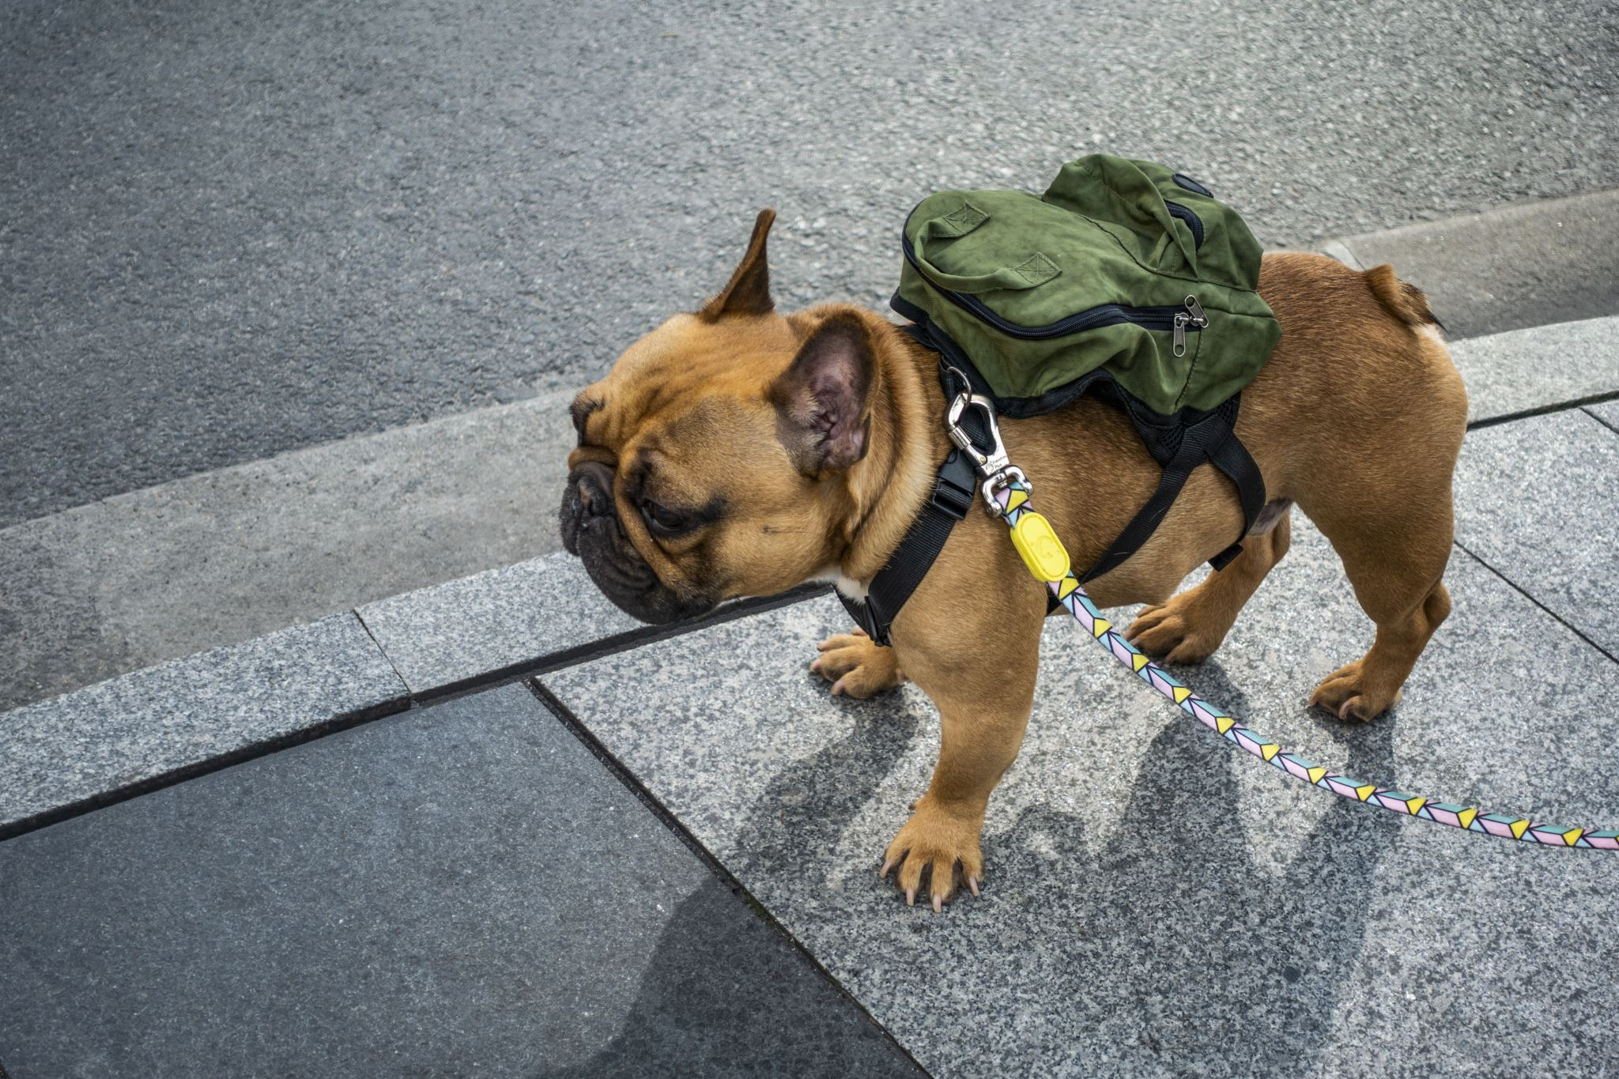
Domesticity and Play in Dogs

Slide 2
Dogs beginning play…….
Observe two dogs meeting and greeting:
  Dog comes face to snout with another dog.
  An intricate dance begins: each movement appears precisely choreographed.
    The dogs visually inspect each other,
    sniff each other,
    walk circles around each other.
  And then the fight begins.
    Could be real aggression; could be play-fighting?
    How do dogs tell the difference?

Slide 3
What IS play?
James L. Gould and Carol Grant Gould
  Describes any behavior that does not have any apparent adaptive function, that is, it serves no obvious purpose.
Serves as a means of social interaction between dogs.
Provides a means of developing and refining motor behaviors, practicing role taking and developing self-control behaviors.

Slide 4
Purpose of Play
Behavioral repertoire required for play is complex.
  Includes a variety of behaviors
  Chasing, play fighting and tug of war.
  Behaviors have different meanings when emitted within the context of play (Bekoff, 1998).
Horowitz (2008): dogs appear to understand that
  they must get the attention of another dog when signaling intent to play
  and that intent to play must be understood by the attending dog.

Slide 5
Play Behavior ≠ Other Behavior
Play behaviors may mimic many elements of predatory, escape and sexual behavior
  but without the serious intent of these behaviors that would occur in “reality” situations.
Behavioral play sequences rarely include the final element of a predation, escape or sexual sequence.
  dogs might chase and grab, but rarely kill.
Some elements of the natural sequence may become exaggerated while the rest stay relaxed.
  Bite response remains inhibited
  Biting may be implied by an exaggerated and symbolic manner via a wide open, toothy mouth (Kaufer. 2013).

Slide 6
Burghard (2005): 5 criteria/ preconditions of play
Play must occur in a familiar and emotionally safe environment (relaxed field).
Play has no specific aim other than play itself. That is, it has limited immediate function.
Play is both voluntary and self-reinforcing. Burghard considers this the endogenous component of play.
Play does not parallel reality in either structural or temporal sequences.
Play behaviors show repetitive behavior patterns.

Slide 7
Evidence in support of Burghard
Social play between dogs contains a repertoire of behaviors and behavior patterns that are only observed during interactive play, including
Play bow
Play slap or play paw
Play nip
Tag and run sequence.
The play bow is particularly important.
Limited to play encounters
This behavior is used to signal intent for all following behaviors:
A bite that follows a play bow is rarely interpreted as an aggression
Play bow signals that any following responses are under the setting condition of “play”.

Slide 8
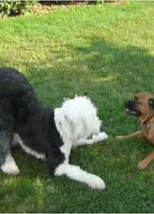
Play Bow as a Signal for Play
Bekoff: Play bow is used more often before and after actions that could be misinterpreted as non-playful
  Infant and adult dogs used the play bow directly before and after mock bites 74% of the time,
  Juvenile wolves 79% of the time,
  Young coyotes 92% of the time.
Play bow “frames” the biting behavior as play rather than aggression

Slide 9
Vocalizations during Play
Play includes a bark that appears acoustically different than barks that occur in non-play situations (Federson-Peterson, 2008),
  both normally hearing dogs and humans appear able to clearly differentiate between the play and non-play barking (Pongracz, et al, 2005, Maros, et al., 2008).
Federson-Peterson (2008: play barks take two typical forms:
  a slow rhythmical, tonal pattern at regular intervals.
    Distance-reducing function
    Come play with me
  an atonal, disharmonious and arrhythmical pattern.
    Distance increasing function
    Go away
    (Meyer 2004)

Slide 10
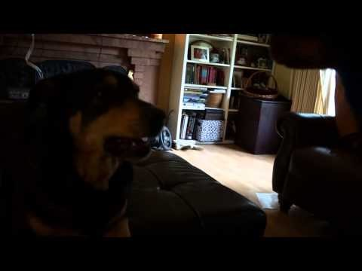

Slide 11
Vocalizations during Play
Developmental sequence to the emergence of the play bark.
  Tonal barking tends to occur as an invitation to play between juvenile dogs
  Adult dogs combine tonal barking with the play bow to form a play solicitation.
  Atonal barking occurs primarily during rough and tumble play and play fighting,
    indicates an escalation of excitement or even stress (Fedderson-Peterson, 2008).

Slide 12
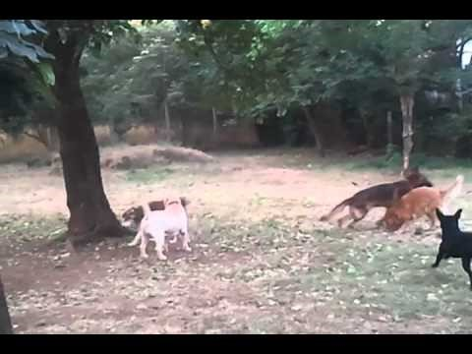
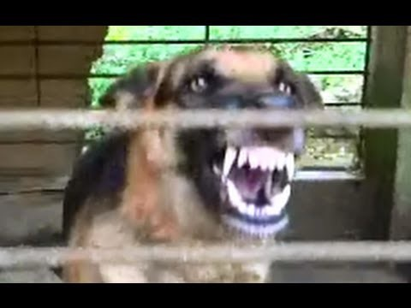
Aggression and Aggression

Slide 13
Honesty and Fairness in Play
Bekoff (2008): Play signals important for showing clear and honest intent for play:
  Dogs that consistently violate the rules of play are avoided by other dogs,
  Often are unable to successfully engage other dogs in play.
Rare that play signals are violated.
  Shyan (2003) found less than 0.5% of play fights developed into actual aggression during extensive observations in American dog parks.
  Bekoff’s work with wild coyotes revealed only 5 or 6 episodes of “cheating” during over 1,000 observations (Bekoff, 2010).

Slide 14
Role-Taking
Dogs engaging in social play exhibit clear role reversals during play
  No “losers” or “winners” (Aldis, 1975, Zimen, 1971).
  The chaser may be chased; the attacker may become the defender.
  Older dogs, a larger or more physically superior dog may take on the “underdog”,
  Will “lose” voluntarily, and thus self-handicap.
Self-handicapping: Bigger, stronger, more skilled dog assuming a disadvantageous position when interacting with a less able dog (Burghardt, 2005; Bekoff & Byers, 1998 )

Slide 15
Experience is important!
Experience plays a role:
Well-socialized dogs play by the rules and follow the behavioral signals critical for framing play sequences.
  Early experience is important!
  Experience playing appears to be integral to the development of appropriate play interactions.

Slide 16
Dogs tend to take 1 of 3 roles during play
Bauer & Smuts (2007): Studied dyadic play in dogs
Dominant dog:
Starts and stops the play
Engages in “top” behaviors: play slaps, over body/head, grabbing at legs/feet
Submissive dog:
Reacts to initiations for play
Engages in “bottom” behaviors such as lies down, receives play slaps and overhead/body behavior, allows legs to be grabbed
Egalitarian dog:
Engages in relatively equal amounts of dominant and submissive behavior
Adapts to play of other dog easily

Slide 17
Age, Breed differences
Fedderson-Peterson (2008): degree and rate at which role reversals occur are a function of
The individual characteristics and experience of the players
Their social relationship to each other.
Age, breed, amount and quality of play experiences all contribute to
Emergence of play differs across puppies
Must have an ability to adhere to the rules of social play.
Puppies often learn bite inhibition between 4 and 8 weeks, but the emergence of bite inhibition can differ greatly across breeds
Differences in the topography of play behavior between some breeds.
Herding breeds more likely to engage in stare and stalk behaviors during play
Retrievers more likely to mouth items, carry them around

Slide 18
Learned or Innate?
Bekoff (1995): Play bow = inherited fixed motor pattern:
  The play bow tends to occur at the beginning of a play sequence to initiate play
  Also, during play when the play sequence has become too rough (Bekoff, 1995).
  Dogs that have been blind since birth and dogs that grew up in social isolation still show the play bow,

Slide 19
Learned or Innate?
Other play behaviors modified through the practice and experience of play.
Feddersen-Peterson (2008) hypothesizes that pups learn consequences of their own behavior through repetition of loosely organized behavioral sequences during play.
While repetitive, the sequences are not rigid in form.

Slide 20
Learned or Innate?
Dog may interact repeatedly with a toy, but how it interacts with the toy may change.
  May retrieve a stuffed animal, grab it from another dog, play tug with a human or another dog, or even shake the toy as if it were prey.
  May interact with a toy alone, with other dogs, with humans, and even with other species.
Experience appears to play a strong role in the development of many play behavior and reinforces the rules of social play

Slide 21
Many animals engage in
“Purposeless Activities”
Heinrich and Smolker: Ravens (Corvus corax): snowboarding.
  https://www.youtube.com/watch?v=mRnI4dhZZxQ
  Ravens in Alaska and Northern Canada are also known to slide down steep, snow-covered roofs; repeat it over and over
  In Maine, ravens were observed tumbling down small mounds of snow, sometimes while holding sticks between their talons. “
  There appears to be no obvious utilitarian function for sliding behavior
DOES look highly similar to playground behavior in children: they also show repetitive sliding activity.

Slide 22


Slide 23
More Animal Play
Herring gulls (Larus argentatus): play with clam shells
  Feed on clams by dropping them onto hard surfaces such as rocks or paved roads.
  If they drop them from high enough, the clamshell might crack, providing access to the juicy snack waiting inside.
  Sometimes, rather than letting clams drop to the ground, herring gulls try to catch the clam in mid-air.
  Other shorebirds play this game of catch as well, including black-backed gulls, common gulls, and Pacific gulls.

Slide 24
Other Animals Show Rules for Play
. Gamble and Cristol noted “rules” of the game in gulls
  Younger gulls played drop-catch more often than mature gulls.
  Drop-catch was performed over soft ground more often than over hard or rocky surfaces.
    if the gull had dropped the clams on the softer ground, it was extremely unlikely that they would break open.
  Drop-catch behavior far more likely to occur when the gull was carrying an object that wasn't a clam.
  Drop-catched clams were less likely to be eaten than dropped ones.
Most interesting: drop-catches were more common when the wind was stronger:
  Suggests that gulls engaged in more challenging tasks
  Are drop-catching gulls are simply having fun.

Slide 25
Is there a Purpose for Play?
Do these behaviors have any adaptive or evolutionary function?
Play = practice for “adult behavior”
  Young animals borrow actions from aggressive, hunting, foraging, or sexual behaviors
  Appears that play may serve as a form of practice.
  Play might help animals become more psychologically flexible.

Slide 26
Is there a Purpose for Play?
Fagen: "the distinctive aspect of playful practice and learning is that they are generic and variational, requiring varied experiences and stressing interactions between simple components."
The variation within “play actions” may better prepare an animal to respond adequately in future aggressive or sexual encounters.

Slide 27
Alexandra Horowitz: Studies Dog Play
Examined dydacdic rough and tumble play
Play between 2 dogs:
Series of coordinated behaviors
Examined how behaviors were moderated in the force of the behavior
Noted exaggerated form of the behaviors
Used the most common play behaviors
Play bow
Play face
Face Paw
Teasing/Chase me

Slide 28
Hypothesis: Play Behaviors must be received and accepted
Critical that audience is able to receive the sent signal
“audience effect”: make sure what you broadcast is what the other dog receives
Must have a receptive audience
Looked for appropriate attentional state
Assume audience has sensory capabilities conduce to receiving the signals
Sender must be sensitive to recipient’s capabilities/ needs/ attentional states
Sender must also seek information from receiver as receiver sends back signals
Look pause: Response waiting
Does the sender wait for a response from the receiver?

Slide 29
Attention Getting Behaviors
Attention getting behaviors = those behaviors which can be used to signal receiver’s attentional state
Sender must alter its behavior depending on attentional state of receiver
Use appropriate attention getting behavior
Attention getting behaviors
Leap on
Bite
Looking at versus looking away
Barking

Slide 30
Horowitz Method
39 clips of play dyads
Made an ethogram of play behaviors
Mutally exclusive list of behaviors
Used only successful play interactions (no aggression)
Anything greater than 10 sec lag in play = end of bout

Slide 31
Method
Examined:
Body posture and body direction
Proximity to one another
Contact with one another
Body pose at each observation point
Categorized interactions as
Attentive: e.g., forward, turned to other dog
Inattentive: sideways, turned away
Divided into 4 groups of responses
Play signals:
Attention getting,
Non attention getting
Other non play specific behaviors

Slide 32
Defining play

Slide 33
Results

Slide 34
Play Behaviors
Used number of behaviors to show interest in, begin or attempt to begin play
  Most were forward facing
  Most came within 1 sec of pause in play

Slide 35
Attention Getting Behavior
During play most dogs occasionally visually inattentive
  Head turned away or to side
  48% of times, dog who was inattentive turned back to other dog before other dog could act
  70% of time dog used following attention getters:
    Bite, paw, bark
    In your face, nose, bump
    Exaggerated retreat, present and self-present
  Dog DID NOT engage in play behavior, but switched to attention getter behaviors: 88% of time the partner responded with play
Most often used tactile signals as means of getting attention

Slide 38
Behaviors in Combination
In 23/ 39 bouts (59%): Dogs used attention getters and play signals together
74% of times attention getters preceded play signals
In 27/31 cases, the communicative act performed matched the audience’s visual attention cues
  Attention getters used when other dog not looking
  Play signals used when other dog looked
  Sender dog paused after giving attention cue and before showing play signal

Slide 39
Horowitz’s analysis
Dogs used visual attention cues as communication to play
Used more attention getters and play signals when other dog was more inattentive
  Most often paused after giving attention getting signal and before showing play signal
Dogs seemed to understand that needed to get attention before signaling the “message”

Slide 40
Conclusions from Horowitz
In her study, dogs paid attention to the attention of their playmate
Changed their behaviors depending on the attentional state of the other dog
Signaled play only when the other dog was paying attention
Shows evidence of intentional communication

Slide 41
Can Humans teach
Social Behaviors to dogs?
Large body of data suggests dogs can learn by observing human behavior
But: do dogs learn a behavior from each other?
Social learning might be another way to teach dogs!
Potentially important when rehabilitating dogs with poor social skills

Slide 42
Byosiere, Espinosa & Smuts (2016)
Defining play is difficult- no “real” decision on
What it is
Why animals engage in this behavior
What its purpose actually is!
Proposed adaptive benefits:
Develop motor abilities important for adult use
Establishing dominance and reinforcing social bonds without engaging in ACTUAL disputes
Improving communication between members of your group

Slide 43
Byosiere, Espinosa & Smuts (2016)
To play, there must be clear play signals
To communicate intent to play
Involves body movements, vocalizations, facial expressions
Often highly stereotyped
Even in dogs!
Dog play particularly involves the play bow, as we discussed earlier
Does play bow frame the play behavior?
In domestic dogs, playbows occur with non-aggressive behavior as well as aggressive behavior

Slide 44
Byosiere, Espinosa & Smuts (2016)
Alternative hypotheses for play bows
Strategic position for running and escape
Communicates common motivations
dogs will play bow together
Synchrony and mimicry of body movements
Little research on function of play bow in domestic dog!
Byosiere, et al. Hypothesis: Play bows function as
Re-initiation of play
Clarification of easily misinterpretable behaviors
Attacking and escaping the play partner
Play bow synchronization
Visual signals

Slide 45
Method
Subjects: 16 well socialized, altered pet dogs
Dyadic play partners
(2 dogs play at once)
Play behavior videotaped over 10 YEARS as part of long term play study
Play bows coded only when occurred as part of play bout
Must have met criteria: facing each other, within one another’s visual field
Sometimes synchronous
What was happening right before/after play bow

Slide 46
Method
Behavioral definitions of dyadic play: mutually exclusive categories
  Offensive: Mock attack, chase/charge
  Vulnerable/escape: Self handicapping, receiving offensive behavior, running away behaviors
  Pause: little movement
  Synchronous: 2 behaviors performed in precise synchrony (e.g., 2 rear ups)
  Miscellaneous: any other behaviors
  Play bows coded separately

Slide 47

Data analysis
Examined 414 play bows from the 16 dogs over 229 play bouts
Examined proportion of behaviors in behavioral category of interest modeled as:
  P=a/a+b+c+d+e
  So the proportion of behavior in that category in comparison to all other behaviors that occurred
Modeled this using a GLMM model to determine four separate binary regressions

Slide 48
Results
Number of play bows per dyad was highly variable:
Range of 1 to 117
Four of the dyads accounted for 3/4ths of the play bows!
Did hypothesis testing:
Hypothesis 1: Reinitiation of play
Data showed that more play behavior occurred after a play bow…this was supported
Hypothesis 2: Clarifying easily misinterpretable behaviors
No difference in offensive behaviors before or after a play bow
More likely to perform an offensive behavior AFTER a play bow
More likely to bite AFTER a play bow
This was not supported

Slide 49
Results
Hypothesis 3: attacking and escaping play partner
Play partners, not bowers, more likely to engage in offensive behaviors after play bow than before
BUT: play bows DID seem to position the dogs better for escape
Seemed to initiate chase, may function as a means to initiate a chase sequence
Hypothesis 4: play bow synchronization
Did show synchrony of play bows
May help partners synchronize their behavior and invite and reinforce mimicry
Hypothesis 5: play bows as visual signals
This was confirmed: 409 of 414 play bows occurred when dogs could see one another
When couldn’t see, dog barked with play bow

Slide 50
So, what is the function of play bows?
Found some differences with Bekoff and wild dogs:
Bite/shake did not occur with play bows
Three hypotheses to explain differences with Bekoff:
Play bows function differently within litters than with unrelated dogs, regardless of age
Play bows may function differently when humans make the dyad pairings
Play bows may function differently when dogs can play as they please, rather than when put in arranged sessions (Bekoff)

Slide 51
So, what is the function of play bows?
Need to study play bows across developmental stages
Need to investigate untested hypothesis that play bows function to gain optimal physical position for attack/escape
BUT: conclusion is that play bows have important purpose
Signal onset and offset of play
Entice partner to play, chase, etc.
Important, if not critical, social signal

Slide 52
Take home lessons:
Play is innate and important for dogs
Playbows have an important signaling function
Dogs understand that must get attention of other dog(s)
Dogs typically take three roles in play
  Dominant:
  Submissive:
  Egalitarian
Experience playing is important: Developmental process!

