Slide 1
Class Summary
We have accomplished
a lot this semester!

Slide 2
This brings us to “take home” lessons from this course!
We THINK we are rational organisms
But we too often are not!
We THINK we are in charge of our own contingencies
But too often we are not!
We THINK we have mastered something
But too often we did not
We are not really aware of our own learning behavior
BUT: We are ALWAYS learning and adapting

Slide 3
Do dogs OR people have to HAVE to be perfect learners?
Answer appears to be a resounding NO!
We have to be “GOOD ENOUGH”
Adaptability, and the ability to show generalization and discrimination appear to be much more important
We need to be “good enough” get the job done.
We don’t need to necessarily analyze it to do it
We don’t necessarily have to be perfect- in fact perfection can be detrimental
And being “good enough” is OKAY!

Slide 4
We have seen that dogs and people work from several Levels of selection
Evolution and Natural Selection affect behavior, too!
Contingencies of survival: Survive to reproduce or be left behind!
Contingencies of behavior: Behave and learn contingencies for reinforcement and punishment…. or be left behind!
BEHAVIOR may be selected as well as physical traits
Behavior is selected on the level of the individual
Situation by situation
Contingency by contingency
Generalized rule by rule
Behavior is selected on the level of the Species
Species that adapt their behavior tend to live and reproduce
The biology that led to that adaptability is then passed on
Behavioral flexibility is critical for dogs, and us humans

Slide 5
Levels of selection
Selection by reinforcement:
Contingencies rule our behavior
We respond to contingencies consciously and unconsciously
Trick is to respond to “best” or “optimal” options
Issues such as
Environmental selection
Self control
Differences in organisms’ reinforcer sensitivity due to environmental and biological backgrounds

Slide 6
Additional level of selection?
Selection and evolution of CULTURE
There is also GROUP selection
As social organisms, we are reinforced by group contingencies as well
Cultural practices:
A need to fit in, belong
Culture “evolves” as well
Adopt novel behaviors
Transfer of cultural norms across groups/situations
Culture practices may persist as well
Culture is shaped by both our biology and our environment…..
Remember it is a 2-way street
Our culture reinforces us
We reinforce cultural practices
We have demonstrated this over and over again throughout the semester!

Slide 7
History of Learning Theories
Since time began, humans have tried to understand how we learn
Two main ideas:
We have innate knowledge
We must learn our knowledge from experience
Each new paradigm rehashes these issues
We still don’t know THE answer
Data appear to suggest: BOTH!

Slide 8
Many Types of Learning
Habituation
Classical Conditioning
Operant Conditioning
Modeling and Social Learning
Problem Solving
Optimizing of Learning and Choice
Cognition and Language

Slide 9
But, many similarities across the types of learning
Learning curves
Extinction
Generalization
Discrimination
Development of learning “rules”
Chaining of behaviors into more complex responses
Importance of biological boundaries

Slide 10
Comparative Psychology
Compared dogs to wolves and foxes and people
We can conclude that dogs learn in the a highly similar manner to our learning.
Discovered that:
Dogs learn in much the same way we do.
Dogs show abilities to think, problem solve, optimize, predict and control their environment
Just like people!

Slide 11
Sometimes we learn more FROM the client than we teach
Goal of behavior analysis is to “listen” to what the behavior is telling us.
Can’t have preconceived notions, but rather must be good observers.
This is very important when dealing with unusual cases
Here is the story of Doris Ann…….

Slide 12
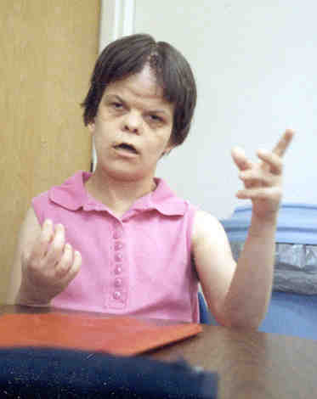
This is Doris Ann
At 30 yrs old:
referred to a state special Inpatient Behavior Center
because of her violent and aggressive behavior.
She would
Hit her head (notice the wound at her hair line)
Bite and pinch others causing severe wounds.
Bite and scratch herself,
including pulling off her own skin on her arms and legs.
Scream incessantly

Slide 13
My team’s job:
Doris Ann arrived in a helmet, arm and leg restraints and on a high dose of sedatives.
Our job was to
get her out of restraints
off the medication
remediate the aggressive behavior using behavioral analysis techniques.
Conducted a functional analysis on the behavior
Collected data in 5 minute bins
Examined the data for patterns:
What was reinforcing and/or punishing the behavior?
What was setting off the behavior?

Slide 14
Functional Analysis indicated that:
Aggression in 2 situations
Self aggression
Demands by staff to follow a direction
Self aggression occurred 30-60 min. after meal/snack
Banging head; Scratching at stomach, legs, bottom
Screamed loudly during these episodes
Form of post-meal aggression
Much more intense
continued when we tried to interrupt

Slide 15
What is YOUR diagnosis:
What is maintaining the self aggression?
What is maintaining the aggression to others?

Slide 16
Diagnosis
Pain was driving her inappropriate behavior
she had developed around her own twin: fetus in fetu
extra intestines, lobes of her liver, prolapsed colon, lactose intolerance
Solution:
Surgery to correct congenital defects
Change in diet
Teach an appropriate behavior to signal pain
Teach social and vocational skills so she could be an active member of society
Outcome:
Moved into a group home
Worked at a sheltered workshop and earned a paycheck
Self injurious behaviors diminished to almost nothing

Slide 17
Lessons from Doris Ann
Behavior talks and tells you the story.
You must be willing and able to listen!!

Slide 18
Take home message #1:
“Learning” occurs constantly….not a stagnant “thing” but a continuous behavior.
Organisms that learn are organisms that can adapt and change as the environment changes
We all learn in different ways, but there are some basic rules or algorithms that we can use to predict how humans AND animals learn.
Biology is IMPORTANT
Can help learning
Can interfere with learning
Biology may guide how and what we learn!

Slide 19
Take home message #2:
Animals, especially dogs, are much more like people than we would like to believe!
It is not that humans aren’t special, it that we aren’t unique!
We are specialized to learn in our environment, using our biology, according to our perceptual world.
Dogs, like all animals, are specialized to learn in their environments, using their biology, according to their perceptual world
Humans are the best at being human!
Dogs are the best at being dogs!

Slide 20
Take home message #3:
Humans are not especially “special”
……we are not so different from animals!
After all, we ARE animals!
We are SPECIALIZED; we are not special.
We are superb at what we do, and that is adapt and change our behavior, often through learning
Dogs, and other animals, are better at us at some types of learning; worse than us at others
But each organism does best what it needs to do best!

Slide 21
Take home message #4:
Dogs
Social learning is strongest in dogs
We have bred dogs, both accidentally and purposefully, as organisms that
Humans
Humans NEED dogs for work, play, comfort and companionship
Dogs are co-social creatures
Dogs love us and we love our dogs
Read our behavior and emotions
Adapt and respond to us, and
most importantly, CHANGE US.

Slide 22
Clive Wynne was correct……and I, for one, am very, very glad that he was.

Slide 23
'People are born so that they can learn how to live a good Life -- like loving everybody all the time and being nice, right? Well, dogs already know how to do that, so they don't have to stay as long.'
So, live like a dog:
Live simply; Love generously; Care deeply; Speak kindly.
Remember, if a dog was the teacher, you would learn things like: When loved ones come home, always run to greet them. Never pass up the opportunity to go for a joyride. Allow the experience of fresh air and the wind in your face to be pure ecstasy. Take naps. Stretch before rising. Run, romp, and play daily. Thrive on attention and let people touch you. Avoid biting when a simple growl will do. On warm days, stop to lie on your back on the grass.. On hot days, drink lots of water and lie under a shady tree. When you're happy, dance around and wag your entire body. Delight in the simple joy of a long walk.
Be loyal.
Never pretend to be something you're not.
If what you want lies buried, dig until you find it. When someone is having a bad day, be silent, sit close by, and nuzzle them gently.
ENJOY EVERY MOMENT OF EVERY DAY -author unknown

Slide 24
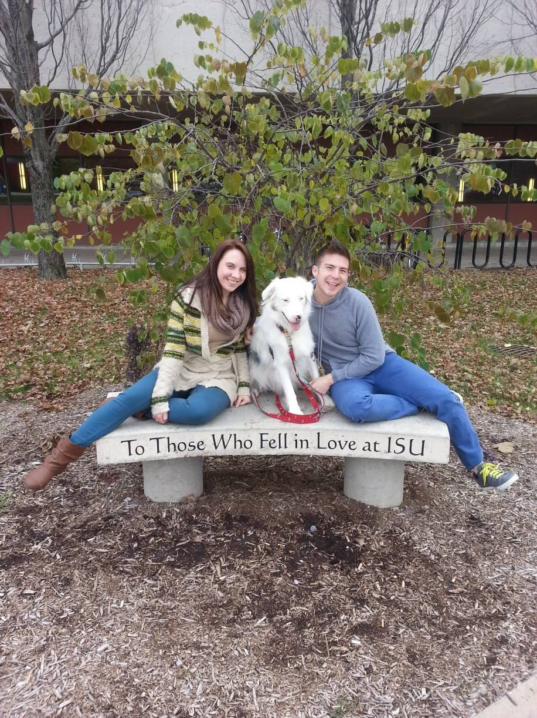
:
In Memory of Keller: 2011-2019

